Slide 1
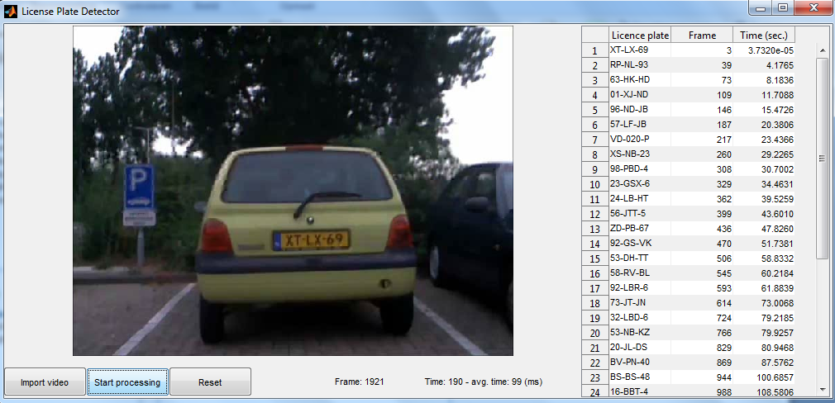

License Plate Recognition
Introduction
Tomas Heinsohn Huala 4326318
Remi van der Laan 4326156
Segmentation
These days is impossible to fill in all the cars you see by hand to find them in a car database. Therefore we thought it should be possible to make this easier with the technology and knowledge of these days. Therefore we made an application in MATLAB that is able to recognize license plates of cars and to write them down. For this application we used several image processing techniques to recognize the license plates.
Character Recognition
Text
Text
GUI
For our application we needed a GUI, that’s why we used the MATLAB toolbox guide. As a result of this we made this GUI:
Evaluation
Text

