Slide 1
InCommand Mitiga
One platform. The whole incident.
Emergency & Disaster Command Platform
Capabilities Overview · 2026
Screenshots are from a live, working prototype.
Notes:
InCommand Mitiga capabilities overview. One platform for the whole incident.

Slide 2
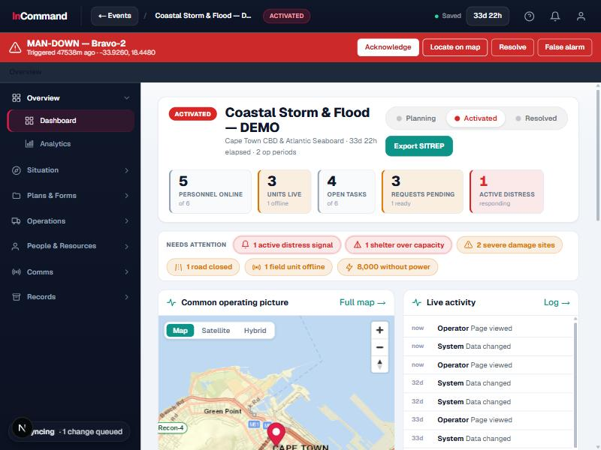
What InCommand Mitiga is
OVERVIEW
One live command picture, from the operations room to the field.
One connected system
Situation, map, comms, people, resources and paperwork in a single platform.
Replaces the scatter
No more juggling a drawer of disconnected tools and radios during an incident.
Office and field
Runs where incidents happen: online or offline, on the network you have.
Live command dashboard: status, needs-attention, the common operating picture and activity.
Notes:
InCommand Mitiga brings every part of an incident into one live, resilient command picture.

Slide 3
The platform at a glance
OVERVIEW
Four connected pillars carry an incident from prevention through to the after-action record.
01
Plan & Prepare
02
Command & Respond
Risk mapping, pre-plans and site surveys before the incident.
Situation, common operating picture, comms and live field video.
03
People & Resources
04
Field & Records
Roster, readiness, fatigue, inventory and equipment.
Devices, vehicle tracking, ICS documentation and analytics.
Notes:
Four pillars: Plan & Prepare, Command & Respond, People & Resources, Field & Records.

Slide 4
SECTION 01
Command &
Situational Awareness
See the whole incident, direct it from one place.

Slide 5
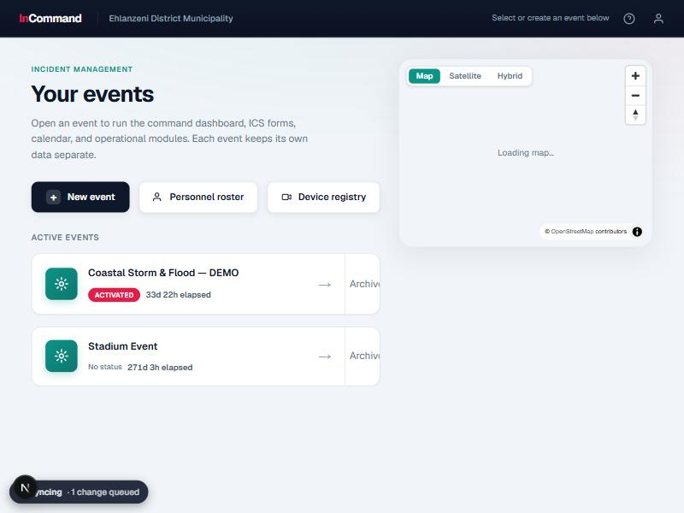
Every incident, its own workspace
COMMAND & SITUATIONAL AWARENESS
Run many incidents at once, each fully self-contained.
Multiple incidents
Stand up a new event in seconds; switch between active incidents instantly.
Self-contained data
Map, people, forms and comms stay scoped to their own incident.
Always in context
Everyone opens the same shared picture for the incident they are working.
Events hub: multiple incidents per organisation, each self-contained.

Slide 6
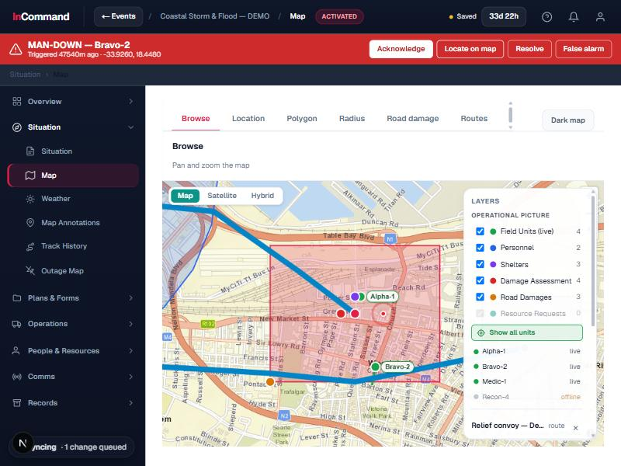
The live common operating picture
COMMAND & SITUATIONAL AWARENESS
One map everyone shares: units, zones, routes and hazards.
Live units and sectors
Track teams, vehicles and zones as they move and change on one map.
Draw and plot
Mark sectors, routes, hazards and damage directly onto the operating picture.
Shared by all
Commanders, tablets and remote responders see the same map in real time.
Common operating picture: live units, sectors, routes and plotted hazards.

Slide 7
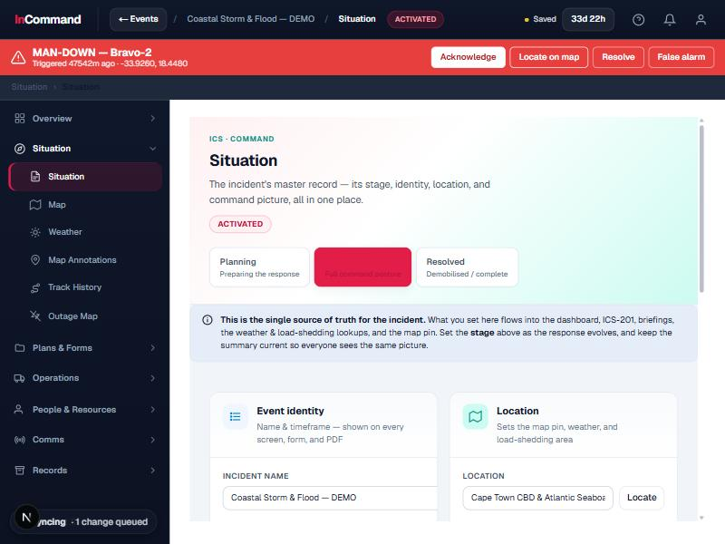
Situation, staging and posture
COMMAND & SITUATIONAL AWARENESS
Know the stage of the incident and your command posture at a glance.
Incident stage
Track the lifecycle of the incident and keep the whole team aligned.
Weather in context
Local conditions and a meteogram for the incident location.
Command posture
A clear read on readiness and how the response is set up.
Situation view: incident stage, weather, location and command posture.

Slide 8
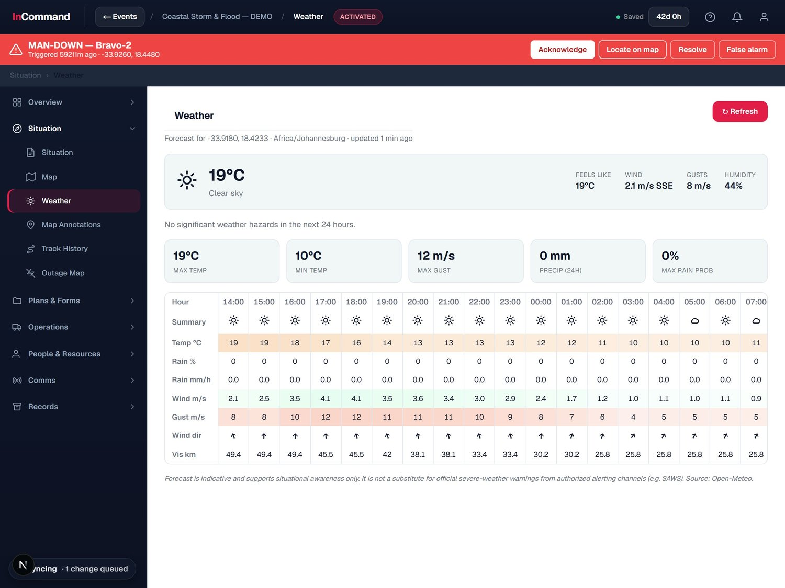
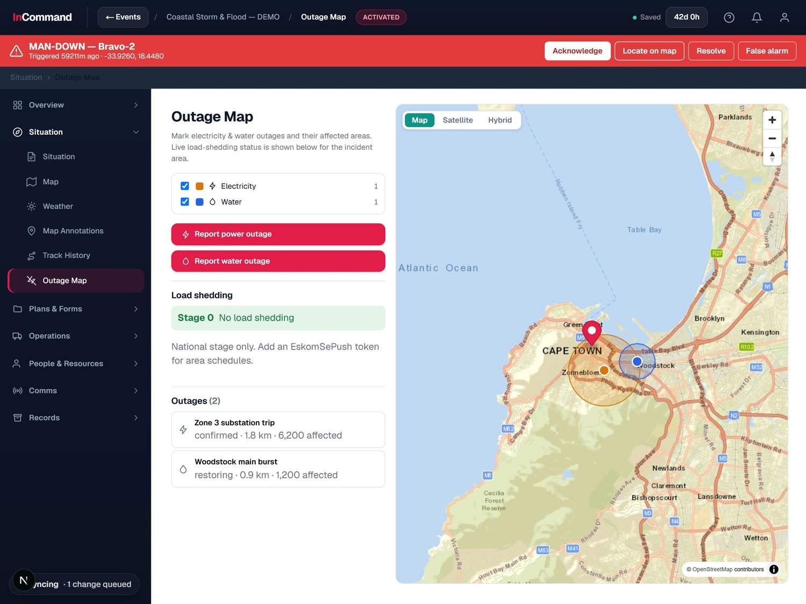
Weather and utility outages, on the picture
COMMAND & SITUATIONAL AWARENESS
Environmental and infrastructure threats, tracked with the incident.
Forecast and meteogram for the incident location.
Outage map: power and water outages, affected numbers and load-shedding stage.
Notes:
Weather and outage mapping keep environmental and infrastructure threats visible.

Slide 9
SECTION 02
Planning &
Tasking
Turn objectives into assigned, tracked work.

Slide 10
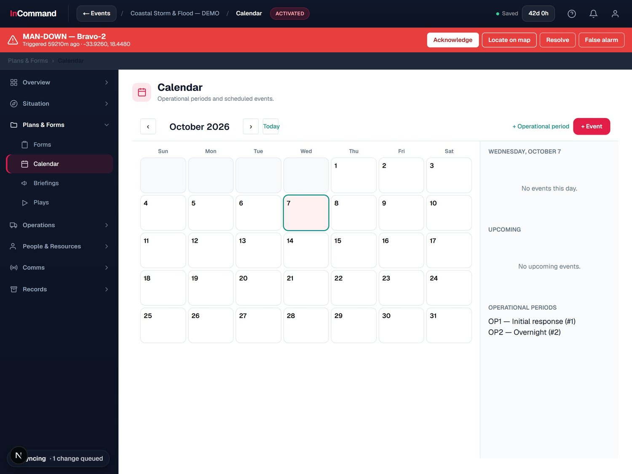
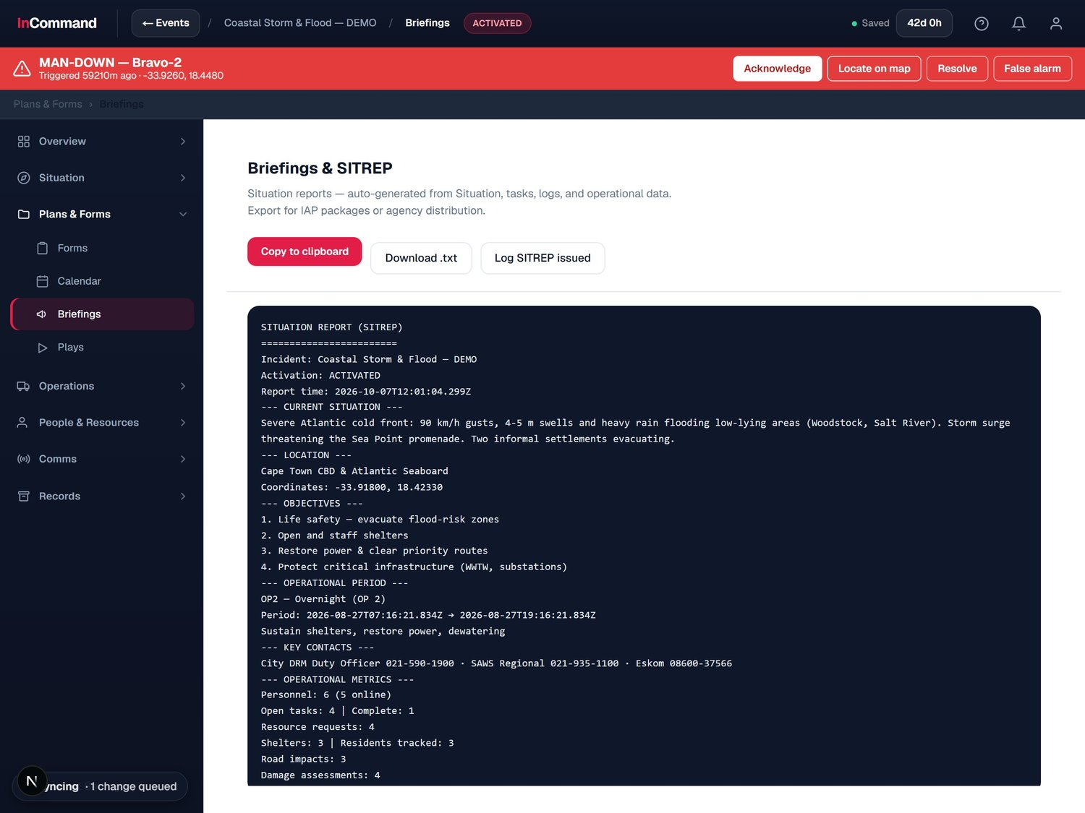
Operational periods and briefings
PLANNING & TASKING
Plan the response in periods and keep everyone briefed.
Calendar: operational periods and scheduled events.
Briefings and one-click SITREP, auto-generated from the incident.
Notes:
Operational periods, calendar and auto-generated SITREP briefings.

Slide 11
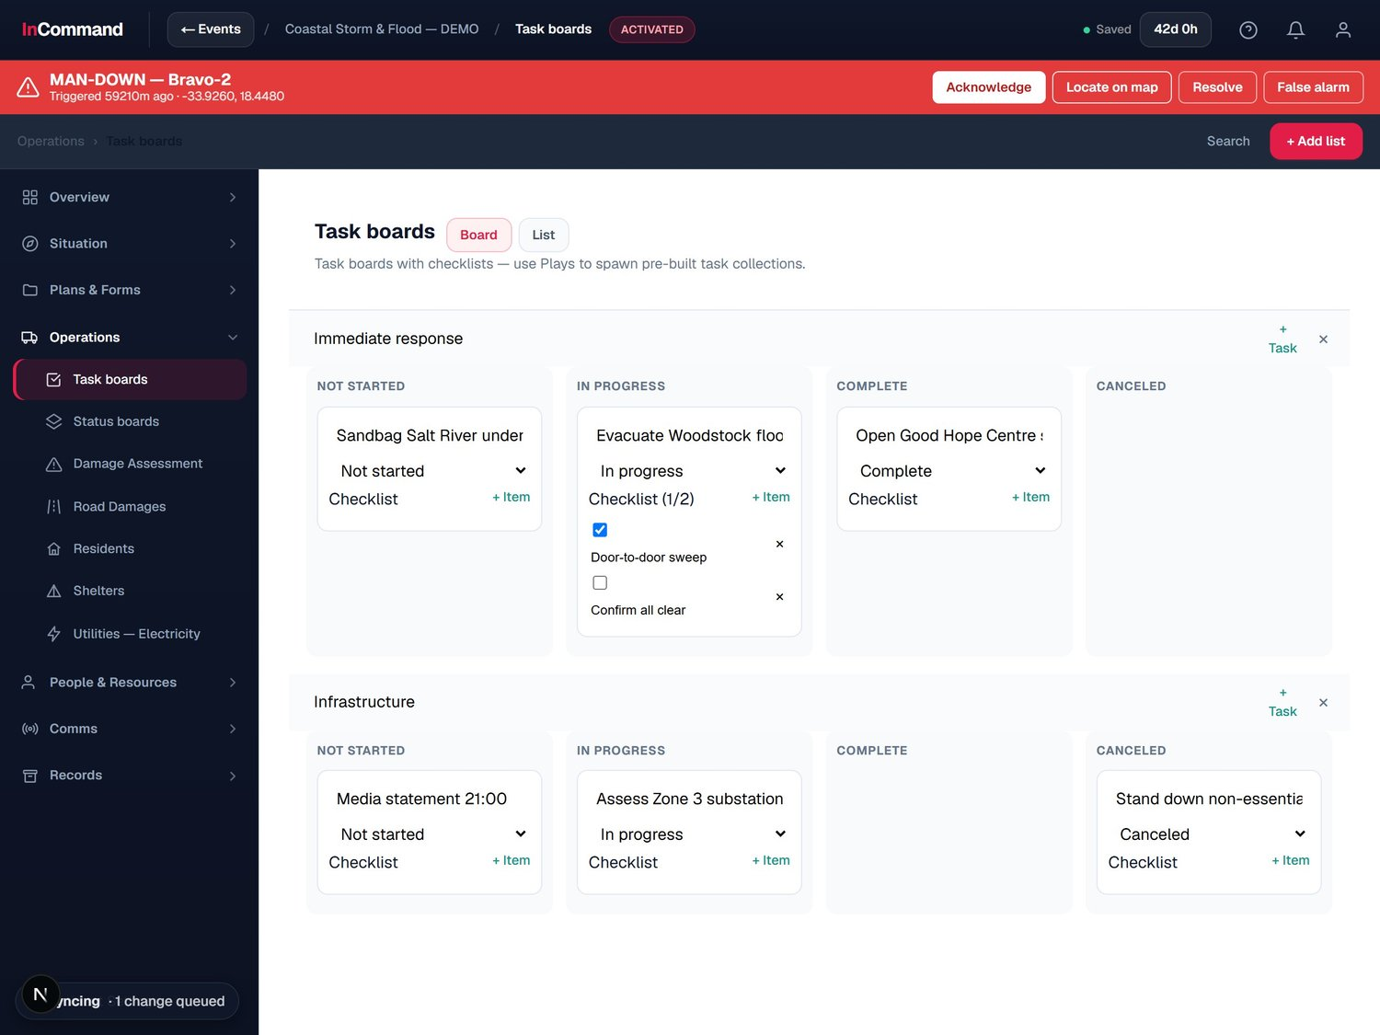
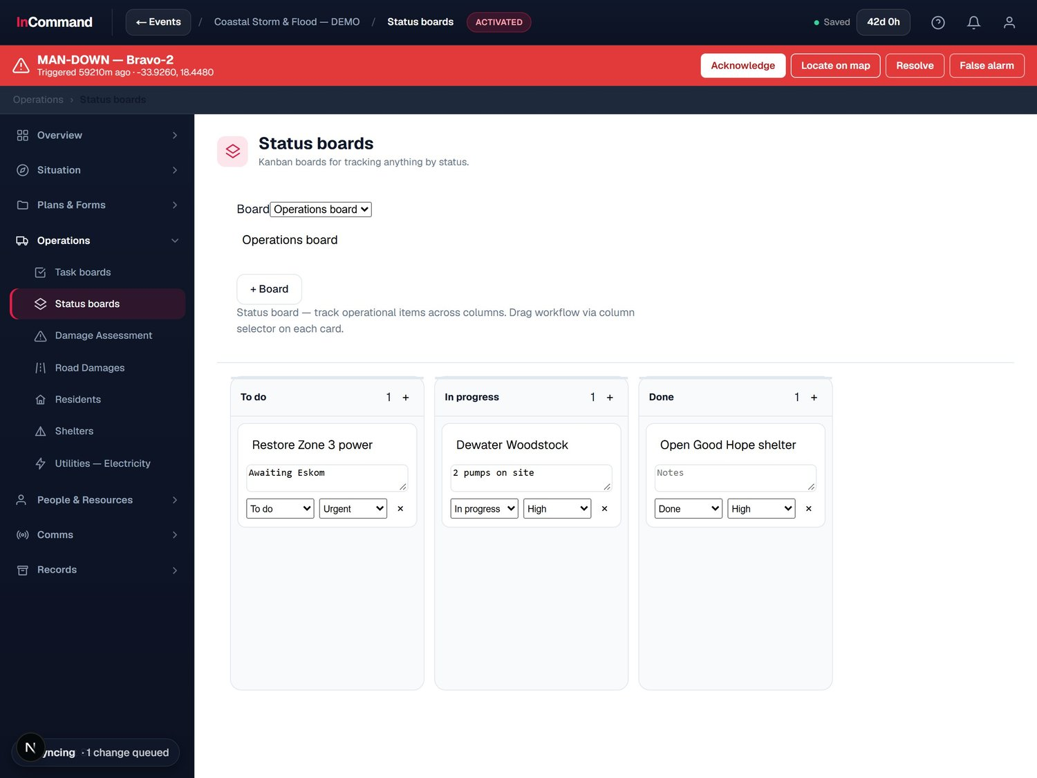
Tasks and status, tracked to done
PLANNING & TASKING
Assign work, track it by status, and see nothing fall through.
Task boards with checklists, assignees and priorities.
Status boards: kanban for tracking anything by status.
Notes:
Task boards and kanban status boards track the work of the response.

Slide 12
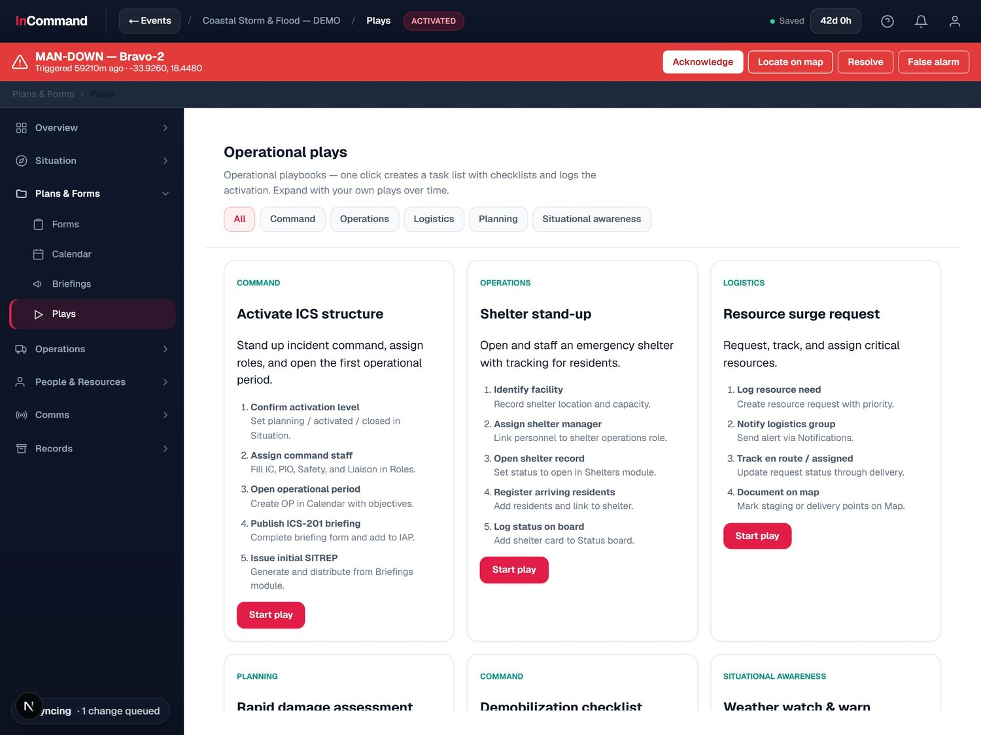
Reusable response playbooks
PLANNING & TASKING
Pre-built plays that spin up the right tasks in one click.
One-click playbooks
Each play creates a task list with checklists, ready to run.
Built for the moment
Activate ICS, open a shelter, request a resource surge and more.
Grows with you
Capture your own standard responses as reusable plays.
Operational plays: activate ICS, stand up a shelter, surge resources.

Slide 13
SECTION 03
Communications &
Field Video
Talk, page, alert and watch the field in real time.

Slide 14
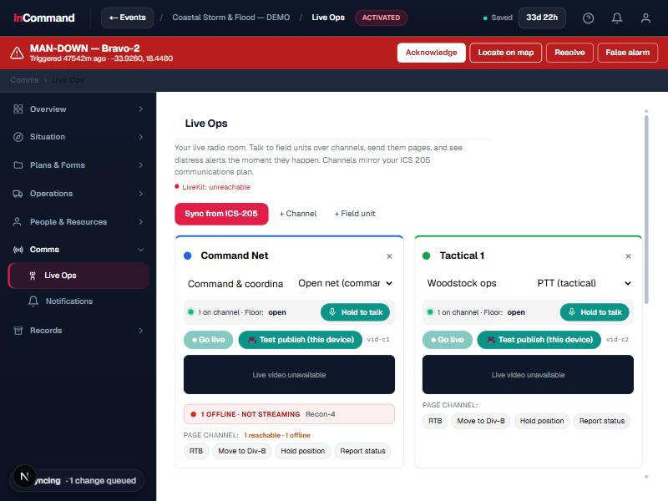
Talk, page and alert in real time
COMMUNICATIONS & FIELD VIDEO
Live Ops channels keep command and the field connected.
Channels and paging
Push-to-talk channels and paging keep everyone on the same page.
Field units
See who is live, where they are and what they are reporting.
Distress alerts
A responder in trouble raises an unmissable alert to command.
Live Ops: channels, field units and a distress banner for emergencies.

Slide 15
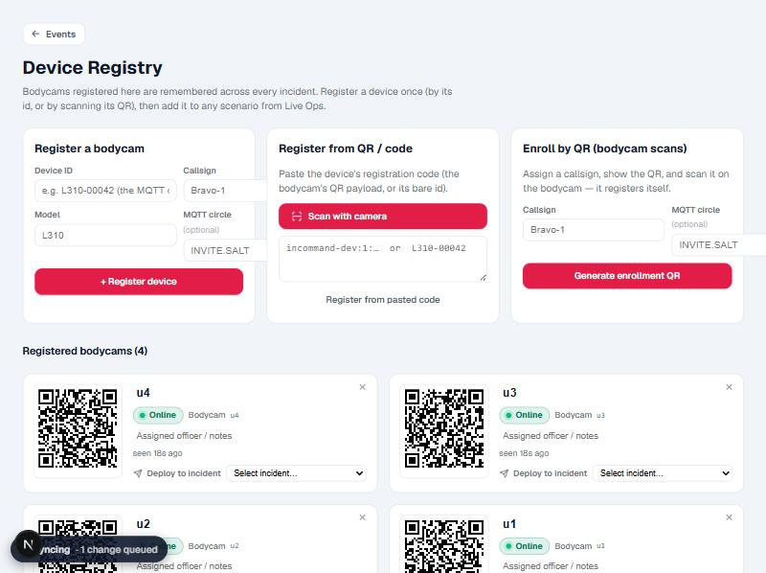
A managed bodycam fleet
COMMUNICATIONS & FIELD VIDEO
Field video streamed into the command picture, device by device.
Fleet registry
An organisation-level register of every bodycam and field device.
QR onboarding
Bring a device online in seconds by scanning a QR code.
Live to command
Streams flow straight into Live Ops and the operating picture.
Device registry: an org-level bodycam fleet, onboarded by QR code.

Slide 16
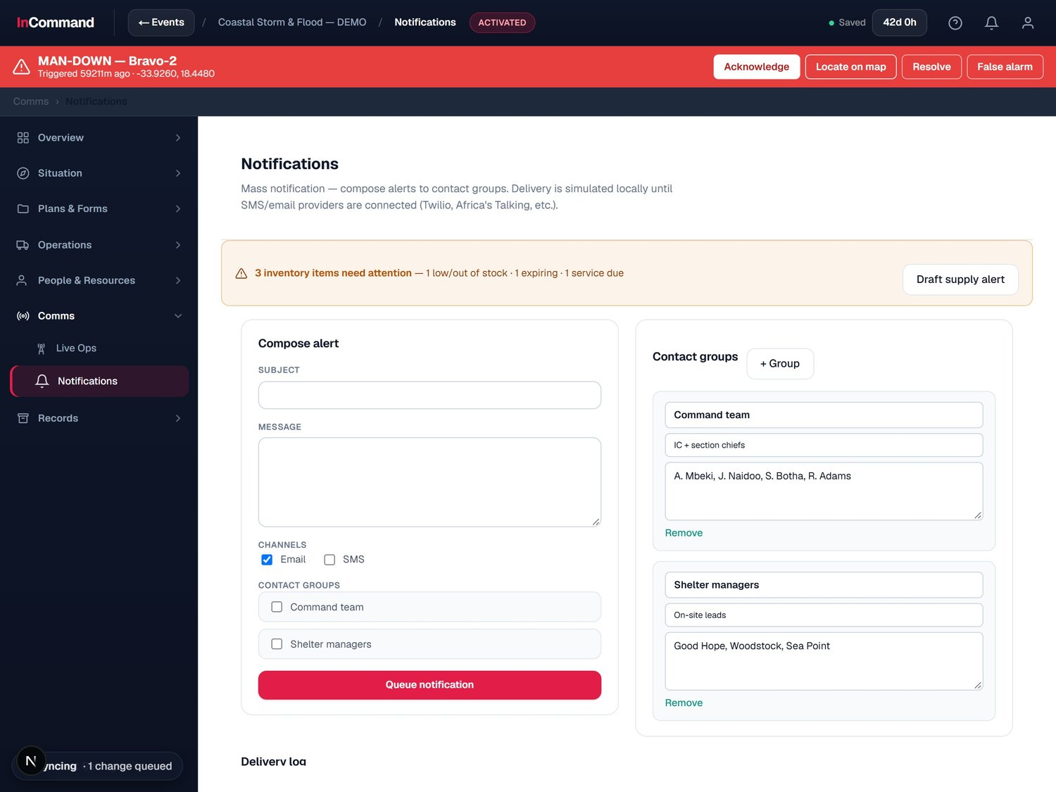
Reach the right people, instantly
COMMUNICATIONS & FIELD VIDEO
Mass notifications to the groups that need to know.
Contact groups
Pre-built groups like command staff and shelter managers.
Multi-channel
Reach people by the channels they actually watch.
Logged and queued
Every notification is tracked, with a delivery record.
Notifications: compose an alert and send to contact groups.

Slide 17
SECTION 04
People, Resources
& Intelligence
Know who is ready, what you have, and what is happening.

Slide 18
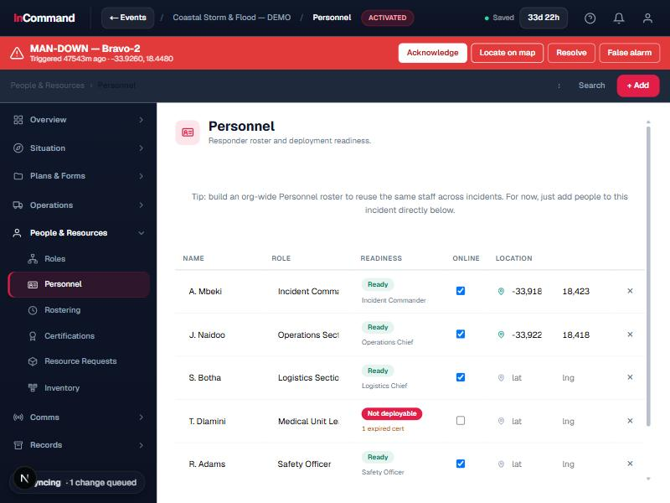
People, readiness and fatigue
PEOPLE, RESOURCES & INTELLIGENCE
A roster that knows who is deployable right now.
Roster and attendance
Shift scheduling with on-duty and rest tracking for every responder.
Readiness engine
Deployment readiness from fatigue, certifications and assignment.
Experience and certs
Qualifications and experience history on every person's record.
Personnel: roster, attendance, certifications, readiness and fatigue.

Slide 19
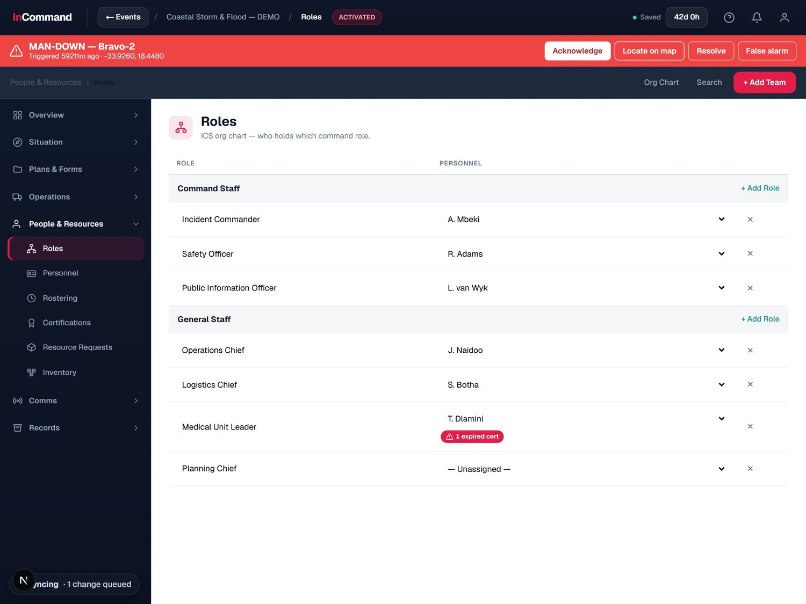
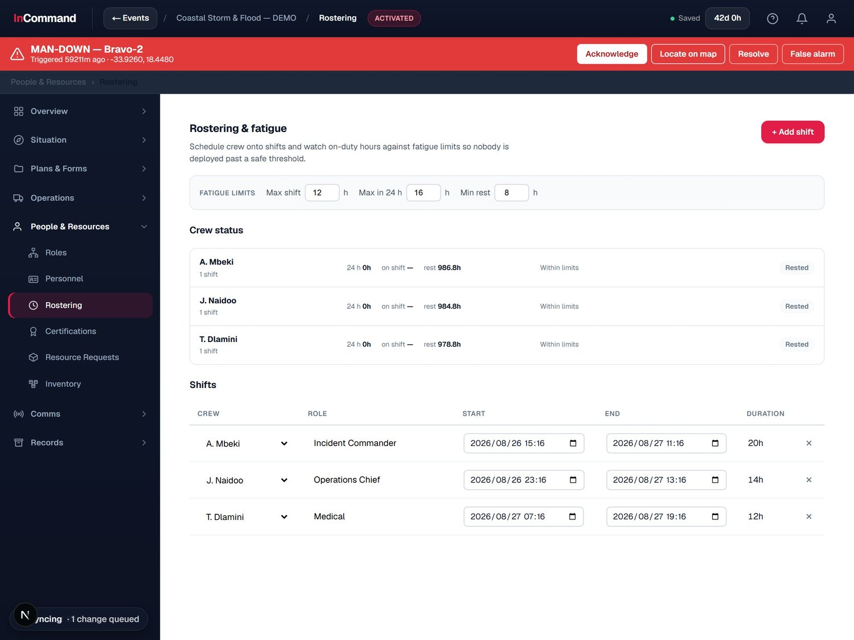
The command org, staffed and rested
PEOPLE, RESOURCES & INTELLIGENCE
Assign every ICS role and keep crews within safe limits.
ICS org chart: command and general staff, role by role.
Rostering and fatigue: crew hours against safe duty limits.
Notes:
ICS org chart plus rostering and fatigue tracking.

Slide 20
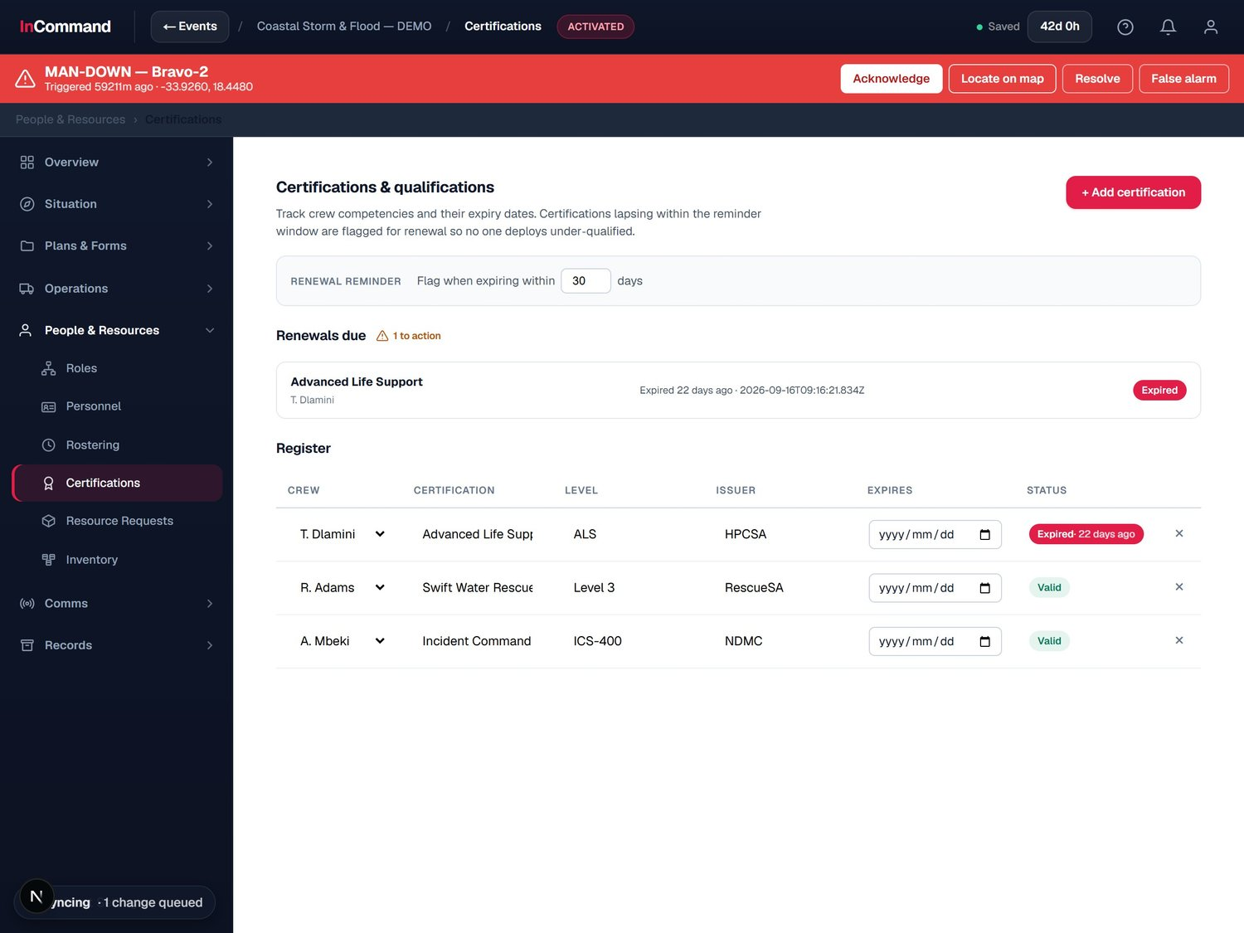
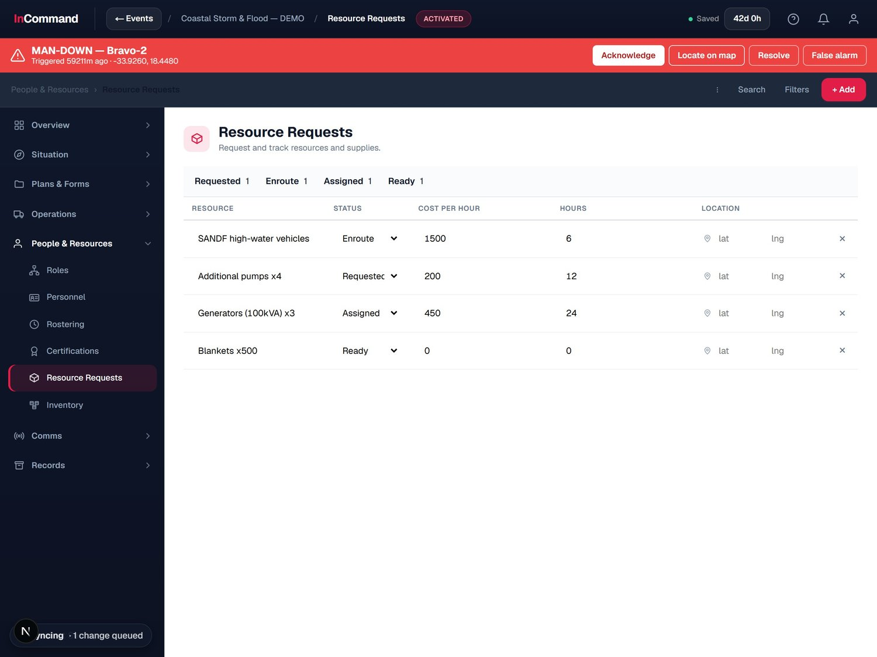
Qualified people, the right resources
PEOPLE, RESOURCES & INTELLIGENCE
Track qualifications and get the right resources moving.
Certifications: qualifications with renewal reminders.
Resource requests: request, cost and track supplies.
Notes:
Certifications with renewal reminders and resource request tracking.

Slide 21
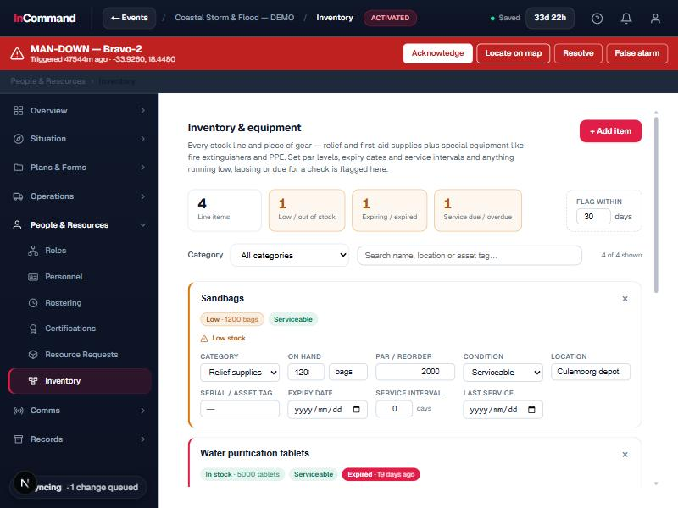
Every resource accounted for
PEOPLE, RESOURCES & INTELLIGENCE
Stock and special equipment, tracked and ready.
Stock and gear
General stock alongside special equipment, all in one register.
Expiry and maintenance
Track service dates, expiry and maintenance so gear is ready.
Low-stock alerts
See what is below par before it becomes a problem.
Inventory: general stock and special gear, with expiry and maintenance.

Slide 22
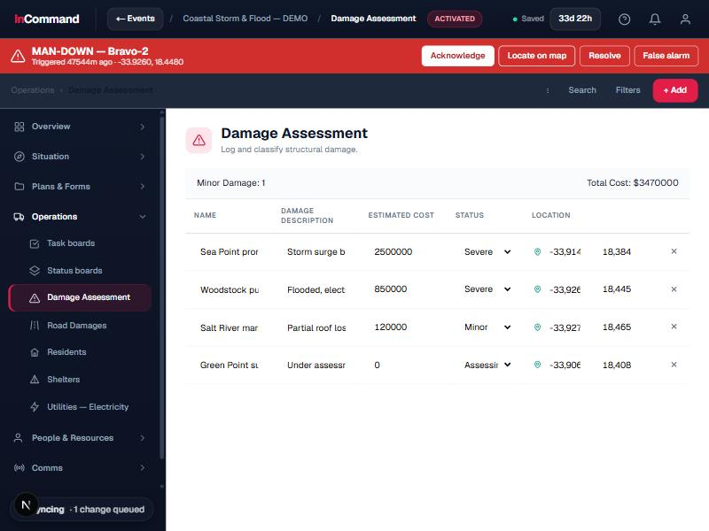
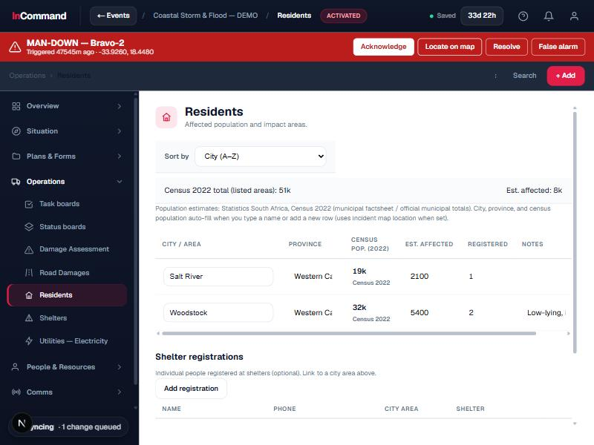
Field intelligence and population impact
PEOPLE, RESOURCES & INTELLIGENCE
Capture what is happening on the ground and who it affects.
Damage and outage reporting, plotted to the map.
Population impact: residents and communities affected.
Notes:
Field intelligence: damage and outages on the map, plus population impact.

Slide 23
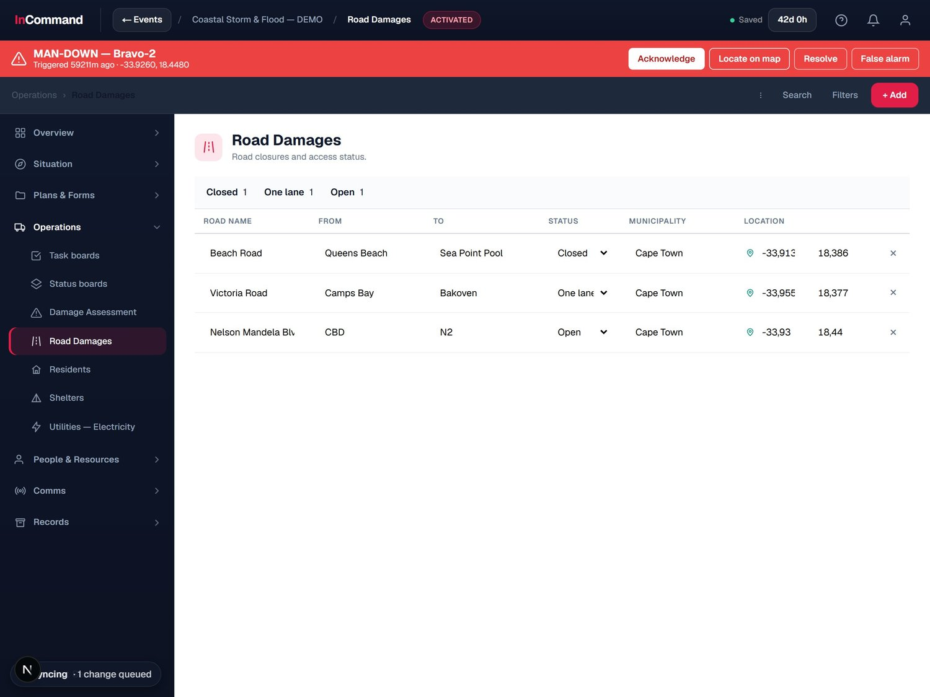
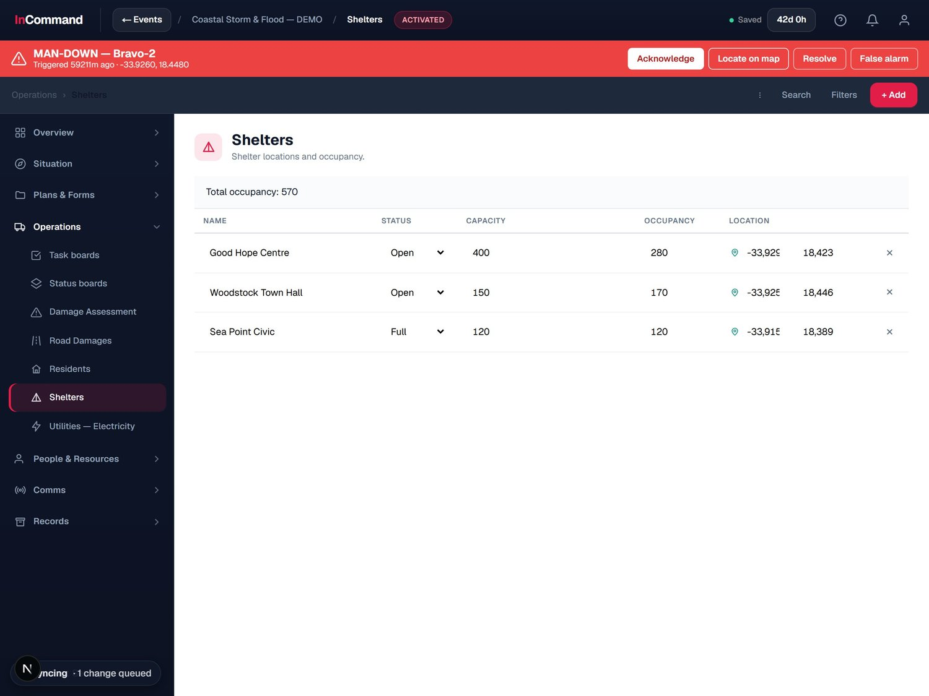
Roads, shelters and the people in them
PEOPLE, RESOURCES & INTELLIGENCE
Keep access, shelter and occupancy current across the incident.
Road damages: closures and access status.
Shelters: locations, capacity and live occupancy.
Notes:
Road closures and shelter occupancy tracked live.

Slide 24

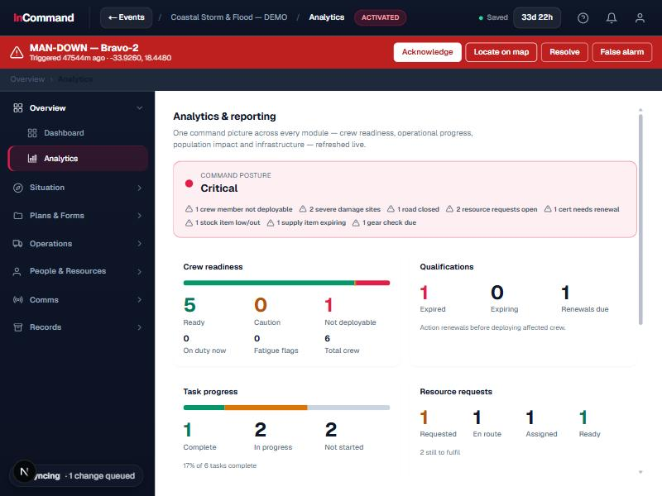
Utilities and command analytics
PEOPLE, RESOURCES & INTELLIGENCE
Watch infrastructure impact and turn it into insight.
Electricity: utilities and customers without power.
Analytics: deployment, readiness and command-posture insight.
Notes:
Utility impact tracking and command analytics.

Slide 25
SECTION 05
Documentation
& Records
The complete ICS form suite, built into the system.

Slide 26
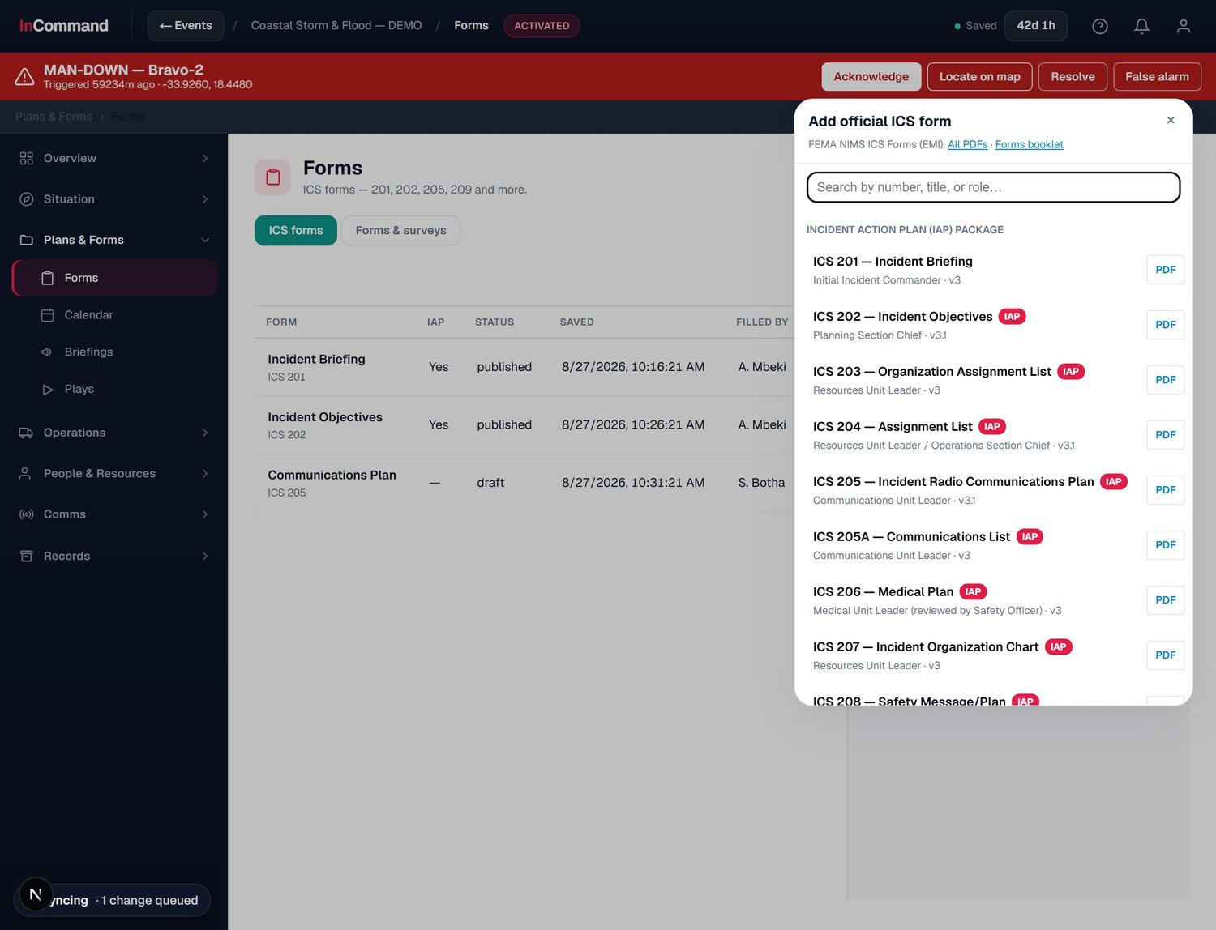
The complete ICS form suite
DOCUMENTATION & RECORDS
Every NIMS ICS form, ready from the live incident.
The whole catalogue
ICS 201 through 260, including the full Incident Action Plan package.
Role-aware
Each form notes its responsible ICS role and official version.
One click to add
Create any form, pre-populated from the live incident.
The full FEMA ICS form catalogue: the IAP package and beyond.

Slide 27
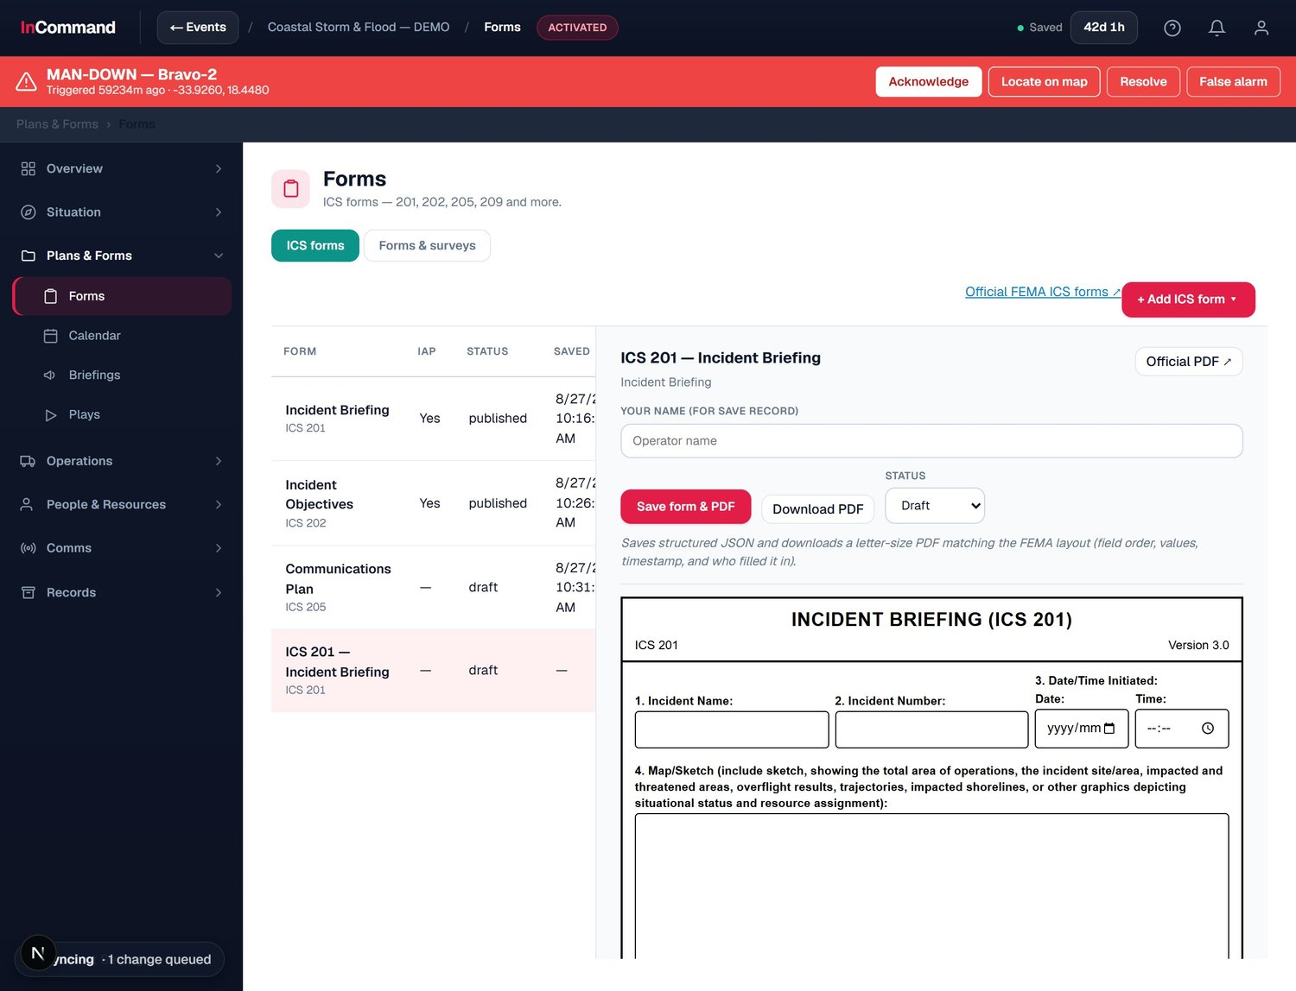
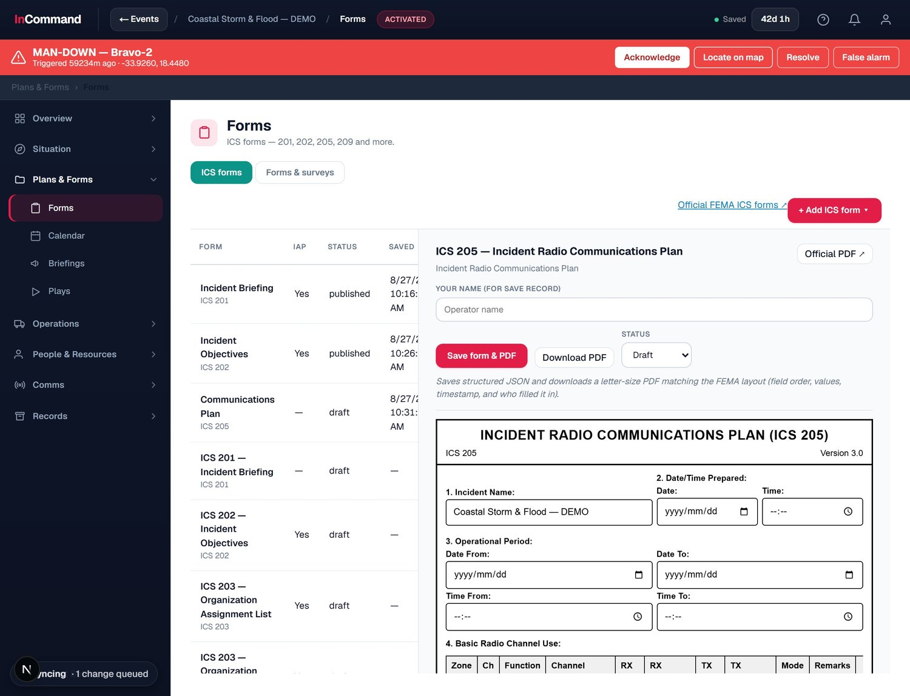
Forms to the official FEMA layout
DOCUMENTATION & RECORDS
Structured forms that match the real ICS paperwork, field for field.
ICS 201 Incident Briefing, to the official FEMA layout.
ICS 205 Radio Communications Plan, with the channel table.
Notes:
Structured ICS 201 and 205 forms matching the FEMA layout.

Slide 28
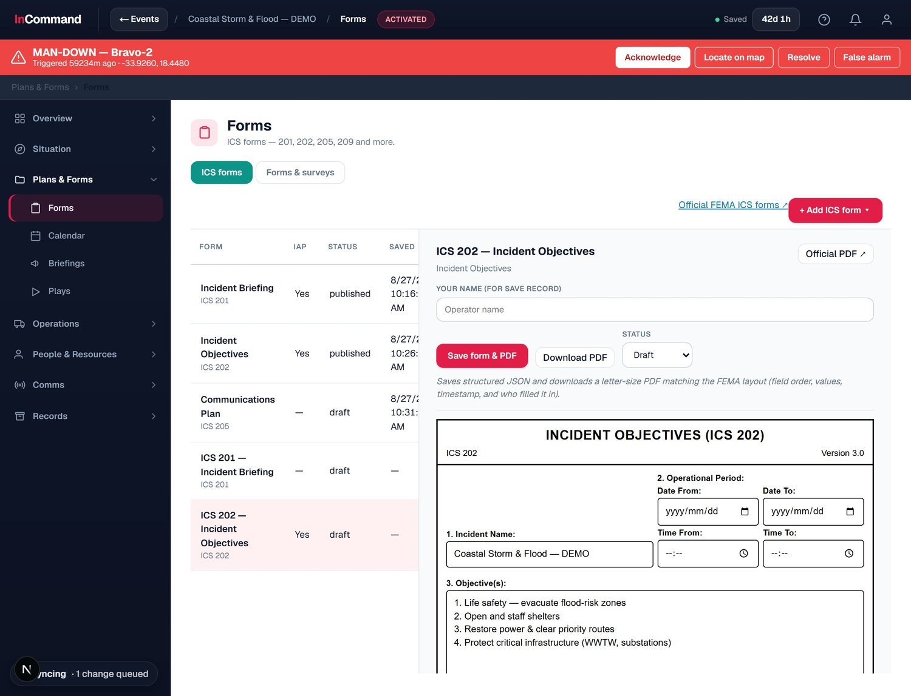
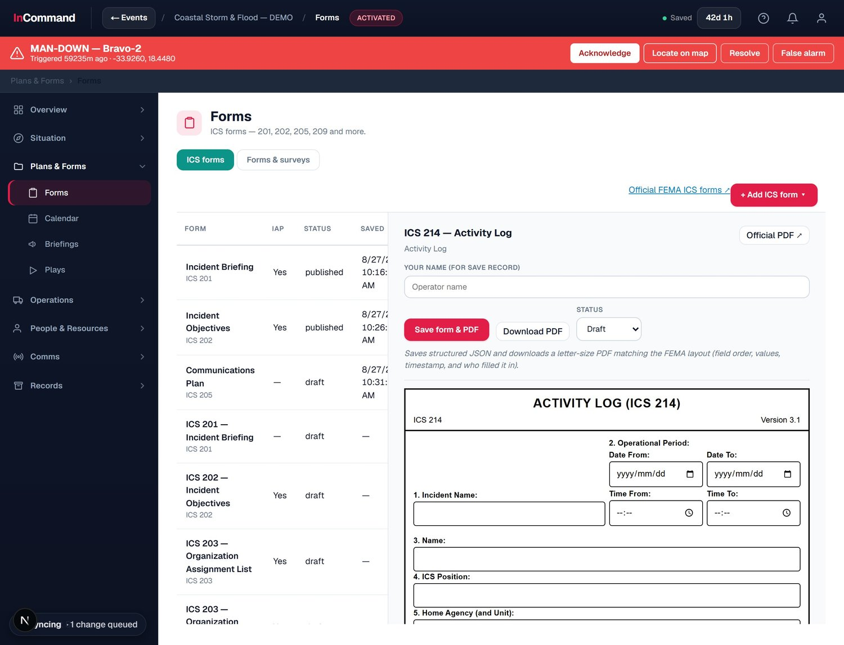
Objectives, logs and letter-size PDFs
DOCUMENTATION & RECORDS
Auto-populated from the incident, exported to a FEMA-matching PDF.
ICS 202 Incident Objectives, auto-filled from the incident.
ICS 214 Activity Log, to the official layout.
Notes:
ICS 202 and 214 auto-populate and export to letter-size PDF matching FEMA.

Slide 29
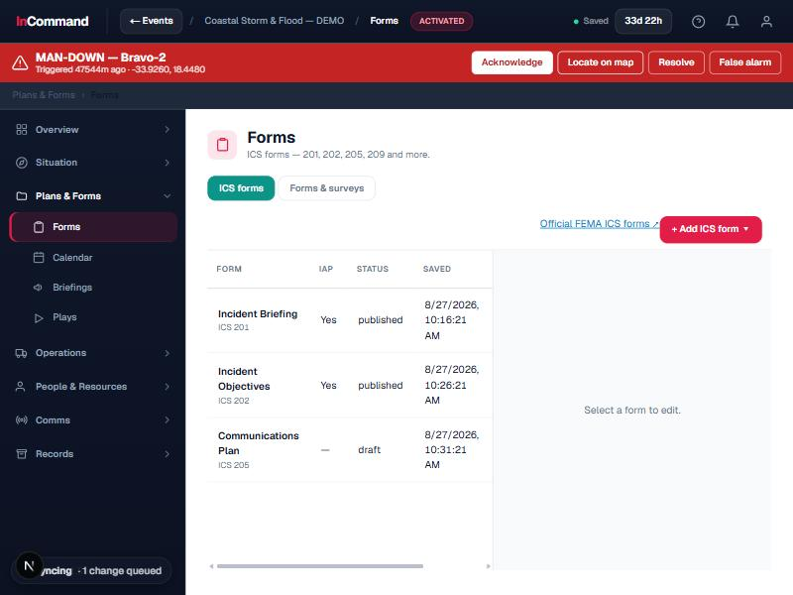
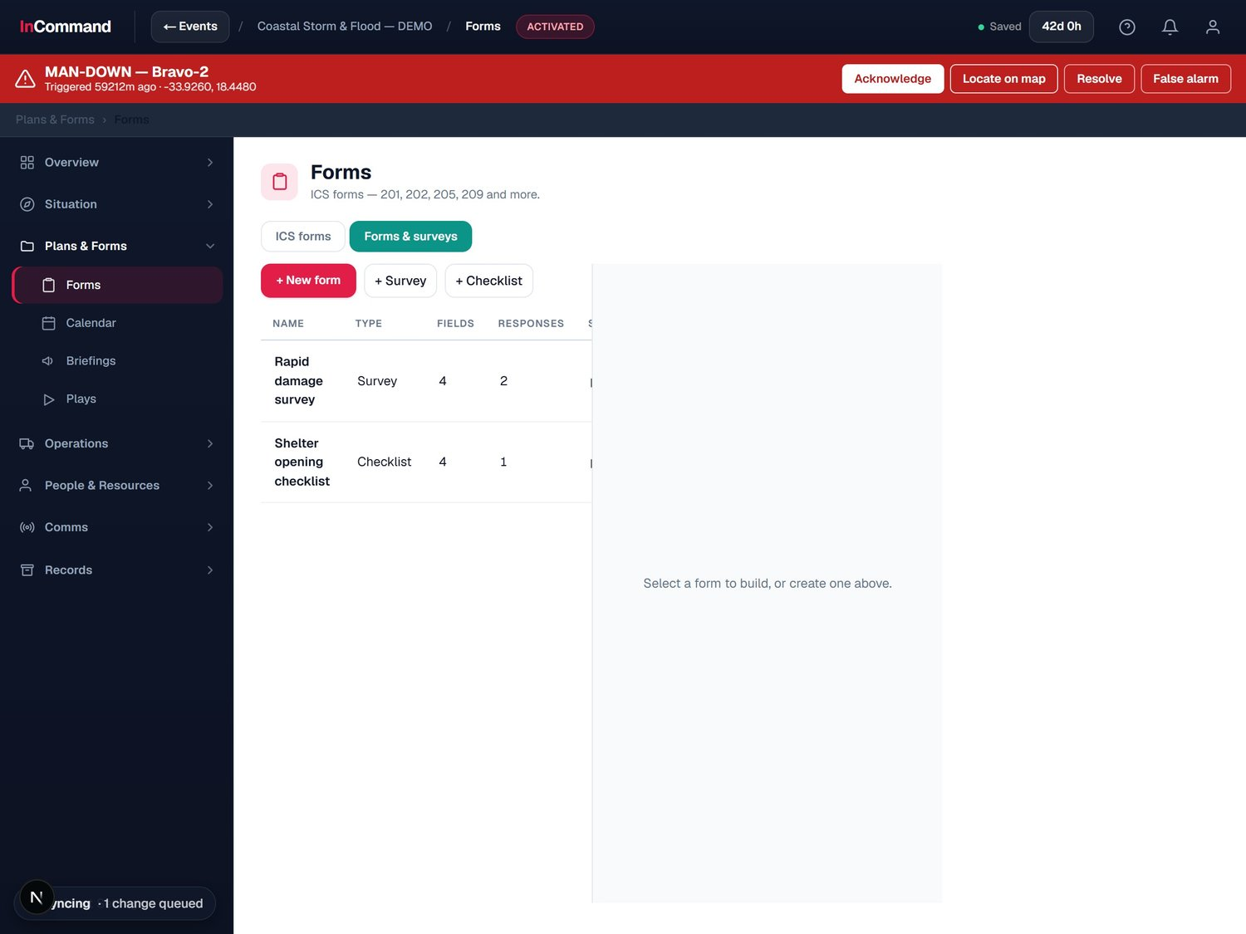
Beyond ICS: build your own forms
DOCUMENTATION & RECORDS
When no standard form fits, build one in minutes.
Forms list: ICS forms, status and PDF export.
Custom form builder: drag-and-drop surveys and checklists.
Notes:
The forms list plus a drag-and-drop custom form builder.

Slide 30
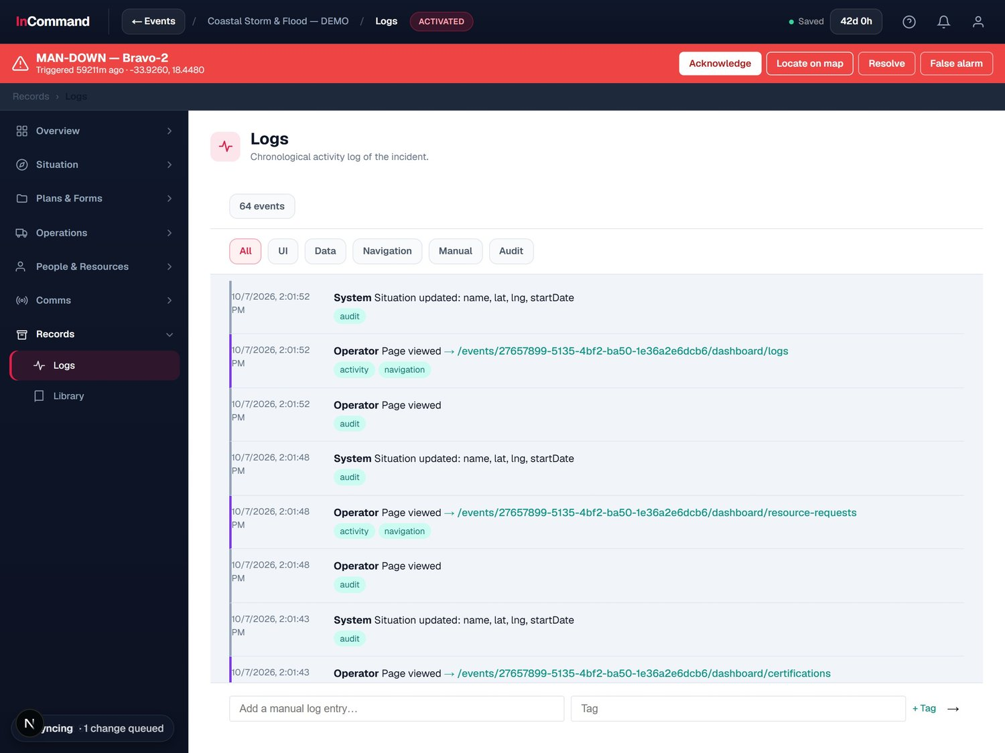
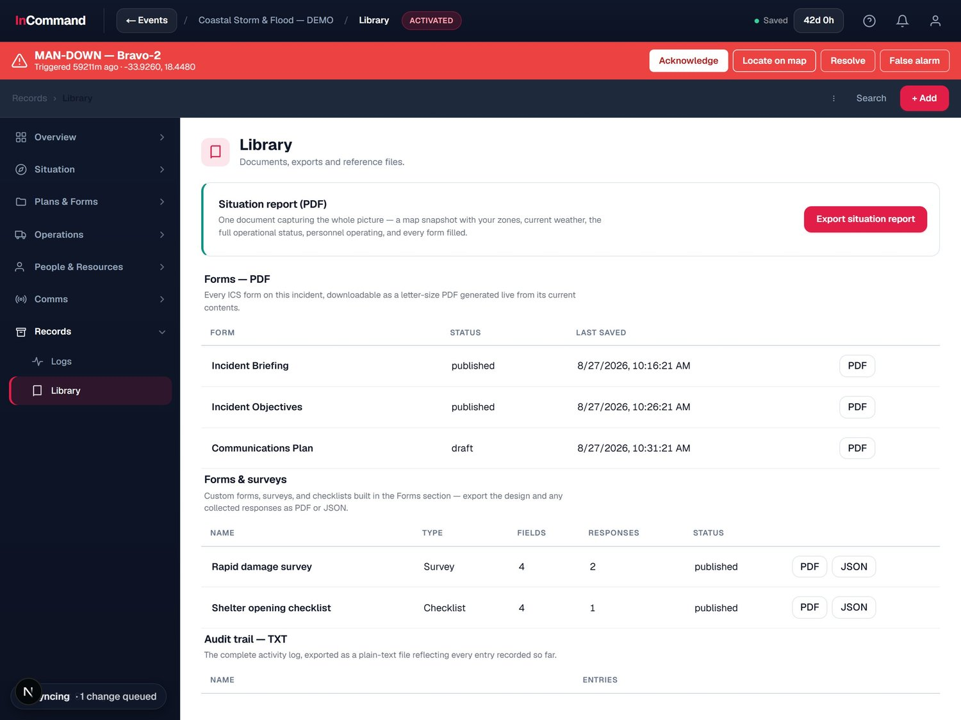
A complete, auditable record
DOCUMENTATION & RECORDS
Everything that happened, kept and exportable.
Activity log: a chronological record of the incident.
Library: documents, exports and the audit trail.
Notes:
Chronological activity log and a document library with audit trail.

Slide 31
SECTION 06
Devices &
Vehicle Tracking
Bodycams, vehicles and critical gear on the same map.

Slide 32
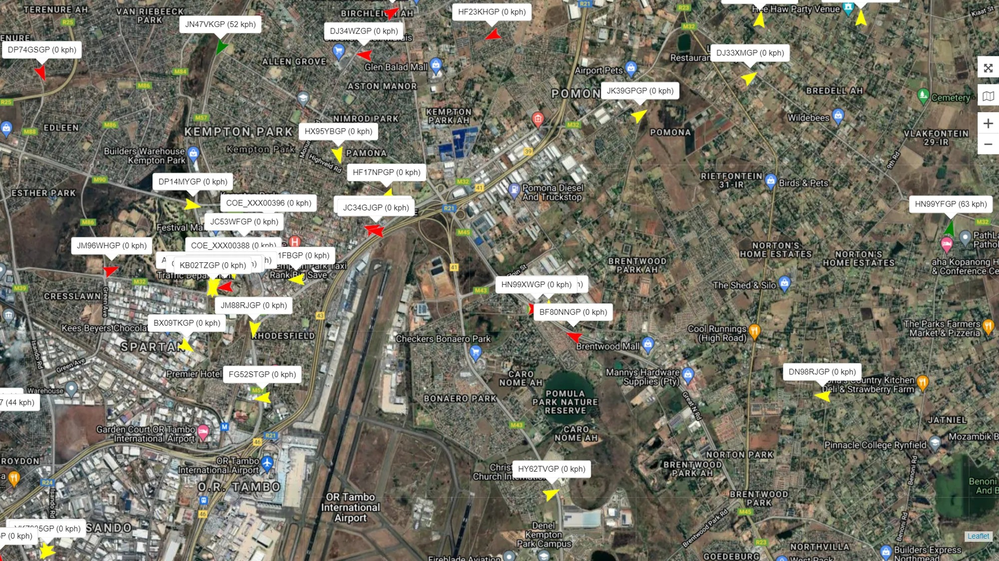
Track every vehicle and critical asset
DEVICES & VEHICLE TRACKING
Emergency vehicles and life-saving gear, always located.
Vehicle telematics
Teltonika FMC150 with CAN / OBD data and driver identification.
GPS Worx tracking
Live fleet positions feeding straight into the command picture.
Critical gear tags
Bluetooth tags track assets like a Jaws of Life or a defibrillator.
GPS Worx: live emergency-vehicle tracking across the fleet.

Slide 33
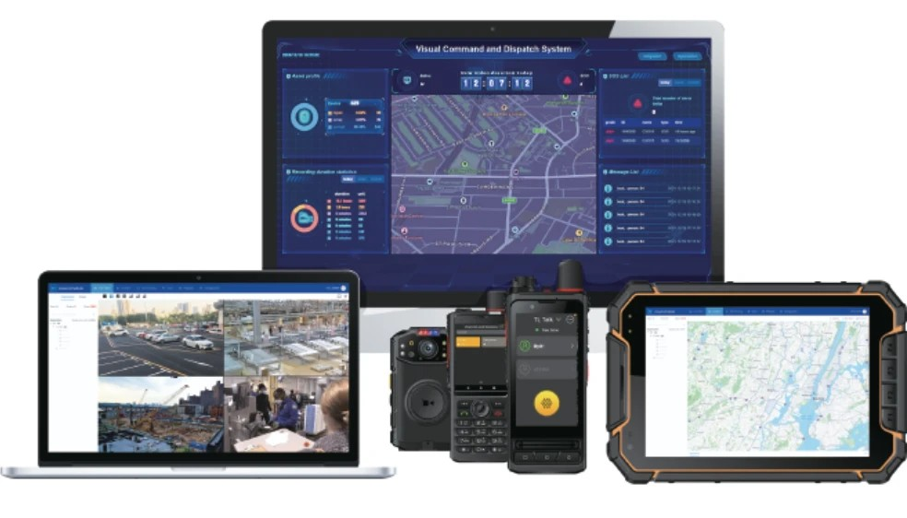
One connected device ecosystem
DEVICES & VEHICLE TRACKING
Command, field and vehicle devices on a single platform.
Command and field
Dashboards, bodycams, PTT radios and rugged tablets, all connected.
No per-device rebuild
Add devices and vehicles without re-engineering the platform.
Fits your fleet
Works with the radios, vehicles and systems agencies already run.
Command dashboards, bodycams, PTT radios and rugged field tablets.

Slide 34
SECTION 07
The Future of
Fire & Risk Surveys
A site-survey engine that reads buildings straight from CAD.

Slide 35
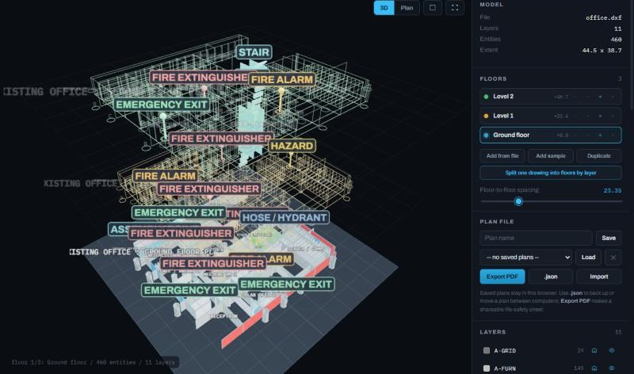
Read a building straight from its CAD file
THE FUTURE OF FIRE & RISK SURVEYS
IN DEVELOPMENT
Floor and site plans become live fire and life-safety maps.
Reads AutoCAD directly
Opens DXF floor and site plans and pulls them apart, floor by floor.
Maps life-safety assets
Exits, stairs, assembly points, alarms, extinguishers, hoses and hydrants.
Plan and 3D views
Switches between a flat plan and a full 3D model for briefings.
Exploded 3D view: every floor and life-safety marker in one model.

Slide 36
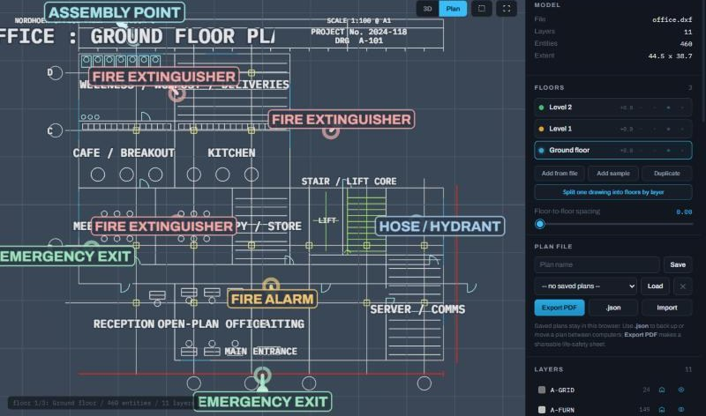
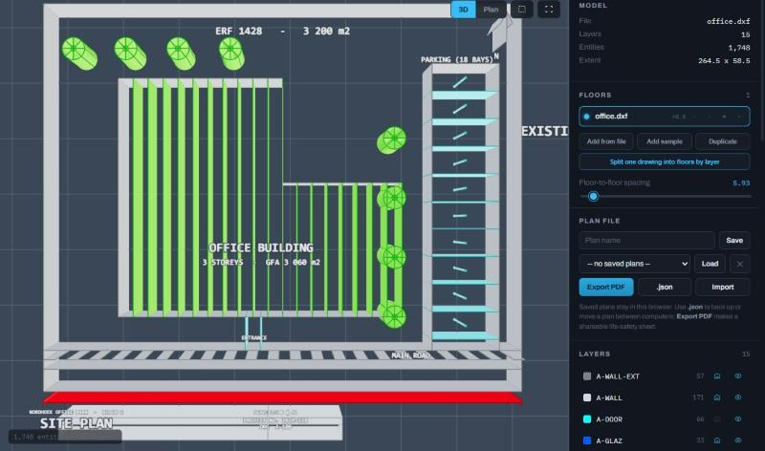
From floor plan to site plan, every marker in place
THE FUTURE OF FIRE & RISK SURVEYS
IN DEVELOPMENT
The survey done before an incident becomes the plan command uses during it.
Ground-floor plan: assembly point, extinguishers, hydrant and exits.
Site plan in 3D: building footprint, roof, parking and access.
Notes:
In development. Floor plans and site plans, marked up for fire and life safety.

Slide 37
One platform. The whole incident.
From the first alert to the after-action report, InCommand Mitiga keeps situation, map, comms, people, resources and paperwork in one live, resilient command picture.
InCommand Mitiga
Notes:
Close: one platform for the whole incident.

