Slide 1
InCommand Mitiga
Functionality Showcase
A guided tour of the live system, running the demo incident
“Coastal Storm & Flood” demo · every screen is the working product with sample data · 2026
Notes:
Functionality showcase: a tour of every module in the live demo incident.

Slide 2
PART 1
The Command Centre
The live picture a commander runs the incident from.

Slide 3
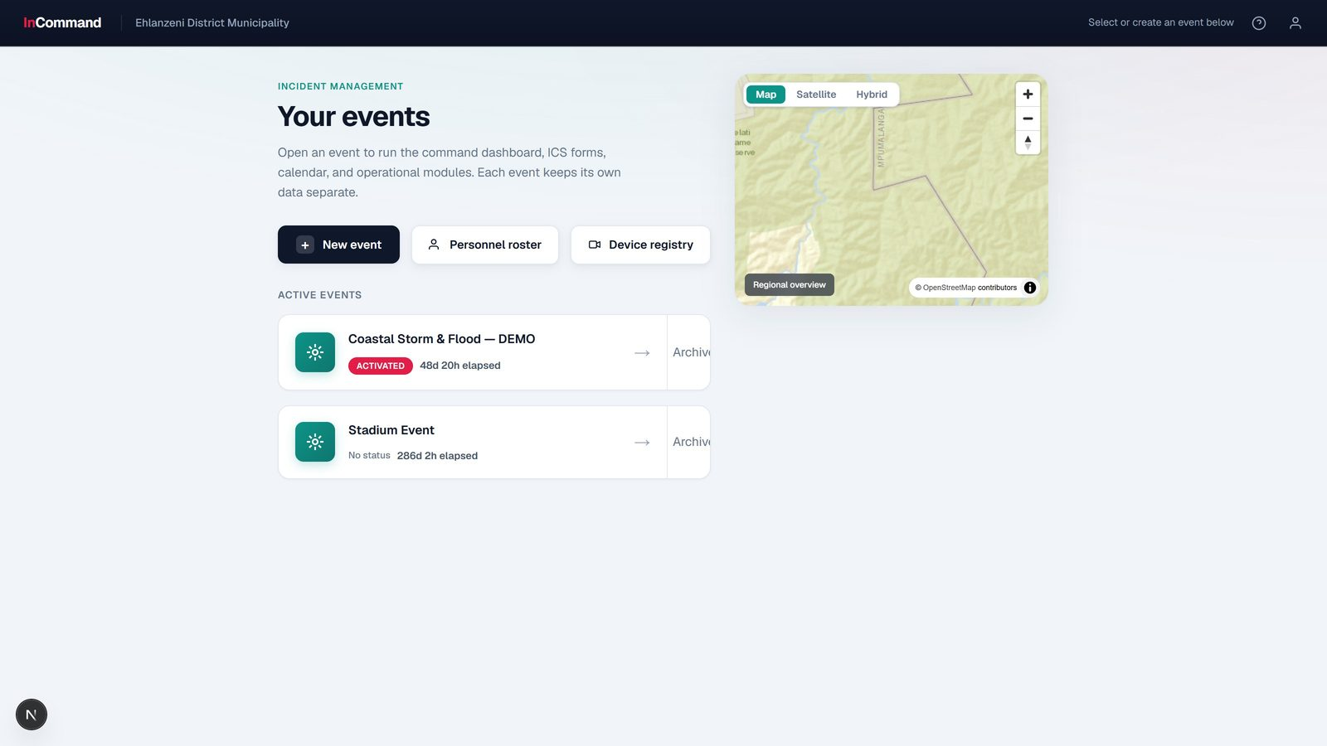
THE COMMAND CENTRE
Events hub
Every incident, its own workspace.
Multiple incidents per organisation
Each with its own map, people and forms
Open straight into the console

Slide 4
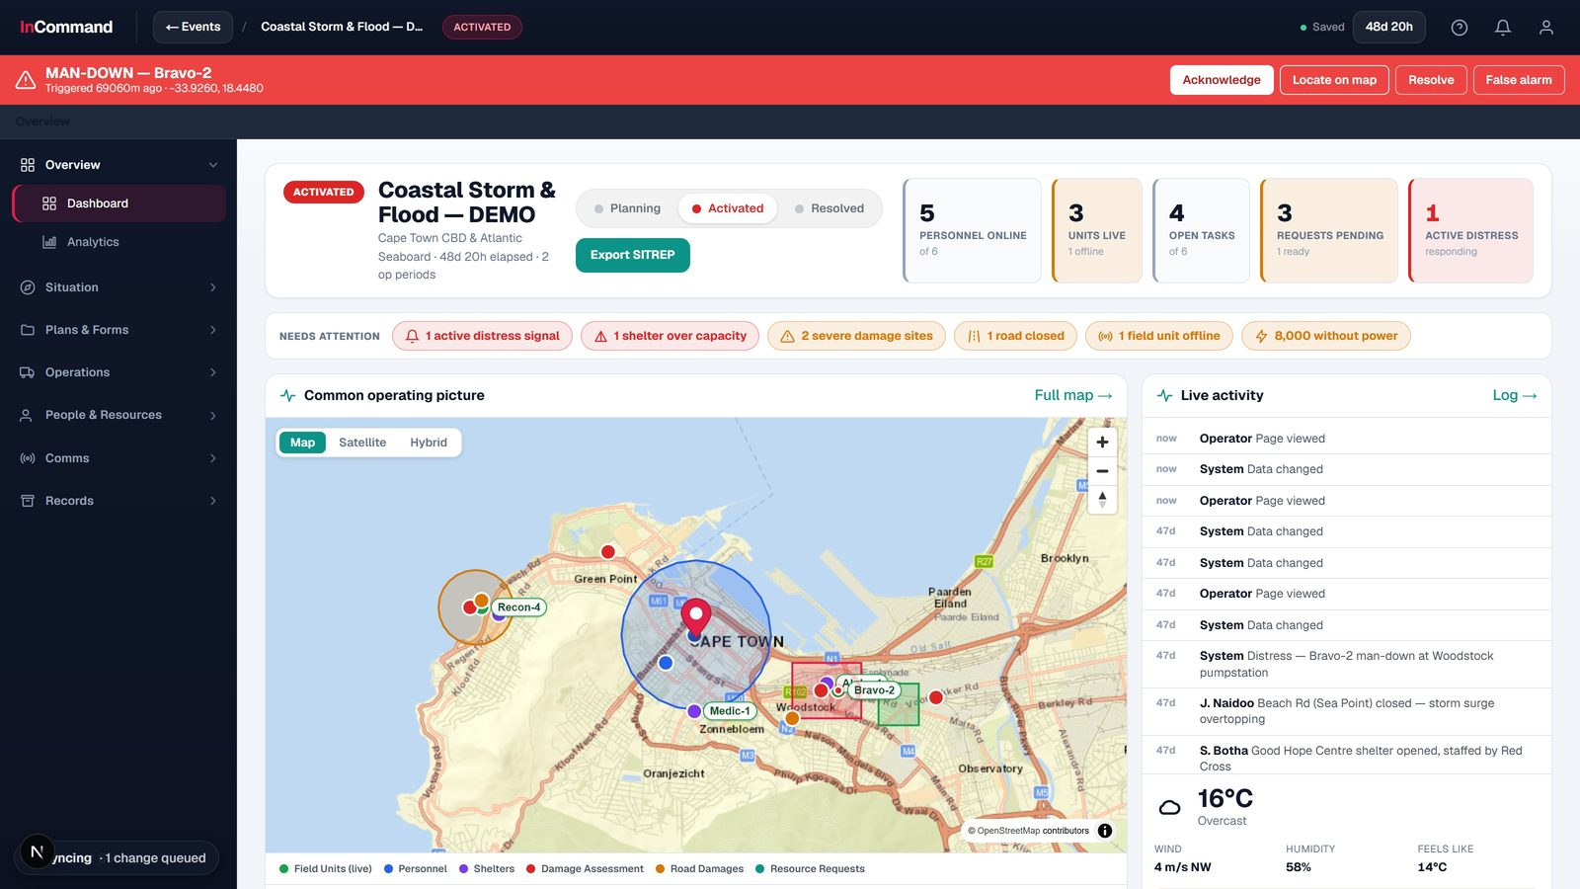
THE COMMAND CENTRE
Command dashboard
The whole incident at a glance.
Live counts: people, units, tasks, requests, distress
Needs-attention strip of active warnings
Operating-picture map + live activity feed

Slide 5
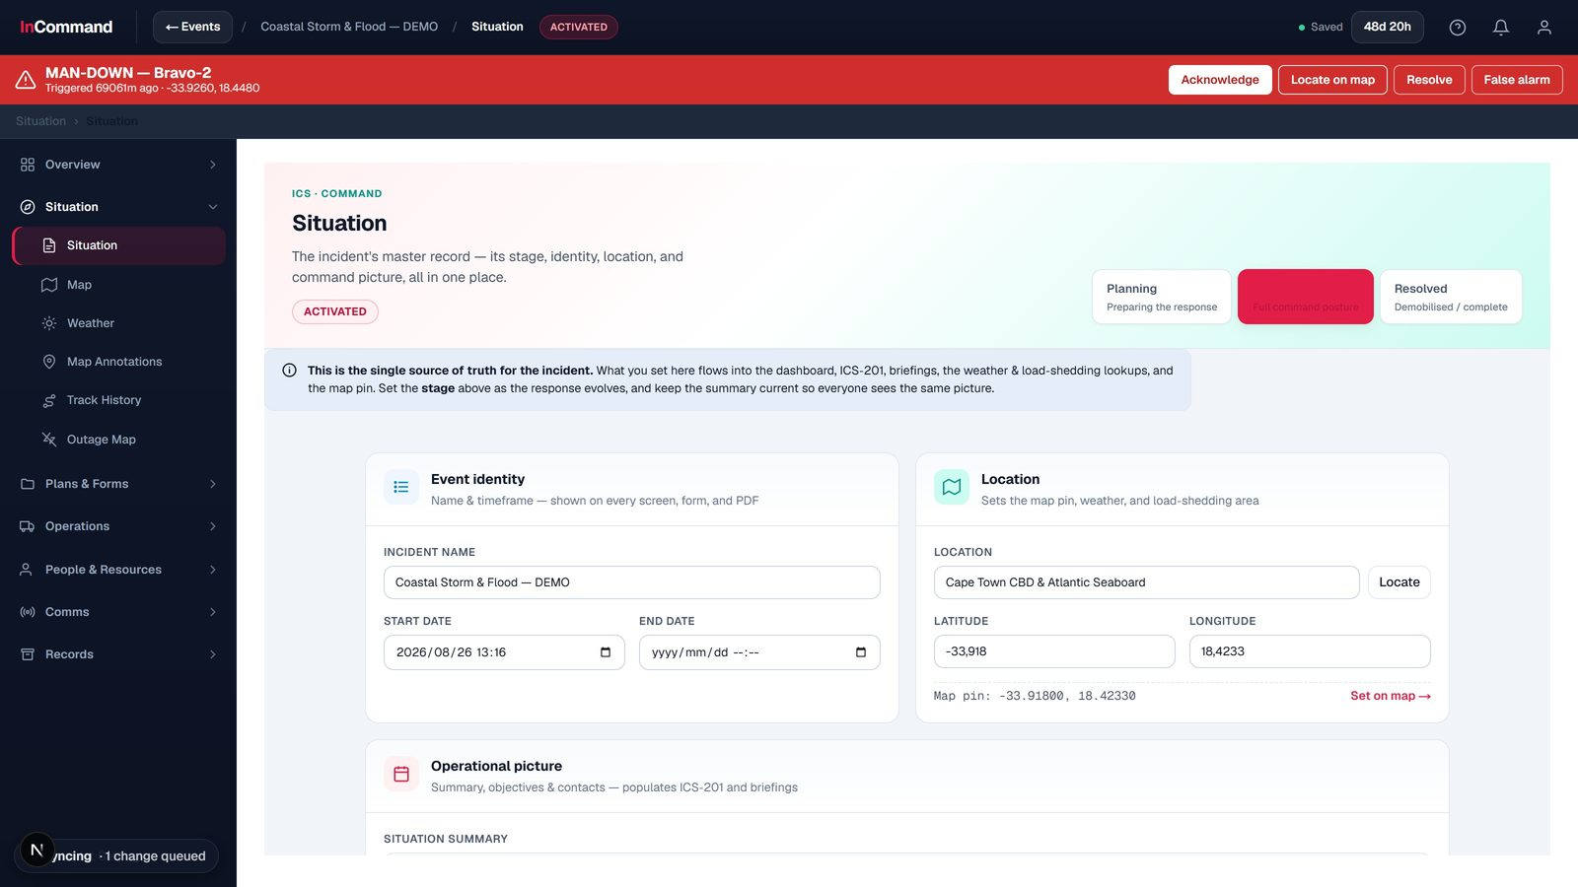
THE COMMAND CENTRE
Situation brief
What happened, where, and the objectives.
Summary, location and key contacts
Objectives and activation level
Feeds the map, weather and SITREP

Slide 6
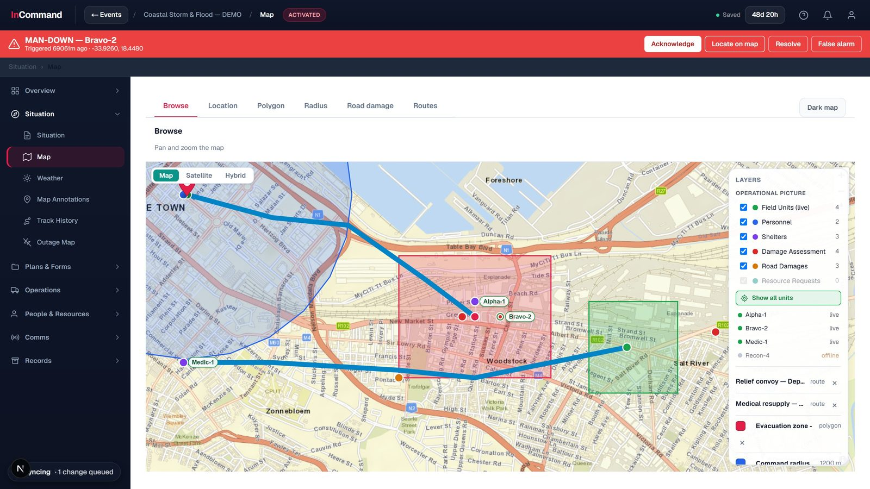
THE COMMAND CENTRE
Common operating picture
One live map everyone shares.
Units, sectors and hazards plotted live
Evacuation zones, command radius and routes
Satellite / hybrid map layers

Slide 7
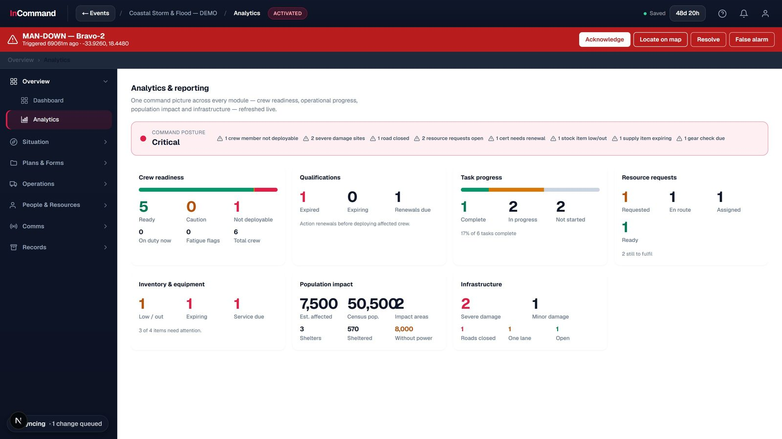
THE COMMAND CENTRE
Analytics & posture
The incident as numbers to act on.
Deployment and readiness at a glance
Command-posture summary
Cross-module reporting

Slide 8
PART 2
Planning & Tasking
Turn objectives into assigned, tracked work.

Slide 9
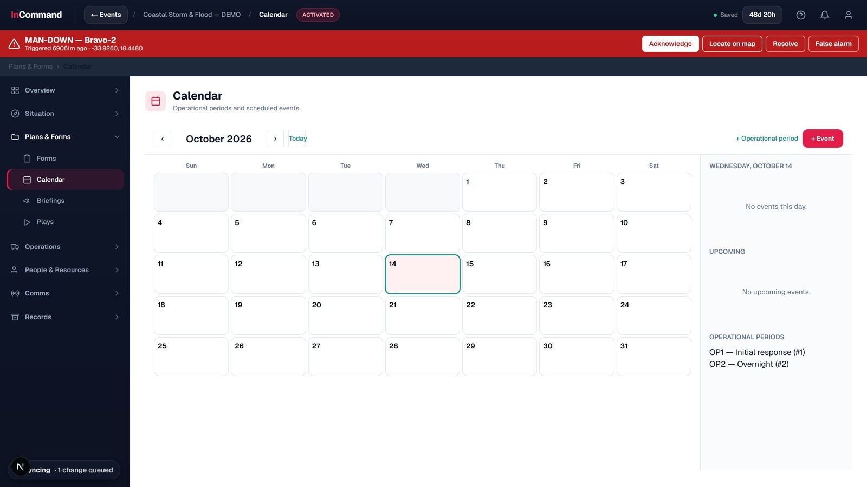
PLANNING & TASKING
Calendar & operational periods
Plan the incident in periods.
Operational periods and scheduled events
Briefings and shift changes
Everyone on one timeline

Slide 10
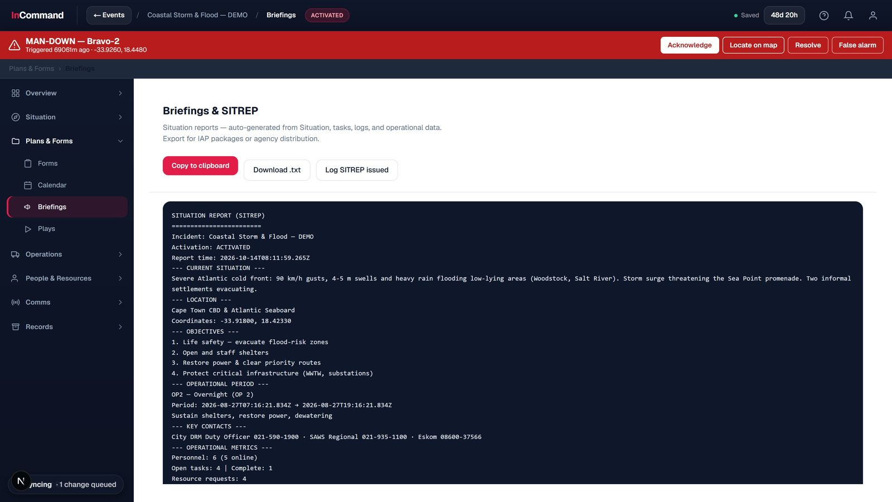
PLANNING & TASKING
Briefings & SITREP
One-click situation reports.
Auto-generated from live incident data
Copy, download or log a SITREP
Ready for agency distribution

Slide 11
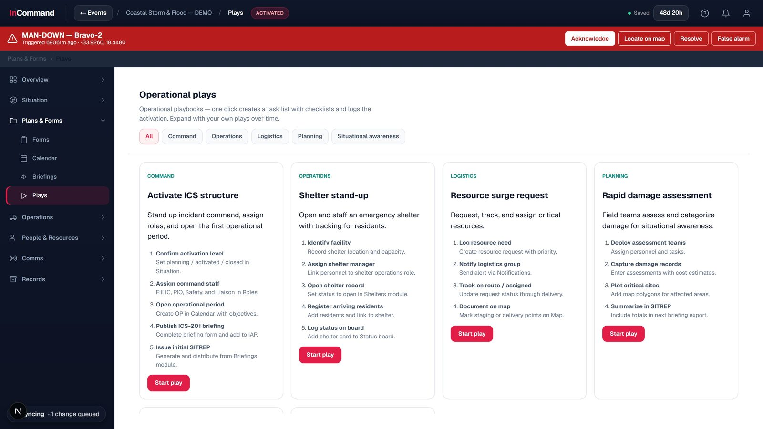
PLANNING & TASKING
Operational plays
Reusable response playbooks.
Activate ICS, open a shelter, surge resources
Each play spins up a task list
Run a standard response in one click

Slide 12
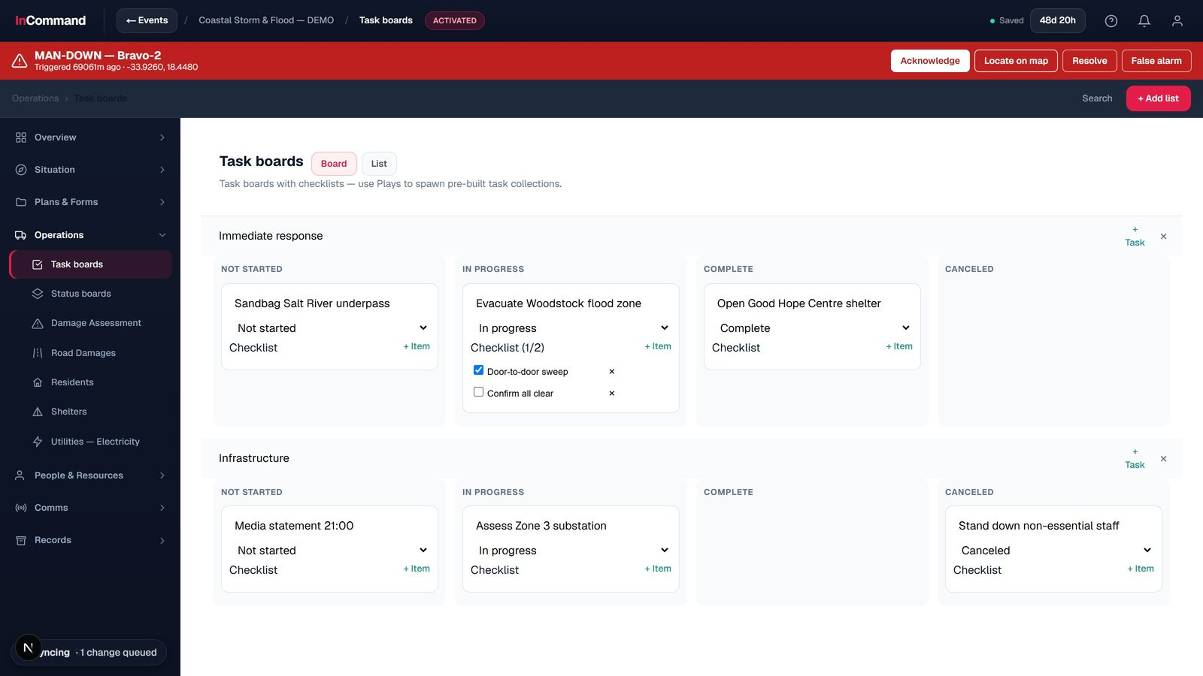
PLANNING & TASKING
Task boards
Assign and track the work.
Tasks with checklists, assignees, priorities
Grouped by workstream
Nothing falls through

Slide 13
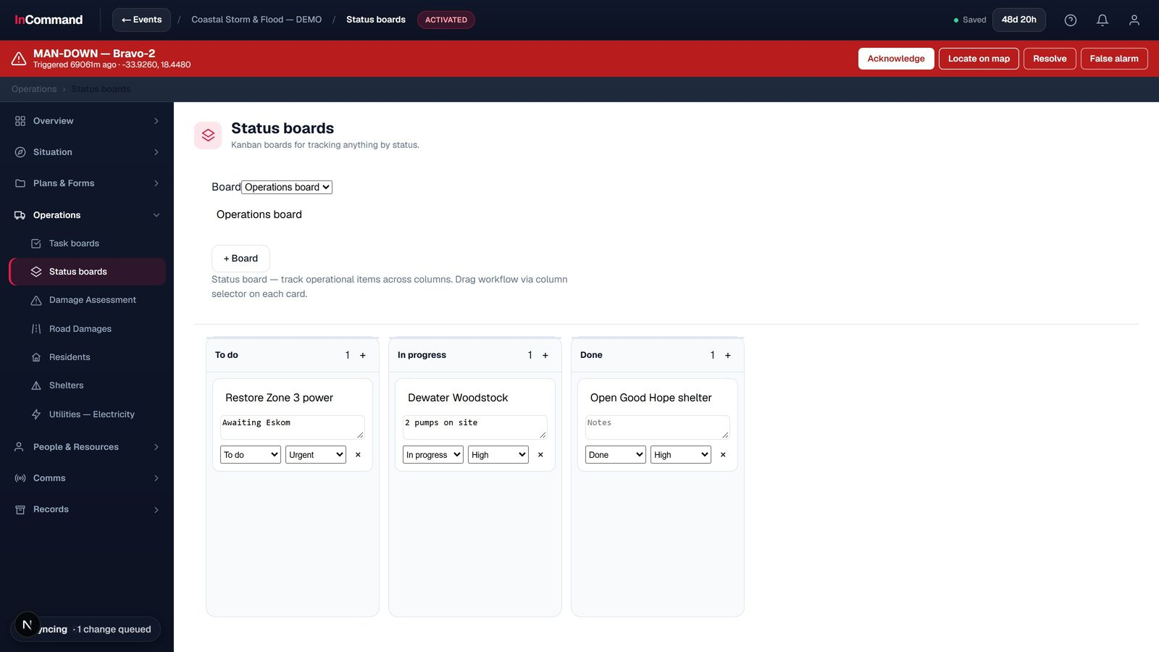
PLANNING & TASKING
Status boards
Kanban for anything, by status.
To-do / in-progress / done
Drag work across as it changes
Custom boards per need

Slide 14
PART 3
ICS Forms & Records
The incident paperwork, done inside the system.

Slide 15
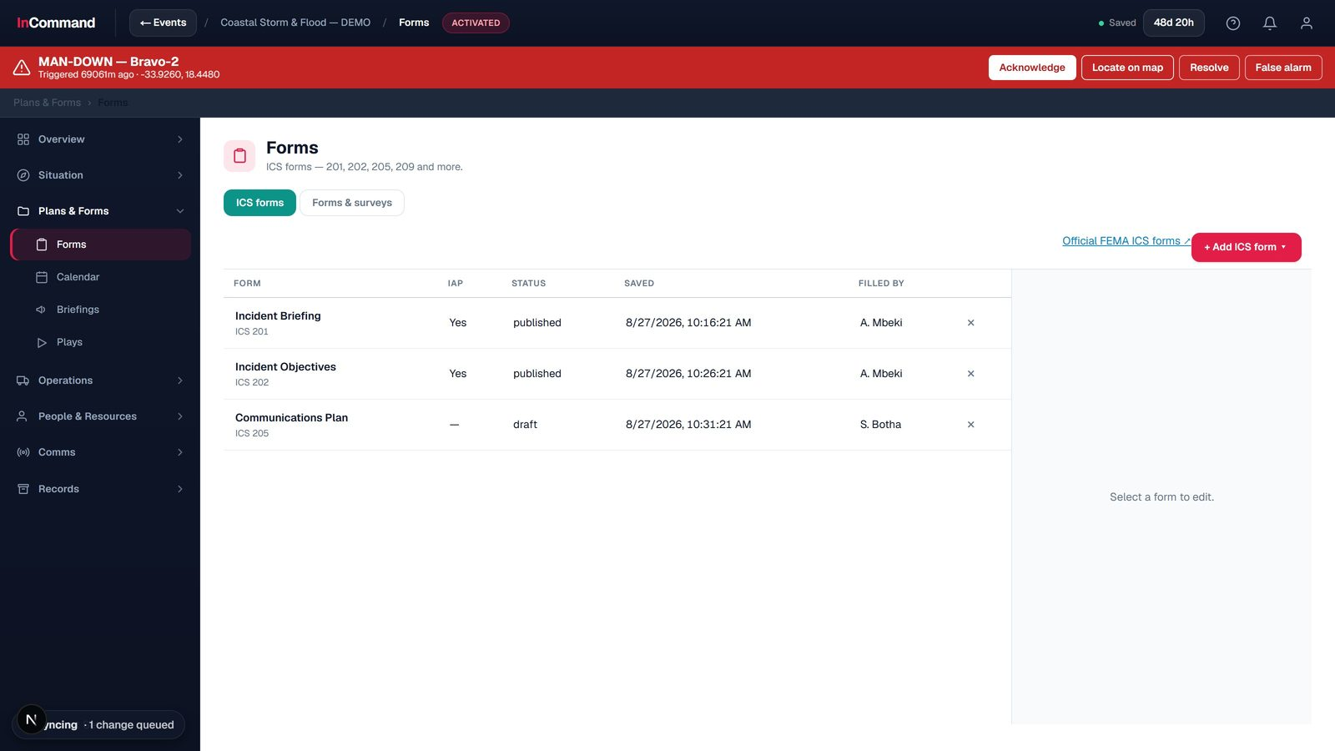
ICS FORMS & RECORDS
The ICS form suite
Every NIMS ICS form, built in.
ICS 201-260, including the IAP package
Seeded from the live incident
PDF export to the official layout

Slide 16
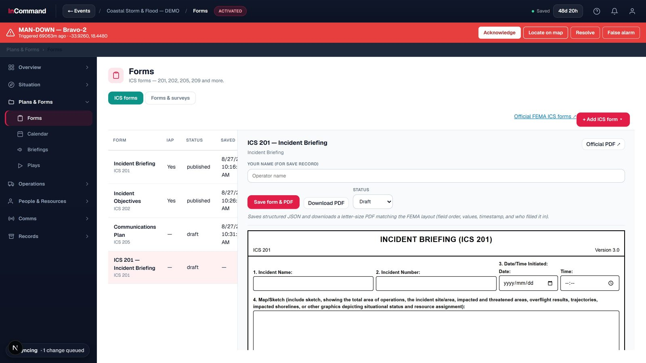
ICS FORMS & RECORDS
ICS 201 - Incident Briefing
To the official FEMA layout.
Structured fields, field for field
Map/sketch, objectives, org, resources
Letter-size PDF matching FEMA

Slide 17
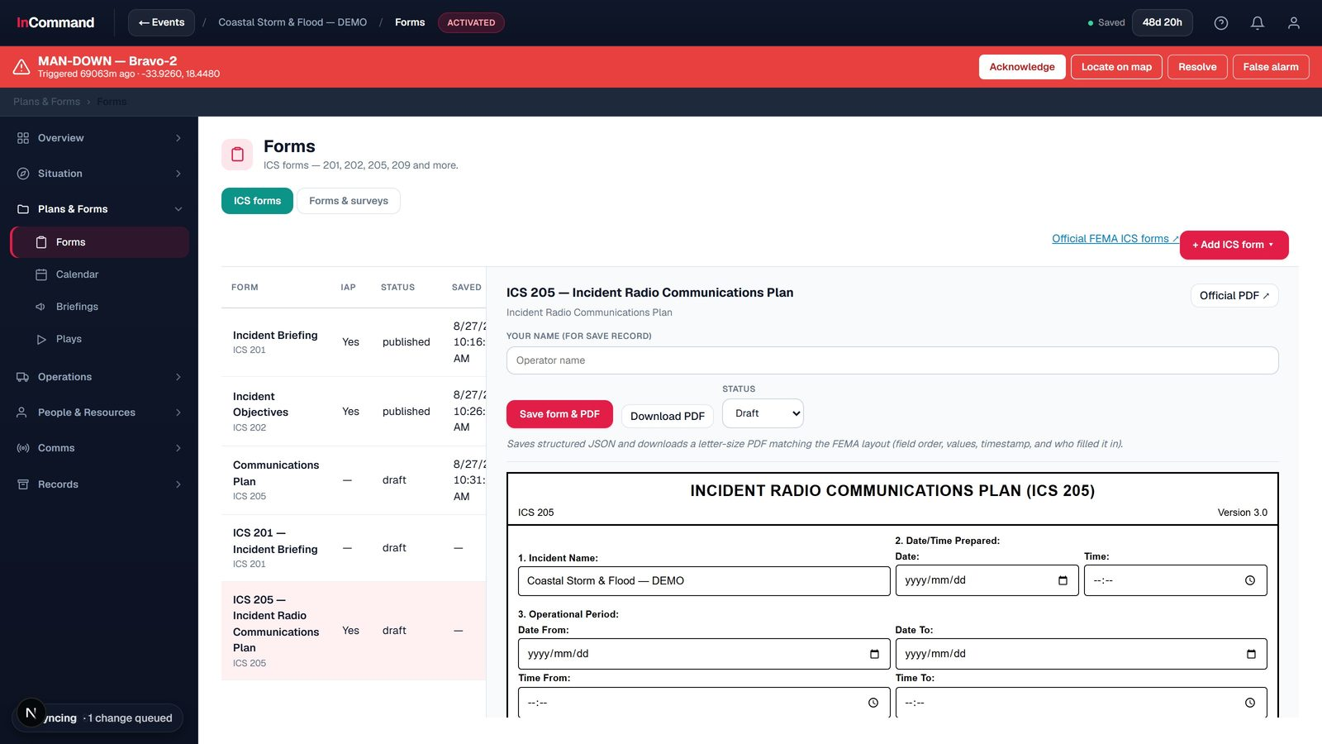
ICS FORMS & RECORDS
ICS 205 - Radio Comms Plan
Auto-filled from the incident.
Incident name and period pre-populated
Basic radio channel table
Exports to the official PDF

Slide 18
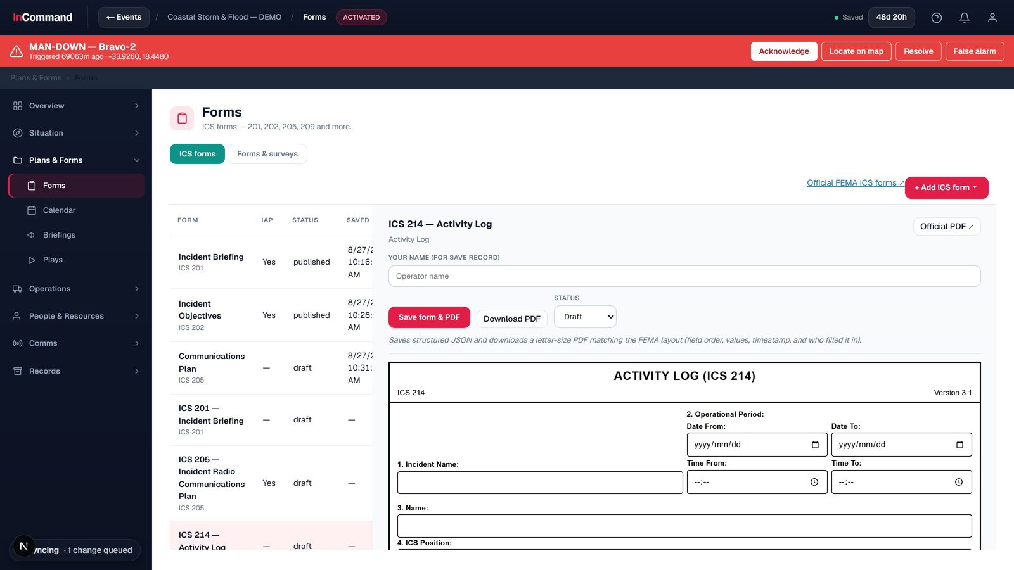
ICS FORMS & RECORDS
ICS 214 - Activity Log
The official activity-log form.
Structured, to the FEMA layout
Per-period, per-unit logging
One-click PDF

Slide 19
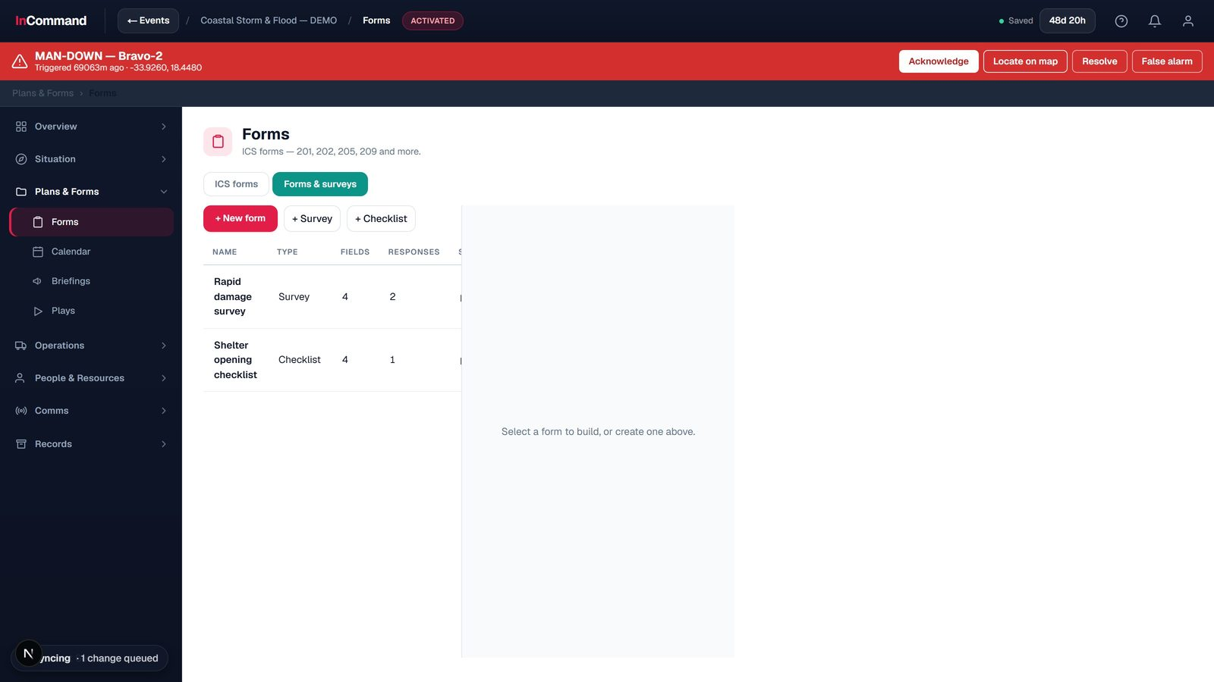
ICS FORMS & RECORDS
Custom form builder
Build your own when no ICS form fits.
Drag-and-drop surveys and checklists
Ten field types
Fill, collect and export responses

Slide 20
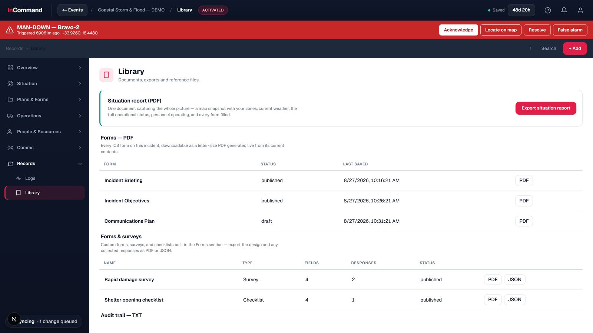
ICS FORMS & RECORDS
Library & exports
Documents, exports and reports.
Reference documents and playbooks
One-click SITREP and ICS PDFs
Audit-trail export

Slide 21
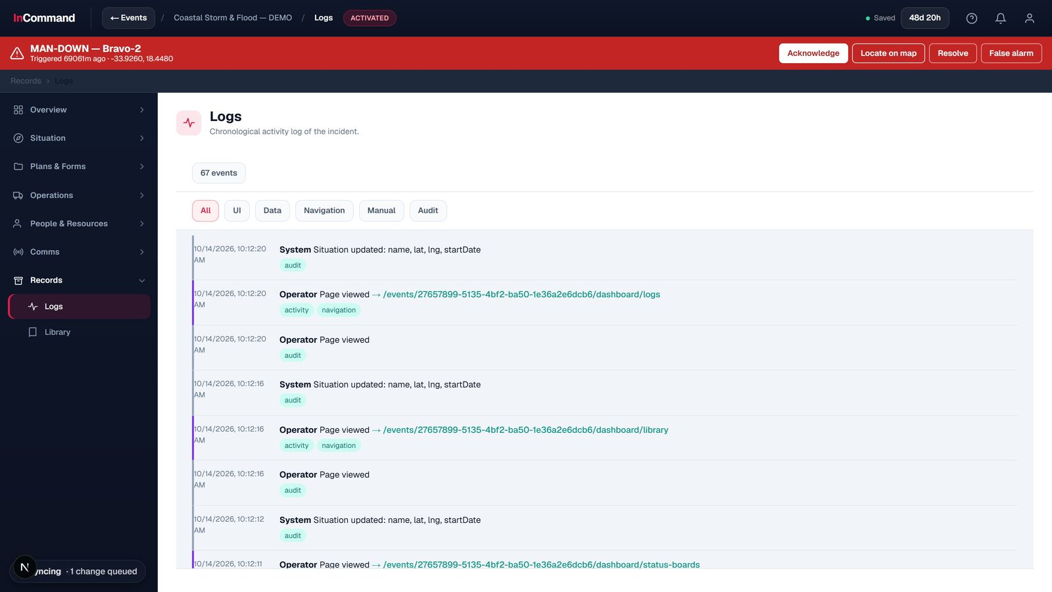
ICS FORMS & RECORDS
Activity log
A chronological record of it all.
Every change, view and action
Filter by type
Exportable audit trail

Slide 22
PART 4
People & Resources
Who is ready, and what you have to work with.

Slide 23
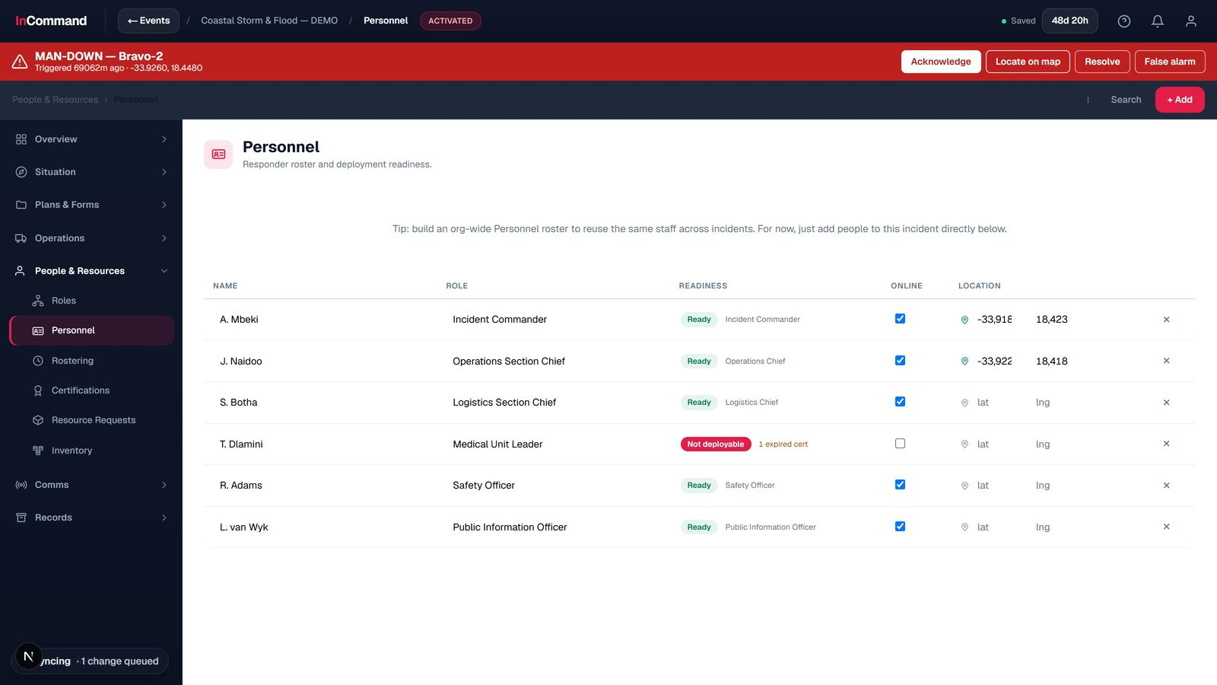
PEOPLE & RESOURCES
Personnel & roster
The responder roster.
Roles, online status and location
Deployment readiness
Experience and certifications

Slide 24
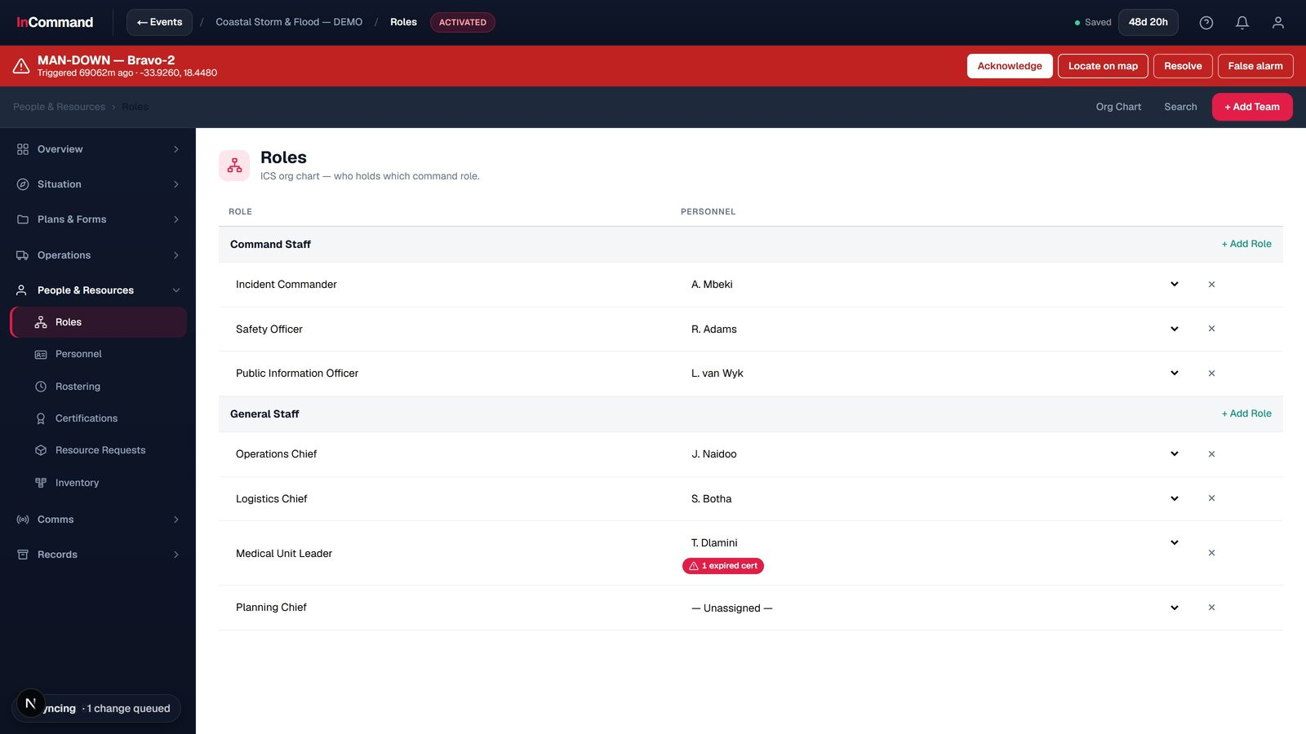
PEOPLE & RESOURCES
ICS org chart
Who holds which command role.
Command and general staff
Assign every ICS position
Flags unassigned or over-committed

Slide 25
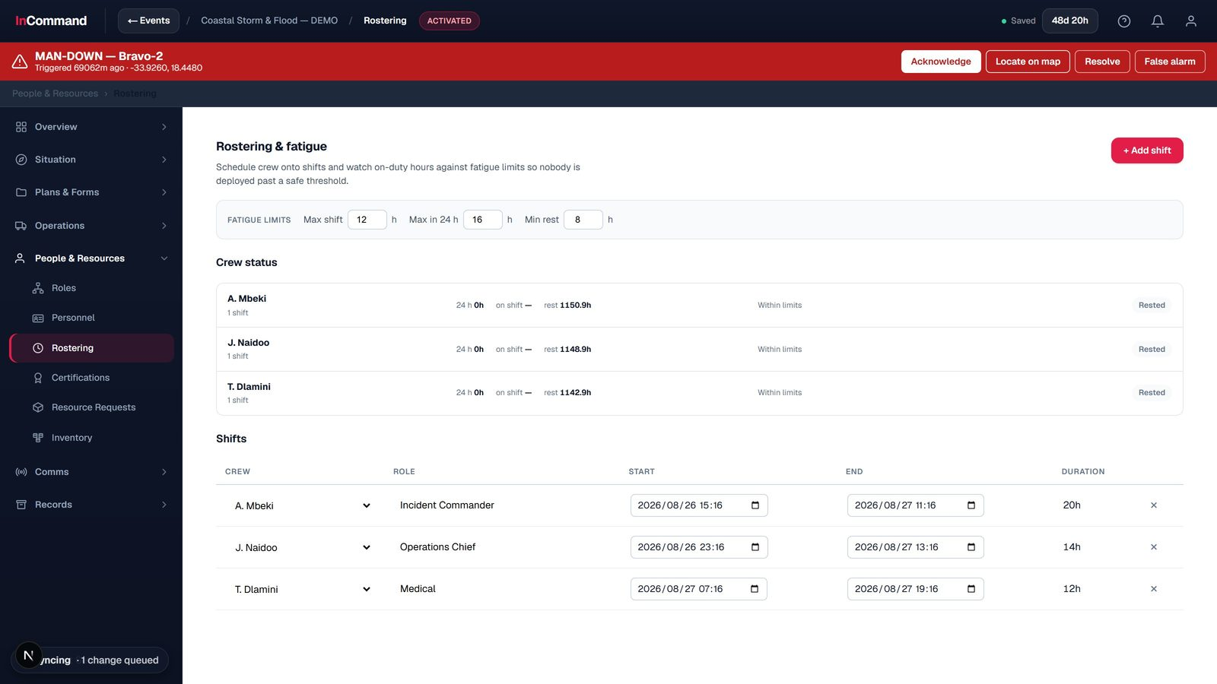
PEOPLE & RESOURCES
Rostering & fatigue
Crews scheduled and rested.
Shift scheduling
On-duty vs rest tracking
Against safe duty limits

Slide 26
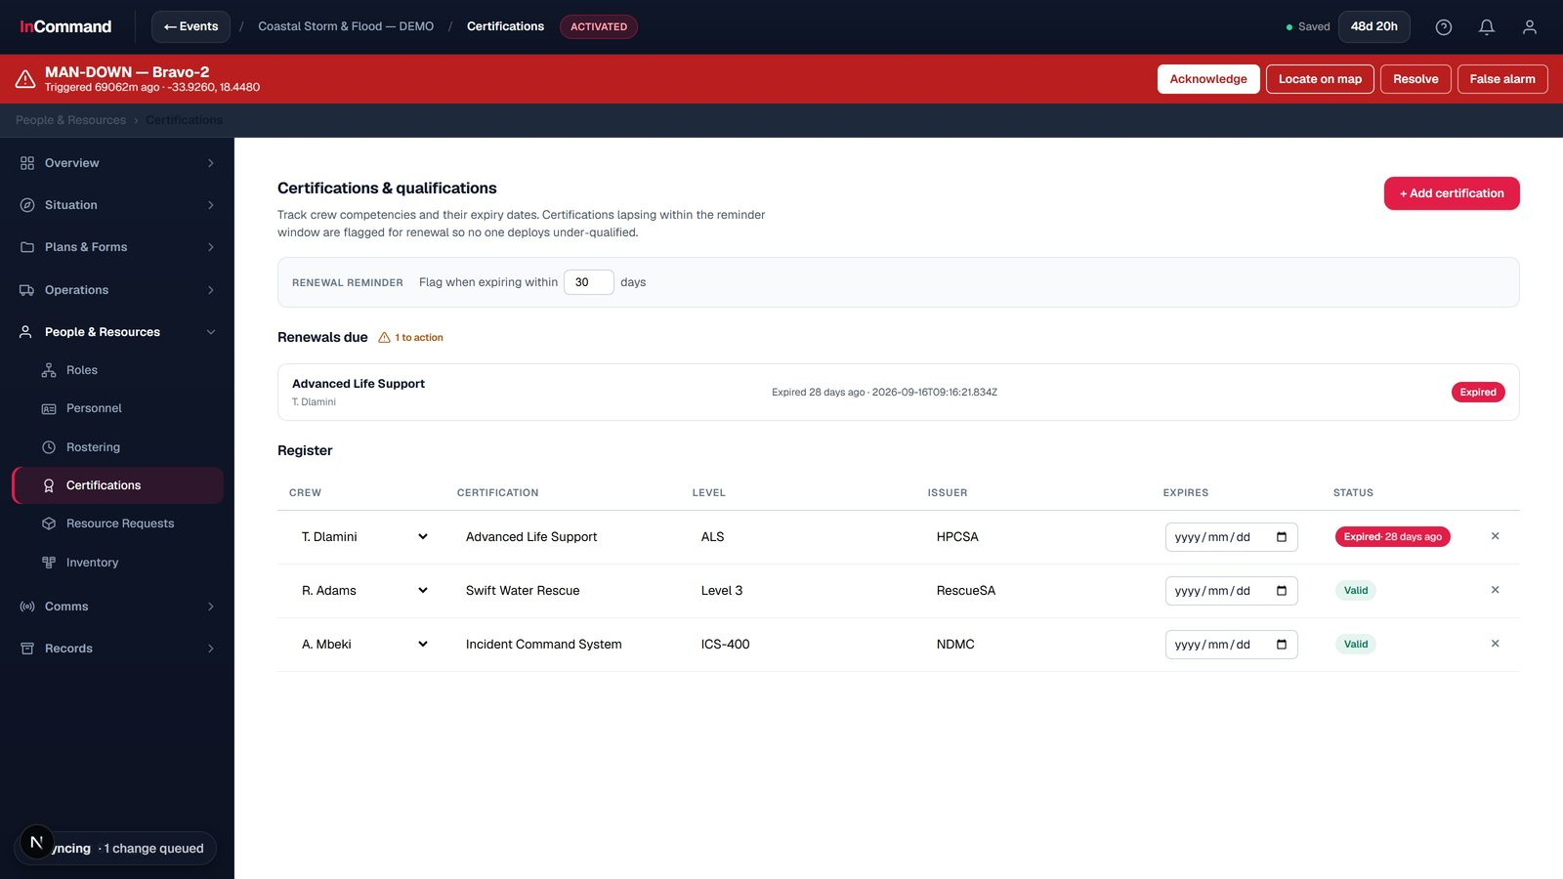
PEOPLE & RESOURCES
Certifications
Qualifications, tracked.
Certifications and levels per person
Expiry and renewal reminders
Flags expiring or expired

Slide 27
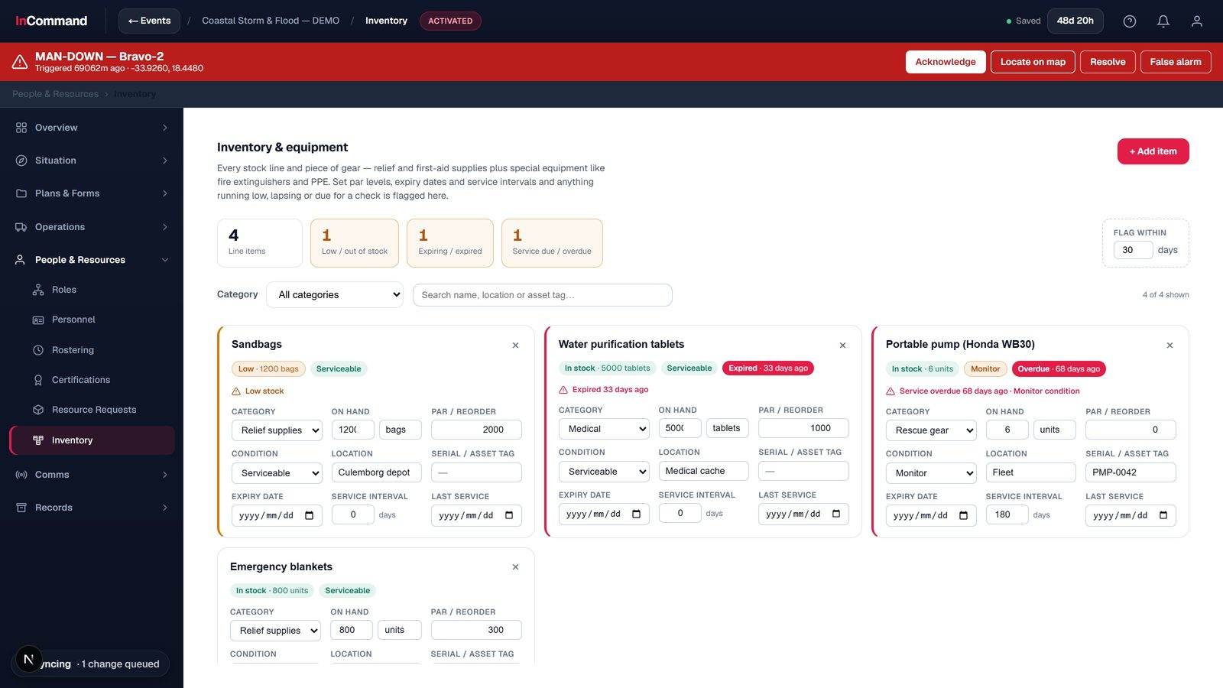
PEOPLE & RESOURCES
Inventory & equipment
Stock and gear on hand.
General stock and special equipment
Expiry and maintenance tracking
Low-stock alerts

Slide 28
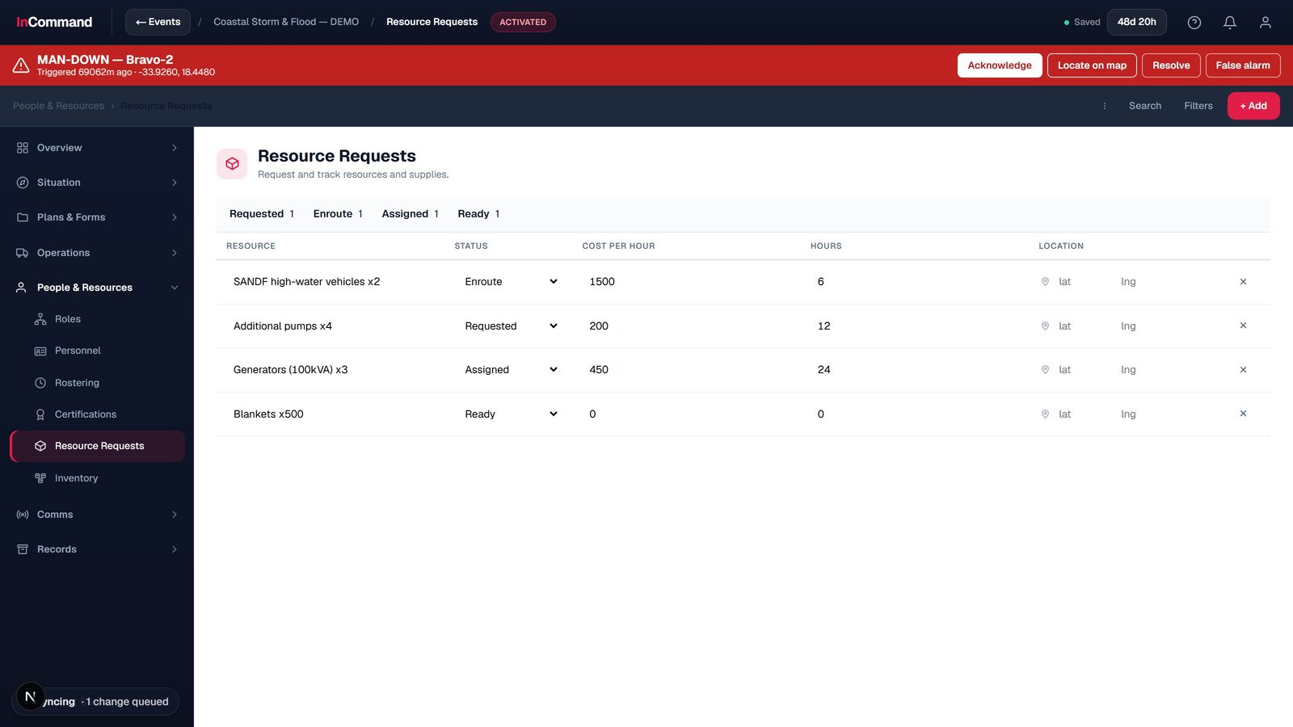
PEOPLE & RESOURCES
Resource requests
Request and track supplies.
Resource, status and cost
Enroute / assigned / ready
Tied to the incident

Slide 29
PART 5
Field Intelligence
What is happening on the ground, and who it affects.

Slide 30
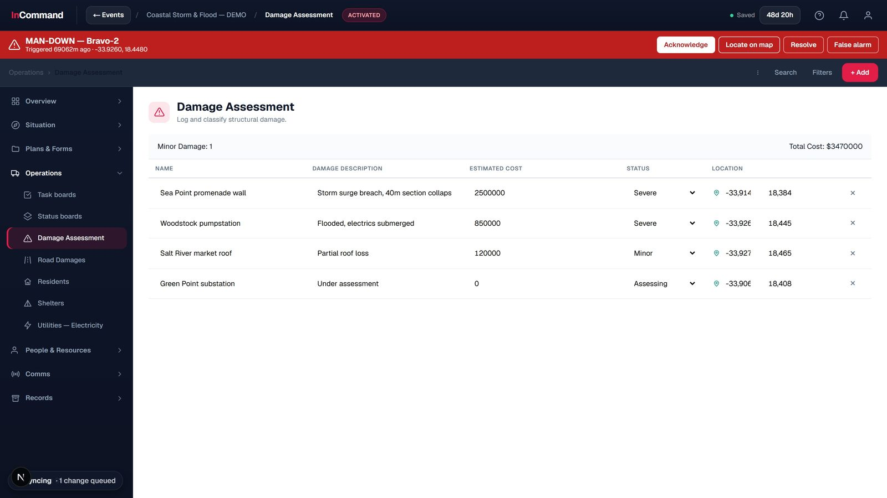
FIELD INTELLIGENCE
Damage assessment
Log and classify structural damage.
Severity, cost and location
Plotted to the map
Running totals

Slide 31
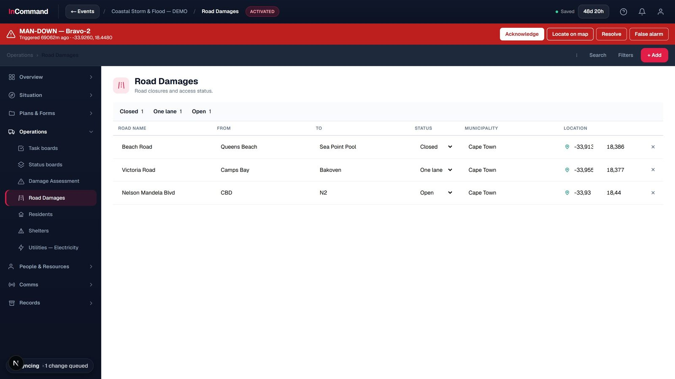
FIELD INTELLIGENCE
Road damages
Closures and access status.
Road, status and location
Closed / one-lane / open
Feeds routing

Slide 32
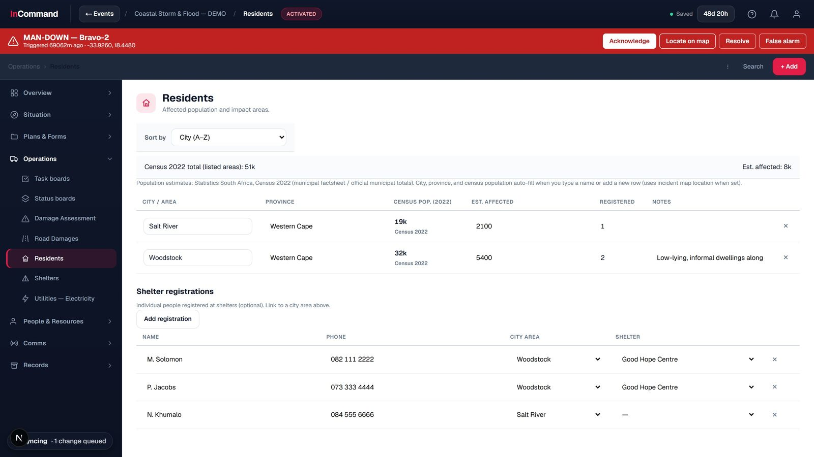
FIELD INTELLIGENCE
Residents & population impact
Who the incident affects.
Affected areas and populations
Census-based estimates
Shelter registrations

Slide 33
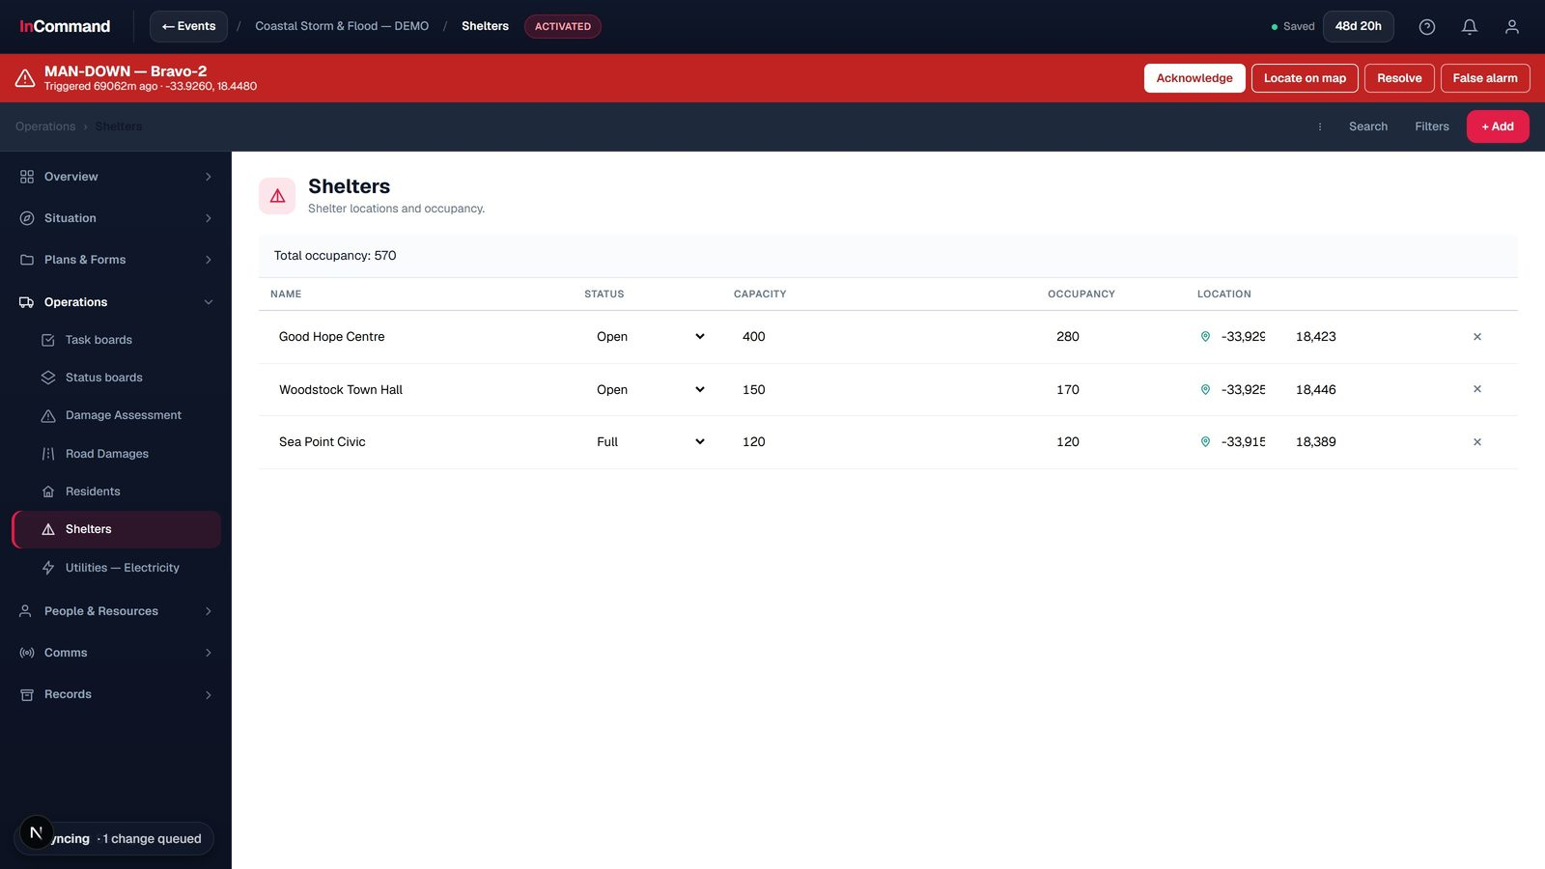
FIELD INTELLIGENCE
Shelters
Locations and live occupancy.
Capacity vs occupancy
Open / full status
On the map

Slide 34
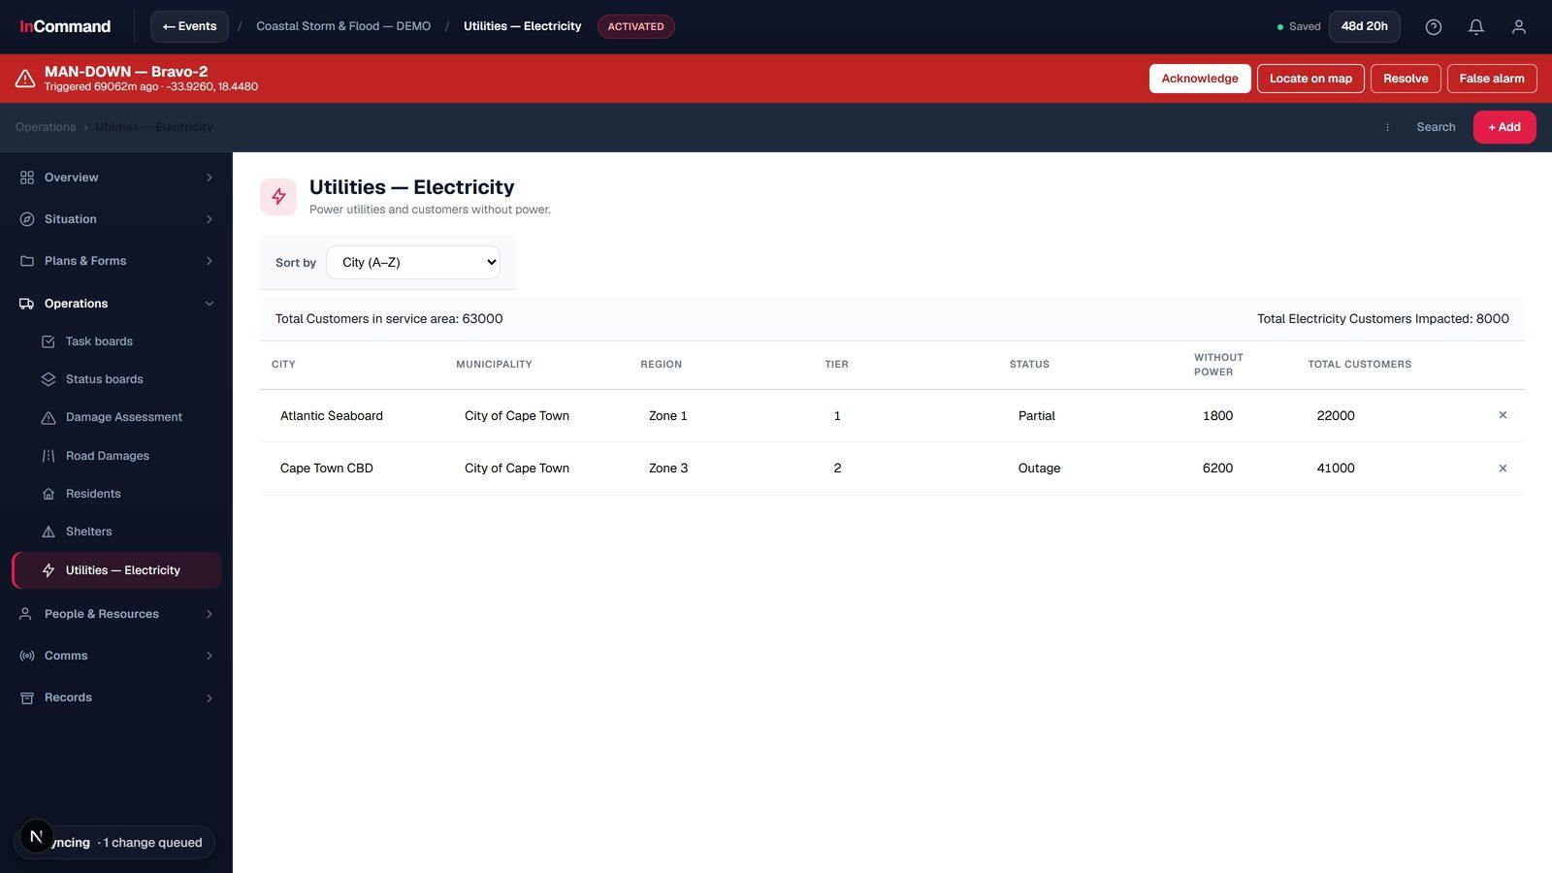
FIELD INTELLIGENCE
Utilities - electricity
Power impact across the area.
Customers without power
By area and tier
Outage vs partial

Slide 35
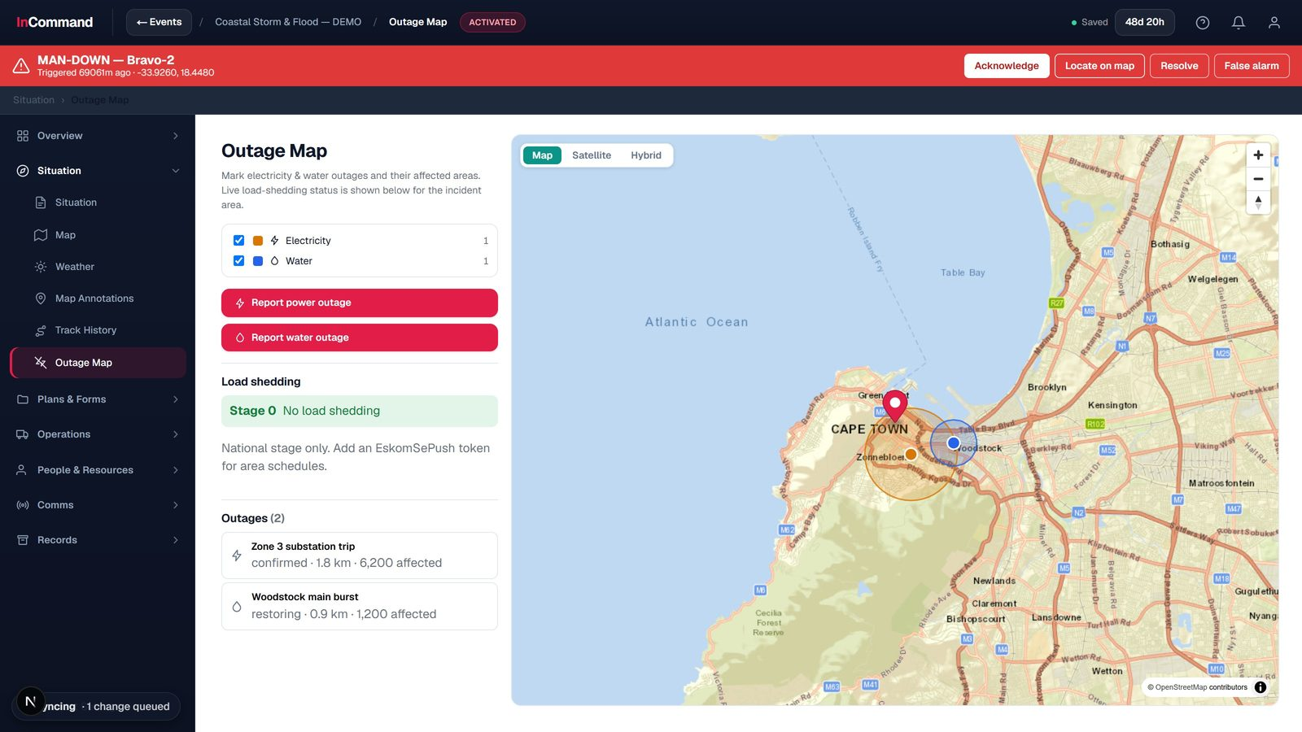
FIELD INTELLIGENCE
Outage map
Power and water outages, mapped.
Affected areas and numbers
Load-shedding stage
Live status

Slide 36
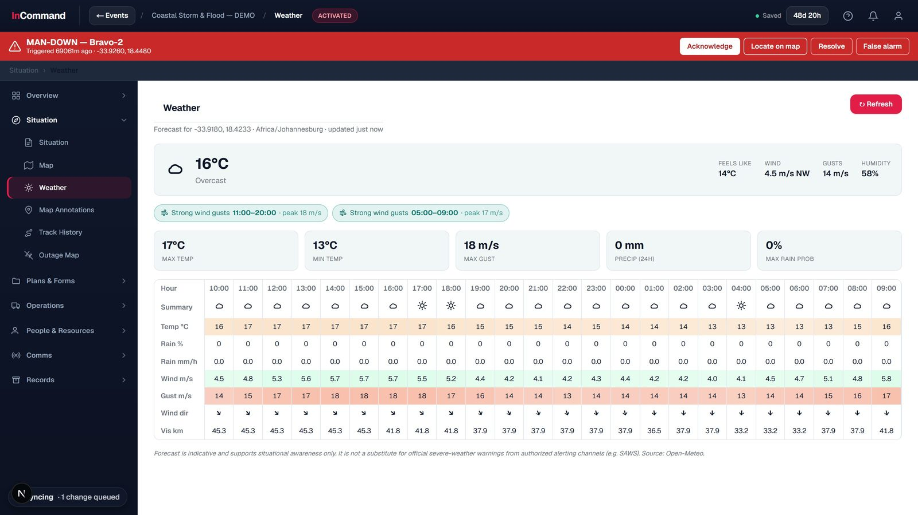
FIELD INTELLIGENCE
Weather
Conditions for the incident location.
Current conditions
Hourly meteogram
Hazard watch

Slide 37
PART 6
Communications & Alerts
Talk to the field, and reach the public.

Slide 38
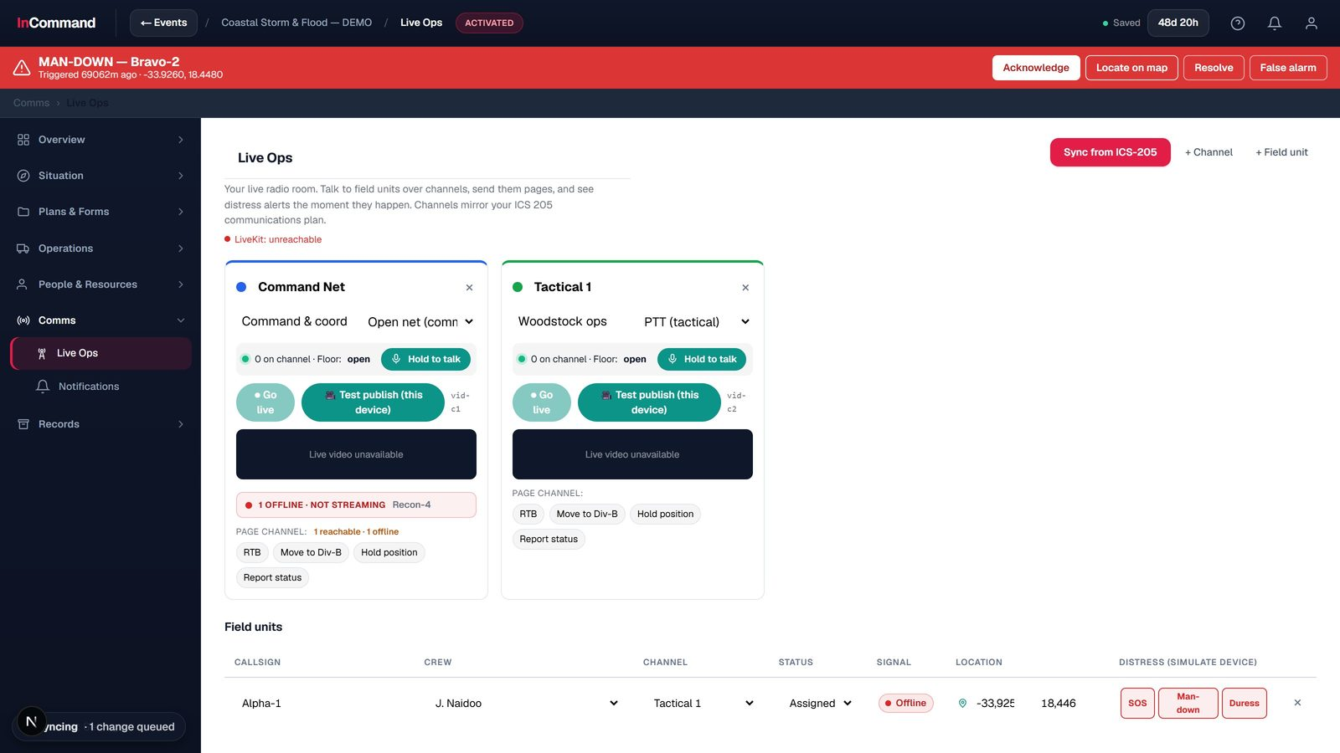
COMMUNICATIONS & ALERTS
Live Ops comms
Channels, field units and distress.
Push-to-talk channels and paging
Live field units
Unmissable distress alerts

Slide 39
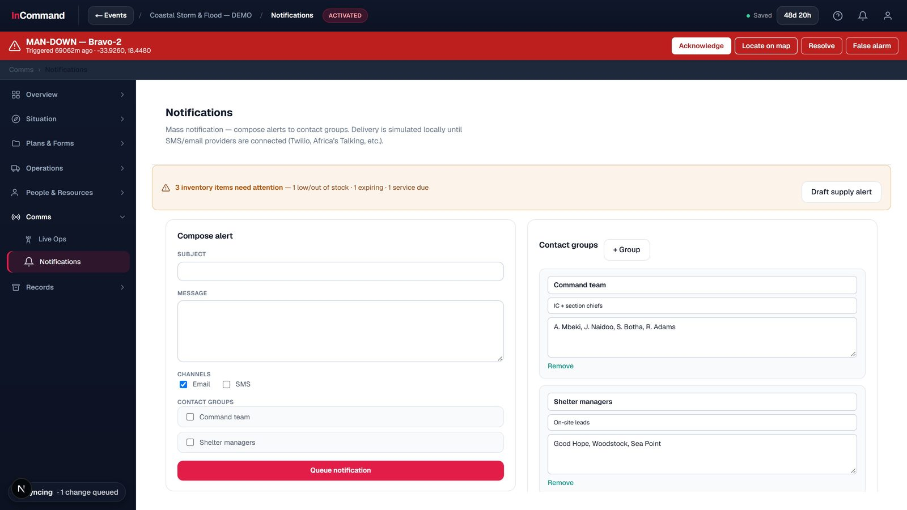
COMMUNICATIONS & ALERTS
Mass notifications
Reach the right people fast.
Compose to contact groups
Multi-channel (SMS / email)
Logged delivery

Slide 40
One platform. The whole incident.
Every screen in this deck is the working product, running one live demo incident end to end.
InCommand Mitiga

