Slide 1

Ecotourism: Destination Offerings Recommendation

Slide 2
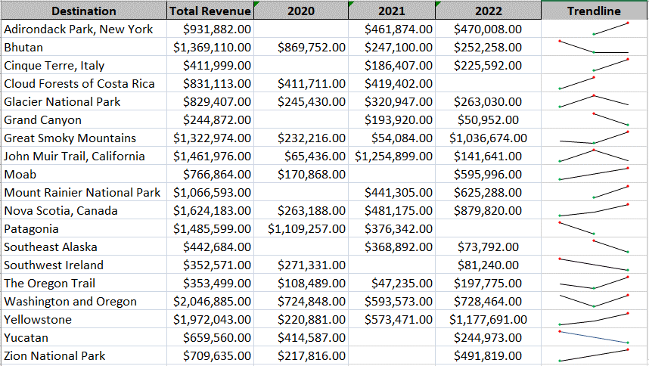
Objective
The main objective of this presentation is to conduct –Decision making data analysis to recommend a destination to be dropped from the list of Trips.
Referring to the above chart lets consider those destination with negative trend, which are highlighted in Red. These are places to be consider for initial phase of Analysis. Total Revenue solely cannot help us in taking the decision for dropping the Trip. So, we may have to consider the Average Revenue, Average Percentage increase in Revenue and Popularity trend of the destination.

Slide 3
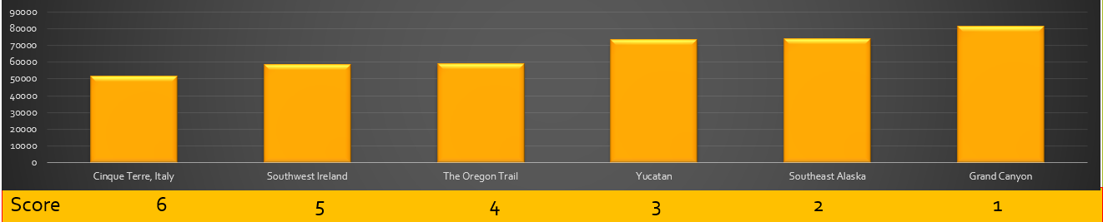
Factor 1 :- Average Revenue Generated per Destination
Average Revenue gives us the bigger picture how much each destination is performing for its given number of trips. This factor has significant role is deciding .
Below are the Six Low Average Revenue Generating Trips
Weighted value Average Revenue parameter is 0.30

Slide 4
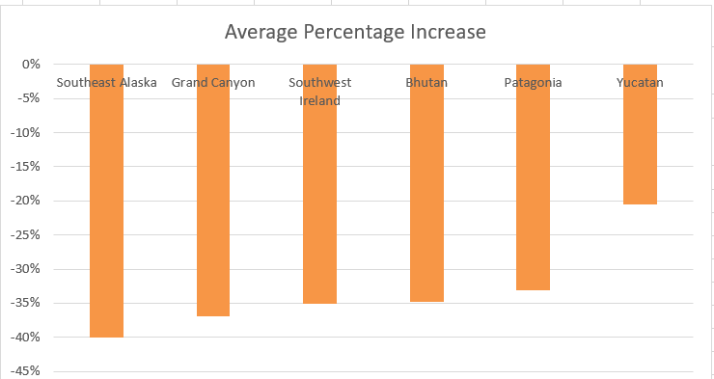
Factor 2 :- Average Percentage Increase In Revenue
Average Percentage Increase in the revenue for destination is the strong measuring factor in analyzing the growth of the revenue in percentage over the period. The Destination with negative growth is to be watched out.
Weighted value Average Revenue parameter is 0.50
These are the Six Destination with percentage decrease in revenue where all other destination have in positive trend w.r.t percentage increase in Revenue
Score 6 5 4 3 2 1

Slide 5
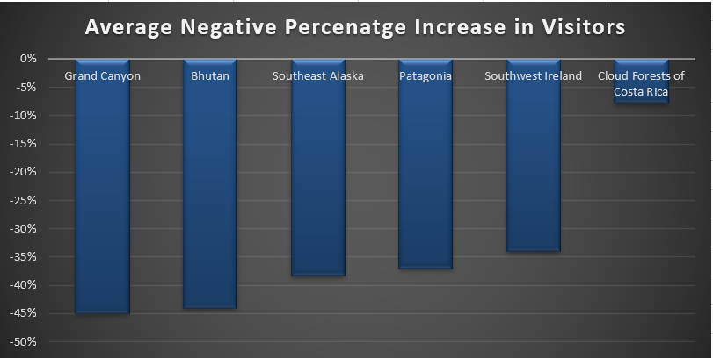
Factor 3 :- Average Percentage Increase In Visitors
Average Percentage Increase in the visitors clearly distinguishes the changes in tip’s popularity .This factor as well contributes to taking decision when it comes to dropping the trip future schedule.
Weighted value Average Revenue parameter is 0.20
These are the Six Destination with percentage decrease in Visitors where all other destination have in positive trend w.r.t percentage increase in Visitors
Score 6 5 4 3 2 1

Slide 6
Decision based in the Weighted Sum
Recommendation
After mathematical calculation of computing Weighted sum considering 3 factors “SOUTHEAST ALASKA” has the heighted score of rejection.

Slide 7
Summary
Trip to SOUTHEAST ALASKA is recommended to be dropped in the future considering below 3 factors and their weighted scores.
1. Average Revenue Generated per Destination
2. Average Percentage Increase In Revenue
3. Average Percentage Increase In Visitors
We can infer that the difficulty in fitness level required has no relation with decrease in the popularity of destination in fact looks they are inversely proportional.

