Slide 1
Swerve Drive
RatPack 830

Slide 2
Goals
Everyone understands the fundamentals of swerve software
Everyone learns and codes in c++
Robust, reliable swerve software implementation
Reusable splining solution for use in Auto

Slide 3
Timeline
July 23rd – Swerve Driving well in Teleop
August 6th – Swerve Odometry Working
Important for splining
August 27th – Splining Working

Slide 4
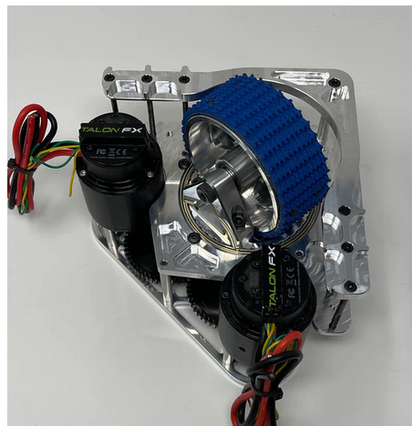
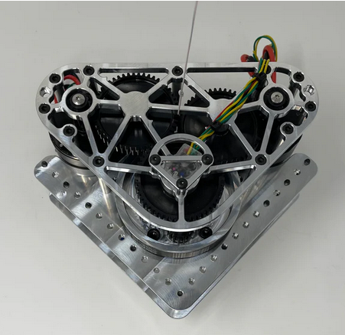






Swerve Components
Turn Motor
Swerve Module
Drive Motor
Gyro
Absolute Encoder

Slide 5
Swerve Module
Turn Motor
Drive Motor
Set wheel to a specific heading
Infinite rotation
Position PID
Drive wheel at a specific speed
Velocity PID

Slide 6
Others
Module Absolute Encoder
Gyro
Provide a way to set the zero heading regardless of where the modules are facing
Used for field centric drive
Forward is always towards opposite alliance wall
Provides a heading bounded from 0-360 deg

Slide 7
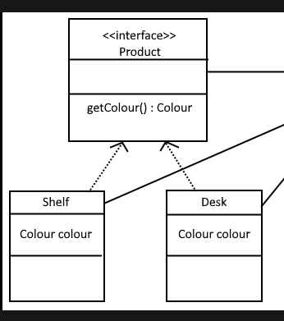
C++ Interface
Describes functions that a class must implement
Example:
Advantage: programming to interface allows others to develop without needing an actual class implementing the functionality
Advantage: if we change one physical component, we just need to implement a new class for it and don’t have to rewrite entire swerve

Slide 8
SwerveGyro
GetYawPitchRoll()
GetHeading()
GetRawHeading()
Get/SetInverted(bool inverted)
SetZeroHeading(double zero_heading)

Slide 9
SwerveAbsoluteEncoder
GetHeading()
GetRawHeading()
Get/ SetInverted(bool inverted)
SetZeroHeading(double zero_heading)

Slide 10
SwerveTurnMotor
SetRotation(double deg)
GetRotation()
Get/ SetInverted(bool invert)
ForceTurnDirectionCW()
ForceTurnDirectionCCW()
SetIdleMode()
GetIdleMode()

Slide 11
SwerveDriveMotor
SetVelocity(double desired_vel)
GetVelocity()
Get/ SetInverted(bool inverted)
SetIdleMode()
GetIdleMode()

Slide 12
SwerveModule
SetState(SwerveModuleState state)
GetState()
SetIdleModes()
GetIdleModes()

Slide 13
SwerveDrive
Get/SetEbreak()
Drive(Translation2d pos, double rotation)
Drive(double vx, double vy, double omega)
Drive(ChassisSpeeds speed)
Drive(SwerveModuleState[] states)
Set/Get Idle Modes
SetRobotOriented()
SetFieldOriented()

Slide 14
Sendable wpilib – look into this
Create overall interface with DumpData() to output to dashboard

