Slide 1

OBJECT ORIENTED PROGRAMMING: SOLID PRINCIPLES
CASE STUDY: TIC-TAC-TOE
PRESENTED BY: Philip and precious

Slide 2
DEFINITION
SOLID in object-oriented programming can be defined as a set of five design principles used in the building of software/application in a more scalable, maintainable, flexible and understandable manner/way.
SOLID is a mnemonic acronym that stands for:
S – Single Responsibility Principle (SRP): A class should have no reason to change, it should only do one job or responsibility.
O – Open-Closed Principle (OCP): A class should be open for extension but closed for modification.
L – Liskov Substitution Principle (LSP): Objects of a superclass should be replaceable with objects of a subclass without breaking the application.
I – Interface Segregation Principle (ISP): Clients should not be forced to depend on methods they do not use.
D – Dependency Injection Principle (DIP): High-level modules should not depend on low-level modules; both should depend on abstractions. Abstractions should not depend on details; details should depend on abstractions.

Slide 3
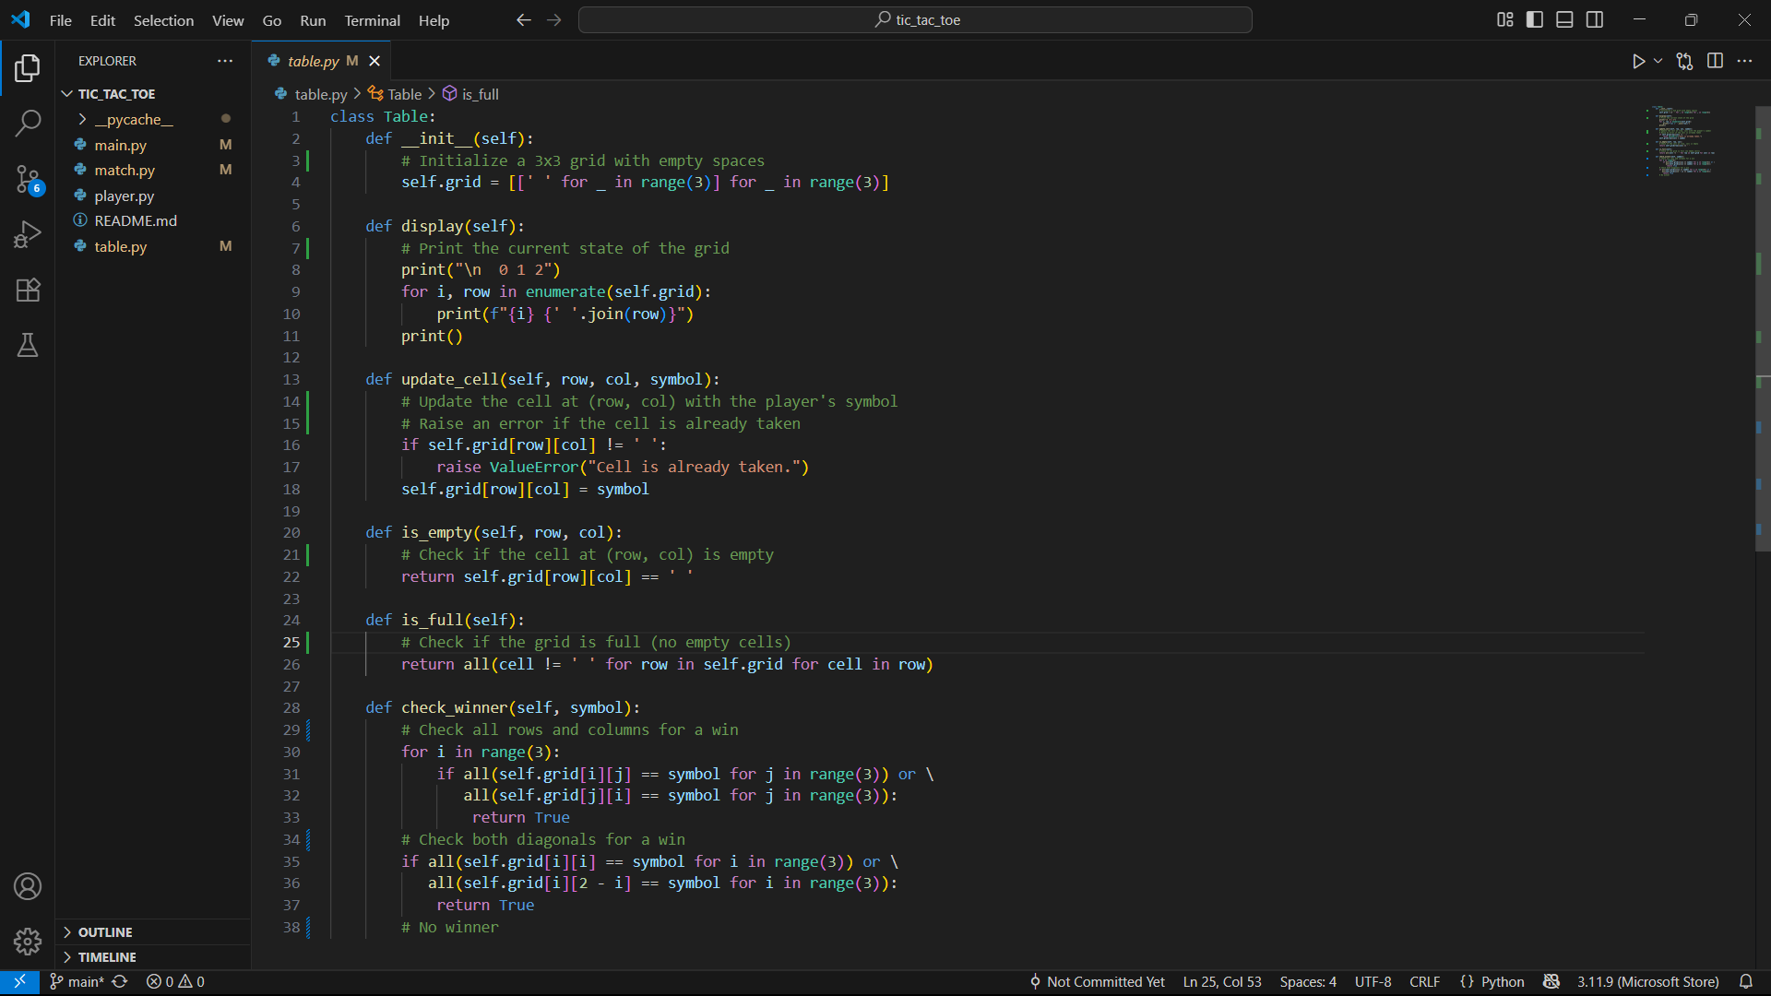
table.py
VIOLATIONS.
SRP violation: Table handles multiple responsibilities: data storage, validation, winner-checking, and rendering (display()).
OCP violation: For different win conditions (e.g larger board), the logic inside table must be rewritten.
ISP/DIP violation: Tied to console output (print() in display()), making it impossible to reuse in GUI/Web.

Slide 4
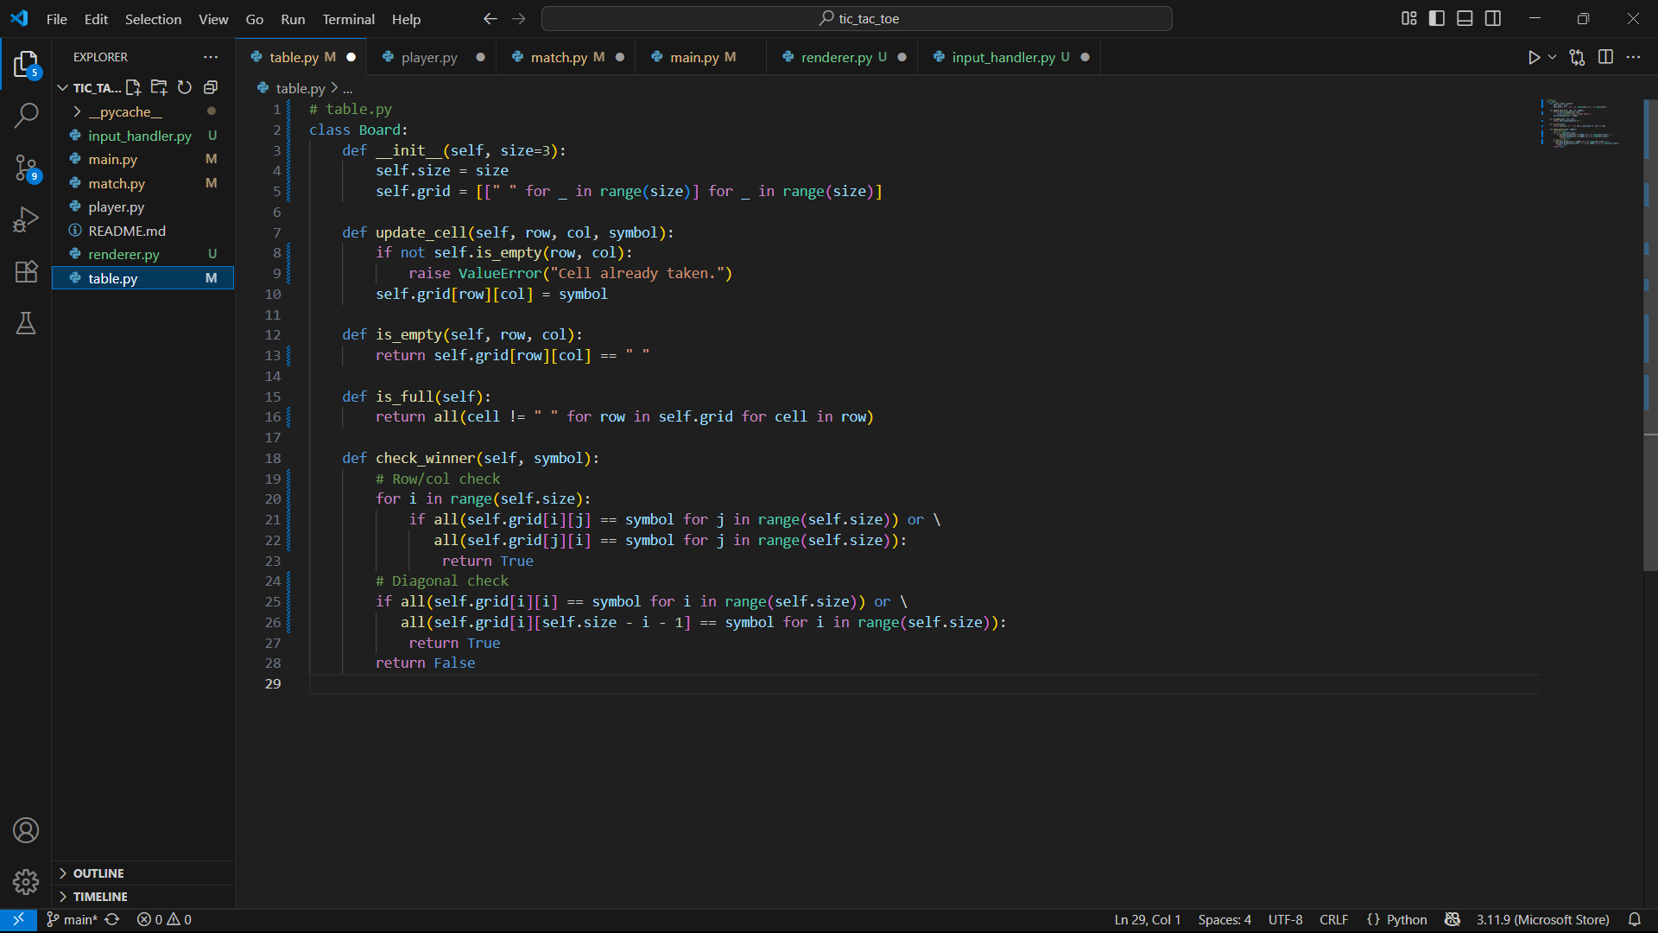
table.py
SOLUTION
Extract rendering into a Renderer.
Keep Table as a pure data model (board states, updates, validations).
Allow board size to be configurable.

Slide 5
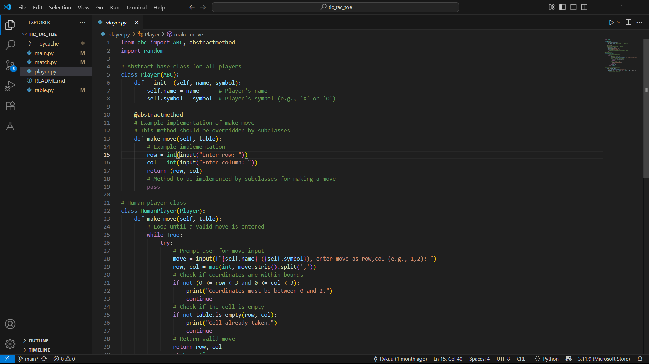
player.py
VIOLATIONS.
SRP violation: HumanPlayer handles both move logic and console input.
DIP violation: HumanPlayer depends directly on input().
OCP violation: Adding another AI strategy requires editing this file

Slide 6
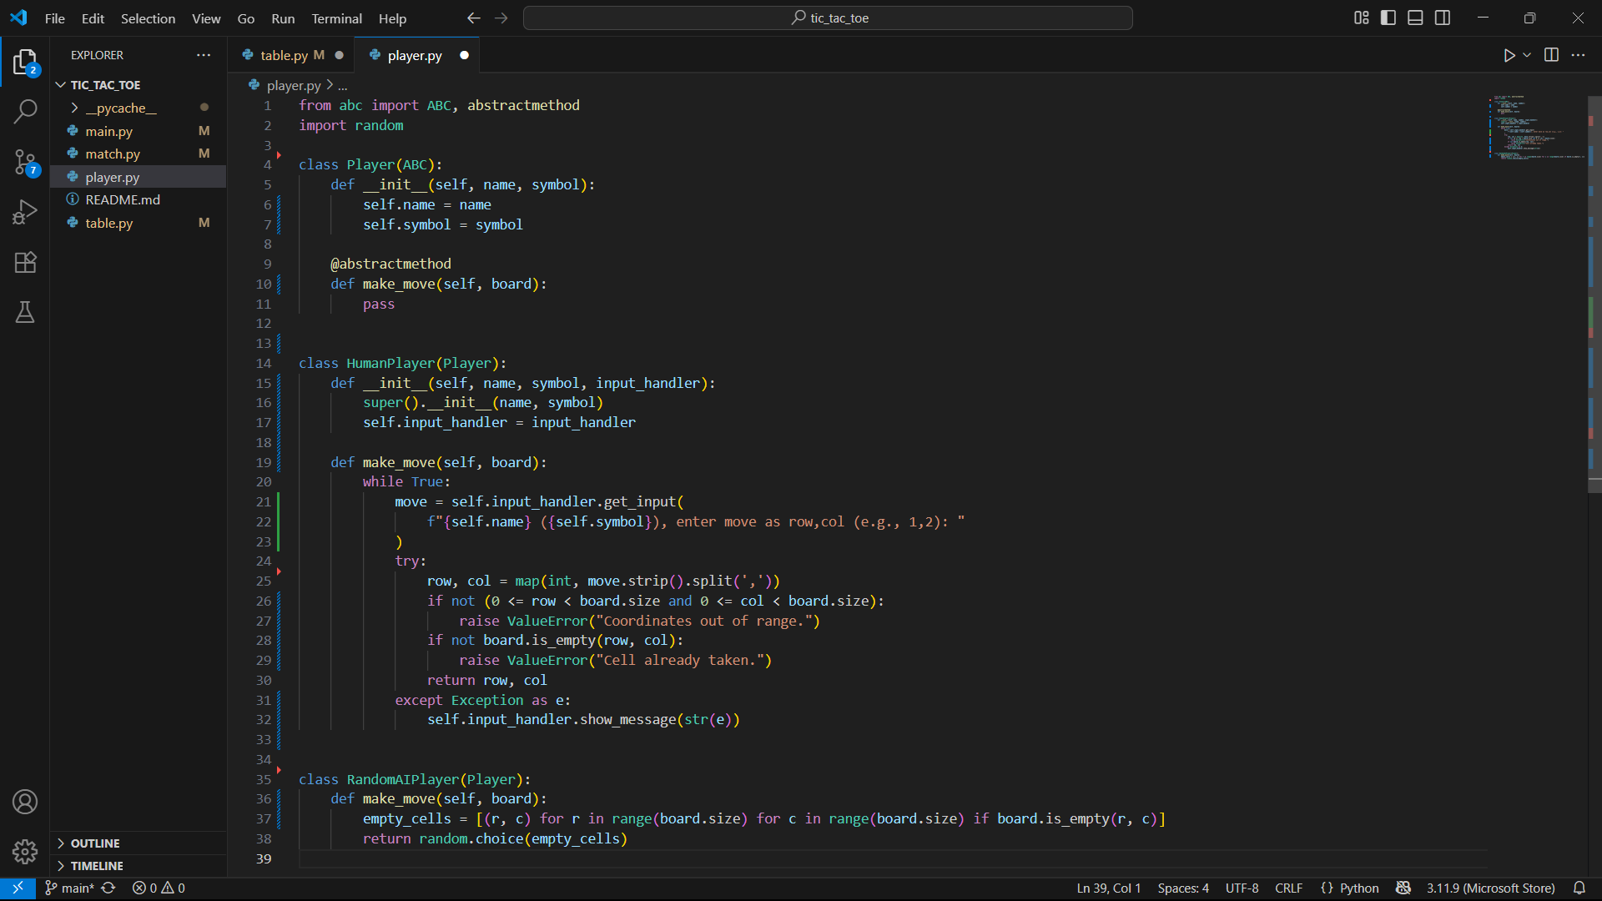
player.py
SOLUTION
Abstract input/output behind an InputHandler.
Make Player depend only on abstractions.
Each AI strategy becomes its own class (open for extension).

Slide 7
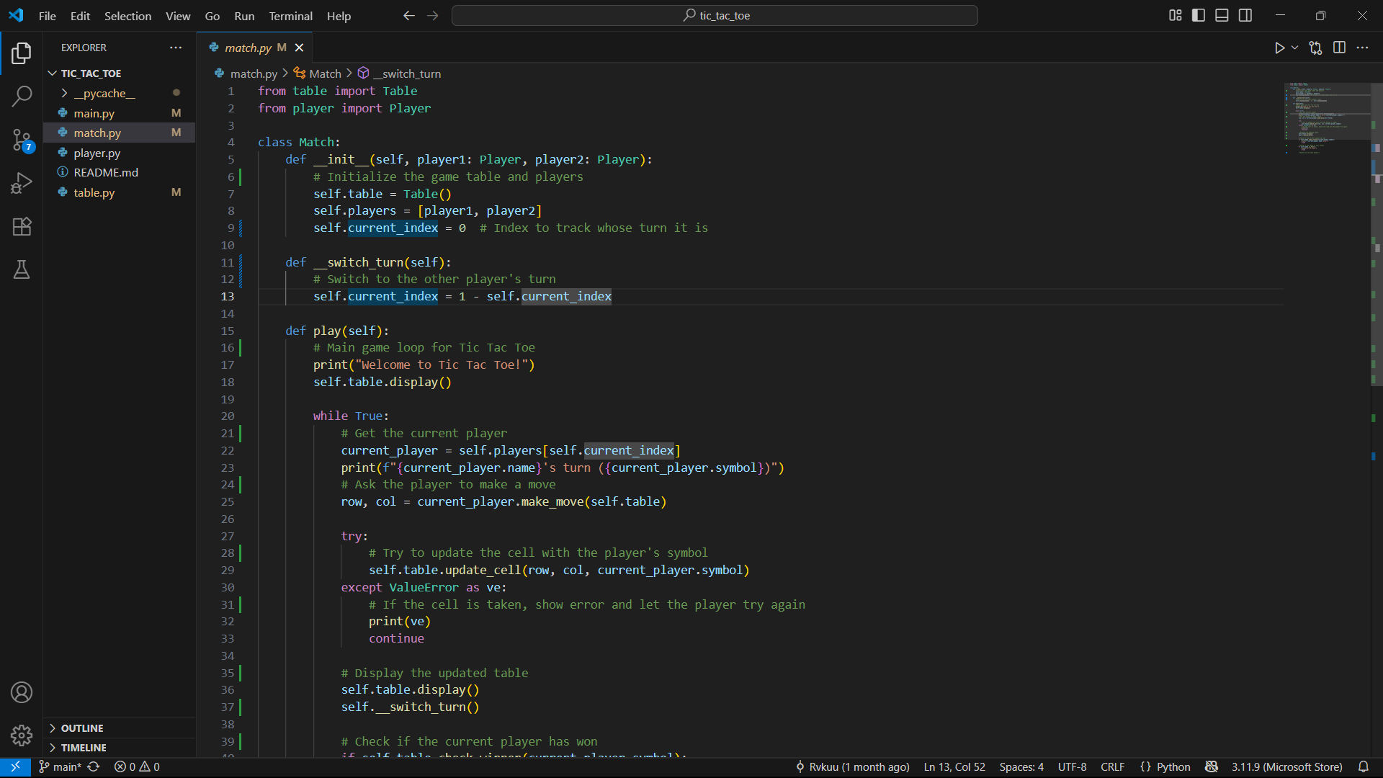
match.py
VIOLATIONS.
SRP violation: Handles game loop + rendering + rules
OCP violation: Hardwired to 3x3 and console prints.
DIP violation: Depends on concrete Table and print().

Slide 8
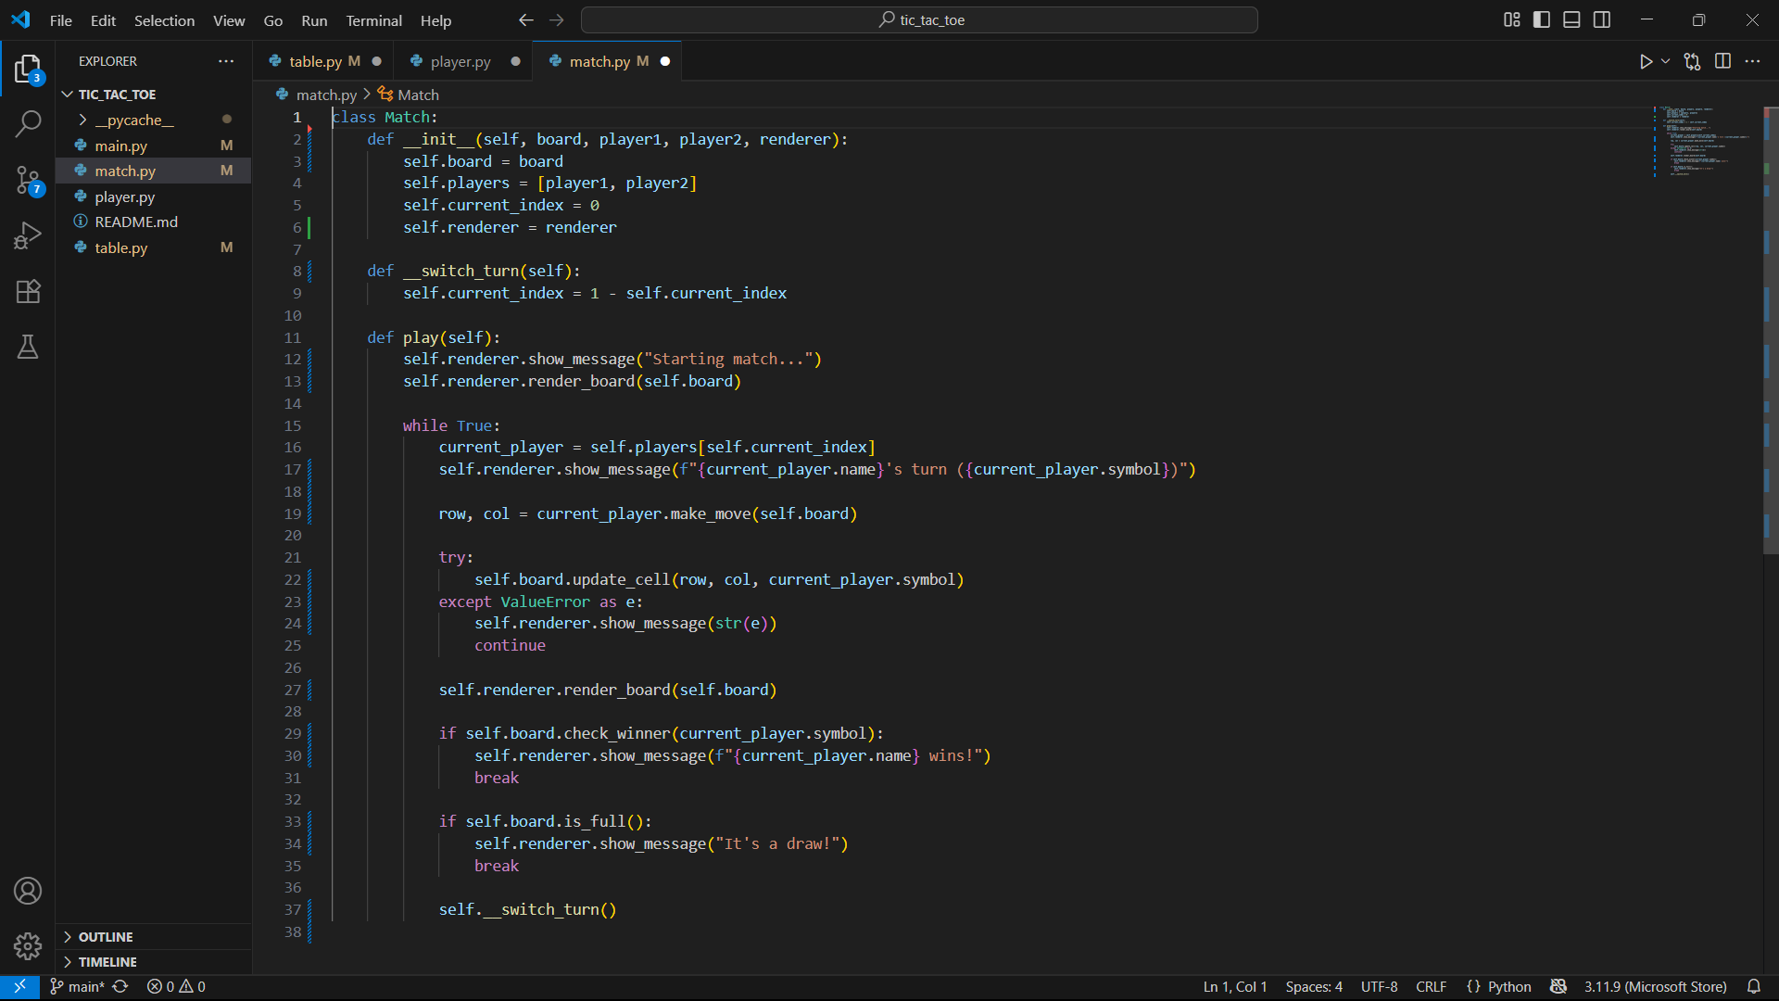
match.py
SOLUTION
Match should orchestrate the game, not render.
Inject Renderer to show messages/board.
Inject Board (size-configurable).

Slide 9
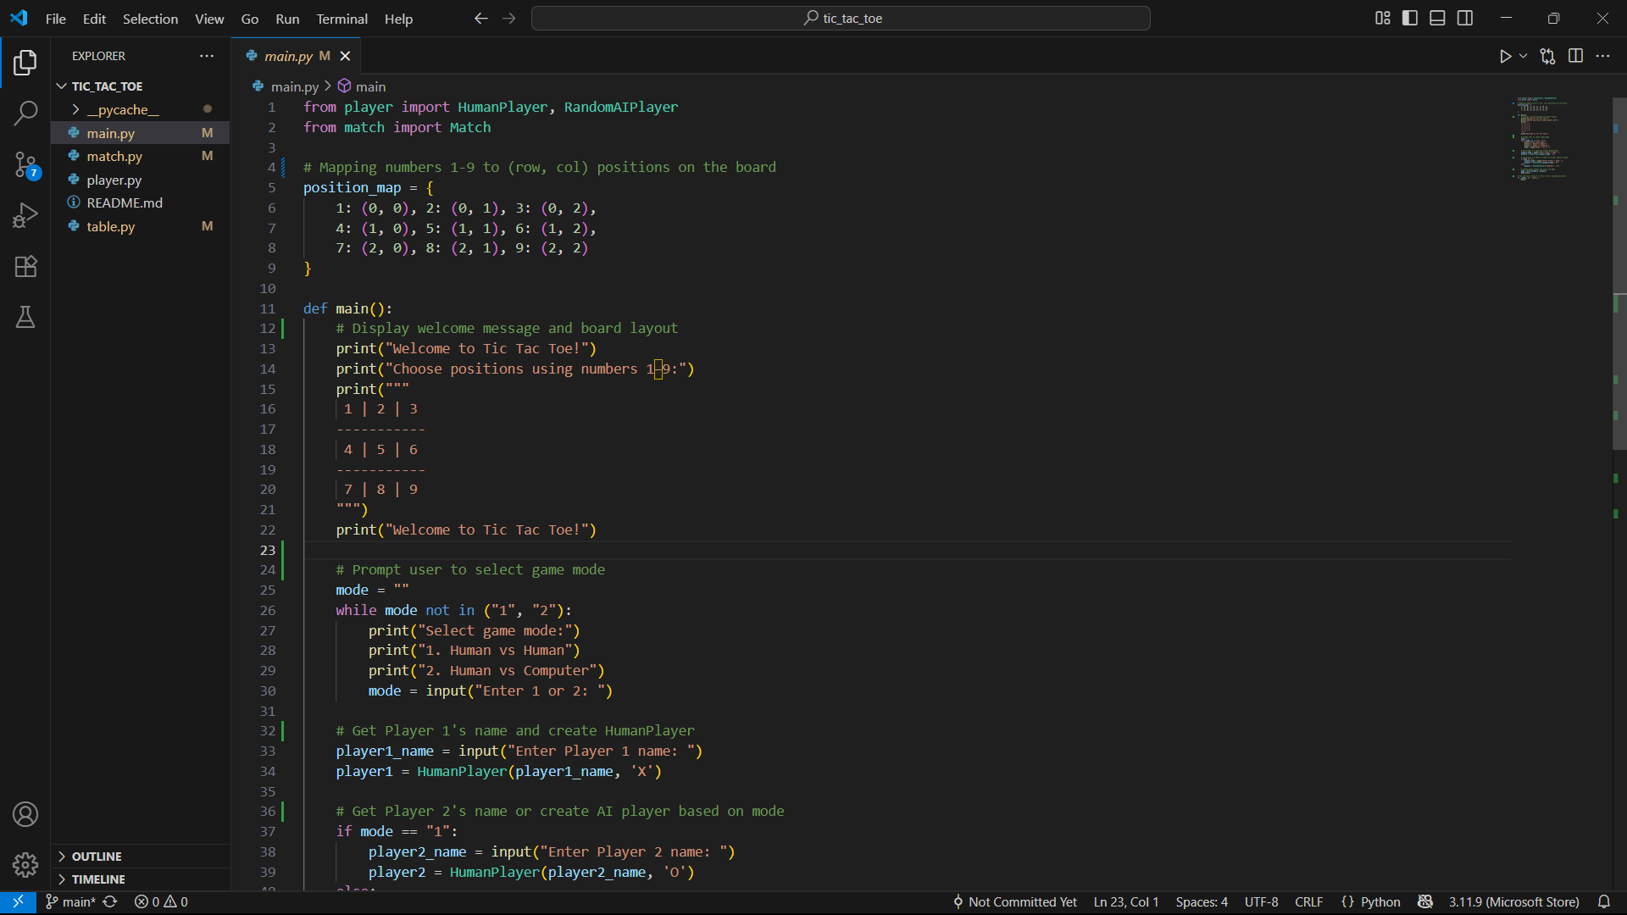
main.py
VIOLATIONS.
SRP violation: Mixes UI rendering, input handling, and game setup.
OCP violation: Adding a new game mode requires editing this file.
DIP violation: Tied to console input/print and concrete players.

Slide 10
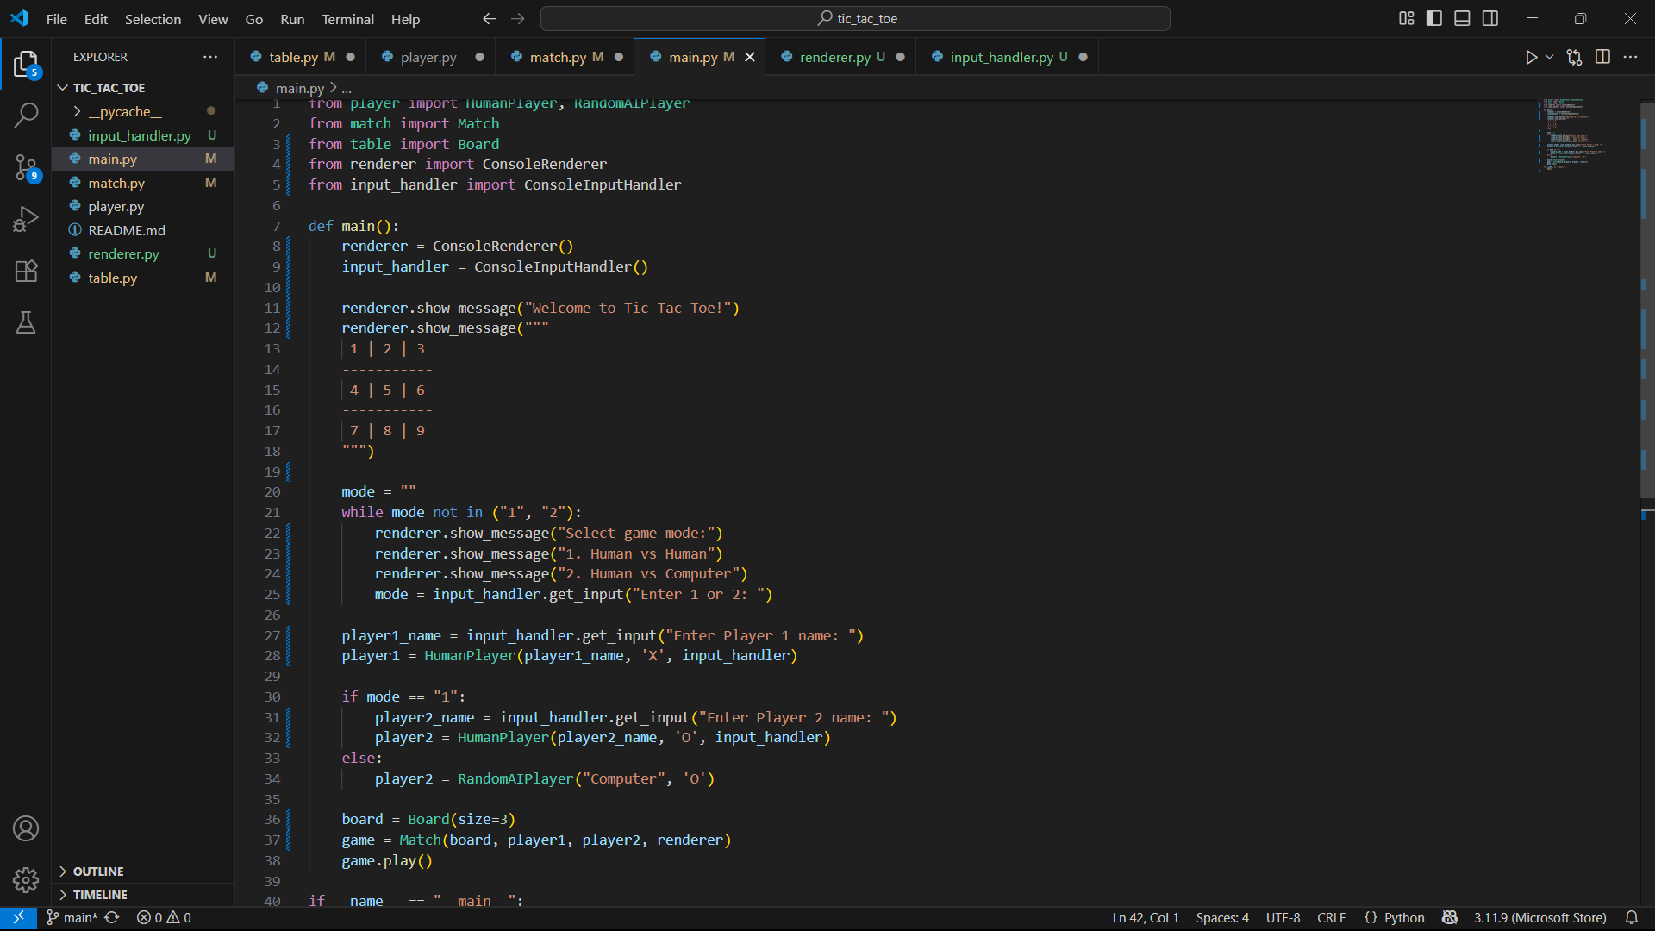
Main.py
SOLUTION
main.py should only wire dependencies and start the game.
Offload input/output to ConsoleRenderer and ConsoleInputHandler.
Optionally introduce a GameModeFactory for extensibility.

Slide 11
COMPARISON BETWEEN OLD CODE VS NEW CODE
File | Current State | SOLID Violations | Refactored Fix
table.py | Board + printing mixed | SRP, DIP, OCP | Pure data model, rendering removed, size-configurable
player.py | Human uses input(), AI inline | SRP, DIP, OCP | Injected InputHandler, AI strategies separate
match.py | Game loop + rendering mixed | SRP, DIP | Match orchestrates only, Renderer injected
main.py | Game setup + UI + logic | SRP, DIP, OCP | Wires dependencies only, ConsoleRenderer/InputHandler handle I/O

Slide 12
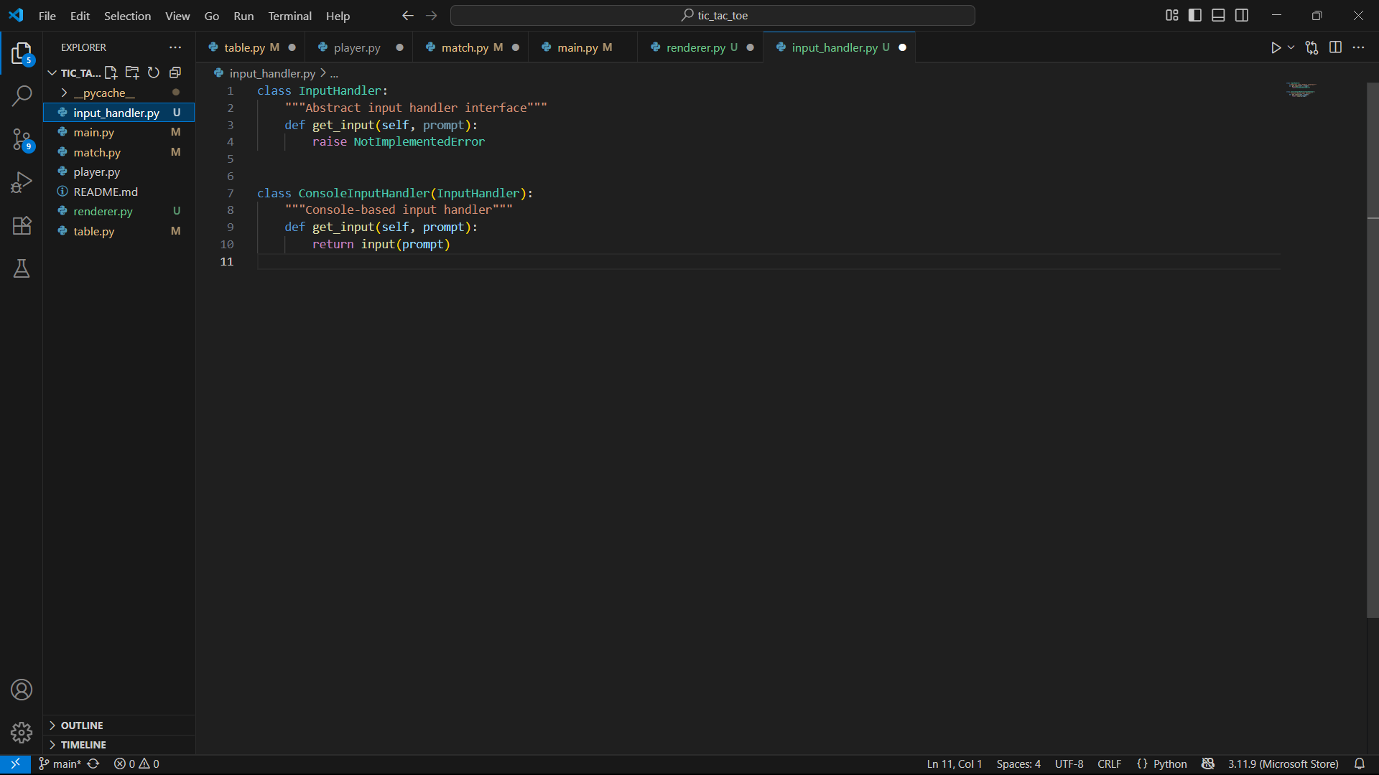
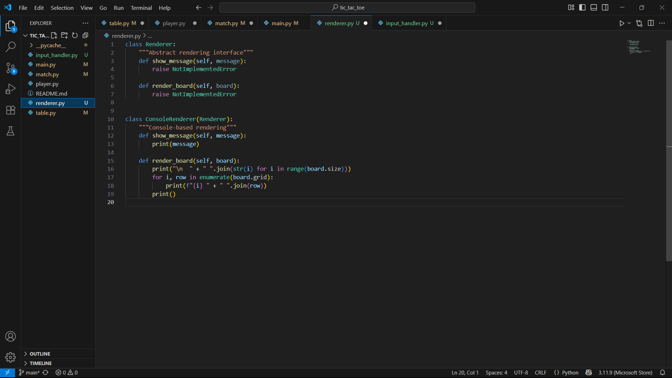
renderer.py and input_handler.py
This will help to separate responsibilities, also apply DIP (Dependency Inversion Principle) instead of having Match, Player, and main.py depend directly on print() and input(). They should rather depend on abstractions.
This also allows for the addition of further modules like GUI, web frontend, automated testing etc without touching the Match, Player and main.py files (Open/Closed Principle).

Slide 13

Summary
In summary, it was observed that in the old tic-tac-toe program there were several violations of the SOLID principles, we have been able to restructure the code base to correct and fix these violations.
SRP: Each class has one reason to change.
OCP: Easy to add new players, modes, renderers.
LSP: Already fine (Player subclasses interchangeable).
ISP: Console vs GUI separated.
DIP: High-level code depends on abstractions, not details.

Slide 14

Thank You.

