Slide 1



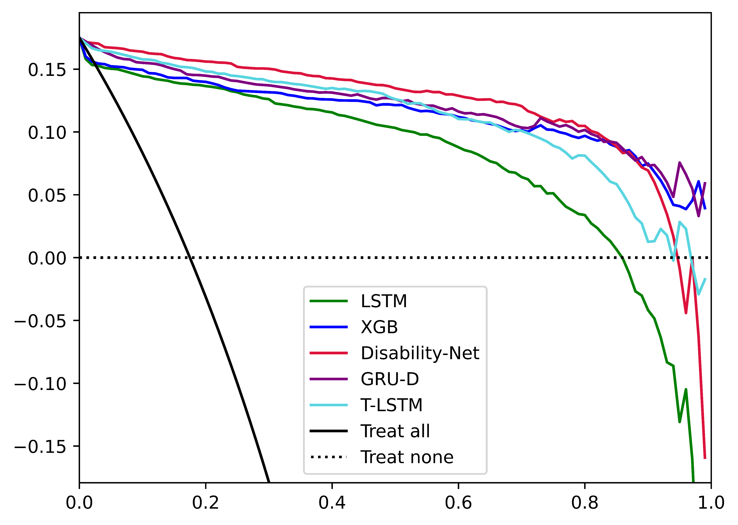
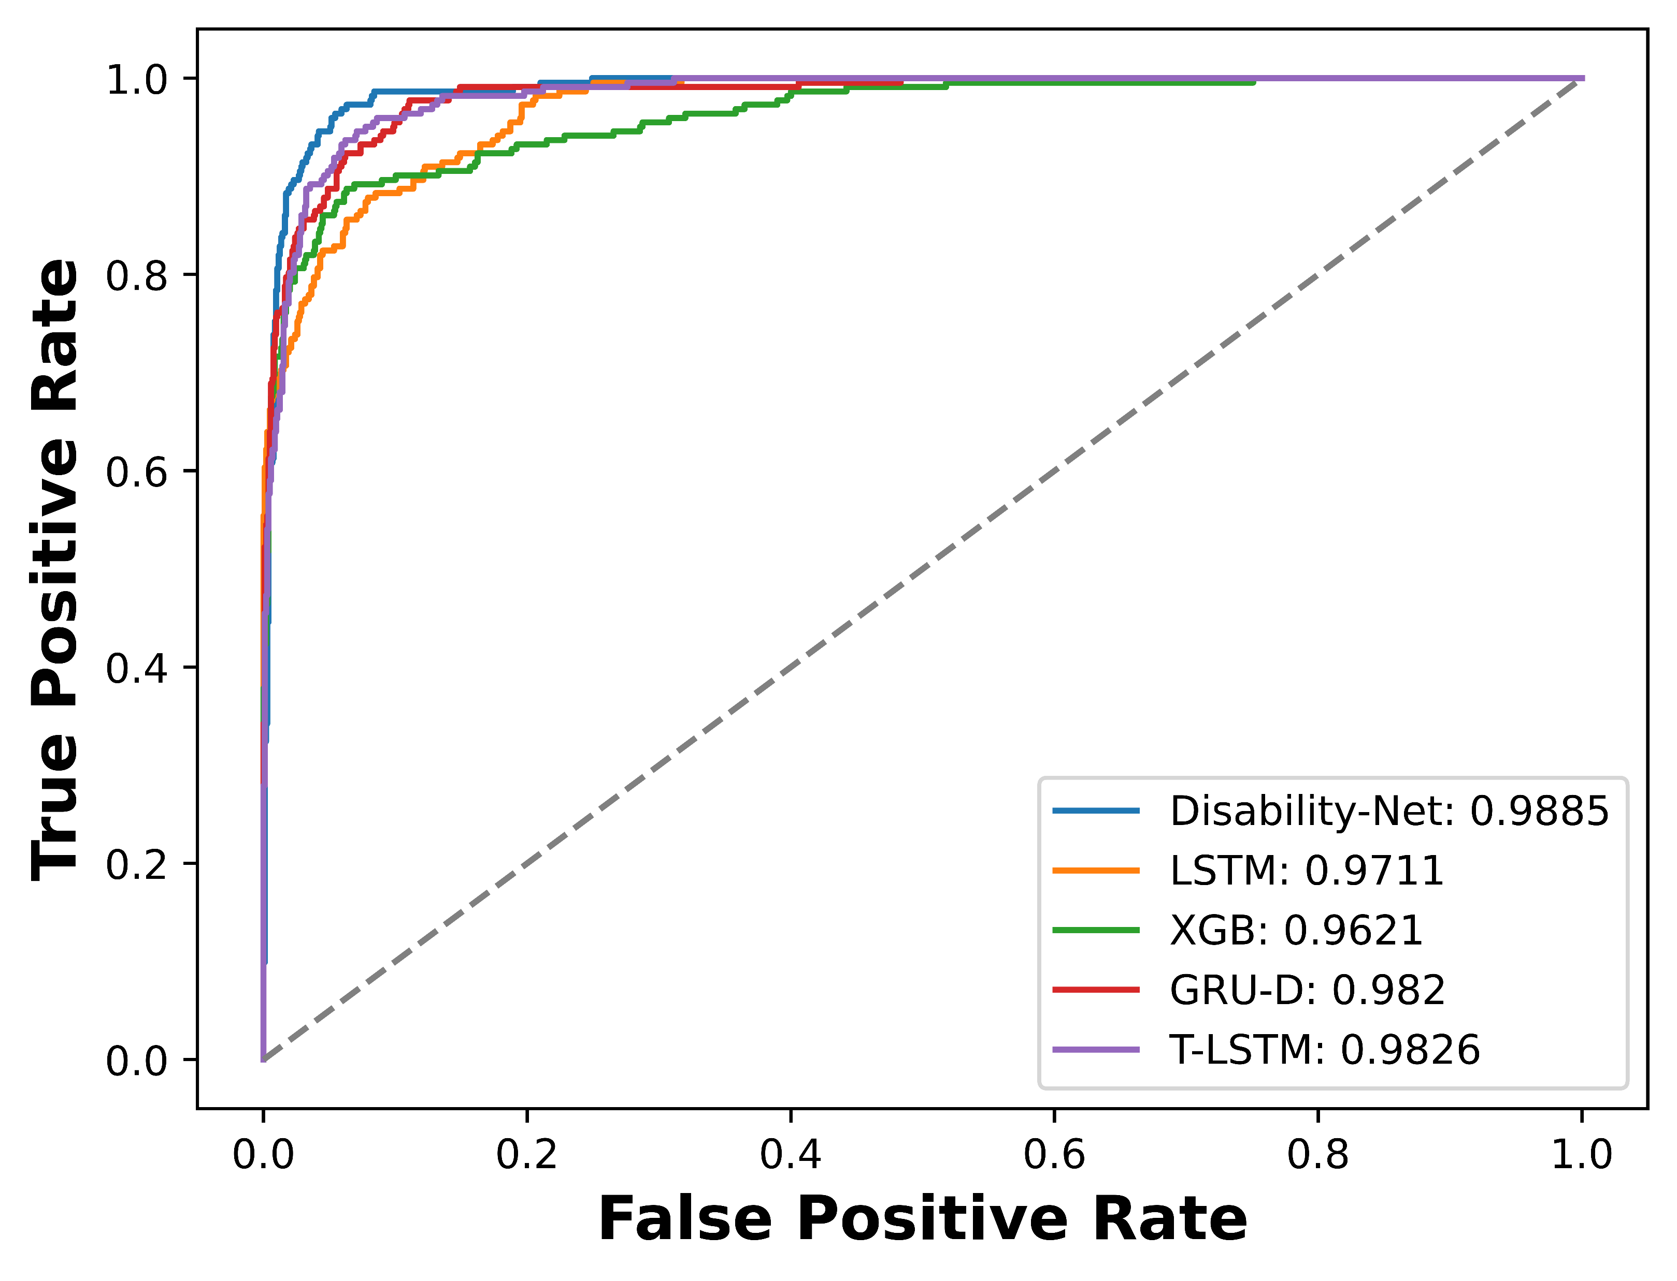
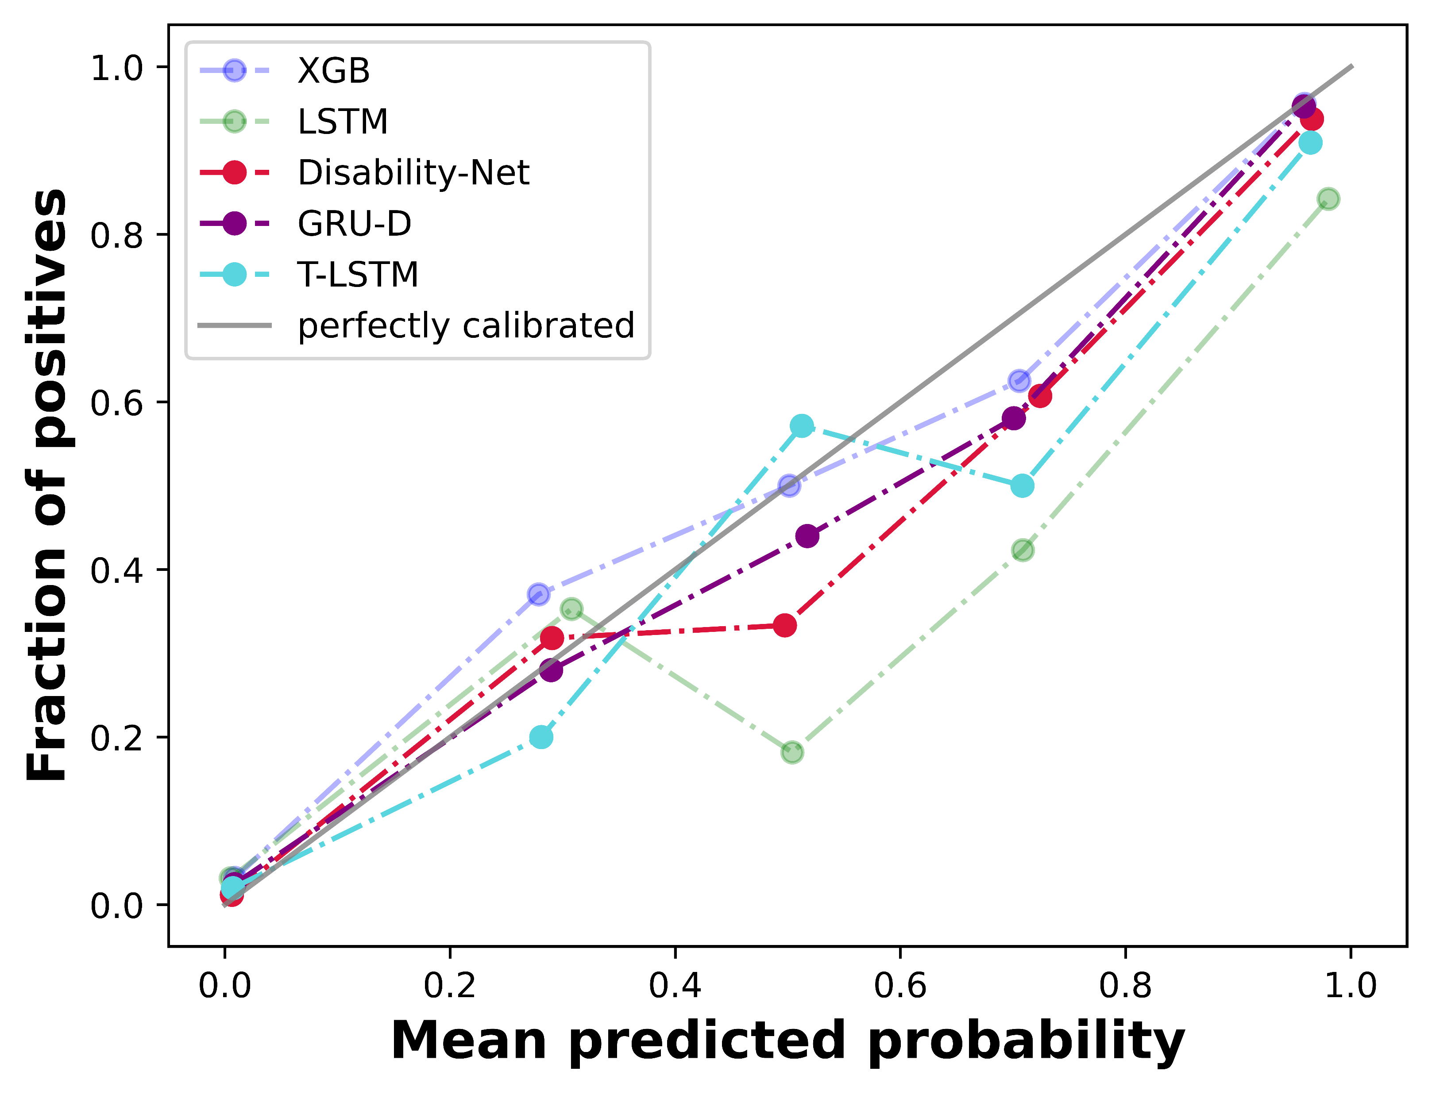

Data collection
Methodology
Health / Disability
Demographic
Causal discovery
ADL
Blood test
SEM
Diseases history
Construct the causal graph scoring function F(W)
Model performance
Solve F(W) using Lagrange multipliers
Warning results
Causal risk factors
Causal-GNN
GCN
ASAP
$$×3$$
Readout
MLP

