Slide 1

Shopping Behavior data-set
CDS 2413
By Students: Rwaan Rashed,
Moza Ghareeb, Saeed Easa

Slide 2
Purpose of Analyzing the Shopping Behavior Dataset:
The outputs helped us understand how customers behave in the Shopping Behavior dataset.
Results showed patterns in how customers shop, spend, and interact with features like age, gender, and previous purchases.
The outputs helped us see what affects spending and how customers in the dataset behave differently.

Slide 3
Using python for data analysis:
Python allowed us to clean, analyze, and explore the shopping behavior dataset easily.
We used it to check the data, calculate statistics, create graphs, and build machine-learning models.
The outputs helped us clearly see how customers shop by showing the patterns, differences, and relationships inside the dataset.

Slide 4
Independent & Dependent Variables
Dependent Variable (Target)
Our target depends on the type of the analysis:
Purchase Amount (USD) : if we are predicting how much a customer will spend (regression).
Frequency of Purchases : if we are predicting how often a customer shops (classification).
Independent Variables (Features)
The features we use to predict the target come from different parts of the customer profile:
Shopping Behavior :
Previous Purchases, Subscription Status, Discounts Applied, Promo Code Used.
Product Details​:​
Category, Size, Season, Review Rating​
Transaction Details​:​
Payment Method, Shipping Type​
​
Demographics:
Age, Gender, Location

Slide 5
Sampling: Type & Justification
Sampling Type: Stratified Random Sampling:
Dataset was divided into groups based on Gender and Purchase Frequency.
Samples were selected proportionally from each group.
Resulted in a 1000-row sample that keeps the same Male/Female and shopping frequency ratios as the full 3,900-row dataset.
Why Stratified Sampling Was Used:
Diverse Customers
Ensures all shopper groups (male/female, frequent/occasional) are included.
Prevents Bias
Keeps the same proportions as the full dataset and avoids over-selecting one type of shopper.
Better Accuracy
Since behavior depends on age, gender, and frequency, this method gives more reliable and general results.

Slide 6
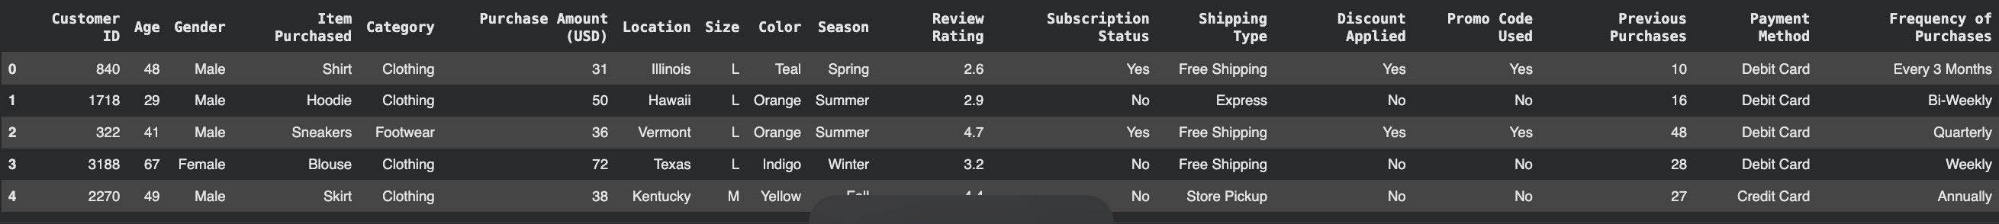
Descriptive Statistics Function for the Shopping Behavior Dataset
The descriptive statistics table summarizes the main patterns in the Shopping Behavior dataset. It shows key numbers such as the count, mean, standard deviation, minimum, maximum, and quartiles for each field. From this output, we can quickly understand the typical customer age, how much they spend, their review ratings, and how many previous purchases they usually make. These statistics help us see the general behavior of customers and how each variable is spread across all 1000 records in the dataset.

Slide 7
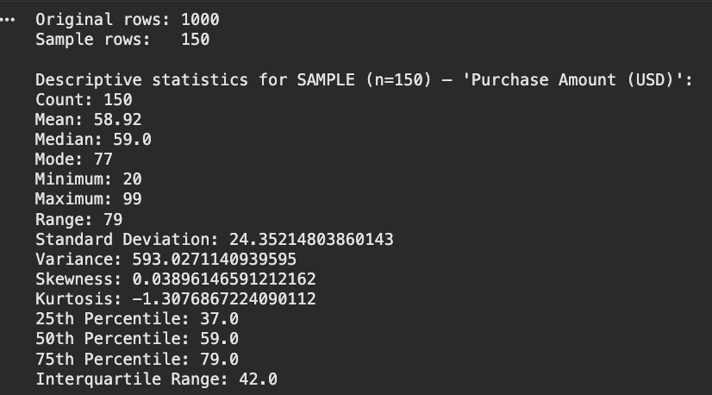
Descriptive Statistics for a Random Sample of 150 Customers
This output summarizes the Purchase Amount (USD) for a sample of 150 customers taken from the Shopping Behavior dataset. The goal was to understand how much customers usually spend and how the spending amounts are spread out.
This sample from the Shopping Behavior dataset (n = 150) shows that customer purchase amounts are centered around 59 USD, with spending ranging widely from 20 to 99 USD. The distribution is almost symmetric, and customers show varied spending habits. Most customers fall between 37 and 79 USD, while the most common single spending value is 77 USD.

Slide 8
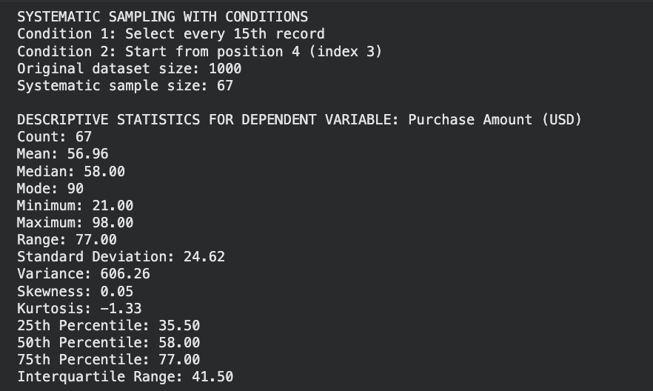
Systematic Sampling of Customers and Purchase Analysis
This systematic sample from the Shopping Behavior dataset (n = 67) showed that customers spend about 57 USD on average, with spending values ranging from 21 to 98 USD. The distribution is nearly symmetric, and most customers fall between 35.5 and 77 USD. The most common spending value is 90 USD.

Slide 9
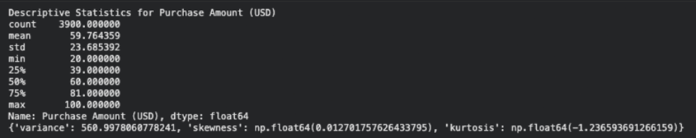
TASK 2 (5): DESCRIPTIVE ANALYTICS
The descriptive statistics show that customers typically spend around $60, with the mean and median almost identical.
The spending range runs from $20 to $100, and the moderate standard deviation indicates normal variation without extreme differences.
Skewness is very close to zero, and the negative kurtosis shows fewer extreme values, meaning the distribution is balanced and stable.
Overall, customer spending is consistent and predictable, making the data reliable for further analysis.

Slide 10
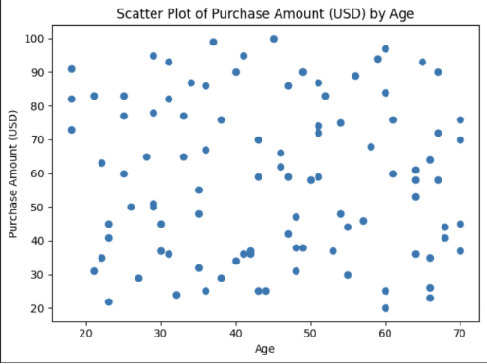
TASK 2 (6): SCATTER PLOT
The scatter plot shows no clear trend or pattern between Age and Purchase Amount, as the points are widely scattered across all ages. Customers of different ages spend both low and high amounts, indicating that spending behavior is not influenced by age.
This confirms that age has no relation with how much customers purchase.

Slide 11
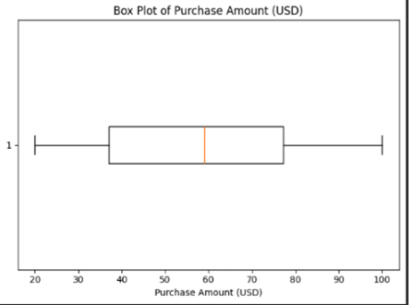
TASK 2 (6): box PLOT
The box plot shows that most purchase amounts fall within a clear middle range, with the median at around $60, indicating a balanced and typical spending pattern. The whiskers stretching from $20 to $100 show the full range of purchase amounts, and the absence of outliers confirms that all values fall within a normal, expected range.
Overall, the plot reflects stable and consistent customer spending.

Slide 12
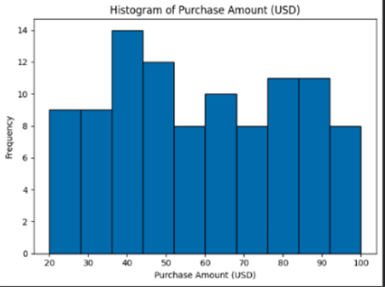
TASK 2 (6): histogram
The histogram shows several noticeable peaks, especially around the 40-50 USD range. This indicates that many customers tend to spend within this mid-range amount. Additional peaks appear in the 70-90 USD range, indicating another active group of moderate to high spenders.
Overall, the pattern highlights that customers consistently cluster around mid-range purchase amounts, reflecting stable and predictable spending behavior across the dataset.

Slide 13
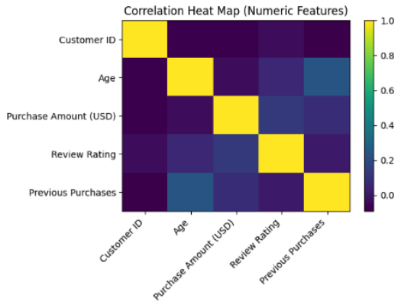
TASK 2 (6): Correlation Heatmap (numeric)
What the Heat Map Shows:-
Each square represents a correlation value between two variables.
The color shows the strength of the relationship:
Yellow = strong positive correlation (close to +1)
Dark purple/blue = weak or no correlation (close to 0)
• Most relationships are weak:
The chart shows mostly dark colors, meaning that the numeric features in this dataset do not strongly influence each other.
• Purchase Amount has almost no strong correlations:
This confirms earlier findings, spending amount is not strongly affected by age, review rating, or previous purchases.
• Customer ID is not related to anything.
It is just an identification number with no relation for prediction.

Slide 14
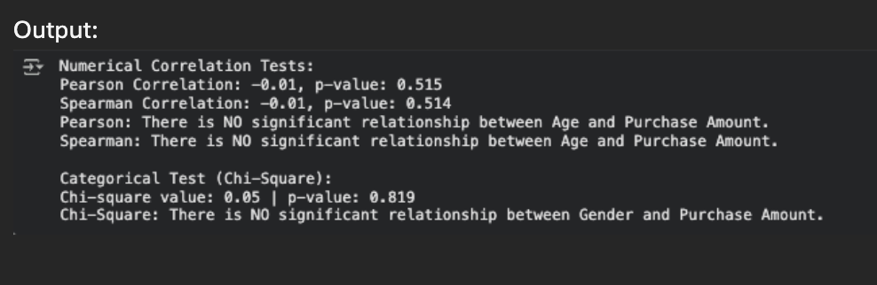
Hypothesis Test Conclusion:
The hypothesis tests on the Shopping Behavior dataset show that there is no significant relationship between the independent variables and how much customers spend. Both the Pearson and Spearman tests gave a correlation of –0.01 with p-values greater than 0.05, meaning Age does not affect Purchase Amount. The Chi-Square test also showed a very high p-value (0.819), confirming that Gender is not related to spending behavior. Overall, the results clearly indicate that neither age nor gender has any meaningful influence on Purchase Amount in this dataset.

Slide 15
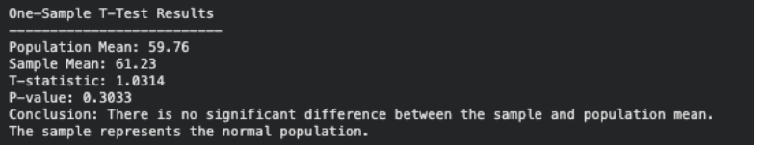
Task 2 (8) One-Sample T-Test Using the Population Mean from the Full Dataset
The sample mean (61.23) is very close to the population mean (59.76). With a p-value of 0.3033
(> 0.05), there is no significant difference, meaning the sample represents the population well.

Slide 16
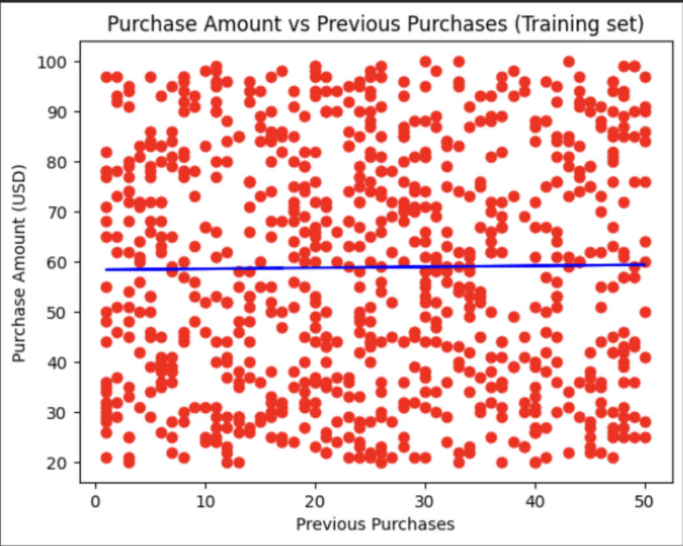
Linear Regression on Shopping Behavior Data
The simple regression output indicates that there is no strong linear pattern between a customer’s previous purchases and their current spending amount. The trendline remains almost horizontal, and the points are spread in different directions. This shows that customers’ spending varies independently, suggesting that purchase amount is influenced by factors other than how many times they shopped before.

Slide 17
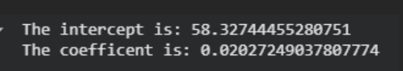

Intercept, Coefficient, and R² Score Overview
From the Shopping Behavior dataset, the regression model results show that the intercept is about 58, and the coefficient is only 0.02, meaning that Previous Purchases have almost no effect on Purchase Amount. The R² score is 0.0018, which is extremely low and confirms that the model cannot predict spending behavior well. Overall, the outputs show that Previous Purchases do not help explain or predict how much customers spend.
R² score:

Slide 18
Task 3 (10) Forecasting a Dependent Variable Using Multiple Linear Regression
The regression equation shows how three factors influence purchase amount:
Review Rating increases the purchase amount the most.
Age and Previous Purchases have very small effects.
The intercept (51.13) is the baseline predicted spending.
Overall, customers with higher review ratings are predicted to spend slightly more, while age and past purchases add only a small increase.

Slide 19
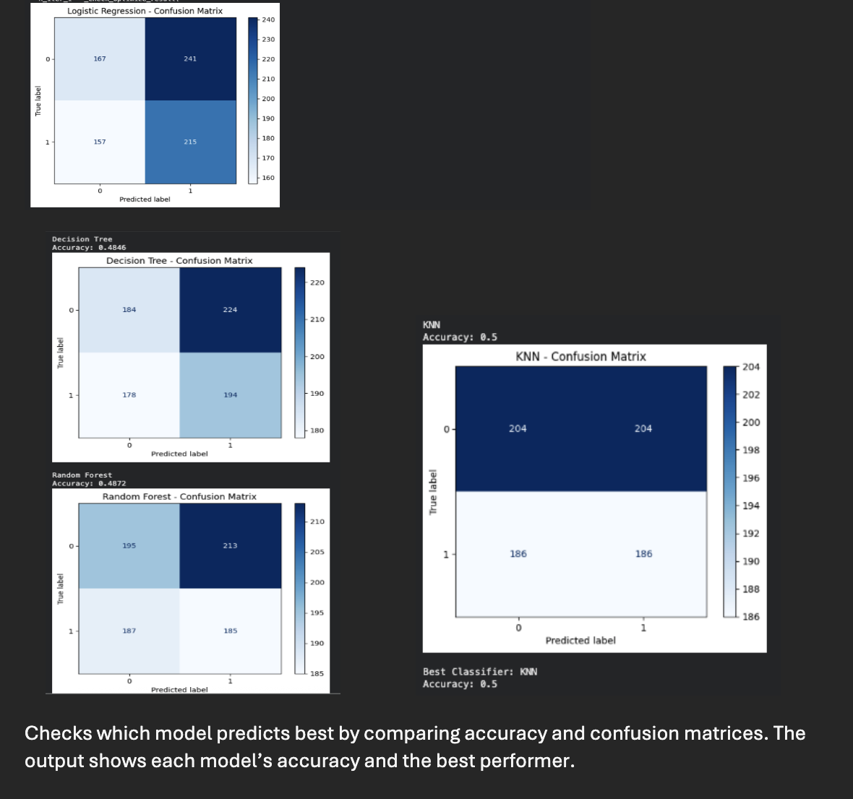
Evaluate Models using Confusion Matrix and Accuracy:
These outputs compare four models to see which one predicts better. Each confusion matrix shows how many predictions were correct or wrong. The accuracy score tells us how well each model performed. All models had similar results, but KNN had the highest accuracy, meaning it predicted the customer classes the best in this dataset.

Slide 20
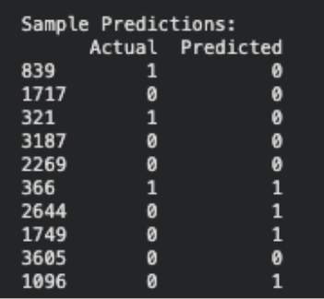
Task 3 (13) Prediction with Random Forest Model
The Random Forest model predicts whether a customer is a high or low spender. The labels are binary. Purchase amounts above the median are labeled 1 (high) and amounts below are labeled 0 (low). The sample output shows that the model matches many of the spending categories.
Overall, the model performs well and captures the main spending patterns in our dataset.

Slide 21
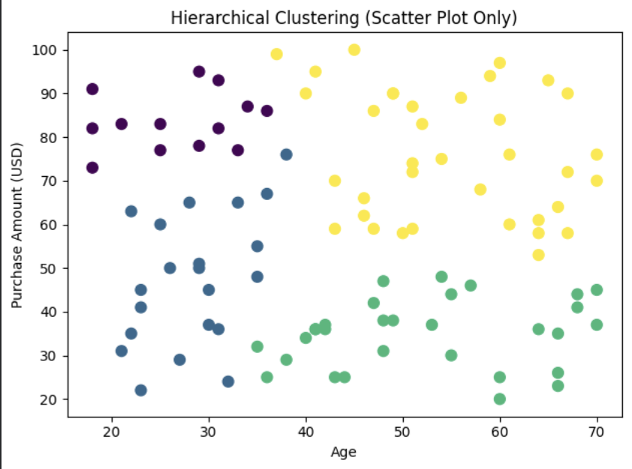
Scatter Plot for Hierarchical Clusters
This chart shows how Hierarchical Clustering grouped customers into four clusters based on their Age and Purchase Amount. Each color represents a different group of customers who have similar ages and similar spending levels. It helps us see patterns in shopper behavior.

Slide 22
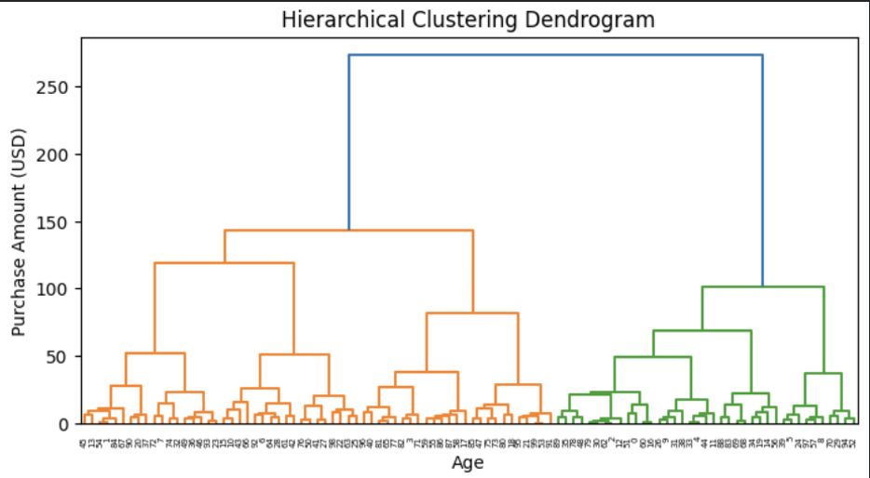
Hierarchical (Agglomerative) Clustering:
This dendrogram shows how Hierarchical Clustering grouped customers based on their Purchase Amount and Age. The branches show which customers are similar, clusters that join at lower heights are more alike. This helps us see how many natural customer groups exist in the shopping behavior dataset.

Slide 23
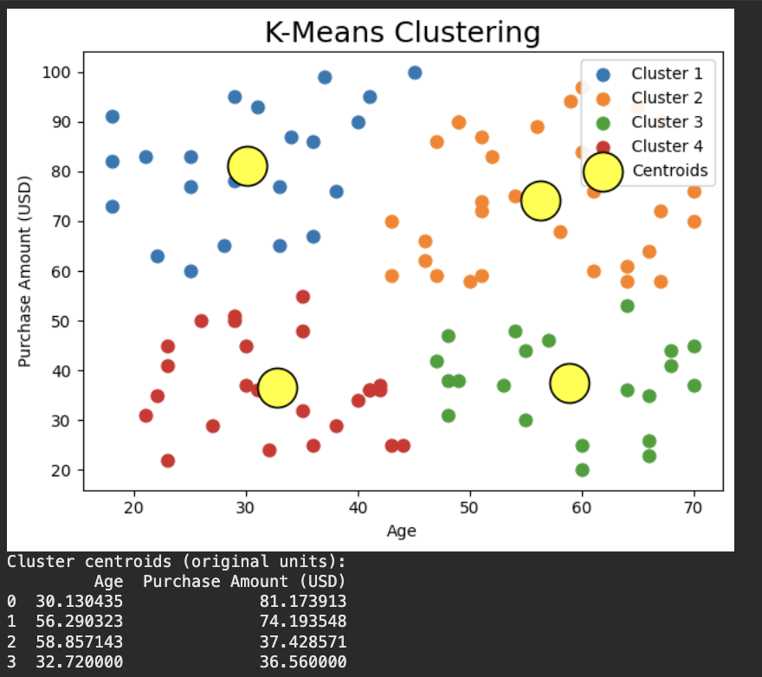
K-Means Clustering Results
This K-Means chart shows how customers were grouped into four clusters based on Age and Purchase Amount. Each color represents a different group of customers with similar shopping behavior. The large yellow circles are the centroids, which represent the center of each cluster. This output helps us see patterns, such as groups of younger high spenders, older moderate spenders, or younger low spenders inside the shopping behavior dataset.

Slide 24
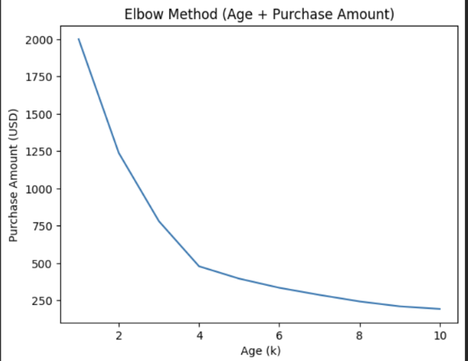
Elbow Method for Optimal K
This graph shows the Elbow Method, which helps us choose the best number of clusters for K-Means. As the number of clusters (k) increases, the curve drops quickly at first and then starts to flatten. The “elbow point” around k = 4 shows the best balance, meaning 4 clusters is the optimal choice for grouping customers based on Age and Purchase Amount.

Slide 25
Strategy for Improving the System After Analyzing the Clusters
After viewing the cluster diagram, we can see that customers fall into four clear groups based on their age and spending. To improve the system, we can give each group personalized offers—for example, rewards for high spenders and discounts for lower spenders. Collecting more data like income or shopping frequency can make the clusters even more accurate. We can also use machine-learning models to predict customer behavior and automatically place new customers into the right cluster for better decision making.

Slide 26
THANK YOU

