Slide 1
Estimation of Obesity Levels Based On Eating Habits and Physical Condition
By Rwagapfizi Igor, 27329, Group E
Sector tackled: HEALTH

Slide 2
PROBLEM DEFINITION & PLANNING
Problem Statement: Can we predict and classify obesity levels based on individual eating habits, physical condition, and lifestyle behaviors using big data analytics?
This project aims to uncover key lifestyle factors, such as diet, physical activity, and technology usage, that correlate with different obesity levels. These insights can support healthcare providers and policymakers in developing targeted interventions for obesity prevention and health improvement.

Slide 3
Dataset Identification:
Dataset Title: Obesity Levels Based on Eating Habits and Physical Condition
Source Link: https://archive.ics.uci.edu/dataset/544/estimation+of+obesity+levels+based+on+eating+habits+and+physical+condition
Rows * Columns: 2111 * 17
Data Structure: ☑️ Structured (CSV, Excel)
Data Status: ☑️ Clean

Slide 4
Dataset details:
Gender (Categorical): Gender
Age (Continuous): Age
Height (Continuous)
Weight (Continuous)
family_history_with_overweight (Binary): Has a family member suffered or suffers from overweight?
FAVC (Binary): Do you eat high caloric food frequently?
FCVC (Integer): Do you usually eat vegetables in your meals?
NCP (Continuous/Integer): How many main meals do you have daily?

Slide 5
CAEC (Categorical): Do you eat any food between meals?
SMOKE (Binary): Do you smoke?
CH2O (Continuous): How much liters of water do you drink daily?
SCC (Binary): Do you monitor the calories you eat daily?
FAF (Continuous): How often do you have physical activity?
TUE (Integer): How much time do you use technological devices such as cell phone, videogames, television, computer and others?
CALC (Categorical): How often do you drink alcohol?
MTRANS (Categorical): Which transportation do you usually use?
NObeyesdad (Categorical): Obesity level

Slide 6
Study research methodology
The data is gotten from interviews from various individuals about the topic of obesity. They were asked various questions, such as if they have a family history with overweight, how many main meals do they partake daily, if they frequently eat high-caloric food, how often do they perform physical activity (sports), what their main transportation method is, if they drink alcohol or smoke, and so on. Their measurements are also taken (weight, height, age)

Slide 7

The data was cleaned from duplicates rows and missing values. Columns with binary yes/no values were then encoded to 1/0, so as to get numeric Boolean values to be used for calculations.

Slide 8
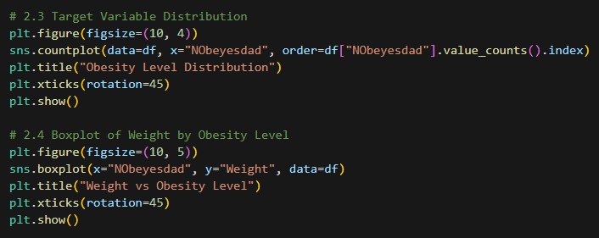
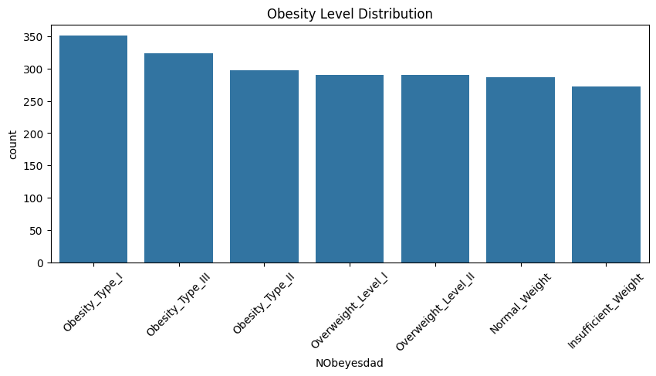
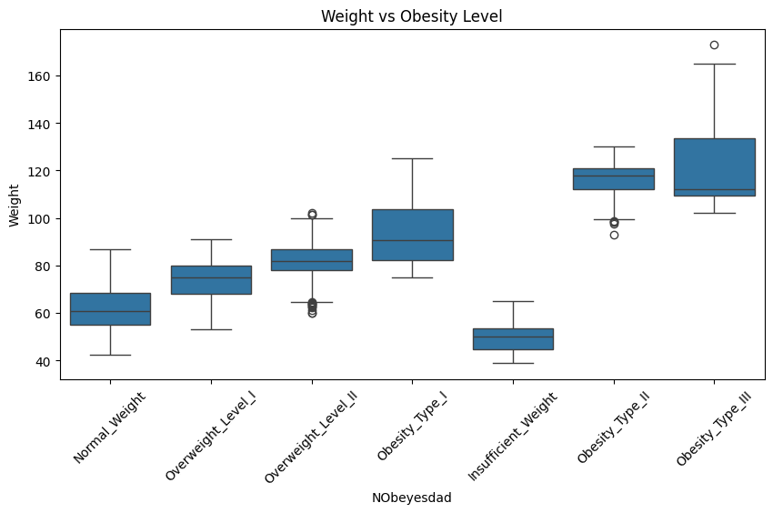
Using pyplot and seaborn, we can visualize Obesity level distribution and weight boxplot based on obesity level

Slide 9
The now cleaned data is then recorded and visualized using PowerBI so as to give a sight in how the data looks and measures.

Slide 10
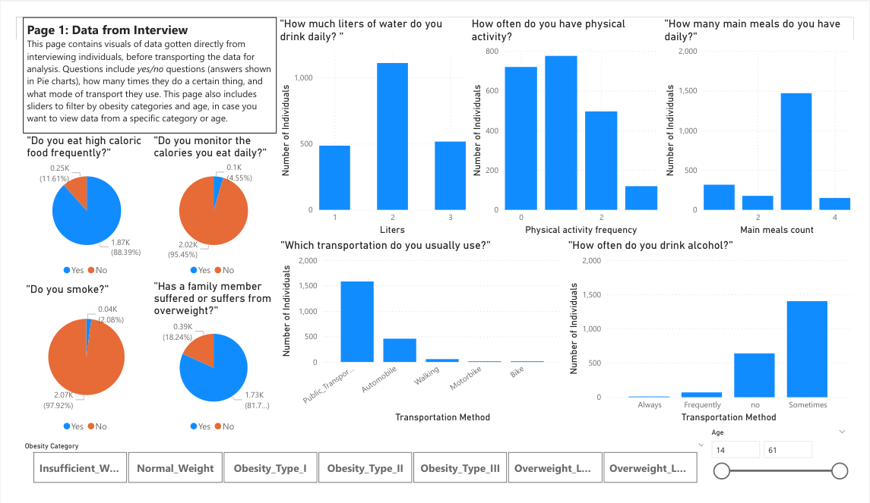
a. Page 1: Data from interviews
This page contains visuals of data gotten directly from interviewing individuals, before transporting the data for analysis.

Slide 11
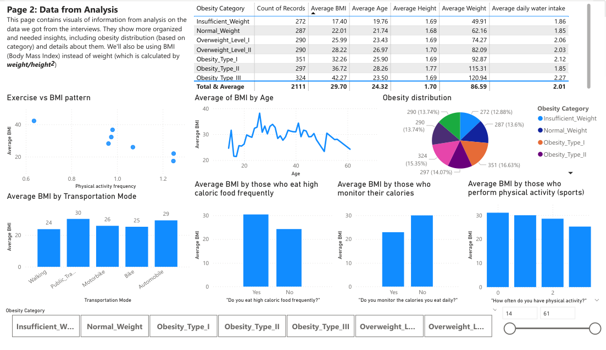
B. Page 2: Data from Analysis
This page contains visuals of information from analysis on the data we got from the interviews.

Slide 12
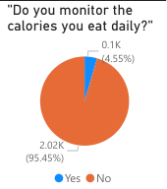
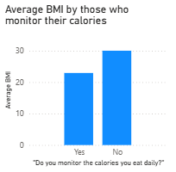
Results highlights
1. Those who don’t monitor their calories tend to get a higher BMI. This makes sense because tracking your calories makes you careful in how much calories you intake, giving you much more discipline in eating, reducing your BMI.

Slide 13
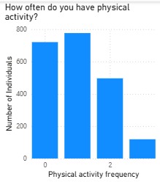
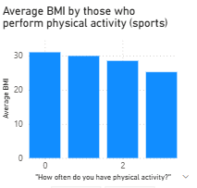
2. Those who regularly perform physical activity tend to have lower BMI

Slide 14
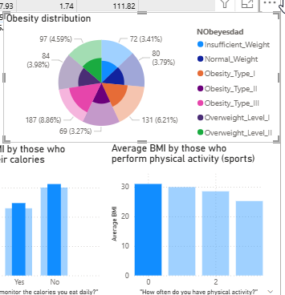
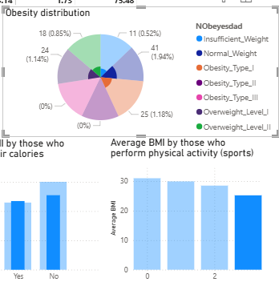
You can see that when we filter using those who don’t do physical activity at all, this is where people with obesity are mostly found. While those who do physical activity 3 times (or more) in a week are mostly normal weight.

Slide 15
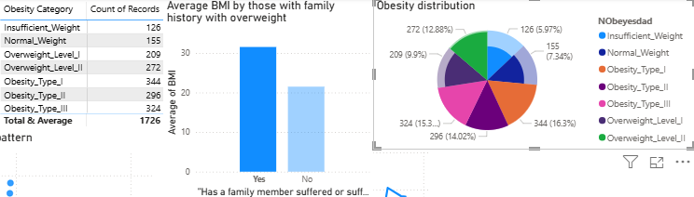
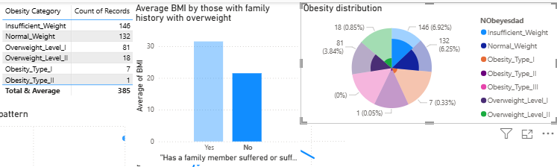
3. Those with family history with overweight are more prone to also suffer from overweight than those who don’t have such a family history.

Slide 16
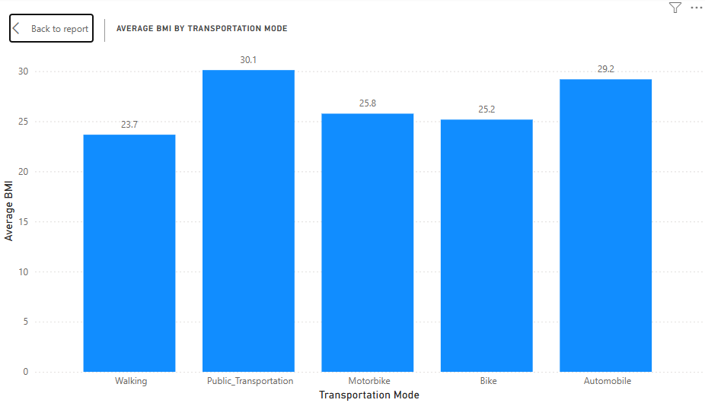
4. Those whose main transportation method is walking have the lowest average BMI, opposed to those who use public transportation/automobile, who have the highest average BMI.

Slide 17
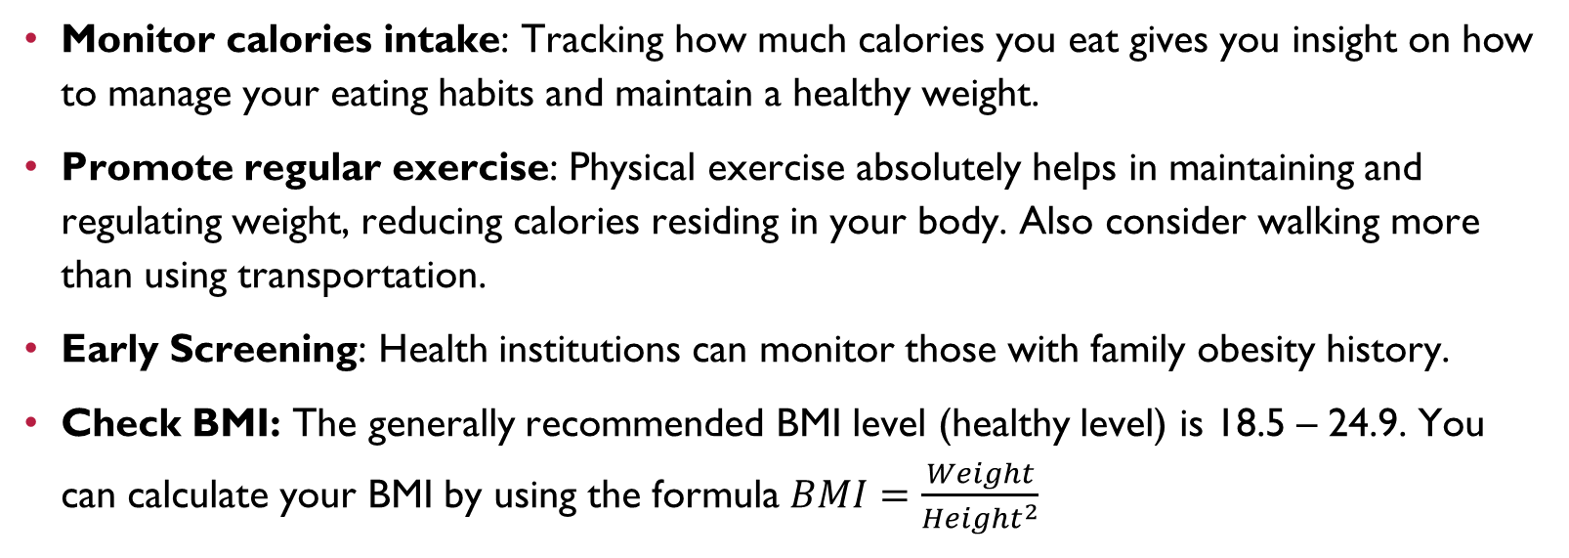
Recommendations
Monitor calories intake: Tracking how much calories you eat gives you insight on how to manage your eating habits and maintain a healthy weight.
Promote regular exercise: Physical exercise absolutely helps in maintaining and regulating weight, reducing calories residing in your body. Also consider walking more than using transportation.
Early Screening: Health institutions can monitor those with family obesity history.
Check BMI: The generally recommended BMI level (healthy level) is 18.5 – 24.9. You can calculate your BMI by using the formula $BMI=\frac{Weight}{{Height}^{2}}$

Slide 18
questions?

Slide 19
THANK YOU FOR YOUR ATTENTION!
By Rwagapfizi Igor, 27329, Group E

