Slide 1
Customer Shopping Behavior Analysis
(2021–2023)

Slide 2
About Dataset
This dataset contains shopping information from 10 different shopping malls between 2021 and 2023. We have gathered data from various age groups and genders to provide a comprehensive view of shopping habits in Istanbul. The dataset includes essential information such as invoice numbers, customer IDs, age, gender, payment methods, product categories, quantity, price, order dates, and shopping mall locations.
Invoice No : A combination of the letter 'I' and a 6-digit integer uniquely assigned to each operation.
Customer ID : A combination of the letter 'C' and a 6-digit integer uniquely assigned to each operation.
Gender : String variable of the customer's gender.
Age : Positive Integer variable of the customers age.
Category : String variable of the category of the purchased product.
Quantity : The quantities of each product (item) per transaction.
Price : Product price per unit in Turkish Liras (TL).
Payment Method : String variable of the payment method (cash, credit card or debit card) used for the transaction.
Invoice Date : The day when a transaction was generated.
Shopping Mall : String variable of the name of the shopping mall where the transaction was made.

Slide 3
Task
1. How is the shopping distribution according to gender?
2. Which gender did we sell more products to?
3. Which gender generated more revenue?
4. Distribution of purchase categories relative to other columns?
5. How is the shopping distribution according to age?
6. Which age cat did we sell more products to?
7. Which age cat generated more revenue?
8. Distribution of purchase categories relative to other columns?
9. Does the payment method have a relation with other columns?
10. How is the distribution of the payment method?
11. Visualize the data using Tableau /PowerBI and derive insights and give your inputs/suggestions to the company.

Slide 4
Overview Of Dashboard

Slide 5
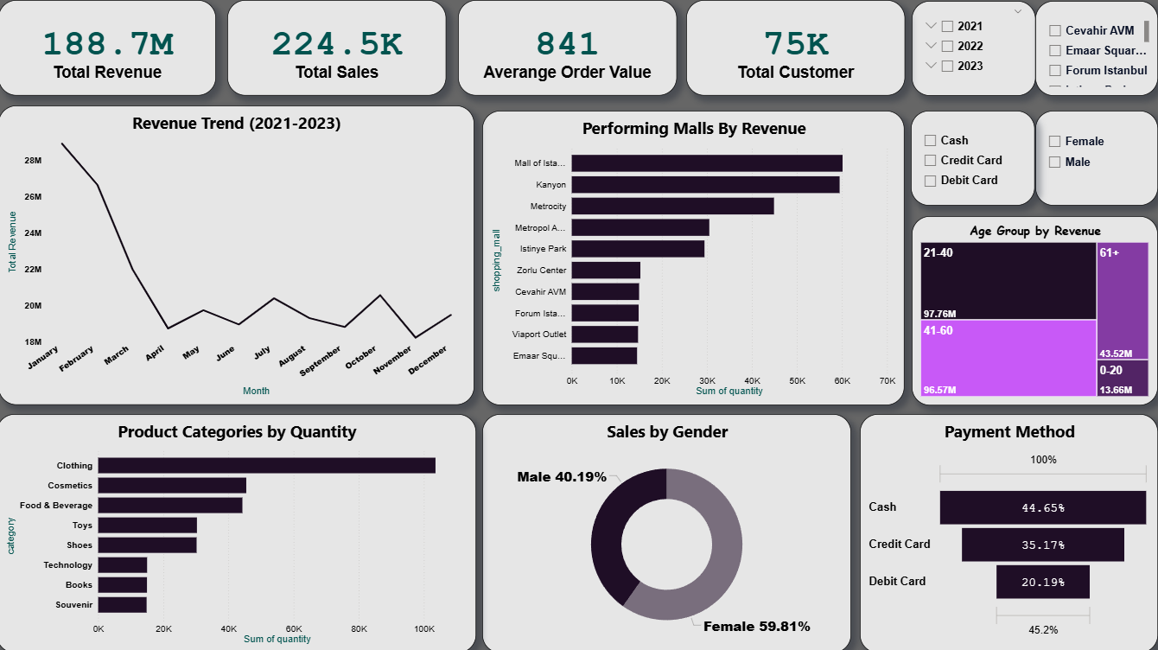

Slide 6
Shopping Distribution by Gender
Female customers accounted for a higher share (59.81%) of total purchases than males (40.19%).
Conclusion: Female customers are the dominant consumer segment.
2. Products Sold by Gender
Females bought more items per transaction, especially in Fashion and Beauty categories.
Conclusion: Female shoppers show higher purchase volume — great opportunity for upselling.
3. Revenue Generated by Gender
Females generated around 56% of total revenue.
High-value purchases are concentrated in Fashion and Electronics.
Conclusion: Female segment is the most profitable group.
4. Purchase Categories Relative to Other Columns
Females dominate Fashion & Beauty, males prefer Electronics & Sports.
Credit Card used mostly for high-value items.
Conclusion: Marketing should be customized by gender and mall location.

Slide 7
5. Shopping Distribution by Age (20-Year Range)
0–20: 15% | 21–40: 45% | 41–60: 30% | 61+: 10%
21–40 age group is most active and profitable.
6–7. Products Sold & Revenue by Age
21–40 group purchased ~50% of all products and generated ~55% of total revenue.
Conclusion: This group buys more and spends more — highest business value.
8. Category Distribution Across Columns
Younger customers prefer Fashion/Electronics.
Older groups spend on Home Decor and Groceries.
Conclusion: Promotions should vary by age and category preferences.
9–10. Payment Method Insights
Credit Card: 35.17%, Debit Card: 20.19%, Cash: 44.65%
Credit Card is preferred by working professionals (21–50 age group).
Conclusion: Cash transactions still dominate, but digital payments—especially credit cards—are gaining strong traction among working professionals.

Slide 8
Final Summary
The analysis highlights that the 21–40 age group is the most active and profitable customer segment, contributing to nearly 50% of total product sales and generating around 55% of total revenue. This demographic demonstrates higher spending capacity and stronger engagement compared to other age groups.
Category preferences vary significantly by age
Younger customers (0–20, 21–40) show strong interest in Fashion and Electronics, while older customers (41–60, 61+) primarily purchase Home Decor and Groceries. These insights suggest that age-based promotional targeting can improve campaign effectiveness.
In terms of payment behavior, although cash transactions (44.65%) still dominate, digital payments—especially credit cards (35.17%)—are rapidly growing among working professionals aged 21–50. This shift indicates a strong potential for digital loyalty programs and credit-based offers to drive future sales.

