Slide 1
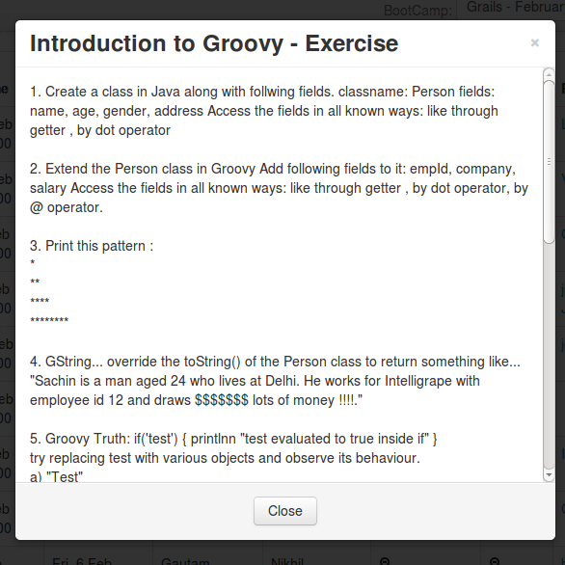
6/24/16
Exercise

Slide 2
