Slide 1
INTRODUCTION TO PROGRAMING LANGUAGES
Sachin Verma

Slide 2
Agenda
Introduction
What’s Programming Language?
Why So many languages?
History
Object Oriented World
Basic Terminologies
misconceptions
Software Methodologies
Waterfall model
Agile
SCRUM
TDD

Slide 3
What’s Programming Language?
A programming language is a set of rules that provides a way of telling a computer what operations to perform.
A programming language is a set of rules for communicating an algorithm
It provides a linguistic framework for describing computations

Slide 4
What’s Programming Language?
English is a natural language. It has words, symbols and grammatical rules.
A programming language also has words, symbols and rules of grammar.
The grammatical rules are called syntax.
Each programming language has a different set of syntax rules.

Slide 5
Why so many languages?
Programming languages have evolved over time as better ways have been developed to design them.
First programming languages were developed in the 1950s
Since then thousands of languages have been developed
Different programming languages are designed for different types of programs.

Slide 6
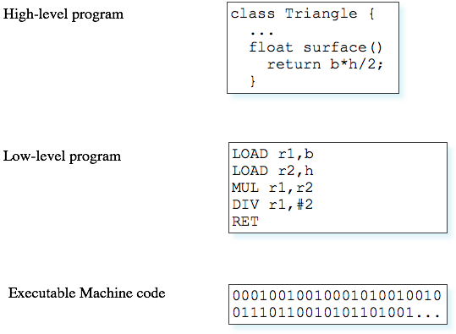
Level of Programming languages

Slide 7
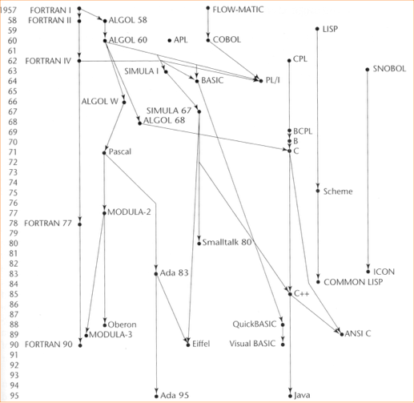
Language
Family Tree

Slide 8
Grouping
Two broad groups
Traditional programming languages
Sequences of instructions
First, second and some third generation languages
b. Object-oriented languages
Objects are created rather than sequences of instructions
Some third generation, and fourth and fifth generation languages

Slide 9
Scripting Language
A scripting language, script language or extension language is a programming language that allows control of one or more software applications. "Scripts" are distinct from the core code of the application, as they are usually written in a different language and are often created or at least modified by the end-user. Scripts are often interpreted from source code or bytecode, whereas the applications they control are traditionally compiled to native machine code. Scripting languages are nearly always embedded in the applications they control.
“ scripts are interpreted and programs are compiled.”

Slide 10
What determines a “good” language?
Formerly: Run-time performance
(Computers were more expensive than programmers)
Now: Life cycle (human) cost is more important
Ease of designing, coding
Debugging
Maintenance
Reusability

Slide 11
Object Oriented World

Slide 12
Why OOPS?
Major issues need to resolved:
How to represent real-life entities
How to ensure reusability and extensibility of modules
How to develop modules that are tolerant to any changes in future
How to improve software productivity and decrease software cost
How to improve the quality of software

Slide 13
Object-Oriented Programming
OOP treats data as a critical element in the program development and does not allow it to flow freely around the system.
It ties data more closely to the functions that operate on it, and protects it from accidental modification from outside functions.
OOP allows decomposition of a problem into a number of entities called objects.

Slide 14
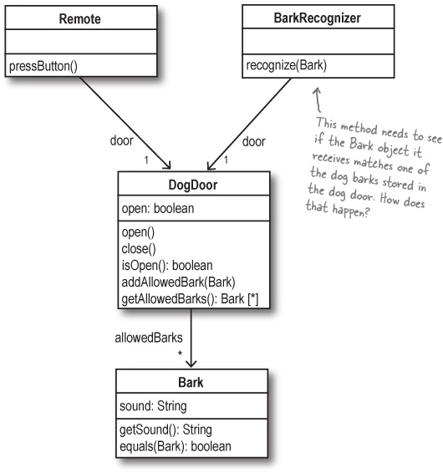

Slide 15
Basic concepts of OOP
Objects
Class
Data Abstraction
Data Encapsulation
Inheritance
Polymorphism
Dynamic binding
Message Passing
The three pillars of object-oriented development:
Encapsulation, Inheritance, and Polymorphism.

Slide 16
Objects
Objects are the basic run-time entities in an object- oriented system
They may represent a person, a place, a bank account, a table of data or any item that the program must handle.
Program objects should be chosen such that they match closely with the real-world objects.
Objects take up space in the memory and have an associated address like structure in C.
When a program is executed the objects interact by sending messages to one another.

Slide 17
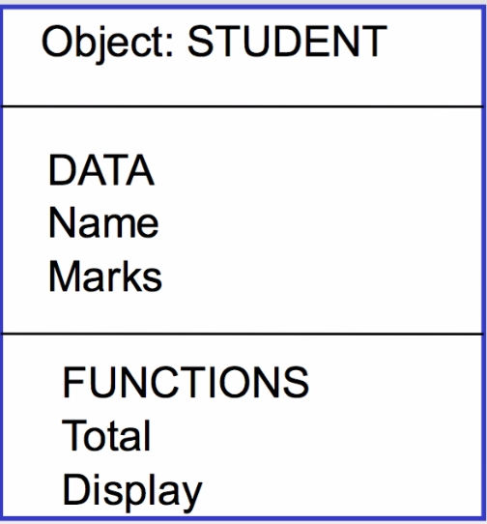
Ways to represent Objects

Slide 18
Class
A class is nothing but a blueprint or a template for creating different objects which defines its properties and behaviors. Java class objects exhibit the properties and behaviors defined by its class. A class can contain fields and methods to describe the behavior of an object.

Slide 19
Encapsulation
The wrapping up of data and functions into a single unit is known as Encapsulation.
The data is not accessible to the outside world and only those functions which are wrapped in the class can access it.
This insulation of the data from direct access by the program is called data hiding or information hiding.

Slide 20
Abstraction
Abstraction refers to the act of representing essential features without including the background details or explanations.
Classes use the concept of abstraction and are defined as a list of abstract attributes such as size, weight and cost, and functions to operate on these functions.
Since the classes use the concept of data abstraction, they are known as Abstract Data Types.

Slide 21
Inheritance
Inheritance is the process by which objects of one class acquire the properties of objects of another class.
The principle behind this sort of division is that each derived class shares common characteristics with the class from which it is derived.
In OOP the concept of inheritance provides the idea of reusability.
This means that we can add additional features to an existing class without modifying it.

Slide 22
Polymorphism
Polymorphism means the ability to take more than one form.
That is an operation may exhibit different behaviours in different instances. The behaviour depends upon the types of data used in the operation.
Example: Operation of addition.
For two numbers the operation will generate a sum. If the operands are strings, then the operation would produce a third string by concatenation.

Slide 23
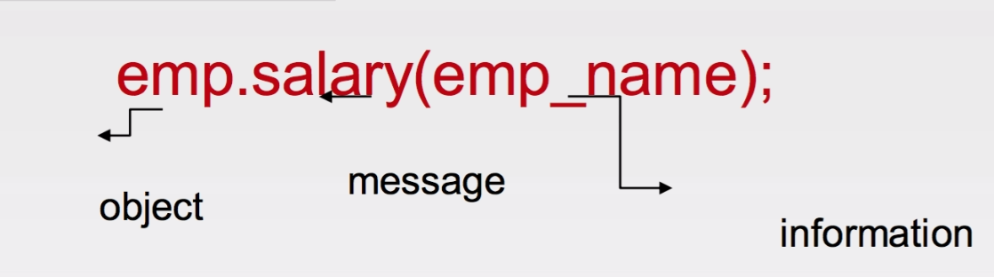
Message Communication
An object-oriented program consists of a set of objects that communicate with each other.
Object communicate with one another by sending and receiving information much the same way as people pass message to one another.
Message passing involves specifying the name of the object, the name of the function (message) and the information to be sent.

Slide 24
Benefits of OOPS
Through inheritance we can eliminate the redundant code and extend the use of existing code
Data hiding helps the programmer to build secure programs that cannot be invaded by code in other parts of the program
It is possible to have multiple instances of an objects to coexist without any interference.
It is possible to map objects in the problem domain to those objects in the program.
Easy to partition the work in a project based on objects

Slide 25
Software Development Methodologies

Slide 26
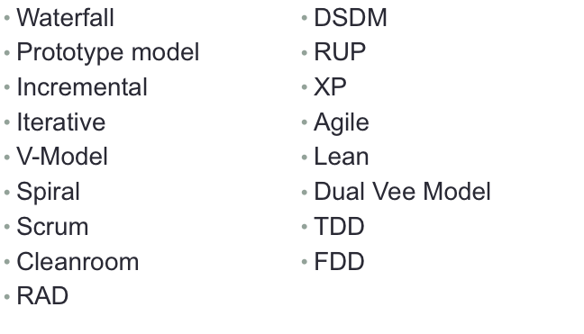
Types

Slide 27
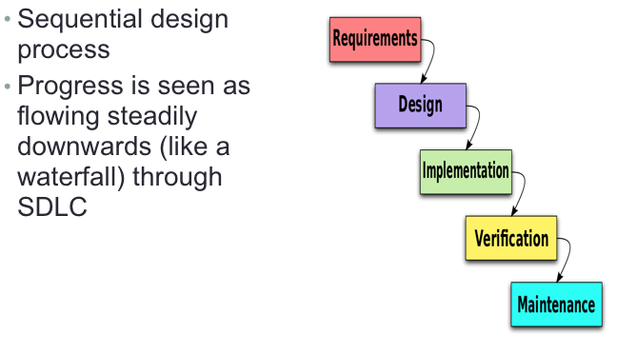
WaterFall Model

Slide 28
WaterFall Model
Jump to next phase only if the prior one is completed
PRO’s
Detailed early analysis cause huge advantages at later phases
If a bug found earlier, it is much cheaper (and more effective) to fix than bugs found in a later phase
Requirement should be set before design starts
Points to importance of documentation (minimized “broken leg” issue)
Disciplined and well-structured approach
Effective for stable software projects
Easy to plan from project management point of view

Slide 29
WaterFall Model
CONs
Changes are expensive
Client does not explicitly know what he or she wants
Client does not explicitly know what is possible to have
Need to finish every phase fully
Long projects, difficult to keep the plan
Designers may not know in advance how complex a feature’s implementation
“Measure twice, cut once”

Slide 30
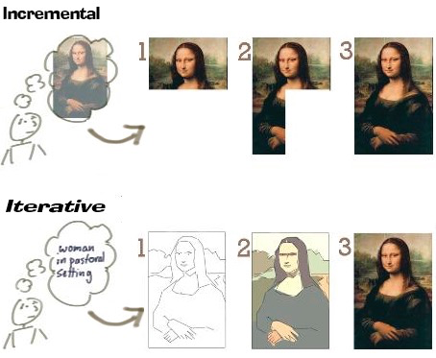
Incremental vs. Iterative

Slide 31
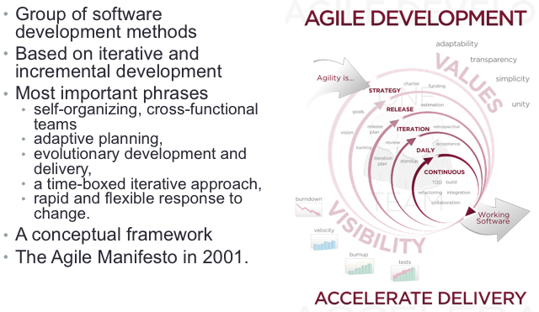
Agile

Slide 32
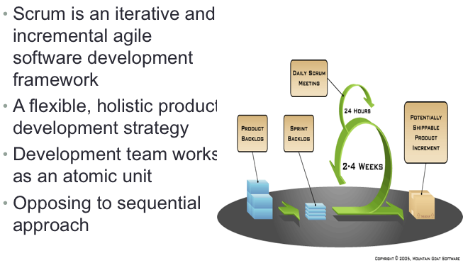
SCRUM

Slide 33
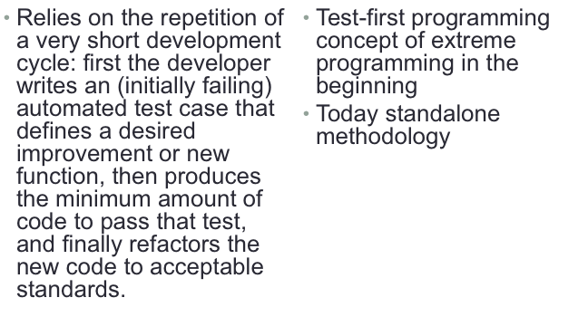
Test-driven development (TDD)

Slide 34
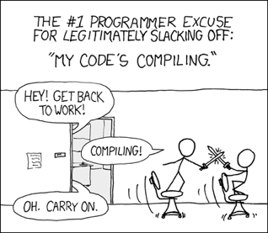
Shouldn’t Forget

Slide 35
Thank you

