Slide 1
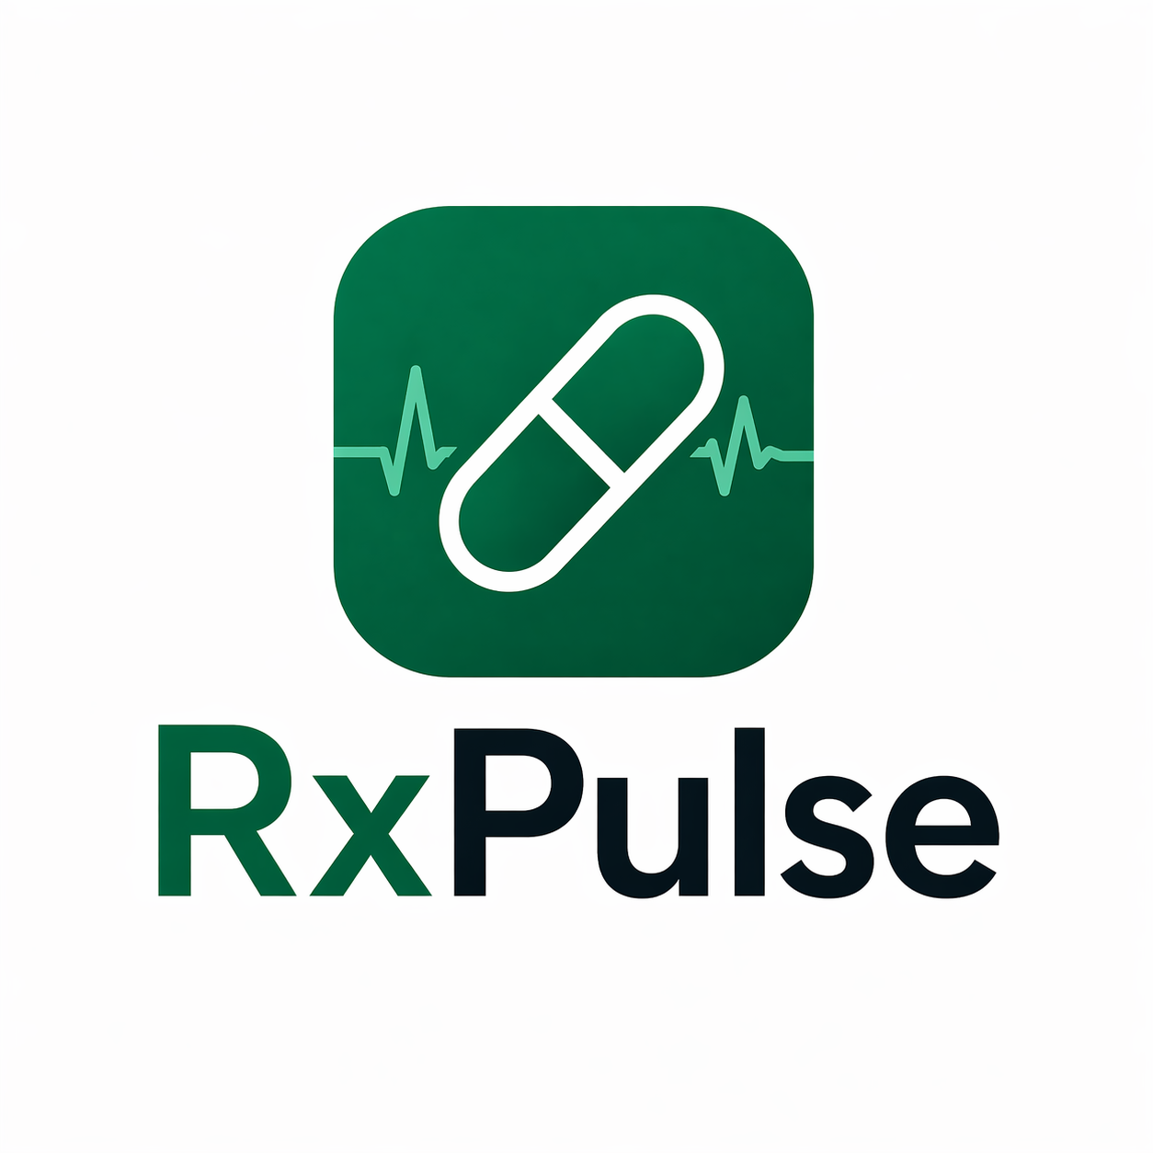
RxPulse —
Pharmacy Management
Platform
Cloud-native microservices with
DevOps & GitOps — built for reliability, security, and
zero-downtime deployments.

Slide 2
What is RxPulse?
RxPulse is a cloud-native pharmacy management platform — three backend microservices, a React + TypeScript frontend, and a DevOps pipeline built for production-grade reliability.
3 Backend Microservices
React + TypeScript Frontend
DevOps & GitOps Pipeline
Each with an isolated MongoDB, deployed as independent Kubernetes workloads.
GitHub Actions CI, ArgoCD GitOps, and security scanning at every stage.
Served via Nginx with Argo Rollouts for blue-green, zero-downtime releases.

Slide 3
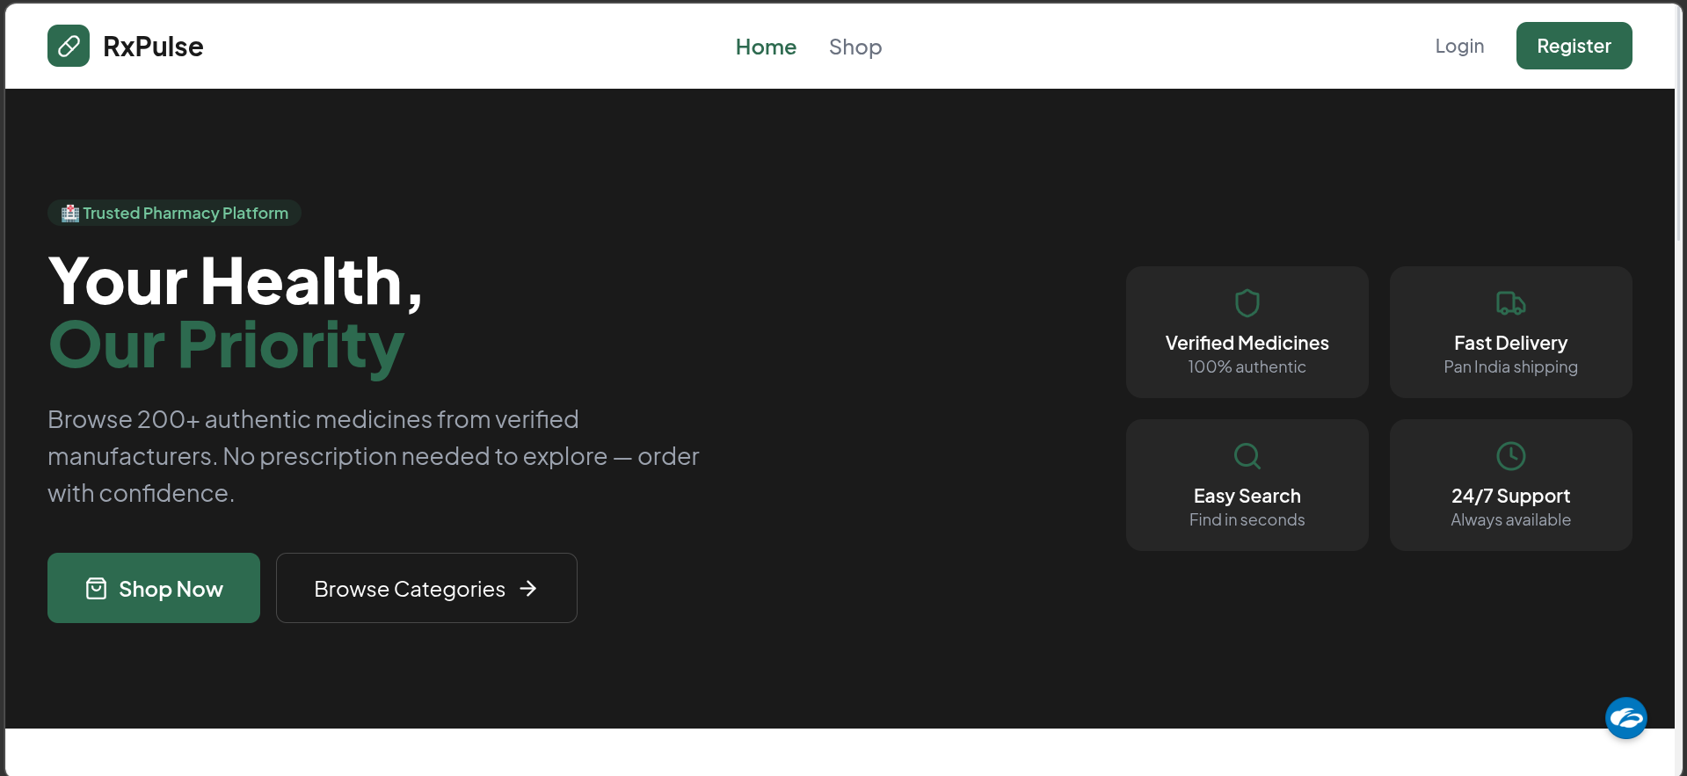
RxPulse Home page

Slide 4
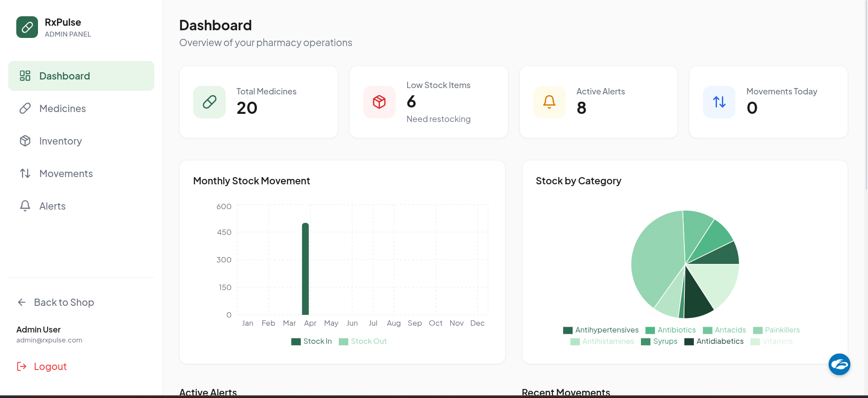
Admin Dashboard

Slide 5
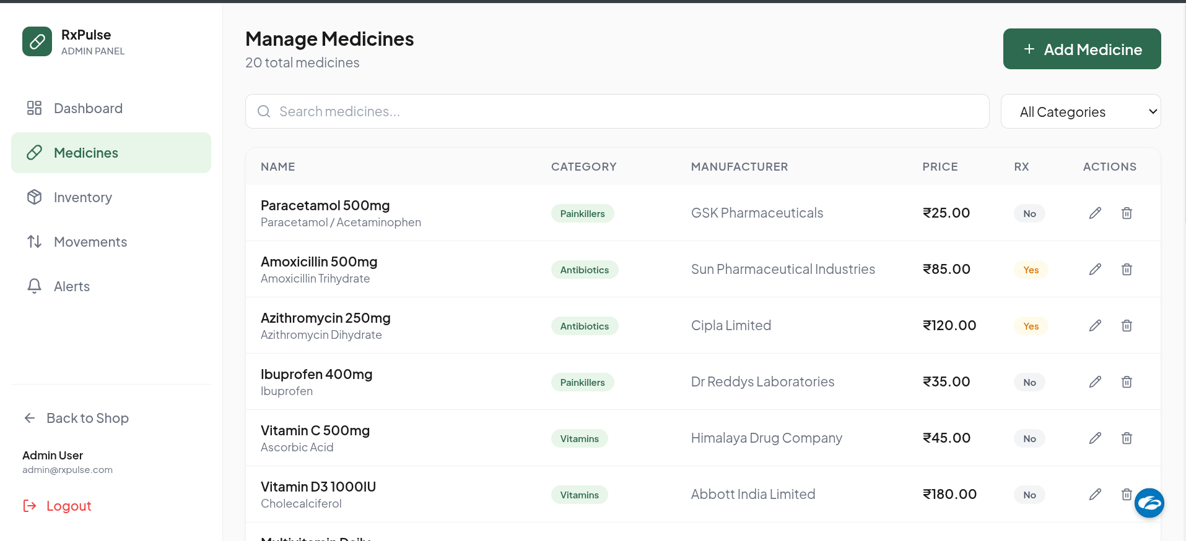
Admin Medicines Page

Slide 6
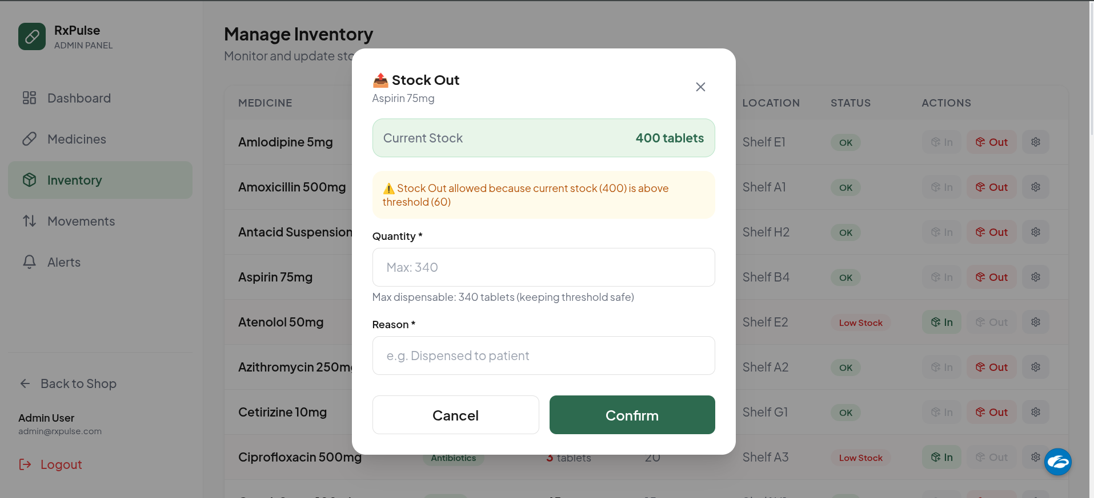
Admin Inventory Page

Slide 7
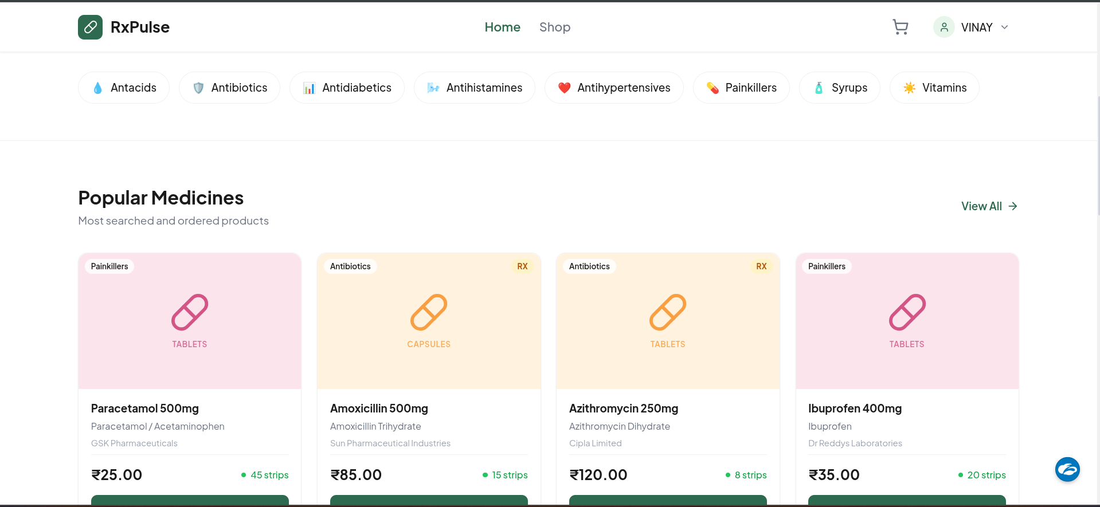
User Home Page

Slide 8
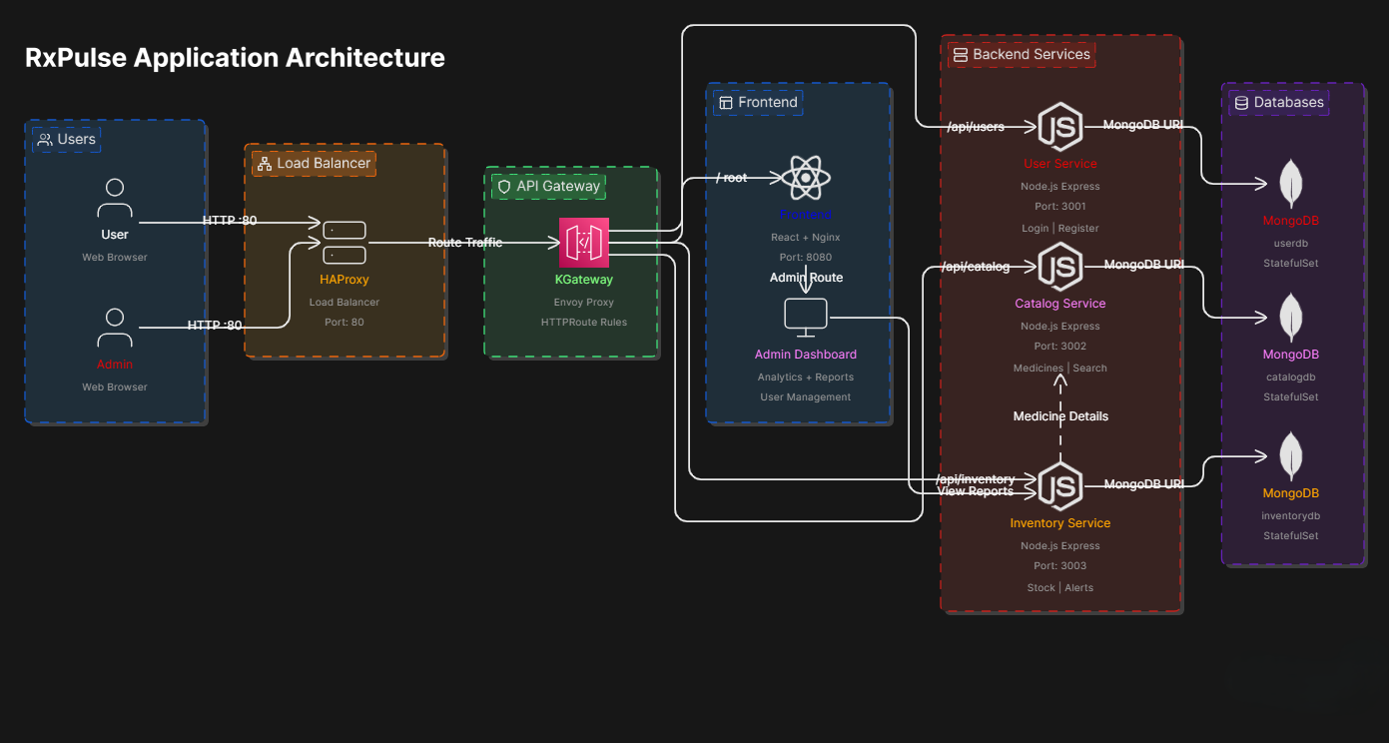
Application Architecture

Slide 9
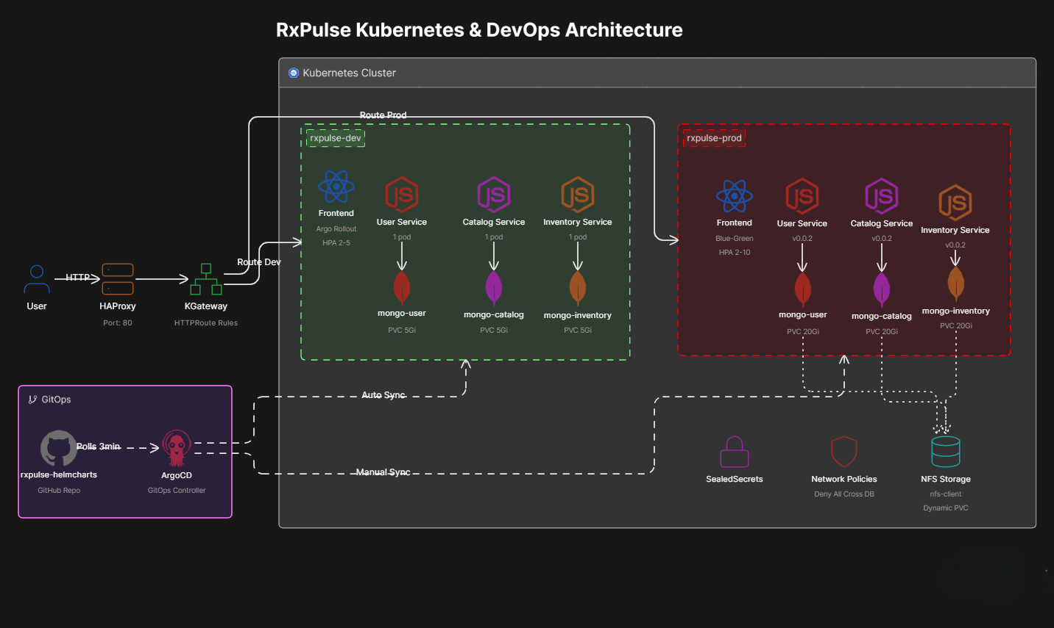

Slide 10



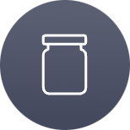
Security Implementation — Defense in Depth
1
JWT-based authentication secures all APIs.
NetworkPolicy
Admin → Full access (dashboard, inventory, alerts)
Customer → Browse medicines & place orders
Default-deny-all posture. Each MongoDB accepts connections only from its owning service. Prevents lateral movement and data exfiltration.
SealedSecrets (Prod)
Non-Root Containers
Sensitive data (DB passwords, API keys) encrypted at rest in Git. Only the prod cluster can decrypt using its sealing key.
All Docker images run as non-root users. Reduces blast radius if a container is compromised. Combined with read-only filesystems where possible.
Security is layered: identity (JWT), network isolation (NetworkPolicy), secrets management (SealedSecrets), and container hardening (non-root). No single point of failure.

Slide 11
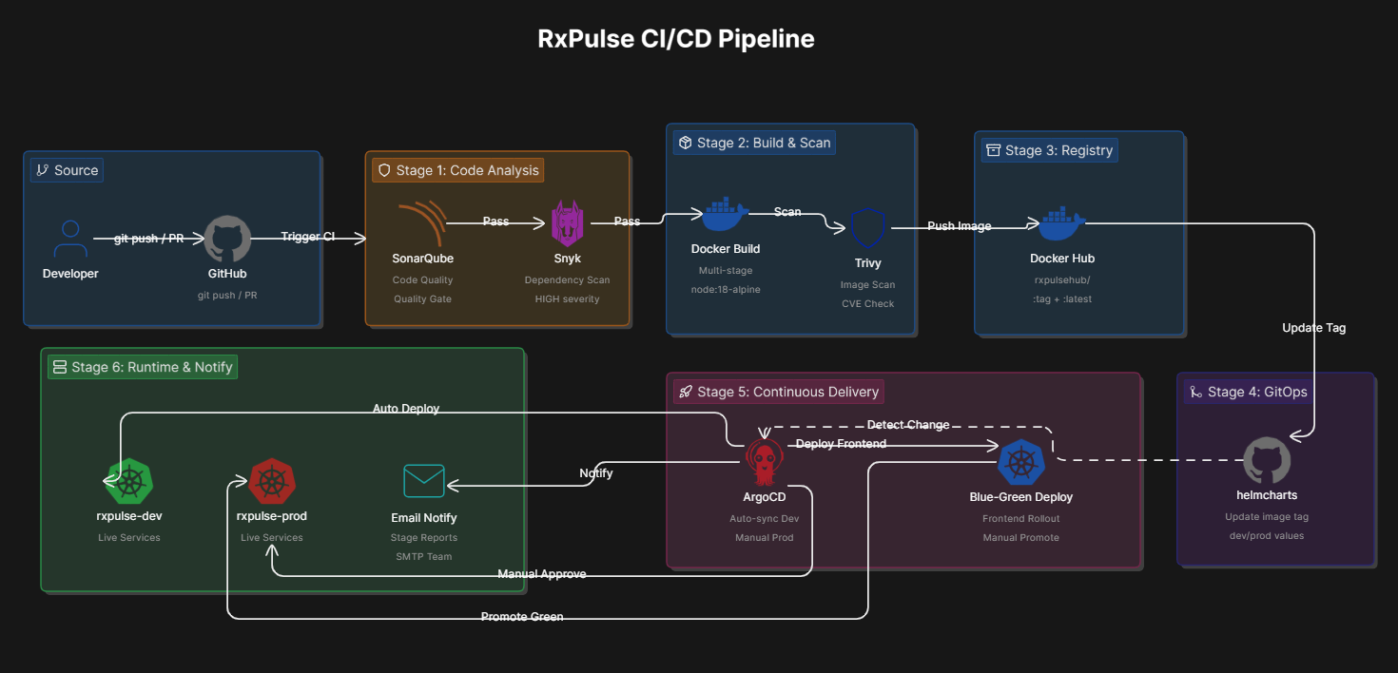

Slide 12
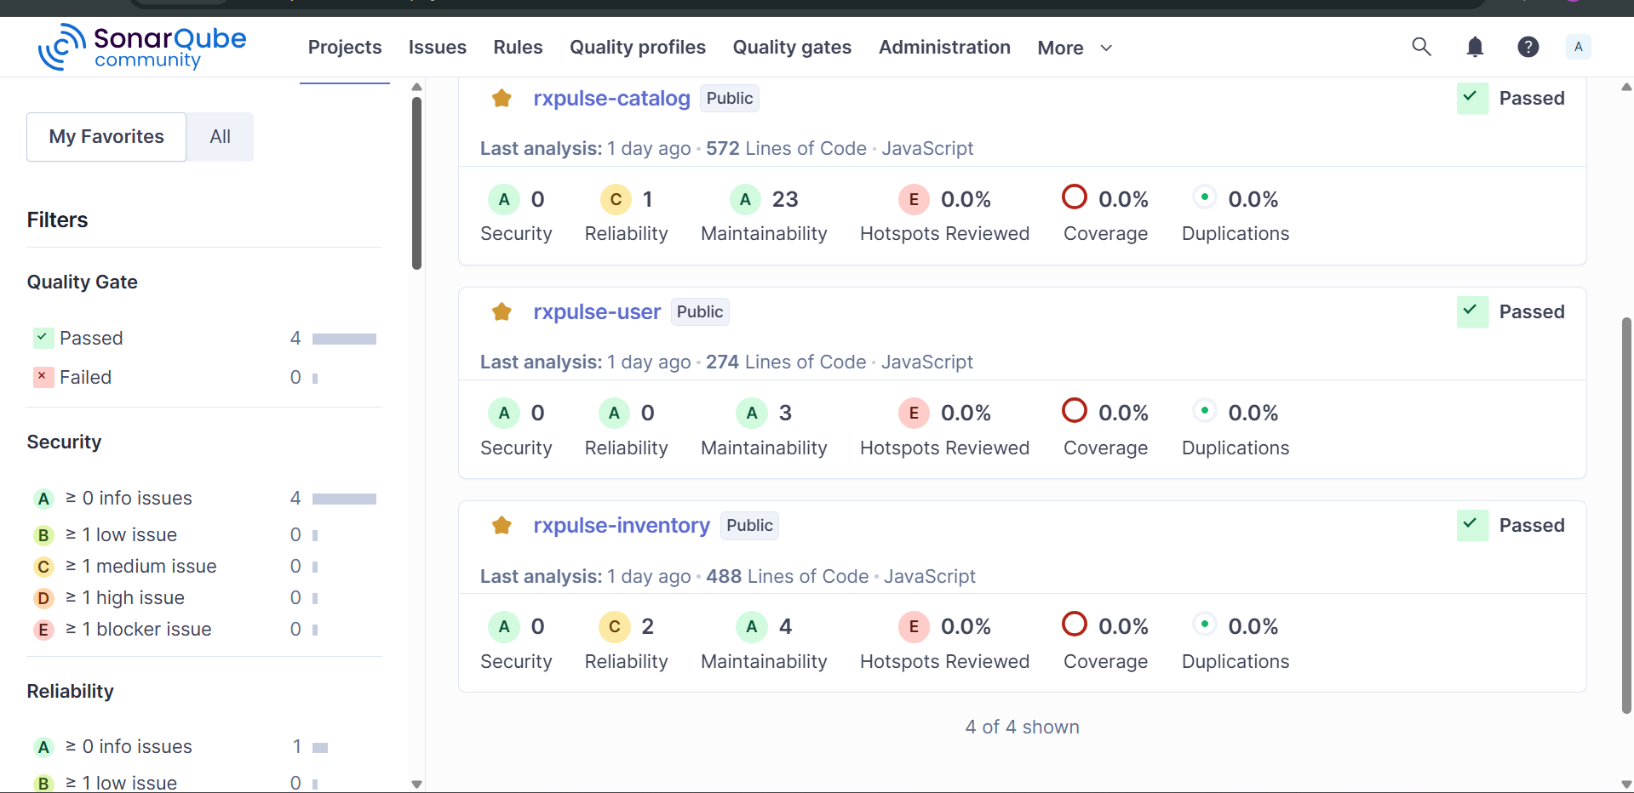
Sonar Qube Report

Slide 13
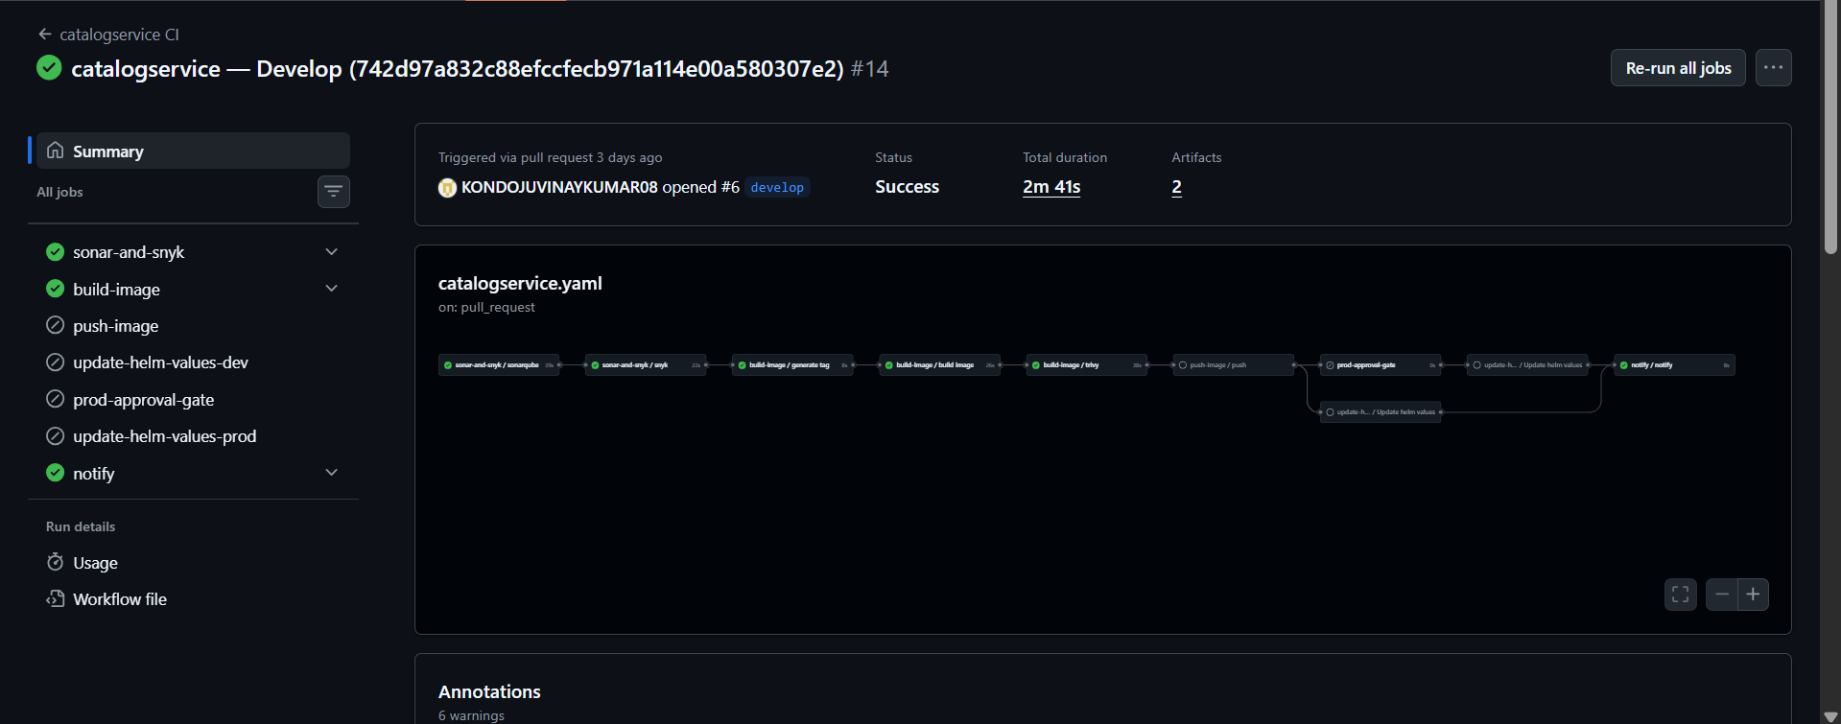
CI Pipeline PR to Main from Develop

Slide 14
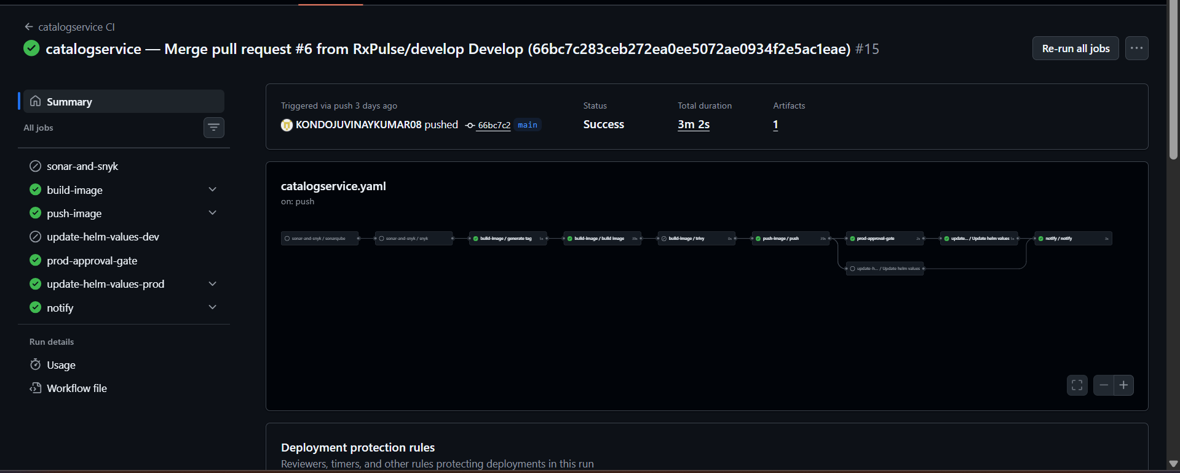
Merge To Main (Push to main) – Manual Apporval Gate

Slide 15
GitOps with ArgoCD & Argo Rollouts
ArgoCD — GitOps Controller
Argo Rollouts — Blue-Green
A separate Helm repo (rxpulse-helmcharts) is the single source of truth. ArgoCD reconciles cluster state to match Git.
Frontend uses Argo Rollouts for zero-downtime releases.
Blue (Active): Live production traffic
Green (Preview): New version staged
Promote: Manual switch after validation
Dev: Auto-sync on every commit
Prod: Manual approval gate before sync

Slide 16
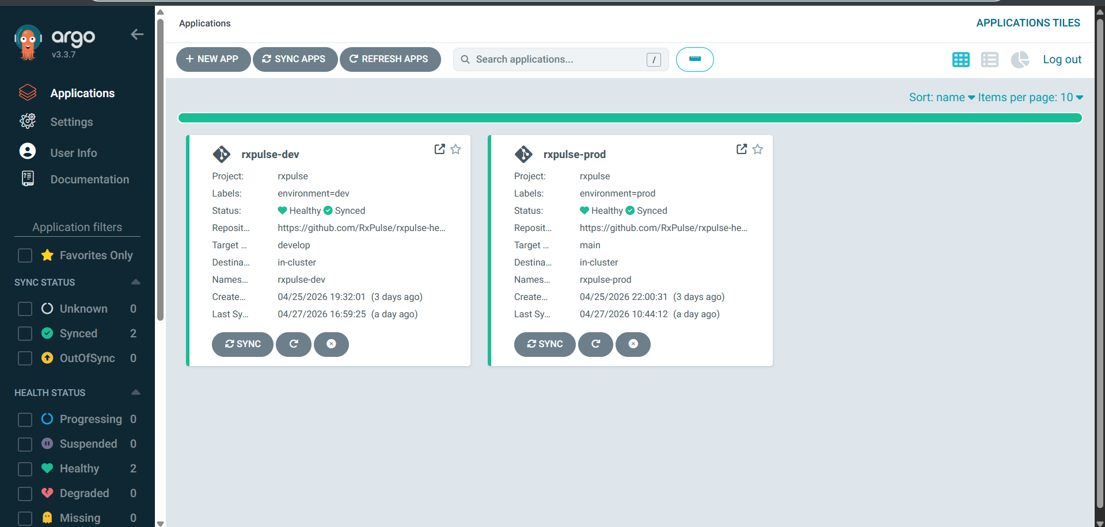
GitOps ArgoCD

Slide 17
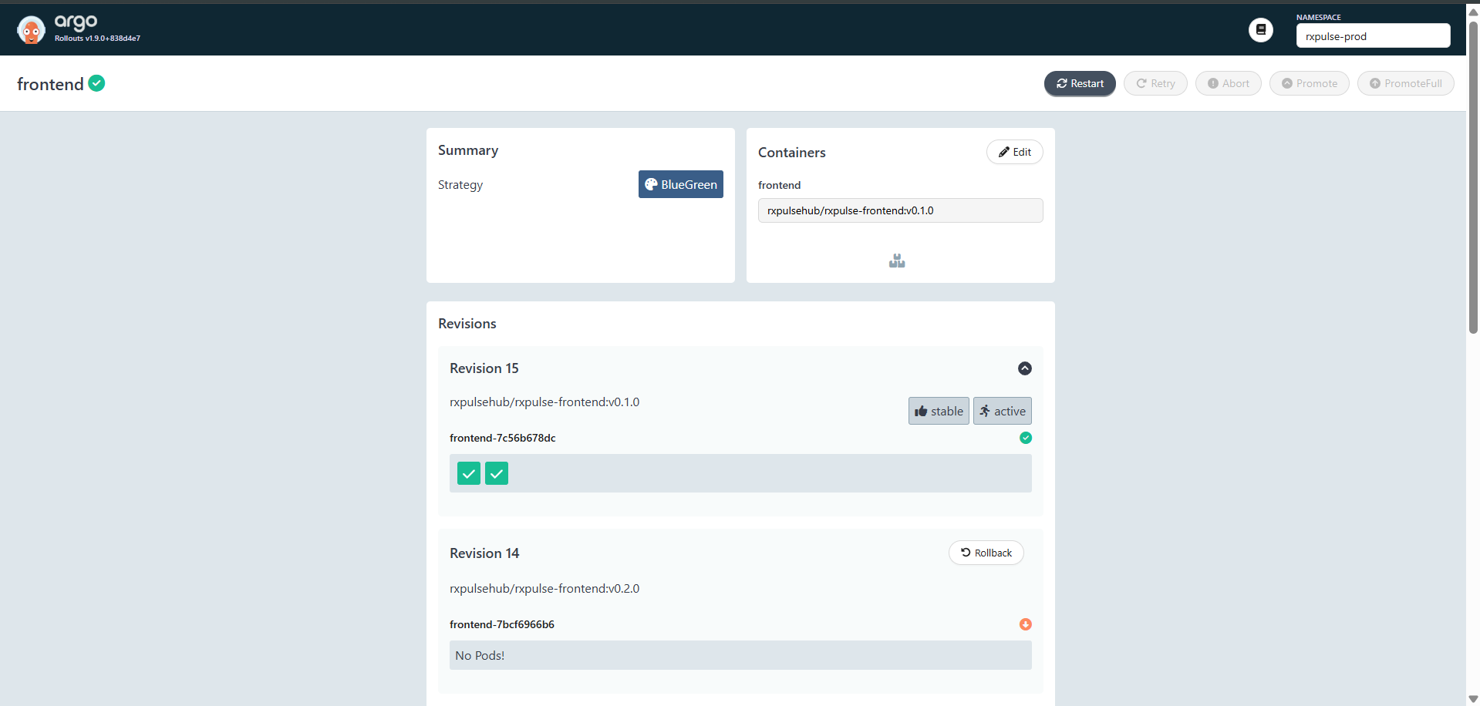
Argo Rollouts

Slide 18
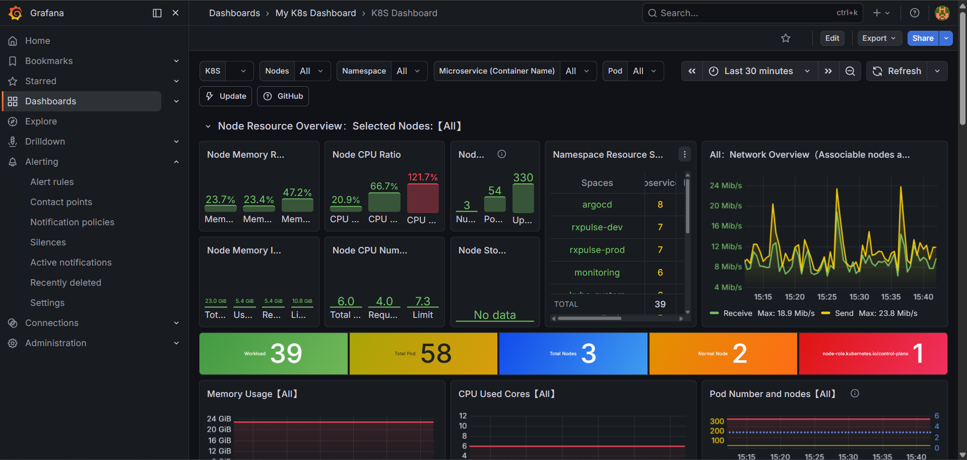
Monitoring – Grafana

Slide 19
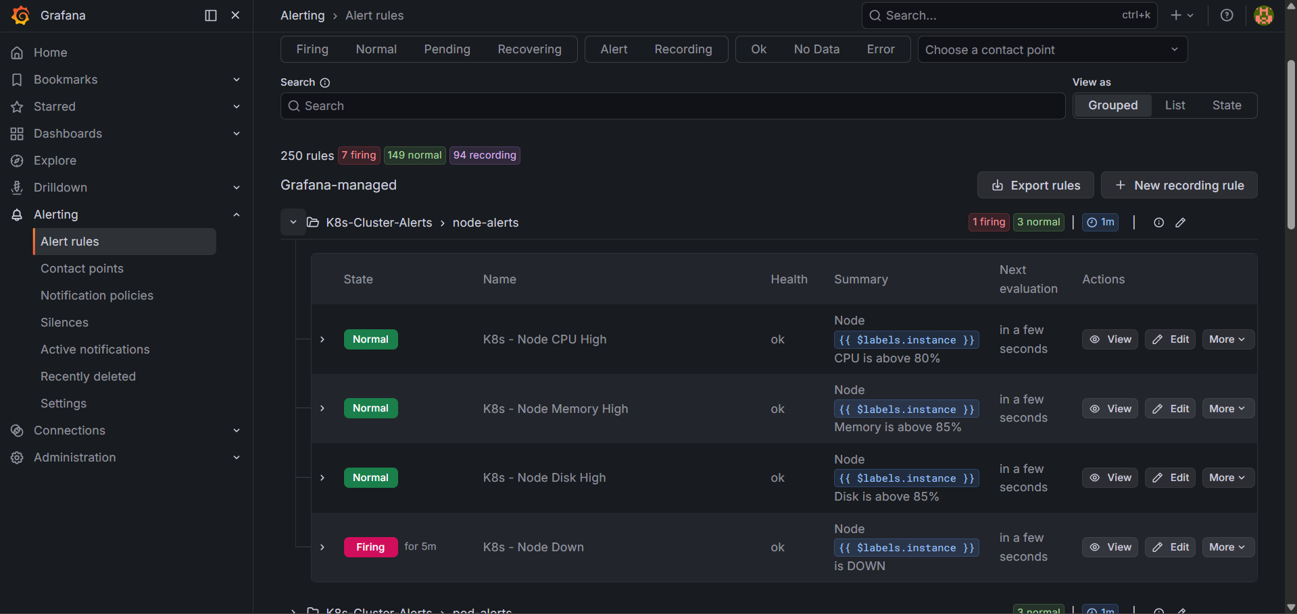
Monitoring Alerts

Slide 20
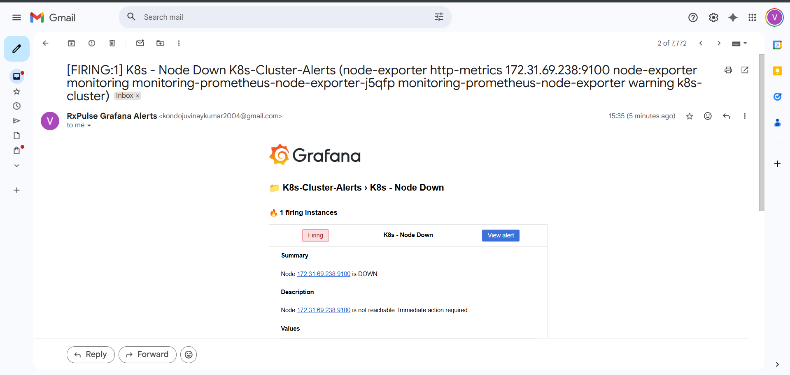
Alerts Notification

Slide 21
THANK YOU
RxPulse Application: http://rxpulse.online
Github Organization : https://github.com/orgs/RxPulse/repositories
Demo- Credentials:
Admin – admin@rxpulse.com
Password: Admin@123

