Slide 1
Smart RideShare
Recommendation and Analytics System
Digital Assignment III • Review-3 Presentation
Godwin Durai Raja A | 26MAI1021
M.Tech CSE (Artificial Intelligence and Machine Learning)
Raghul T | 26MCB1023
M.Tech Big Data Analytics
VIT Chennai • October 2026
Smart RideShare | Review 3
01
Notes:
Product development project. The application coordinates shared commutes; it does not operate a real payment gateway. Authors and programmes are supplied by the project team.

Slide 2
Problem and project objectives
People travel along similar routes while seats remain unused.
Passengers need suitable locations, departure times and available seats.
Drivers need reliable bookings and a way to coordinate pickup.
The project combines recommendations, maps, chat and analytics.
Smart RideShare | Review 3
02
Notes:
Informal coordination does not maintain seat inventory or consistently compare route and time. Scope: local academic prototype.

Slide 3
User workflow
01
Register / sign in
02
Offer or request a ride
03
Review automatic matches
04
Confirm a seat
05
Payment and ride chat
06
Complete / rate / analyse
Smart RideShare | Review 3
03
Notes:
Recommendations are automatic; the passenger confirms the booking. Payment is an optional test-mode workflow. Completed journeys allow feedback.

Slide 4
System architecture
Browser: HTML, CSS, JavaScript
Java Servlets / JSP on Apache Tomcat
Python + scikit-learn
MySQL database
OSRM road routing
Eclipse + Maven build the Java project; Python runs as a separate local service.
Tomcat 8080 | Python 5001 | MySQL 3307
Smart RideShare | Review 3
04
Notes:
Source: src/main/java/com/smartride, src/main/webapp, ml-service/app.py. The browser uses Java endpoints; Java calls Python and OSRM. MySQL persists application state.

Slide 5
Database and access control
Identity: users, settings and audit_log
Ride lifecycle: rides, ride_requests, bookings, match_history and feedback
Communication: ride_messages and ride_chat_reads
Payments: demo_payments stores test-mode transaction attempts
Passwords use salted hashing. Sessions, CSRF checks and ownership rules protect actions.
Smart RideShare | Review 3
05
Notes:
Source: database/schema.sql, 002_ride_chat.sql and 003_demo_payments.sql; Api.java and Passwords.java. Eleven tables in total. No actual passwords or local database contents are submitted.

Slide 6
Automatic ride matching
1 Filter infeasible offers
Exclude own, past, full or closed rides and incompatible route/time windows.
2 Rank compatible offers
Pickup + destination + time + preference + driver rating
Similarity baseline; Random Forest contributes after sufficient valid feedback.
3 Refresh saved requests
Check every 5 seconds while the interface is active. The user confirms booking.
Smart RideShare | Review 3
06
Notes:
Source: ml-service/app.py. Weights: pickup .30, destination .30, timing .25, preference .10, rating .05. Baseline .8 weighted magnitude + .2 cosine similarity. With valid feedback, .6 baseline + .4 Random Forest prediction. Model: 80 trees, depth 5, minimum leaf 2. No measured predictive accuracy is claimed.

Slide 7
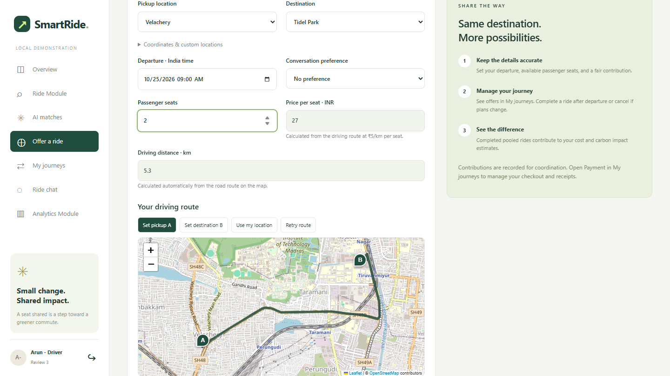
Map routes and distance-based pricing
Choose locations on the map or from the menus.
Java calculates the road distance and fare.
Location changes clear stale values and trigger a fresh quote.
No live vehicle tracking
Smart RideShare | Review 3
07
Notes:
Source: Routing.java and maps.js. Leaflet displays OpenStreetMap tiles; Java queries OSRM road routes. Price = rounded route km x INR 5 per seat. Internet needed; duration excludes live traffic. Screenshot: actual local application, 24 October 2026.

Slide 8
Booking consistency
A booking transaction checks availability and locks the ride row.
One booking consumes one seat; cancellation restores it once.
Driver cancellation updates the passenger bookings.
Only completed bookings accept feedback. Future rides cannot be completed.
Smart RideShare | Review 3
08
Notes:
Source: Api.java; docs/TEST-RESULTS.txt. Controlled concurrency test: exactly one passenger wins the final seat.

Slide 9
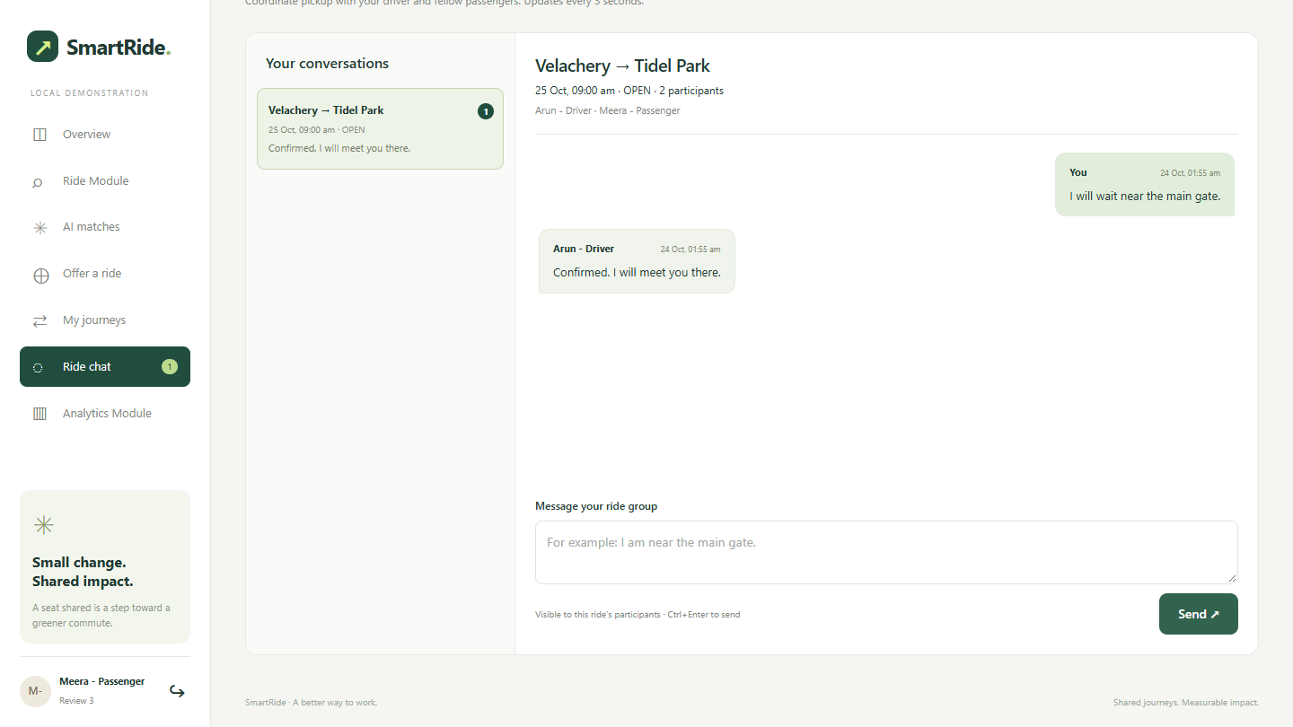
Ride chat
Coordinate the pickup point
Only the driver and booked passengers can participate.
Messages, unread counts and history persist in MySQL.
Closed rides become read-only.
Smart RideShare | Review 3
09
Notes:
Source: Chat.java, chat.js, docs/CHAT-TEST-RESULTS.txt. Polling every 3 seconds. Messages persist; cancelled booking loses access. Screenshot from actual local application.

Slide 10
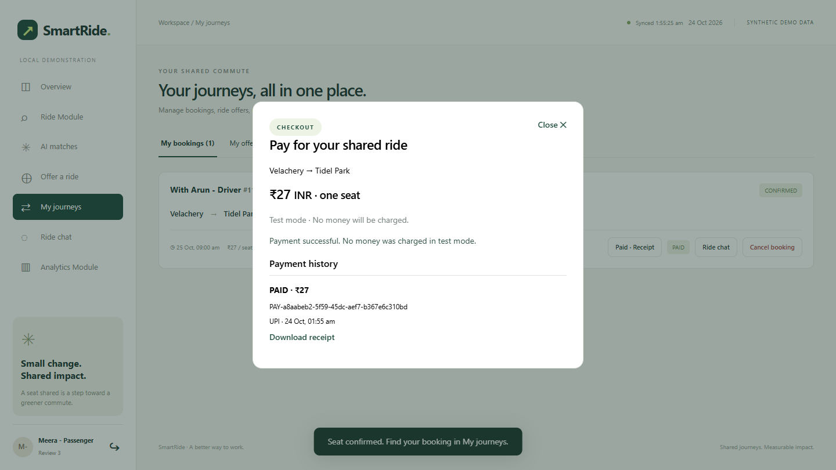
Payment workflow
Checkout and receipts
UPI, card and net banking selections.
Success, failure and retry states.
Cancellation records a test refund.
Test mode: no money charged
Smart RideShare | Review 3
10
Notes:
Source: Payments.java, payments.js, docs/PAYMENT-TEST-RESULTS.txt. Local test-mode checkout only; no Razorpay API or actual money movement. Screenshot from actual local application.

Slide 11
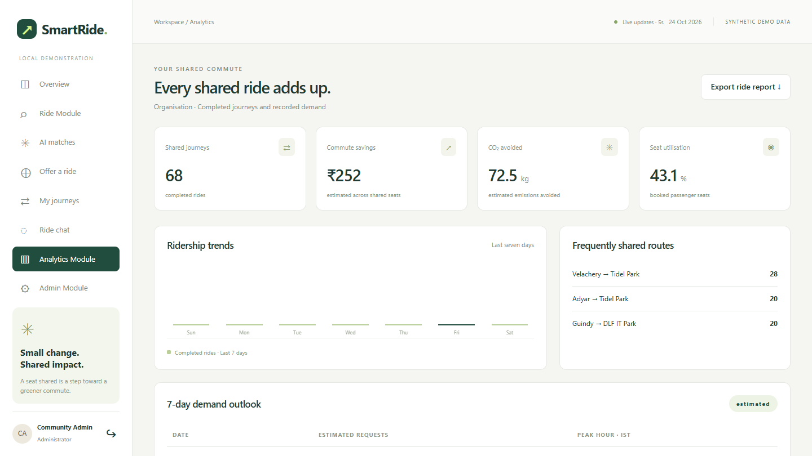
Analytics and administration
Understand recorded activity
Completed rides and occupancy.
Estimated cost and carbon savings.
Admin controls, health and exports.
Forecasts and impact are estimates.
Smart RideShare | Review 3
11
Notes:
Source: Api.analytics, ml-service/app.py /forecast. Metrics derive from completed records and configurable assumptions. Existing records include synthetic history. Administrator demand forecast is exploratory and has no validated error estimate.

Slide 12
Functional verification
59
automated checks passed
Functional tests do not establish predictive AI accuracy.
Smart RideShare | Review 3
12
Notes:
Source: docs/TEST-RESULTS.txt, MAP-TEST-RESULTS.txt, CHAT-TEST-RESULTS.txt, PAYMENT-TEST-RESULTS.txt; Java SecurityTest; Python test_app.py. Final full suite results recorded 22 October 2026. Payment checks rerun after UI label changes. Total 3+6+17+12+11+10=59. A routing timeout required retry; all 12 map checks passed on the complete rerun. Counts do not represent ML accuracy.

Slide 13
Execution and demonstration
Extract the source; run scripts/setup.ps1 on the first installation.
Open http://localhost:8080/smartride/ and use generated local credentials.
Use separate driver and passenger accounts with matching future journeys.
Demonstrate booking, checkout, chat, cancellation and analytics.
Included: captioned MP4 walkthrough and written execution procedure.
Smart RideShare | Review 3
13
Notes:
Use the submitted execution instructions. Fresh Windows setup requires Python 3.11, MySQL Server 8.0 binaries and internet; downloads Java, Maven and Tomcat. Local credentials are generated at setup. See Demo_Chapters.txt for the captioned video.

Slide 14
Conclusion and future work
A complete shared-commute workflow
Implemented: automatic matching, road pricing, booking, chat and reporting.
Current limits: synthetic history, test payments and external routing dependency.
Next steps: evaluate ranking with real consented data and add detour-aware matching.
Smart RideShare | Review 3
14
Notes:
The implementation is a local product-development prototype. No independent real-commuter accuracy study, real payment gateway, live tracking or production-readiness claim. Future work includes consented data evaluation, route-overlap matching, notifications and deployment hardening.

