Slide 1
Development of a root-state and child-state abstraction algorithm for the game 2048
Stefan Werner

Slide 2
Motivation
Similar states and actions saved
Problem with larger state spaces
Storage space increases
Many structurally similar states

Slide 3
Methods
Splitting existing Q-table in parent table and child table
State is depicted as a matrix
Sequence of operations (example “rdvm”)
Rotation, mirroring and scaling
Parent saves Q-values child saves changes from parent

Slide 4
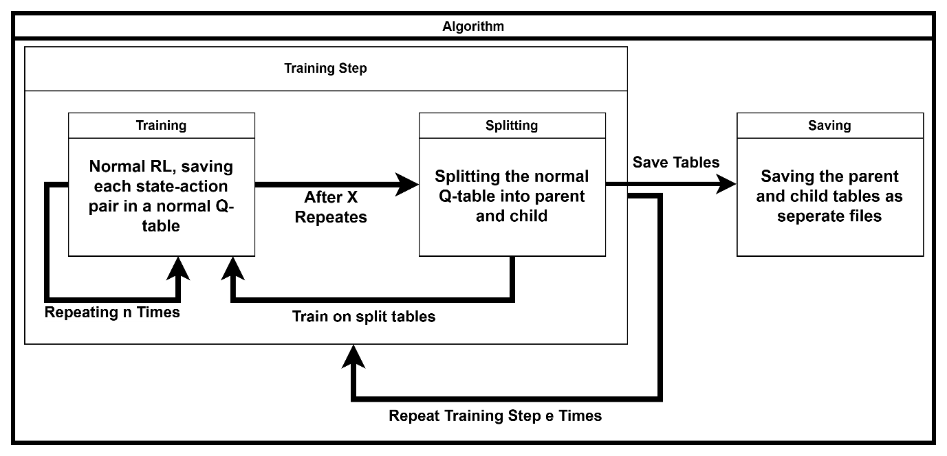
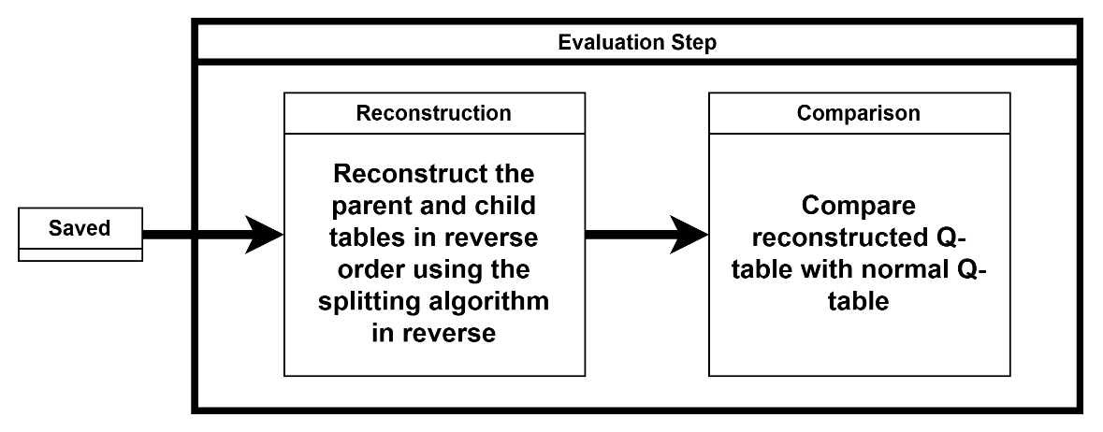
Procedure
Testing environments: 2x2, 3x3, 4x4
Save original Q-table for comparison later
Reconstruction step uses the same methods as Splitting

Slide 5
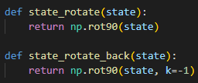
Splitting
Splitting via the „PreCalculator“
Operations applied to parent (BFS)
All reached states temporarily saved

Slide 6
Saving
Looping through original Q-table
Applying “PreCalculator”
If state in temporary table → child state of the tested state
Else → new parent state
Saving parent and child tables

Slide 7
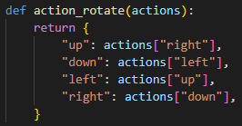
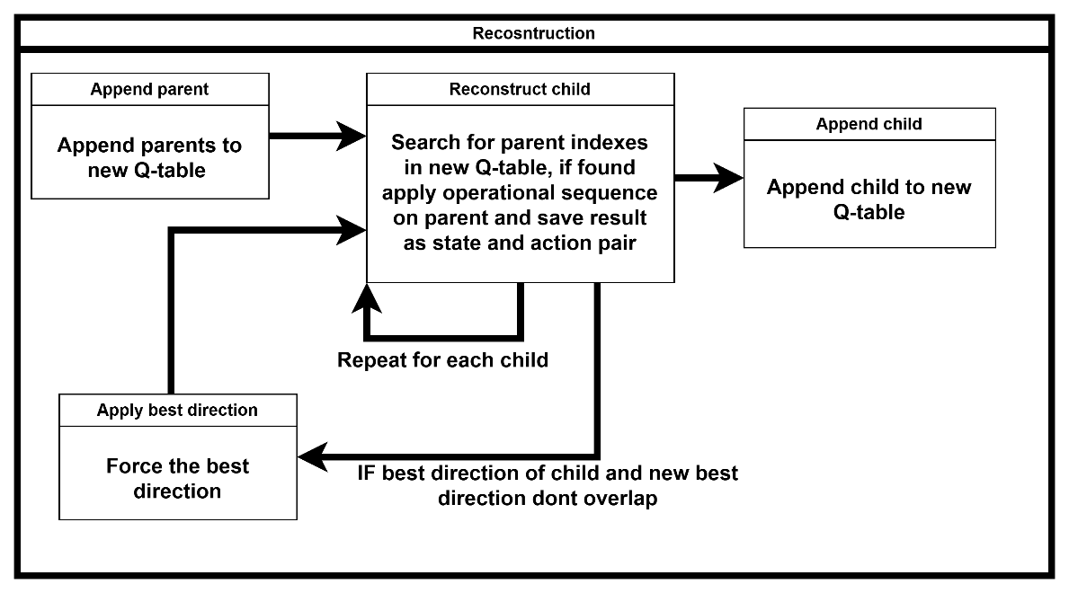
Reconstruction and Evaluation
Reconstruction done in reverse order
Reconstructed table formed out of parent and child table
If needed best direction is applied
“Force” best direction:

Slide 8
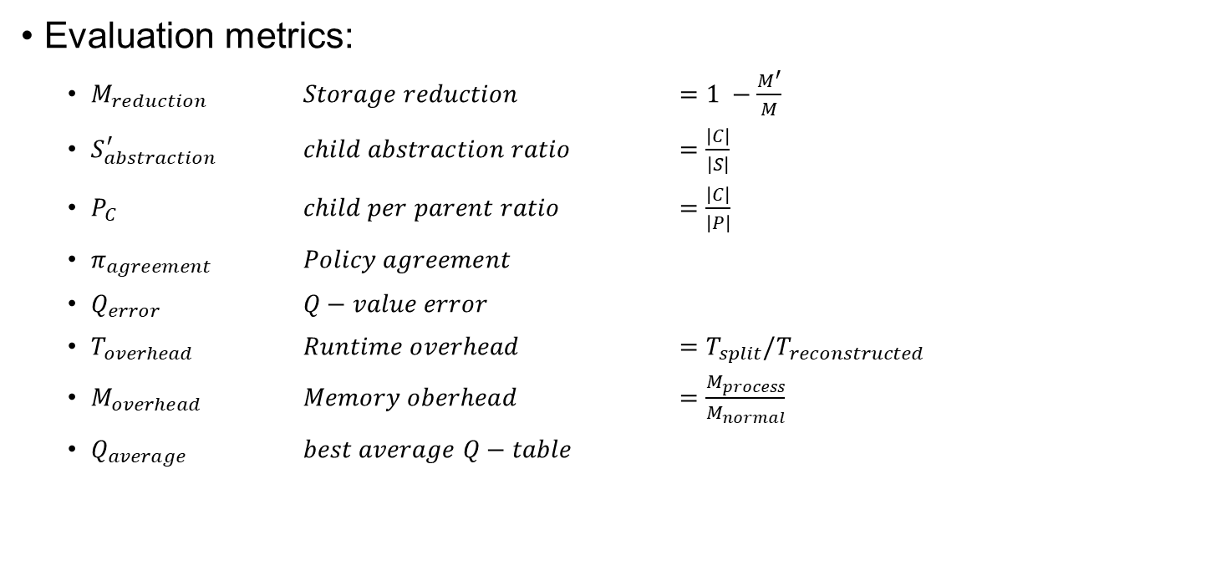
Evaluation
Evaluation metrics:
$M_{reduction}$ $Storage reduction$ $=1 −\frac{M^{′}}{M}$
$S_{abstraction}^{′}$ $child abstraction ratio$ $=\frac{\left|C\right|}{\left|S\right|}$
$P_{C}$ $child per parent ratio$ $=\frac{\left|C\right|}{\left|P\right|}$
$π_{agreement}$ $Policy agreement$
$Q_{error}$ $Q−value error$
$T_{overhead}$ $Runtime overhead$ $=T_{split}/T_{reconstructed}$
$M_{overhead}$ $Memory oberhead$ $=\frac{M_{process}}{M_{normal}}$
$Q_{average}$ $best average Q−table$

Slide 9
Results – Storage Reduction
3x3 environment achieves up to 56% storage reduction
2x2 starts at increased storage with -4% and ends at 25% reduction
4x4 has the least reduction with an average of 5%
Storage Reduction %
Grid Size | Depth 1 | Depth 3 | Depth 5 | Depth 7 | Depth 10
2x2 | - 4% | 11% | 18% | 21% | 25%
3x3 | 28% | 55% | 55% | 55% | 56%
4x4 | 3% | 6% | 5% | 5% | 5%

Slide 10
Results – Policy Agreement & Q-value Error
Policy agreement never below 99,6 percent
Average q-error less than 0,5
Game performance nearly identical
But q-values not the same

Slide 11
Results – Time and Memory Overhead
No significant memory overhead
Extreme time overhead
Time overhead increased with each „PreCalculator“ depth
Time Relativity
Grid_Size | Depth 1 | Depth 3 | Depth 5 | Depth 7 | Depth 10
2x2 | 0,00123 | 0,00285 | 0,00335 | 0,00414 | 0,00539
3x3 | 0,59742 | 0,98558 | 1,36360 | 2,31417 | 3,18643
4x4 | 2,17796 | 8,44021 | 17,75082 | 35,74774 | 72,16574

Slide 12
Conclusion
Parent and child abstraction can reduce storage without great loss of information
Game performance nearly identical with reduction in storage space of 56% percent
Not practical due to time overhead
3x3 environment shows best results
4x4 is to large given the current operation set
Action values of parent inevitably leads to loss of information

Slide 13
Challenges
Extremely long waiting time for 4x4 environment
Splitting algorithm
Better operations
Policy agreement
Training on 2 tables instead of 1

Slide 14
Outlook
Optimization of the splitting algorithm
Intelligent parent state selection
Adaptive searching
Adaptive “PreCalculator” depth search
Increased storage reduction
Reduction in Loss of information
Operation Concepts such as:
Edge expansion, Triangle detection, chunk detection

