Slide 1
Development of a root-state and child-state abstraction algorithm for the game 2048
Stefan Werner

Slide 2
Motivation and Methods
Saving both A and B = a lot of storage wasted
Saving only A with a link to B = reduced storage space
*Example 4x4 environment

Slide 3
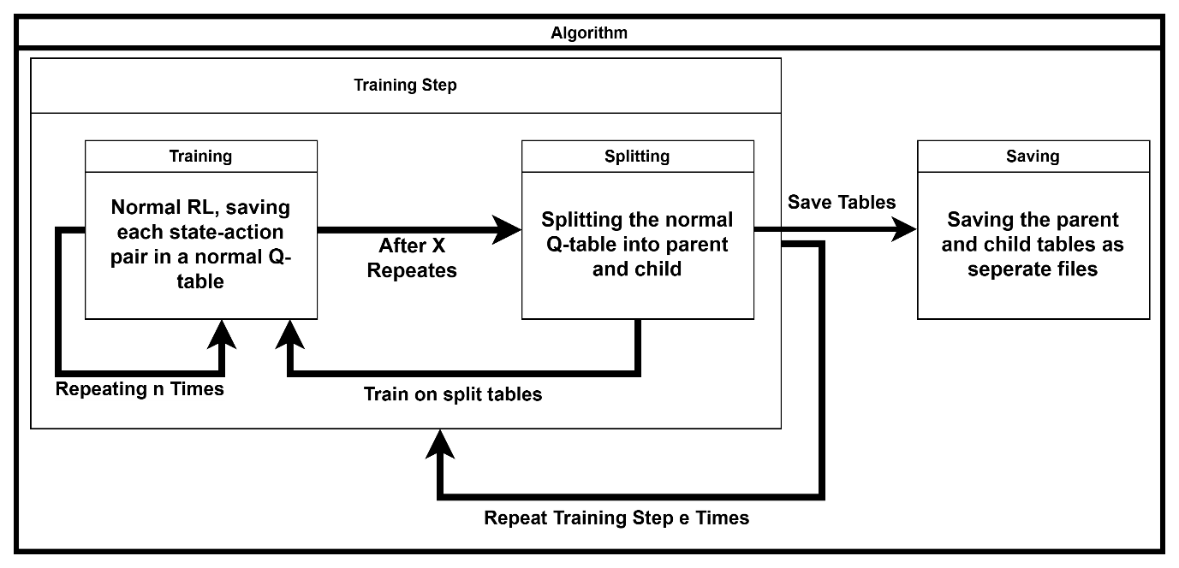
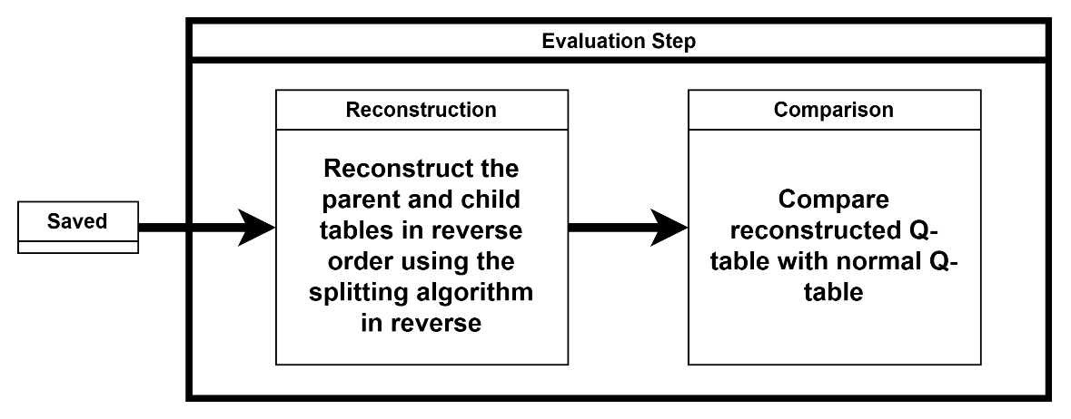
Procedure

Slide 4
Splitting

Slide 5
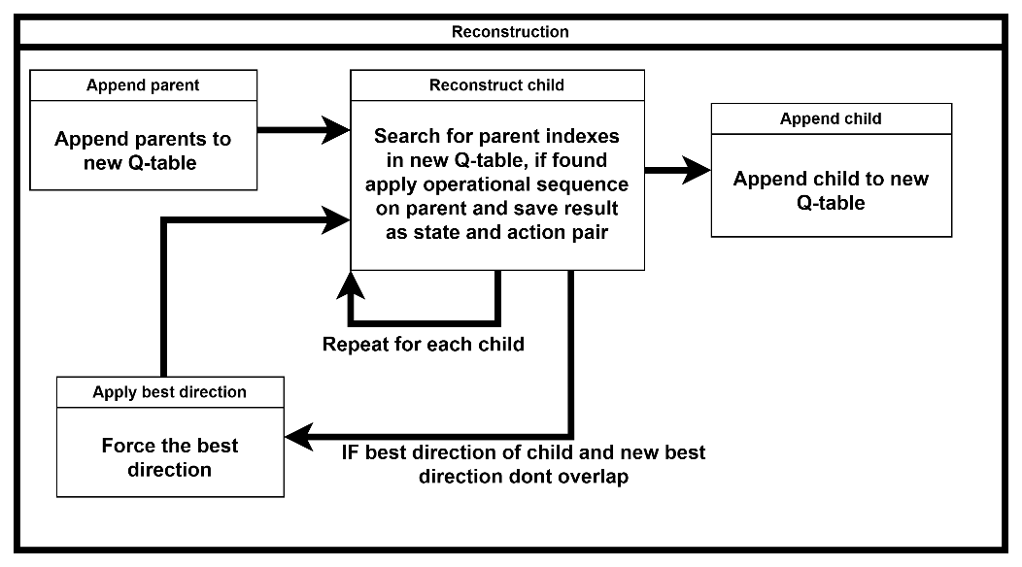
Saving and Reconstruction

Slide 6
Results – Storage Reduction, Policy Agreement and Q-Error

Slide 7
Results – Time and Memory Overhead
No significant memory overhead

Slide 8
Conclusion, Challenges and Future Outlook

