Slide 1


DEPARTMENT OF ARTIFICIAL INTELLIGENCE & DATA SCIENCE
Mini project (21ADMP67) Seminar on
“AI POWERED SOLO TRAVEL COMPANION APP”
Under the guidance of:
Prof . Rajashree D Ingale
Assistant Professor
Dept., of AI & DS, KSSEM
Project co-oridinator:
Prof . Manjunath T K
Associate Professor and head of
Dept., of AI & DS, KSSEM
Presented by:
Ashwini L (1KG21AD001)
Lakshya Srivastava (1KG21AD022)
Ruchitha B J (1KG21AD042)
Swarnashree D S (1KG21AD050)

Slide 2
CONTENTS
Introduction
Objectives
Requirement Specification
Flow Diagrams
Snapshots
Limitations
Future Enhancement
Conclusion

Slide 3
INTRODUCTION
Our AI-based solo travel companion app is a big step forward in travel technology. This app uses artificial intelligence to give solo travelers personalized help and advice. It creates customized itineraries based on the user's needs and preferences. An interactive chatbot provides quick access to local info and travel tips. Our goal is to help solo travelers explore the world with confidence and ease, making their trips more enjoyable and worry-free.

Slide 4
OBJECTIVES
The objective of our AI-powered solo travel companion app is to enhance the solo travel experience through personalized recommendations and seamless interaction. It provides tailored suggestions for destinations and activities based on real-time data analysis and user preferences. The app features an interactive chatbot for instant communication ,ensuring travelers have access to local insights and travel tips. Our goal is to empower solo travelers to explore confidently and independently, enriching their journeys with intuitive design and comprehensive support.

Slide 5
REQUIREMENT SPECIFICATION
Hardware Requirements:
Processor: Intel Core i5 or equivalent
RAM: 8 GB or higher
Storage: 256 GB SSD or higher
Network: Reliable internet connection
for accessing APIs and online resources
Software Requirements:
Operating System: Windows 10/11, macOS Catalina or later, or Linux
Python: Version 3.8 or later
Flask: Version 2.0 or later
pip: Python package installer
IDE/Text Editor: Visual Studio Code
Browser: Google Chrome, Firefox, Safari, or Edge

Slide 6
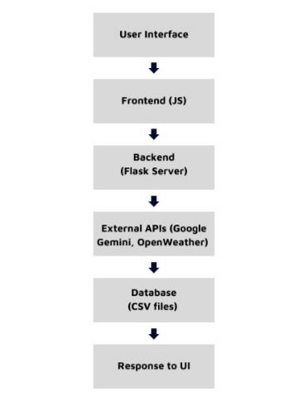
FLOW DIAGRAMS
PROJECT FLOW DIAGRAM
This diagram represents the overall flow of the project from user interaction to the backend processing and response display.
1. User accesses the web application.
2. User interacts with the interface
3. Frontend sends data to the backend via API calls.
4. Backend processes the request
5. Backend sends response to the frontend.
6. Frontend displays the response to the user.

Slide 7
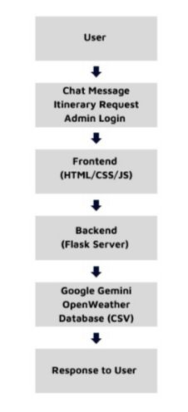
INTERACTION FLOW DIAGRAM
This diagram details the interactions between the user and the system components for different actions like chat, itinerary generation, and admin login.
1. User inputs a message in the chatbox.
2. User requests an itinerary.
3. User logs in as admin and accesses the database.
4. Visual Representation

Slide 8
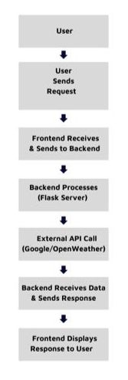
RESPONSE CYCLE DIAGRAM
This diagram shows how the system responds to different user inputs, including the request and response cycle.
1. User sends a request (chat message, itinerary, admin login).
2. Frontend captures the request and sends it to the backend.
3. Backend processes the request and interacts with external APIs or databases as needed.
4. Backend sends the response back to the frontend.
5. Frontend updates the UI with the response.

Slide 9
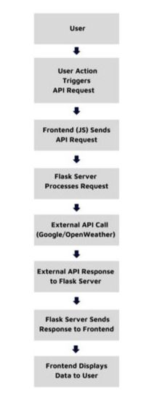
API REQUEST CYCLE DIAGRAM:
This diagram illustrates the detailed process of an API request
from the frontend to the backend and back.
1. User interaction triggers an API request from the frontend. A 2. Frontend sends the request to the Flask server.
3. Flask server processes the request and interacts with the
necessary external APIs or databases.
4. Flask server receives data from external APIs or databases.
5. Flask server sends the response back to the frontend.
6. Frontend updates the UI with the received data.

Slide 10
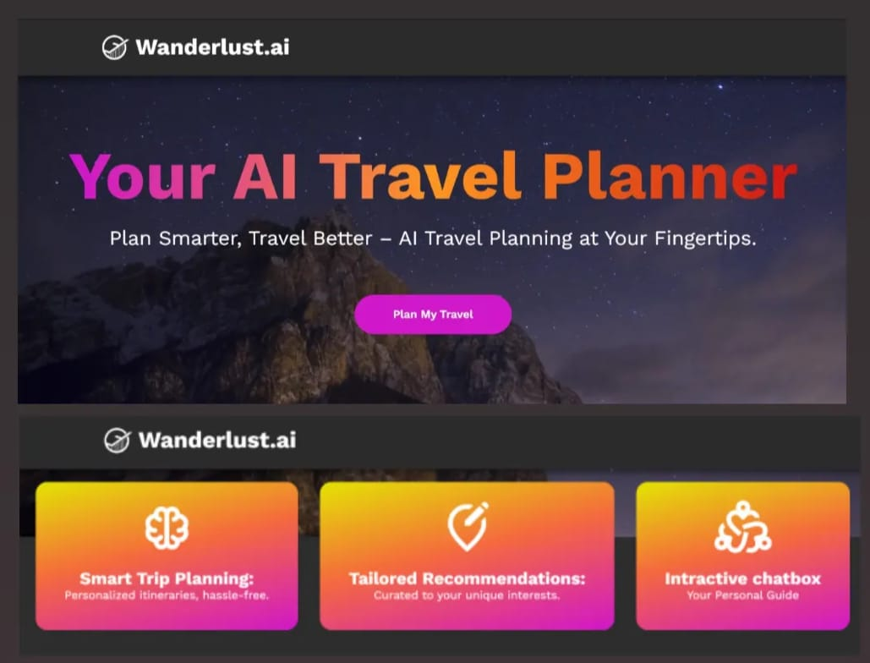
SNAPSHOTS
Frontend:

Slide 11
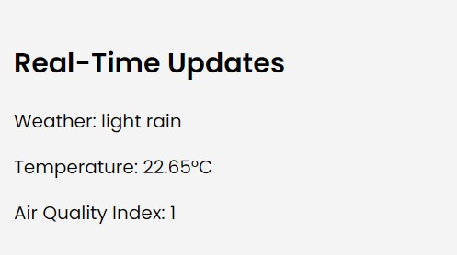
Real-time Weather Updates:

Slide 12
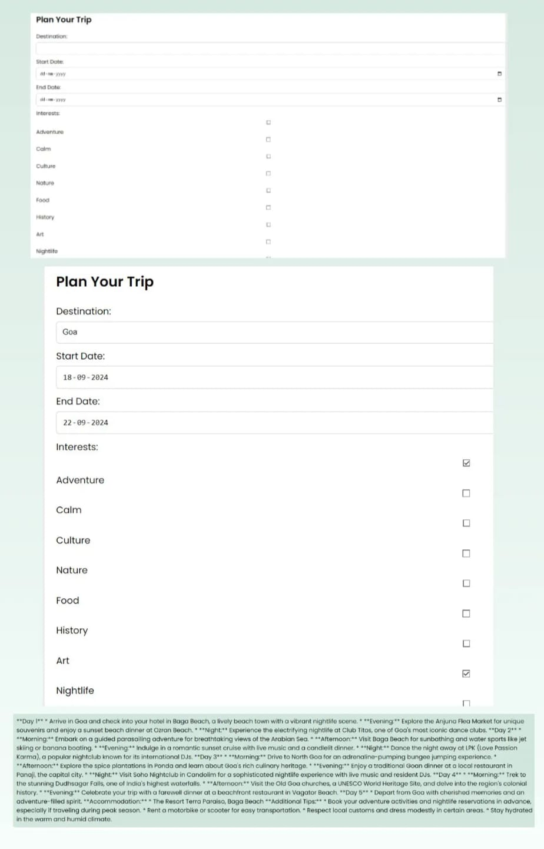
Personal Itinerary Planning:

Slide 13
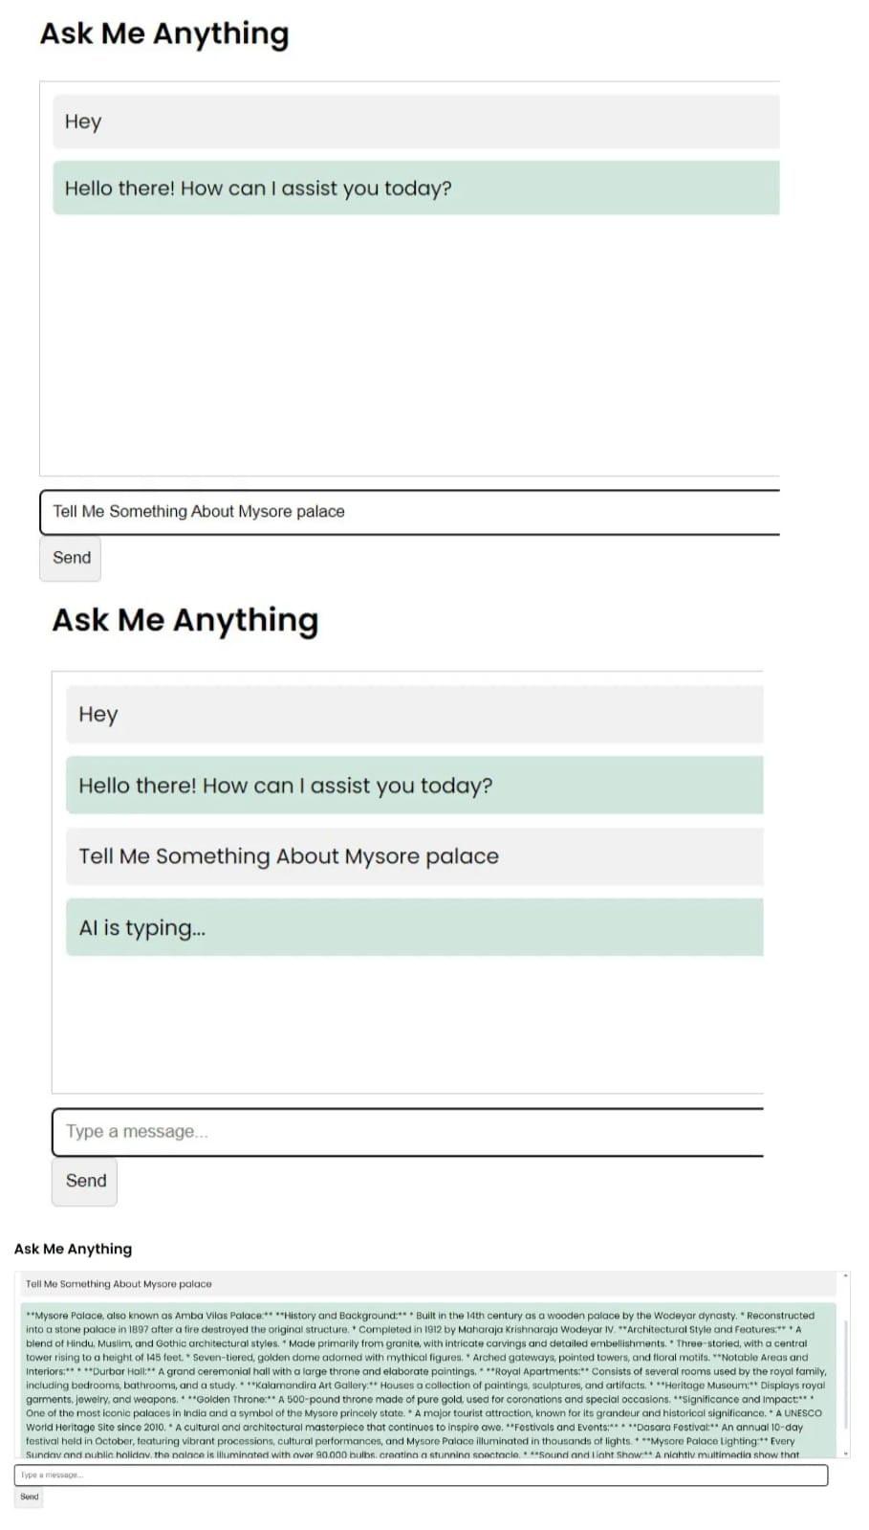
Chatbot:
Slide no: 09

Slide 14
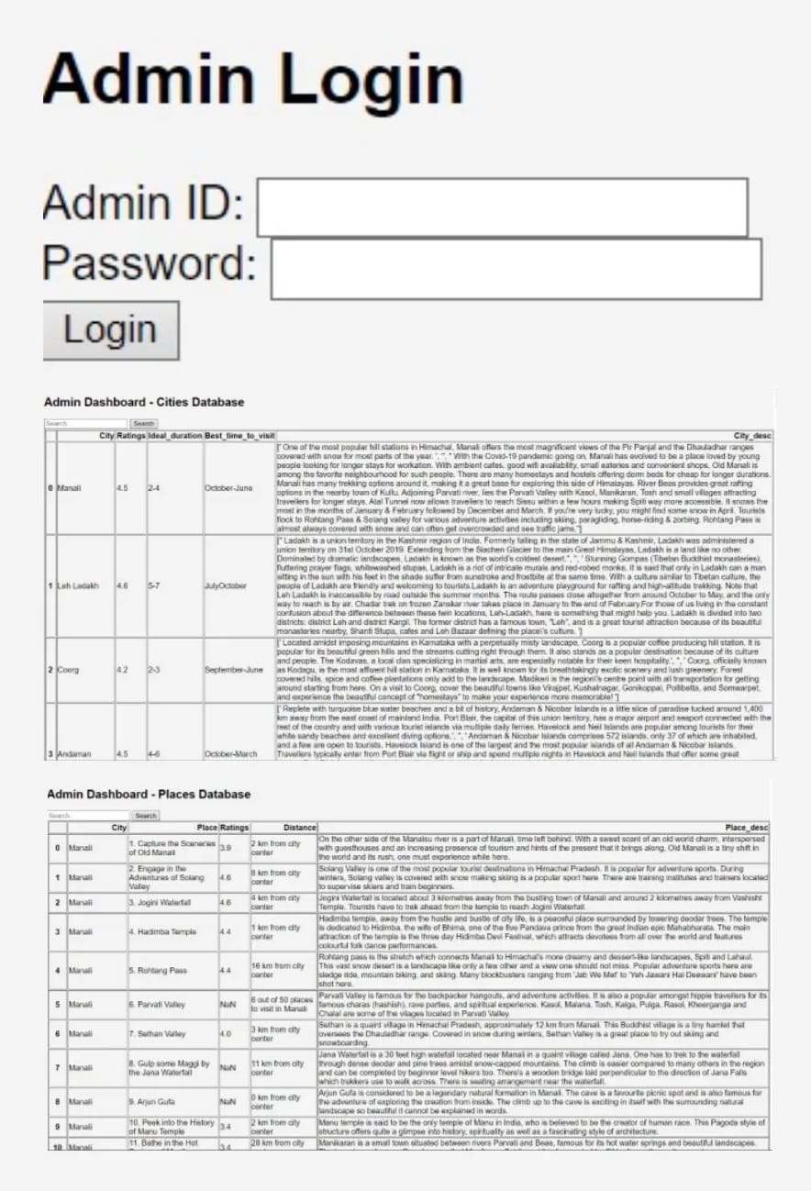
Admin Login and Admin Dashboard:

Slide 15
LIMITATIONS
Dependency on External APIs
Internet Connectivity
Data Accuracy and Completeness
Scalability
User Privacy and Data Security
Limited Customization

Slide 16
FUTURE ENHANCEMENT
In-App Social Media Connectivity:
Traveler Community: Create a community feature within the app where users can connect with other solo travelers.
User Profiles: Allow users to create detailed profiles, share travel stories, photos, and itineraries.
Travel Stories: Enable users to post travel experiences, read others' stories, comment, and like posts.
2. Augmented Reality (AR) Integration:
Interactive Maps: Enhance maps with AR to show directions, points of interest, and historical facts when users point their camera at landmarks.

Slide 17
3. User Feedback and Reviews:
Review System: Integrate a review system for itineraries, destinations, accommodations, and activities.
Personalized Recommendations: Utilize user feedback to refine and personalize future travel suggestions.
4. Flight and Hotel Booking Integration:
Booking APIs: Integrate with APIs for flight and hotel bookings to offer seamless reservation capabilities.
Comparison Tools: Provide tools for users to compare prices, read reviews, and book directly within the app.
Additional Services: Include options for booking rental cars, local tours, and travel insurance.

Slide 18
Enhanced Personalization:
Advanced AI: Improve AI algorithms to offer more personalized travel recommendations based on user preferences and behavior.
Tailored Deals: Present users with customized travel deals, discounts, and promotions. Preference Analysis: Continuously analyze user data to refine suggestions and enhance the user experience.
Voice Assistance:
Voice Commands: Integrate voice recognition technology for hands-free interaction with the app.

Slide 19
CONCLUSION
In conclusion, the AI-powered solo travel companion app has shown it can greatly improve solo travel. It provides personalized travel recommendations and real-time data, making trip planning easier. The interactive chatbot gives instant local tips and support, enhancing the travel experience. With its easy-to-use design and helpful features, the app empowers solo travelers to explore confidently. By continuing to focus on user needs and technology, this app can become a reliable companion for solo travelers everywhere.

Slide 20
THANK YOU
Slide no: 10

