Slide 1
Employee Data Analysis using Excel
STUDENT NAME: S.Raveena
REGISTER NO: 312217033(F57C13CD17AB5BBA57140E64A2D40490)
DEPARTMENT: B.Com General
COLLEGE: Shri Krishnaswamy College for women.

Slide 2
PROJECT TITLE
USING PIVOT TABLES FOR EMPLOYEE TURNOVER ANALYSIS

Slide 3


AGENDA
Problem Statement
Project Overview
End Users
Our Solution and Proposition
Dataset Description
Modelling Approach
Results and Discussion
Conclusion
3/21/2024 Annual Review

Slide 4

PROBLEM STATEMENT
Employee turnover is a significant challenge for organisations, leading to increased recruitment costs, loss of valuable knowledge, and disruptions in team dynamics
.The challenge is to identify the patterns and factors contributing to employee turnover, which could help in devising strategies to retain talent.

Slide 5

PROJECT OVERVIEW
This project aims to leverage pivot tables as a tool for analysing employee turnover within an organisation.
By organising and summarising large datasets, pivot tables can reveal insights about turnover rates, identifying trends across different departments, tenure, job roles, and other demographic factors.
The project seeks to provide actionable insights to reduce turnover and improve employee retention strategies.
.

Slide 6

WHO ARE THE END USERS?
HR Departments: To identify trends in employee turnover and implement strategies to retain employees.-
Senior Management: To understand the impact of turnover on the business and allocate resources effectively.
Team Leaders: To address turnover at the team level and improve employee engagement.

Slide 7

OUR SOLUTION AND ITS VALUE PROPOSITION
Dynamic Analysis : The ability to drill down into specific categories and time periods.
Trend Identification : Highlighting departments or roles with high turnover rates.
Root Cause Analysis : Identifying potential reasons for turnover to inform retention strategies.

Slide 8
Dataset Description
Employee Demographics : Age, gender, tenure, department, job role, and education level.
Employment History: Start and end dates, promotions, and job changes within the organisation.
Turnover Information: Reason for leaving, voluntary or involuntary termination, and exit interview feedback.
Performance Data: Annual reviews, performance ratings, and attendance records.

Slide 9

THE "WOW" IN OUR SOLUTION
Wow, this solution provides a clear and practical approach to tackling employee turnover using pivot tables, making it easy for HR and management to gain deep insights and take actionable steps to improve retention. The dynamic analysis and trend identification features are particularly impressive, allowing organisations to pinpoint exactly where their retention efforts need to focus
3/21/2024 Annual Review
9

Slide 10
MODELLING
Pivot Table Construction: Creating pivot tables to summarise and analyse the data across various dimensions, such as department, tenure, and turnover reasons.-
Trend Analysis: Using pivot tables to identify trends and patterns in the data.-
Correlation Analysis: Examining relationships between turnover and factors like job satisfaction, performance, and tenure.
10

Slide 11
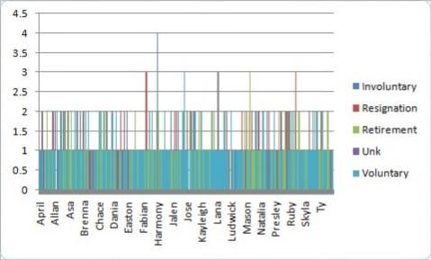
RESULTS
11

Slide 12
conclusion
The analysis using pivot tables has provided valuable insights into the factors driving employee turnover within the organisation.
Key trends and areas of concern have been identified, allowing HR and management to focus on specific strategies to improve retention.
Future work could involve more advanced analytics, such as predictive modelling, to further enhance the understanding of employee turnover dynamics.

