Slide 1
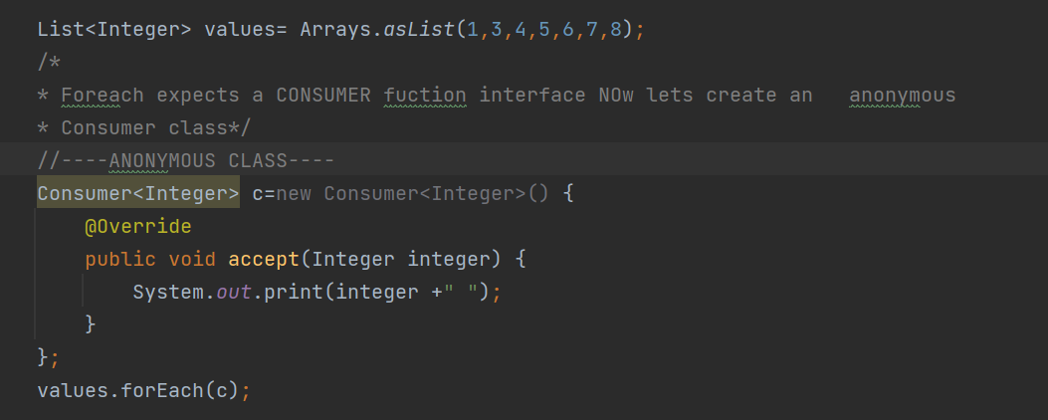
How it works
Foreach expects an interface Class called Consumer and it has only one function named accept(T t)

Slide 2
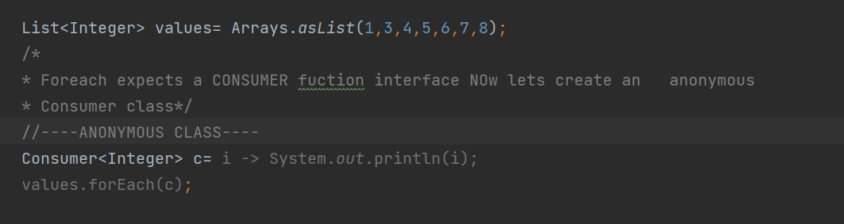
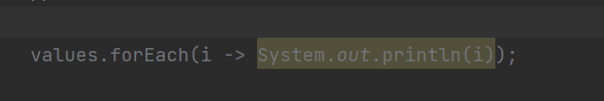
Lambda Exp
VERSION 1
VERSION 2

Slide 3
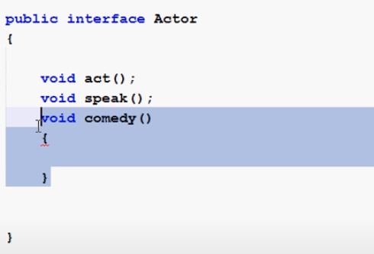
Do not modify the Interfaces in java 1.7

Slide 4
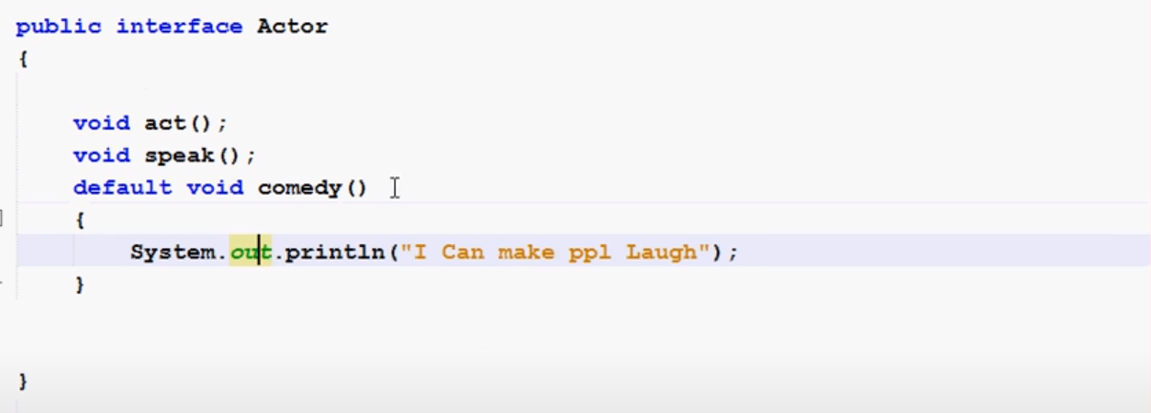
In java 1.8 we can define functions in Interfaces with the ‘default’ key world.

Slide 5
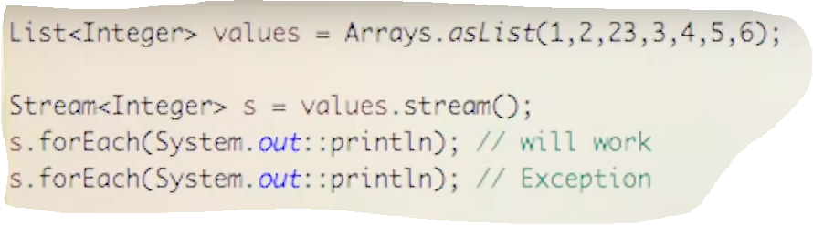
You can not use streams multiple times

Slide 6
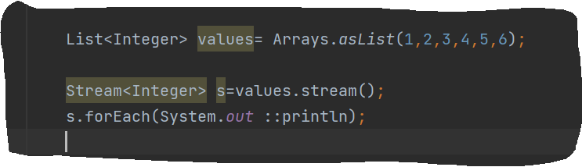
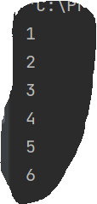
Streams 101 ☺
Foreach
Source Code
Output

Slide 7
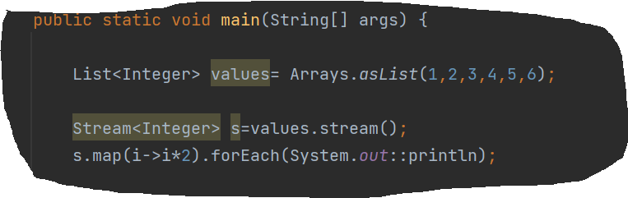
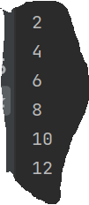
MAP Double The Stream
Source Code
Output

Slide 8
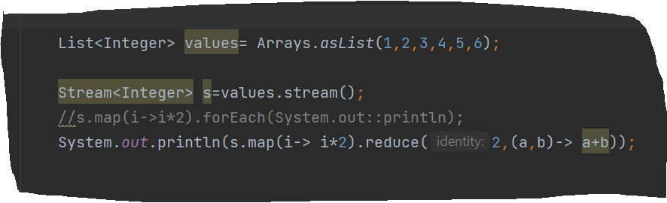
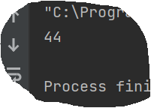

Reduce
Source Code
The initial value of the result(result =2;result+=a+b)
Output

Slide 9
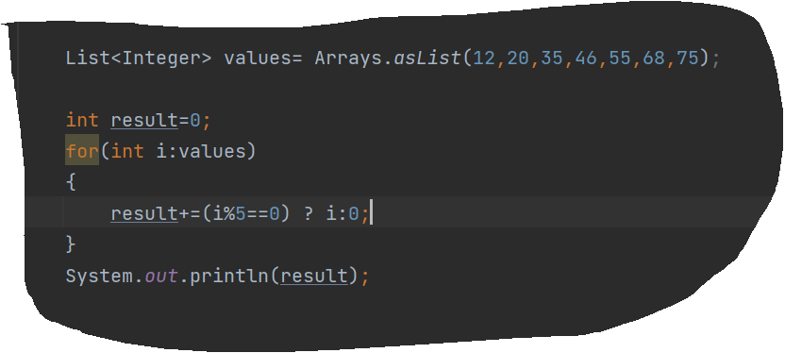
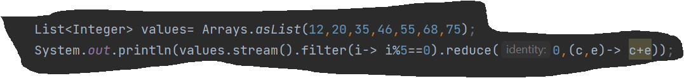
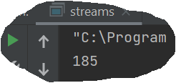
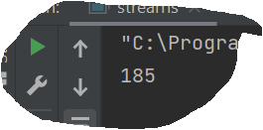


Filters
Source Code
Source Code
Turn into stream
Internal iteration
Output
Output

Slide 10
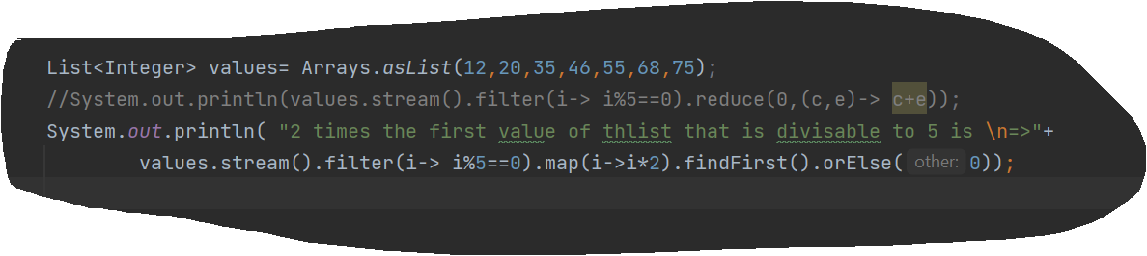
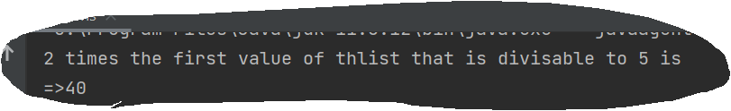

Find First & or else(If not exist gives 0)
Source Code
Output

Slide 11
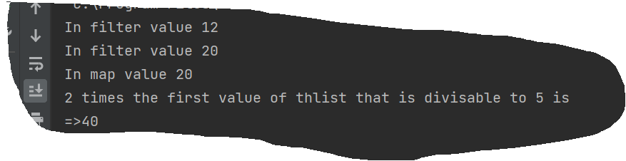
Lazy Evaluation
In intermediate operations like filter or map it is not actually applies to the whole stream, but when the terminal operation like findfirst() called it applies the operation to the necessary elements
In our example it looks to the first element it is not divisible to 5 then checks second element and then goes to the MAP function. After that gives the output

