Slide 1





Task-level Parallelism
İnt arr
FINISH
ASYNC
Sum1=sum(firstHalf)
FINISH
S1
S2
S3
S4
S5
ASYNC
Sum2=sum(secondHalf)
ASYNC
ASYNC
total=sum1+sum2
Has to wait the other operations

Slide 2
async⟨stmt1⟩=causes the parent task (i.e., the task executing the async statement) to create a new child task to execute the body of the async, ⟨stmt1⟩, asynchronously (i.e., before, after, or in parallel) with the remainder of the parent task.
finish ⟨stmt2⟩= causes the parent task to execute ⟨stmt2⟩, and then wait until ⟨stmt2⟩ and all async tasks created within ⟨stmt2⟩ have completed.
finish {
async S1; // asynchronously compute sum of the lower half of the array
S2; // compute sum of the upper half of the array in parallel with S1
}
S3; // combine the two partial sums after both S1 and S2 have finished

Slide 3
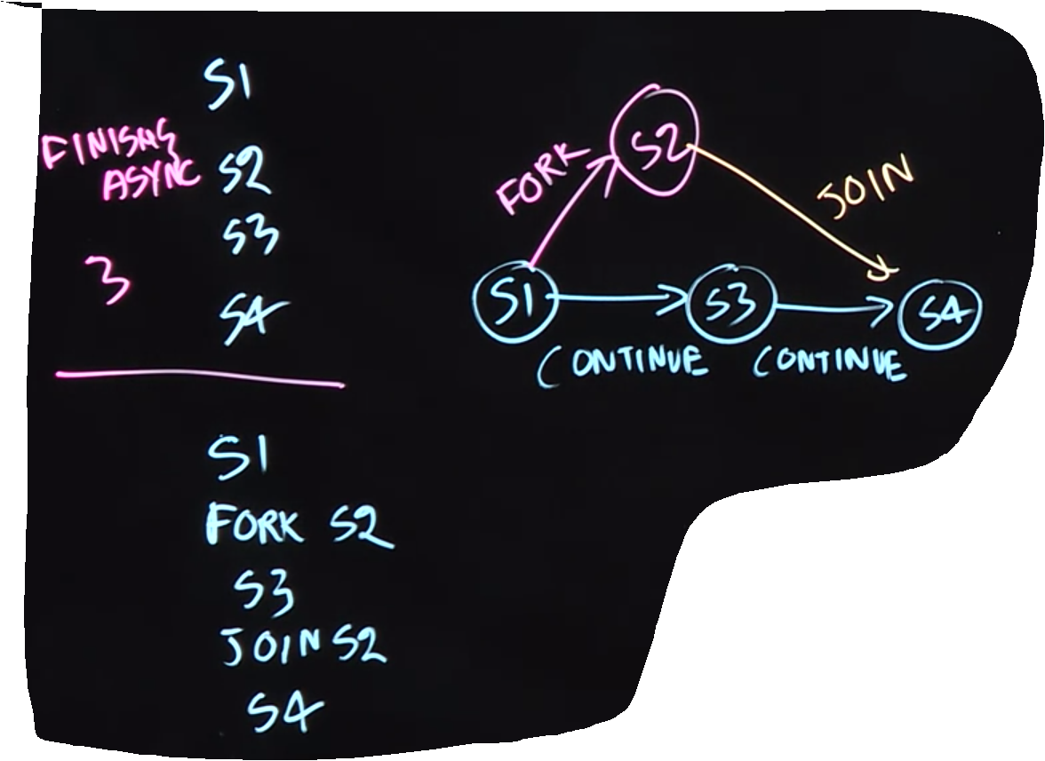




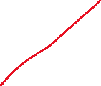
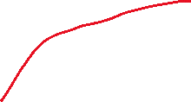






Fork-Join
Computation Graph
Ideal Par=Work/Span
Same Representation
Work=22
Span=12(Longest Path)

Slide 4
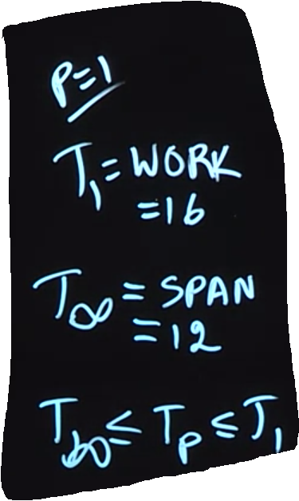
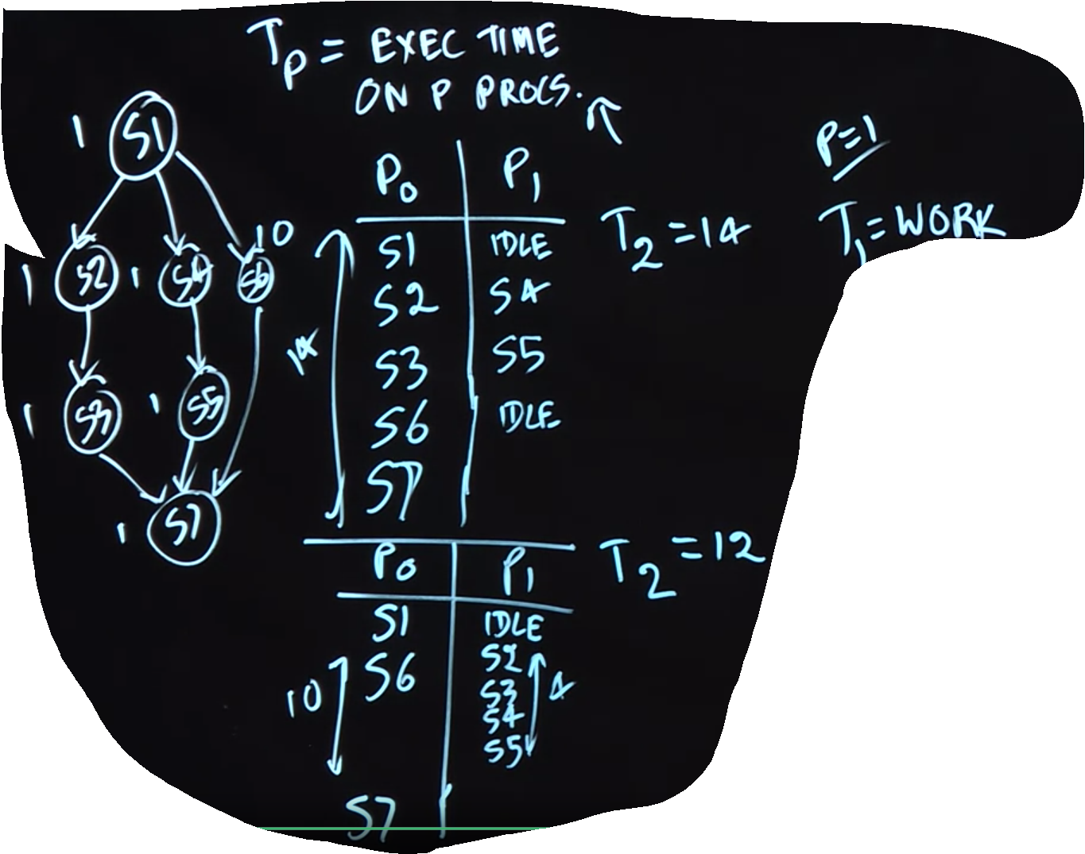








We see that there is a problem S6 takes longer time we can arrange another Schedule.
1Processor
INF Processor
Boundry of a pararllel execution time
New Schedule is more resonable
SppedUP=
SppedUP=

Slide 5
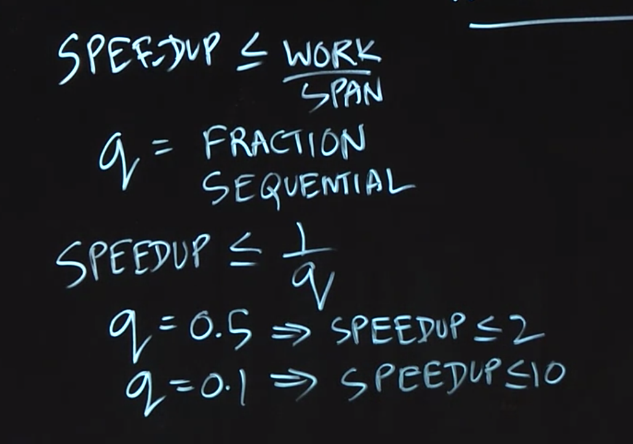
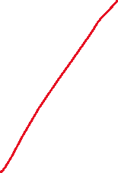


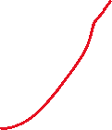



Amdahl’s LAW

