Slide 1
AI-Driven Monitoring and Predictive Maintenance
on Smart Home Media Server
Ryan Arnzen • Prasiddha Neupane
Most interesting finding
A LSTM model with a 30-minute window had the lowest test error, this shows that our recent server scrapes held enough short-term data to forecast the next 10-minute CPU average better than a longer 60-minute window or using a flattened MLP model baseline
0.0316
10,081
0
Best Test RMSE
Rows
Missing values
30-minute LSTM
one week at 1-minute steps
complete telemetry export with preprocessing
CSC 426 Deep Learning • Smart Media Server ML Monitoring • 1

Slide 2
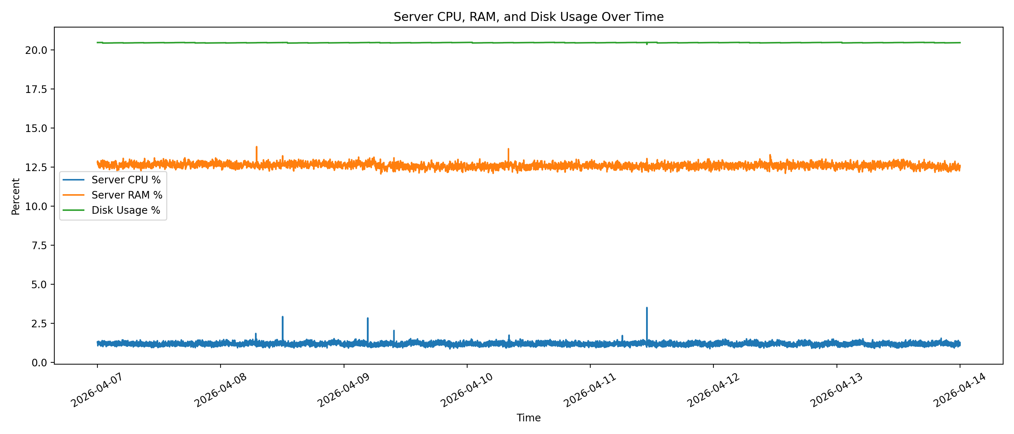
Problem and Motivation
Move from reactive monitoring to short predictive maintenance.
Smart home media servers run multiple services continuously: media streaming, cloud storage, reverse proxy, metrics, and container workloads. Waiting until CPU or memory is already high makes alerts reactive instead of predictive.
Goal: predict short-term CPU load from recent server and container telemetry.
Why CPU: it reflects system stress during transcoding, background services, and container activity.
Value: early warning, anomaly detection, and automated maintenance triggers.
CSC 426 Deep Learning • Smart Media Server ML Monitoring • 2

Slide 3
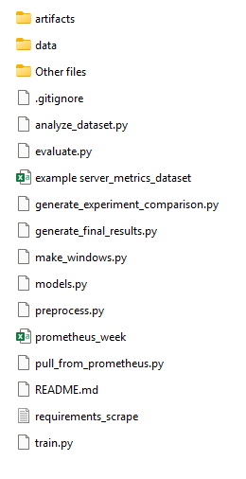
End-to-End Approach
Prometheus export
Dataset analysis
Preprocess + scale
Window generation
Train models
Evaluate results
HTTP API, CSV
stats + plots
time split, target
30/60-min windows
LSTM + MLP
MAE/MSE/RMSE
Deliverables in Zip file
Raw and processed CSV/NumPy datasets, metadata, and reusable scripts.
Dataset tables, seven visualizations, model checkpoints, learning curves, predictions, residuals, and final comparison charts.
Three experimental settings: MLP 60-min, LSTM 60-min, and LSTM 30-min.
CSC 426 Deep Learning • Smart Media Server ML Monitoring • 3

Slide 4
Dataset Overview
One week of server telemetry collected from Prometheus at a one-minute interval.
10,081
7
60 sec
0
Rows
Columns
Step
Missing
2026-04-07 to 2026-04-14
timestamp + six metric columns
fixed interval after export
complete raw export
Raw columns and roles
The label is the future 10 minute average CPU value.
The other metrics are used as model input features.
timestamp datetime64[UTC] time index
server_cpu_percent float64 target source
server_ram_percent float64 feature
disk_usage_percent float64 feature
container_ram_mb float64 feature
container_cpu_cores float64 feature
container_count int64 feature
CSC 426 Deep Learning • Smart Media Server ML Monitoring • 4

Slide 5
Methodology: Models and Learning Objective
Compared a flattened neural baseline to a LSTM recurrent model.
MLP baseline
Training objective
Flatten(60×6) → Dense(64, ReLU) → Dense(32, ReLU) → Dense(1)
25,217 trainable parameters
Tests whether a non-sequential model can learn from recent metrics. Turns data into a list of numbers and outputs one predicted CPU value.
Minimize MSE using Adam optimizer; report MSE, MAE, and RMSE on the held-out test split.
MSE = (1/n) Σ(yᵢ − ŷᵢ)²
MAE = (1/n) Σ|yᵢ − ŷᵢ|
RMSE = √MSE
LSTM primary
LSTM(64) → Dropout(0.2) → Dense(16, ReLU) → Dense(1)
19,233 trainable parameters
Processes server telemetry in time order, preserving sequential data.
Why this comparison: if the LSTM beats the MLP, the order of our readings is adding useful forecasting.
CSC 426 Deep Learning • Smart Media Server ML Monitoring • 5

Slide 6
Dataset Statistics and Target Variable
The target is the future 10-minute average CPU usage.
Statistical snapshot
Metric Mean Std Min Max
CPU % 1.168 0.104 0.864 3.514
RAM % 12.611 0.149 12.067 13.818
Disk % 20.473 0.010 20.366 20.496
Container RAM MB 1749.203 21.196 1672.477 1831.941
Container CPU cores 0.082 0.006 0.063 0.107
Container count 10.000 0.000 10.000 10.000
Target formula
target_t = mean(cpu_{t+1}, …, cpu_{t+10})
Our target is the average of the next 10 CPU readings. CPU stayed relatively low and stable, so the focus is on short term forecasting rather than high-load classification.
No missing values were present in the raw export; preprocessing still included fixed-interval resampling and forward/backward filling.
CSC 426 Deep Learning • Smart Media Server ML Monitoring • 6

Slide 7
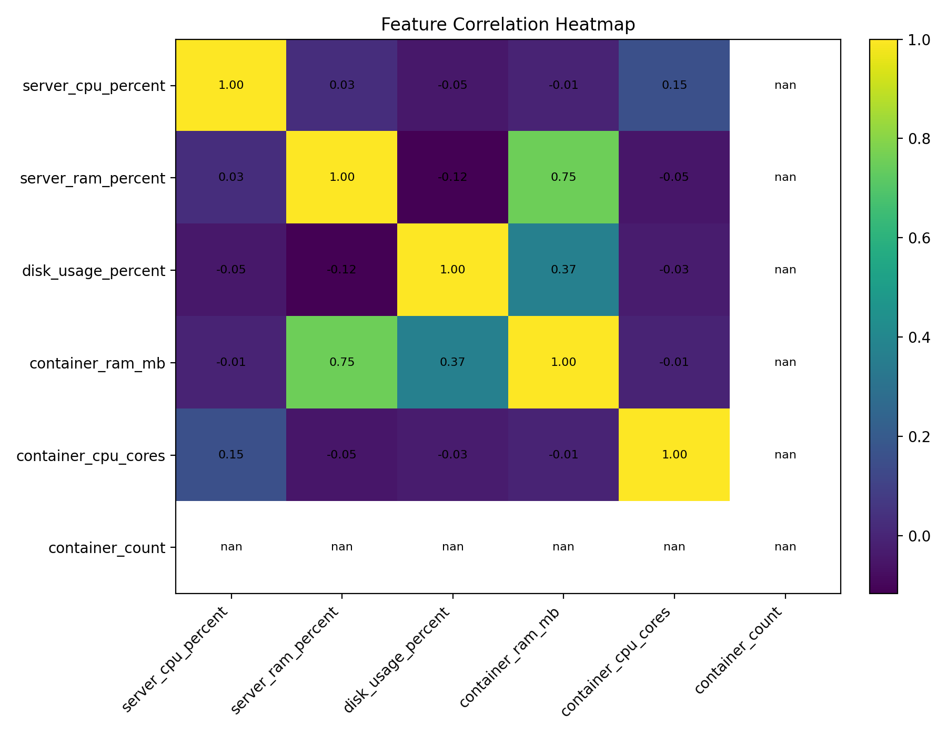
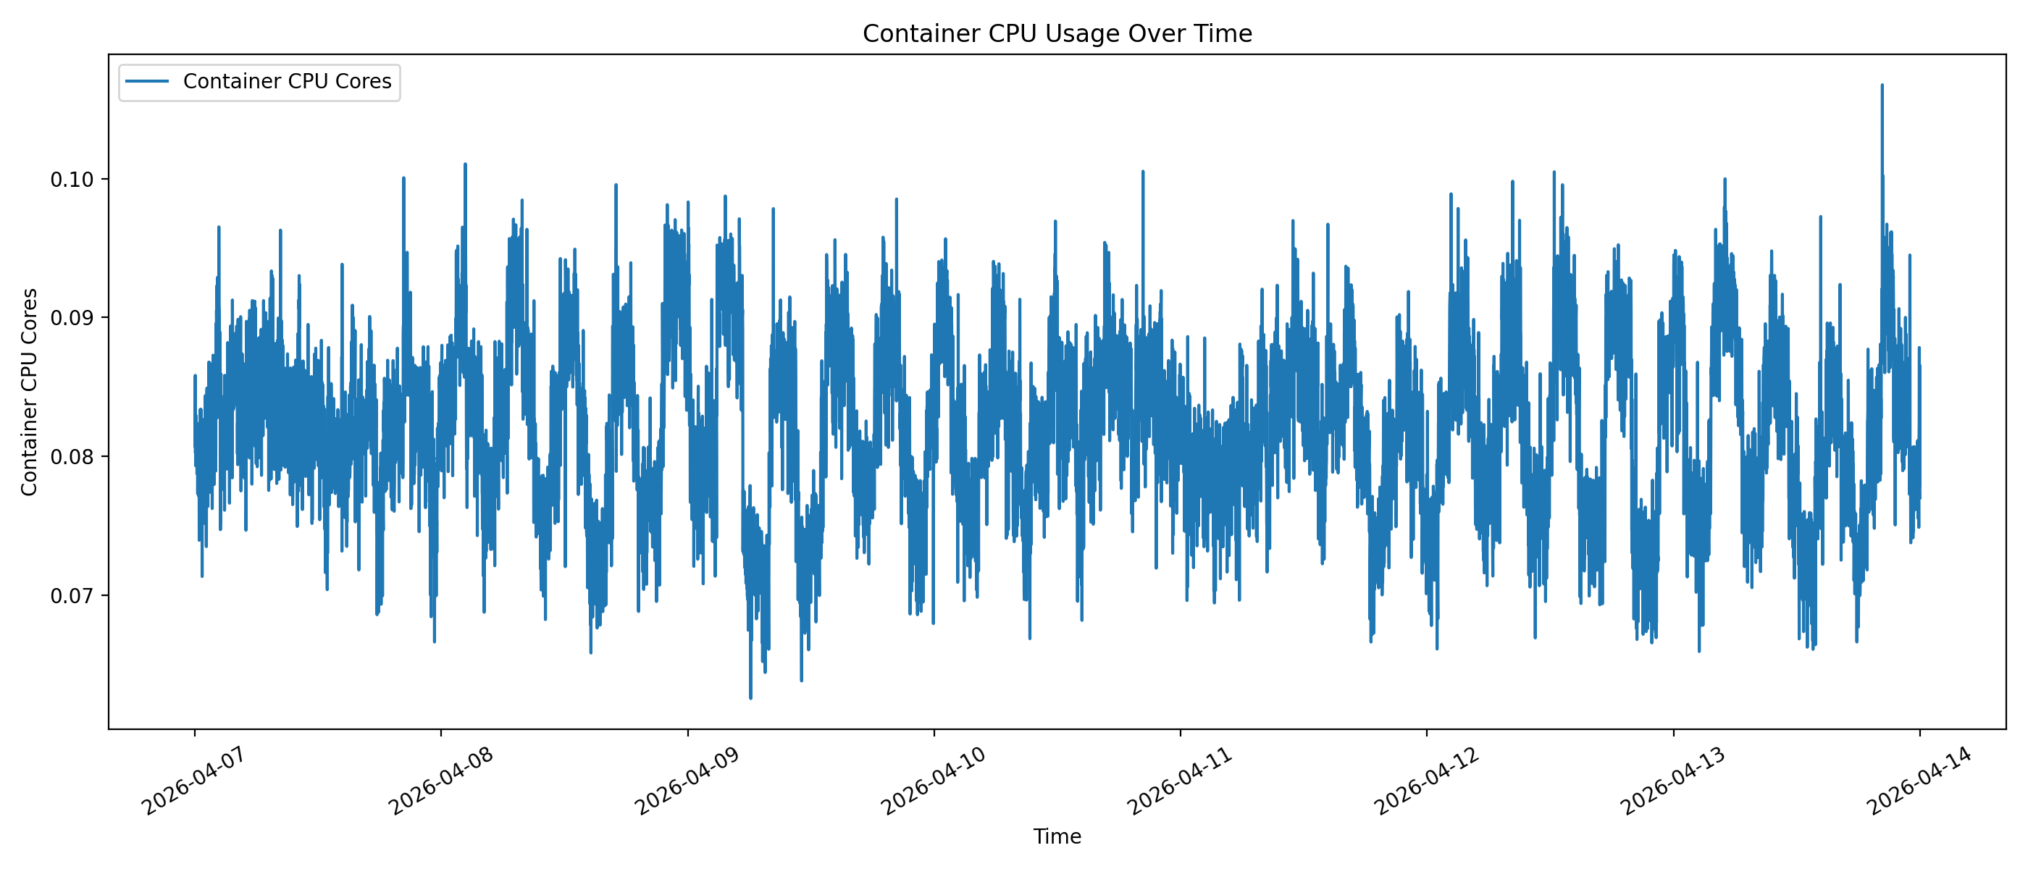
Feature Relationships
Correlation and container CPU plots help explain what the model has and hasn’t learned.
Key reading
Container CPU has visible minute-to-minute movement that provides useful sequential data for our model.
Container count is constant, so it contributes no variance in this run.
Low variance in some of our features shows why RMSE values are small and why our future implementations need to test with higher server loads.
CSC 426 Deep Learning • Smart Media Server ML Monitoring • 7

Slide 8
Experimental Setup
Time-ordered splits and training-set-only scaling avoid future-data leaks.
Experiment matrix
Features were standardized using training-set mean and standard deviation.
Early stopping monitored validation loss with patience of 5 epochs.
Best model checkpoints and final Keras models were saved per run.
Training ran on CPU because CUDA drivers were not available on the laptop.
MLP baseline MLP 60-min window next 10-min avg CPU
LSTM primary LSTM 60-min window next 10-min avg CPU
LSTM shorter window LSTM 30-min window next 10-min avg CPU
7,051
1,510
1,510
Train rows
Validation rows
Test rows
first 70% by time
middle 15% by time
final 15% by time
CSC 426 Deep Learning • Smart Media Server ML Monitoring • 8

Slide 9
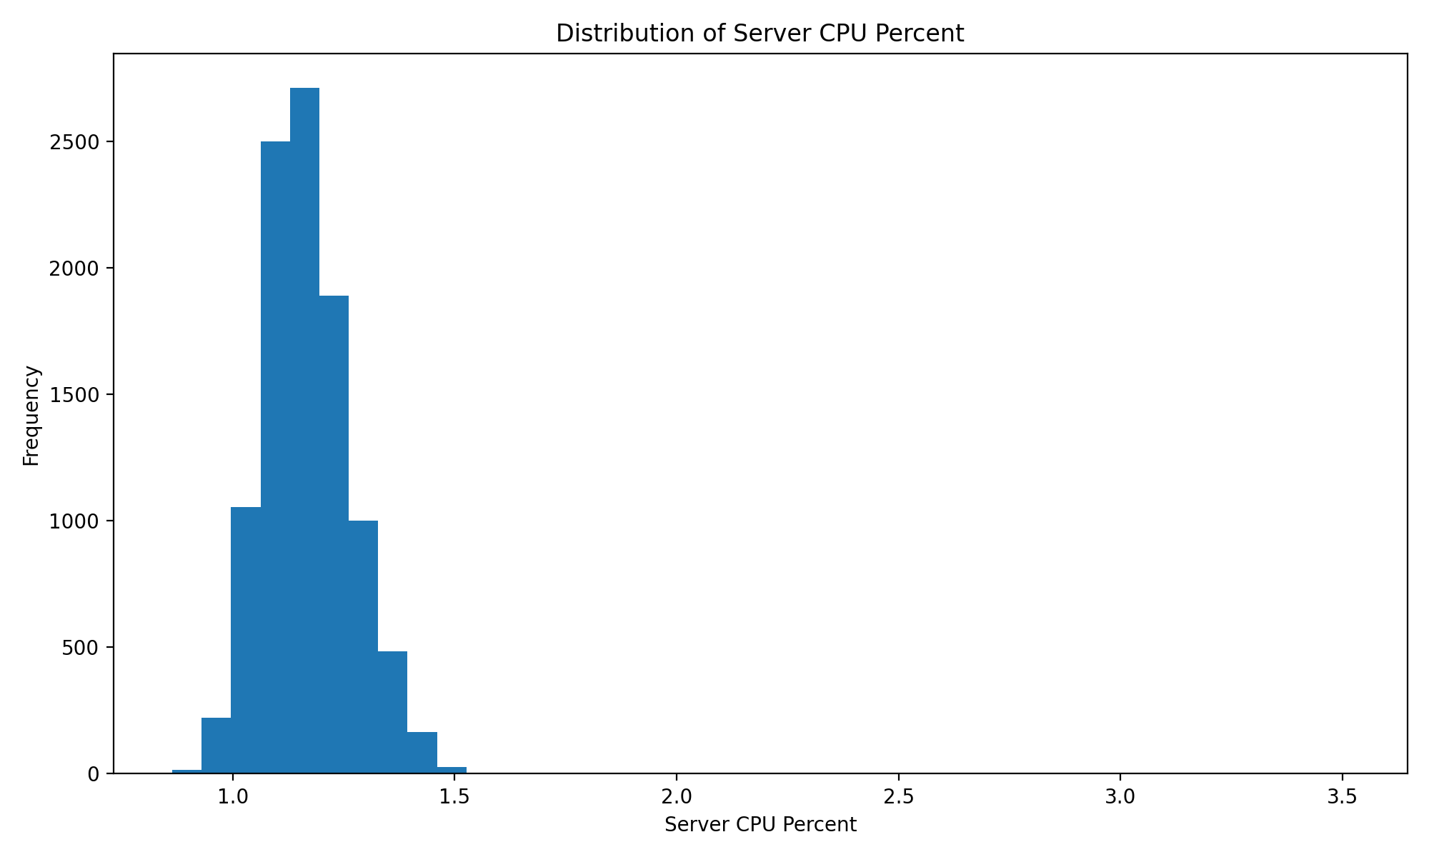
Exploratory Data Analysis: System Load Over Time
EDA shows stable server behavior with small CPU spikes and light container RAM movement.
Interpretation
CPU was very stable and did not fluctuate drastically throughout the data that was collected.
CSC 426 Deep Learning • Smart Media Server ML Monitoring • 9

Slide 10
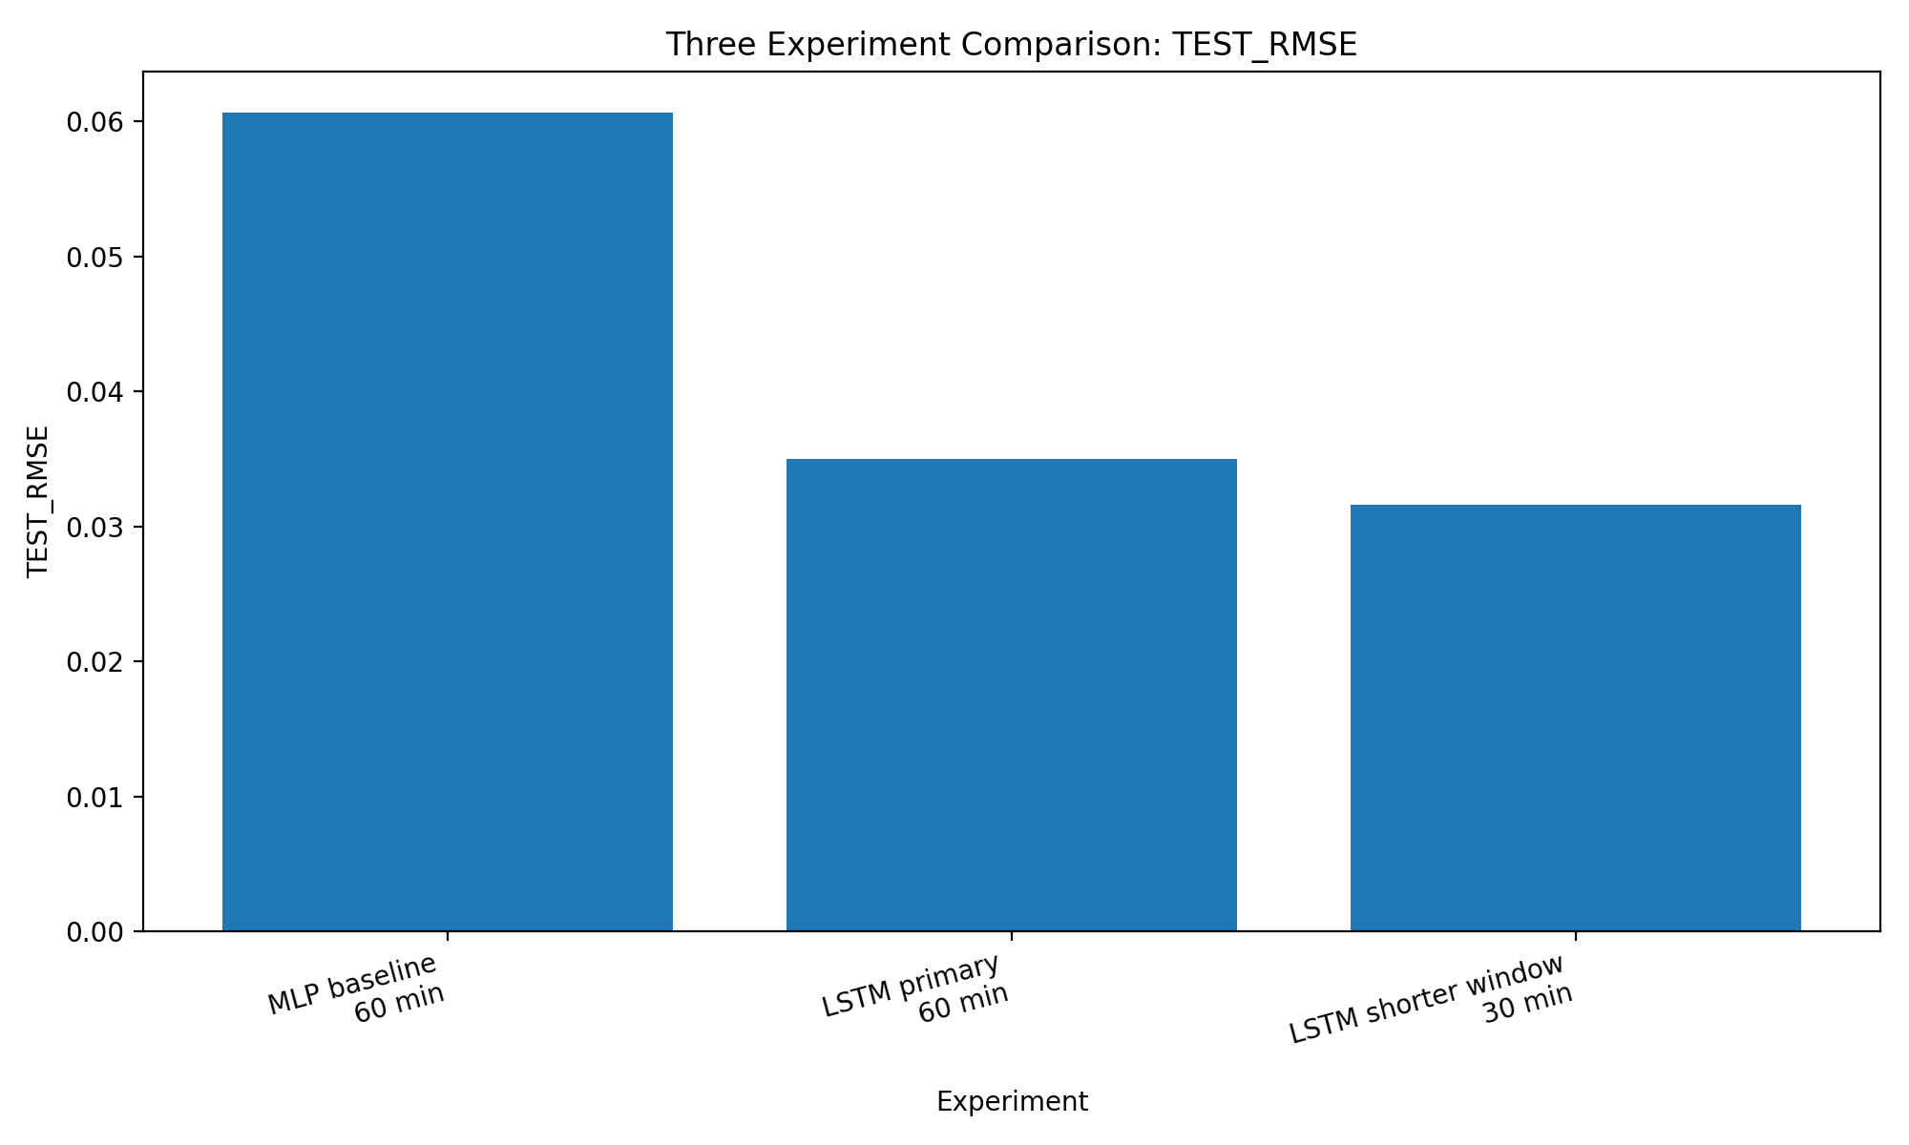
Results: Performance Comparison
The LSTM models beat the MLP baseline; the 30-minute LSTM was best in the final experiment set.
Test metrics
Experiment MSE MAE RMSE
MLP 60-min 0.003684 0.048503 0.060694
LSTM 60-min 0.001227 0.028447 0.035034
LSTM 30-min 0.001000 0.026000 0.031600
Conclusion
LSTM 60-min reduced RMSE by about 42% relative to the MLP baseline.
LSTM 30-min improved again, suggesting the most recent half hour was enough context for this stable workload.
The improvement supports modeling for short-term server telemetry prediction.
CSC 426 Deep Learning • Smart Media Server ML Monitoring • 10

Slide 11
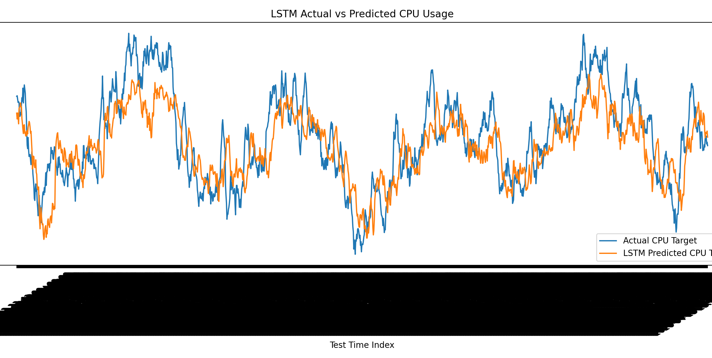
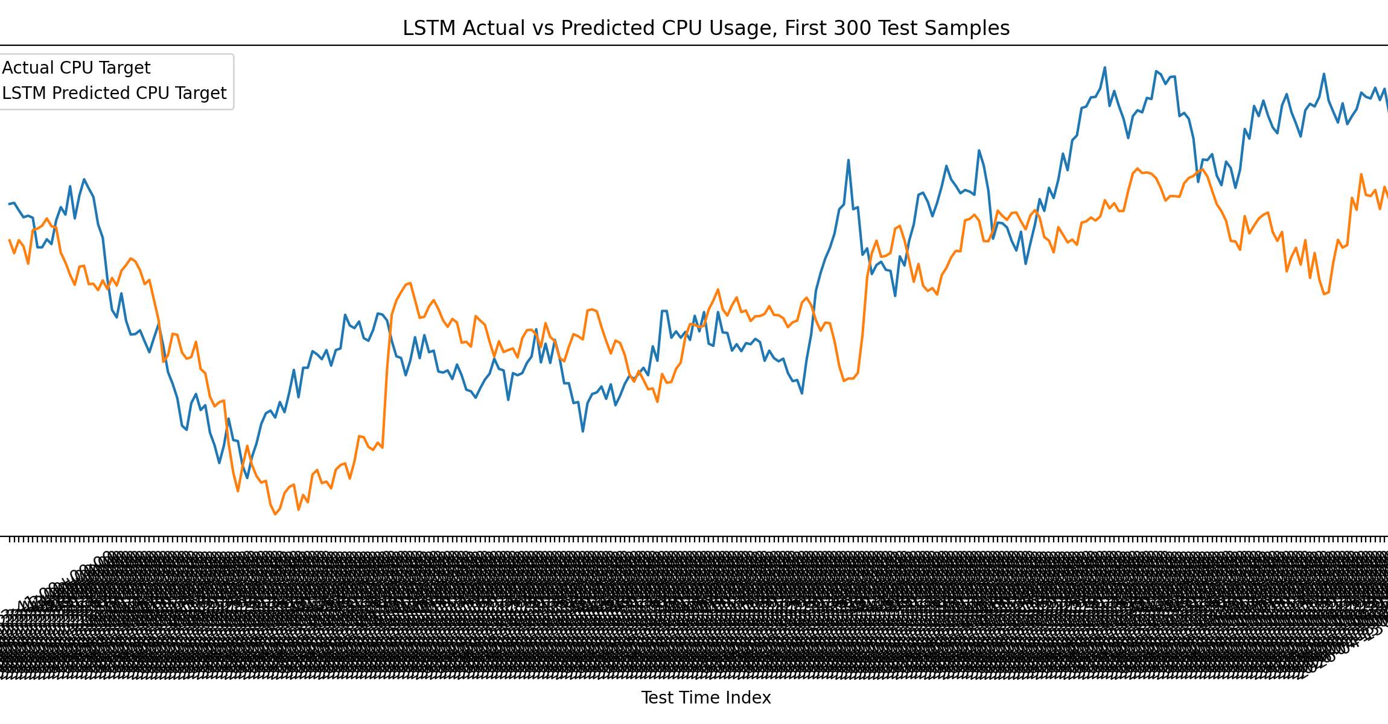
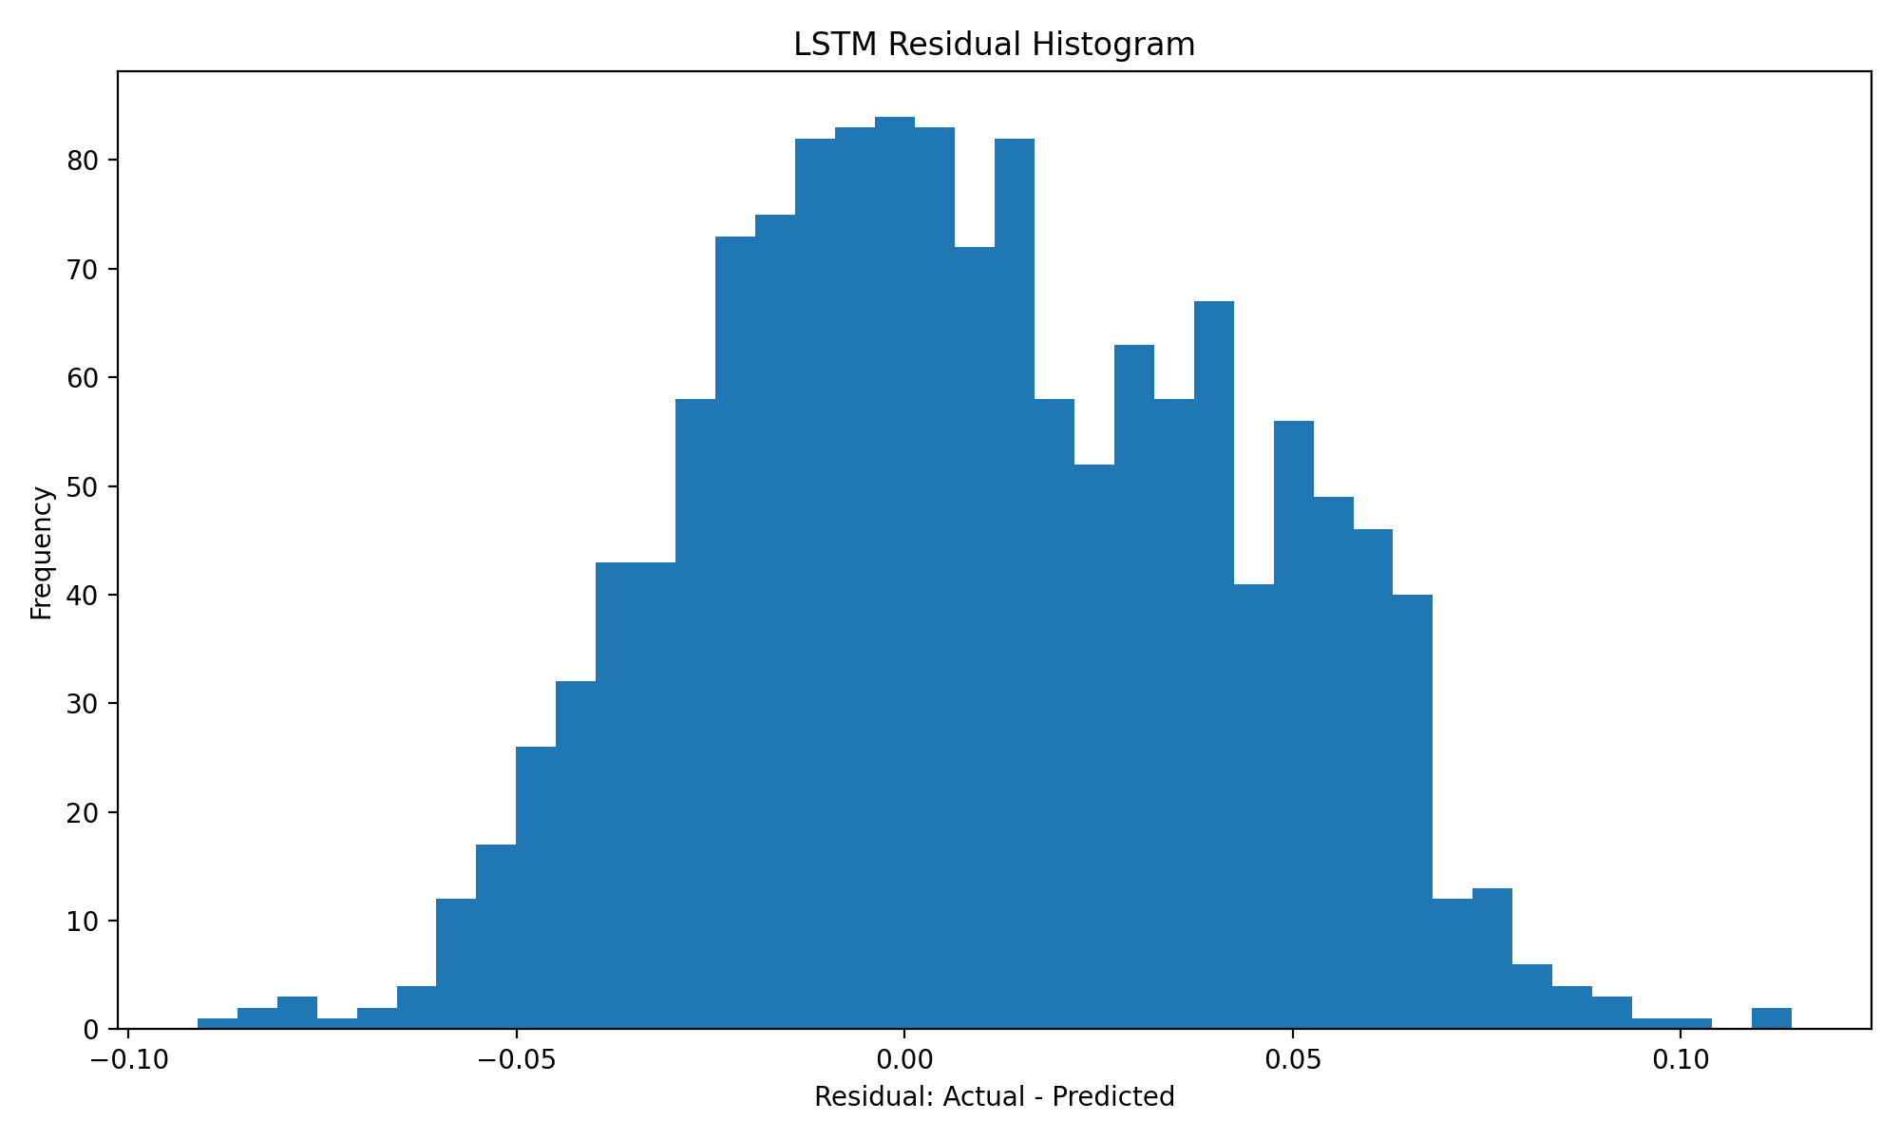
Results: LSTM Predictions and Residuals
Visual checks show the model tracks the low-load CPU pattern, with small residuals.
After training, the LSTM predictions generally track the actual held-out test telemetry pattern.
The set of predictions based on the first 300 samples had larger variations in predictions.
The residual histogram shows most prediction errors are distributed near zero. Most errors are within about ±0.05 CPU percentage points, and nearly all are within about ±0.10 CPU percentage points.
CSC 426 Deep Learning • Smart Media Server ML Monitoring • 11

Slide 12
Discussion, Limitations, and Future Work
Positive results
Limitations
End-to-end pipeline is complete: export, analyze, preprocess, window, train, evaluate, and save artifacts.
LSTM sequence modeling consistently improves over the flattened MLP baseline.
The project uses server telemetry collected from the home media environment.
Only one week of data was tested, and CPU load was mostly low.
The target is CPU forecasting, not full predictive maintenance classification yet.
Container count did not vary, limiting feature diversity.
Next improvements
Collect longer time spans and including high-load events: Plex transcoding, backups, downloads, and simulated stress tests.
Turn forecasts into decisions: anomaly score, overload warning, and maintenance action.
Deploy the model as a container for real time data analysis.
CSC 426 Deep Learning • Smart Media Server ML Monitoring • 12

Slide 13
Individual Contributions and References
Final slide for accountability, sources, and Q&A.
Ryan Arnzen
References / tools used
Server architecture and integration
Data collection pipeline
Feature engineering
Model implementation baseline
Git Documentation
Tools:
Git, Python, NumPy, pandas, matplotlib, TensorFlow/Keras.
Prometheus HTTP API, and Prometheus telemetry export.
GitHub repo: RyArnz/csc426-smart-media-ml-monitoring.
TensorFlow/Keras: https://www.tensorflow.org/-
pandas: https://pandas.pydata.org/
NumPy: https://numpy.org/
matplotlib: https://matplotlib.org/
Prometheus HTTP API: https://prometheus.io/docs/prometheus/latest/querying/api/
Prasiddha Neupane
Exploratory data analysis
Model evaluation and comparison
Performance analysis and visualization
Documentation and final report preparation
CSC 426 Deep Learning • Smart Media Server ML Monitoring • 13

Slide 14
QUESTIONS?

