Slide 1
split graphs into eaten vs havent eaten
localize graphs around mealtimes, 4 hours

Slide 2
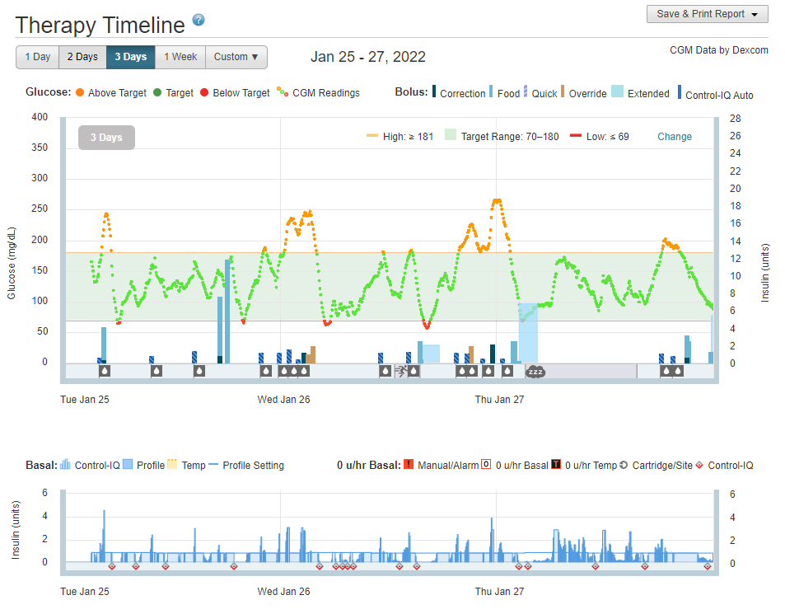

Slide 3
