Slide 1
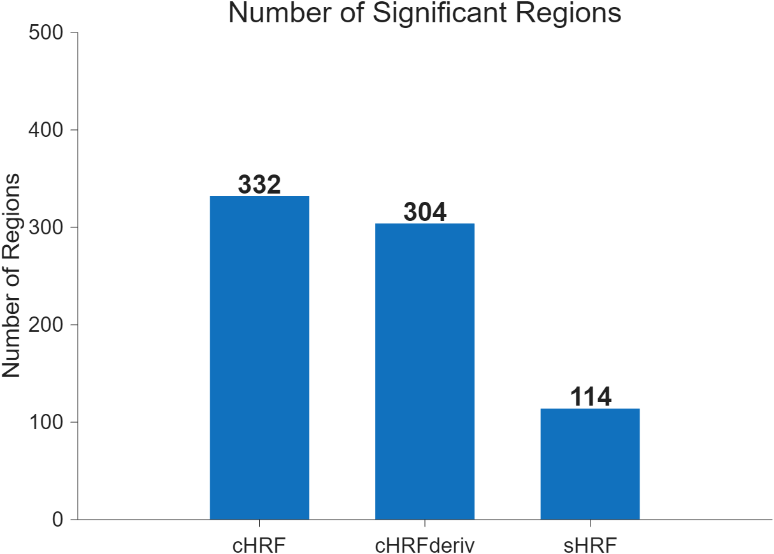
Results from Working Memory
WM interaction: (2-back body − 0-back body) − (2-back faces − 0-back faces)

Slide 2
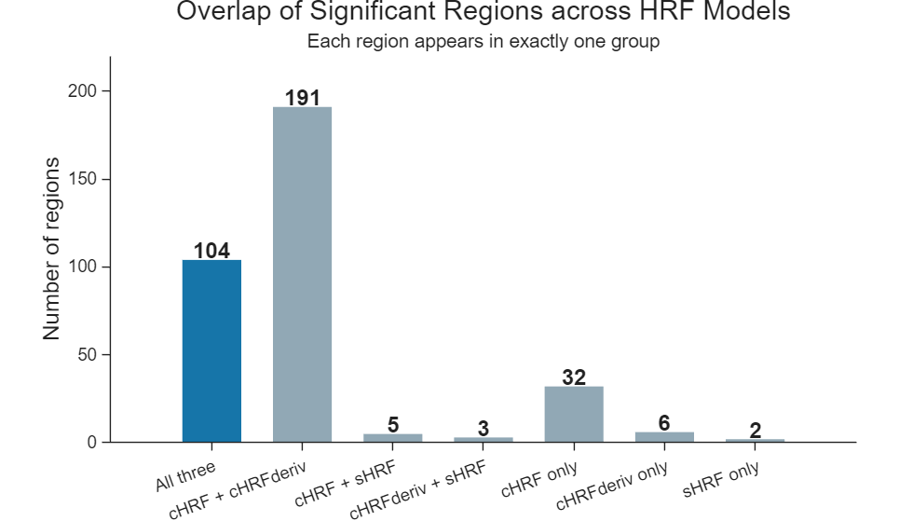
104 regions are significant in all three models
343 regions are significant in at least one
146 regions are significant in none

