Slide 1
Software Quality: Engineering Practices
Alexander Botsiev
March 2016

Slide 2
Software Development Life Cycle
Exploration
&
Planning
Requirements
Design
Development
Testing
Release
&
Deployment
Notes:
Quality should be ensured on all stages

Slide 3
Integrated Development Environment
IDE
Smart Code Completion
Refactoring
Inspections &
Profiling
Version Control
Testing
Debugging

Slide 4
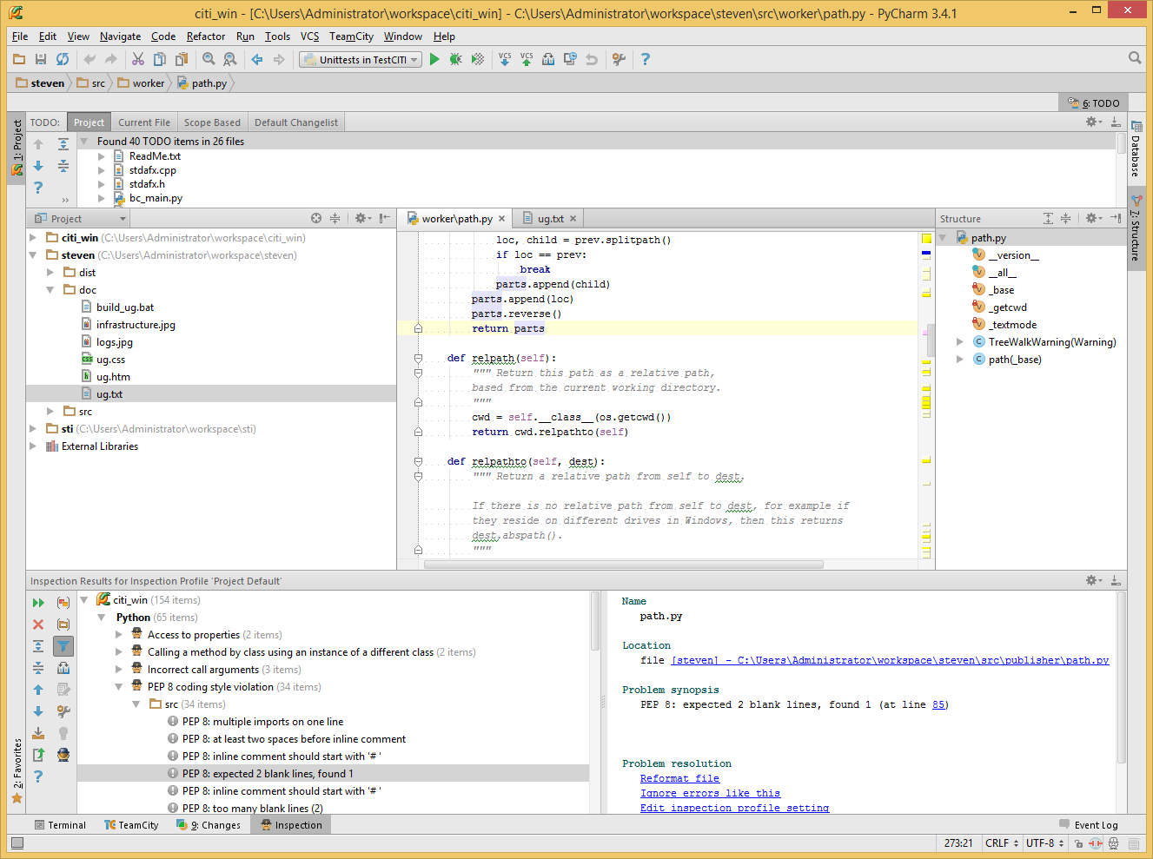
JetBrains* PyCharm* IDE

Slide 5
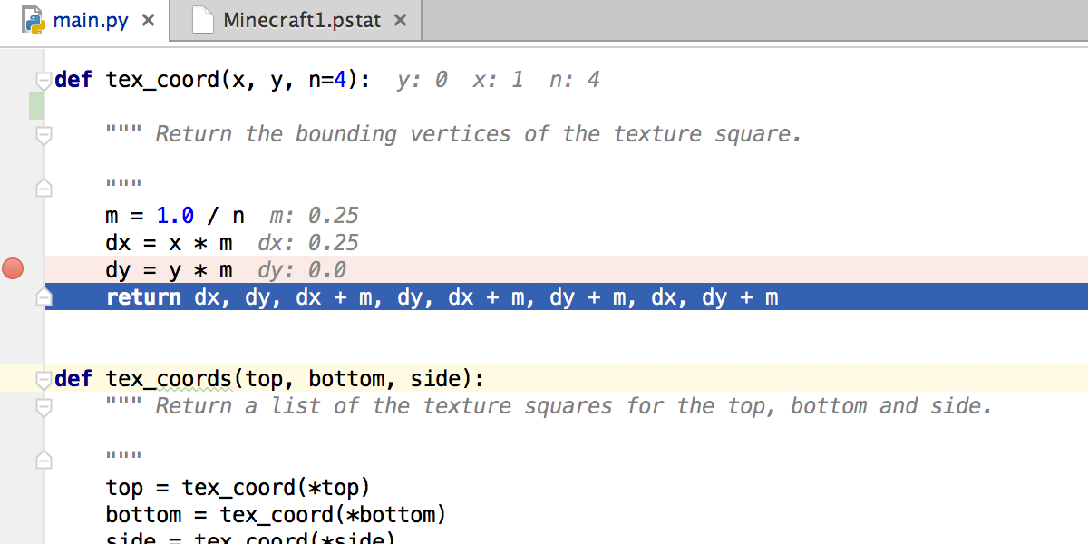
Inline Debugging

Slide 6
Code Inspections and Review
Quality
Design
Maintainability
Testability
Mentoring

Slide 7
Major Testing Types Definition
Unit testing
Automated
(code-based)
Engineering team
Smallest pieces of system in isolated environment
Integration testing
Mostly automated
(using internal API)
Quality Assurance team
Set of comp-s works together according to technical specs
System testing
Manual & automated
(end-user scenarios)
Validation team
Entire system works in a production-like environment
Notes:
Focus on proactive approaches -> unit testing first of all

Slide 8
Unit Testing - Concept
Application Code
Unit Test(s) Code
Test Runner

Slide 9
Unit Testing – Application Code
def multiply(a, b):
return a * b

Slide 10
Unit Testing – Test Code
def test_num_mul_1(self):
self.assertEqual(multiply(2, 2), 4)
def test_str_1(self):
self.assertEqual(multiply('a', 3), 'aaa')
def test_input_1(self):
self.assertRaises(TypeError, multiply, 'a', 'b')

Slide 11
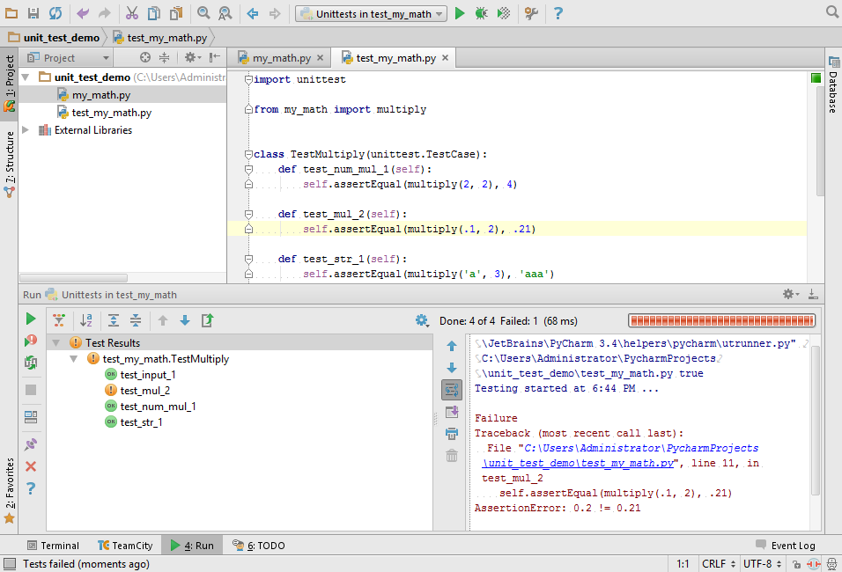
Unit Testing – Test Runner

Slide 12
Unit Testing – Mocks (Application)
def remove(file_name):
if os.path.exists(file_name):
os.remove(file_name)

Slide 13
Unit Testing – Mocks (Test)
@mock.patch('my_remove.os.path.exists')
def test_remove(self, mock_exists):
with mock.patch('my_remove.os.remove') as mock_remove:
test_path = r'C:\remove_me_please.txt'
mock_exists.return_value = False
my_remove.remove(test_path)
self.assertFalse(mock_remove.called, 'Remove unexpectedly called')
mock_exists.return_value = True
my_remove.remove(test_path)
mock_remove.assert_called_with(test_path)

Slide 14
Unit Testing Fundamentals
Consistent
Atomic
Obvious
Single Responsibility
Isolated (dependency injection)
Notes:
Consistency – no changes in code = the same result
Atomic – no dependencies between tests
Obvious – as simple as possible and informative
Single Responsibility – one behavior = one test
Isolation – no test methods in production code (dependency injection + mocks)

Slide 15
Continuous Integration (CI)
Code
Build
Test
Deploy
Notes:
Productization -> customers receive not code, but product (package). Need to ensure repeatability for product builds… Also need to have daily build for internal testing needs. + deployment process (may be complex, including pre-production, etc.)

Slide 16
CI Development Process

Slide 17
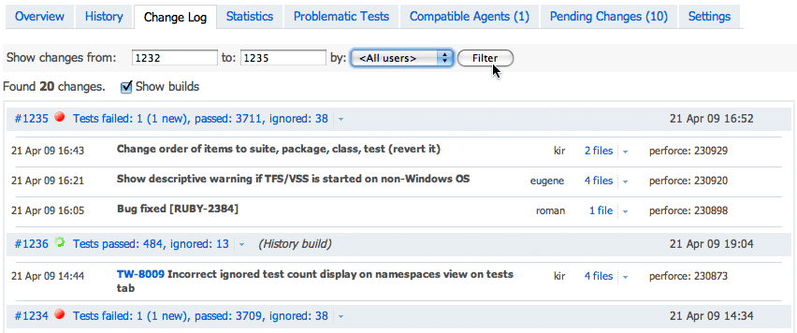
CI – Change Management

Slide 18
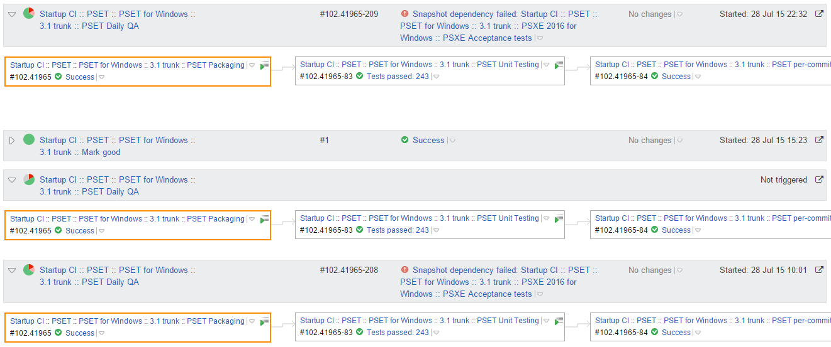
CI – Build Chains

Slide 19
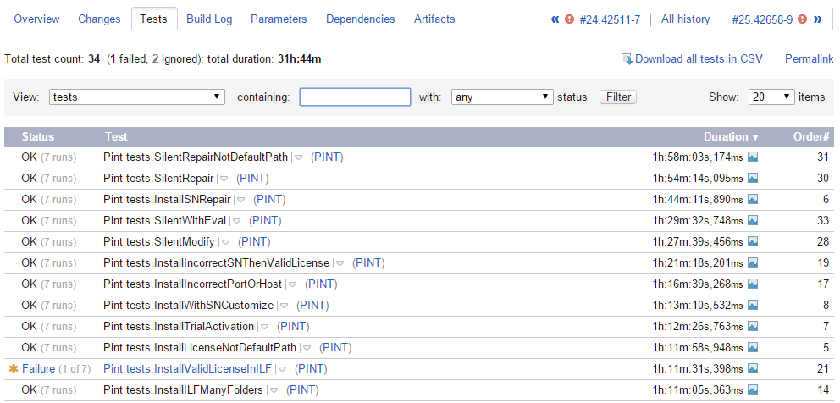
CI – Test Results

Slide 20
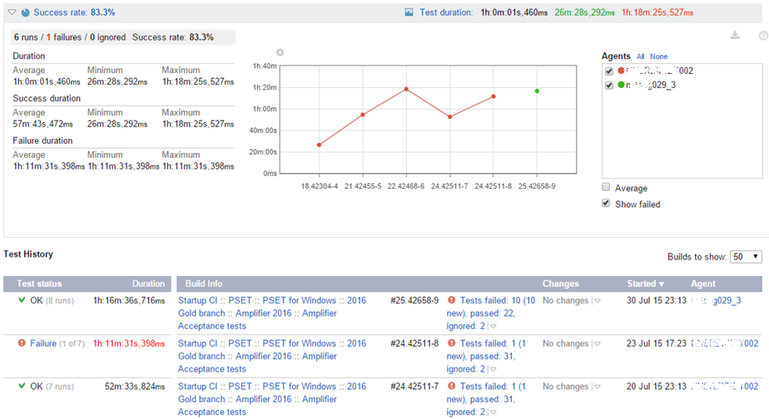
CI – Test History

Slide 21
Q&A
Notes:
АНКЕТЫ!!!

