Slide 1

Analyzing the Interplay Between Employment, Socioeconomic Factors, and Mental Health Using SQL
Saumya karn

Slide 2
Introduction
Context: The Importance of Mental Health
Global Concern:
Mental health is crucial for overall well-being, impacting how individuals think, feel, and act.
Mental health disorders affect millions worldwide, leading to significant social and economic consequences.
Stigma and underdiagnosis often prevent people from seeking help.
Purpose:
Exploring Relationships:
Investigate how employment status and socioeconomic factors influence mental health conditions.
Utilize SQL to analyze a real-life dataset and uncover patterns.
Goals:
Provide insights that can inform interventions and policies to improve mental health outcomes.

Slide 3
Objectives
Research Questions:
How does employment status affect the prevalence of mental health conditions like anxiety and depression?
Is there a correlation between annual income levels and mental health issues?
Does education level influence the occurrence of mental health conditions?
How do age and gender impact mental health conditions across different regions?
What is the relationship between internet access, living arrangements, and mental health?
Do individuals with employment gaps experience higher rates of mental health issues?
Is there an association between the type of device used and the prevalence of mental health conditions?

Slide 4
Dataset Overview
Description:
A comprehensive dataset containing information on:
Employment status
Mental health conditions
Socioeconomic factors
Demographics
Source & Ethics:
Data Source:
Collected from mental health surveys and employment records.
Ethical Considerations:
Personal identifiers anonymized to protect privacy.
Complies with data protection regulations.

Slide 5
Dataset Overview(continued..)
Variables:
Employment Status:
employed_at_least_part_time
unemployed
gap_in_resume
gaps_in_months
Annual_income_in_USD
Mental Health Conditions:
Anxiety
Depression
Mood_swings
Panic_attacks
Compulsive_behavior
Tiredness
Socioeconomic Factors:
Education
regular_access_to_internet
live_with_parents
Device_Type
Demographics:
Age
Gender
Region

Slide 6
Methodology
Data Analysis Approach:
SQL for Data Extraction and Analysis:
Queried the dataset to explore relationships between variables.
Used SQL to handle large data efficiently and perform complex queries.
Techniques:
Aggregate Functions:
AVG, COUNT, SUM for calculating statistics.
Conditional Statements:
CASE statements to handle categorical data.
Grouping and Ordering:
GROUP BY to segment data.
ORDER BY to sort results.
Joins and Subqueries:
Combined data for multifaceted analysis.

Slide 7
Research Scenarios
Scenario 1: Impact of Internet Access on Mental Health
Scenario 2: Employment Status and Mental Health
Scenario 3: Regional Differences in Mental Health
Scenario 4: Gender Differences in Mental Health
Scenario 5: Relationship Between Mental Health and Employment Gaps
Scenario 6: Mental Health and Living Arrangements
Scenario 7: Mental Health and Education Level
Scenario 8: Device Usage Patterns and Their Association with Mental Health Symptoms Scenario 9: Correlation Between Multiple Mental Health Conditions and Employment Status
Scenario 10: Analyzing Mental Health Trends Across Different Age Groups
Scenario 11: Exploring the Relationship Between Education Level and Employment Gaps
Scenario 12: Assessing the Impact of Unemployment on Internet Access and Mental Health

Slide 8
Scenario 1: Impact of Internet Access on Mental Health
Finding:
Regular access to the internet may be correlated with the prevalence of mental health conditions such as anxiety, depression, and tiredness.
Solution:
Understanding how internet access influences mental health can aid in developing strategies to promote digital well-being and manage screen time effectively.

Slide 9
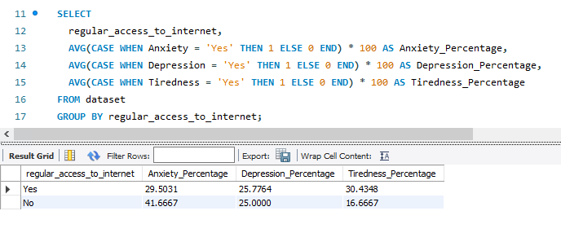
CODE AND OUTPUT

Slide 10
Scenario 2: Employment Status and Mental Health
Finding:
Unemployment is associated with higher prevalence rates of mental health conditions such as anxiety and depression.
Solution:
Implementing support programs for unemployed individuals can help address mental health challenges associated with joblessness.

Slide 11
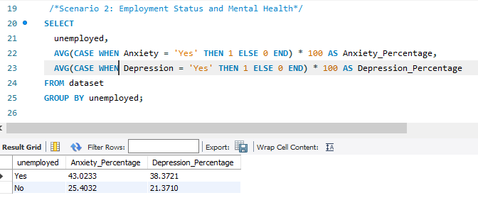
CODE AND OUTPUT

Slide 12
Scenario 3: Regional Differences in Mental Health
Finding:
The prevalence of mental health conditions varies across different regions.
Solution:
Targeted regional mental health initiatives can be developed to address specific needs in areas with higher prevalence.

Slide 13
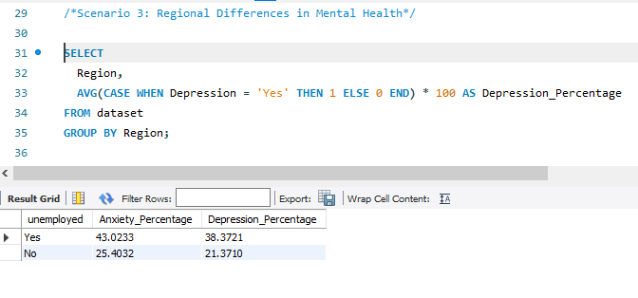
CODE AND OUTPUT

Slide 14
Scenario 4: Gender Differences in Mental Health
Finding:
Mental health condition prevalence differs between genders.
Solution:
Gender-specific mental health services can address these differences effectively.

Slide 15
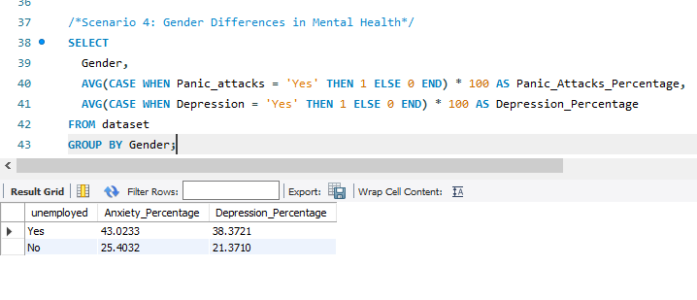
CODE AND OUTPUT

Slide 16
Scenario 5: Relationship Between Mental Health and Employment Gaps
Finding:
Individuals with longer employment gaps might experience higher rates of mental health conditions such as anxiety and depression.
Solution:
This insight can guide interventions and support programs for individuals with longer employment gaps, helping them manage their mental health.

Slide 17
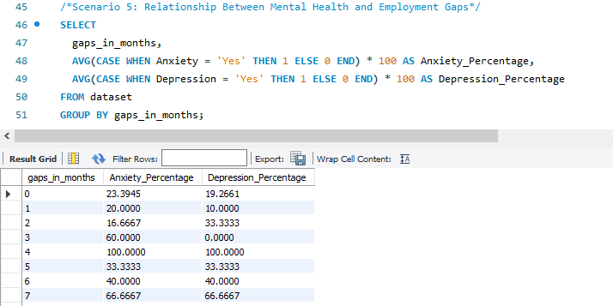
CODE AND OUTPUT

Slide 18
Scenario 6: Mental Health and Living Arrangements
Finding:
Living arrangements, such as living with parents, might influence the prevalence of mental health conditions.
Solution:
Insights can inform family support initiatives and mental health interventions for individuals living with parents.

Slide 19
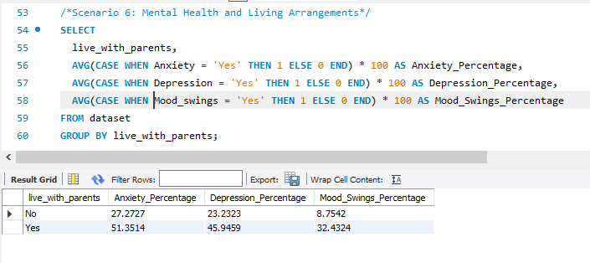
CODE AND OUTPUT

Slide 20
Scenario 7: Mental Health and Education Level
Finding:
Individuals with lower education levels might experience higher rates of mood swings and other mental health issues.
Solution:
Educational institutions can develop mental health awareness and support programs tailored to different education levels.

Slide 21
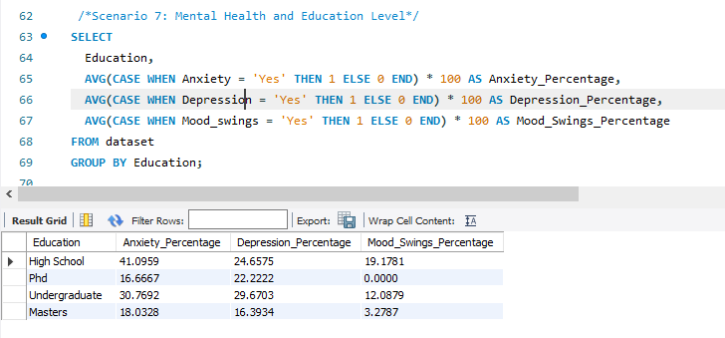
CODE AND OUTPUT

Slide 22
Scenario 8: Device Usage Patterns and Their Association with Mental Health Symptoms
Finding: Certain device usage patterns are associated with higher prevalence of specific mental health symptoms like compulsive behavior and lack of concentration.
Solution:
Insights can inform digital well-being strategies, encouraging healthier device usage habits to mitigate associated mental health symptoms.

Slide 23
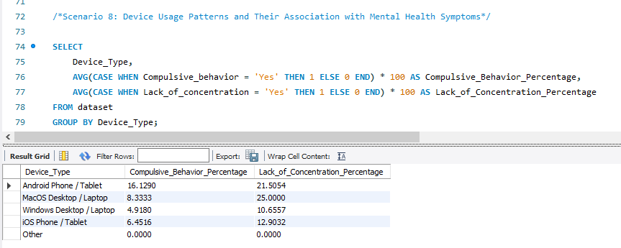
CODE AND OUTPUT

Slide 24
Scenario 9: Correlation Between Multiple Mental Health Conditions and Employment Status
Finding:
Individuals experiencing multiple mental health conditions are more likely to be unemployed or have gaps in their employment history.
Solution:
Understanding the compounded effect of multiple mental health conditions on employment helps in crafting comprehensive support programs that address not just one but multiple co-occurring conditions.

Slide 25
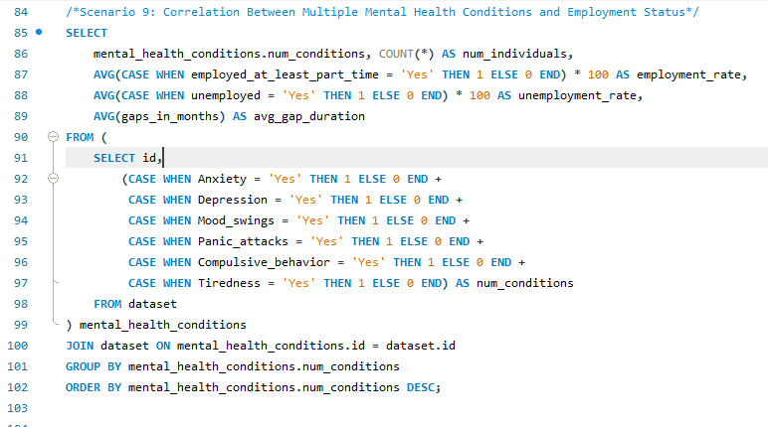
CODE AND OUTPUT

Slide 26
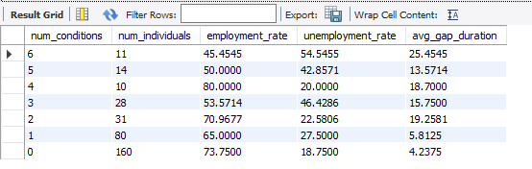

Slide 27
Scenario 10: Analyzing Mental Health Trends Across Different Age Groups
Finding: Different age groups exhibit varying prevalence rates of mental health conditions, which could indicate generational differences in mental health challenges.
Solution:
Age-specific mental health programs can be designed to address the unique needs of each group.

Slide 28
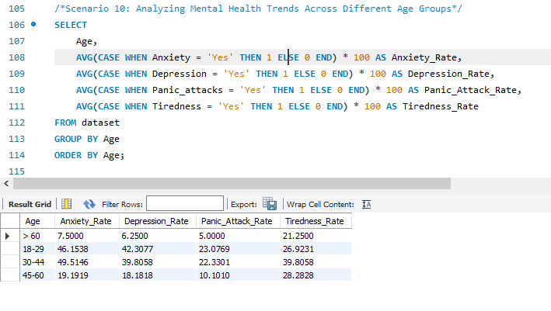
CODE AND OUTPUT

Slide 29
Scenario 11: Exploring the Relationship Between Education Level and Employment Gaps
Finding: Education level may influence the duration of employment gaps and the likelihood of experiencing mental health conditions during those gaps.
Solution:
Education-specific career support and mental health resources can assist individuals in minimizing employment gaps and managing related stress.

Slide 30
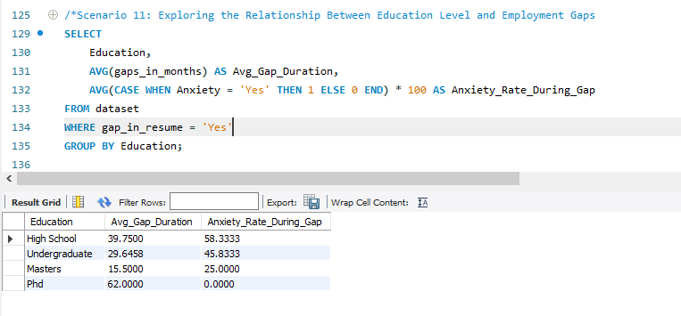
CODE AND OUTPUT

Slide 31
Scenario 12: Assessing the Impact of Unemployment on Internet Access and Mental Health
Finding: Unemployment may reduce regular access to the internet, which in turn could affect mental health due to social isolation or lack of resources.
Solution:
Providing internet access to unemployed individuals may help reduce feelings of isolation and provide better access to job opportunities and mental health resources.

Slide 32
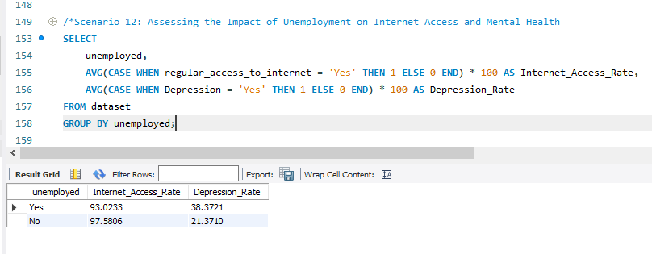
CODE AND OUTPUT

Slide 33
Conclusions
Summarize Key Insights:
Employment and Mental Health:
Unemployment and employment gaps are associated with higher mental health issues.
Socioeconomic Factors:
Lower income and education levels correlate with increased prevalence of mental health conditions.
Demographic Trends:
Age, gender, and regional differences significantly impact mental health outcomes.
Lifestyle Influences:
Internet access, living arrangements, and device usage patterns affect mental well-being.

Slide 34
Recommendations
Actionable Steps:
Policy Implementation:
Develop employment programs that include mental health support.
Educational Initiatives:
Integrate mental health education into school curricula.
Healthcare Access:
Increase accessibility to mental health services for low-income and underserved populations.
Community Support:
Establish community centers offering counseling and digital literacy programs.
Further Research:
Encourage studies on technology's impact on mental health to guide responsible usage.

Slide 35
References
Citations:
Data Sources:
https://www.kaggle.com/datasets/michaelacorley/unemployment-and-mental-illness-survey?resource=download
Literature and Reports:
Nami: https://www.nami.org/Press-Media/Press-Releases/2014/Mental-Illness-NAMI-Report-Deplores-80-Percent-Une
Tools Used:
SQL Database Management Systems
Data visualization software (e.g., Excel)

