Slide 1
Unit-6
I/O Management

Slide 2
I/O Management
Principles of I/O Hardware:
I/O devices
Device controllers
Direct memory access
Principles of I/O Software:
Goals of Interrupt handlers
Device drivers
Device independent I/O software
Secondary-Storage Structure:
Disk structure
Disk scheduling algorithm

Slide 3
Principles of I/O Hardware: I/O device
Computers operate a great many kinds of devices. Most fit into the general categories:
storage devices (disks, tapes)
transmission devices (network cards, modems)
human-interface devices (screen, keyboard, mouse).

Slide 4
Principles of I/O Hardware: I/O device
Two types of I/O devices
block, character
Block device:
can read blocks independently of one another
Hard disks, CD-ROMs, USB sticks
512 bytes to 32,768 bytes
Character device:
accepts characters without regard to block structure
Printers, mouse, network interfaces
Not everything fits:
e.g. clocks don’t fit

Slide 5
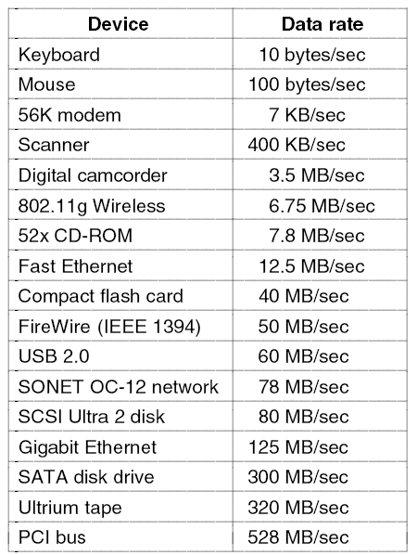
I/O Devices
Figure : Some typical device network, and bus data rates.

Slide 6
I/O Management
Principles of I/O Hardware:
I/O devices
Device controllers
Direct memory access
Principles of I/O Software:
Goals of Interrupt handlers
Device drivers
Device independent I/O software
Secondary-Storage Structure:
Disk structure
Disk scheduling algorithm

Slide 7
Device Controllers
I/O unit has two components:
Mechanical components
Device itself.
Electronic components:
Known as device controller.
The controller card usually has a connector on it, into which a cable leading to the device itself can be plugged.

Slide 8
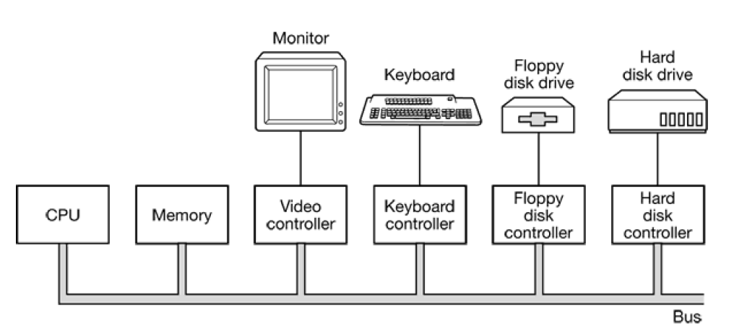
Device Controller

Slide 9
Device Controllers
Device controller for disk:
convert the serial bit stream into a block of bytes and perform any error correction:
The block of bytes is typically first assembled, bit by bit, in a buffer inside the controller. After its checksum has been verified and the block declared to be error free, it can then be copied to main memory or disk.
The controller for a monitor:
It reads bytes containing the characters to be displayed from memory and generates the signals used to modulate the CRT beam to cause it to write on the screen.
The controller also generates the signals for making the CRT beam do a horizontal retrace after it has finished a scan line, as well as the signals for making it do a vertical retrace after the entire screen has been scanned.
If it were not for the CRT controller, the operating system programmer would have to explicitly program the analog scanning of the tube.

Slide 10
I/O Management
Principles of I/O Hardware:
I/O devices
Device controllers
Direct memory access
Principles of I/O Software:
Goals of Interrupt handlers
Device drivers
Device independent I/O software
Secondary-Storage Structure:
Disk structure
Disk scheduling algorithm

Slide 11
Memory Mapped I/O
Each controller has a few registers that are used for communicating with the CPU. By writing into these registers, the operating system can command the device to deliver data, accept data, switch itself on or off, or otherwise perform some action.
In addition to this many devices have a data buffer that the operating system can read and write.

Slide 12
Memory Mapped I/O
OUT PORT, REG
IN REG,PORT
Two alternatives exist. In the first approach, each control register is assigned an I/O port number, an 8- or 16-bit integer. Using a special I/O instruction such as
The issue thus arises of how the CPU communicates with the control registers and the device data buffers.

Slide 13
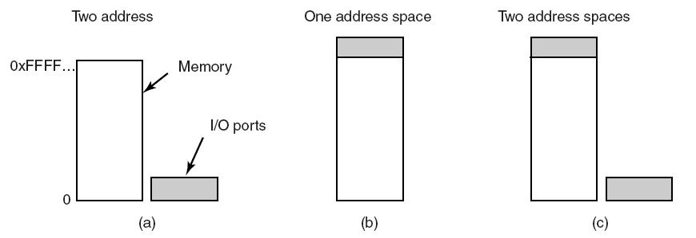
Memory-Mapped I/O
(a) Separate I/O ports and memory space.
(b) Memory-mapped I/O.
(c) Hybrid Approach, Memory mapped data buffers and separate ports

Slide 14
Memory-Mapped I/O
The second approach is to map all the control registers into the memory space. Each control register is assigned a unique memory address to which no memory is assigned. This system is called memory-mapped I/O.
A hybrid scheme, with memory-mapped I/O data buffers and separate I/O ports for the control registers.

Slide 15
How does CPU communicate with registers and buffers?
First scheme
If CPU want to read word,
Puts read SIGNAL on control line
Put address on address line
A second signal line is used to tell weather I/O space or memory space is needed.
Memory mapped approach
If CPU want to read word,
Puts read SIGNAL on control line
Put address on address line and let memory module and I/O devices compare address with the ranges they serve.

Slide 16
Memory mapped advantages
As the I/O space is mapped into memory so no need of any special instructions to read/write control register, can write a device driver in C
Don’t need special protection to keep users from doing I/O directly. Just don’t put I/O memory in any user space.

Slide 17
Memory mapped disadvantage
If there is only one address space, then all memory modules and all I/O devices must examine all memory references to see which ones to respond to.
solution: A dual-bus memory

Slide 18
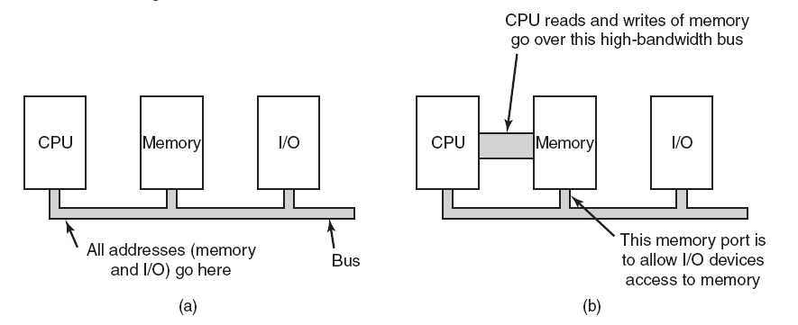
Memory-Mapped I/O
(a) A single-bus architecture. (b) solution: A dual-bus memory architecture.

Slide 19
I/O Management
Principles of I/O Hardware:
I/O devices
Device controllers
Direct memory access
Principles of I/O Software:
Goals of Interrupt handlers
Device drivers
Device independent I/O software
Secondary-Storage Structure:
Disk structure
Disk scheduling algorithm

Slide 20
Direct Memory Access (DMA)
CPU could request data one byte at a time from I/O controller, Big waste of time. So other schema can be used DMA.
DMA controller can access system bus independent of CPU. DMA contains serval registers that can be written and read by CPU.
Memory address register
Byte count register
Control registers-I/O port, direction of transfer, transfer units (byte/word), number of bytes to transfer in a burst.

Slide 21
How Disk read occurs when DMA is not used??
First the controller reads the block (one or more sectors) from the drive serially, bit by bit, until the entire block is in the controller’s internal buffer.
Next, it computes the checksum to verify that no read errors have occurred. Then the controller causes an interrupt.
When the operating system starts running, it can read the disk block from the controller’s buffer a byte or a word at a time by executing a loop, with each iteration reading one byte or word from a controller device register and storing it in main memory.

Slide 22
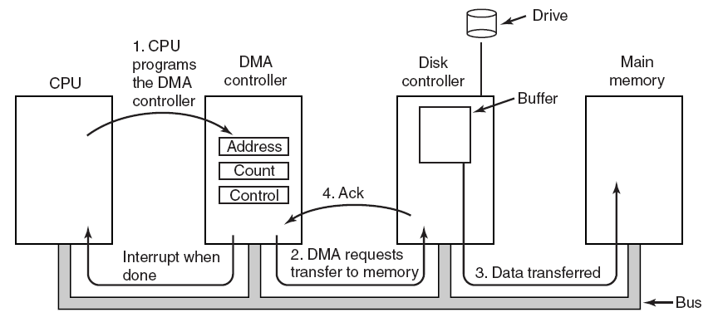
How does DMA work?
Operation of a DMA transfer.

Slide 23
Direct Memory Access (DMA)
When DMA is used, the procedure is different. First the CPU programs the DMA controller by setting its registers so it knows what to transfer where (step 1).
The DMA controller initiates the transfer by issuing a read request over the bus to the disk controller (step 2).
The write to memory is another standard bus cycle (step 3).
When the write is complete, the disk controller sends an acknowledgement signal to the disk controller, also over the bus (step 4).

Slide 24
DMA controller modes
Cycle stealing mode ( word at a time mode)
the DMA controller requests for the transfer of one word and gets it. If the CPU also wants the bus, it has to wait.
Burst mode
(Block mode)
DMA controller grabs bus and sends a block.
Fly by mode
DMA controller tells device controller to transfer data directly to main memory. Otherwise device controller send the word to DMA controller, which then then use bus to write the word.
delaying CPU slightly.
Here multiple word can be transfer.

Slide 25
Questions
Why buffer data in controllers?
Can do check-sum
Bus may be busy so need to store data some place
Is DMA really worth it?
Not if CPU is much faster then DMA controller and can do the job faster
Or don’t have too much data to transfer

Slide 26
I/O Management
Principles of I/O Hardware:
I/O devices
Device controllers
Direct memory access
Principles of I/O Software:
Goals of Interrupt handlers
Device drivers
Device independent I/O software
Secondary-Storage Structure:
Disk structure
Disk scheduling algorithm

Slide 27
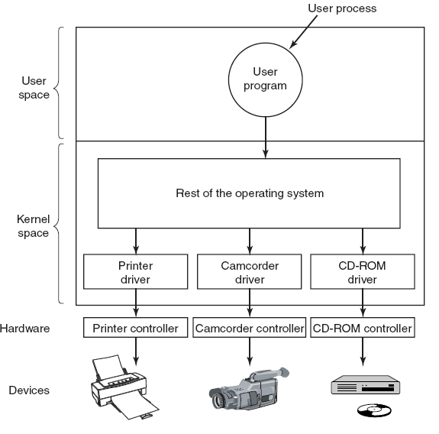
Device Drivers

Slide 28
Device Drivers-Act 1
Driver contains code specific to the device
Supplied by manufacturer
Installed in the kernel
User space might be better place
Why?
Bad driver can mess up kernel
Need interface to OS
block and character interfaces
procedures which OS can call to invoke driver (e.g. read a block)

Slide 29
Device drivers Act 2
Checks input parameters for validity
Abstract to concrete translation (block number to cylinder, head, track, sector)
Check device status. Might have to start it.
Puts commands in device controller’s registers
Driver blocks itself until interrupt arrives
Might return data to caller
Does return status information
The end
Drivers should be re-entrant
OS adds devices when system (and therefore driver) is running

Slide 30
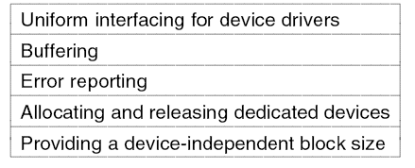
Device-Independent I/O Software
Figure : Functions of the device independent I/O software

Slide 31
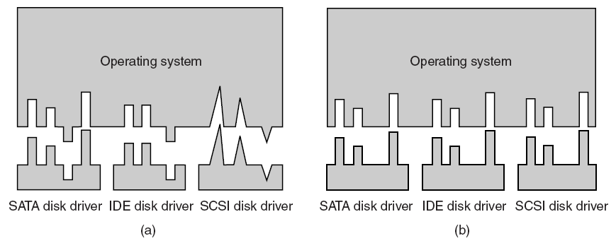
Why the OS needs a standard interface
Driver functions differ for different drivers
Kernel functions which each driver needs are different for different drivers. Too much work to have new interface for each new device type

Slide 32
Interface : Driver functions
OS defines functions for each class of devices which it MUST supply, e.g. read, write, turn on, turn off……..
Driver has a table of pointers to functions
OS just needs table address to call the functions
OS maps symbolic device names onto the right driver

Slide 33
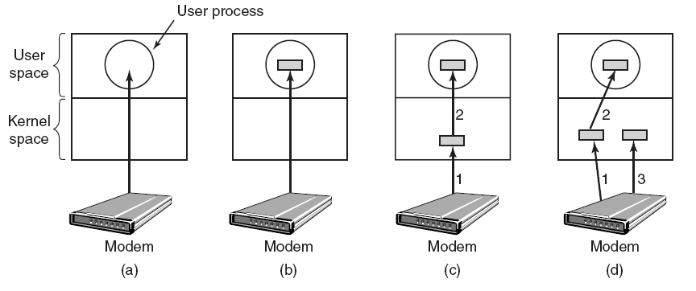
Buffering
(a) Unbuffered input. (b) Buffering in user space. (c) Buffering in the kernel followed by copying to user space. (d) Double buffering in the kernel.

Slide 34
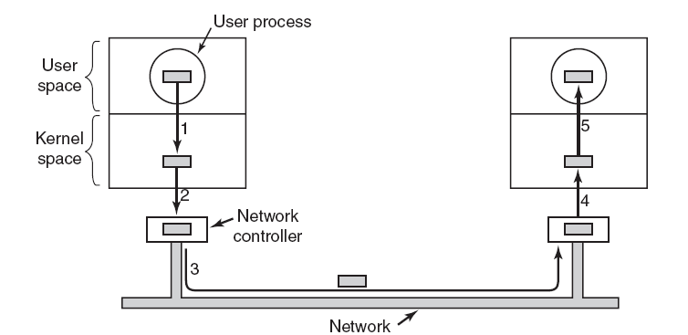
Buffering

Slide 35
More Functions of Independent Software
Error reporting-programming errors (the user asks for the wrong thing eg. writing to an input device or reading from output device), hardware problems (bad disk or invalid device) are reported if they can’t be solved by the driver .
Allocates and releases devices which can only be used by one user at a time (CD-ROM players)
Queues requests or
Lets open simply fail
Device independent block size-OS does not have to know the details of the devices
E.g. combine sectors into blocks

Slide 36
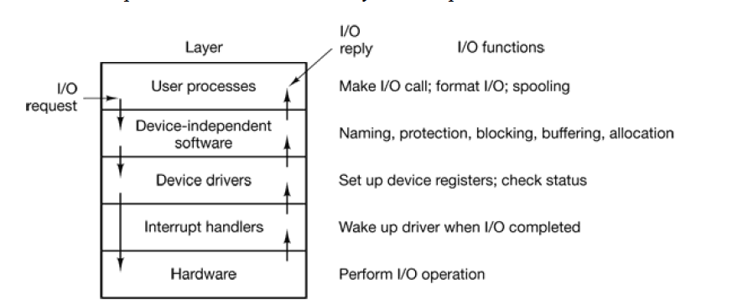
Layers of I/O Software & Function of Each Layer

Slide 37
I/O Management
Principles of I/O Hardware:
I/O devices
Device controllers
Direct memory access
Principles of I/O Software:
Goals of Interrupt handlers
Device drivers
Device independent I/O software
Secondary-Storage Structure:
Disk structure
Disk scheduling algorithm

Slide 38
Disks
it is relatively permanent and can hold large quantities of data. Its access time is slow compared with that of main memory and magnetic disk. provide the bulk of secondary storage for modern computer system.
disk platter: has a flat circular shape, like a CD. The two surfaces of a platter are covered with a magnetic material. We store information by recording it magnetically on the platters.
The surface of a platter is logically divided into circular tracks which are subdivided into sectors. The set of tracks that are at one arm position makes up a cylinder.

Slide 39
Disks
Disk speed has two parts.
transfer rate: is the rate at which data flow between the drive and the computer.
positioning time / Seek time: sometimes called random access time the consists of the time necessary to move the disk arm to the desired cylinder.
rotation latency:
the time necessary for the desired sector to rotate to the disk head.

Slide 40
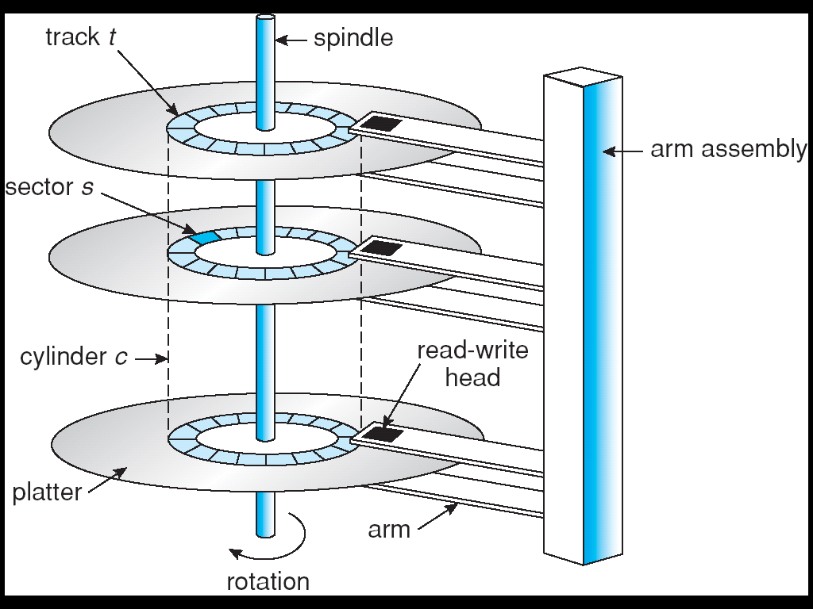
Moving-head Disk Mechanism
Notes:
40

Slide 41
Disk Arm Scheduling Algorithms
Algorithms are :-
First Come First Serve
Shorted Seek First
Elevator Algorithm/ SCAN algorithm
C-SCAN (circular-SCAN)
C-LOOK (circular-LOOK)

Slide 42
First Come First Serve (FCFS)
Handle I/O requests sequentially.
Fair to all processes.
Approaches random scheduling in performance if there are many processes/requests.
Suffers from global zigzag effect.

Slide 43
First Come First Serve (FCFS)
Several algorithms exist to schedule the servicing of disk I/O requests.
We illustrate them with a I/O request queue (cylinders are between 0-199): queue = 98, 183, 37, 122, 14, 124, 65, 67
head starts at 53

Slide 44
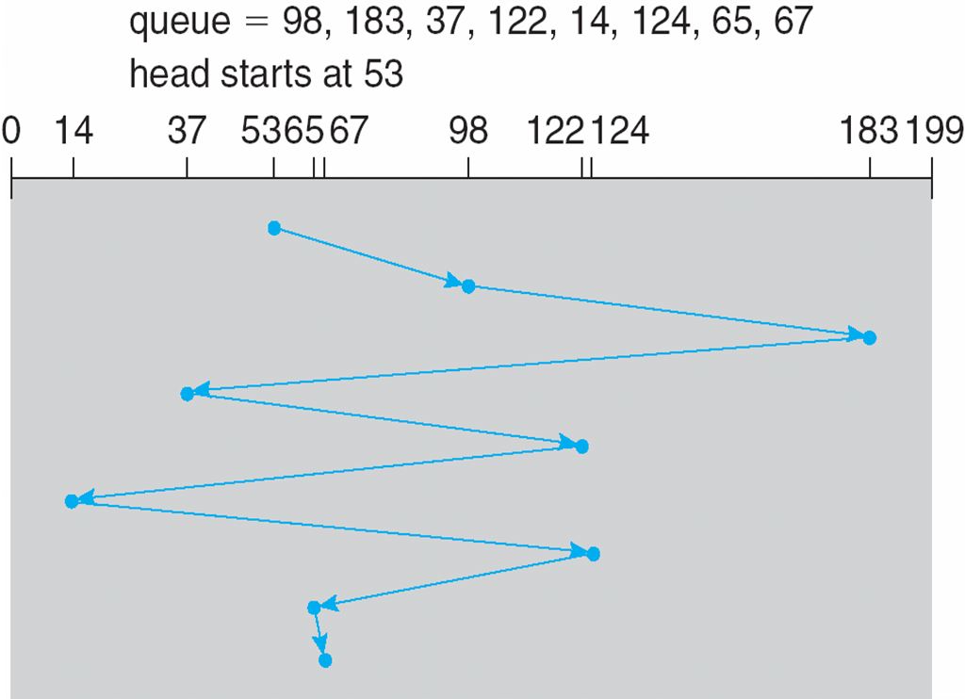
First Come First Serve (FCFS) Example
Illustration shows total head movement of 640 cylinders.
Illustration shows total head movement or seek distance is 640 cylinders.

Slide 45
First Come First Serve (FCFS) Example
1,36,16,34,9,12
Disk head 11.
Illustration shows total head movement of 640 cylinders.

Slide 46
Shortest Seek Time First (SSTF)
Selects the request with the minimum seek time from the current head position.
Also called Shortest Seek Distance First (SSDF) – It’s easier to compute distances.
It’s biased in favor of the middle cylinders requests.
SSTF scheduling is a form of SJF scheduling; may cause starvation of some requests.

Slide 47
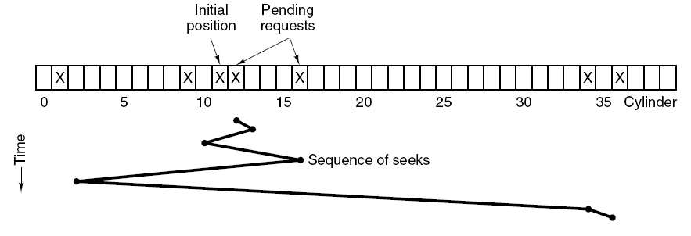
SSF (Shortest Seek Time First)
While head is on cylinder 11, requests for 1,36,16,34,9,12 come in
FCFS would result in total of 111 cylinders
SSF would require 1,3,7,15,33,2 movements for a total of 61 cylinders

Slide 48
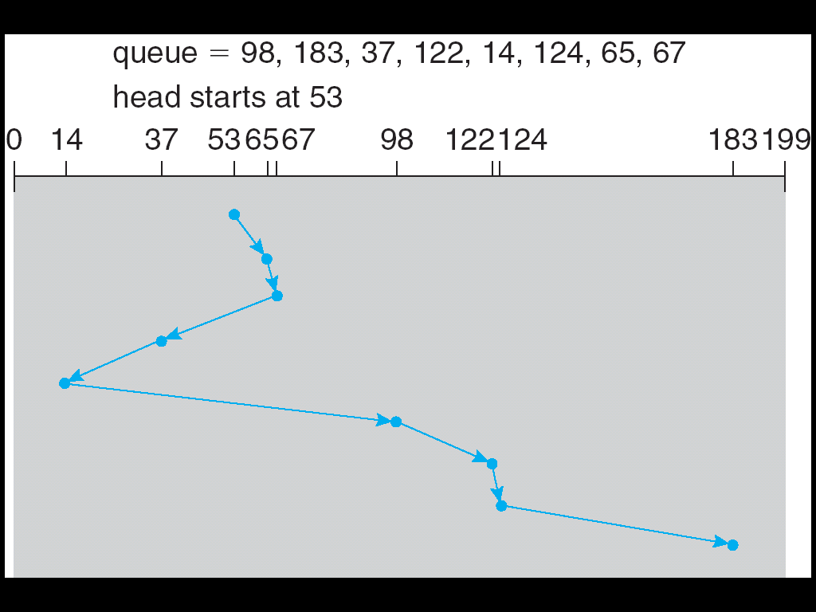
SSF (Shortest Seek Time First)
Illustration shows total head movement of 236 cylinders.

Slide 49
LOOK (Elevator) disk arm scheduling
Keep moving in the same direction until there are no more outstanding requests pending in that direction, then algorithm switches the direction.
After switching the direction the arm will move to handle any request on the way. Here first go it moves in up direction then goes in down direction.
This is also called as elevator algorithm.
In the elevator algorithm, the software maintains 1 bit: the current direction bit, which takes the value either UP or DOWN.
As per LOOK request will be satisfied in order 11, 12, 16, 34, 36, 9, 1.
• Total cylinder movement: (12-11) + (16-12) + (34-16) + (36-34) + (36-9) + (9-1)=60

Slide 50
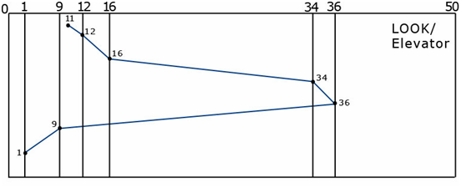
LOOK GRAPH

Slide 51
SCAN ALGORITHM
From the current position disk arm starts in up direction and moves towards the end, serving all the pending requests until end.
At that end arm direction is reversed (down) and moves towards the other end serving the pending requests on the way.
As per SCAN request will be satisfied in order: 11, 12, 16, 34, 36, 50, 9, 1
• Total cylinder movement: (12-11) + (16-12) + (34-16) +(36-34) +(50-36) + (50-9) + (9-1)
= 88

Slide 52
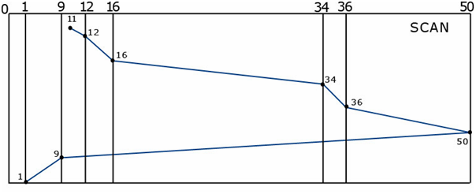
SCAN GRAPH

Slide 53
C-SCAN
Provides a more uniform wait time than SCAN.
The head moves from one end of the disk to the other. servicing requests as it goes. When it reaches the other end, however, it immediately returns to the beginning of the disk, without servicing any requests on the return trip.
Treats the cylinders as a circular list that wraps around from the last cylinder to the first one.
382

Slide 54
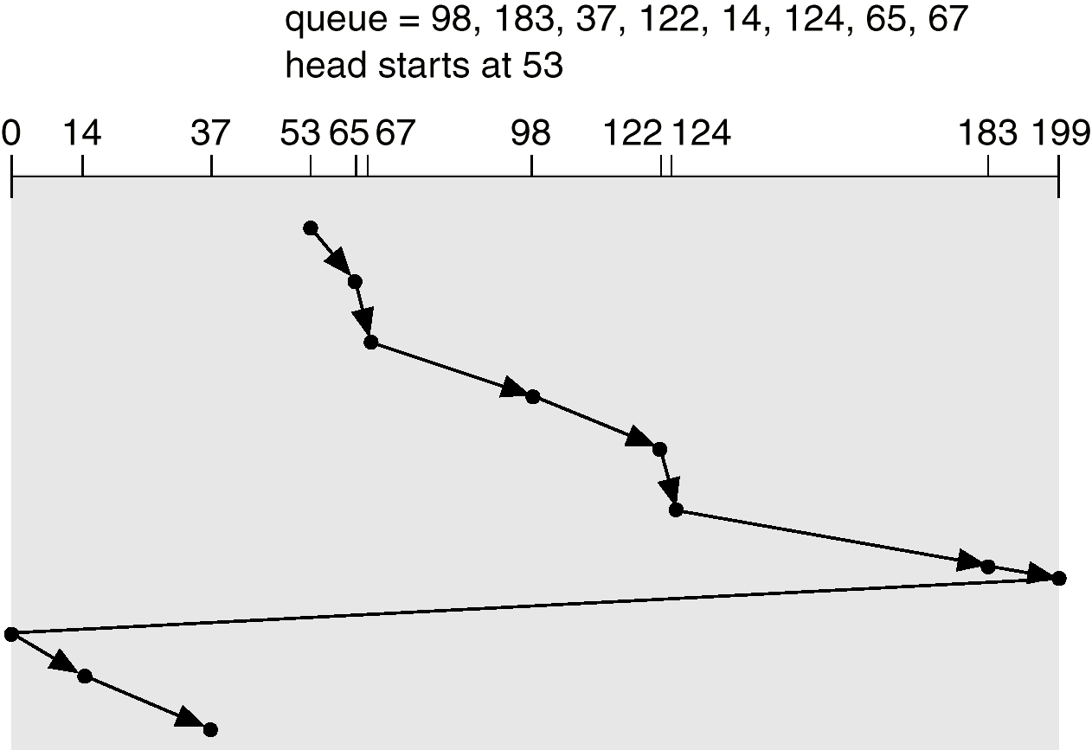
C-SCAN (Cont.)

Slide 55
C-LOOK
Version of C-SCAN
Arm only goes as far as the last request in each direction, then reverses direction immediately, without first going all the way to the end of the disk.

Slide 56
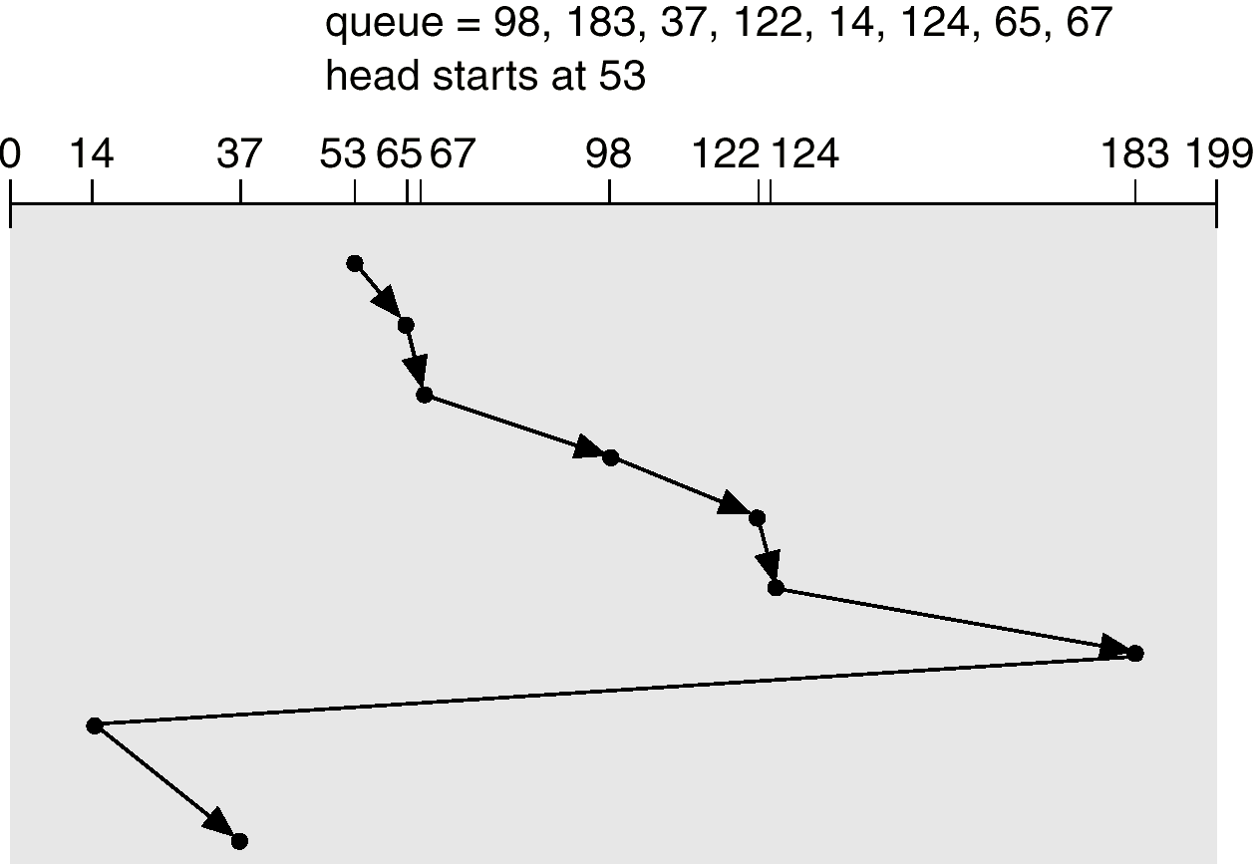
C-LOOK (Cont.)

Slide 57
Selecting a Disk-Scheduling Algorithm
SSTF is common and has a natural appeal
SCAN and C-SCAN perform better for systems that place a heavy load on the disk.
Performance depends on the number and types of requests.
Requests for disk service can be influenced by the file-allocation method.
The disk-scheduling algorithm should be written as a separate module of the operating system, allowing it to be replaced with a different algorithm if necessary.
Either SSTF or LOOK is a reasonable choice for the default algorithm.

Slide 58
RAID model
Redundant Array of Independent Disks.
Parallel processing is used more and more to increasing speed of the CPU same we can even paralysed the I/O operation with help of redundant disks.

Slide 59
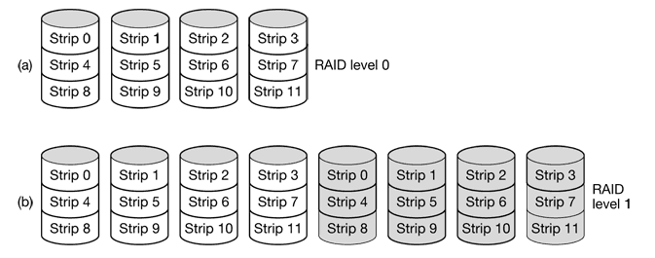
RAID 0:
stripping
Data is split up into blocks.
Easy to implement.
Not fault tolerant.
RAID 1:
Mirroring
Data are stored twice.
Offers excellent read and write speed.
The effective storage capacity is only half.

Slide 60

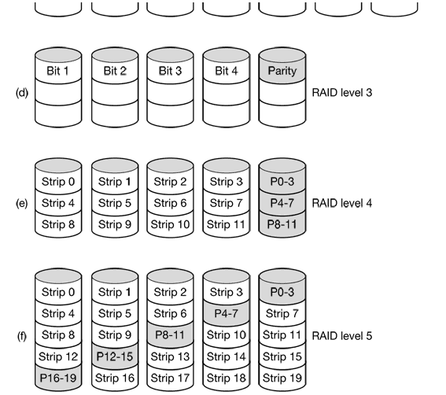
RAID 2:
Unlike level 0 and 1 level 2 work on word basis.
Splitting each byte and then add humming code into this bytes.
Loss of the drive only lost 1 byte.
RAID 3:
Here will use single parity bit.
Individual data word are spread over multiple drives.

Slide 61
RAID Level 4:
work with strips again,
If drive crashes, the lost byte can be recomputed from parity drive.
Even if one drive change we have to recomputed parity.
RAID level 5:
Single parity bottleneck is eliminated.
By distributing parity bit uniformly over disk.

Slide 62
FIGURES

Slide 63
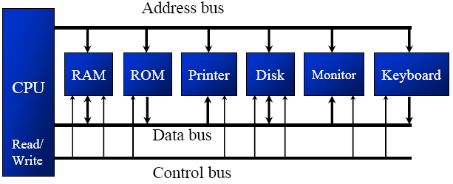
CPU & H/W Alignment

Slide 64
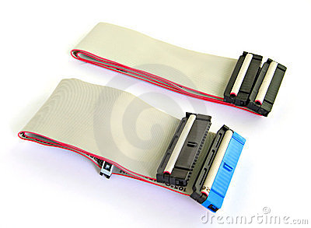
Computer Bus

Slide 65
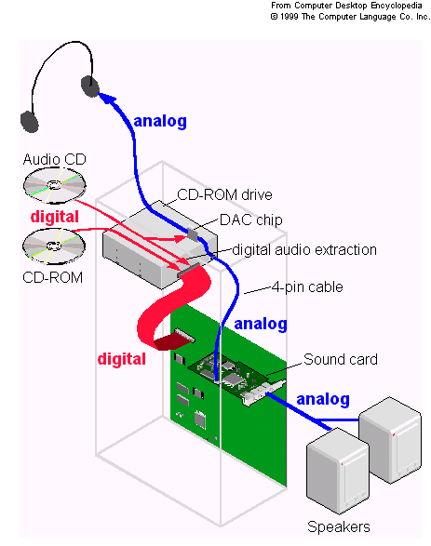
H/W Attachment on Motherboard

Slide 66
END OF UNIT - 6

