Slide 1
When Should an Electric Ride-Hailing Driver Charge?
Joint intra-day optimisation of charging time and order acceptance
Ruixi Liang (梁睿希) · Student ID 202464870791
Big Data Class 1 · School of Future Technology
[Team member 2 — Name, Student ID, Major and Class]
[Team member 3 — Name, Student ID, Major and Class]
Course: Optimization Methods (084100551) · Supervisor: Prof. Zhenhong Lin
In one sentence: we model a single electric ride-hailing driver's charging and order decisions as a Markov decision process and show that the cheapest electricity hour is almost never the right hour to charge.

Slide 2
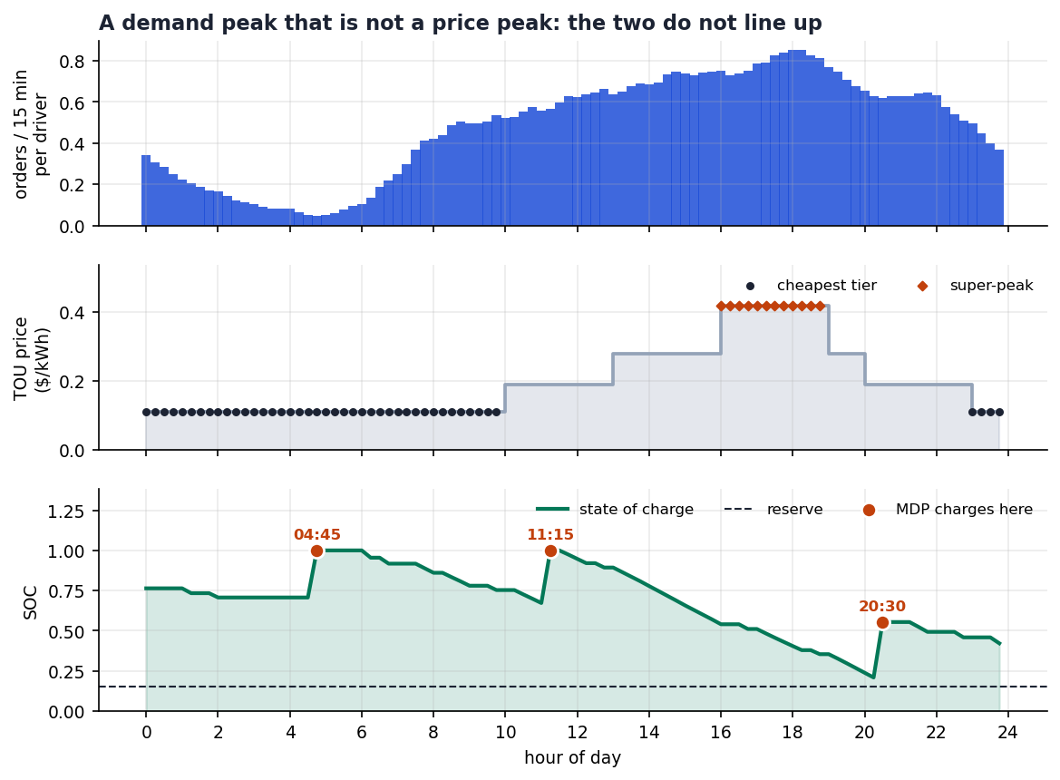
Background: the driver is paid to drive, and billed for the plug
Electric ride-hailing drivers face a time-of-use electricity tariff and an order flow that both vary over the day — but they do not vary together.
▪ A driver earns from serving orders; electricity is a pure cost with a time-of-use (TOU) tariff that is ~3.8× cheaper at night than at the 16:00–19:00 super-peak.
▪ Charging takes a 15-minute slot, and the driver keeps earning while the car charges — but only if orders are still arriving.
  – Opportunity cost, not the tariff, decides the answer: a slot that saves $0.31/kWh but sits in a dead hour is a bad slot.
▪ Naive rule (“charge in the cheapest hour”) ignores this entirely, and it is exactly what real drivers and naive dispatchers propose.
One simulated day: demand (blue), tariff (grey), and the MDP charging policy (orange dots) on the state-of-charge curve.
When Should an Electric Ride-Hailing Driver Charge? | Optimization Methods (084100551)
2

Slide 3
Research question and contributions
A deliberately small, sharply-posed question — a single driver, one day, one battery.
RQ. When should an electric ride-hailing driver charge, and how much do we lose by charging in the cheapest hour instead of the optimal one?
▪ Contributions
▪ A joint MDP of order acceptance and charging for a single driver: 8,256 states, 96 slots, Poisson arrivals summed analytically.
▪ A decomposition that shows exactly why the optimal policy departs from the tariff-following rule — the opportunity cost of an idle hour.
▪ A closed-form extension to the multi-day cycle, giving the shadow price of stored energy (μ = $0.2414/kWh).
▪ Full reproducibility: public data, published seeds, and every number in the paper regenerated by one script.
When Should an Electric Ride-Hailing Driver Charge? | Optimization Methods (084100551)
3

Slide 4
The optimization problem
Decision variables, one objective, three constraints — and the trade-off that makes it worth optimising.
Decision variables
Objective (max)
▪ a(t) ∈ {0, 1}: charge or not in slot t
▪ u(t) ≥ 0: number of orders accepted in slot t
▪ s(t): state of charge at the start of slot t
▪ π: the policy mapping (t, s) → (a, u)
max E [ Σₜ ( fare(t)·u(t) − price(t)·P·a(t)·Δt ) ]
earnings from accepted orders, minus the electricity bill
Constraints
The key trade-off
Every slot spent charging is a slot not spent earning — but the value of that slot depends on the demand profile, not on the tariff.
Cheap electricity + no orders = a loss. Expensive electricity + peak orders = a smaller loss.
▪ SOC reserve floor: s(t) ≥ 15% at all times
▪ Energy balance: s(t+1) = s(t) + η·a(t)·P·τ(s)·Δt − d(t)·u(t)
▪ Capacity and slot limits: s(t) ≤ 100%, one slot per driver
When Should an Electric Ride-Hailing Driver Charge? | Optimization Methods (084100551)
4

Slide 5
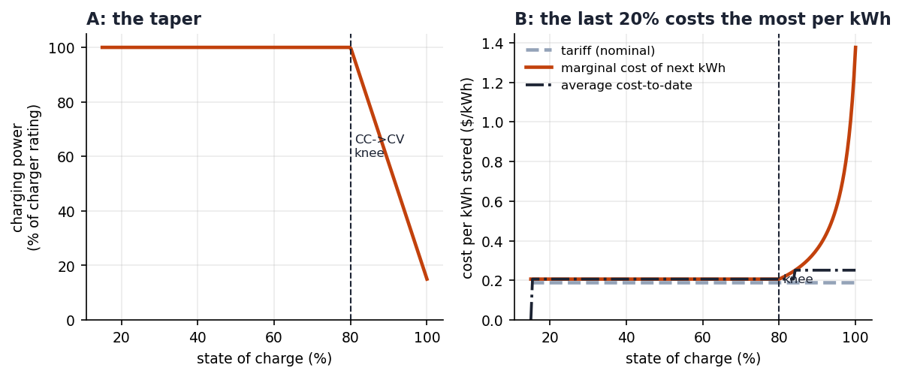
Data and assumptions
One public dataset for demand; the tariff and vehicle parameters are stated assumptions, not measurements — and we say so explicitly.
Parameter | Value | Source / note
Order arrival rate λ(t) | 91 → 1,684 orders/h | NYC TLC trip records, 2024-01
Fare rate | $53.0/h mean, $93.5/h peak | derived from trip fare ÷ trip duration
Battery / charger | 40 kWh, 60 kW, η = 92% | typical BEV ride-hailing vehicle
Reserve floor / knee | 15% SOC / 80% SOC | CC–CV taper above the knee
TOU tariff | $0.11 – $0.42 / kWh | assumption; 4 tiers, 44 valley slots
Horizon / step | 96 slots × 15 min = 24 h | a full operating day
CC–CV taper and the resulting cost per kWh stored.
▪ What is measured and what is assumed is the honesty line of this paper: the demand profile is measured, the tariff is an assumption, and the sensitivity analysis in Section 7 varies the assumption.
When Should an Electric Ride-Hailing Driver Charge? | Optimization Methods (084100551)
5

Slide 6
Method: three models, each answering one question
Each step is justified by what the previous one could not resolve.
Model | Question it answers | Why this method
DP expected value | What is the best schedule if the future is known in advance? | A lower bound and a sanity check; deterministic and easy to verify by hand
MDP Poisson arrivals | What should the driver do given only the current state? | Orders arrive stochastically; the Bellman recursion sums over the Poisson arrivals in closed form
Cyclic multi-day MDP | What is worth carrying into tomorrow? | The terminal value is the value of starting tomorrow, so it is a fixed point, solved by value iteration
▪ Why not MILP?
▪ A MILP is possible, but the stochastic arrival process makes the objective non-linear in the decision variables, and we would have to sample scenarios — trading a 20-minute solve for 50 approximation error.
▪ The MDP is exact and its structure is interpretable: the policy can be read off slot by slot, which is what makes the key insight visible at all.
  – No code on the slides: the Bellman recursion is the whole method — V(t, s) = max over actions of [ immediate reward + expected continuation ].
When Should an Electric Ride-Hailing Driver Charge? | Optimization Methods (084100551)
6

Slide 7
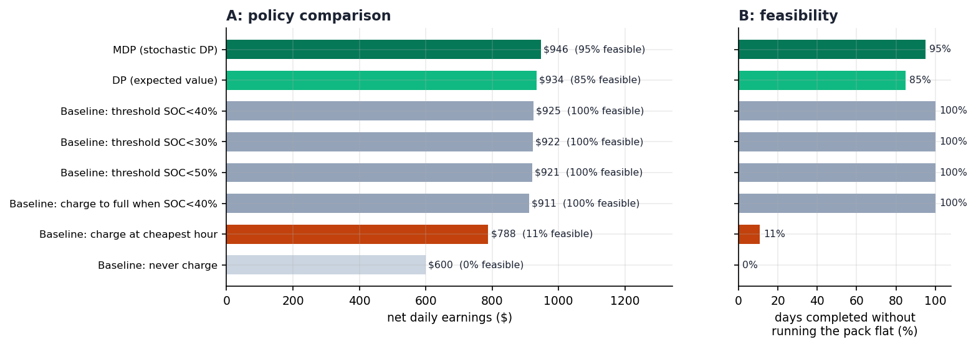
Baseline and comparison: what does optimisation buy?
Eight policies, 570 simulated feasible days, same demand realisation for every policy.
Policy | Net ($/day) | Feasible
MDP (ours) | $946.46 | 95%
DP (perfect forecast) | $934.15 | 85%
Charge-to-full rule | $911.06 | 82%
Cheapest-hour rule | $788.21 | 11%
Never charge | $600.09 | 0%
Net daily earnings and feasibility rate of the eight policies.
▪ +$158.25/day (+20.1%) over the cheapest-hour rule
▪ +$21.47/day (+2.3%) over a perfect-forecast deterministic DP
▪ The perfect-forecast DP is not the benchmark to beat — it wins on earnings but fails feasibility 10% more often, because a static plan cannot adapt to a bad draw.
▪ Feasibility is a first-class metric: a policy that strands the driver at 0% SOC is worthless even at a high average.
When Should an Electric Ride-Hailing Driver Charge? | Optimization Methods (084100551)
7

Slide 8
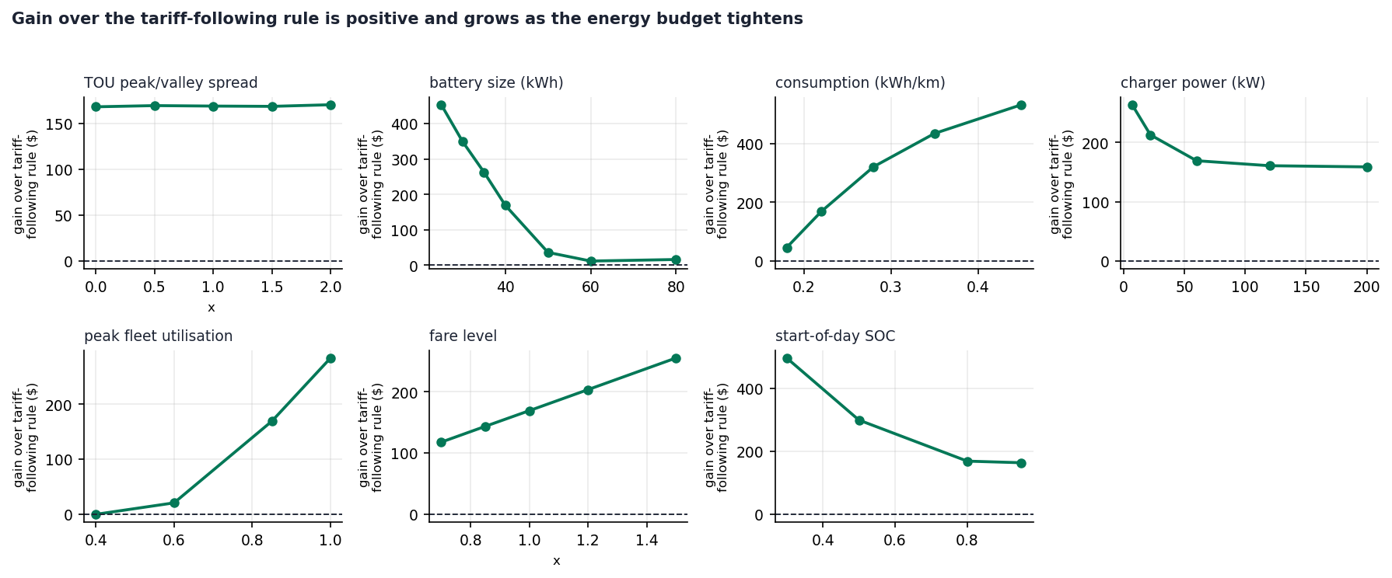
Sensitivity and extension
Does the conclusion survive when the assumptions move?
▪ 7 sweeps: TOU spread, battery size, consumption, charger power, peak utilisation, fare level, start-of-day SOC
▪ The gain is positive everywhere and grows as the energy budget tightens — optimisation matters more when energy is scarcer.
▪ Ablations A1–A6 isolate every mechanism
▪ Removing the opportunity-cost term from the reward is the only ablation that changes the policy qualitatively — and it turns the MDP back into the cheapest-hour rule.
▪ Multi-day cycle
▪ Cyclic MDP: μ = $0.2414/kWh shadow price, optimal start-of-day SOC 36.8%, steady-state charging at 04:45 and 12:00.
Gain of the optimal policy over the tariff-following rule, 7 one-factor sweeps.
When Should an Electric Ride-Hailing Driver Charge? | Optimization Methods (084100551)
8

Slide 9
Key insight: the cheapest hour is the wrong hour
This is the one figure we would keep if we could only keep one.
The tariff spread is $0.31/kWh, but the demand spread over the same 24 hours is 18.5×. Opportunity cost dominates, so the optimal policy buys cheap energy in slots where it is cheap — and charges where the demand gap is small.
▪ Measured on the optimal policy:
▪ 74.4% of feasible days contain at least one off-valley charge; 25.6% are valley-only.
▪ 100% of days charge in the deep night (00:00–05:00).
▪ Modal slot: 04:45 (87.2% of days); then 20:30 (9.5%), 12:30 (9.0%).
▪ Why 20:30 and 12:30 appear:
▪ They are shoulder-tier (2× cheaper than peak) AND still inside the demand shoulder — the only slots that satisfy both conditions.
▪ The general lesson:
▪ Price a time slot by its opportunity cost, not by its sticker price.
The optimal day: charge at the shoulder boundary, not at the tariff minimum.
When Should an Electric Ride-Hailing Driver Charge? | Optimization Methods (084100551)
9

Slide 10
Conclusion
Direct answer to the research question, with the conditions attached.
▪ Finding 1.
▪ Charging at the tariff minimum is the worst reasonable rule: $788.21/day and 11% feasibility, against $946.46/day and 95% for the optimal policy — a 20.1% gain.
▪ Finding 2.
▪ The optimal policy is strongly valley-anchored (74.4% of days charge off-valley, 100% charge after midnight) but not valley-exclusive: 25.6% of days stay entirely in the valley.
▪ Finding 3.
▪ The decision is driven by demand availability, not by price: 18.5× demand spread vs a 3.8× tariff spread, so the opportunity cost of an idle slot sets the optimum.
▪ Finding 4.
▪ Across a multi-day cycle, stored energy is worth μ = $0.2414/kWh and the optimal start-of-day SOC is 36.8%.
Limitations and next steps
Single driver (the fleet-scale version needs a different treatment); the tariff is an assumption, not a measured price; revenue is modelled as a deterministic rate. Next: multi-agent congestion, and pricing the charging slot as a market.
When Should an Electric Ride-Hailing Driver Charge? | Optimization Methods (084100551)
10

Slide 11
Backup: verification and reproducibility
Because every number in the paper is regenerated by one script.
Check | Result
Planner vs simulator consistency | 2.25 standard errors (consistent rule); 2.31 SE (legacy rule)
Bellman residual (cyclic MDP) | 9.29 × 10⁻¹⁰ after 34 sweeps
Formula validation | 105 LaTeX formulas checked with KaTeX, 0 failures
Paper equations in Word | 101 native OMML equation objects, 0 pasted images
Data | 2,803,713 cleaned trips; 2,739,936 in-profile over 30 full days
Reproduction | code/ + data/ + published seeds; one command regenerates all figures and tables
▪ AI use statement (also in the paper):
▪ Generative AI was used for literature understanding, model discussion, code debugging and English-language editing. All results, equations and code logic were verified by the team; the authors take full responsibility for the submitted content.
When Should an Electric Ride-Hailing Driver Charge? | Optimization Methods (084100551)
11

Slide 12
Backup: expected questions
The guide lists eight questions we should be ready for; three of them have non-trivial answers.
Question | Short answer
Why is this an optimization problem? | Two coupled decisions (when to charge, which orders to take) compete for the same scarce resource: the driver's time and battery.
Why is this constraint necessary? | Without the 15% reserve floor the DP would plan runs that strand the driver at 0% SOC; we proved the constraint is non-redundant and measured the resulting infeasibility.
Why this method? | The arrivals are stochastic and the state is (time, SOC) — exactly the structure of an MDP with a closed-form Poisson expectation.
Why does the optimal solution have this shape? | Because the value of a slot is the demand it forgoes; when demand is flat, the tariff decides, and when demand is steep, the tariff cannot outvote it.
What if a key parameter changes? | 7 sensitivity sweeps: the gain over the tariff-following rule stays positive and grows as the energy budget tightens.
Would the conclusion hold under different assumptions? | Yes for the tariff shape and fare level (re-calibrated VOT still gives 16 of 96 slots below $15.20/h) — but a flat tariff would collapse the problem to a pure energy-balance question.
When Should an Electric Ride-Hailing Driver Charge? | Optimization Methods (084100551)
12

