Slide 1
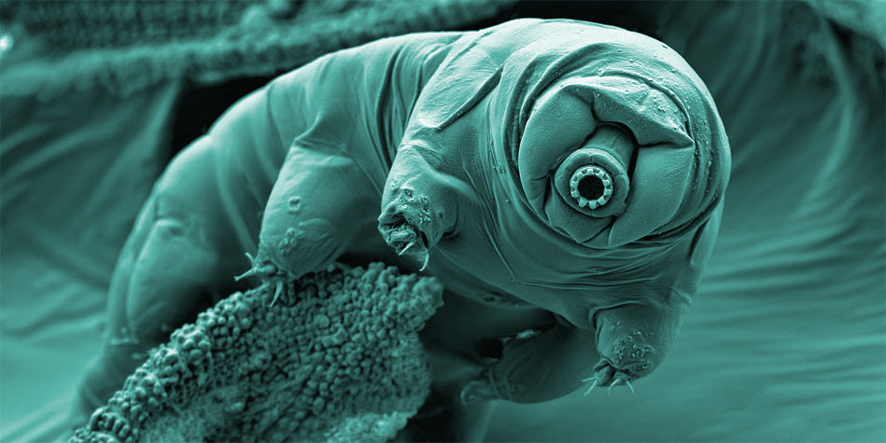
Tardigrades
Isaac Breinyn
Ryan Erickson
Sebastian Gonzalez
Joey Penn
Physics 135

Slide 2
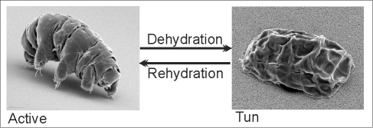
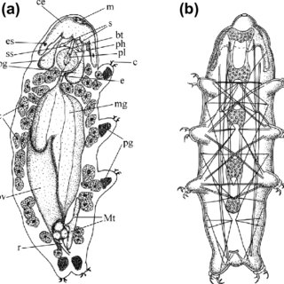
Tardigrades (Water Bears)

Slide 3
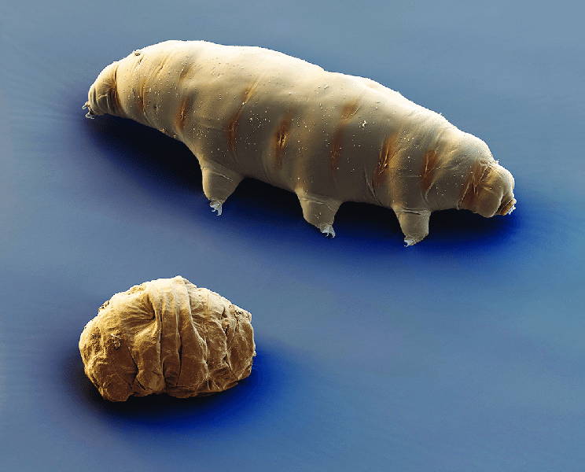
Desiccation
The Tun State
Metabolism < .01%
Water content ~1%
Trehalose
Disaccharide
Very low levels
Why?
IDPs

Slide 4
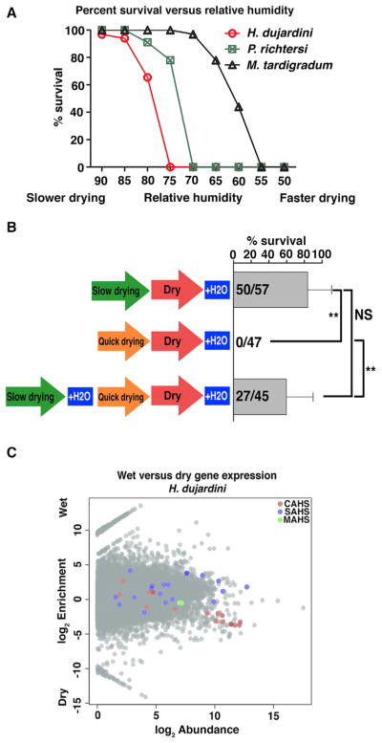
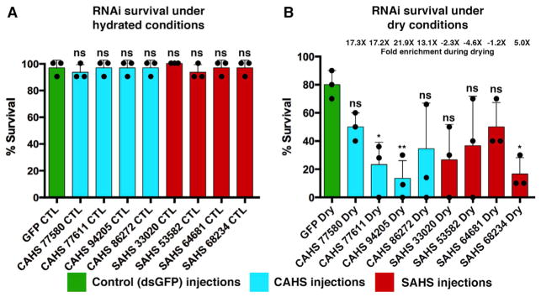
Anhydrobiosis and TDPs
Preconditioned vs sudden
Protectant?
Protein families thought to encode IDPs
CAHS (Cytosolic)
SAHS (Secreted)
TDPs
IDPs ~ stress resistance
Stress → TDP production
RNA interference (RNAi)
Boothby, et. al. Tardigrades Use Intrinsically Disordered Proteins To Survive Desiccation 2018

Slide 5
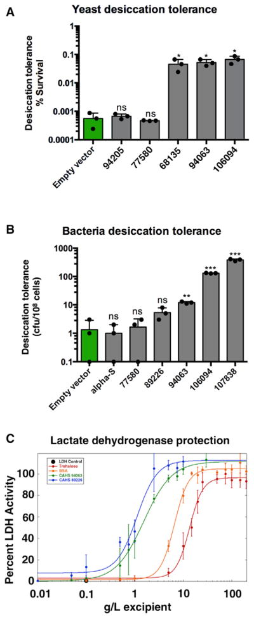
TDPs in other Organisms
Common IDP, but no increase in desiccation tolerance
Boothby, et. al. Tardigrades Use Intrinsically Disordered Proteins To Survive Desiccation 2018

Slide 6
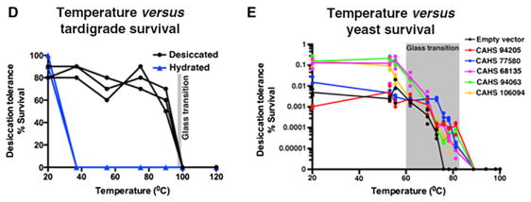
The Mechanism (vitrification)
Boothby, et. al. Tardigrades Use Intrinsically Disordered Proteins To Survive Desiccation 2018

Slide 7
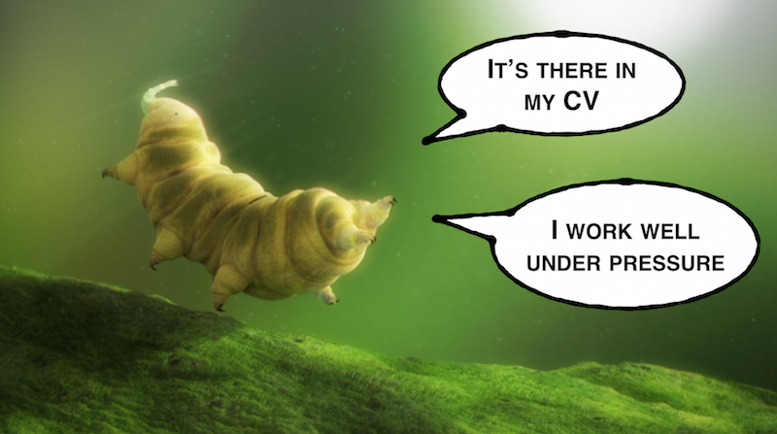
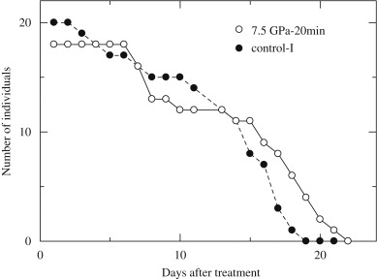
Extreme Pressures
Up to 13 hours of 7.5 GPa pressure
Equivalent to pressure at 180km below Earth’s Surface
Up to 10 days of extremely low pressure (vacuum)
Ono, et. al. Effect of high hydrostatic pressure on to life of the tiny animal tardigrade (2008)

Slide 8
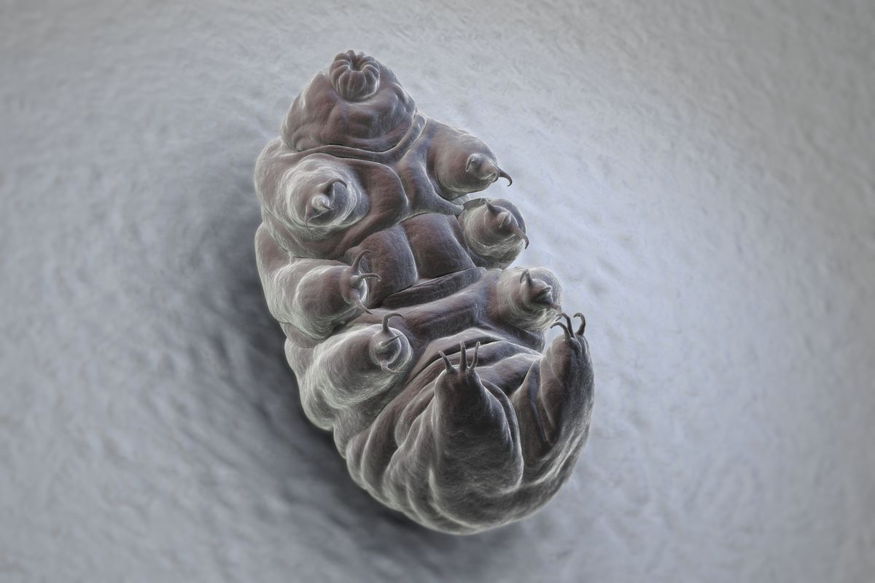
Extreme Temperatures
Below -273°C and above 90°C in Tun state
Below -196°C and above 120°C for short periods of time (<30 min) in normal state
Possibility to survive near-zero temperatures during interplanetary travel
Horikawa, et. al. Survival of Tardigrades in Extreme Environments: A Model Animal for Astrobiology (2011)

Slide 9
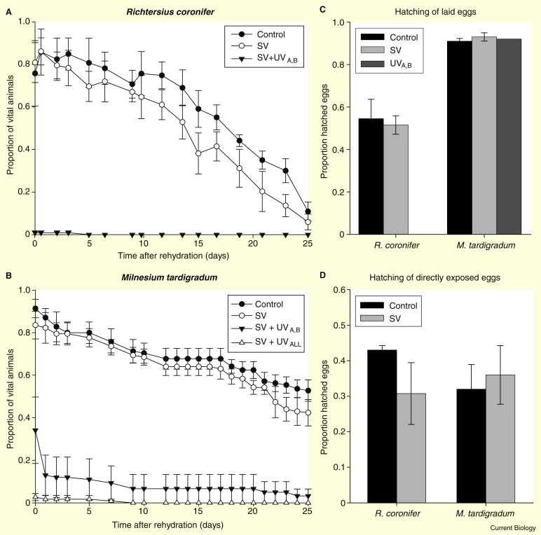
Tardigrades survive space vacuum and radiation
Experiment:
Orbit radius: 258-281 km
Period of experiment: 10 days
Conclusions:
Tardigrades survived in vacuum
M. Tardigradum survives vacuum + radiation
Mechanism of survival remains a mystery!
Jonsson et al. Tardigrades survive exposure to space in low Earth orbit (2008)

Slide 10
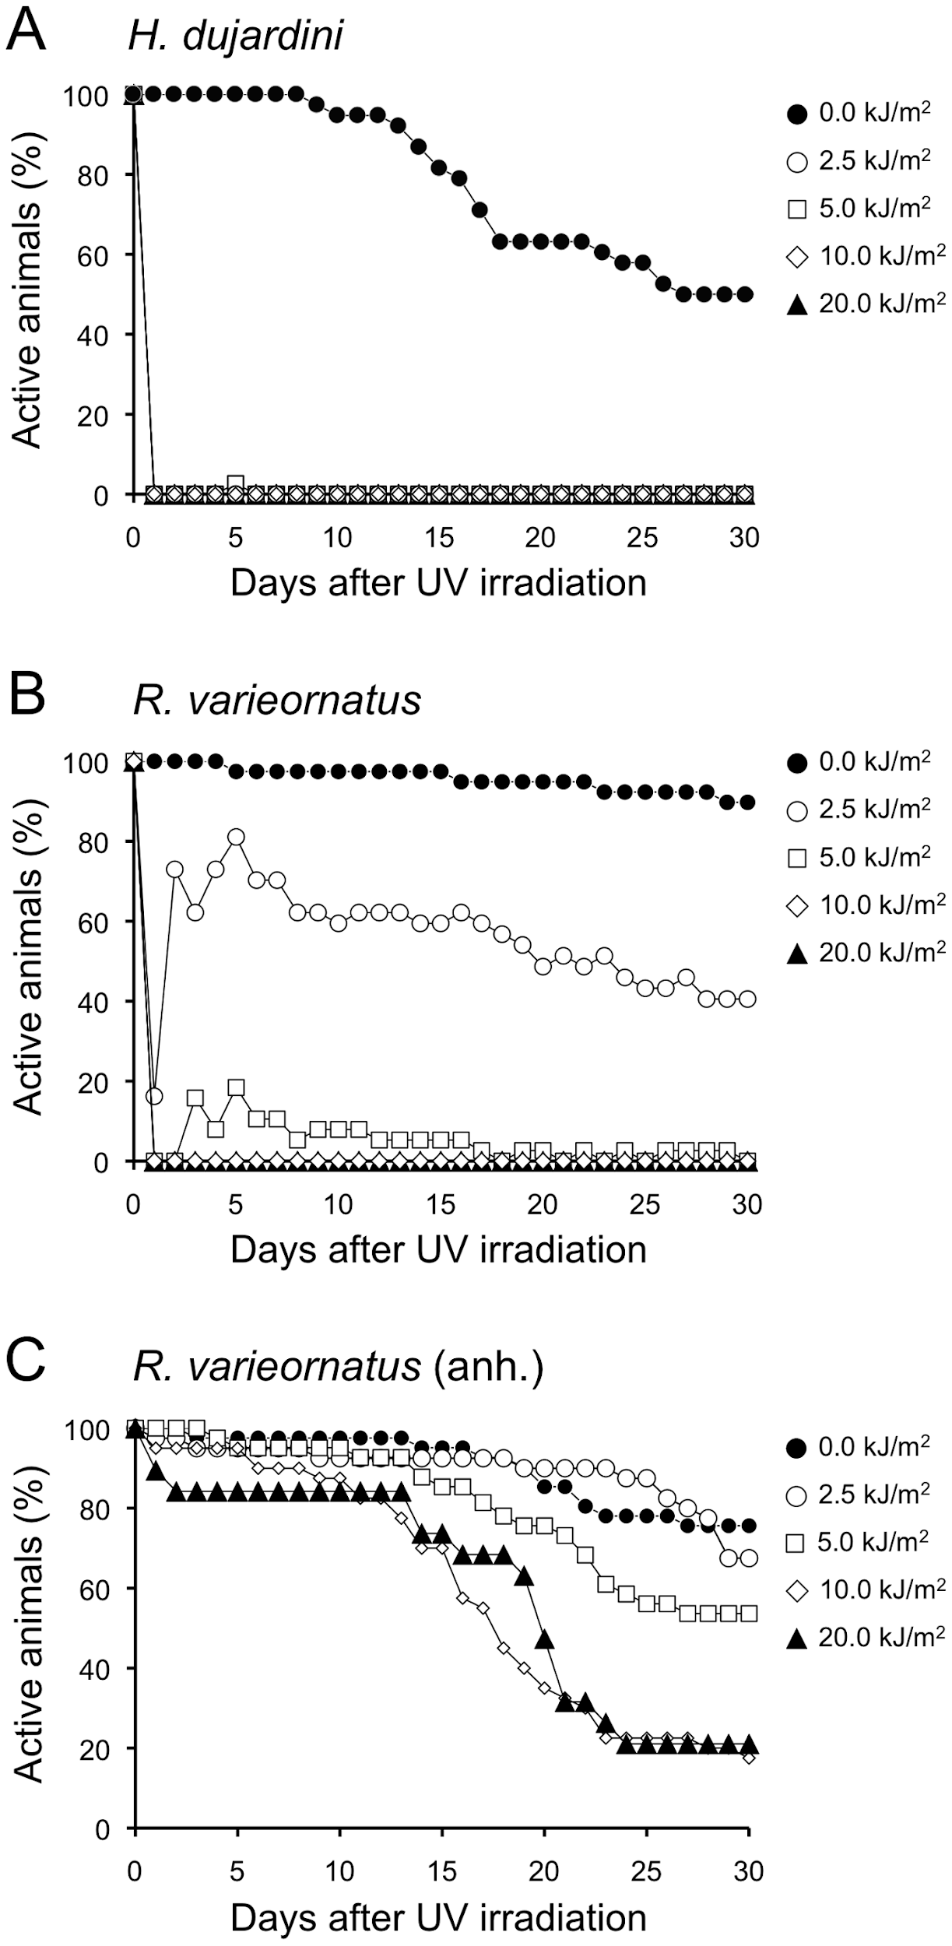
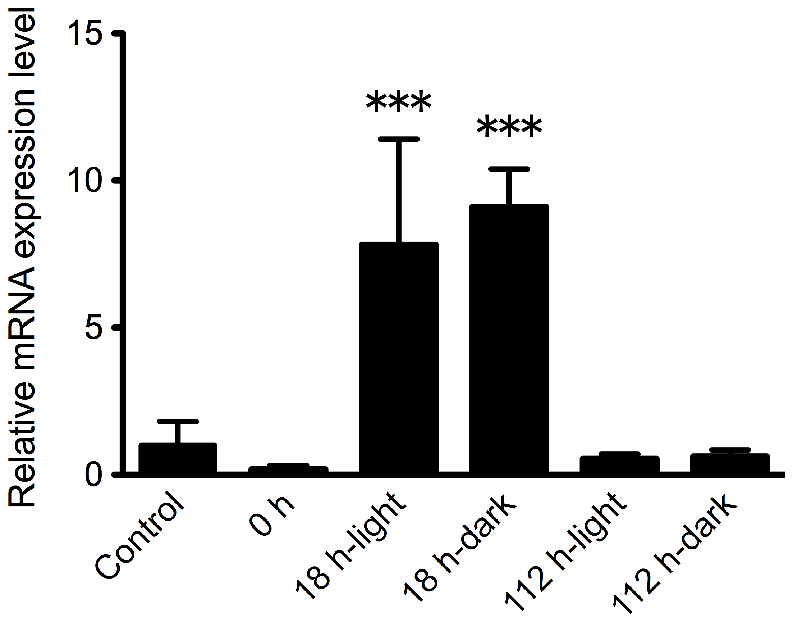
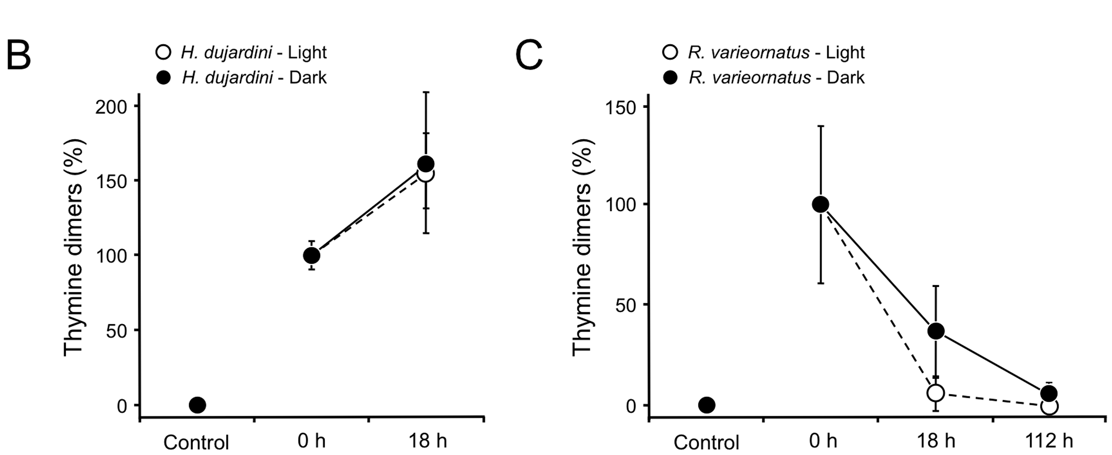
DNA repair and protection in Tardigrades
Photolyases gene “phrA” responsible for DNA repair network
CPD DNA Photolyase breaks thymine dimers
Horikawa et al. Analysis of DNA repair and Protection in the Tardigrade Ramazzottius varieornatus and Hypsibius dujardini after exposure to UVC Radiation. PLOS communication. 2013

Slide 11
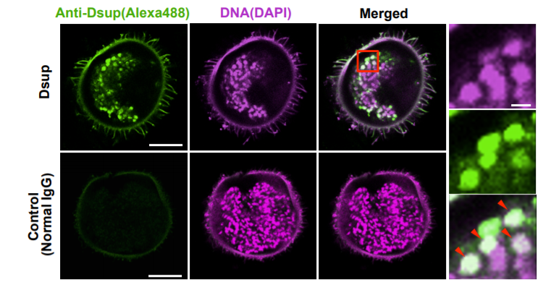
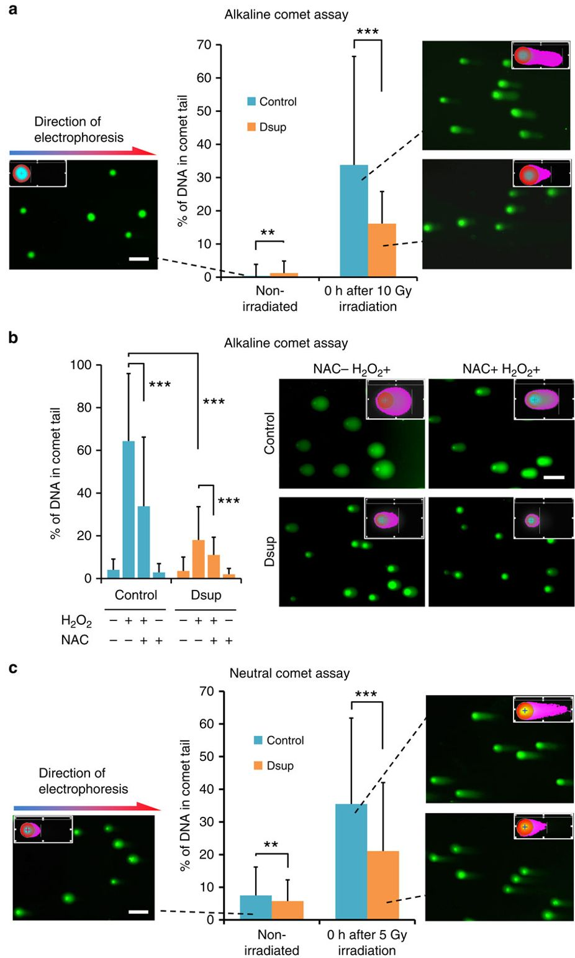
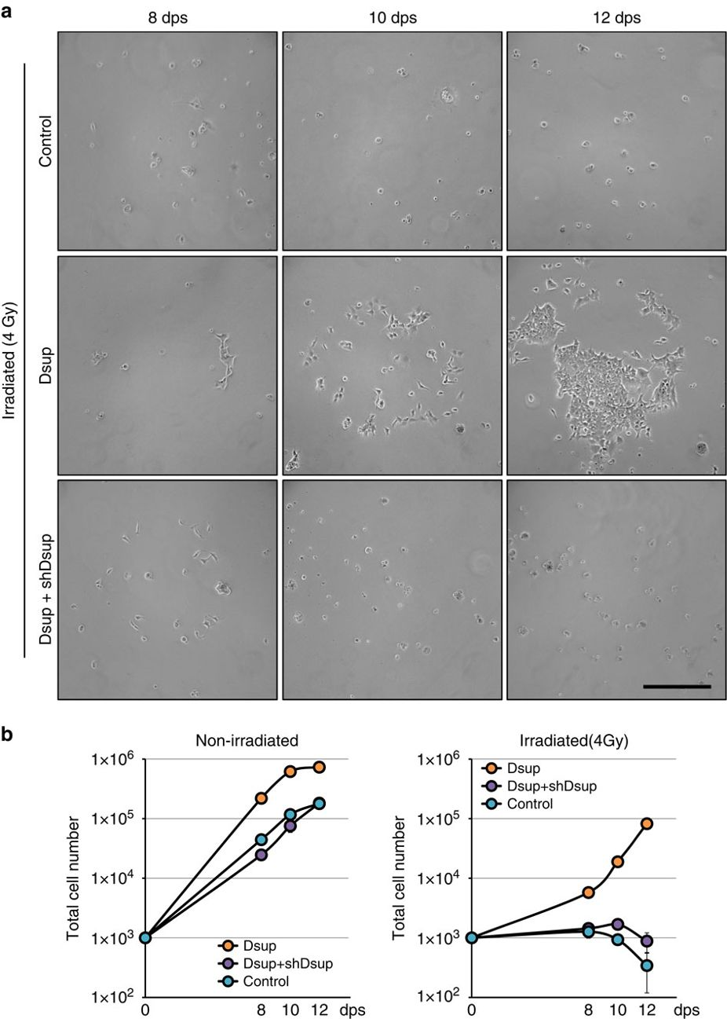
Damage Suppressor Protein is a novel mechanism for survival
Hashimoto et al. Extremotolerant tardigrade genome and improved radiotolerance of human cultured cells by tardigrade-unique protein.
Nature Communications. 2016
Notes:
Species used in this study: Ramazzottius varieornatus

Slide 12
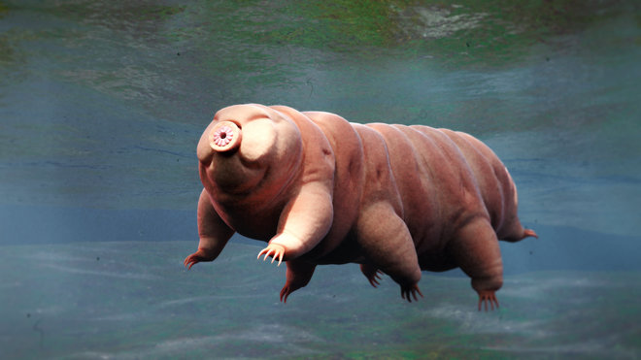
Summary
Desiccation - using CAHS and SAHS
These dry-tolerant proteins are intrinsically disordered in water but develop secondary structures in the dehydrated state that allow them to stabilize DNA, proteins, and cell membranes
Can survive extreme pressures and temperatures using desiccation
DSUP protects from radiation
Combined with desiccation allows for space survival

Slide 13
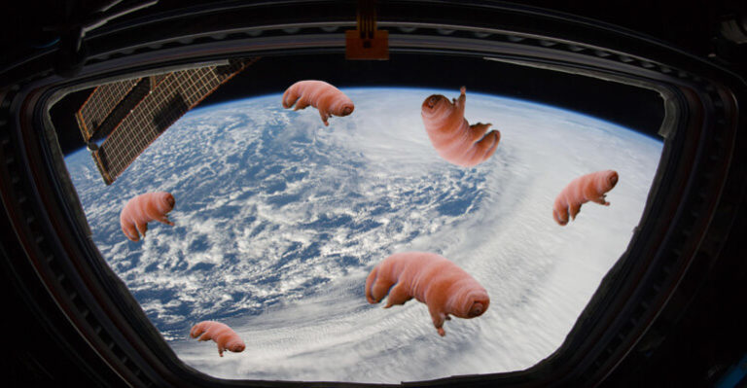
Future
Tardigrades could travel through space
Possibly arrived from space
Natural model for human space travel
DSUP protein mixed with human cell proved to protect human DNA from radiation
Cryosleep by desiccation
Applications of DSUP protein in chemotherapy

Slide 14
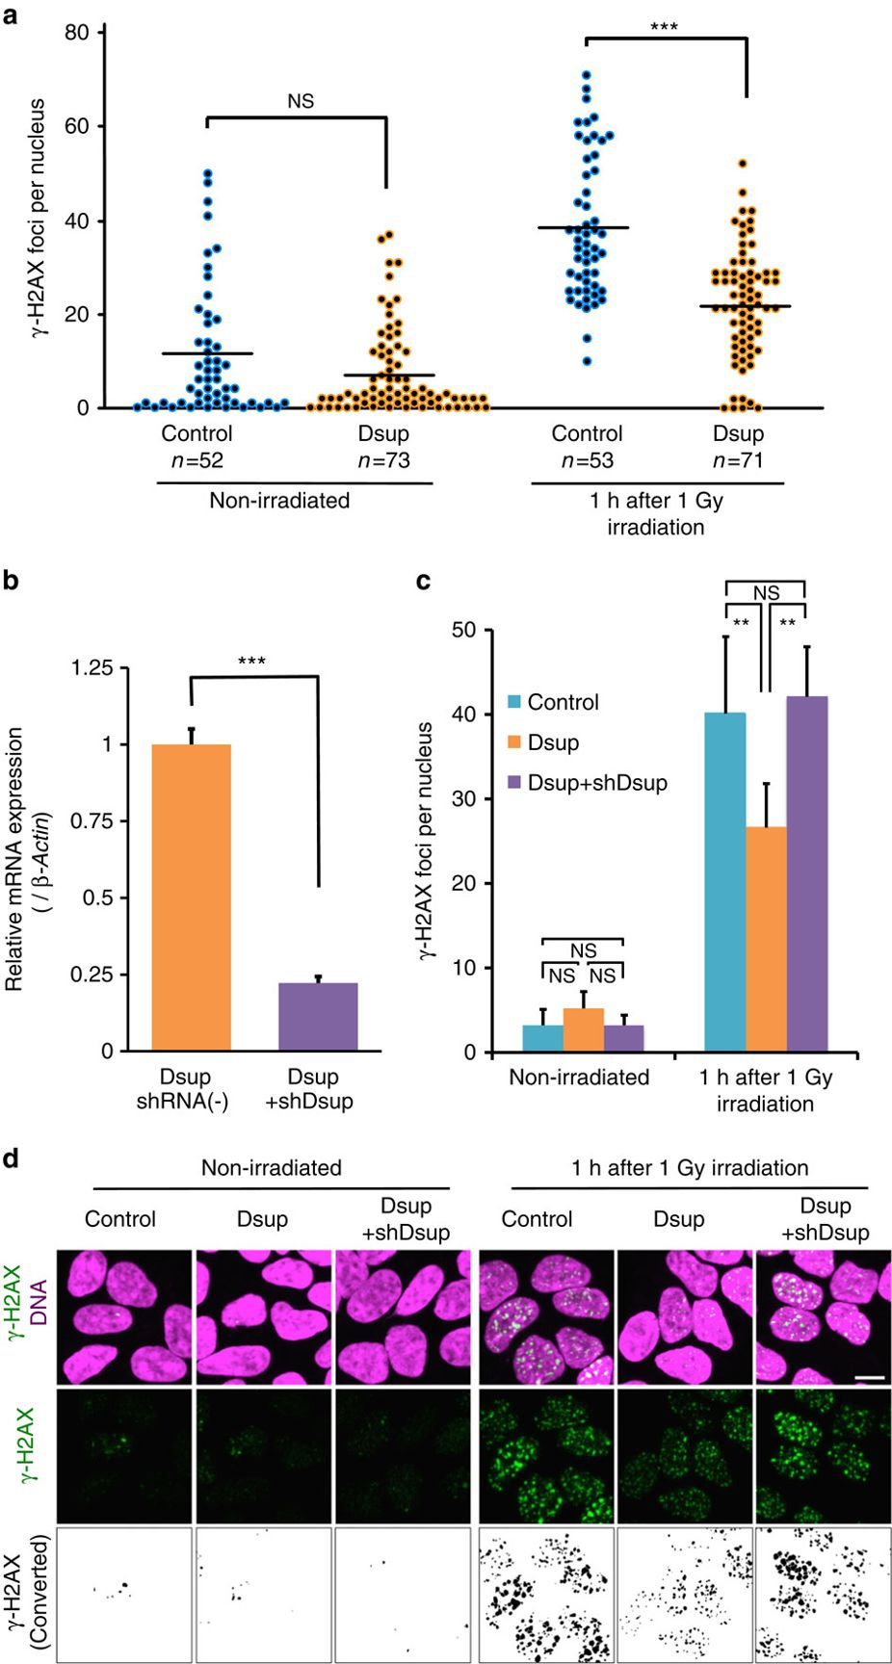
Supplementary slides: Dsup needs to be colocalized with DNA in order to protect

