Slide 1
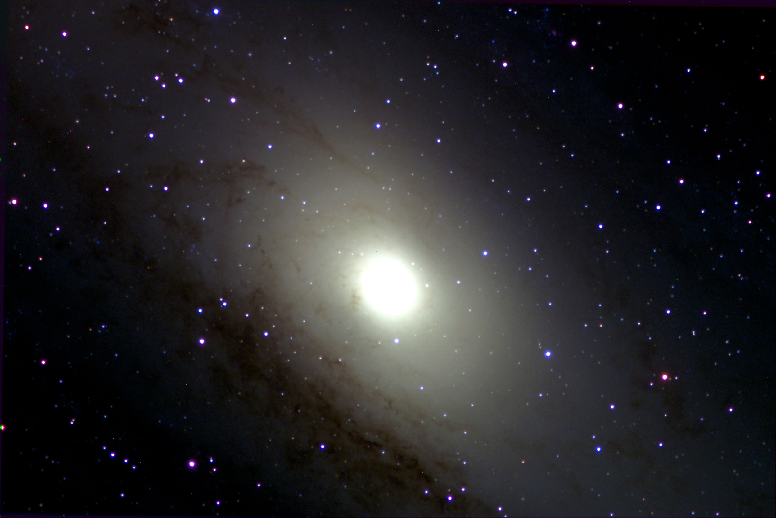
4-Vesta, Orion Nebula, Andromeda Galaxy
Emet Zeitz, Ryan Erickson, Zack Farr

Slide 2
Asteroids
•Near-Earth Asteroids are Easily Accessible
•There are over 16,000 near-Earth asteroids that share a similar orbit to Earth.
•Detecting asteroids and labeling It’s threat level to Earth.
•NEA – Near Earth Asteroid: Labeled if closer than 1.3 AU (120,800,000 mi)
•PHA – Potentially Hazardous Asteroid: labeled if asteroid is closer than .05 AU (4,650,000 mi)
•Rich in Resources
•There are an estimated two trillion tons of water available on near-Earth asteroids. This water can be used to sustain human life and as propellant for spacecraft.

Slide 3
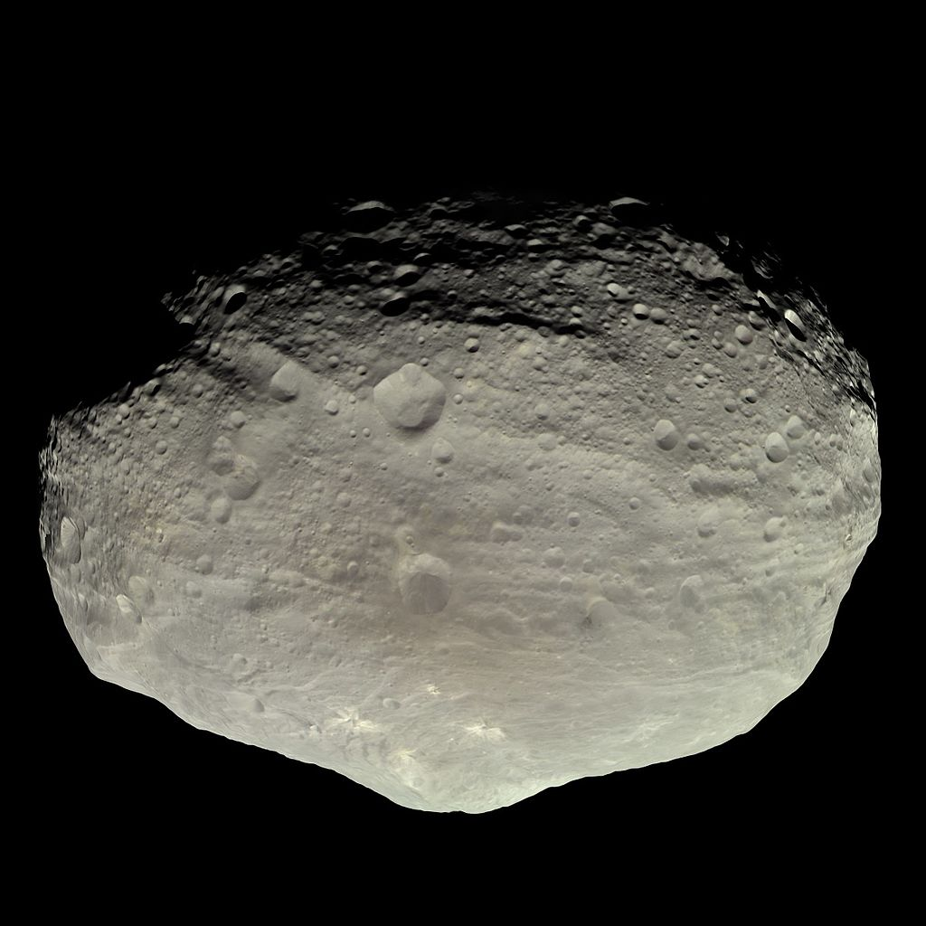
4-Vesta
Discovered by the German astronomer Heinrich Wilhelm Olbers on 29 March 1807
Mean diameter of 525 kilometres
It is one of the largest and most massive asteroids in the asteroid belt, second only to Ceres ( a dwarf planet)
it contributes an estimated 9% of the mass of the asteroid belt
Notes:
the largest objects in the asteroid belt

Slide 4
Observation
Target Name | RA | Dec | Filter | # Exposures | Integration Time (s)
4 Vesta | 281.2875 | -25.7169 | Clear | 10 | .5
4 Vesta | 281.2875 | -25.7169 | SDSS u’ | 3 | 1
4 Vesta | 281.2875 | -25.7169 | SDSS i’ | 3 | 1
4 Vesta | 281.2875 | -25.7169 | SDSS g’ | 3 | .5
4 Vesta | 281.2875 | -25.7169 | SDSS r’ | 3 | 1

Slide 5
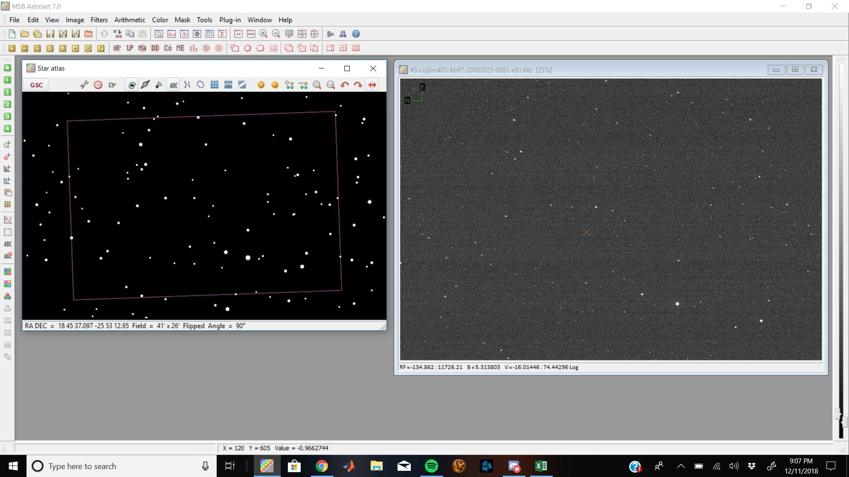
Locating 4-Vesta
Include image and star atlas
Notes:
RA dec, compared to what wasn’t on Star Atlas with closest RA and Dec; RA error = 0.021 Dec Error = 0.053

Slide 6
Light Curves
One of the things we hoped to learn through observation of near-Earth objects is their exact rotation rate, by taking a series of observations of the object over time, and plotting the change in brightness.
Unfortunately we did not know the extent of data needed to produce accurate light curves.
Instead of using our data we pulled some secondary source data from https://theskylive.com/vesta-info and used that to plot our own light curve
The three plots we have made are magnitude vs phase, magnitude vs date, and altered magnitude vs phase.
Notes:
Phase

Slide 7
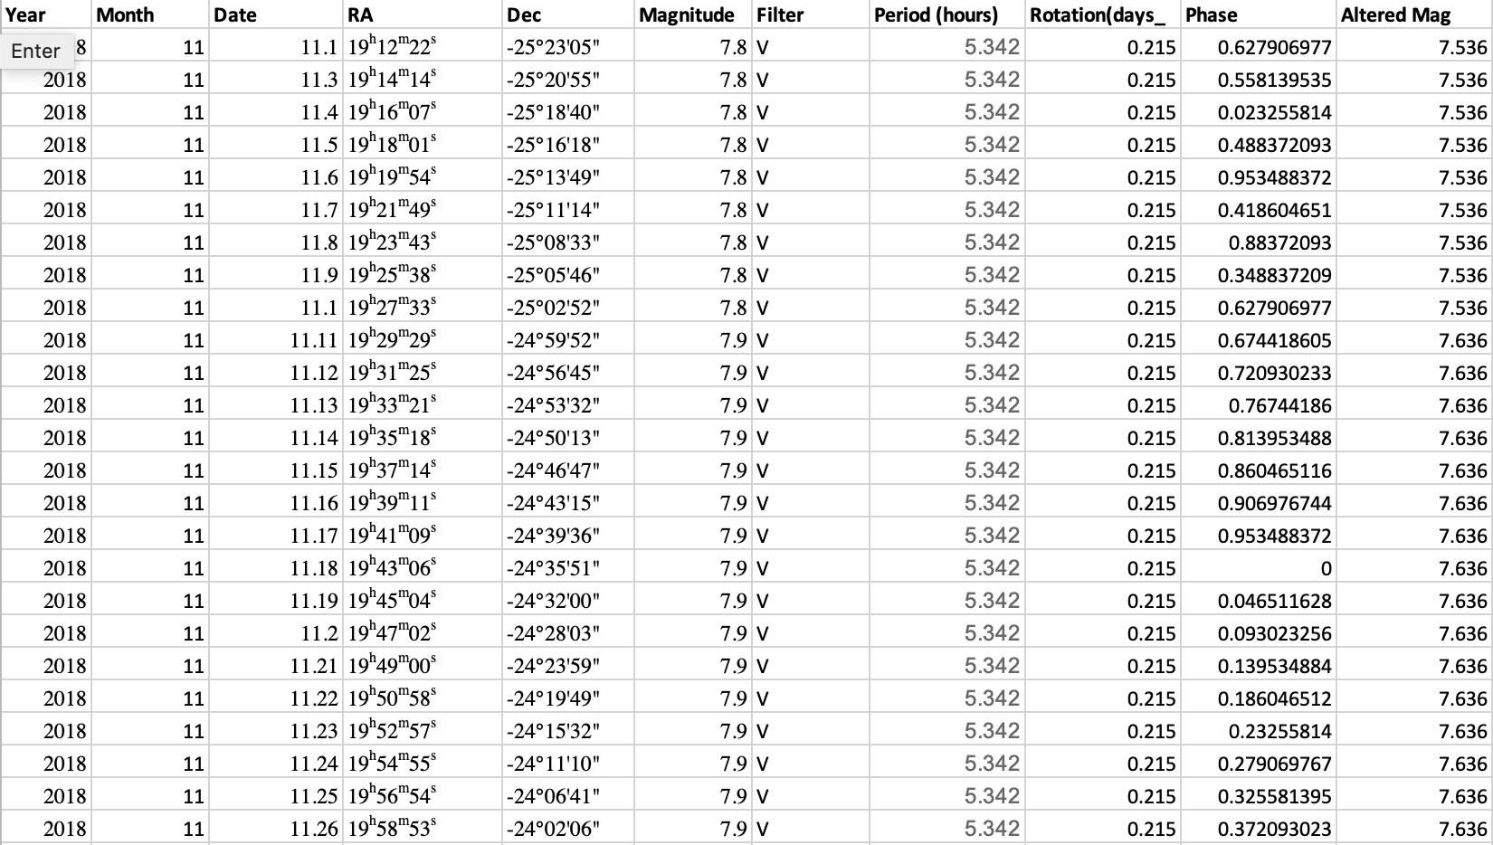
Data from TheSkyLive

Slide 8
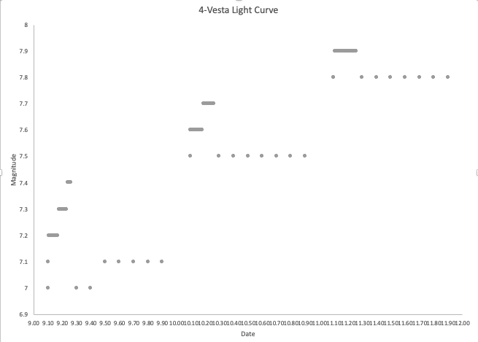

Slide 9
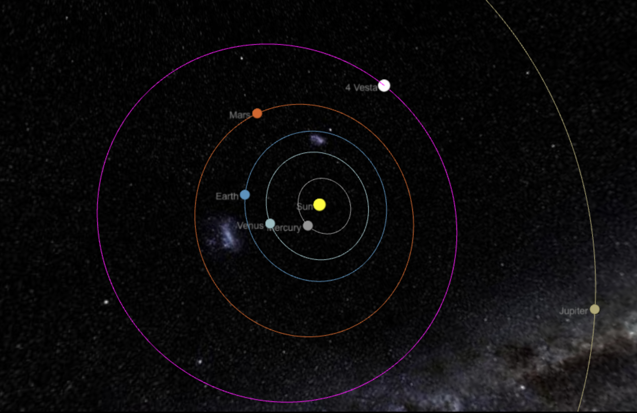

Slide 10
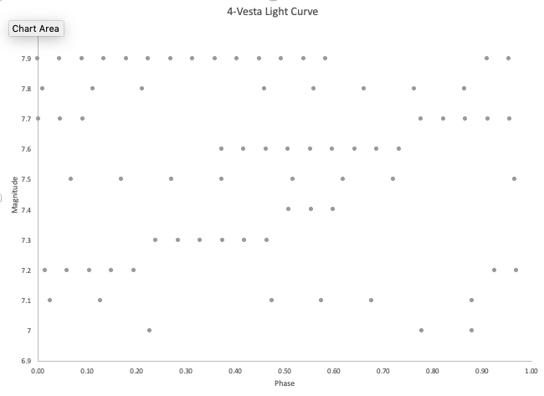

Slide 11
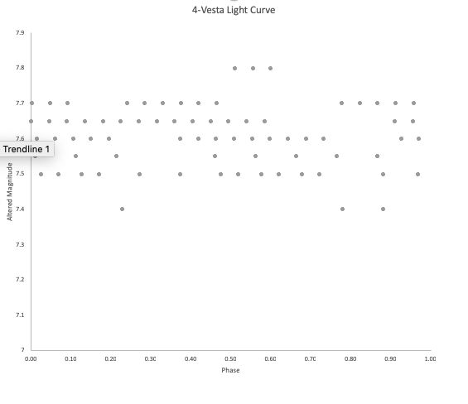
Rotation Period 5.342 hours

Slide 12
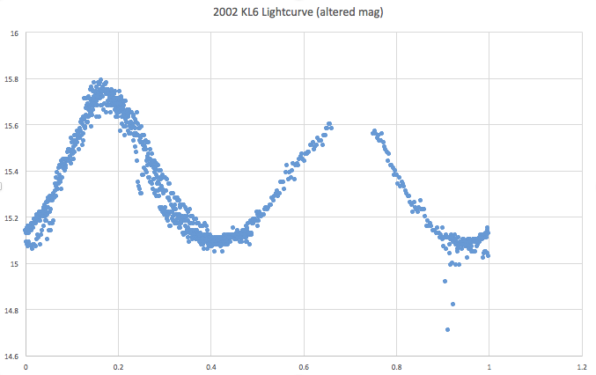
What a good Light Curve Looks like

Slide 13
Astrophotography - Orion Nebula
Also known as M42, Orion Nebula is a diffuse nebula situated in the Milky Way, being south of Orion's Belt in the constellation of Orion. It is one of the brightest nebulae, and is visible to the naked eye in the night sky.
The M42 nebula is estimated to be 24 light years across and its 1,344 ly and has a mass of about 2,000 times that of the Sun.
The nebula has revealed much about the process of how stars and planetary systems are formed from collapsing clouds of gas and dust.
Astronomers have directly observed protoplanetary disks, brown dwarfs, intense and turbulent motions of the gas, and the photo-ionizing effects of massive nearby stars in the nebula.
We initially started with exposures of 1-2 sec, as we used apparent magnitude when calculating exposure time rather than absolute magnitude, which later produced exposure times of around 30 seconds.

Slide 14
Process of stacking/merging images
-Preprocessing: “Raw” Photos
- This was a streamlined process done in astro art made even easier by LCO’s BANZI program, which eliminated the need for any flat fields, dark frames, and dark flats as it already merged them into the best possible picture
- Mainly used to align, and merge (sigma) multiple captures at once
-Light curves
- This option wasn’t as apparent in Astroart, and it was difficult to dim brighter areas while enlightening darker areas
- Then, we used two methods to add color and it was simply a matter of playing with the different options in Astroart/GIMP to produce the best images with the best results

Slide 15
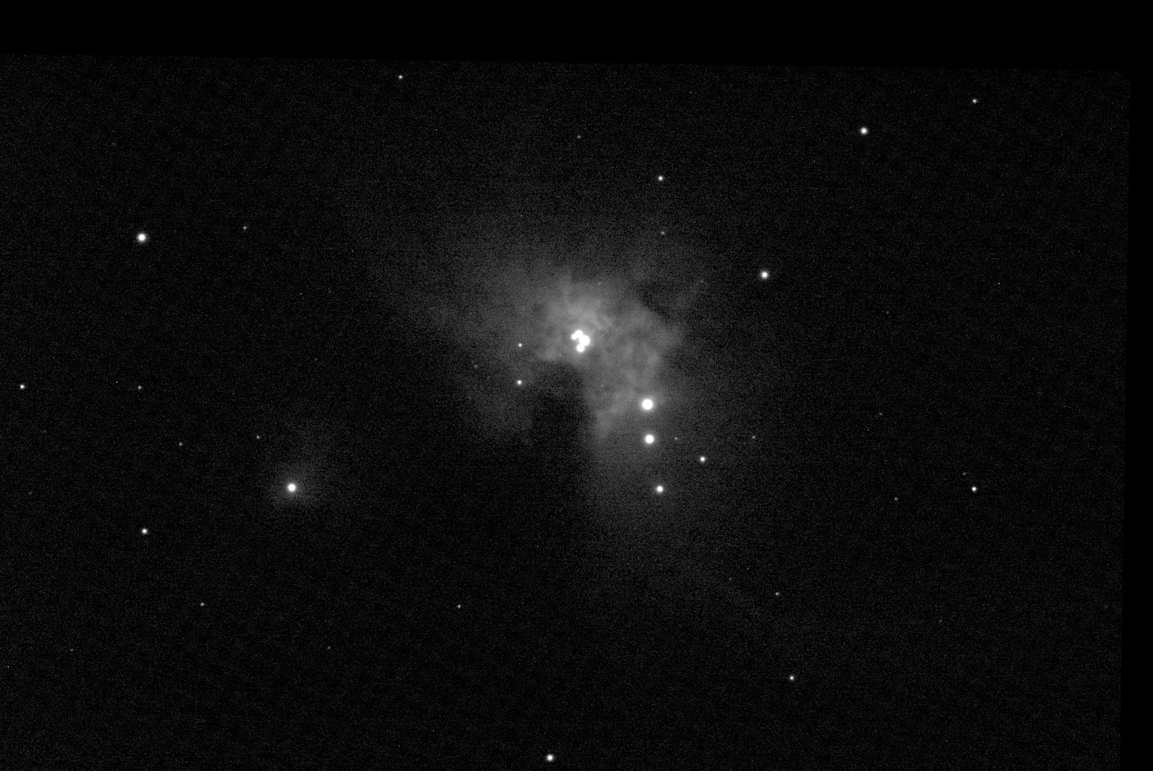
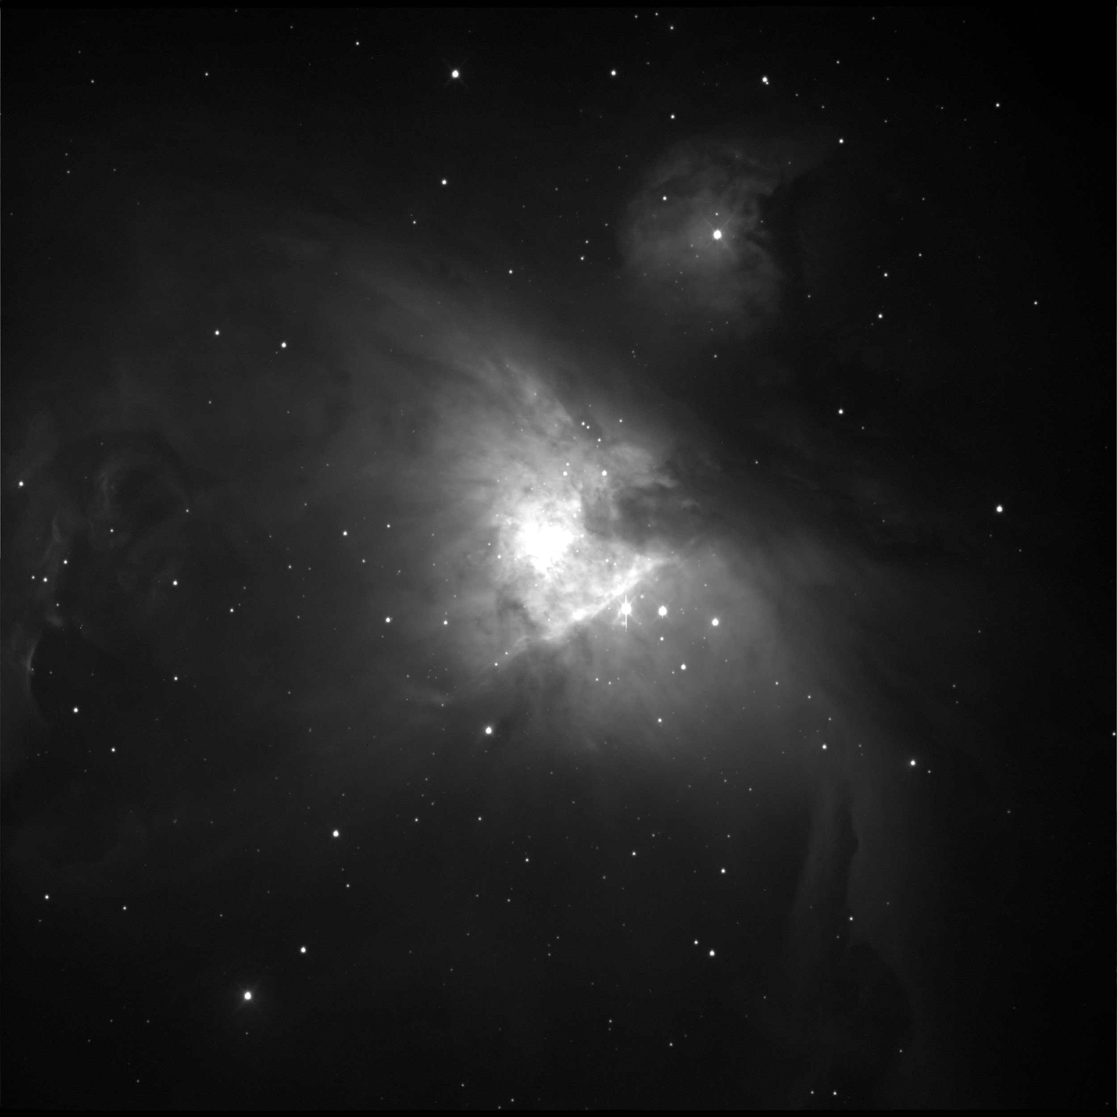
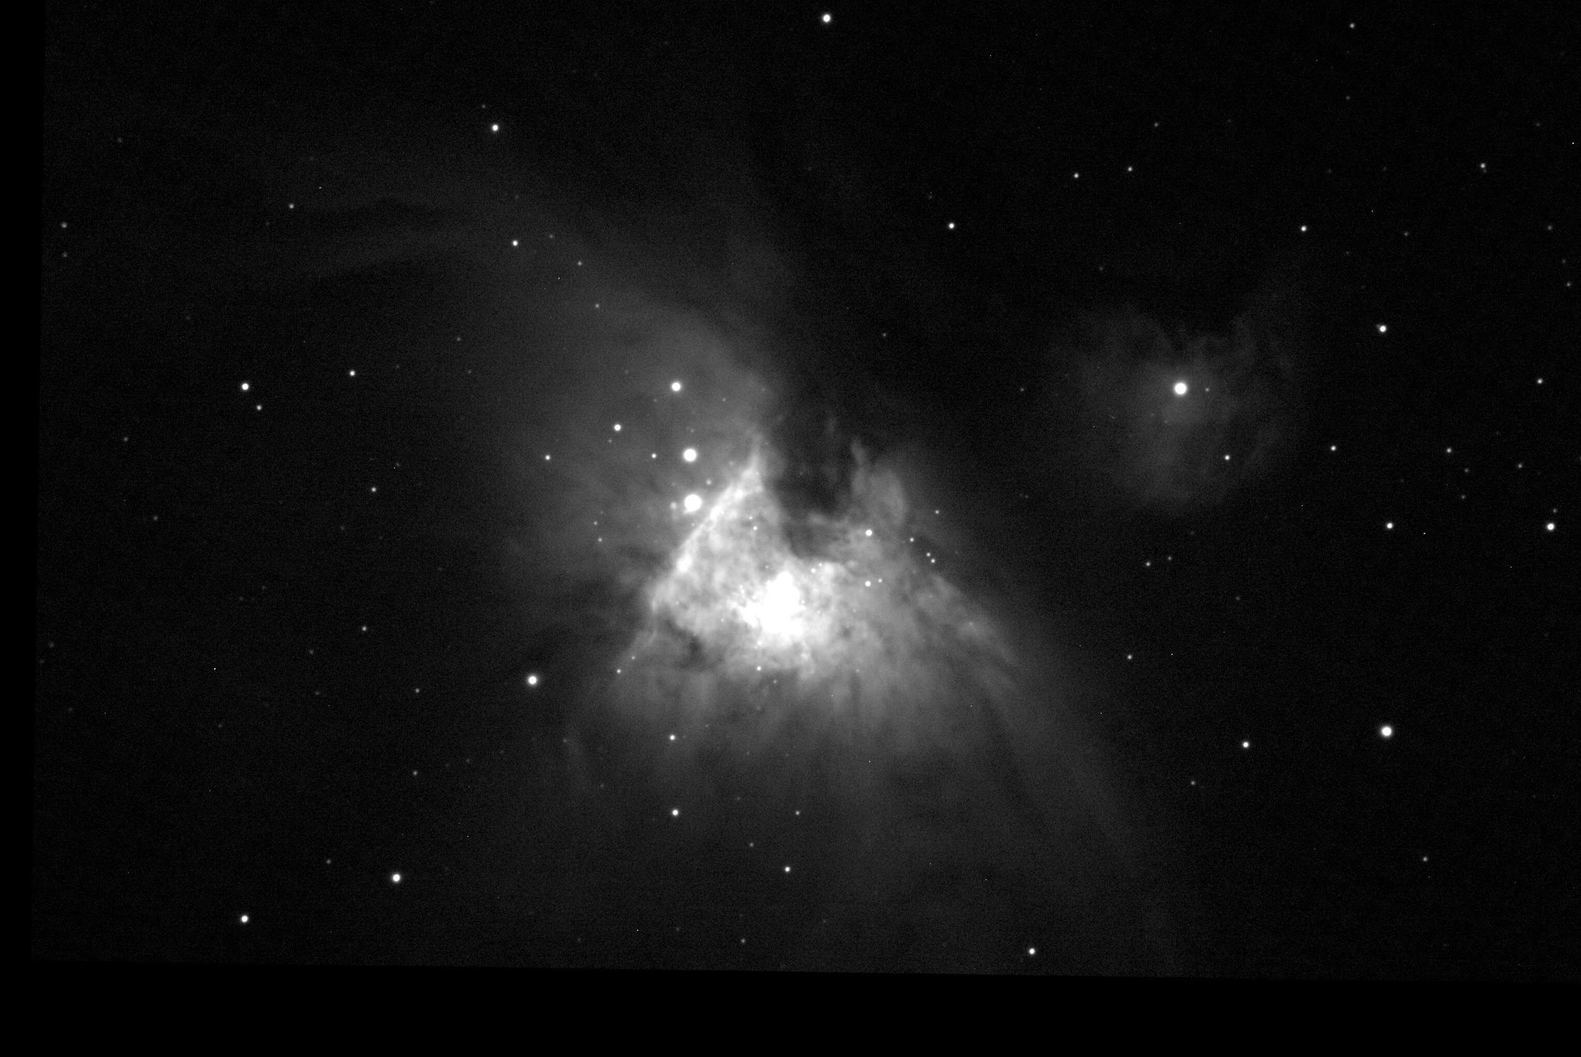
Images after stacking (all of these are through SDSS r’ filters)

Slide 16
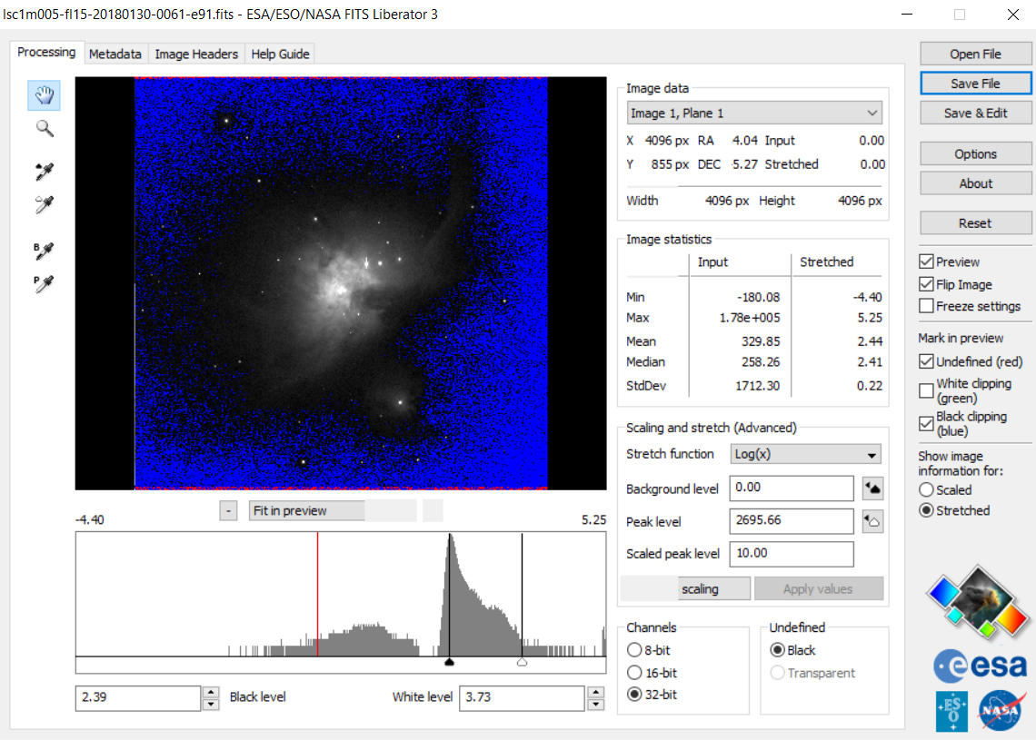
GIMP
GIMP is short for GNU Image Manipulation Program, and is a free photoshop tool for Windows, Linux, and Mac
Before using GIMP, a file conversion from .FITS to .TIFF done by FitsLiberator so GIMP can read the file
In FitsLiberator, levels could be adjusted
and slight brightness control was also
avaliable before they were edited
further in GIMP
It has many more options to play around with
than Astroart, such as but not limited to:
Exposure filters
More accurate reading of light levels
and curves
Saturation and black levels
Real time editing previews

Slide 17
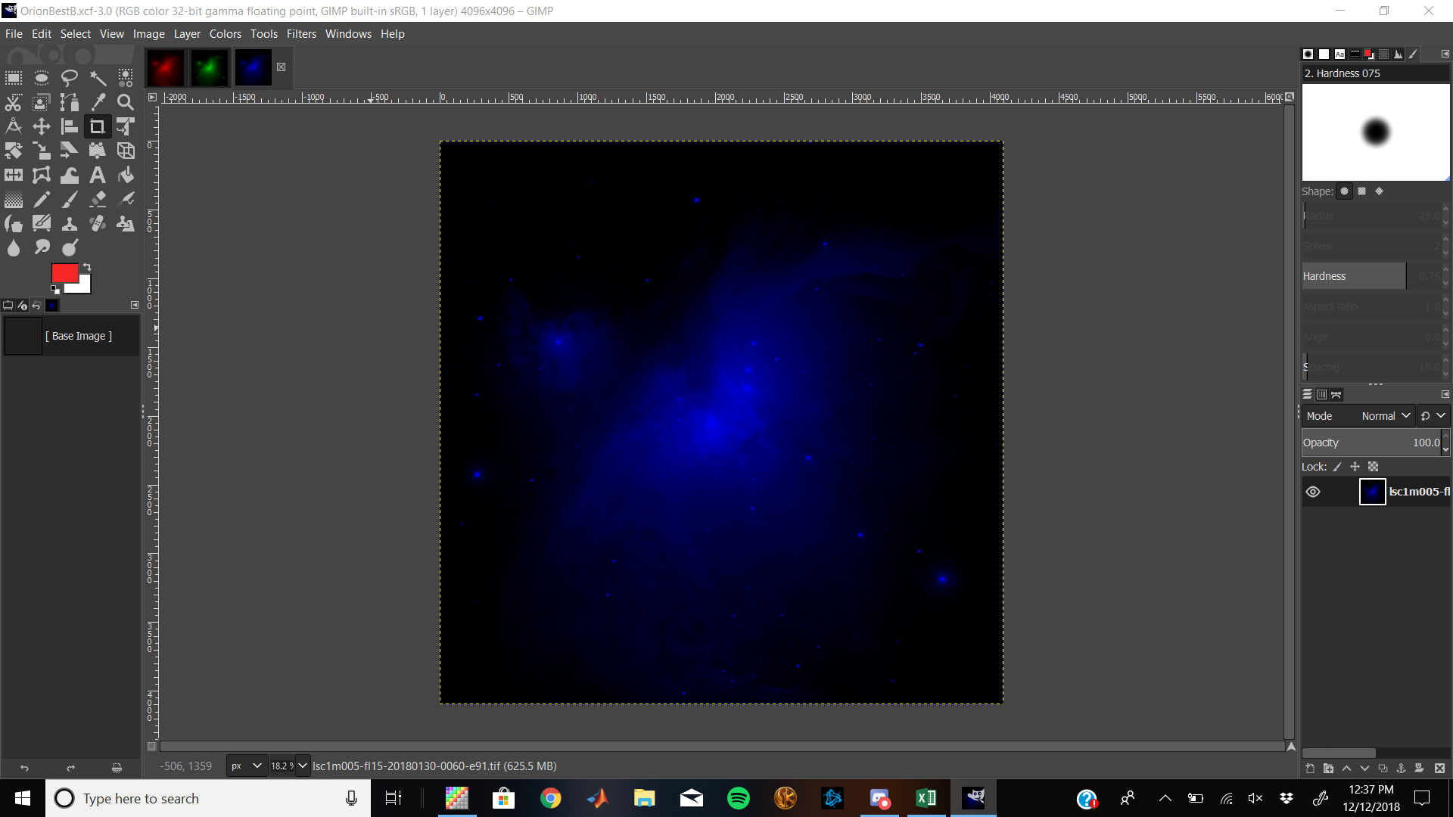
Coloring
-2 methods of coloring
-AstroArt - simple process, as each filter was layered and pre colored in the Trichomy section
-GIMP - a couple more steps involved, but able to play around with this option and see/do more with colors.
-After colors were layered with the correct
RBG hues, the light curves and contrast
was then able to be
adjusted.
-Final touches include contrast levels,
hue exposure and color saturation

Slide 18
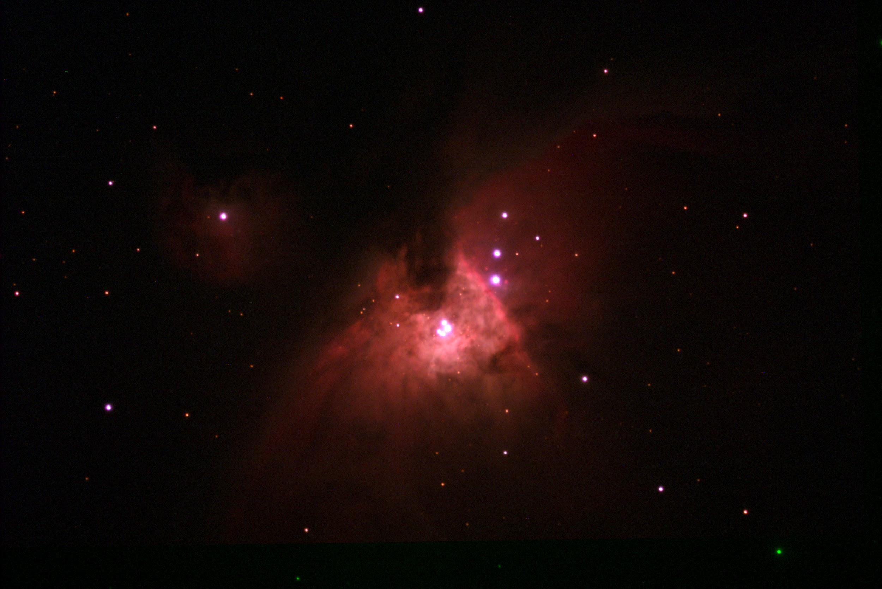
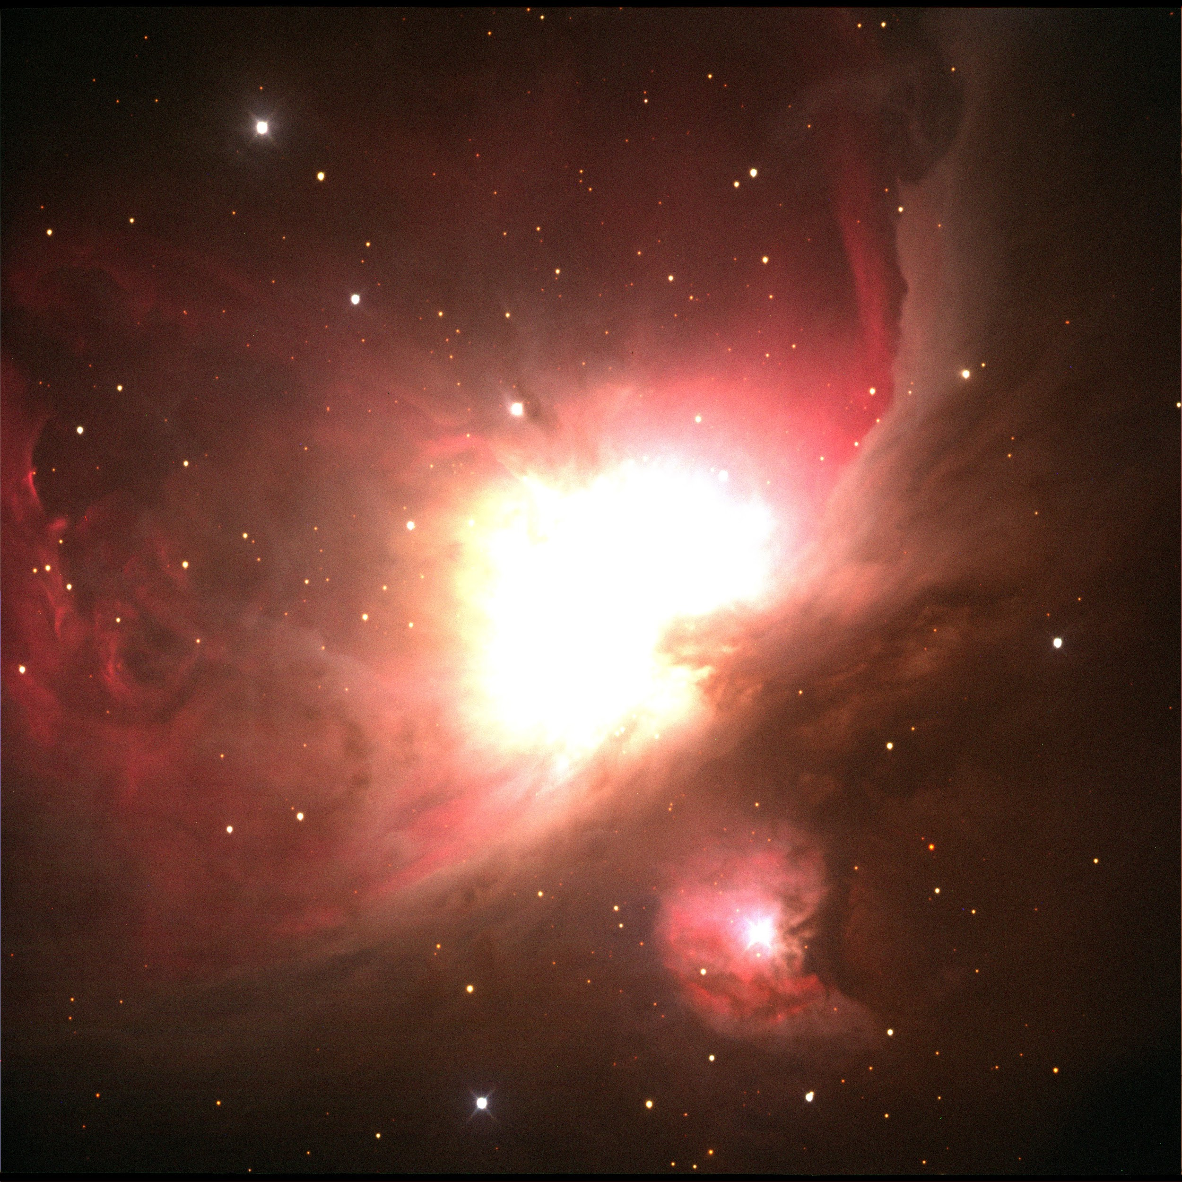
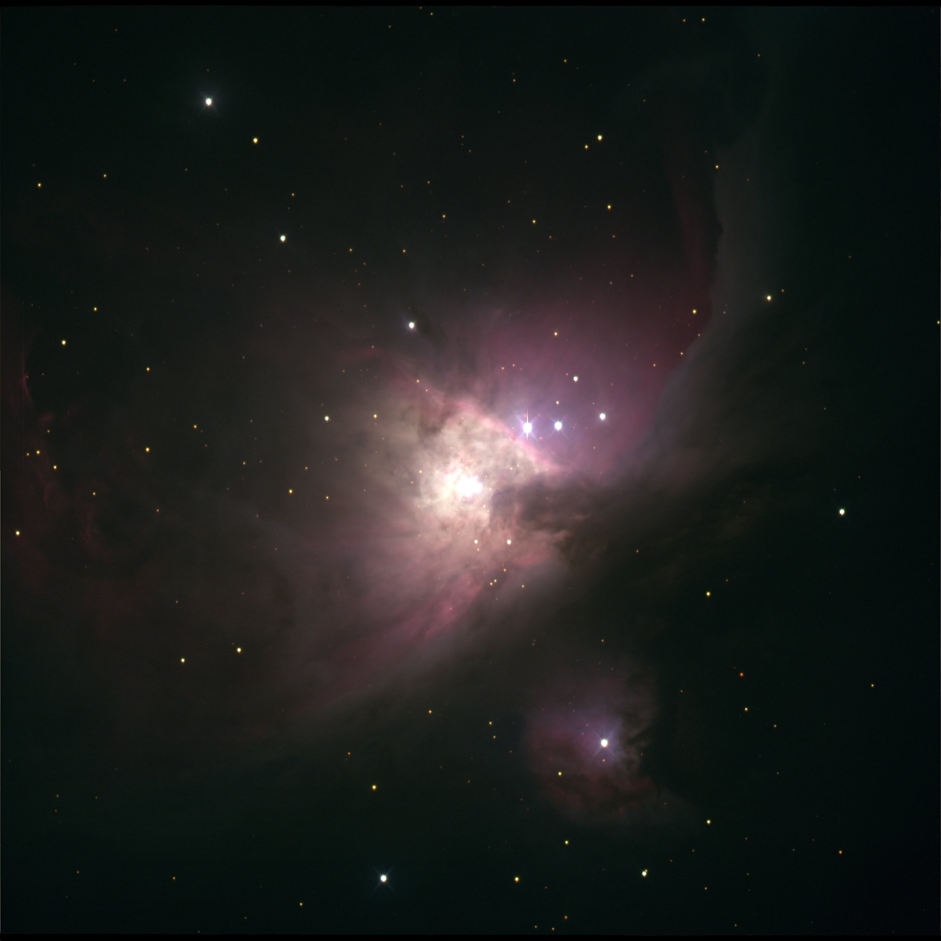
Merged photos

Slide 19
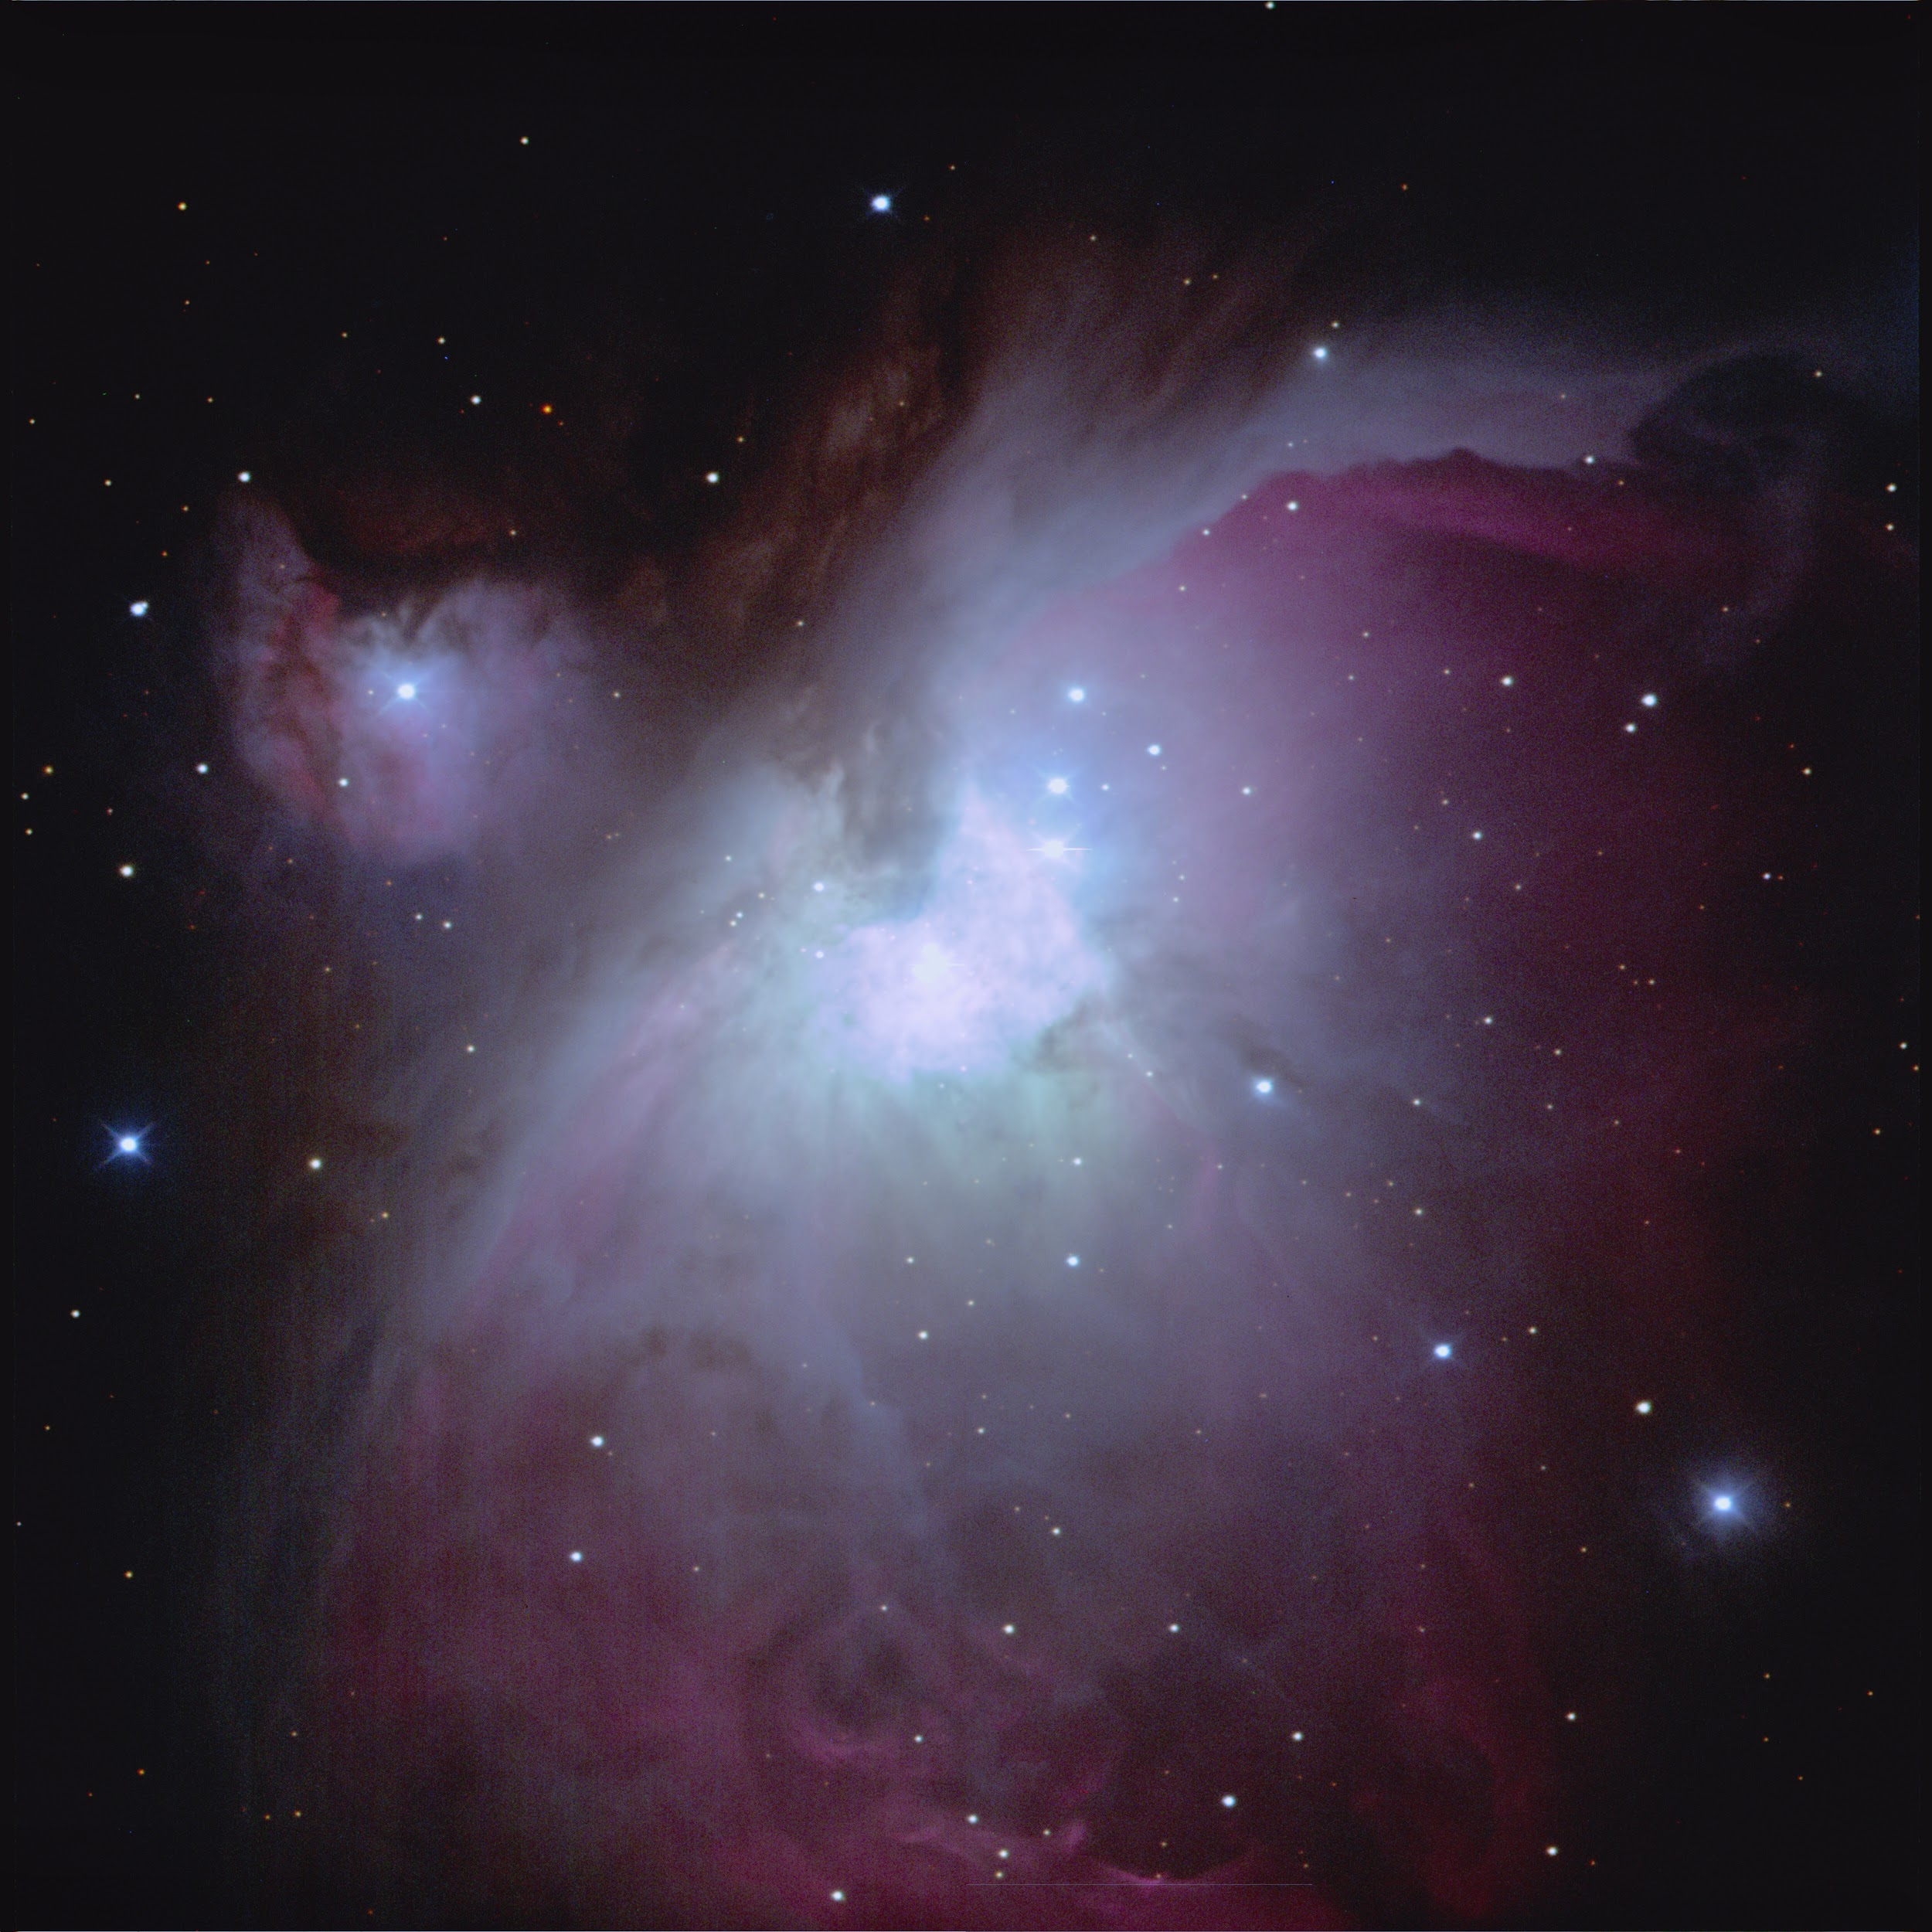
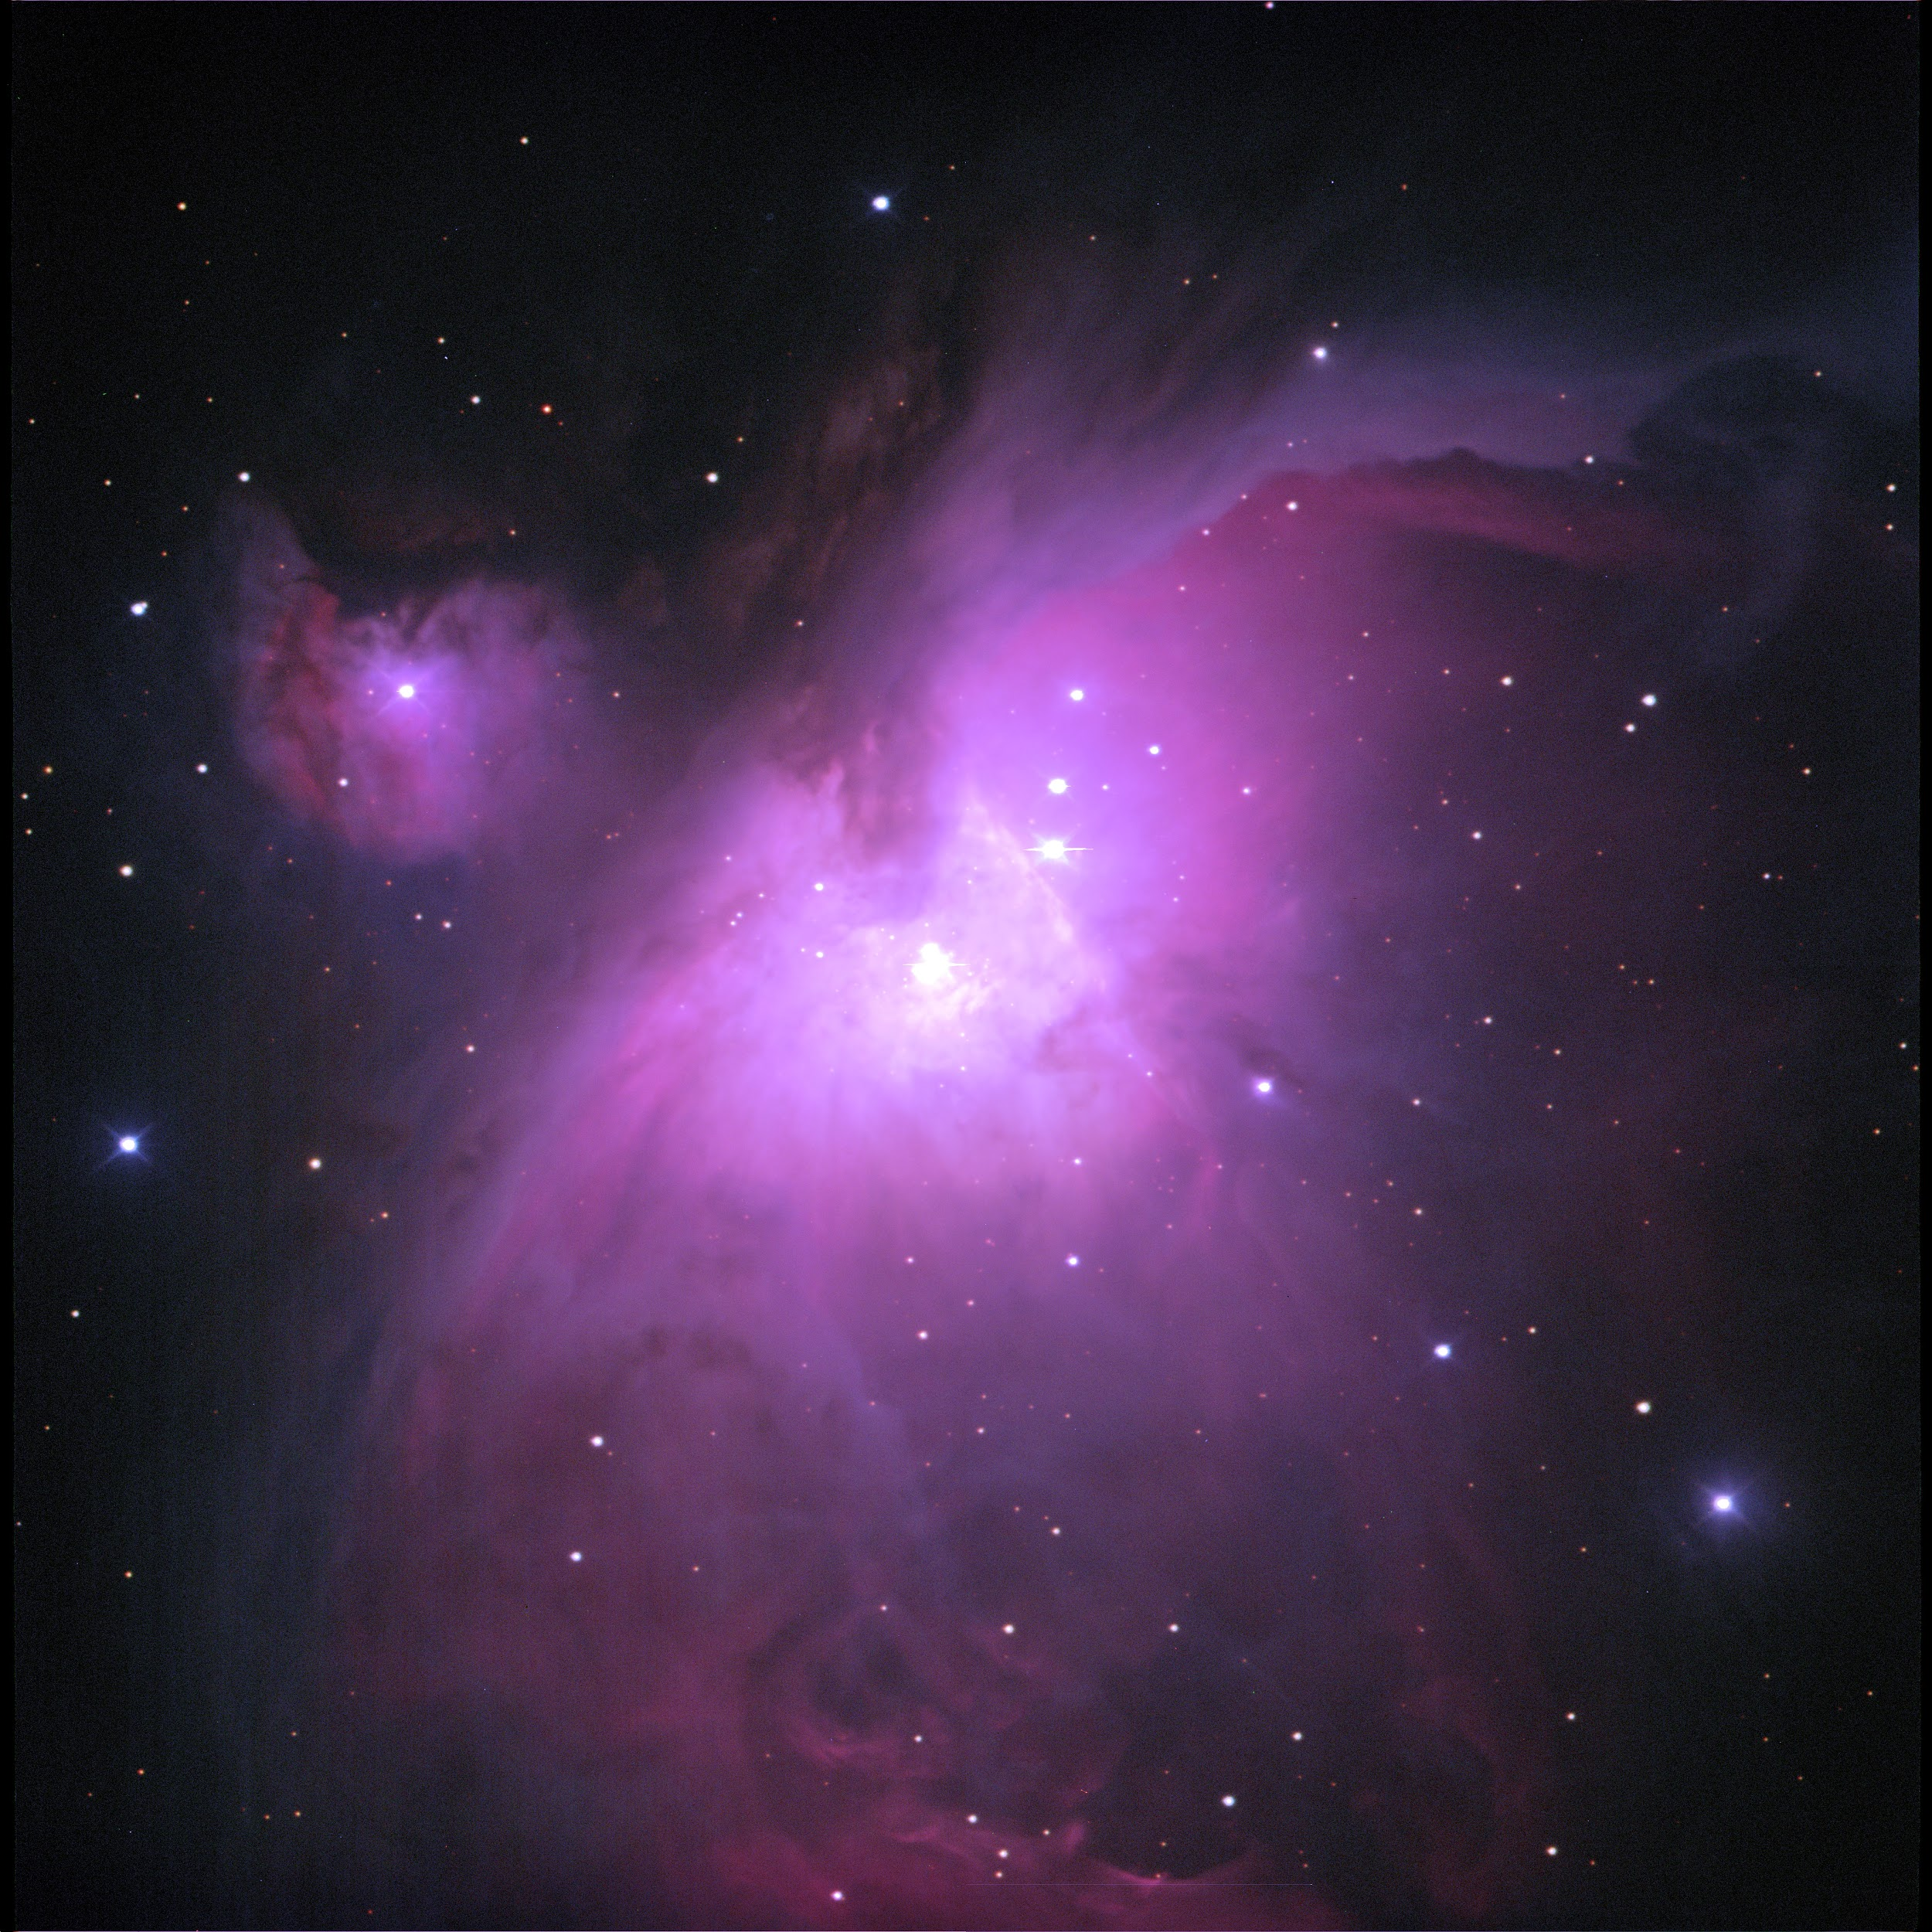
GIMP images

Slide 20
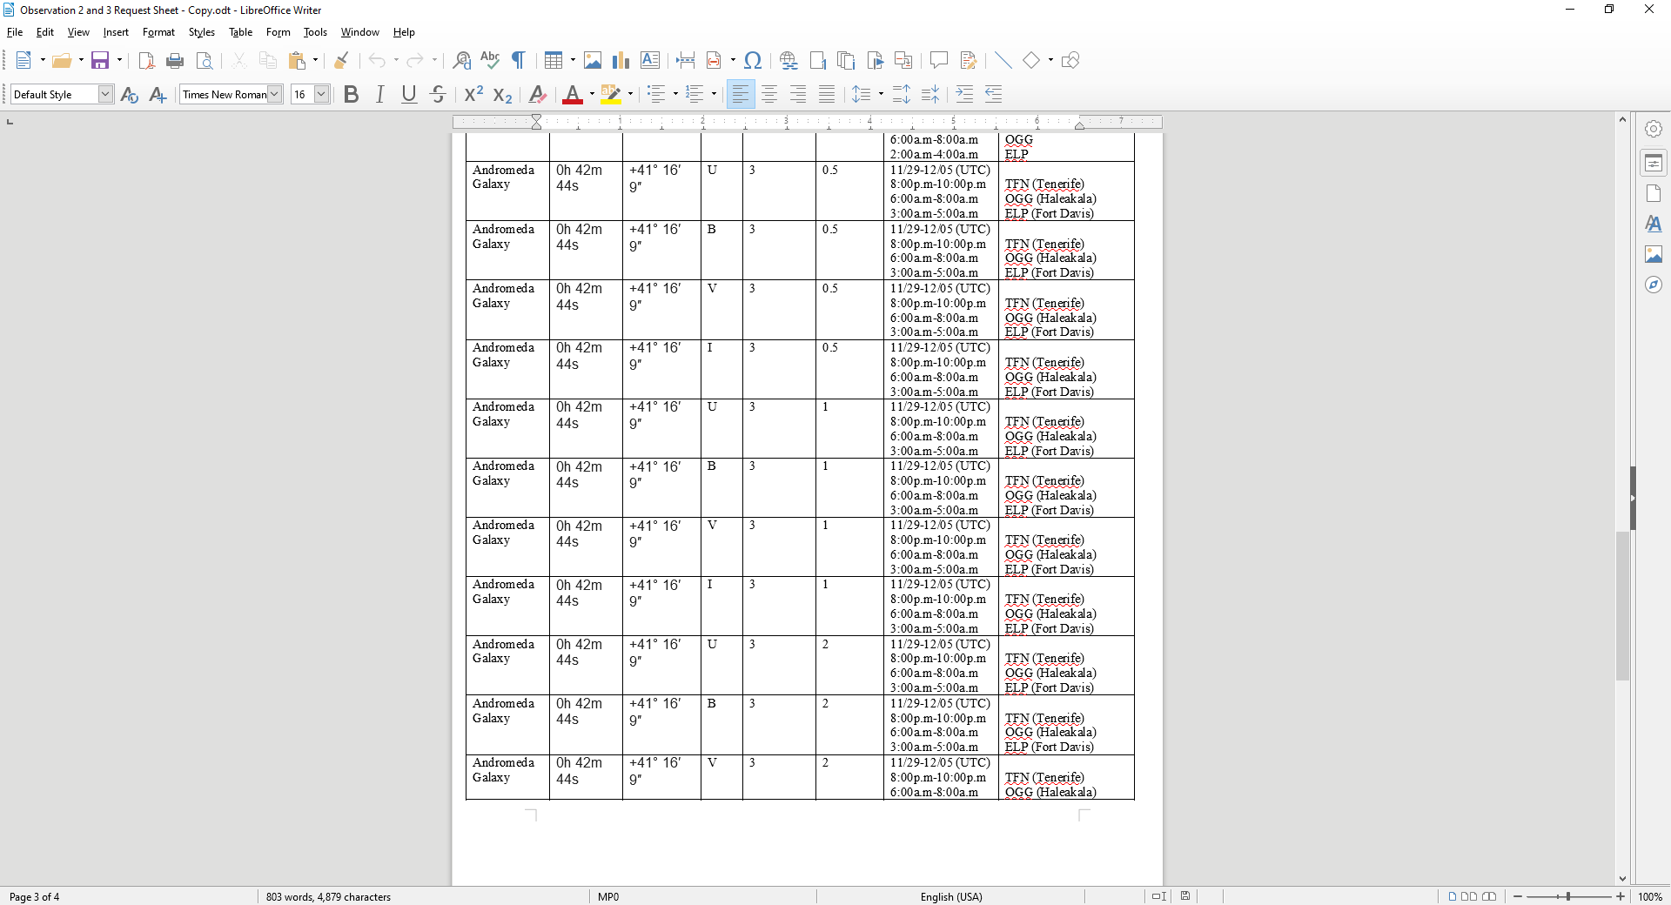
Andromeda Observation request

Slide 21
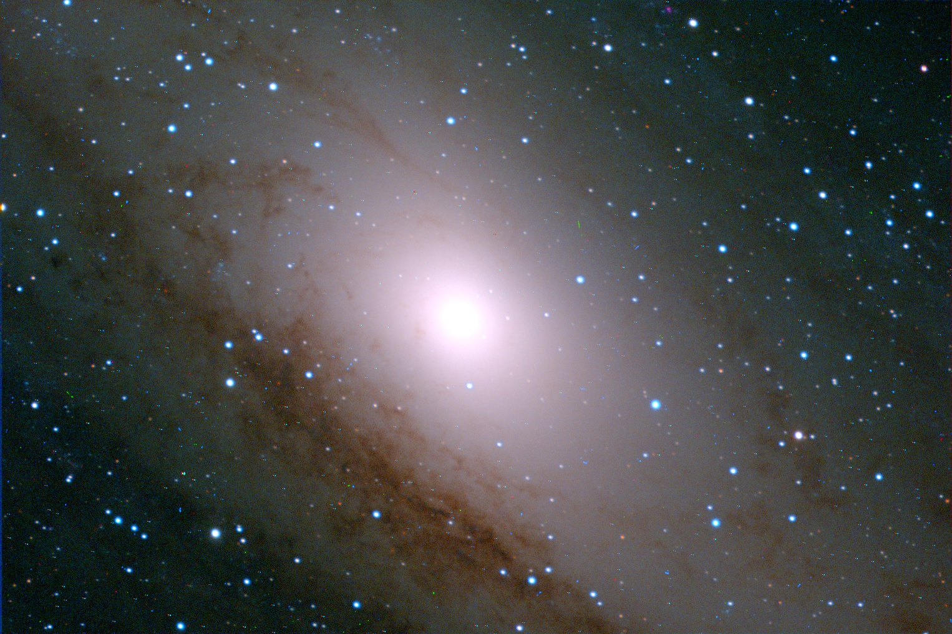
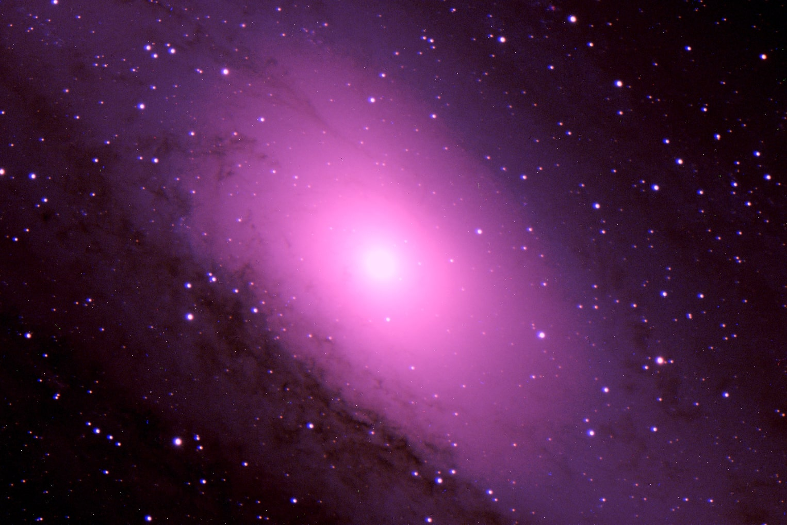
AstroArt w/ Andromeda: Project 3

Slide 22
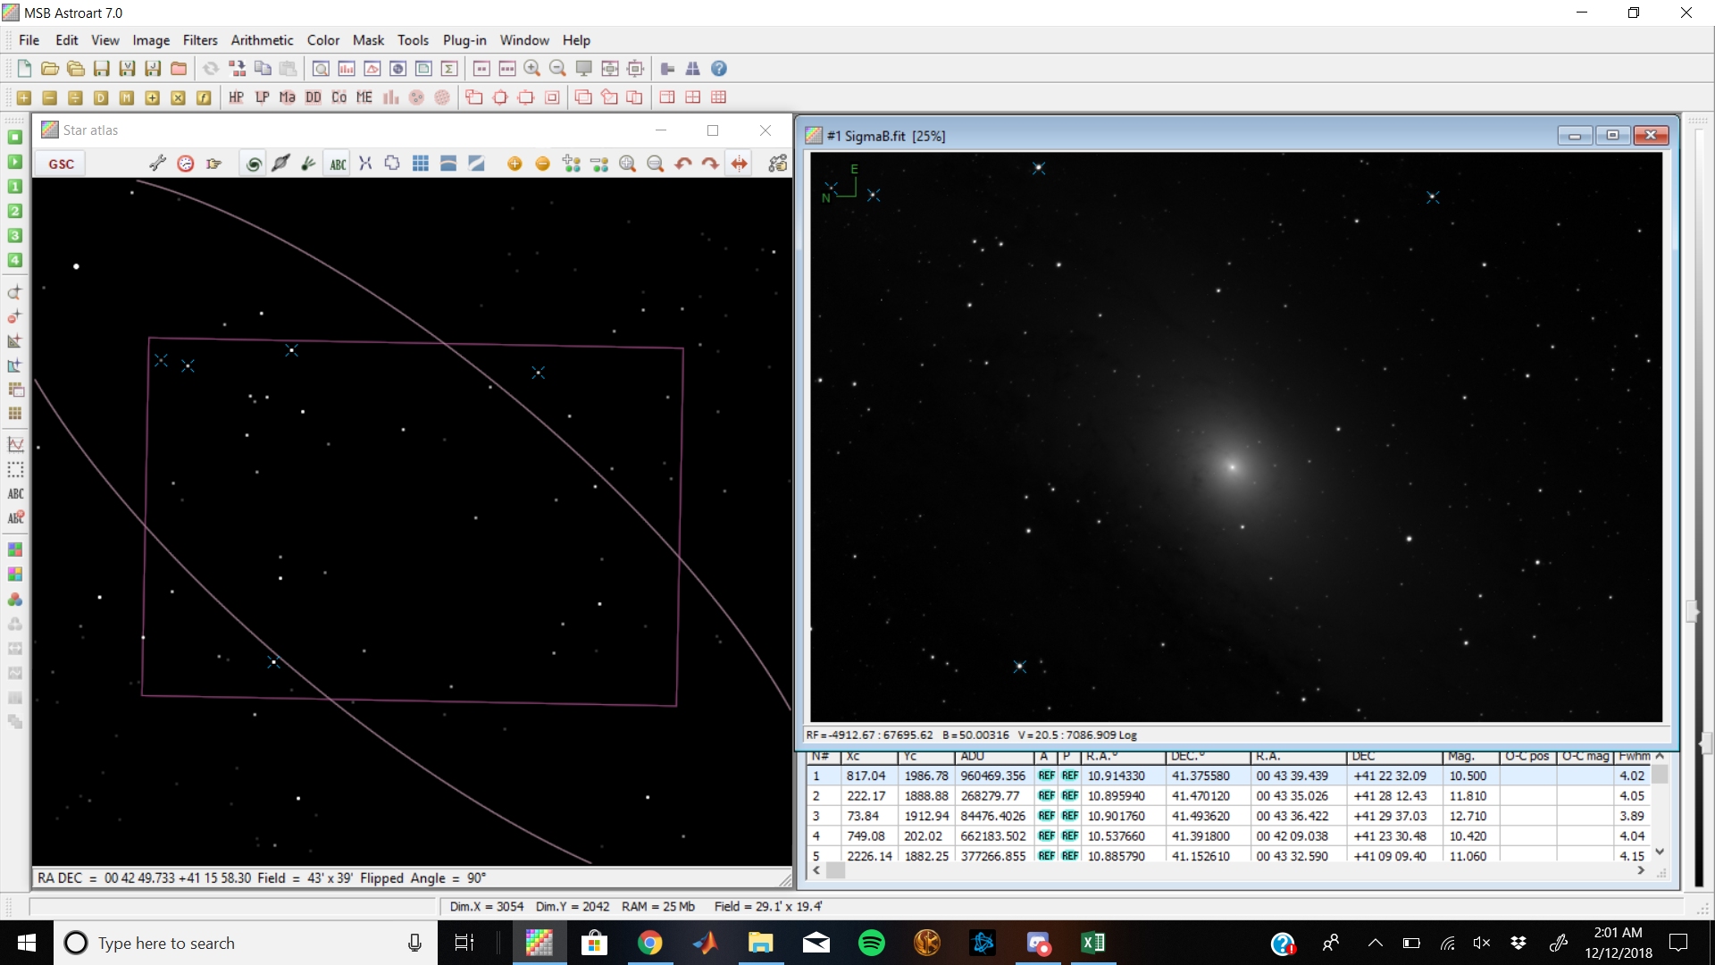
Andromeda Data: Finding Reference Stars
- Star Atlas

Slide 23
Color Indices to find temperature curve
Using the star atlas map on astroart we were able to set reference stars
Using known magnitudes of those reference stars astroart did the calculations for the magnitudes of the rest of the stars in our photo
We did this for both the B and V filters, then calculated B-V magnitudes of those stars
Then plugging in those values to this equation we got associated temperature values ((1/(0.92*(B-V)+1.7))+(1/(0.92*(B-V)+0.62)))*4600=T

Slide 24
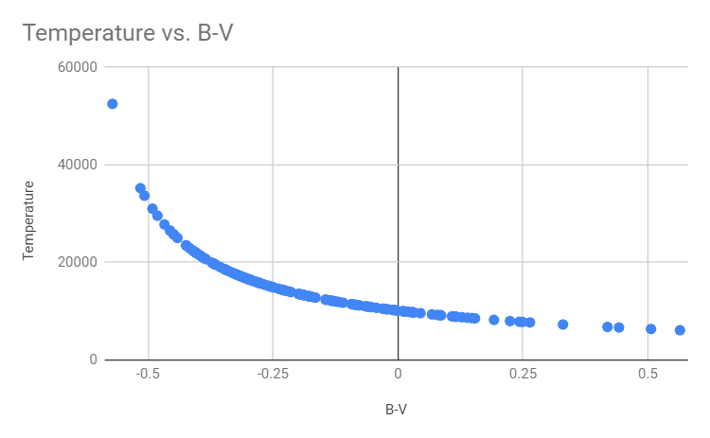
Data Analysis: Temperature vs Color Indices

Slide 25
Data Anaylsis
One of our goals was to construct an H-R diagram for Andromeda
These are graphs of star Luminosity/Absolute magnitude vs temperature
We realized we could not calculate luminosity very easily as it depends on the stars distance and radius
Instead we can procure similar data using known a H-R diagram to compare with our own data
All of our calculated magnitudes are apparent magnitudes but since the relative scale is the same between both apparent and absolute we can match our data to the known H-R diagram with an absolute magnitude scale
http://web.physics.ucsb.edu/~jatila/LambdaLabs/Globulars/HRdiagramlab_JKV.pdf

Slide 26
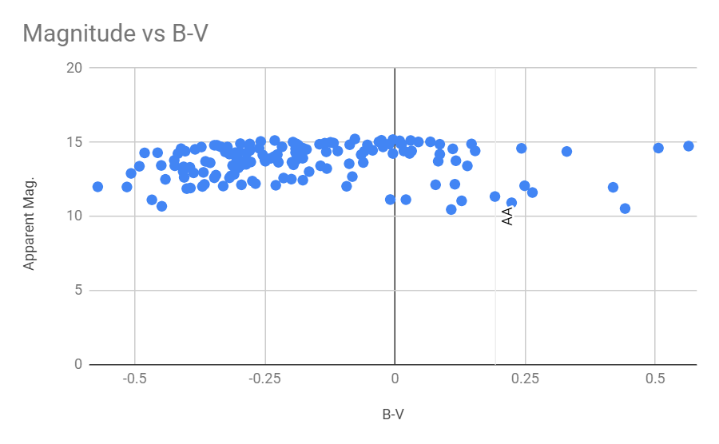
Note: The apparent magnitude should be inverted so that it starts at 20 and goes to 0
The best data points lie in the region of B-V values ranging from -0.5 to 0.25 which have corresponding temperatures in the range of ~40,000k to ~7000K
Now we can match this up with the known H-R diagram!

Slide 27
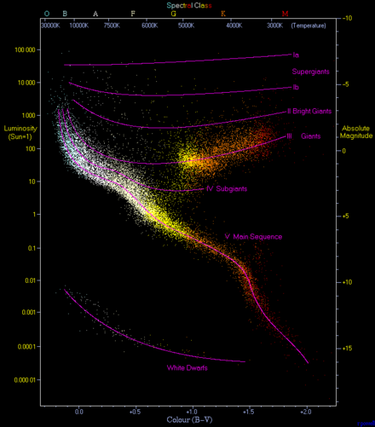
H-R Diagram

Slide 28
Data Analysis: Other methods of distance
We can’t use parallax since Andromeda is too far and the arcsecond that would too small
We can use Cepheid Variable stars to measure the distance quite accurately
A Cepheid variable is a type l; ,star that pulsates radially, varying in both diameter and temperature and producing changes in brightness with a well-defined stable period and amplitude.
There are Cepheid variable stars located inside Andromeda, as discovered by Edwin Hubble
By the end of 1924, Hubble had found 36 variable stars in Andromeda, 12 of which were Cepheids.
This in turn allows one to determine the distance to the star, by comparing its known luminosity to its observed brightness.

