Slide 1
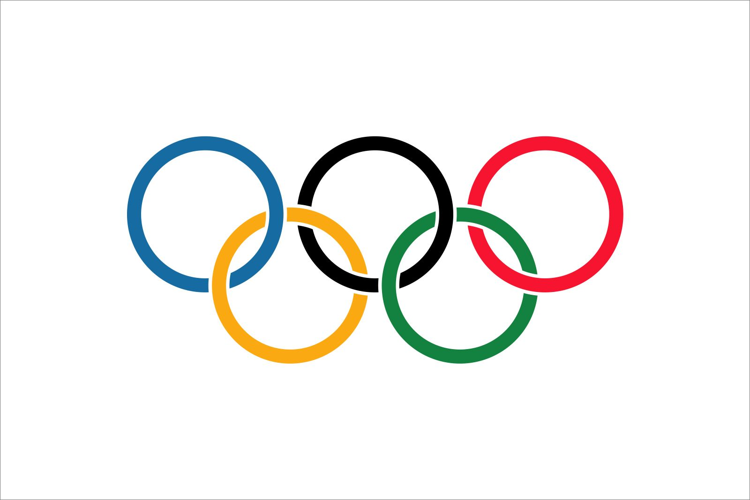
Summer Olympic Games Data Analysis
Ryan Feryo

Slide 2
Datasets Used
Olympic Athlete Dataset: Time Period From 1896-2016, 130,000 Athletes, Over 200 Countries
NBA Player Data from 1996 - 2024
European Soccer Player Data 2014 - 2024
Notes:
For this project, there were multiple datasets that I used for my analysis. One was an Olympic athlete dataset from 1896-2016 where I analyzed over 130,000 athletes from over 200 countries for both summer and winter sports. I also analyzed data from international NBA players as well as Soccer players across the Top 5 European leagues which we will look at later in my analysis.
(***Disclaimer: The Olympic athlete dataset was given to me by my prompt for my capstone in my Data Analyst Bootcamp from Adelphi University. We were told that some data might not be historically accurate, but that the dataset was used for demonstrative purposes.)

Slide 3



Tools Used
Excel
Python
Tableau
Notes:
The tools that I used for this project were Excel, Python, and Tableau. I used Excel to store the data into csv files and used Python to clean the data and remove any null values and outliers. I then used Tableau once the data was properly cleaned for data visualizations.

Slide 4
How The Data was Treated
Removing Duplicate Rows
Handling Missing Values
Removing and Handling Outliers
Objective
Show which sports United States is falling behind in and which sports the country needs to be aware of in the future.
Give recommendations on how to improve on the United States’ performance in the future
Notes:
How the Data was Treated: First, I dropped all the duplicate rows, then for missing values, I replaced the values with the median for age, height, and weight of athletes from each event and each country, followed by replacing the remaining null values for each column with the median by event, sport, and team separately if needed. because I wanted to be specific and as accurate as possible. I decided to only remove outliers in the age column and decided that it was necessary to keep the outliers for the height and weight as they are mostly basketball players, wrestlers, and weight-lifters that make it seem like there are outliers, and it would be detrimental to the analysis to remove them in this scenario.
My objective for this project will be to show how the United States has been behind the pack in some sports and the reasons for that, as well as showing some sports the United States has dominated in but might need to reevaluate their approach in preparing for future Olympic Games. I will also be giving some recommendations on how to improve and compete with the top nations in their respective sport for years to come.

Slide 5
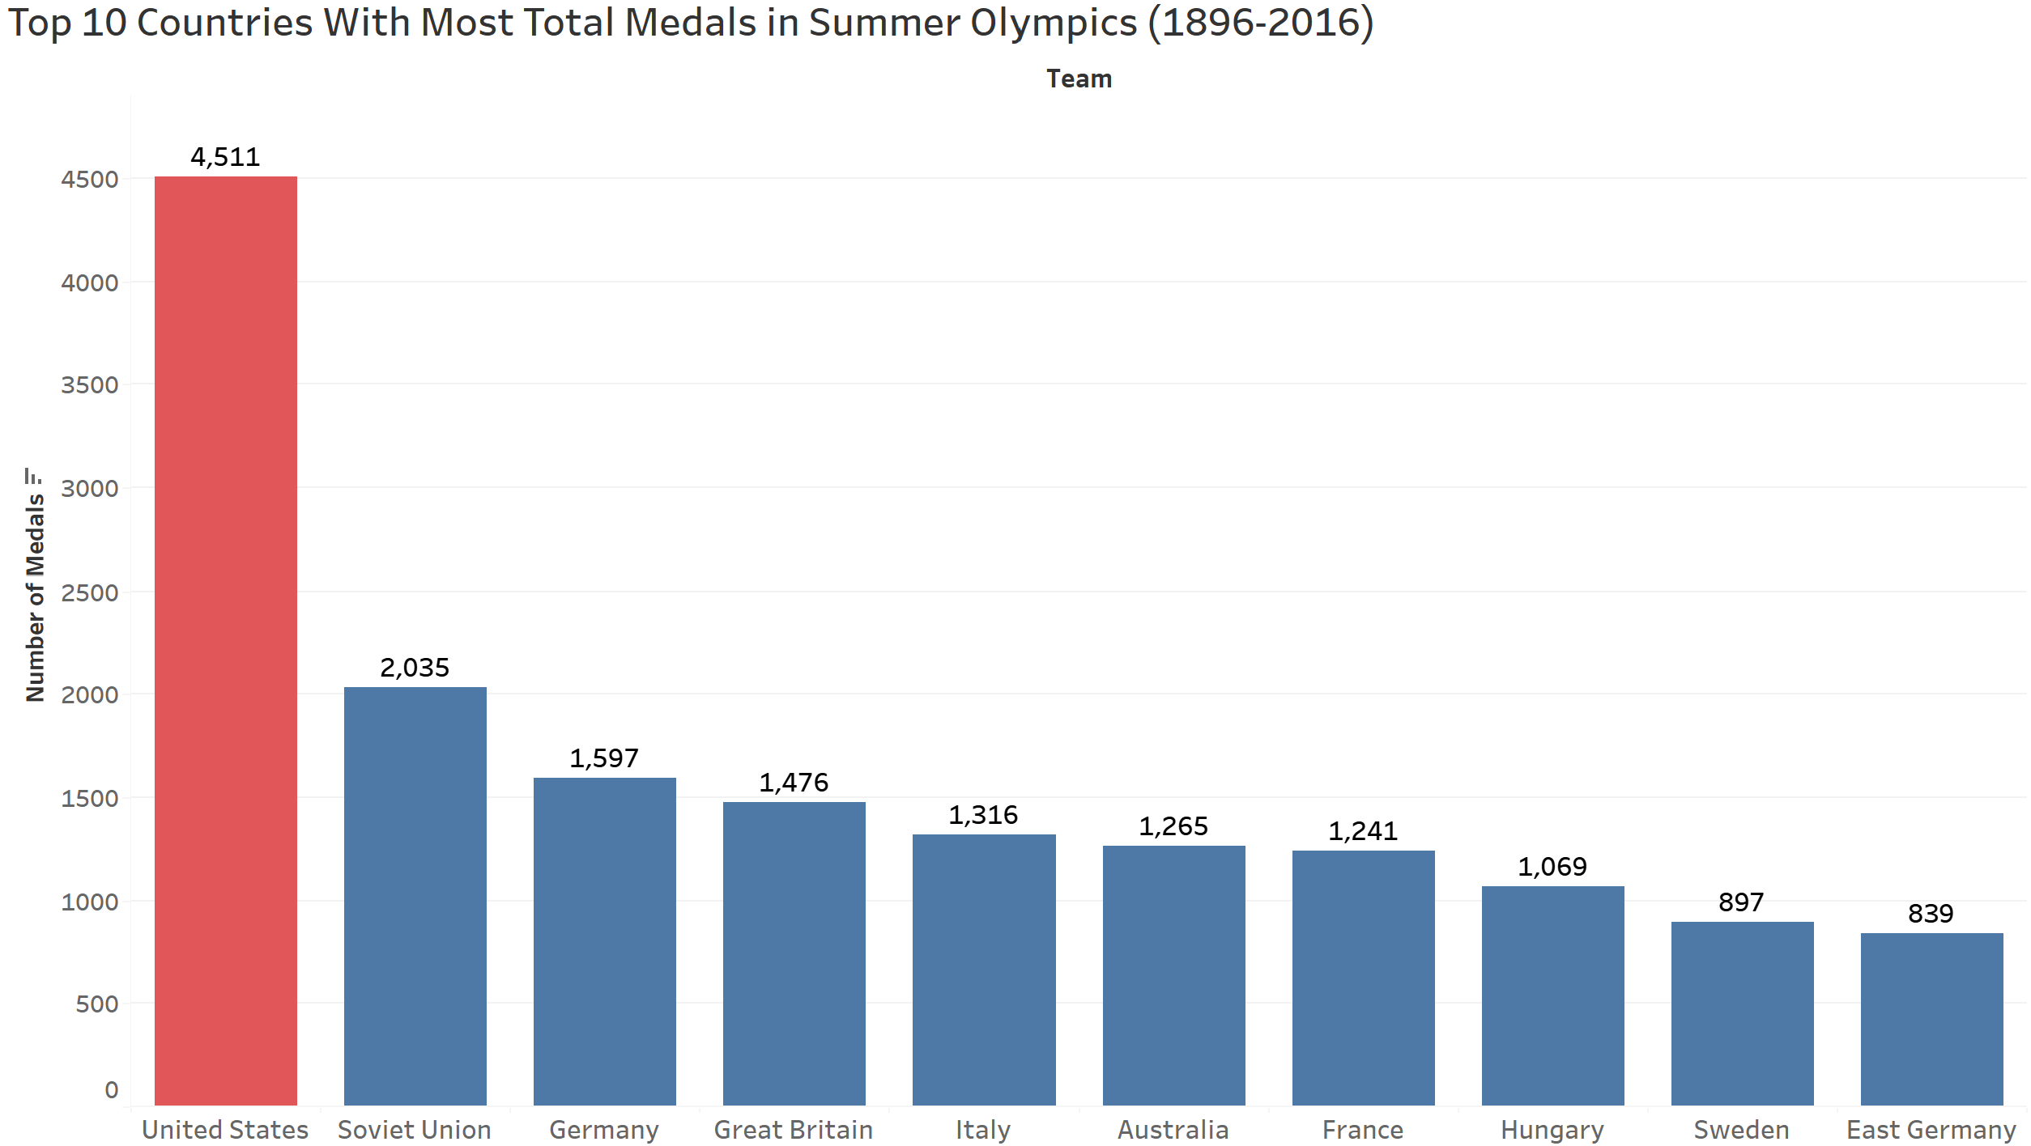
Notes:
Firstly, I wanted to get a general picture of the overall dataset showing some history of past results and outcomes. Shown are the top 10 countries with the most total medals from the Summer Olympics from 1896-2016 with the United States clearly leading over the other countries. A lot of factors go into the reasoning for these numbers, including population. With a higher population, it increases the number of high-level Olympic athletes available to compete. Also, geopolitically, with countries like the Soviet Union that was only able to compete until 1991 before they collapsed. Before the 1992 Olympic Games the gap in medals won between the United States and the Soviet Union was less than 1000. Had the team still be able to compete in the Olympics, the gap in medals won between the United States and the Soviet Union would be significantly smaller.

Slide 6
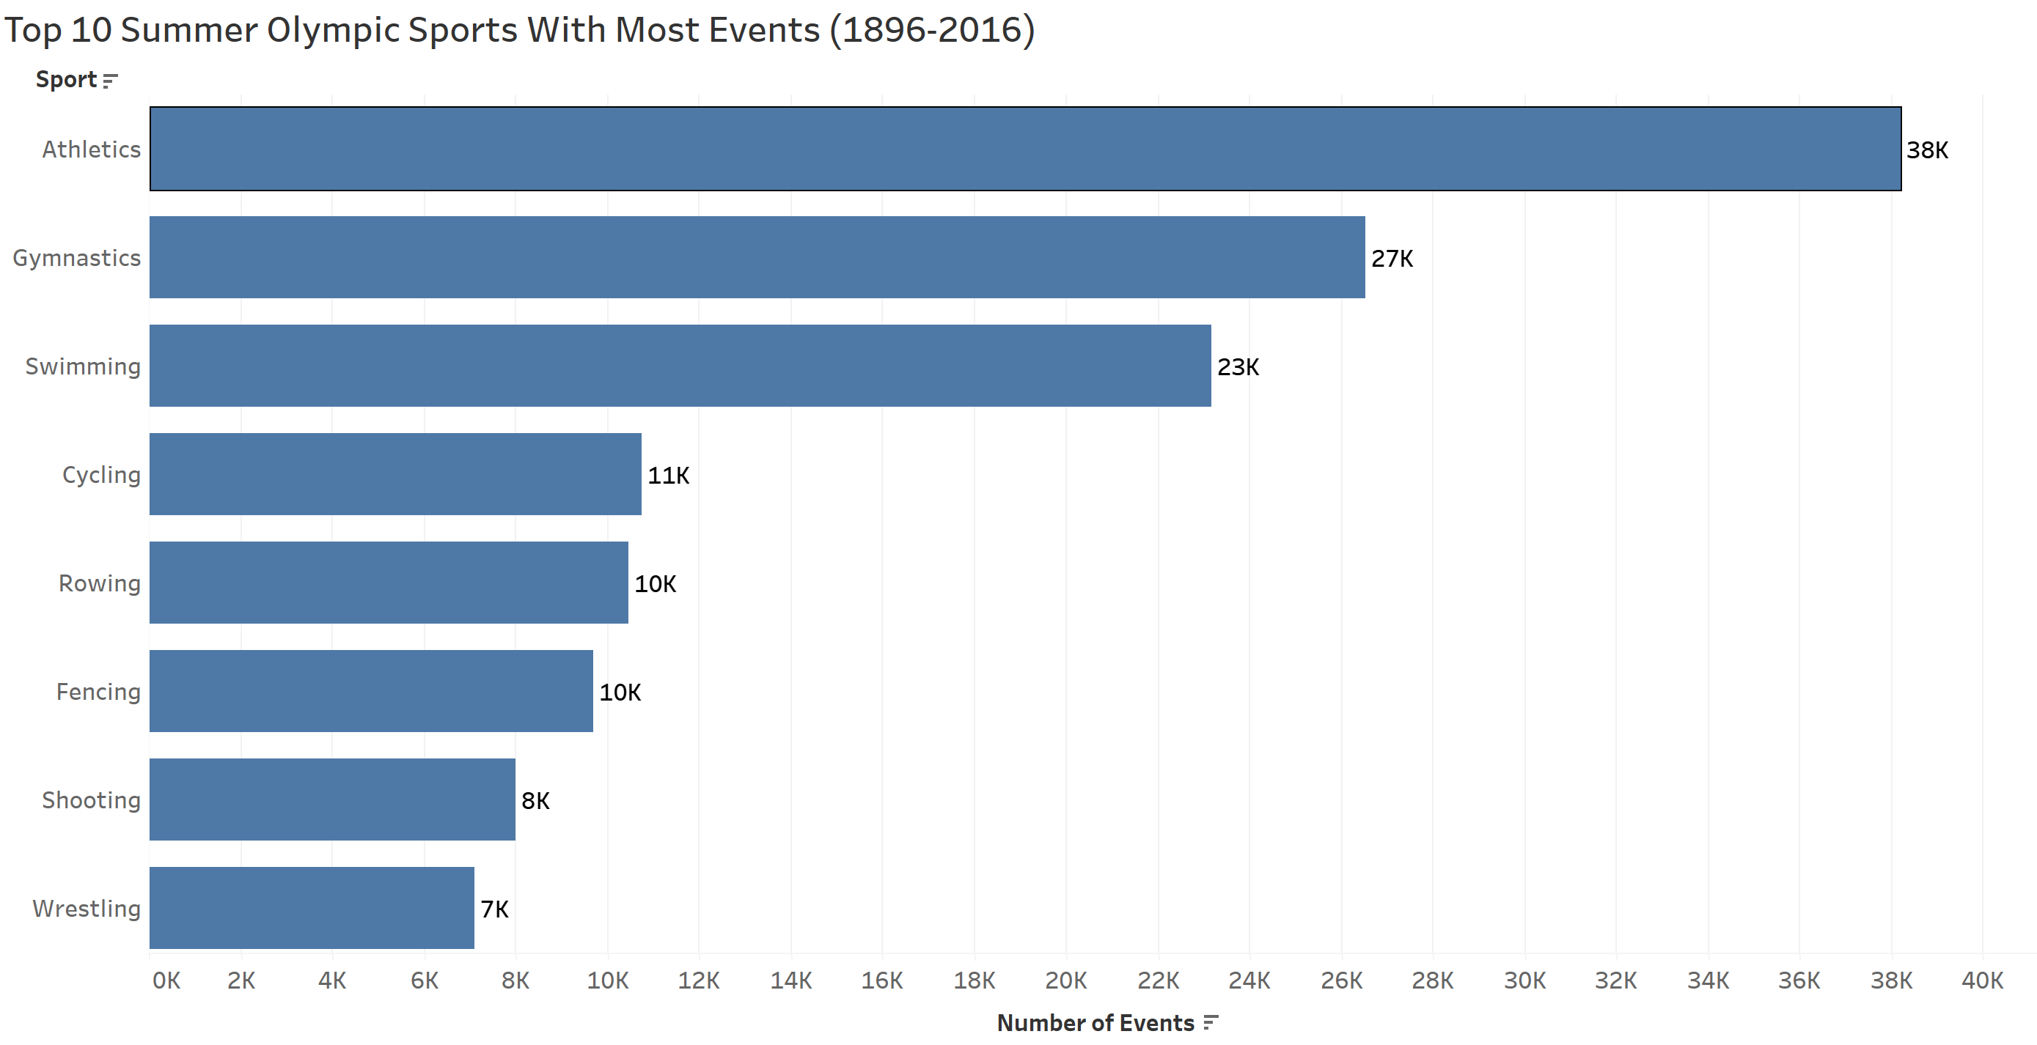
Notes:
Here are the top 10 sports with the most events from 1896-2016. A reason that athletics, gymnastics, swimming are so far ahead is because there are about 80 events for Athletics, 60 events for swimming and almost 20 events for gymnastics in each Olympic games. So, as time goes on, the gap between these top 3 sports and the rest of the sports will eventually become wider.

Slide 7
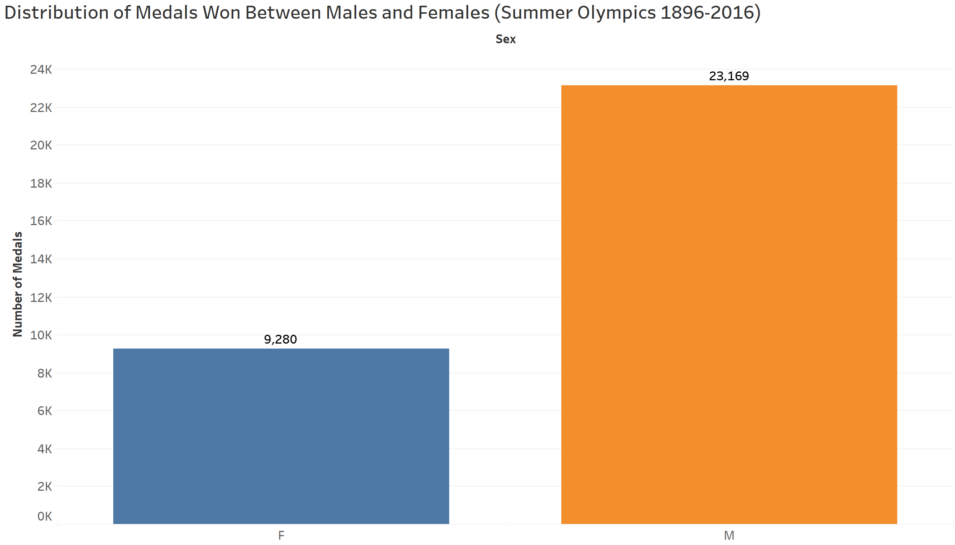
Notes:
Shown is a distribution of medals won between males and females in the summer games. There is a 14,000 count difference in medals won between Men and Women. Part of the reason for this large discrepancy is because there were not nearly as many Olympic events for women are there were for men many years ago.

Slide 8
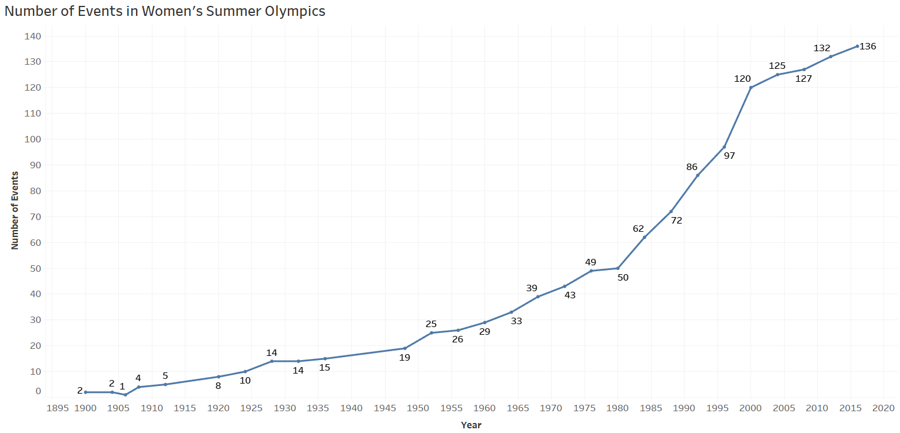
Notes:
Following up on the previous slide, shown is a graph of the amount of events for women over the years in the summer Olympic games. One significant catalyst that stands out for an increase in events starting in 1980s is the passing of title xi in 1972 by President Nixon. Which led to an increase in funding and equal opportunities for women to compete in sports. Since the passing of title xi, there has been over a 200% increase in women's events and only a 13% increase in men’s events in the same time period. As the years go on, we will see the gap between number of men’s and women’s medals become smaller and smaller percentage wise.

Slide 9
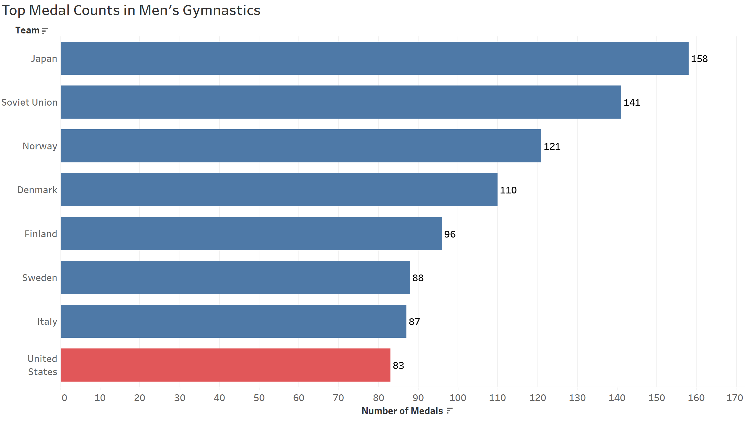
Notes:
Moving into individual sports, here are the top countries with the most medals in Men’s Gymnastics. The United States are clearly behind in medals compared to the top countries, with Japan, Soviet Union and Norway being at the top.

Slide 10
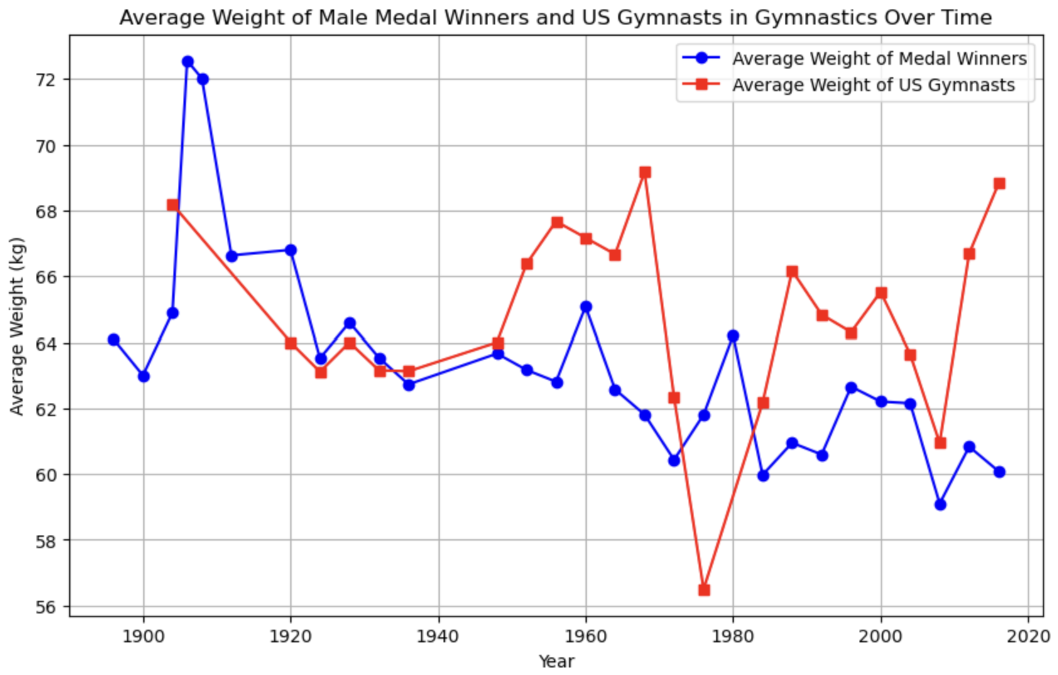
Notes:
I wanted to compare physical statistics of previous medal winners in gymnastics compared to the United States. The red line shows the average weight of U.S. gymnasts and the blue line shows the average weight of previous medal winners in the given year. I noticed that compared to the medal winners, the United States average weight were noticeably different, (between 2-3 kg difference), and higher in 17 of the last 18 Olympic Games (between 2-3 kg difference). This could have a huge impact on their movements when doing routines, by effecting their agility, movement and balance both in the air and on the ground. And with such fine margins from judges scoring, the potential between winning a medal and not winning a medal can be less than a point.

Slide 11
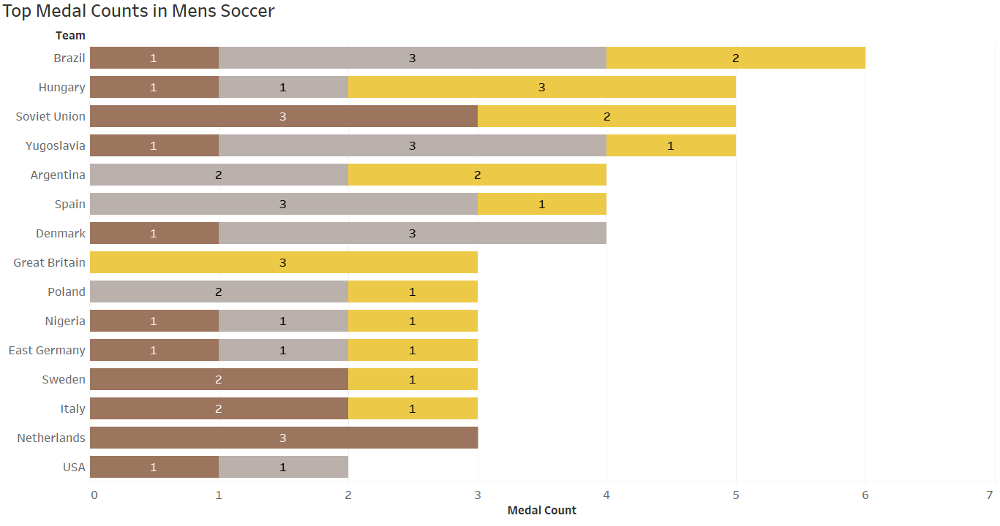
Notes:
Looking at the top countries for Men’s soccer, the United States is a major laggard compared to other countries in the world. The United States has only won 2 medals since the event came into the Olympics in 1904.

Slide 12
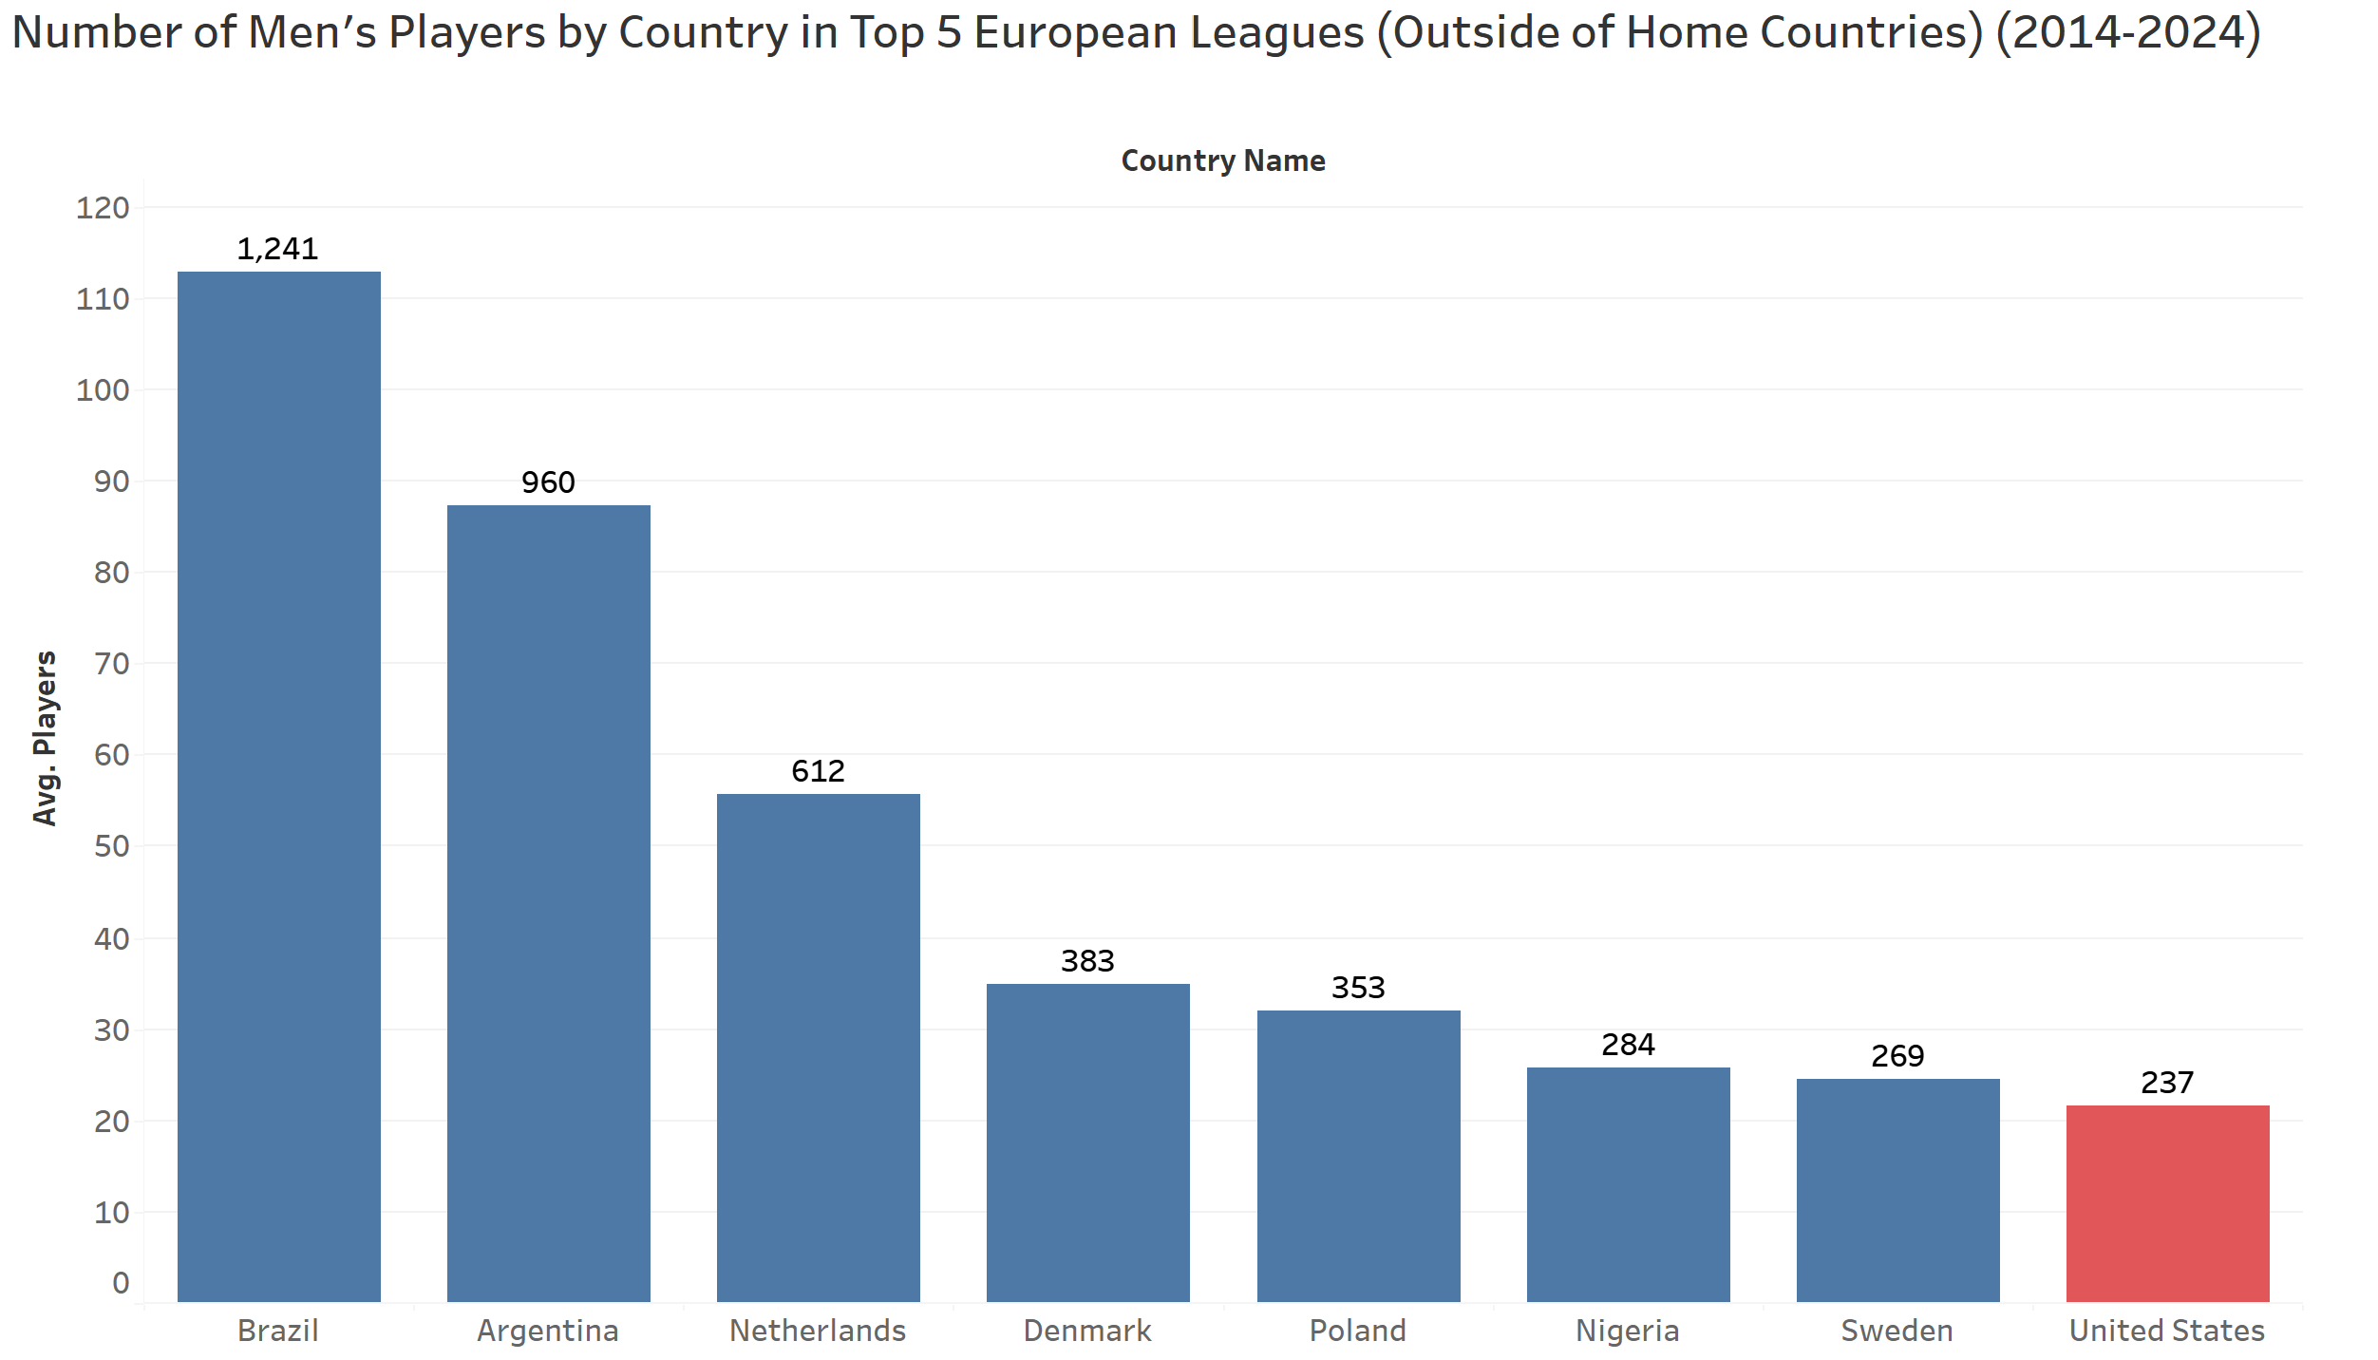
Notes:
A major part in the United States lack of success in international competition is the scarcity of United States players that play overseas in Europe. Shown is a graph of Men’s soccer players that play in the top 5 European leagues that are not including the countries where the leagues are domesticated. The top 5 soccer leagues in Europe have some of the best players who compete at the highest level in club football. In order for United States to compete internationally, we need more U.S. born players competing in Europe with the world’s best players, because with our own league, Major League Soccer, is no where near good enough compared to the European Leagues. Based on soccer league rankings, the MLS ranks 9th in the world in terms of skill, which is a similar level to the Belgian League and second tier of English football.

Slide 13
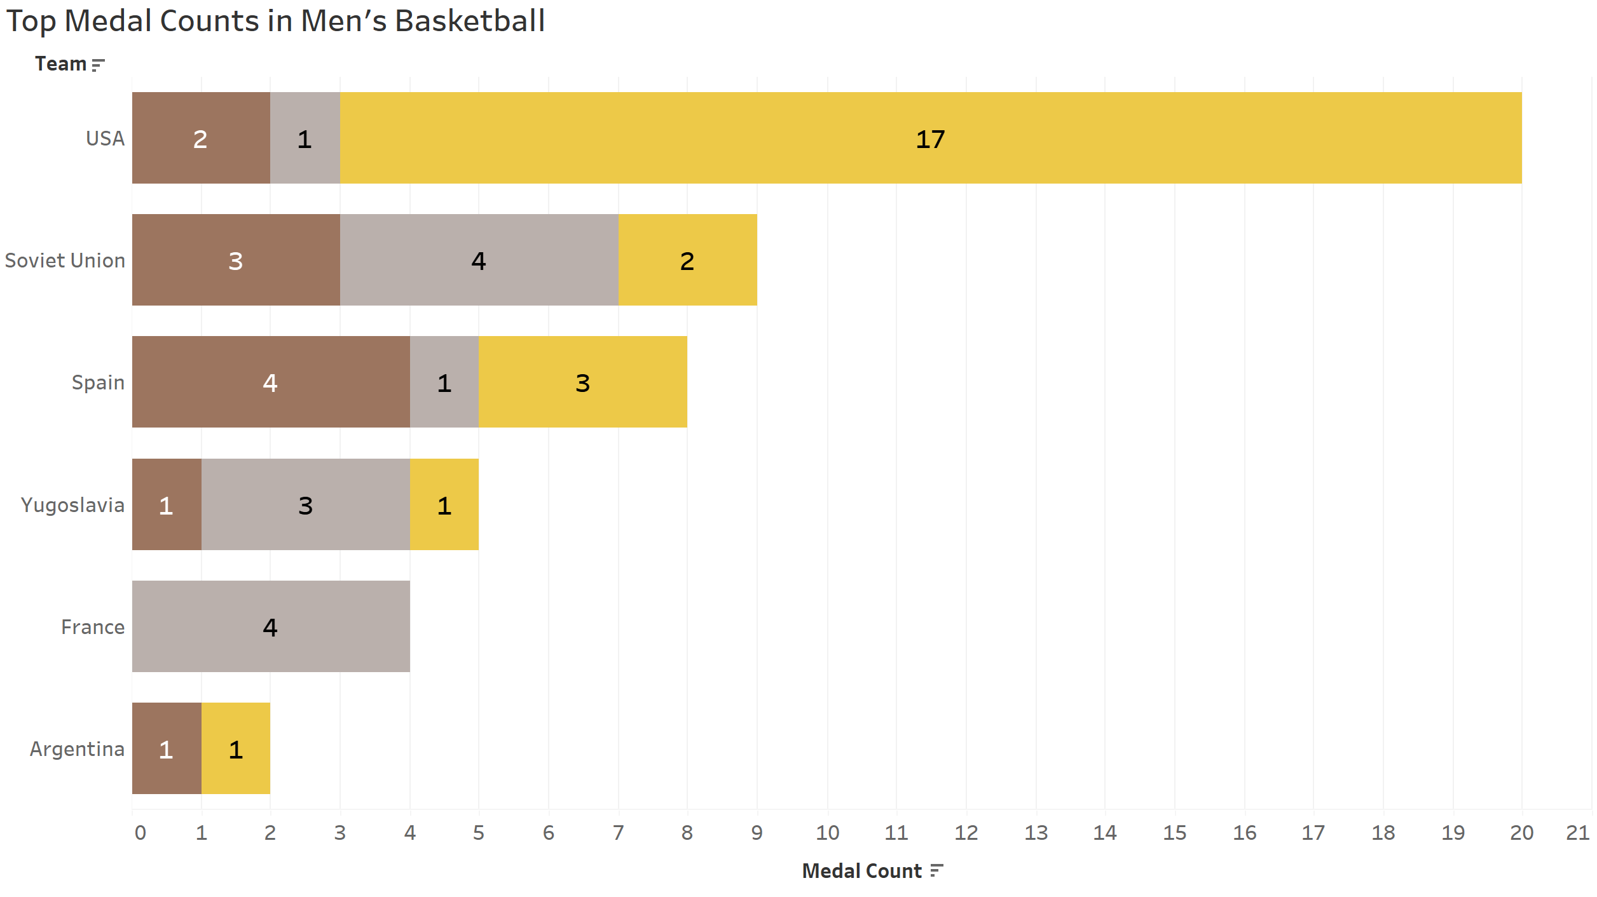
Notes:
Here is a list of the most successful countries in Olympic men’s basketball. To no surprise, the most dominant country in the event has been the United States, with 17 gold medals. This is due to the amount of US born players that play in the NBA. The talent pool is so deep. In 1989, FIBA allowed NBA players to compete in the Olympics. Since then, the United States has won 8 out of the last 9 gold medals in the event. However, international competition has definitely picked up in terms of skill level and has been closely competing with the United States as the years go on.

Slide 14
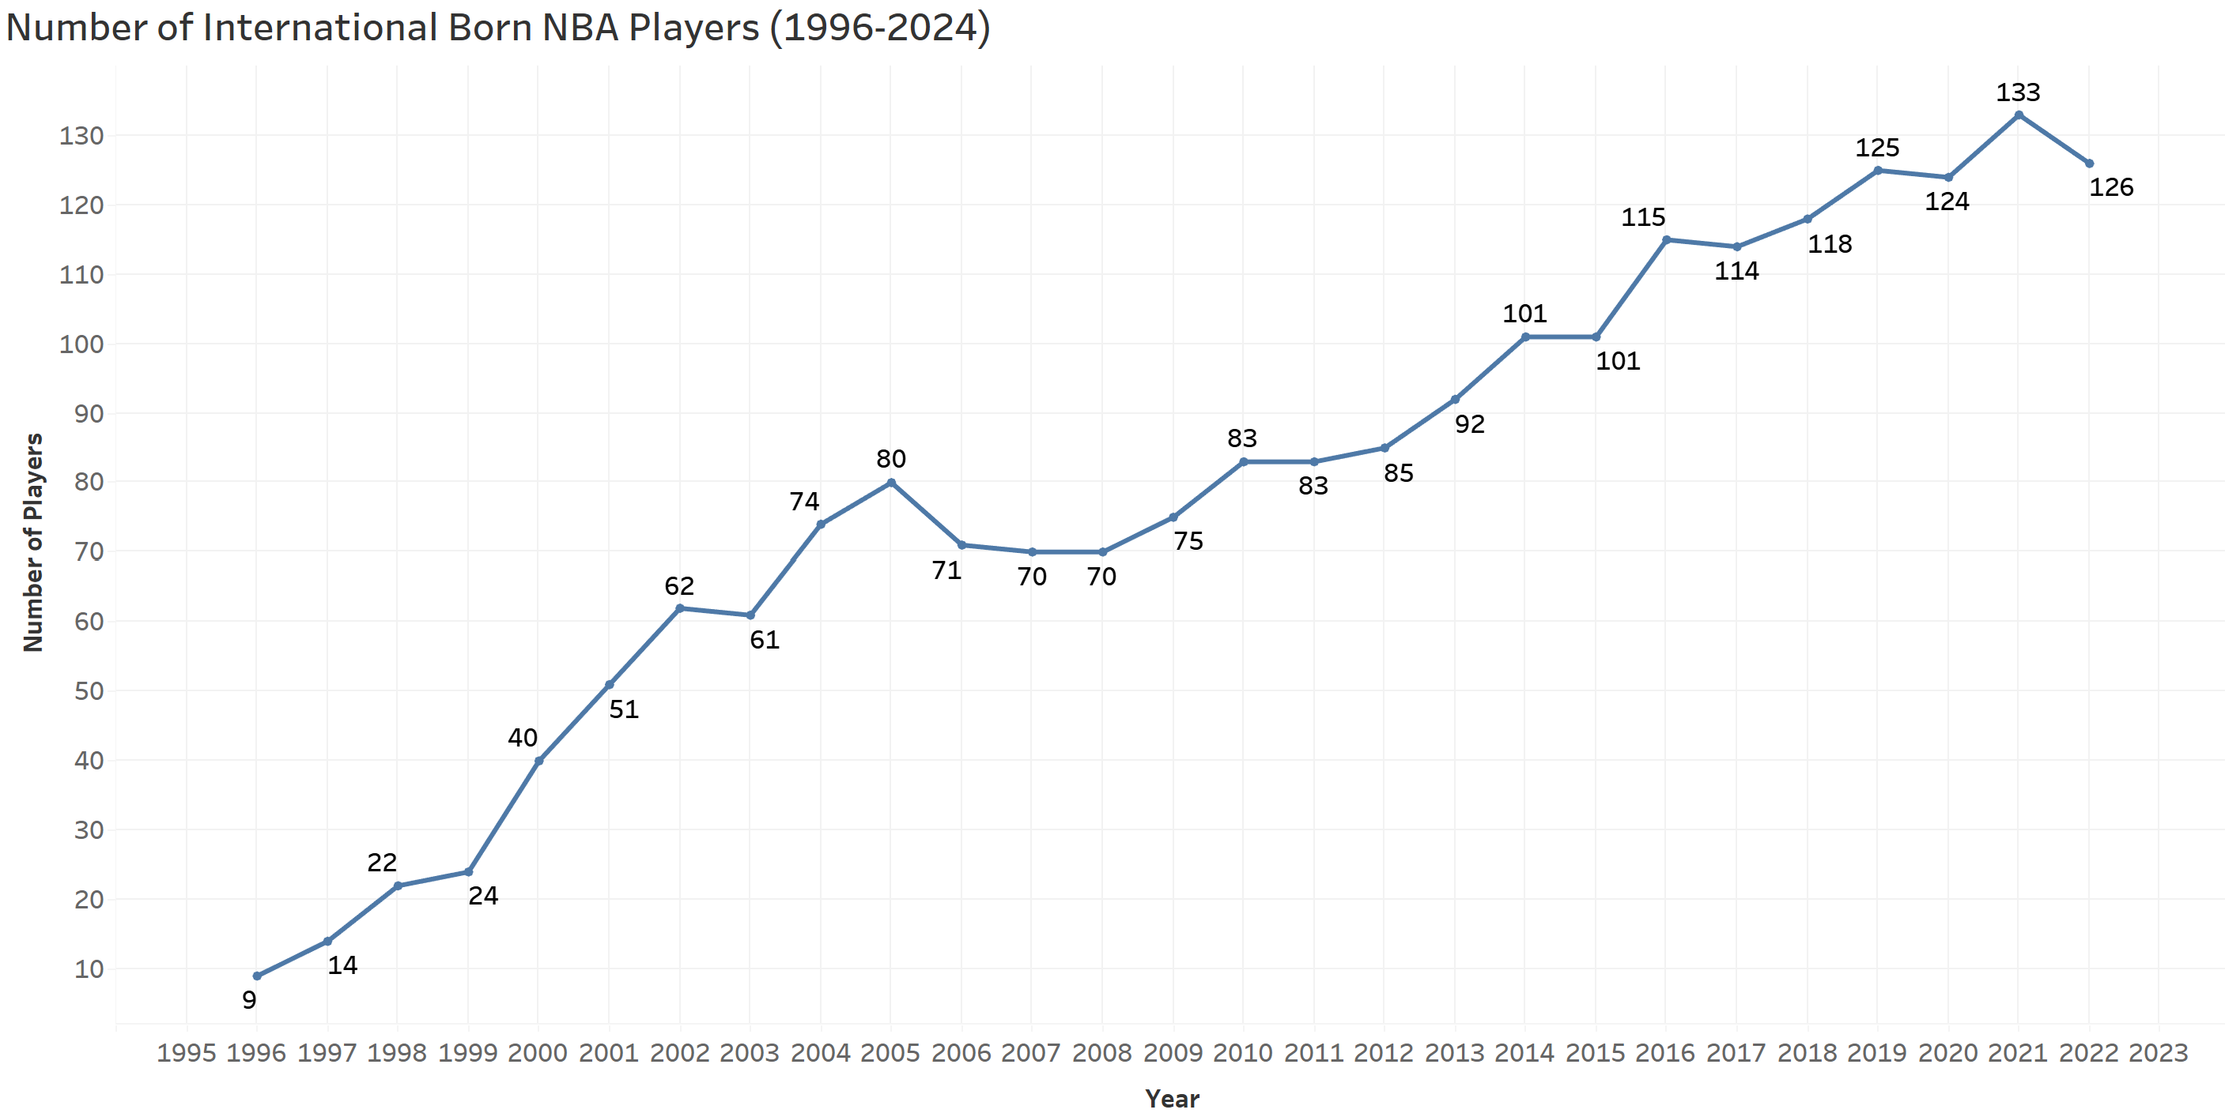
Notes:
One aspect the U.S. men’s basketball team should be aware of is the rise in international players in the NBA. From 1996 to 2024, there has been a 1300% increase in the amount of international players in the NBA. This is something for the United States to be aware of in the future, because not only the international talent is increasing, but it allows for international teams to exploit weaknesses in the United States team while their players match up against US born players during the NBA season.

Slide 15
Recommendations
Men’s Gymnastics – Address discrepancy in weight between medal winners and United States team
Men’s Soccer- Overhaul Youth Development
Send players into top 5 leagues in Europe
Have Major League Soccer sign more international talent to make league more competitive
Men’s Basketball - Create annual USA basketball camp each summer
Notes:
With the data that has been shown there is clear evidence that the United States has to change their ways in order to compete with the top nations in the country. Here are some of my recommendations for each sport.
Men’s Gymnastics - There is a noticeable discrepancy of weight between average medal winners and the United States team. My recommendation for the United States men’s gymnastic team to compete is to reevaluate the training program for the men’s gymnastics team. The program should be catered towards creating a physique and maintaining a weight that is similar to that of a medal winner from previous years. 2-3 kilos can be a major difference between medals, especially when every movement in the sport requires such precision.
Men’s Soccer - A major reason for the United States not being able to compete with the top nations is the lack of youth development for the sport. About 450,000 play varsity soccer where as over 1 million play varsity football. I think most states should consider moving their soccer season to the spring in order to not have our country’s top athletes not have to decide to pick between football or soccer. This I believe will lead to an increase in men’s soccer scholarships in college and make college soccer is more competitive as well. And with higher talent in college soccer, the more US born talent will be brought in through the MLS draft every year. As mentioned before about top United States players needing to play in Europe, I believe Major League Soccer also needs to sign more skilled international talent and not just older stars that are well past their prime, (Leo Messi, David Beckham, Zlatan Ibrahimovic, etc). The more highly skilled international talent that plays in the MLS will make the league more competitive and make the US born players better, which in turn will help make the United States more competitive amongst the top nations in the world for men’s soccer.
Men’s Basketball - The international basketball rules are fairly different compared to the NBA, including the ball itself, and the playstyle is a lot more physical. Many International players are used to the rules and physicality of the game, which can be used to their advantage. Instead of USA Basketball only meeting in Las Vegas to train right before the Olympics a few weeks before the games, the team should have a USA Basketball camp every summer for 2 weeks minimum for players to get more experience playing with international rules, as well as set up exhibitions with other countries to get more experience. As the NBA international player base is only growing, setting up yearly basketball camps is now essential for the United States to stay ahead of the rest of the competition.

