Slide 1
KNN Implementation
Ryan Gallagher, Austin Snyder, Sean Gallaway, Matt Hansen, Vandan Amin, Chaker Baloch, Aaron Snyder, Bobi Vladimirov, Alex Buckley, Noah Rodal

Slide 2
KNN Problem
We were tasked with further optimizing a K Nearest Neighbors based Information Energy computation to use as an R package.
Our task was to take existing code created by previous students, and further optimize it for speed.
Approach
Standard C++
CUDA
OpenCL
Goal: Maintain results, and decrease execution time

Slide 3
Basic Requirements
C++ 11 or higher
Rcpp library installed. Needed because of the use of NumericVector.
Depending on the machine, this may need to be manually added to your compiler’s include path.
Cuda or OpenCL runtime if the user wishes to run using the “openCL” or “cuda” parameters to the KNN function. The package installation will automatically detect support for these options and compile with the necessary flags.
R must also be installed, and before running the code, the user must install our package.

Slide 4
Setup
Setting up the package is quite simple.
A user needs R installed, and on PATH.
After this, navigate into the KNN_PACKAGE directory, and in powershell or your command prompt, run the command “R CMD INSTALL .” this installs it as a library for R to use.
Once this is done, in R, the command library(CWUKNN) allows you access to our functionality, just as you do with typical R libraries.
If published on CRAN, a user should be able to simply use R’s “install.packages(CWUKNN)” to install our package, and then use “library(CWUKNN)” to call our functionality.

Slide 5
CUDA
CUDA is a platform specific language that takes advantage of NVidia graphics cards specifically.
Some speedups won’t be seen if the data size is too small, as there is a bit of overhead copying data back and forth from the GPU and CPU.
Code takes into account a max heap size of 2gb, if the process would require more than 2gb then it splits up the computation into chunks.

Slide 6
CUDA Approach
The first crack at optimization was started with the kNN() function from the original codebase. There is a for-loop of N size that can easily be unwrapped into a kernel function.
Specifically, the Distance Vector that is calculated can be sped up by allocating a flattened 2d array, and launching a kernel to memcpy the data in parallel to the flattened array.
Multithreaded CUDA Streams were an avenue explored, to try to use as much of the hardware as possible, but they were either not optimized enough or added overhead to the process. The release version uses 1 thread, but maintainers will see that the code still supports multithreaded streams if the threadCount define is changed.

Slide 7
CUDA Approach
As of writing, Quick Select could be implemented to help with speedup, as the current sorting method on the average case is slower than Quick Select.
Additional speedup was found in finding opportunities to reuse allocated space before calling cudaFree(). This saved some API calls that help in the long run.
Future maintainers can probably figure more dynamic ways of figuring blocks per grid and threads per block to get better efficiency.

Slide 8
OpenCL Intro
OpenCL is a cross platform GPU programming API.
Users who have integrated graphics can use the OpenCL version, but are encouraged to use their CPU. This is because the overhead of kernel data-loading will not be worth it when using a very slow GPU
The OpenCL code is built for very large datasets, in with small datasets, users should opt for CPU execution.

Slide 9
OpenCL Approach
Distance Matrix Calculation
Replacing the NxN nested loop structure with a parallelized version
Kth Element (and result calculation)
In the previous groups implementation of the code, the Rcpp::kth_element function is used to find the kth element for each column iteratively. By running a similar operation using OpenCL, each column of data is operated on simultaneously, reducing the execution time significantly.
A single result value is provided for each column, using a formula provided by the original code author,
Result Averages
During initial observation, we identified the average of the results to be an operation capable of parallelization, however upon timing each operation, we observed little to no impact on overall time, and determined that parallelizing would hinder the program with overhead.

Slide 10
OpenCL Approach (Distances)
Analyzing on the existing codebase, we see that we are performing a KNN computation on each group of x values corresponding to a unique y value. So, our algorithm as follows is performed on each subset of x values that we find.
This KNN computation entails generating the distances from each particular x value in this subset to x0, then x1, and so on. We take the Kth largest distance of each of these computations.
This can be generated in parallel of course, where we instead generate the distance matrix of each pair of x’s and store that value.
Rather than, N times generating N distances all sequentially, we are going to instead generate N² distances in parallel. This sounds like a small optimization, but allows for a large reduction in time.

Slide 11
OpenCL Approach (Kth Element)
After we have obtained the distance matrix, our task is to find the Kth largest element. We implemented a commonly found quickselect algorithm for this task (similar to quicksort, but runs in linear time on average, compared to O(N log N).
Once we have obtained our N number of Kth elements, those are stored in a separate vector, equal in length to our number of x’s.
These values are simply copied back to the CPU, where we use standard library functions to perform mean computation.
While theoretically it would be faster not to copy all the memory back, and instead calculate mean with a kernel reduction using the existing memory on the GPU, we found this was actually slower. This is likely due to the number of elements in a single group being too small to gain any increase in execution time.

Slide 12
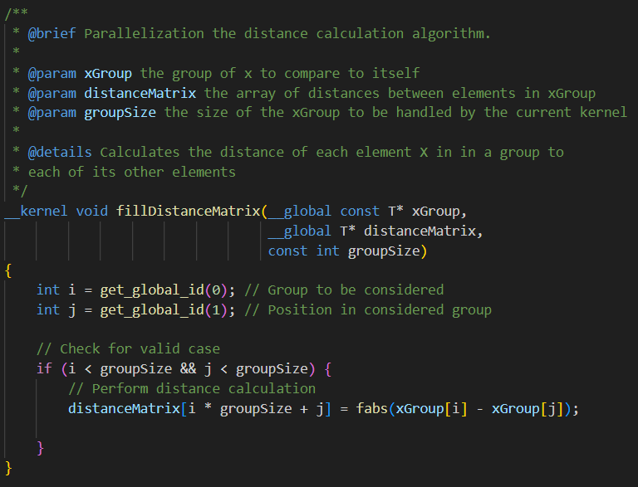
OpenCL Distance Kernel
Populates the NxN distance matrix one element at a time.
Each thread gets their row by the global ID (group ID). And then their individual index is the localID in that group.
A thread populates one single element.
A future optimization would be to have a thread write that value to both indexes i,j and j,i as they are the same value.

Slide 13
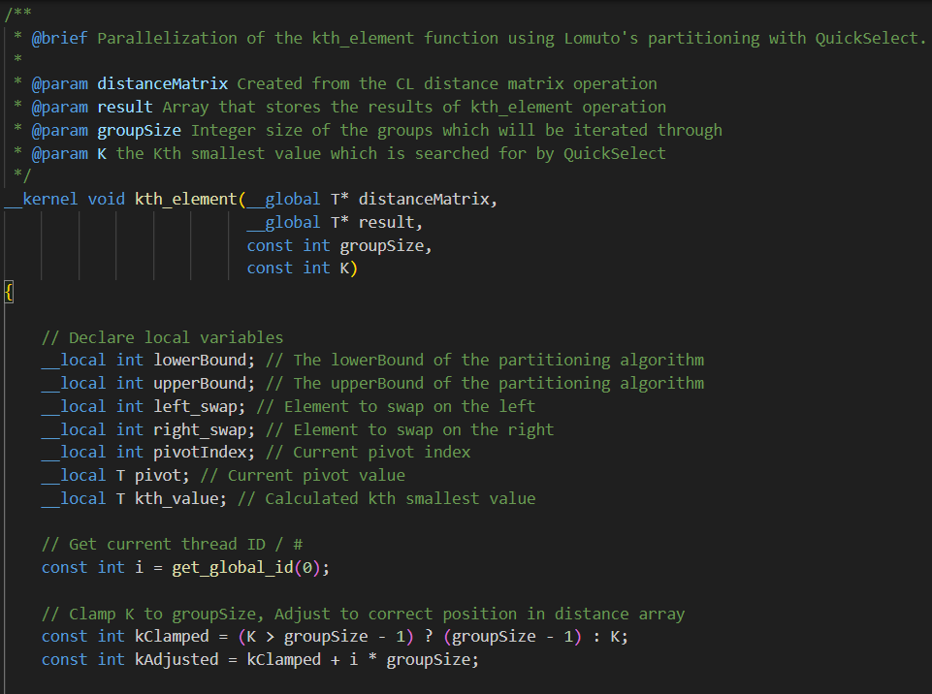
OpenCL Kth Element Kernel
Replaces the std::nth_element calculation for each column.
The distance kernel result memory is operated on, to avoid passing the memory back to the C++ code.
Uses an in-place quickselect algorithm, using Lomuto’s partitioning.

Slide 14
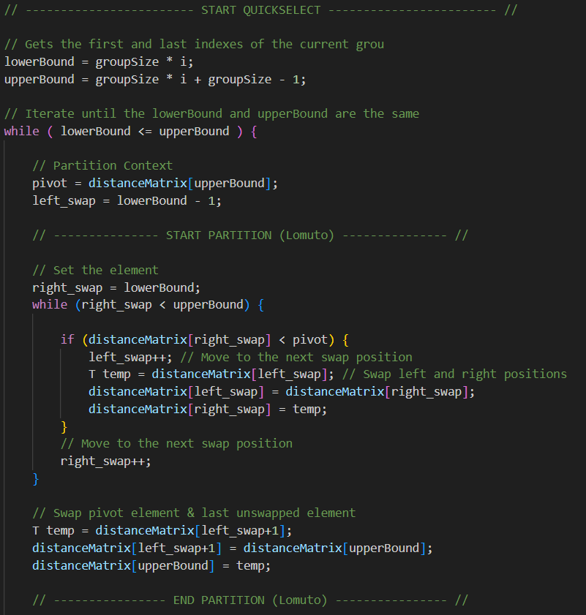
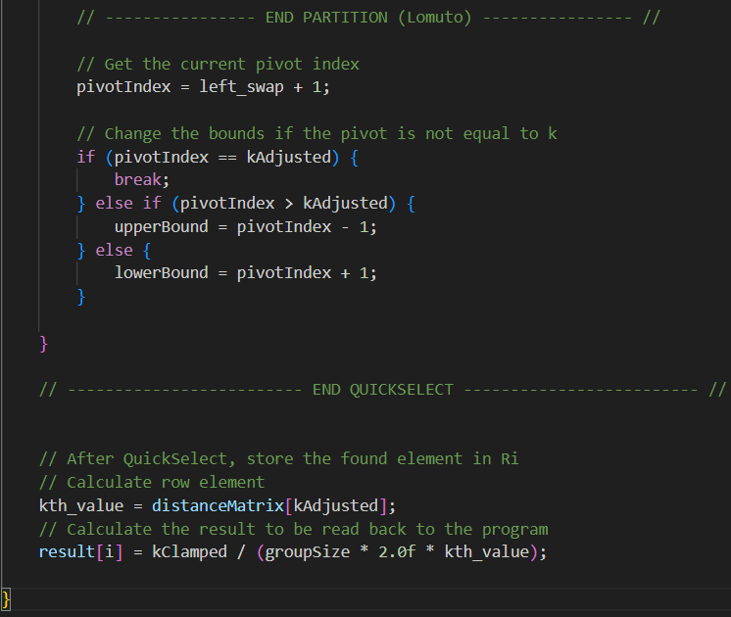
OpenCL Kth Element Kernel

Slide 15
OpenCL Results
NVIDIA GeForce GTX 2080ti and Ryzen 5 5600x
Pre-optimization CPU code : 30.78 seconds
GPU Double: 3.36 seconds
GPU Float: 2.81 seconds
NVIDIA GeForce RTX 4070 and Intel i7 13th Generation (Laptop)
Pre-optimization CPU code : 56.42 seconds
GPU Double: 3.90 seconds
GPU Float: 3.38 seconds
N = 50,000 , K values: {5000, 10000, 15000, 20000}

Slide 16
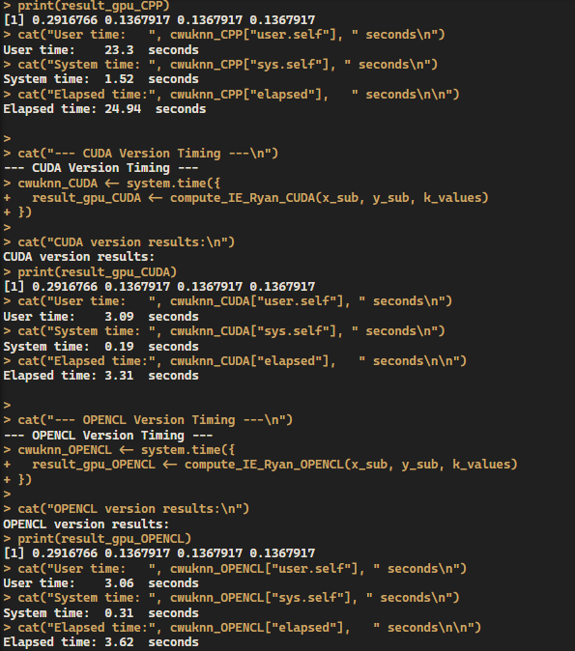
Benchmarking Cont.
N = 140,000
K = 5,000
Precision : double
NVIDIA GeForce GTX 2080ti and Ryzen 5 5600x

Slide 17
C++ Multithreading
Among the changes, parallelization had the biggest effect
Several attempts were made at multithreading the C++ code, with different Implementations including:
OpenMP
Manual Thread Usage
Thread Pooling
The OpenMP implementation was the most successful, with two different version tested, parallelization in the kNN function and parallelization in the IE_xy function.
Manual thread pooling was scrapped, due to its similarities to OpenMP
Manual Thread Usage was successful, and followed parallelizing one of the functions

Slide 18
C++ Times and Results
Times for each test using 12 cores over 50,000 data points:
OpenMP in kNN: 0.6192086 seconds
OpenMP in IE_xy: 0.644455 seconds
Manual Thread Usage in kNN: 1.160404 seconds
Manual Thread Usage in both: 3.285736 seconds
Times for each test using 12 cores over 100,000 data points:
OpenMP in kNN: 2.123394 seconds
OpenMP in IE_xy: 2.903357 seconds
Manual Thread Usage in kNN: 2.848945 seconds
Manual Thread Usage in both: 9.038733 seconds
Additionally, each file was tested on computers with with a different amount of threads changing which was faster
Computer with 4 cores: Manual Thread Usage in kNN was the fastest
Computer with 6 cores: OpenMP in IE_xy was the fastest

