Slide 1
JavaScript
Loops
Conditional Statements
Functions
Variables
Parameters
Arrays
Associative Arrays

Slide 2


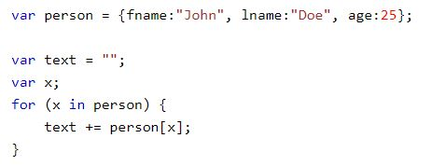
For and FOR/IN LOOP
For Loop Syntax
For/In Loop
- Used to loop through an object.
For Loop Example
For Loop Example

Slide 3

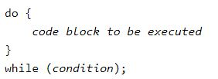
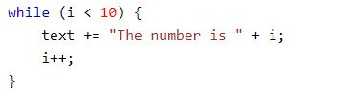
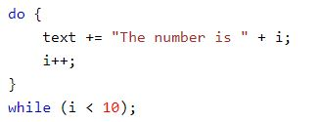
While and Do/While Loop
While Syntax
Do/While Syntax
While Example
Do/While Example

Slide 4

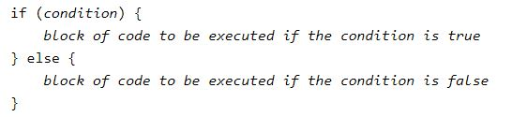
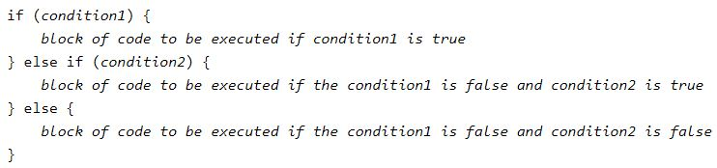

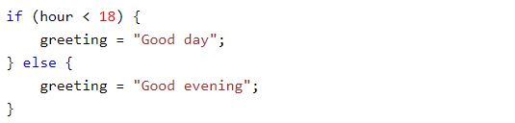
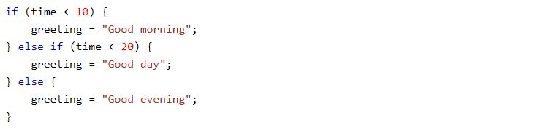
Conditional Statements
If Syntax
Else Syntax
If Else Syntax
If Example
Else Example
If Else Example

Slide 5


Functions and parameters
Function to execute code
Function to return value

Slide 6



Variables
Variable Undefined
Variable Arithmetic
Variable Multiple

Slide 7

Arrays
Array syntax
Array methods
Array example
Array best practice

Slide 8
Associative Arrays
Associative Arrays use names for indexing.
JavaScript DOES NOT use Associative Arrays.
JavaScript will convert an Associative Array in to an object.
Arrays: Number index
Object: Name index

