Slide 1
AJAX
requesting a JSON file

Slide 2
What is AJAX
AJAX = Asynchronous Java Script And XML
AJAX uses a combination of a browsers built in XMLHttpRequest object and JavaScript and HTML DOM

Slide 3
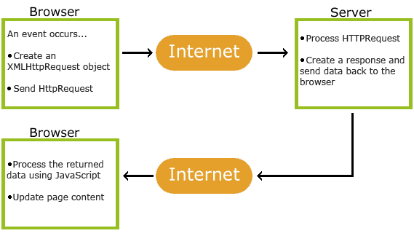
How AJAX Works
An event occurs in a web page (the page is loaded, a button is clicked)
An XMLHttpRequest object is created by JavaScript
The XMLHttpRequest object sends a request to a web server
The server processes the request
The server sends a response back to the web page
The response is read by JavaScript
Proper action (like page update) is performed by JavaScript

Slide 4
Requests
Method Description
open(method, url, async) Specifies the type of request
method: the type of request: GET or POST
url: the server (file) location
async: true (asynchronous) or false (synchronous)
send() Sends the request to the server (used for GET)
send(string) Sends the request to the server (used for POST)
GET – simpler and faster
POST – No size limitations; Send user inputs; more robust and secure.
xhttp.setRequestHeader (header, value) – adds HTTP headers to the request.
onreadystatechange – executes a function when the request receives an answer.

Slide 5
Response
Property Description
onreadystatechange Defines a function to be called when the readyState property changes
readyState Holds the status of the XMLHttpRequest.
0: request not initialized
1: server connection established
2: request received
3: processing request
4: request finished and response is ready
status 200: "OK"
403: "Forbidden"
404: "Page not found“
statusText Returns the status-text (e.g. "OK" or "Not Found")

Slide 6
Requesting a JSON file
var xmlhttp = new XMLHttpRequest(); //create AJAX variable
//Runs AJAX call on readyState and uses JSON.parse() xmlhttp.onreadystatechange = function() { if (this.readyState == 4 && this.status == 200) { var myObj = JSON.parse(this.responseText); document.getElementById("demo").innerHTML = myObj.name; } };
xmlhttp.open("GET", "json_demo.txt", true); //opens AJAX call with get
xmlhttp.send(); //sends AJAX call

