Slide 1
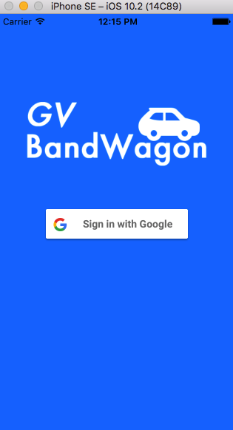
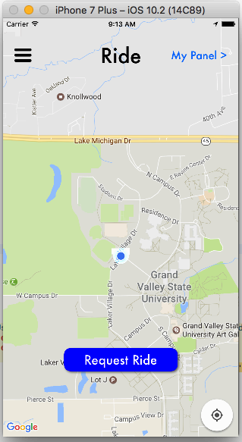
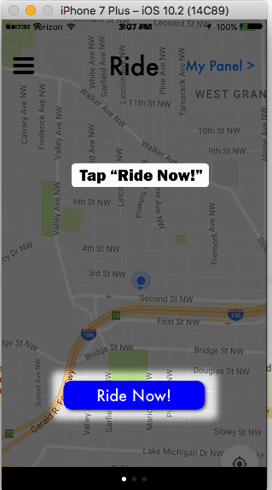
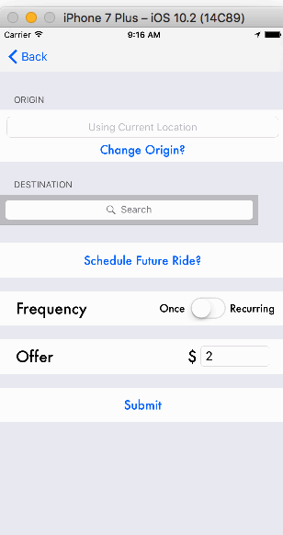
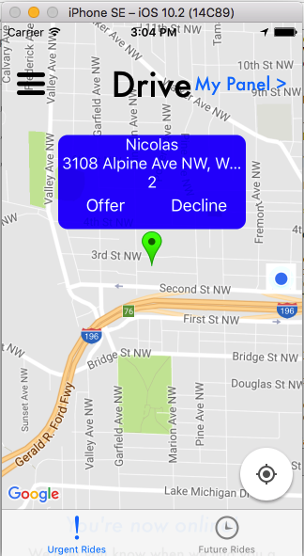
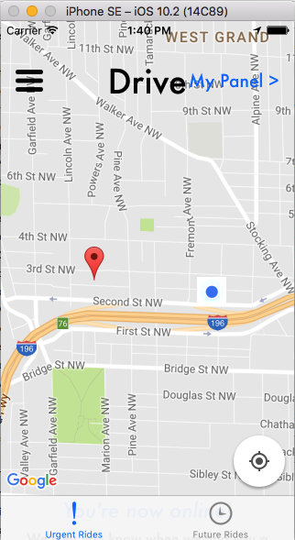
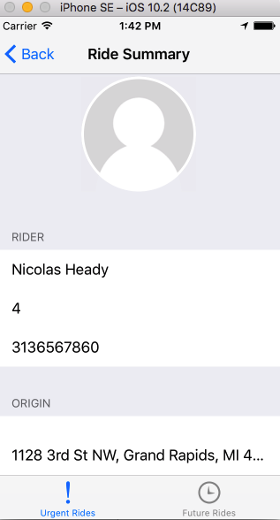
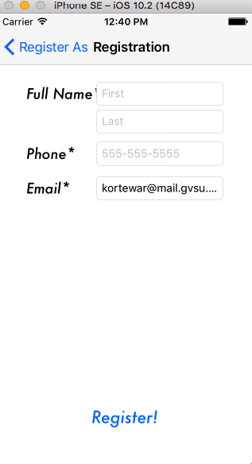
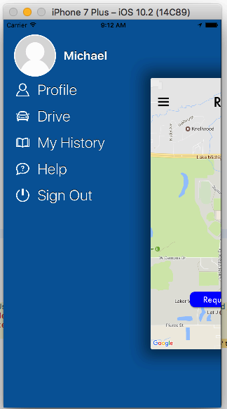
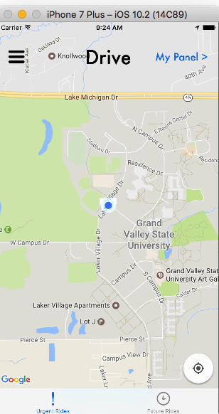
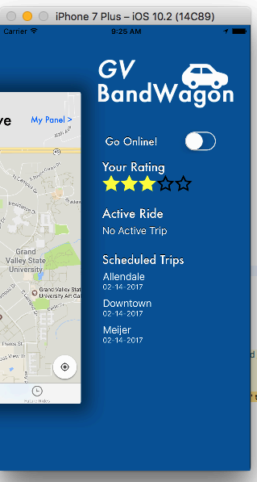
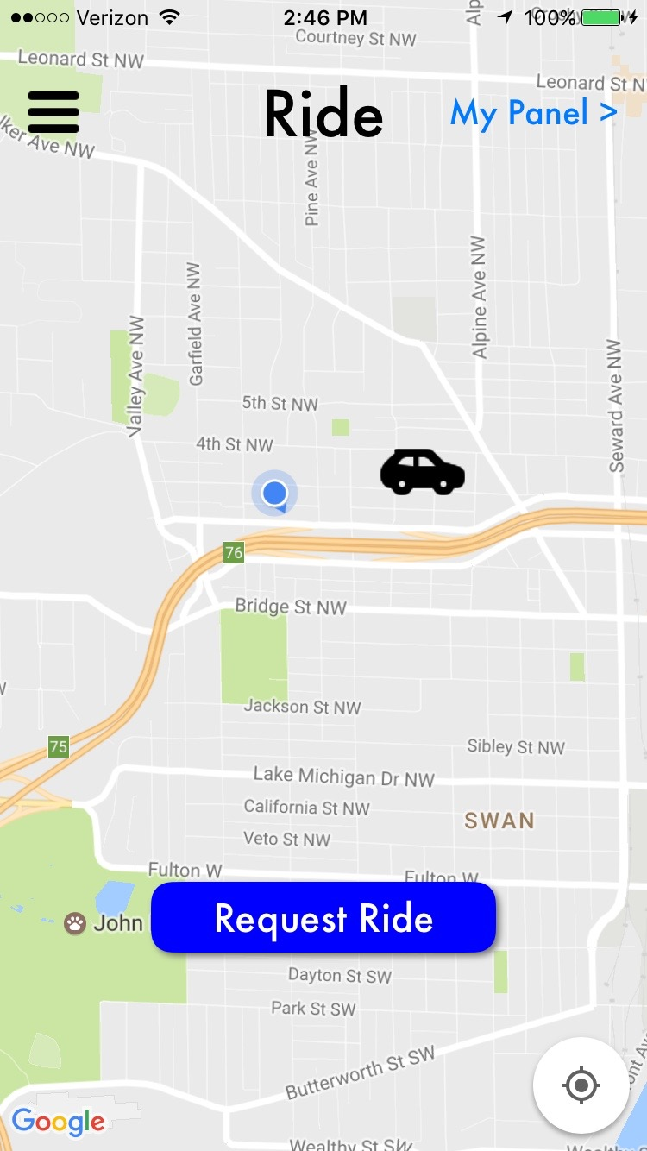
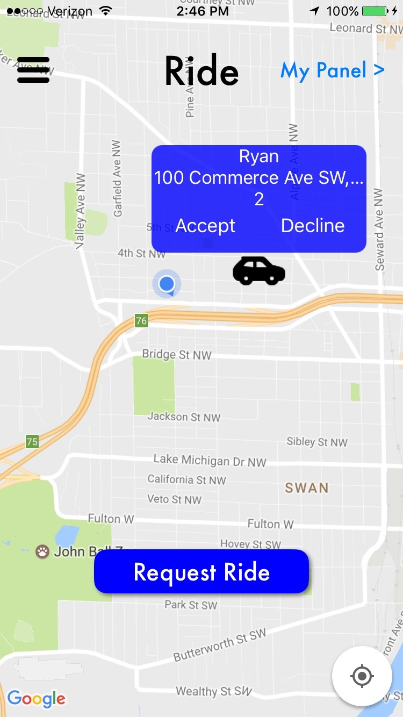
Grand Valley Bandwagon: GVSU Ride Sharing App
Michael Christensen, Nicolas Heady, Ryan Korteway Advisor: Dr. Jonathan Engelsma
Abstract
How Our App Works
Results/Demonstration
Public transportation between GVSU’s campuses often becomes overcrowded and can be very busy during the school day. We are developing an app that would give Grand Valley State University students a way to share rides to and from campuses as an alternative to using Rapid busses that can fill quickly during peak hours. We believe this problem can be addressed through a crowd sourced transportation system of students giving rides to one another. This means that rides can happen any time as long as there are riders in need and drivers willing to provide their time and energy.
Sign In Rider View Rider Tutorial Ride Request
Rider Registration Page Main Menu Driver View Ride Info Menu
Unseen pages include a table view controller of our ride history, our help screen with information about the app, and our profile page which properly retrieves and saves our profile information from and to Firebase should the user make any changes to their data.
2 Ride Request Seen 4 Ride Offer Accepted 6 Ride Summary
Make an Offer when you see red. as seen by the Driver
1 Ride Request Being 3 Ride Offer Seen 5 Driver Accepted
Made Accept the Driver and Visible
*If it was the rider checking the active trip summary page, the "Rider" label would switch to "Driver" and the information that follows would be about the Driver. IE their name, rating, and phone number, etc would be shown.
What is Grand Valley Bandwagon?
An iOS app for Grand Valley State University Students to
Schedule ride requests immediately.
Or request a scheduled ride (single or recurring)
Implementation
IOS SDK front end with built in:
Google maps with custom pins used to gather location data for pairing of riders and drivers
Google Places for easy location picking for the user
Google Sign-In for registering, logging in, and to verify users are Grand Valley State University Students
The custom pins also have an info window that displays information and allows users to accept or decline a ride
Firebase Backend for our Database
Stores information about our Drivers and Riders
Stores our ride requests so that we can pair Riders with Drivers
For payments
Drivers can accept cash
Or set up the app with a Venmo ID and the rider can then click a button in app to open a venmo url that will direct them to the driver's profile
Discussion
Conclusions and Future Work
We initially started building our own user interface but after discussing the UI with Dr. Engelsma, he introduced us to an open source interface called KGFloatingDrawer. It is also used in the Laker Mobile app. We have been seeking legal advice about the future of our app and the possiblity of launching it to the App Store despite recent regulations by Michigan that affect Ride Sharing Apps/Networks.
We would like to see this app make it to the App Store so that students at GVSU can use it make their commutes a little easier.
We believe the scheduled ride functionality is critical to the app’s success, since students have regular patterns and class hours at both campuses that they can use to center their requests around.
References
Google Maps APIs | Google Developers. (n.d.). Retrieved April 09, 2017, from https://developers.google.com/maps/
Google Places API for iOS | Google Developers. (n.d.). Retrieved April 09, 2017, from https://developers.google.com/places/ios-api/
API Reference | Firebase. (n.d.). Retrieved April 09, 2017, from https://firebase.google.com/docs/reference/
K. (2016, November 29). KyleGoddard/KGFloatingDrawer. Retrieved April 09, 2017, from https://github.com/KyleGoddard/KGFloatingDrawer
Hegedűs, Attila. (2016, September 19). Firebase Tutorial: Getting Started. Retrieved Jan 25th, 2017 from https://www.raywenderlich.com/139322/firebase-tutorial-getting-started-2
UseYourLoaf. (2016, October 31). Local Notifications with IOS 10. Retrieved February 18th 2017 from https://useyourloaf.com/blog/local-notifications-with-ios-10/

