Slide 1
Differences Between Members and Casual Bicycle Riders
Created by: Ryan O’Hanlon
Last Updated: January 10th, 2021

Slide 2
Table of Contents
Differences Between Members and Casual Bicycle Riders
Can we convert casual riders into annual members?
Annual Members vs Casual Riders
How we can convert casual riders into annual members

Slide 3
Can we convert casual riders into members?

Slide 4
Objective
Identify how annual members and casual riders use Cyclistic bikes differently using historical data of rides taken from November 2020 to October 2021.
Which group uses Cyclistic bikes more?
What type of Cyclistic bikes do they prefer?
How long does each group use Cyclistic bikes?
When does each group use Cyclistic bikes?

Slide 5
Annual Members vs Casual Riders

Slide 6

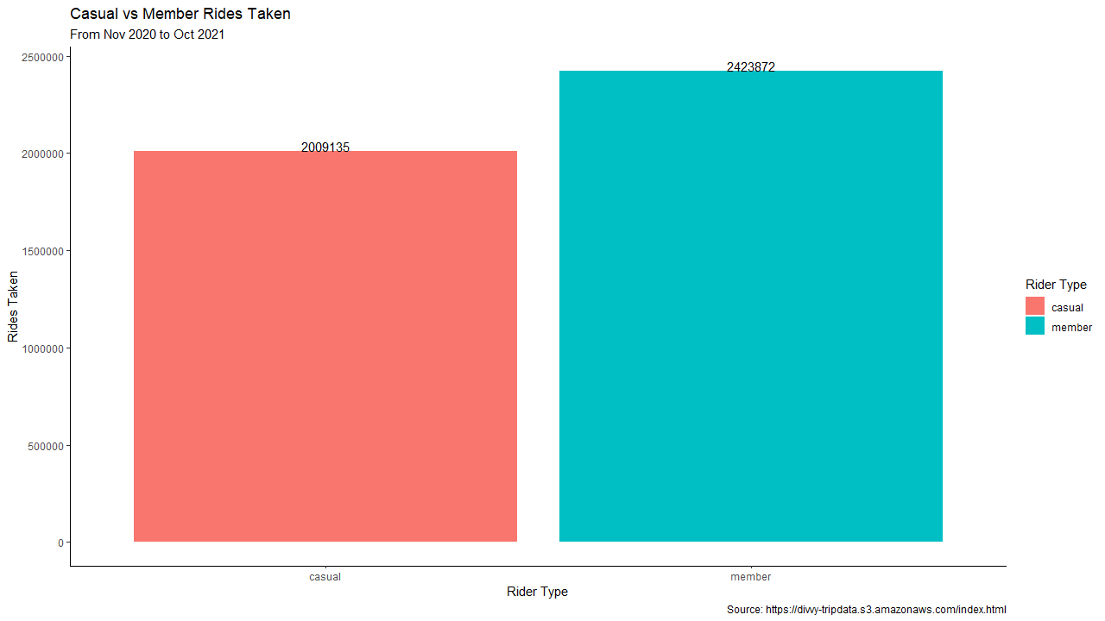



Who uses Cyclistic bikes more?
Annual Members have used Cyclistic bikes more than Casual Riders over 400,000 times.
What kind of bikes do our customers use?

Slide 7
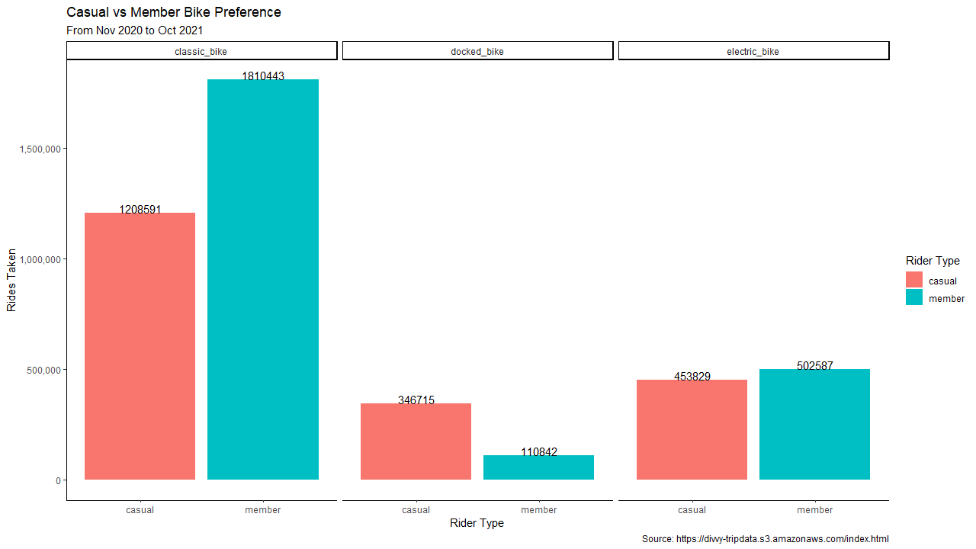
What type of bike do they prefer?
Classic bikes are still the preferred option between annual member and casual riders.
Casual riders prefer using docked bikes while annual members slightly use electric bikes more.

Slide 8
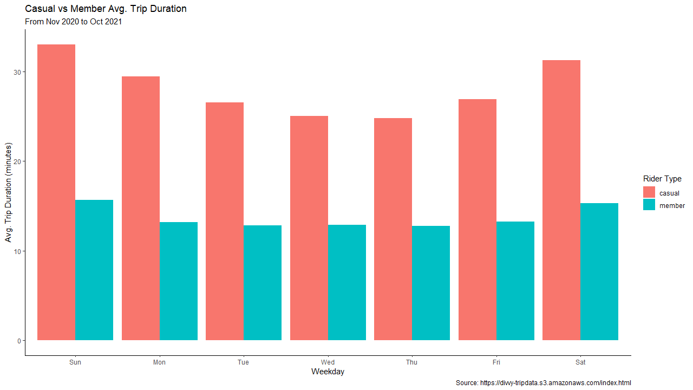
How long does each group use Cyclistic Bikes?
Annual members use our bikes for much shorter periods of times while using our services more often.
Casual riders take less rides but will use bikes for longer periods of time.

Slide 9
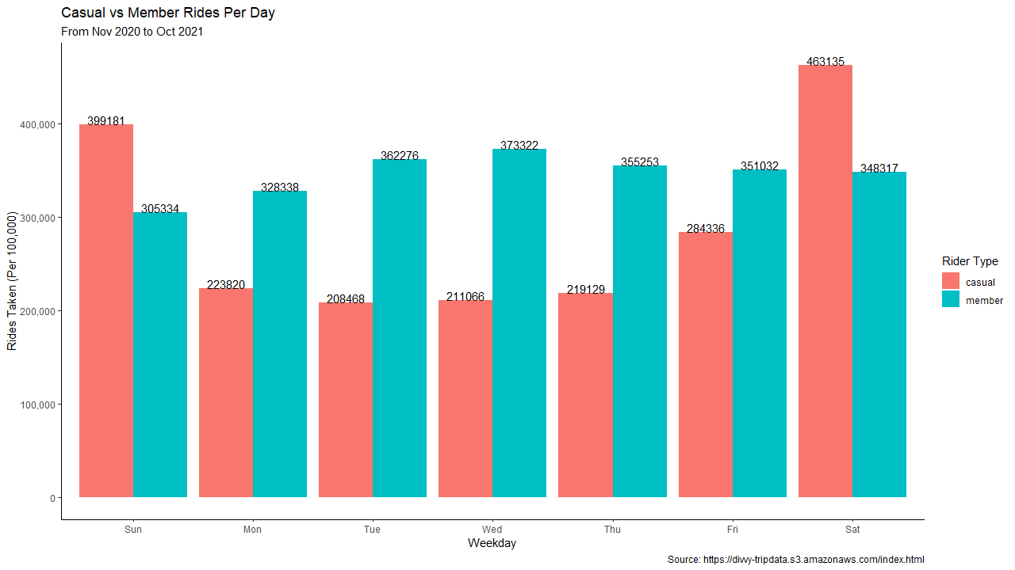
When does each group use Cyclistic Bikes?
Annual members are reliant use our service on the weekdays.
Casual riders are more reliant on our service on weekends.

Slide 10
How we can convert casual rides into annual members

Slide 11
Results
Annual members are already our main consumer base over casual riders.
While both annual members and casual riders use classic bikes, electric bikes are starting to become popular to annual members
Annual members use our service more on the weekdays and for shorter periods of time. Likely used for transportation to work.
Casual riders take longer rides and more on the weekend. Likely used for relaxation or vacation.

Slide 12
Recommendations
Target casual riders who use Cyclistic bikes on the weekdays as they are more likely to also use our service the same way as annual members.
1
Offer incentives for casual riders to use electric bikes.
2
Offer weekend incentives to convert casual riders to become annual members.
3

