Slide 1
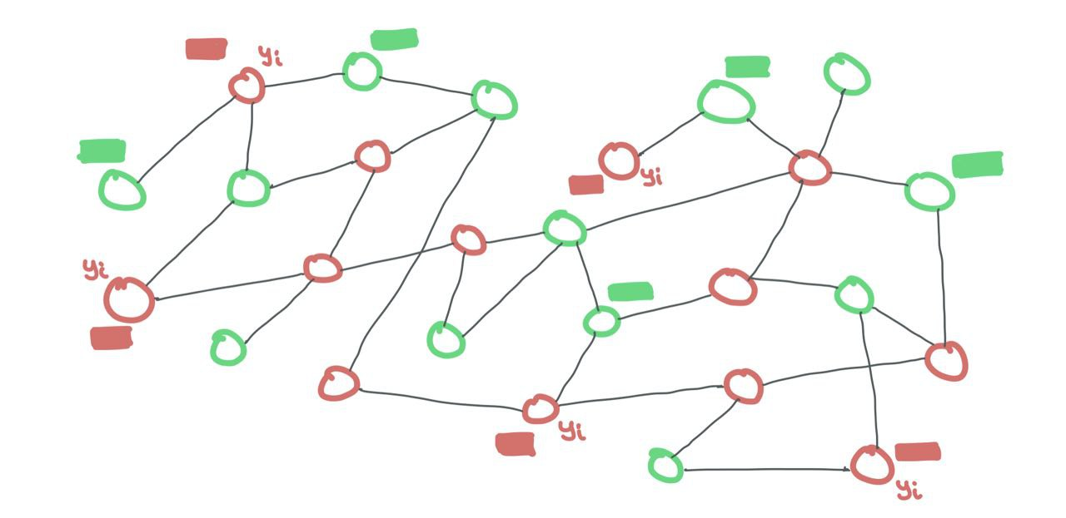
Node Classification
in Citation Networks
using Graph Neural Networks
(GNNs)
Habib Heidari (Ryan Heida)
401651114

Slide 2
Project Description
Project title
Node Classification in Citation Networks using Graph Neural Networks (GNNs)
Objective
The main goal of this project is to apply Graph Neural Networks (GNNs) to a citation network to classify academic papers based on their subject areas. Citation networks are represented as graphs where:
Nodes: Represent academic papers.
Edges: Represent citation relationships between papers.
Each paper (node) is linked to others that cite it or are cited by it. The objective is to use GNNs to predict the subject category of each paper based on the citation network structure and paper features.

Slide 3
Dataset
Cora Dataset
The Cora dataset is commonly used for projects of this type and includes:
Nodes: Papers.
Edges: Citation links between papers.
Features: A sparse bag-of-words representation for each paper.
Labels: Subject areas (e.g., Machine Learning, Data Mining, Neural Networks, etc.).
The dataset can be sourced from libraries like PyTorch Geometric or TensorFlow Graphs.

Slide 4
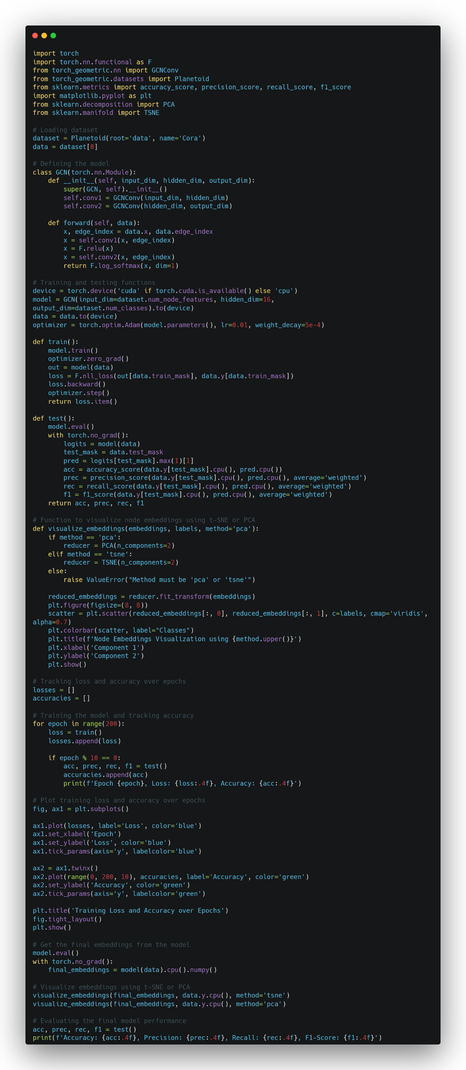
Code
Habib Heidari (Ryan Heida)
401651114

Slide 5
Code
Habib Heidari (Ryan Heida)
401651114

Slide 6
Code
Habib Heidari (Ryan Heida)
401651114

Slide 7
Code
Habib Heidari (Ryan Heida)
401651114

Slide 8
Code
Habib Heidari (Ryan Heida)
401651114

Slide 9
Code
Habib Heidari (Ryan Heida)
401651114

Slide 10
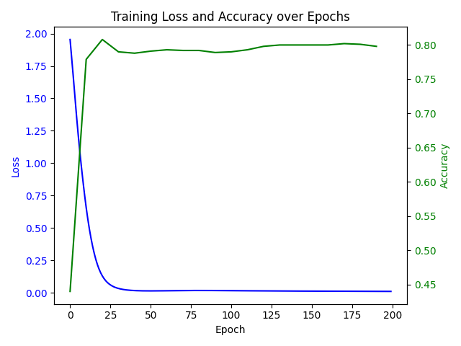
Loss / Accuracy & Statistics
Final Result
Accuracy: 0.8020
Precision: 0.8120
Recall: 0.8020
F1-Score: 0.8030
Habib Heidari (Ryan Heida)
401651114

Slide 11
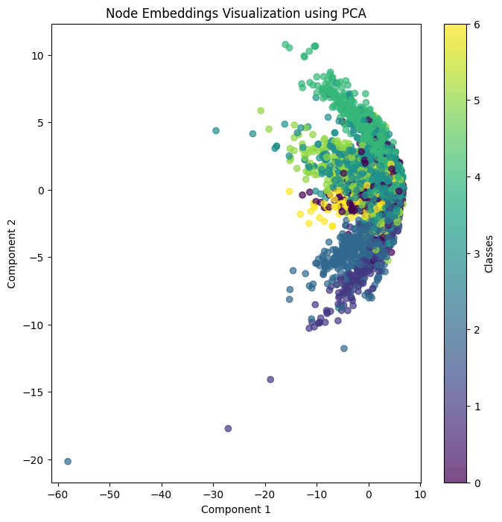
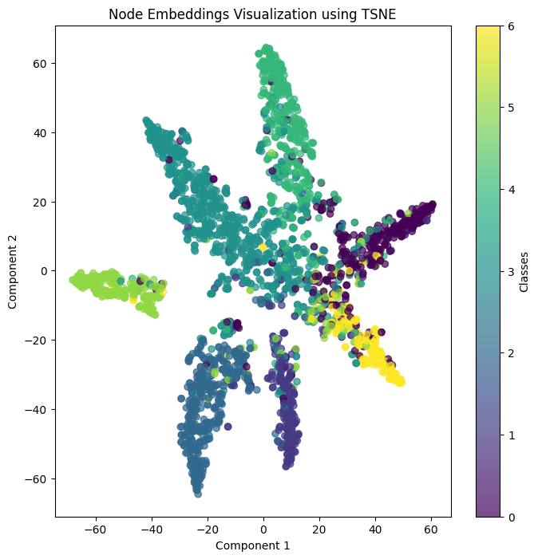
Visualization
PCA
t-SNE
Habib Heidari (Ryan Heida)
401651114

Slide 12
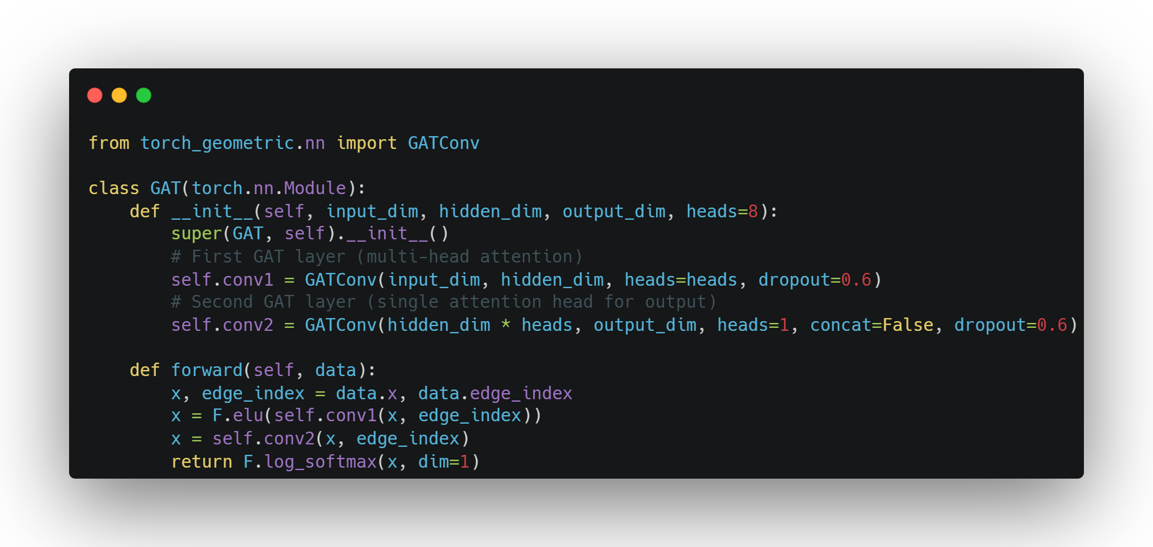
Extensions - GAT
Implementation
Accuracy: 0.7790
Precision: 0.8012
Recall: 0.7790
F1-Score: 0.7811
Results
Habib Heidari (Ryan Heida)
401651114

Slide 13
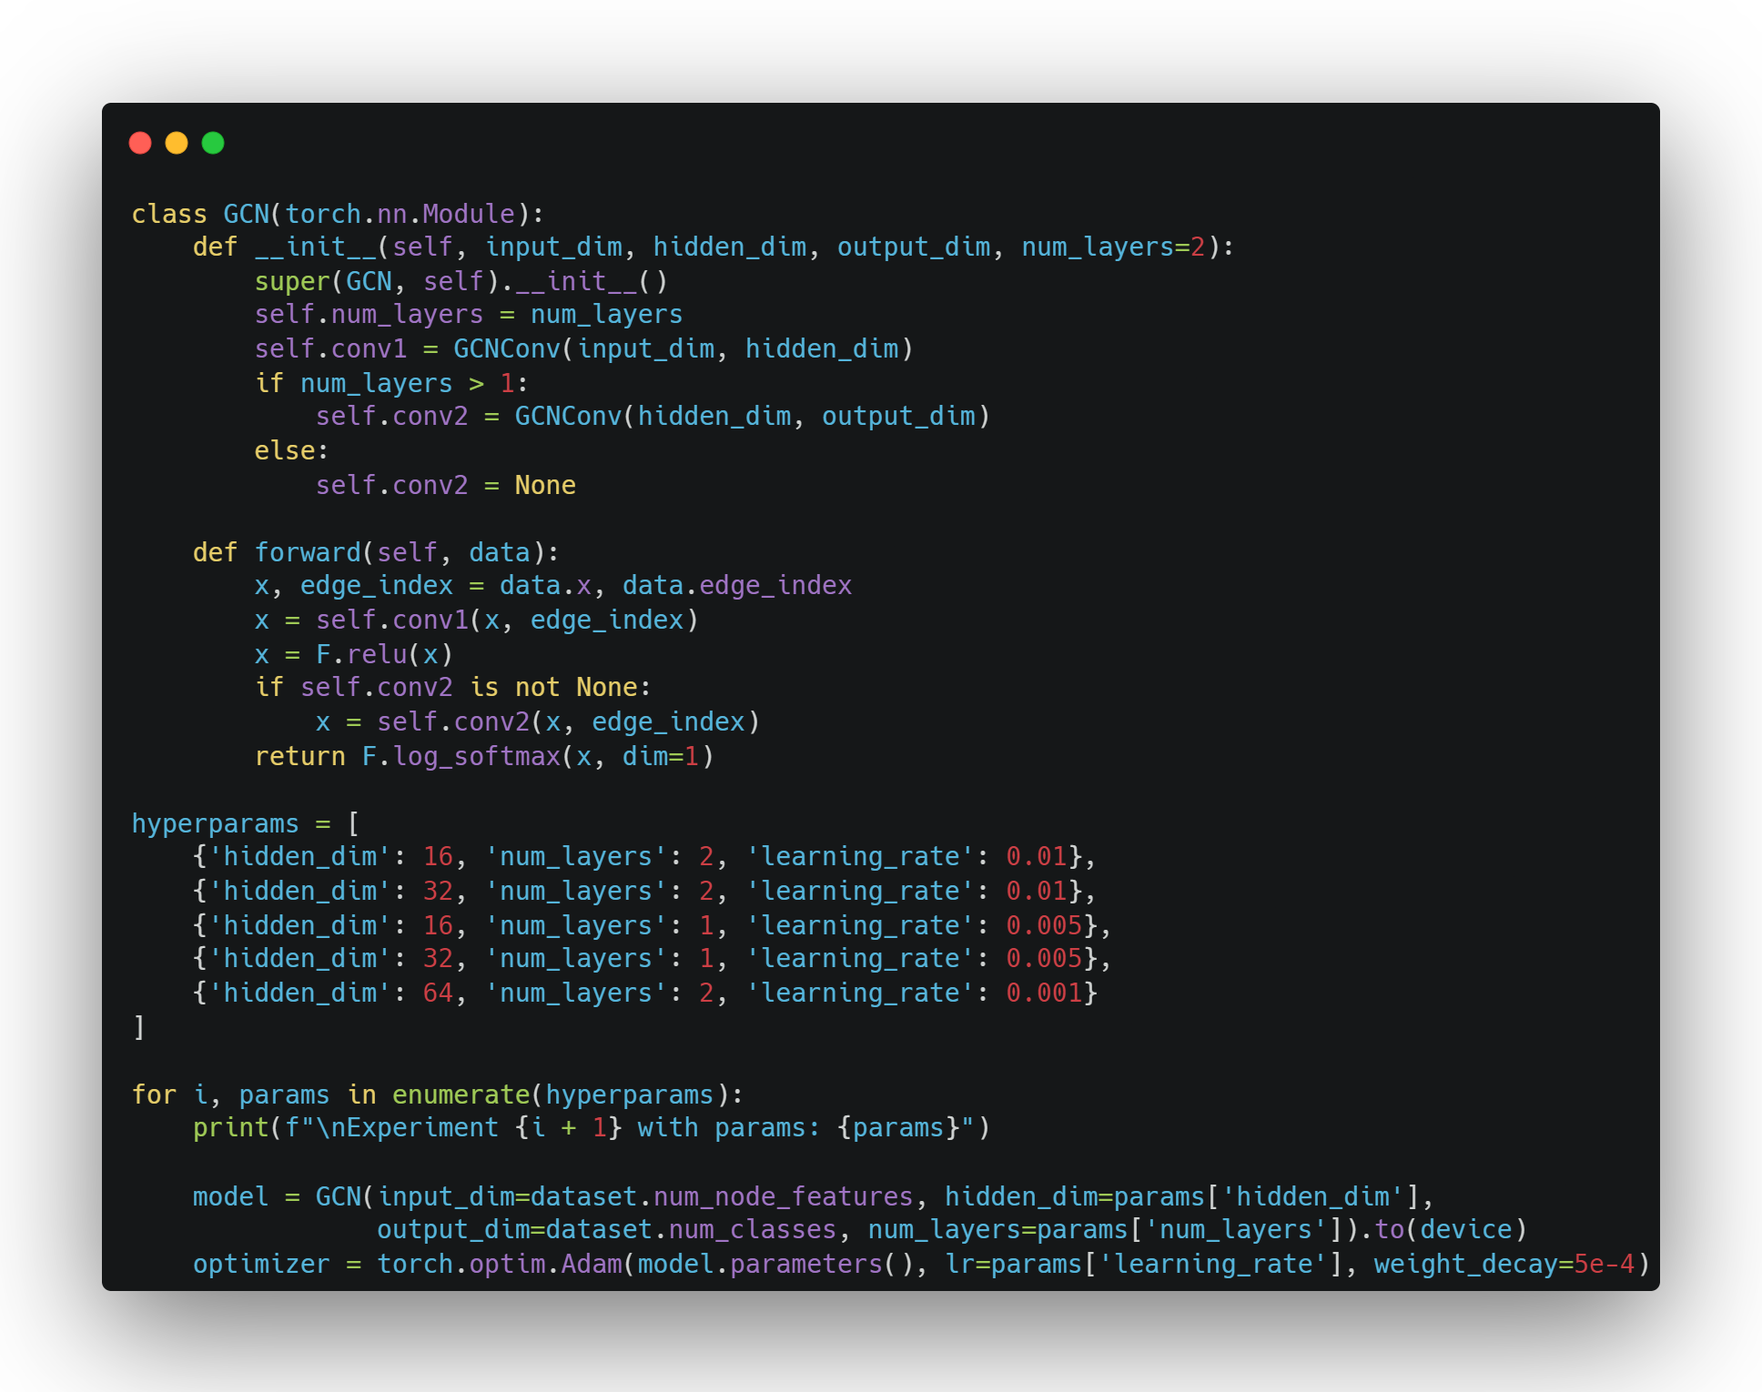
Extensions - Explore hyperparameters
Implementation
Habib Heidari (Ryan Heida)
401651114

Slide 14
Extensions - Explore hyperparameters
Experiment 1 with params: {'hidden_dim': 16, 'num_layers': 2, 'learning_rate': 0.01}
Accuracy: 0.8050, Precision: 0.8156, Recall: 0.8050, F1-Score: 0.8066
Experiment 2 with params: {'hidden_dim': 32, 'num_layers': 2, 'learning_rate': 0.01}
Accuracy: 0.8140, Precision: 0.8242, Recall: 0.8140, F1-Score: 0.8155
Experiment 3 with params: {'hidden_dim': 16, 'num_layers': 1, 'learning_rate': 0.005}
Accuracy: 0.7270, Precision: 0.7484, Recall: 0.7270, F1-Score: 0.7283
Experiment 4 with params: {'hidden_dim': 32, 'num_layers': 1, 'learning_rate': 0.005}
Accuracy: 0.7330, Precision: 0.7524, Recall: 0.7330, F1-Score: 0.7344
Experiment 5 with params: {'hidden_dim': 64, 'num_layers': 2, 'learning_rate': 0.001}
Accuracy: 0.7970, Precision: 0.8108, Recall: 0.7970, F1-Score: 0.7987
Results
Habib Heidari (Ryan Heida)
401651114

Slide 15
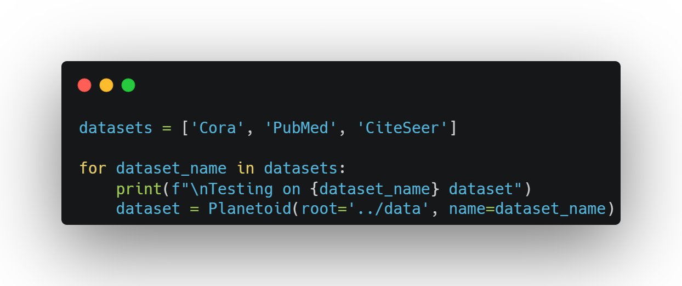
Extensions - Test on other datasets
Implementation
Cora dataset
Accuracy: 0.8010, Precision: 0.8162, Recall: 0.8010, F1-Score: 0.8025
PubMed dataset
Accuracy: 0.7910, Precision: 0.7946, Recall: 0.7910, F1-Score: 0.7903
CiteSeer dataset
Accuracy: 0.6820, Precision: 0.7049, Recall: 0.6820, F1-Score: 0.6889
Results
Habib Heidari (Ryan Heida)
401651114

Slide 16
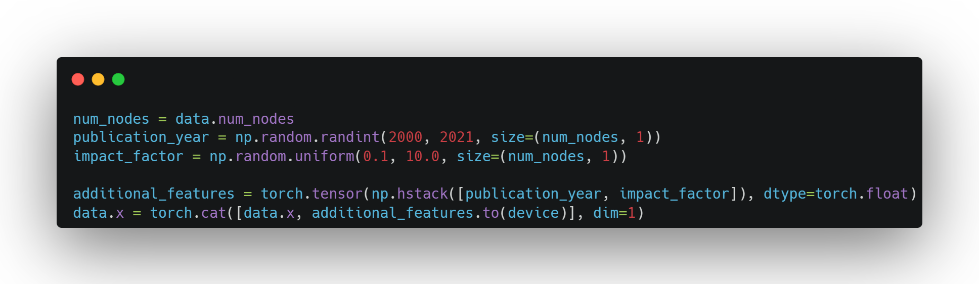
Extensions - Add Features (Like Publication Year or Journal Impact Factor for Enhanced Modeling)
Implementation
Accuracy: 0.7110
Precision: 0.7711
Recall: 0.7110
F1-Score: 0.7198
Results
Habib Heidari (Ryan Heida)
401651114

