Slide 1

EDD Fall 2021 Final Project
TEAM MEMBERS: Brahim Nid-Youssef, Ryan I Pupia, Enrique Reyes, Christino L Barbosa

Slide 2

Agenda
Summary of Findings
Data
Methodology-Analysis
Results
Next Steps
Appendix

Slide 3
Summary of Findings
This Spotify data set was used to look at certain features using Spotify's Web API.
The objective was to figure out what tracks were a 'Hit' or a 'Flop'. This was labeled with a '1' for 'Hit' and '0' for a 'Flop'
We are helping an artist figure out what features he should have in their song in order to increase the probability of making it a hit.
We will be looking at the danceability and the duration of songs to figure if this song will be a hit

Slide 4
Summary of Findings
After cleaning and filtering data we are left with only columns and rows that were necessary for our hypothesis. So we created a new variable called "danceability_proximity" is what our new target variable is and what will determine our hypothesis. "danceability_proximity" is the
Null Hypothesis: 60% or more of hit songs from 2000s and 2010s have a “danceability_proximity” coefficient of 0.7 or more.
Alternate Hypothesis: 55% or less of hit songs from 2000s and 2010s have a “danceability_proximity” coefficient of 0.7 or more.

Slide 5
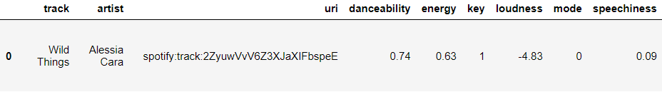
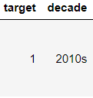
Data
The Spotify Dataset is comprised of 44894 rows, each representing a Spotify track
21 columns.
The data was collected through python modules for both Spotify and Billboard’s web APIs.
Below is sample of the first row:
This row represents a track named “Wild Things” by artist Alessia Cara, this row has a danceability value of 0.74, a target of 1 which means it’s a “hit” track, and was released in the 2010s.

Slide 6
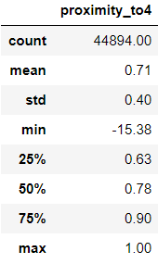
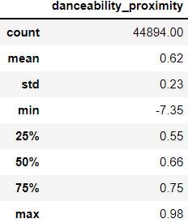
Data
Analysis was performed on how some variables were distributed among recent “hit” songs focusing on the duration and danceability.
Used a track’s duration feature to examine how close it is to four minutes.
Averaged that value with track's danceability to achieve equal weight.

Slide 7
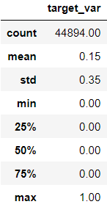
Data
Defined target population on which to perform analysis:
QA
Didn’t fill null values.
Dropped any duplicate rows based on the “track” and “artist” column.
Analyzed the difference in distributions for multiple variables before and after QA guarantee safety.

Slide 8
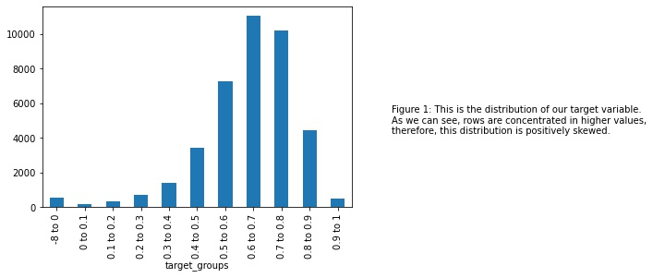
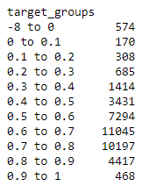
Analysis

Slide 9
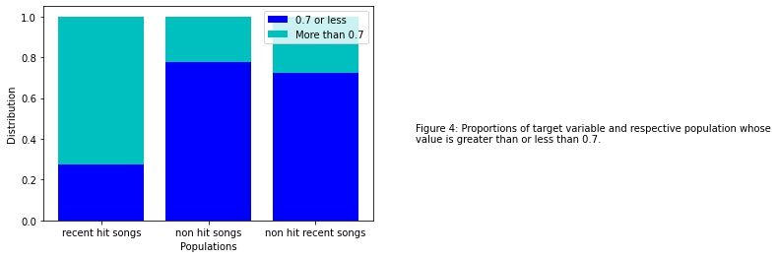



Analysis
Add conclusion

Slide 10
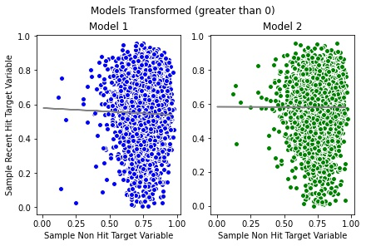
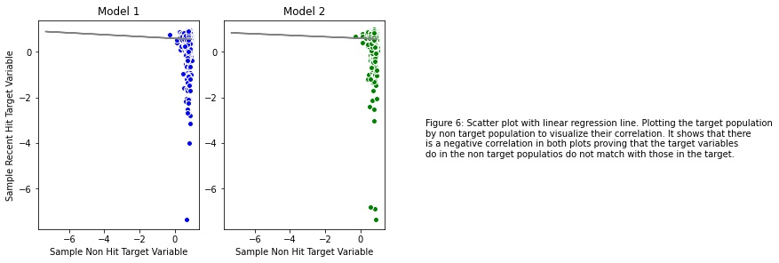
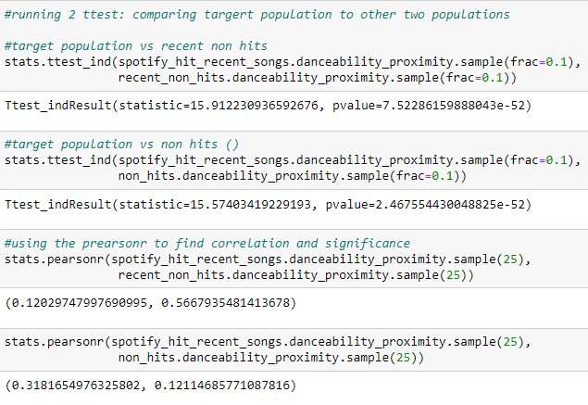
Analysis
- ttest: how significantly different are means
* (significance, pvalue (reject null if pvalue < 0.05))
- pearson r (two tailed): correlation of sample means
* (left-tail, right-tail)

Slide 11
Next Steps
In order to increase the probability of making the artist's song a hit is by ensuring the duration of the song is as close to 4 minutes as possible.
They would also want to make sure that their danceability is high through a combination of musical elements including tempo, rhythm stability, beat strength, and overall regularity.
More analysis should be done on other features to better determine the nature of a hit song. Thus increasing likeliness of making a hit.

Slide 12
Appendix
Appendix
A1. description of supporting graph/table

Slide 13
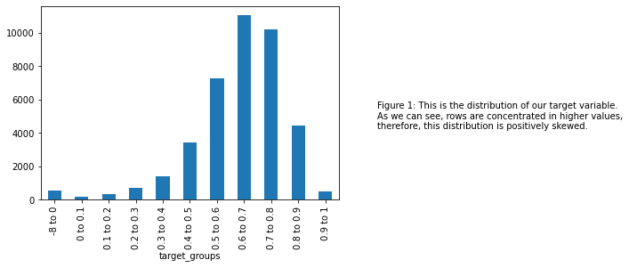
Distribution of target variable
This graph shows the amount of songs that are in different target groups for our target variable "danceability_proximity".

Slide 14
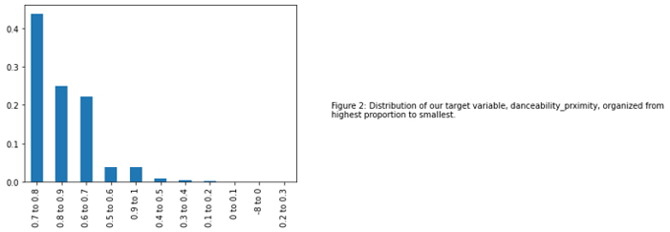
Distribution of target variable within target population
This bar graph shows the proportion of the distribution of our target variable "danceability_proximity" in our target population.

Slide 15
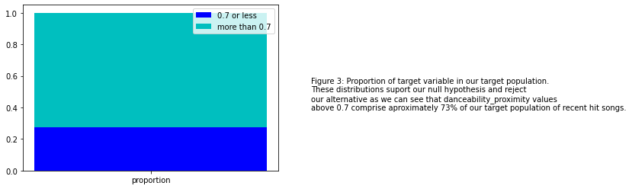
Proportion of target variable within target population
This bar graph shows the proportion of songs that satisfy value of our target variable "danceability_proximity" and those that do not within our target population. The top half represents those that do and the bottom half represents those that don't.

Slide 16
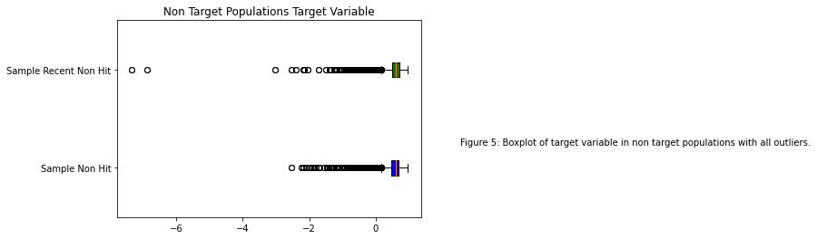
Boxplot 1
This plot shows distribution of target variable "danceability_proximity" in non-target populations.

Slide 17
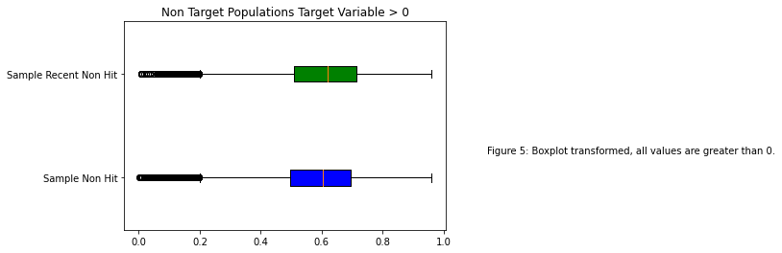
Boxplot 2
This plot removes all of the non-zero values from the first plot.

