Slide 1


F1 Data Science Project
By Ryan Pupia

Slide 2
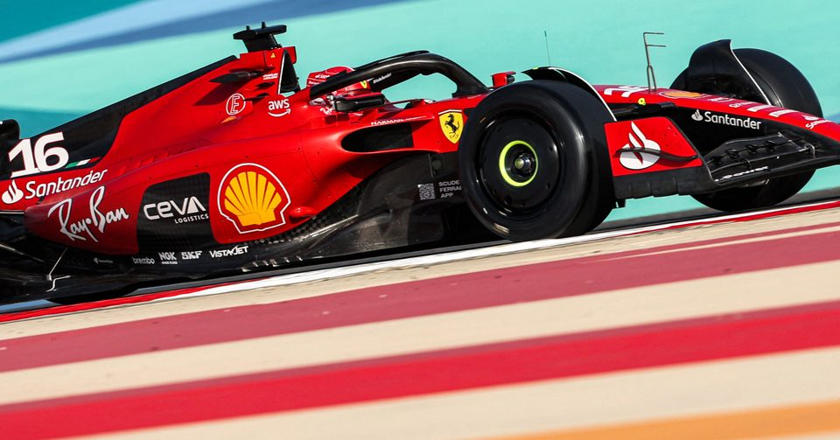
1. Introduction

Slide 3
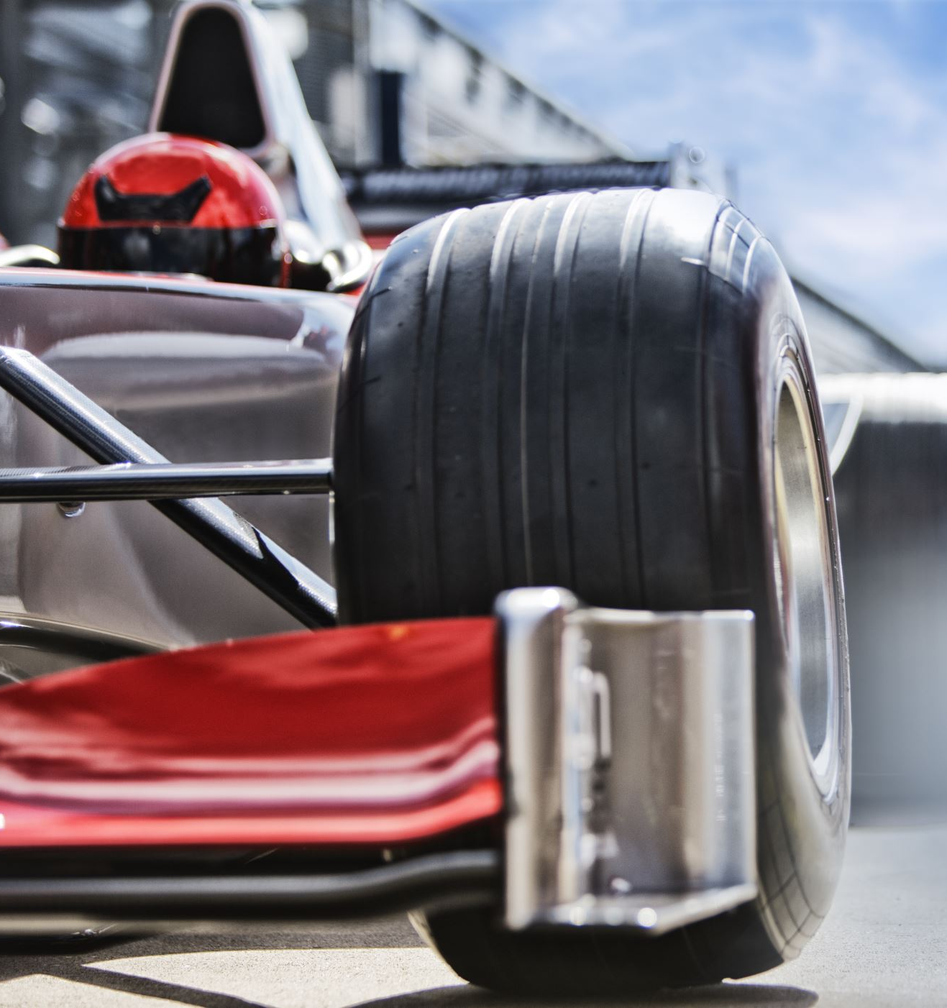
Formula 1 is a racing sport that combines human prowess with precise engineering
Over the years, the sport has become more and more data-driven in efforts to perfect car design and race strategies

Slide 4
The Format
Drivers represent themselves and their teams in a series of races to earn points
The pointing system has gone through many revisions and has reached its current iteration in 2010

Slide 5
Points
Each race is driven by 20 drivers simultaneously
the top 10 drivers are attributed 1 to 25 points for their placement, along with a single extra point for the fastest lap
The bottom 10 drivers aren’t attributed any points

Slide 6

2. The project

Slide 7
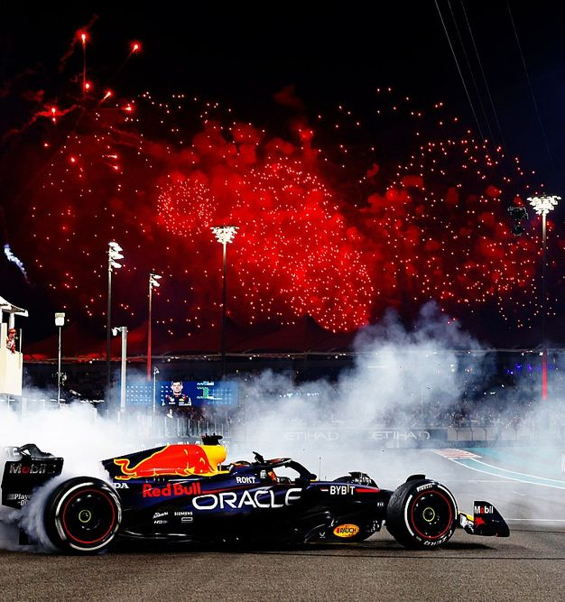
Objective
Currently, F1 is being dominated by the Red-Bull team
The project aims to make the sport more exciting for viewers and engaging for competitors
It will assist lower ranking teams in selecting drivers for the season, as well as strategizing with pit-stops

Slide 8
Methods
The project intends to take data on the individual driver’s results for each race and predict whether a specific driver, racing for a specific team, in a specific track, in a specific year will earn any points based on their pit-stops

Slide 9

3. The Data and Preparation

Slide 10
The Data-Set
The Formula 1 World Championship (1950 - 2023) Data-Set, Available on Kaggle, contains data on the results for each driver for every race since the 1950s to current day, as well as information on drivers, constructors, circuits, and car/driver status.

Slide 11
Manipulation
Manipulation mostly consisted of joining the values from different tables into one as the data-set was in a relational data-base format
More manipulation was required to calculate each Driver’s total Pit-Stops per race and handle the null values generated by this operation

Slide 12
Null-Values
Before the 841st race pit-stop data wasn’t being recorded, so those records were eliminated, this would be the case regardless because data that old would likely negatively impact the model due to the new categories for the variables.

Slide 13
Null-Values cont.
For other null values, results with zero laps completed and with status different from ‘finished’ were filled in with zero pit-stops.
There was one race that ended prematurely due to wet conditions for which the results were also removed from the data.

Slide 14
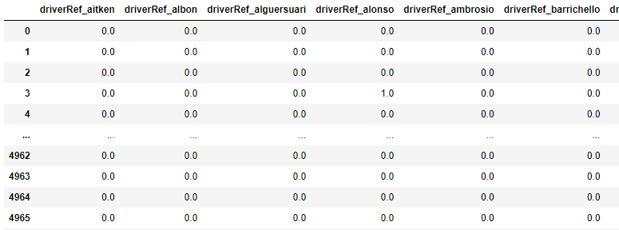

Preparing for modeling
Results were binned into either “Scoring” or “Not-scoring” in a new column
The driverRef, CircuitRef, and ConstuctorRef columns were One-Hot-Encoded for the model as well.

Slide 15

4. Modeling

Slide 16

Original Techniques Selected
A Random Forest classifier was selected due to its versatile hyper-parameters and its ability to handle categorical variables
A Naïve Bayes Classifier was also selected due to its design for categorical variables

Slide 17
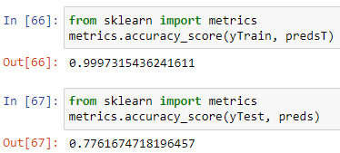
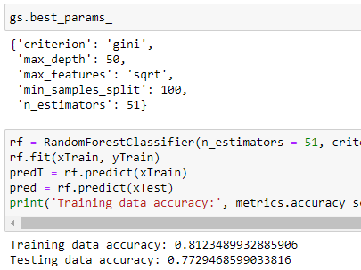
Random Forest Classifier
Originally, the classifier depicted a large disparity between training and testing accuracy indicative of over-fitting
I then experimented with a grid search and use of less parameters, which led to an improved model.
Less features had the same accuracy, so I kept the fully featured model

Slide 18
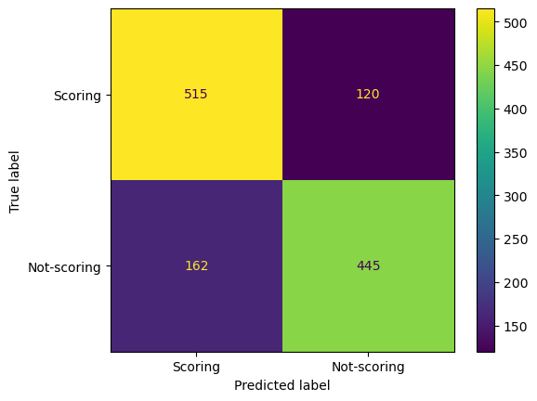
Random Forest Performance Analysis
The model had a considerably even confusion matrix
Out of every “Scoring” prediction, the model was correct 76% of the time. This is good for driver confidence in race.
Out of every “Not-scoring” prediction, the model was correct 79% of the time. This is good for team strategy adjustments and driver acquisition.

Slide 19

Naïve Bayes Classifier
During hyper parameter tuning, I found that the nature of the Naïve Bayes algorithm is not well suited for the data.
Because there were many categories for each variable, it became difficult to guarantee the model included all the testing categories in it’s training data.
Therefore, I changed my approach to a KNN Classifier instead.

Slide 20

K-Neighbors Classifier
This model was promising as it could handle unseen data quite well, and it didn’t require seeing every category in the training data to function on the testing data.

Slide 21
KNN Design
The model had initial training and testing accuracies of 84% and 77% respectively.
I attempted to improve this through a grid-search and couldn’t achieve any improvements.

Slide 22
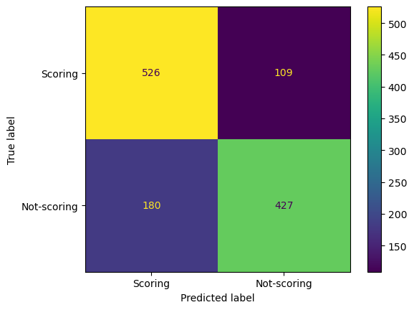
KNN Model-Evaluation
This model also has a relatively even confusion matrix.
Out of all its “Scoring” predictions the model was correct 74% of the time, not as good as RDF but still good
Out of all its “Not-Scoring” predictions, the model waws correct 80% of the time, this is an improvement over the RDF model in aid to strategy adjustment

Slide 23

Selected model
I believe the KNN model to be superior for the project’s objectives as it is more conservative with “Not-Scoring” predictions.
This is desirable as strategy adjustments can be both complicated and expensive, so a more conservative model is less likely to guide decisions into un-needed expenses

Slide 24

5. Conclusions

Slide 25
An accuracy of 75 is considerably high, especially considering the limitations of the data, as a sport such as F1 has constant driver and track turn-over leading to low support for some variable categories.
This model could aid in guiding teams during both driver acquisition and race strategizing.
This is especially useful for lower ranking teams, introducing more excitement into the sport, which is beneficial to the entire F1.
The model can also improve as data is collected and become even more accurate.

Slide 26

Thank you!

