Slide 1
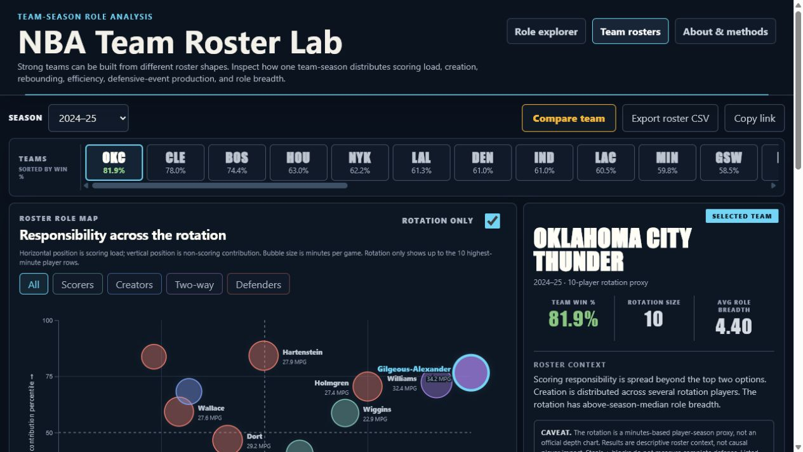
DATASCI 209 — FINAL PROJECT
Beyond Points Per Game
A usability-driven player-role and roster explorer
Ryan Wenstrom and Kenny Dolgin
Final Project Presentation
01
Notes:
Presenter: Kenny
Timing: 0:30
Talk track: Open with the final thesis: points per game is familiar, but it does not explain how responsibility is distributed. Frame the talk around what changed after the midterm, what the final workflows do, and what usability testing taught us.
[Sources]
- Final deployed project screenshot captured 2026-07-29.
- Live project: https://kennydolgin.github.io/nba-project/

Slide 2
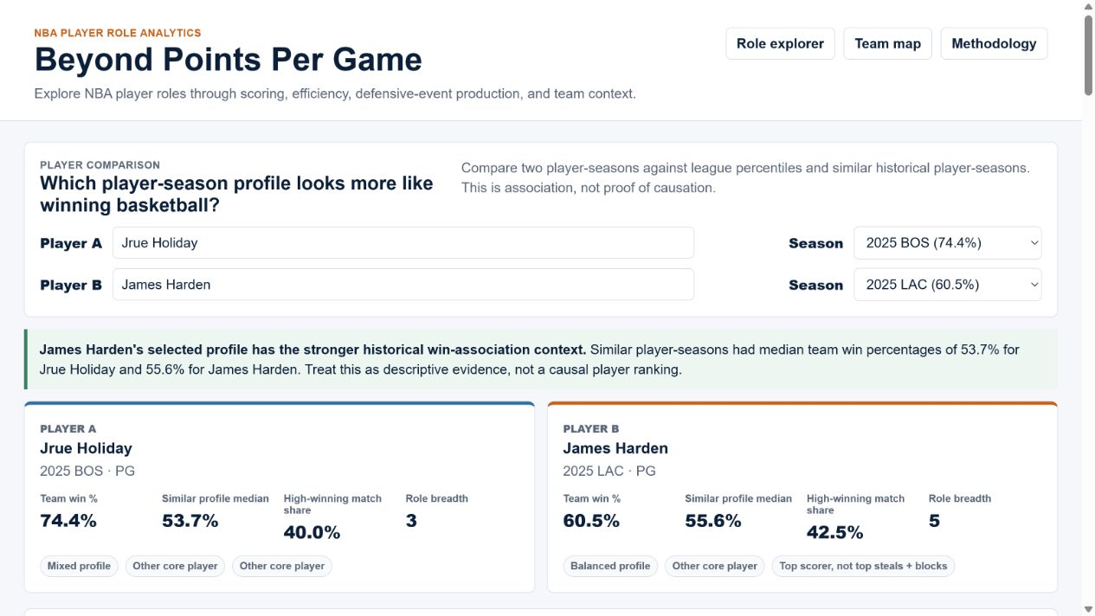
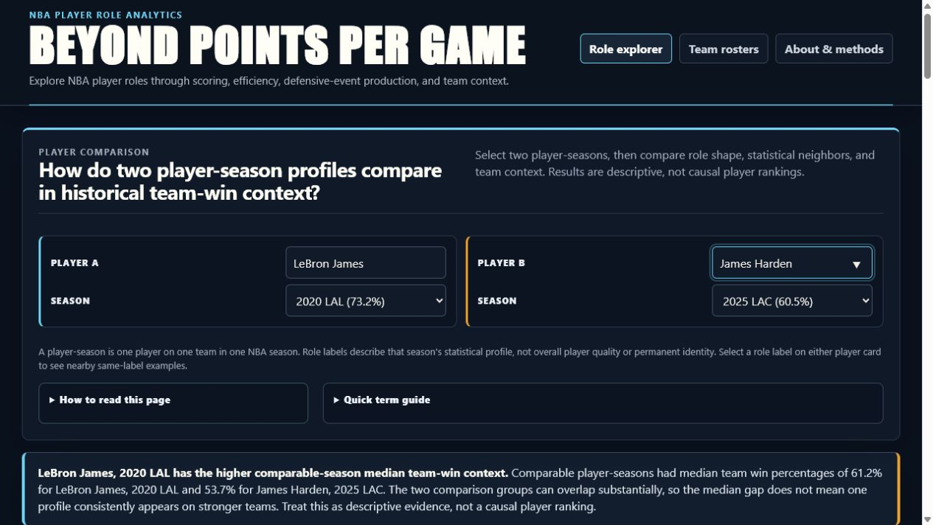
WHAT CHANGED
Since the midterm, the project became a guided workflow
Midterm prototype
Final dashboard
- Evaluative “winning basketball” framing
- Hover details were easy to lose
- Player comparison was the only core workflow
- Neutral comparison question and visible guardrails
- Persistent selections and exact values
- A second workflow for roster-level responsibility
Beyond Points Per Game / 02
Notes:
Presenter: Kenny
Timing: 1:00
Talk track: Do not re-present the midterm analysis. Use this slide only to establish the delta: the final product changed its framing, interaction state, and unit of exploration.
[Sources]
- Earlier project QA screenshot: outputs/github_pages_role_explorer_prototype.png.
- Final deployed project screenshot captured 2026-07-29.
- Commit 68b2882: Incorporate usability study feedback.

Slide 3
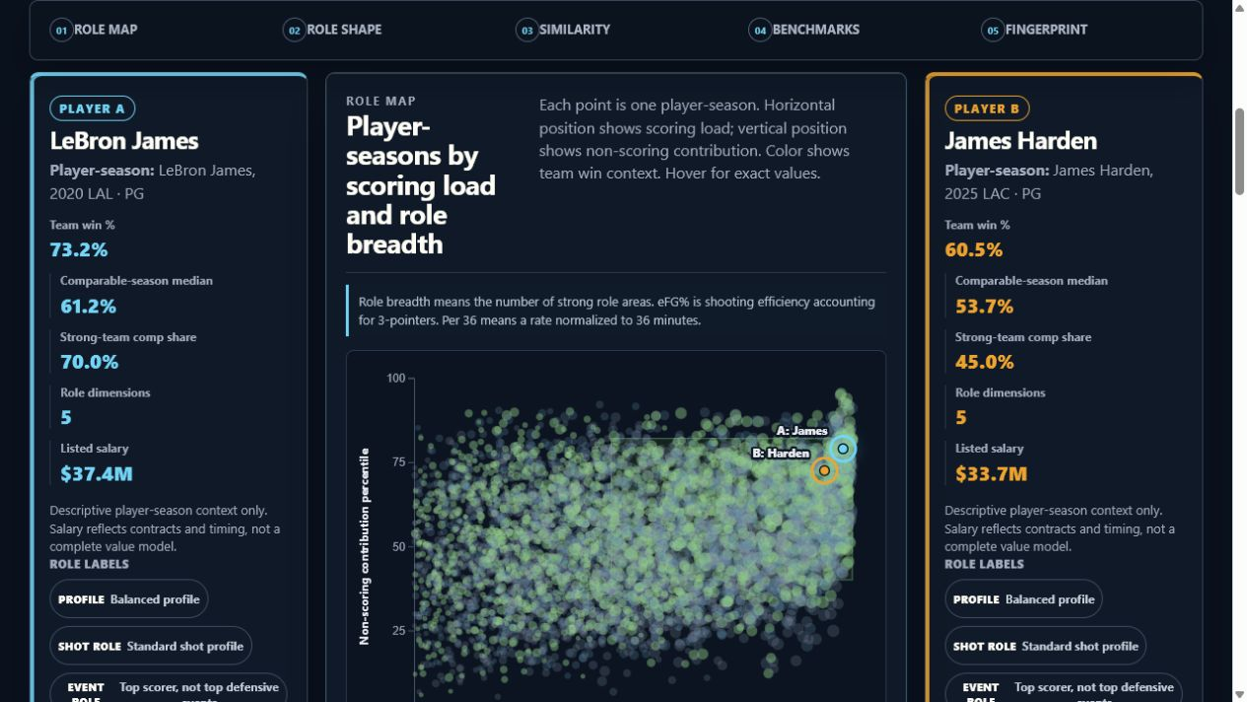
LIVE DEMO
Compare two seasons without ranking the players
Demo question
LeBron 2020 LAL vs. Harden 2025 LAC
ROLE MAP — FALLBACK IF THE LIVE SITE STALLS
1. Select both seasons
2. Read role map + fingerprint
3. Inspect similar seasons
4. Keep winning as context
Switch to the live dashboard here.
Profile similarity describes shape—not player quality.
Beyond Points Per Game / 03
Notes:
Presenter: Kenny
Timing: 3:00
Talk track: Move to the live Role Explorer. Select LeBron James 2020 LAL and James Harden 2025 LAC. Show the comparison sentence, role map, fingerprint, and closest matches. Explicitly say that the comparison is descriptive and not a player ranking.
[Sources]
- Live project: https://kennydolgin.github.io/nba-project/
- Final deployed Role Explorer screenshot captured 2026-07-29.

Slide 4
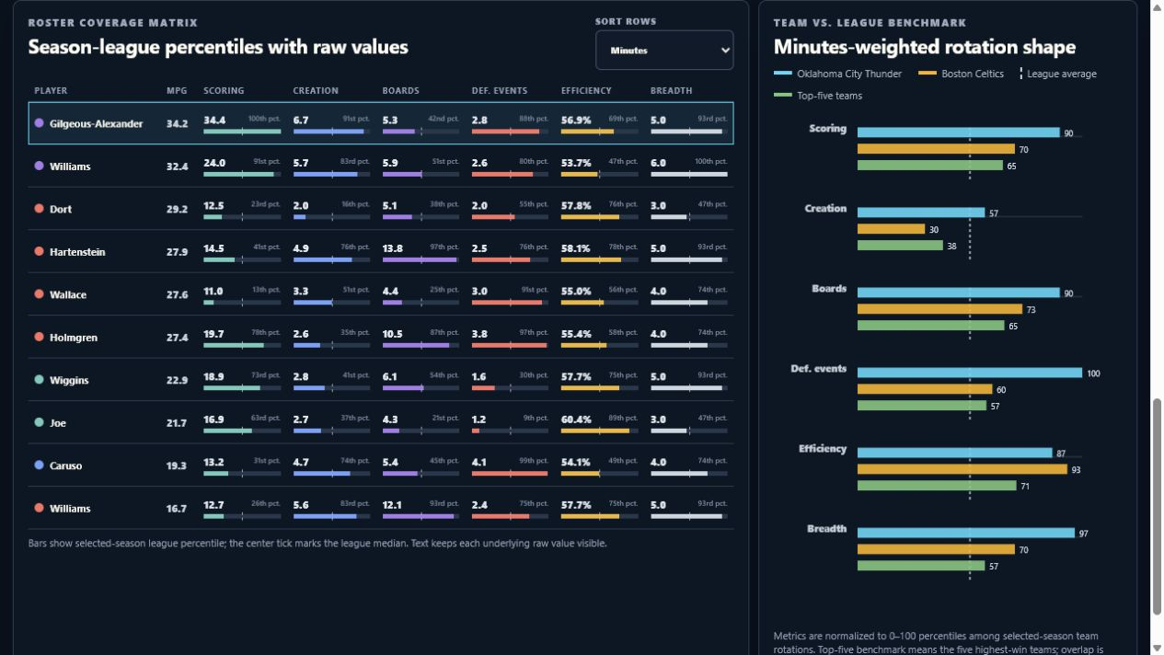
LIVE DEMO
Inspect how one team shares responsibility
COVERAGE + BENCHMARK AFTER ADDING BOSTON
Demo path
1. Choose Oklahoma City
2. Select a player
3. Open Coverage
4. Add Boston + swap teams
Top 10 by minutes = rotation proxy, not official depth chart.
Beyond Points Per Game / 04
Notes:
Presenter: Ryan
Timing: 3:00
Talk track: Move to Team Roster Lab. Choose Oklahoma City, select one player, switch from Roster map to Coverage, add Boston as the comparison team, and use Swap teams. Explain that swapping changes the active roster while preserving the previous team for comparison, and that the benchmark is descriptive rather than causal.
[Sources]
- Live project: https://kennydolgin.github.io/nba-project/map.html
- Final deployed Team Roster Lab screenshot captured 2026-07-29.

Slide 5
USABILITY STUDY
Six participants tested comprehension, interaction, and trust
One study round
What participants did
What we recorded
- 6 moderated sessions
- 3 conducted by Ryan
- 3 conducted by Kenny
- About 30 minutes each
- Oriented without coaching
- Compared player-seasons
- Explained similarity and percentiles
- Used team and methods views
- First action and evidence used
- Hesitation and help needed
- Interpretation errors
- Ease and effectiveness
Varied expertise exposed failures that experts missed
Beyond Points Per Game / 05
Notes:
Presenter: Ryan
Timing: 1:30
Talk track: Name the study as one usability round with six participants: Ryan P01–P03 and Kenny K-01 Paul, K-02 Caroline, and K-03 Sean. Explain that the team tracked observed behavior and interpretation errors, not just preferences.
[Sources]
- outputs/Beyond_Points_Group_Final_Usability_Study_Assignment_Ready.docx.
- tools/build_group_usability_study_final.py, study overview and participant logs.

Slide 6
WHAT WE LEARNED
Interpretation—not interaction—was the recurring problem
- Ryan P03 and Kenny K-03 read parts of the app as a ranking or winning formula
- eFG%, per-36, percentiles, denominators, and similarity needed local definitions
- Dense charts made exact answers harder; participants preferred bars and tables
- Hover-only state was easy to lose while scrolling
Ranking risk
Causal language
Local definitions
Exact values
Dense charts
Persistent state
Bars + tables
Clearer team question
Observed behavior
Interpretation risk
Design priority
Beyond Points Per Game / 06
Notes:
Presenter: Ryan
Timing: 1:30
Talk track: Continue directly from the study method into the repeated failure pattern. Two participants made explicit ranking or causal interpretations; other participants independently flagged evaluative wording. Connect terminology, dense evidence, and lost hover state to the design priorities.
[Sources]
- Cross-participant findings in outputs/Beyond_Points_Group_Final_Usability_Study_Assignment_Ready.docx.
- Participant logs: Ryan P01–P03 and Kenny K-01–K-03.

Slide 7
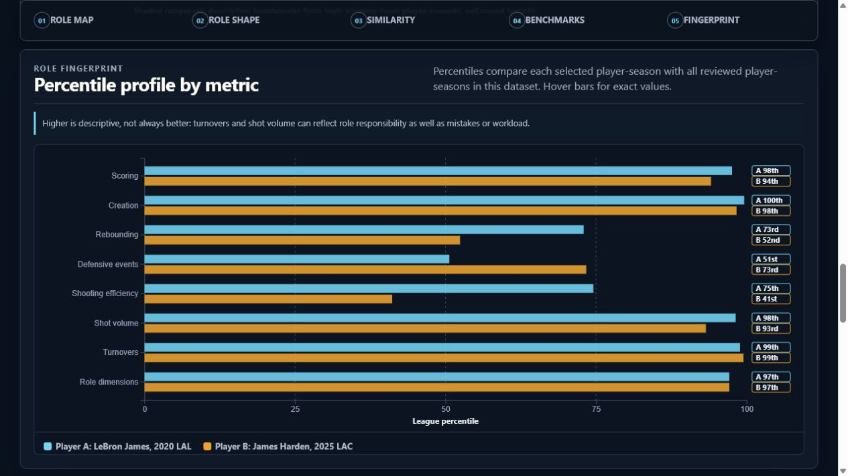
DESIGN RESPONSE
We moved definitions and guardrails into the interaction
FINAL FINGERPRINT — GUIDANCE APPEARS WITH THE EVIDENCE
What changed
- Neutral framing
- Persistent selections
- Exact values beside percentiles
- Local “higher ≠ better” note
- Similarity ≠ quality
Beyond Points Per Game / 07
Notes:
Presenter: Ryan
Timing: 1:30
Talk track: Tie every visible change to an observed issue: neutral titles for ranking risk, local definitions for terminology, persistent state for lost hover context, exact values for dense-chart tasks, repeated similarity caveats, and the aligned value-label gutter that keeps 90th-to-100th-percentile labels readable.
[Sources]
- Commit 68b2882: Incorporate usability study feedback.
- Final deployed Role Fingerprint screenshot captured 2026-07-29.
- Group usability-study MoSCoW priorities.

Slide 8
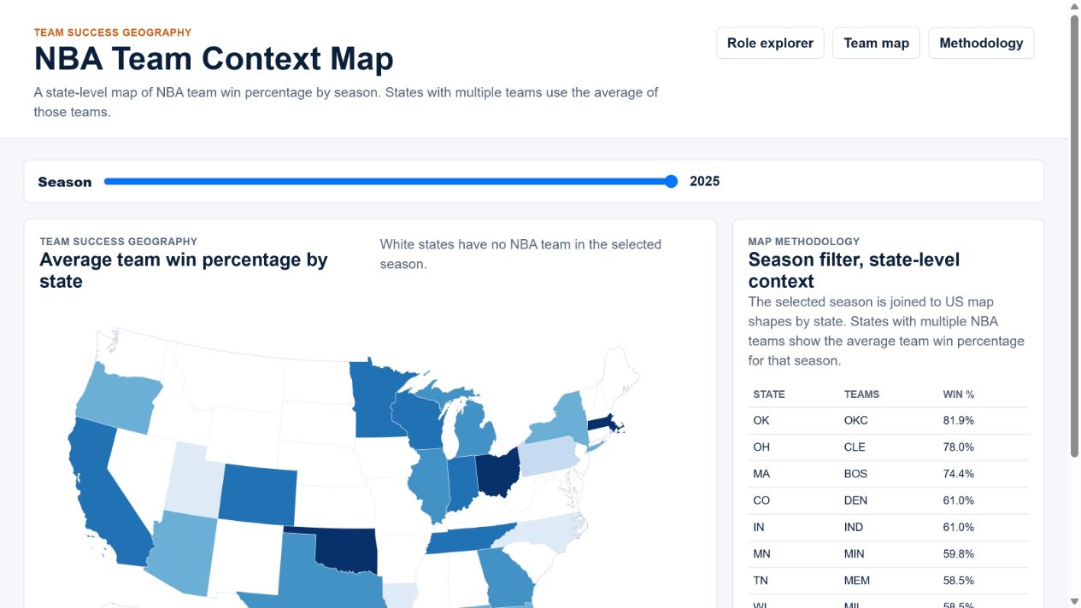
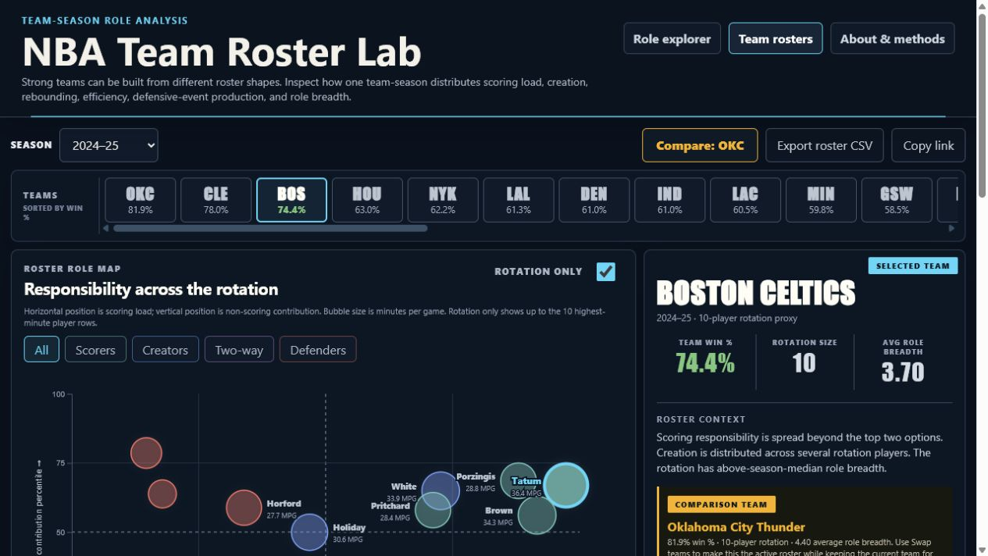
DESIGN RESPONSE
Geography answered the wrong question
Before: Team Context Map
Now: Team Roster Lab
- Mechanically easy, but secondary to the role story
- State averages hid differences between teams
- Exact answers came from the table, not the map
- Team-season rotation becomes the unit
- Swap keeps the prior team available for comparison
- Role map, coverage, and benchmark answer one question
Beyond Points Per Game / 08
Notes:
Presenter: Kenny
Timing: 1:15
Talk track: Begin the final Kenny block by explaining the decision, not just the visual change. The map was intuitive, but it did not advance the player-role question and state averages could hide team differences. The Roster Lab turns team context into a roster-structure question, and Swap teams lets the comparison work in both directions.
[Sources]
- Earlier project QA screenshot: outputs/github_pages_team_map_prototype.png.
- Final deployed Team Roster Lab screenshot captured 2026-07-29.
- Commits 3889696 and 564faf6.

Slide 9
TOOL CHOICE
The stack matched the interaction and hosting constraints
- Flask kept local routes, templates, and data endpoints simple
- D3 and vanilla JavaScript supported linked custom interactions
- A static build made the public version reliable and portable
- CSV and JSON keep the data path inspectable
Custom charts
Persistent state
Keyboard paths
CSV + JSON
Responsive CSS
No database
Portable hosting
Inspectable build
Flask + Jinja
Local app and data routes
D3 + JavaScript
Linked interactive views
Static build + Pages
Reliable public delivery
Beyond Points Per Game / 09
Notes:
Presenter: Kenny
Timing: 0:45
Talk track: Continue from the design decision into the required tool-choice rationale. Flask made local development and data routes straightforward; D3 supported custom linked interactions; the static export removed server-hosting complexity for the public class demonstration.
[Sources]
- app.py and templates/.
- static/js/app.js and static/js/team_explorer.js.
- tools/build_static_pages.py and .github/workflows/pages.yml.

Slide 10
CONCLUSION
The dashboard explains itself at the point of use
What changed
What testing showed
What remains limited
- Guided comparison workflow
- Persistent state and exact values
- Roster-level responsibility view
- Plain language builds trust
- Bars and tables support precise answers
- Repeated guardrails reduce overreach
- Descriptive, not causal
- Minutes-based rotation proxy
- No lineup, injury, coaching, or full-defense model
Live project: https://kennydolgin.github.io/nba-project/
Questions?
Beyond Points Per Game / 10
Notes:
Presenter: Kenny
Timing: 1:00
Talk track: Close the final Kenny block by resolving the opening: the project now supports exploration without pretending to be a player grade or causal model. Name the remaining limitations, invite questions, and keep both team members available for discussion.
[Sources]
- Final project application and About & Methodology page.
- Group usability-study conclusions and MoSCoW priorities.
- Live project URL verified 2026-07-29.

