Slide 1

RAMAIAH INSTITUTE OF TECHNOLOGY, Bangalore (Autonomous Institute Affiliated To VTU)
Dept. of Electronics and Communication Engineering
Course code - Mini Project
Power Allocation in Cognitive Radio Networks using Deep Reinforcement Learning
A Learning-Based Approach to Adaptive Decision-Making
Guide
Dr. CHITRA M
Assistant Professor
Team Members
ADITYA GANGWANI 1MS23EC007
RYAN GOMEZ 1MS23EC109
SHREYA REVANAKAR 1MS23EC123
SNEHA TAPADAR 1MS23EC155

Slide 2
Table of Contents
Introduction
Problem Statement
Proposed design/Circuit/Algorithm
Implementation/Methodology
Results and Discussion
Conclusion and Future Work
References

Slide 3
Introduction — Cognitive Radio Networks
What is a Cognitive Radio Network?
A Cognitive Radio Network (CRN) is an intelligent wireless system in which unlicensed Secondary Users (SU) opportunistically access licensed spectrum bands originally allocated to licensed Primary Users (PU), without causing harmful interference. CRNs address the spectrum-scarcity problem caused by static allocation, where licensed bands sit under-utilised 15–85 % of the time (FCC 2002).
UNDERLAY
• SU transmits with PU simultaneously; keeps interference below a threshold.
• Needs accurate CSI and continuous power control.
• Used in this project — SU adapts P_s to keep SINR_p ≥ γ_th.
OVERLAY
• SU has prior knowledge of PU codebook; splits power between own data and relaying.
• Maintains or improves PU performance while gaining SU rate.
• Strong cooperation assumption — mostly a theoretical bound.
INTERWEAVE
• SU transmits only in spectrum holes (when PU absent).
• Relies on accurate sensing; vulnerable to mis-detection.
• Discontinuous access — SU rate drops at high PU activity.
This work focuses on the UNDERLAY paradigm with continuous power control via Deep Reinforcement Learning.
CRN Power Allocation via Deep RL | RIT, Bangalore

Slide 4
Introduction — Reinforcement Learning
What is Reinforcement Learning?
Reinforcement Learning (RL) is a branch of machine learning in which an agent learns to take actions in an environment to maximise cumulative reward — purely through trial-and-error interaction.
Markov Decision Process (S, A, P, R, γ)
• S — state space · A — action space
• P(s′|s, a) — transition dynamics
• R(s, a) — reward function
• γ ∈ [0, 1] — discount factor
max_π E_τ~π [ Σ_t γ^t · r(s_t, a_t) ]
Families of RL Algorithms
• Value-based — Q-Learning, DQN
• Policy-based — REINFORCE, Policy Gradient
• Actor–Critic — DDPG, TD3, SAC, PPO
[Diagram placeholder]
Agent ⇄ Environment
(state → action → reward)
Why Deep RL for CRN?
• Continuous-action capable — DDPG / TD3 output a real-valued P_s directly.
• Model-free — no need for an analytical channel model.
• Closed-loop adaptive — keeps refining the policy online.
• Multi-objective rewards trade off throughput, interference, energy.
CRN Power Allocation via Deep RL | RIT, Bangalore

Slide 5
Problem Statement
Cognitive Radio Networks (CRNs) enable efficient spectrum utilization by allowing secondary users to opportunistically access licensed bands while maintaining acceptable interference levels to primary users. Dynamic power allocation plays a crucial role in maximizing secondary network performance under time-varying channel and interference conditions.
However, existing DQN-based power allocation methods rely on discrete action spaces, resulting in coarse power control and performance loss in continuous settings. They also inadequately capture heterogeneous interference and QoS constraints in CRNs, motivating the need for more effective learning frameworks for dynamic power adaptation.
Core Challenges Driving This Work
• Continuous control: DQN-style discrete bins are too coarse for fine-grained P_s tuning under fading.
• Heterogeneous interference: PU and SU experience different channel statistics — single-weight rewards mis-prioritise.
• QoS constraints: PU SINR threshold must be respected without manually hand-tuning penalty weights.
• Non-stationarity: Channel realisations vary every coherence block — the policy must adapt online.
CRN Power Allocation via Deep RL | RIT, Bangalore

Slide 6
Objectives
Objective 1
To develop a learning-based framework for dynamic power allocation in Cognitive Radio Networks that overcomes the limitations of discrete action spaces in conventional DQN methods.
Objective 2
To incorporate heterogeneous interference awareness and QoS constraints into the power control strategy for improved secondary user performance and primary user protection.
Objective 3
To evaluate the proposed approach in terms of spectrum efficiency, interference management, and learning convergence under dynamic CRN environments.
How We Address Them
• Objective 1 → continuous-action actor–critic (DDPG → TD3 → Proposed Algorithm).
• Objective 2 → decomposed multi-objective reward + adaptive Lagrangian weights inside the Proposed Algorithm.
• Objective 3 → reproducible benchmarking with PDF reports under Nakagami-m = 1 and m = 3, imperfect CSI.
CRN Power Allocation via Deep RL | RIT, Bangalore

Slide 7
Recap — From Self-Driving Cars to CRN Power Control
TD3 (Fujimoto, 2018) was originally designed for continuous-control benchmarks such as autonomous driving (steering / throttle), robotic locomotion (MuJoCo Half-Cheetah, Walker, Ant), and OpenAI CarRacing. The same mathematical structure transfers directly to CRN power control.
Component | Self-Driving Car (TD3 classic use case) | Our CRN Power Allocation
State (s_t) | Lidar / camera, velocity, steering angle, lane position | Channel gains |h_pp|², |h_sp|², |h_ss|², |h_ps|², SINR_p, SINR_s, P_s(t−1)
Action (a_t) | Continuous steering angle and throttle ∈ [−1, +1] | Continuous transmit power P_s ∈ [0, P_max]
Reward (r_t) | Distance travelled − collision penalty − fuel penalty | SU throughput − PU interference penalty − energy penalty
Constraint | Stay in lane, avoid collision | Keep SINR_p ≥ γ_th to protect Primary User
Episode | Drive one lap / fixed time | 200 channel uses (one fading block)
Why TD3 fits | Smooth continuous control, avoids overestimation that DDPG suffers from | Same — TD3 stabilises learning where DDPG oscillates under Nakagami fading
Take-away — both problems are continuous-action MDPs under noisy observations, so the same TD3 machinery transfers from the car domain to CRN power control with minimal redesign.
CRN Power Allocation via Deep RL | RIT, Bangalore

Slide 8
System Model — Topology, Channels, Reward
4-Node Underlay CRN
• |h_pp|² : PT → PR (primary direct link)
• |h_sp|² : ST → PR (SU interference on PU)
• |h_ss|² : ST → SR (secondary direct link)
• |h_ps|² : PT → SR (PU interference on SU)
Nakagami-m Block Fading
|h|² ~ Gamma(shape = m, scale = Ω/m)
• m = 1 → Rayleigh (severe) · m = 3 → moderate
• σ² = 10⁻³ W (AWGN), P_p = 1.0 W, P_max = 3.0 W
SINR & Throughput
SINR_p = (P_p · |h_pp|²) / (P_s · |h_sp|² + σ²)
SINR_s = (P_s · |h_ss|²) / (P_p · |h_ps|² + σ²)
R_s = log₂(1 + SINR_s) BER = ½·erfc(√SINR)
[Diagram placeholder]
4-node CRN topology
PT ↔ PR, ST ↔ SR
interference links
Scalar Reward (DDPG / TD3)
r = α·R_s − β·max(0, γ_th − SINR_p) − γ_e·(P_s/P_max)
• α = 1.0 — SU throughput
• β = 1.5 — PU constraint penalty
• γ_e = 0.005 — energy penalty
The Proposed Algorithm decomposes this scalar into 3 separate signals.
CRN Power Allocation via Deep RL | RIT, Bangalore

Slide 9
MDP Formulation for Power Control
State s_t (7-dim, continuous)
s_t = [ |h_pp|², |h_sp|², |h_ss|², |h_ps|², SINR_p, SINR_s, P_s(t−1) ]
Four channel gains describe the propagation environment; the two SINRs give immediate feedback from the previous action; P_s(t−1) provides action continuity.
Action a_t (1-dim, continuous)
a_t = P_s ∈ [0, P_max] , P_max = 3.0 W
Episode Structure
• Episode length: 200 time steps · Training: 1 500 – 3 500 ep/algorithm
• Channels are drawn i.i.d. per step ⇒ Markov property holds.
CSI Assumption
• This work uses IMPERFECT CSI — the agent observes noisy channel estimates rather than perfect gains. This is the realistic deployment scenario for underlay CRNs.
CRN Power Allocation via Deep RL | RIT, Bangalore

Slide 10
Algorithm Evolution — DDPG → TD3 → Proposed
We progressively addressed limitations of each baseline. The Proposed Algorithm is a constrained, adaptive, multi-objective extension of TD3.
DDPG
(Baseline 1)
• Single critic
• Symmetric OU exploration noise
• Actor updated every step
• Memoryless 7-D state
• Suffers Q-value overestimation
• → noisy, often unstable on Nakagami-m=3
TD3
(Baseline 2)
• Twin critics → take min of Q1, Q2
• Delayed policy updates (every 2 critic steps)
• Target policy smoothing (clipped Gaussian)
• Polyak target updates (τ = 0.005)
• Reduces overestimation bias
• → stronger and more stable than DDPG, but still scalar reward
Proposed Algorithm
• GRU belief encoder — 8-step history
• Decomposed multi-objective critics (6 critics)
• Adaptive Lagrangian weights (λ₁, λ₂, λ₃)
• Directional exploration noise (safe bias)
• Explicit constrained optimisation framework
• → better PU protection without losing SU throughput
CRN Power Allocation via Deep RL | RIT, Bangalore

Slide 11
Background — DDPG (Deep Deterministic Policy Gradient)
Core Idea
DDPG (Lillicrap et al., 2015) is an actor–critic algorithm for continuous-action MDPs. It pairs a deterministic policy π_φ(s) with a Q-function critic Q_θ(s, a).
Update Equations
y = r + γ · Q_θ′(s′, π_φ′(s′))
L(θ) = E[ (Q_θ(s,a) − y)² ]
∇_φ J ≈ E[ ∇_a Q_θ(s,a)|_{a=π_φ(s)} · ∇_φ π_φ(s) ]
θ′ ← τθ + (1−τ)θ′, φ′ ← τφ + (1−τ)φ′
Exploration — Ornstein–Uhlenbeck Noise
dx_t = θ(μ − x_t) dt + σ dW_t
Limitations Observed in CRN
• Single critic ⇒ Q-value overestimation, unstable.
• OU noise sometimes drives P_s to extremes → high outage early on.
• No constraint mechanism — relies on penalty term.
• Sensitive to learning rate and (α, β, γ) tuning.
Inference
DDPG is a valid baseline but its instability under Nakagami-m fading motivated the move to TD3.
CRN Power Allocation via Deep RL | RIT, Bangalore

Slide 12
TD3 — Twin Delayed DDPG
Three Tricks (Fujimoto et al., 2018)
• 1. Twin critics — two Q-nets; use min(Q1, Q2) in target.
• 2. Delayed policy updates — actor updated every d = 2 critic steps.
• 3. Target policy smoothing — add clipped Gaussian noise to target action.
Update Equations
a′ = clip(π_φ′(s′) + ε, 0, P_max), ε ~ clip(N(0, σ²), −c, +c)
y = r + γ · min_{i=1,2} Q_{θ_i′}(s′, a′)
L(θ_i) = E[(Q_{θ_i}(s,a) − y)²]
Why TD3 Beats DDPG Here
• min(Q1, Q2) eliminates DDPG's positive bias.
• Delayed actor updates → fewer noisy gradients.
• Smoothing noise → robustness to function-approx error.
Remaining Limitations
• Scalar reward (α, β, γ fixed).
• No constraint guarantee.
• Memoryless state — no temporal context.
• Symmetric noise wastes safe-side exploration.
Inference
TD3 was stable and accurate, but constraint adherence remained weight-dependent — leading us to the Proposed Algorithm.
CRN Power Allocation via Deep RL | RIT, Bangalore

Slide 13
Proposed Algorithm — Overview
The Proposed Algorithm modifies standard TD3 with four targeted innovations that address the multi-objective constrained nature of CRN power control.
1. GRU Belief Encoder
Encodes the last 8 observations with a 2-layer GRU into a 16-D belief vector. Provides temporal context that the standard 7-D Markov state cannot.
2. Decomposed Multi-Objective Critics
Twin critics per objective (throughput, interference, energy) — 6 critics total. Each learns a clean per-objective Q-value, enabling explicit trade-offs.
3. Adaptive Lagrangian Weights
λ₁, λ₂, λ₃ learned by dual gradient descent — no more hand-tuning of α, β, γ. Clamped to [0.1, 20.0] for stability.
4. Directional Exploration Noise
Biased Gaussian whose mean μ pushes actions toward safer (lower-power) regions when PU violations are frequent.
CRN Power Allocation via Deep RL | RIT, Bangalore

Slide 14
Proposed Algorithm — GRU Belief Encoder & Decomposed Critics
1. GRU Belief Encoder
Encodes the last SEQ_LEN = 8 observations via a 2-layer GRU (hidden 64) into a 16-D belief vector b_t. Captures temporal channel trends the static 7-D state cannot.
O_t = [s_{t−7}, …, s_{t−1}, s_t] (8 × 7)
h_i = (1 − z_i)⊙h_{i−1} + z_i⊙ñ_i
b_t = W_proj · h_L + c_proj ∈ ℝ¹⁶
Actor and critics consume the concatenation [s_t, b_t].
2. Decomposed Multi-Objective Critics
Replace the single scalar critic with twin critics per objective:
r_t = ( r_t^{tput} , r_t^{intf} , r_t^{energy} )
• r^{tput} = α · log₂(1 + SINR_s)
• r^{intf} = − β · max(0, γ_th − SINR_p)
• r^{energy} = − γ_e · (P_s / P_max)
y_k = r_t^k + γ · min_{j=1,2} Q_{θ_j,k}′(s′, b′, ã′)
L_k = Σ_i E [ (Q_{θ_i,k}(s,b,a) − y_k)² ]
⇒ 6 critic networks (twin × 3 objectives).
CRN Power Allocation via Deep RL | RIT, Bangalore

Slide 15
Proposed Algorithm — Adaptive Lagrangians & Directional Noise
3. Adaptive Lagrangian Weights
Primal: maximise SU throughput, subject to PU SINR and energy constraints. Dual formulation:
L = λ₁·E[Σ R_s] − λ₂·(E[Σ max(0, γ_th−SINR_p)] − δ) − λ₃·(E[Σ P_s] − P_budget)
Actor Loss
L_actor = − E [ λ₁·Q^{tput} + λ₂·Q^{intf} + λ₃·Q^{energy} ]
Dual Gradient Ascent on λ_k
λ_k ← clip( λ_k + η_λ · ∇_{λ_k} L , λ_min , λ_max )
Softplus parameterisation enforces positivity. λ_init = 3.0 / 1.0 / 0.01.
4. Directional Exploration Noise
Standard TD3 uses symmetric noise ε ~ N(0, σ²). This wastes 50 % of exploration on unsafe (higher-power) actions, causing many early PU violations.
Biased Gaussian Noise
μ_t = μ_bias · decay(t) · (1 + v_t)
decay(t) = max(0, 1 − t / T_decay)
ε ~ N(μ_t, σ²)
v_t = rolling violation rate (window 100), μ_bias = −0.05 (negative ⇒ safer).
• Bias strengthens when violations rise.
• Bias decays to zero after ~1 000 episodes — no distortion of final policy.
CRN Power Allocation via Deep RL | RIT, Bangalore

Slide 16
Proposed Algorithm — Architecture & Training Loop
[Architecture diagram placeholder]
Replay Buffer
↓
GRU Belief Encoder → b_t
↓
Actor π(s, b) → P_s + Directional Noise
↓
6 Critics Q^k(s, b, a)
↓
Lagrangian (λ₁, λ₂, λ₃) ↻ Dual updates
↓
CRN Environment
Training Pseudocode (per step)
b_t = g_ψ(O_t)
a_t = clip(π_φ(s_t, b_t) + ε_t, 0, P_max)
observe r^{tput}, r^{intf}, r^{energy}
store in sequence replay buffer
for k in {tput, intf, energy}:
update twin critics on TD3 target y_k
if t mod 2 == 0: # delayed update
L_actor = −E[λ₁Q^t+λ₂Q^i+λ₃Q^e]
update φ, ψ
λ_k ← clip(λ_k + η_λ∇L, λ_min, λ_max)
soft-update target nets
CRN Power Allocation via Deep RL | RIT, Bangalore

Slide 17
Implementation Stack & Methodology Pipeline
Software Stack
• Python 3.10, PyTorch 2.x, NumPy, SciPy
• FastAPI + WebSocket — live backend
• React 19 + Vite + Recharts — dashboard
• Matplotlib + PDFPages — auto reports
Repository Layout
• config.py — all hyper-parameters
• environment.py — CRN env (Gym-like)
• ddpg.py / td3.py / proposed.py — agents
• train_compare.py — experiment driver
Hardware
• Local: NVIDIA RTX 4060 (laptop)
• Cloud: Kaggle / Colab T4 GPU
Methodology Pipeline
• Step 1 — build CRN environment (Nakagami-m sampler, SINR / reward on GPU).
• Step 2 — train DDPG (3 500 ep). Observe convergence variance; high outage.
• Step 3 — upgrade to TD3 (twin critic, delayed update, smoothing). Faster, smoother.
• Step 4 — add GRU encoder, decomposed critics, adaptive Lagrangians, directional noise → Proposed Algorithm.
• Step 5 — run identical-seed comparisons at m = 1 and m = 3 under imperfect CSI; auto-generate multi-page PDFs.
CRN Power Allocation via Deep RL | RIT, Bangalore

Slide 18
Hyper-parameters Summary
All hyper-parameters live in config.py — kept identical across algorithms for a fair comparison.
Parameter | Value | Notes
HIDDEN_DIM | 512 | Actor / critic hidden width
BATCH_SIZE | 256 | GPU-efficient mini-batch
LR_ACTOR / LR_CRITIC | 3 × 10⁻⁴ | Adam optimiser
GAMMA_DISCOUNT | 0.99 | Discount factor
TAU | 0.005 | Polyak target update rate
POLICY_NOISE / NOISE_CLIP | 0.2 / 0.5 | Target smoothing
POLICY_DELAY | 2 | Delayed actor update
REPLAY_BUFFER_SIZE | 200 000 | Pre-allocated on GPU
STEPS_PER_EPISODE | 200 | Block-fading per episode
GRU_HIDDEN / LAYERS | 64 / 2 | Belief encoder
SEQ_LEN / BELIEF_DIM | 8 / 16 | History length / belief
LAMBDA1 / LAMBDA2 / LAMBDA3 (init) | 3.0 / 1.0 / 0.01 | Adaptive Lagrangians
LR_LAMBDA | 5 × 10⁻⁴ | Dual gradient learning rate
MU_BIAS | −0.05 | Directional noise mean
NAKAGAMI_m | 1.0 or 3.0 | Fading severity (Rayleigh / moderate)
P_p / P_max | 1.0 / 3.0 W | Fixed PU and max SU power
SINR_THRESHOLD γ_th | 1.0 (0 dB) | PU protection threshold
CRN Power Allocation via Deep RL | RIT, Bangalore

Slide 19
Experimental Set-up for Results
Common Settings — Imperfect CSI
• Channel: Nakagami-m block fading, Ω = 1.0, σ² = 10⁻³ W. All experiments use IMPERFECT CSI.
• Powers: P_p = 1.0 W, P_max = 3.0 W; PU threshold γ_th = 1.0 (≈ 0 dB).
• Episode = 200 steps, identical seed across algorithms.
Experiments Reported
• Experiment A — Imperfect CSI, m = 1 (Rayleigh): TD3 vs DDPG, 3 500 episodes.
• Experiment B — Imperfect CSI, m = 3 (moderate): TD3 vs DDPG, 3 500 episodes.
• Experiment C — 3-way comparison, m = 3: TD3 vs DDPG vs Proposed Algorithm, 1 500 episodes.
Metrics Tracked
• Average episode reward · SU throughput · PU throughput · Outage probability · Average BER · Training time.
CRN Power Allocation via Deep RL | RIT, Bangalore

Slide 20
Experiment A — Imperfect CSI, m = 1 (TD3 vs DDPG)
Severe Rayleigh fading — measures robustness in the worst channel.
Metric | TD3 | DDPG | Winner
Avg Reward (last 100 ep) | 310.75 | 272.07 | TD3
SU Throughput (bits/s/Hz) | 2.365 | 2.065 | TD3
PU Throughput (bits/s/Hz) | 0.785 | 0.999 | DDPG
Outage Probability | 0.249 | 0.321 | TD3
Average BER | 0.0589 | 0.0770 | TD3
Training Time (s) | 24 163 | 22 598 | –
Observations
• TD3 wins on 4 of 5 quality metrics — higher SU throughput, lower outage, lower BER, higher reward.
• DDPG keeps PU throughput slightly higher because it transmits less aggressively — at the cost of SU performance.
• Even TD3 struggles to push outage below 25 % under m = 1 — motivating the constrained Proposed Algorithm.
• Note — Stick the SU-throughput-vs-episode and outage-vs-episode plots (next slide) here for visual confirmation.
CRN Power Allocation via Deep RL | RIT, Bangalore

Slide 21
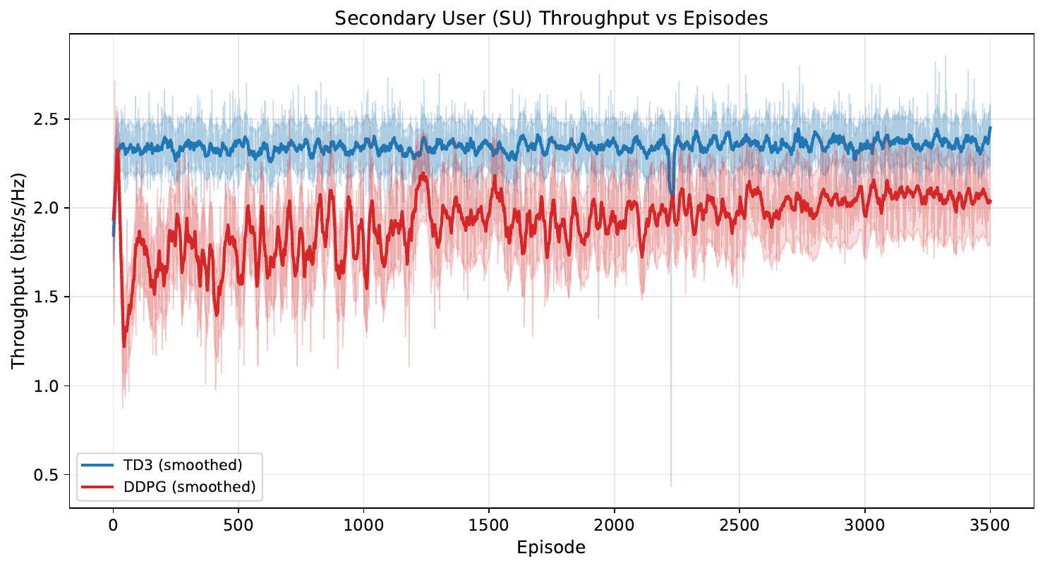
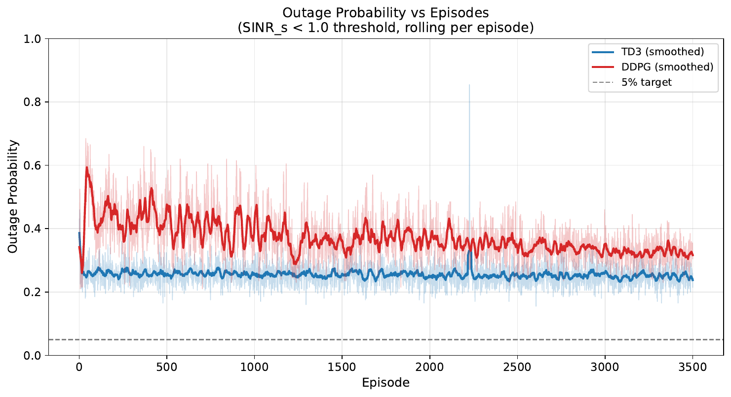
Experiment A — m = 1 Training Curves (TD3 vs DDPG)
Figure: SU throughput vs episodes — TD3 ≈ 2.35, DDPG ≈ 2.05 bits/s/Hz.
Figure: Outage probability vs episodes — TD3 ≈ 25 %, DDPG ≈ 32 %; both above the 5 % target.
Note — Both graphs come directly from the imperfect-CSI m=1 PDF report. Stick the SU-SINR-vs-BER and PU-SINR-vs-BER scatters on the next slide if you want the BER view too.
CRN Power Allocation via Deep RL | RIT, Bangalore

Slide 22
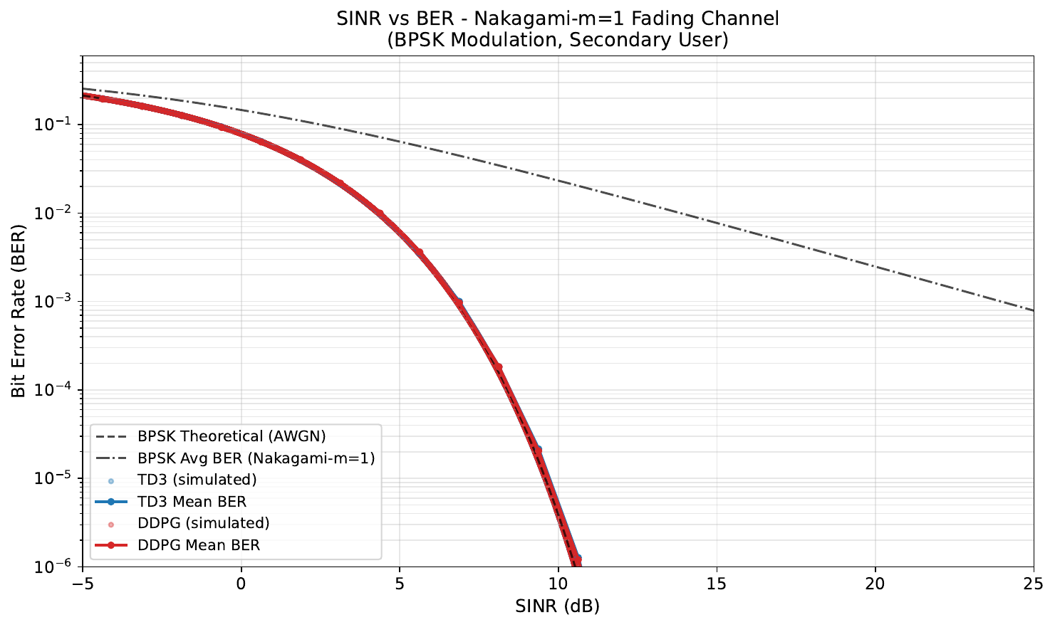
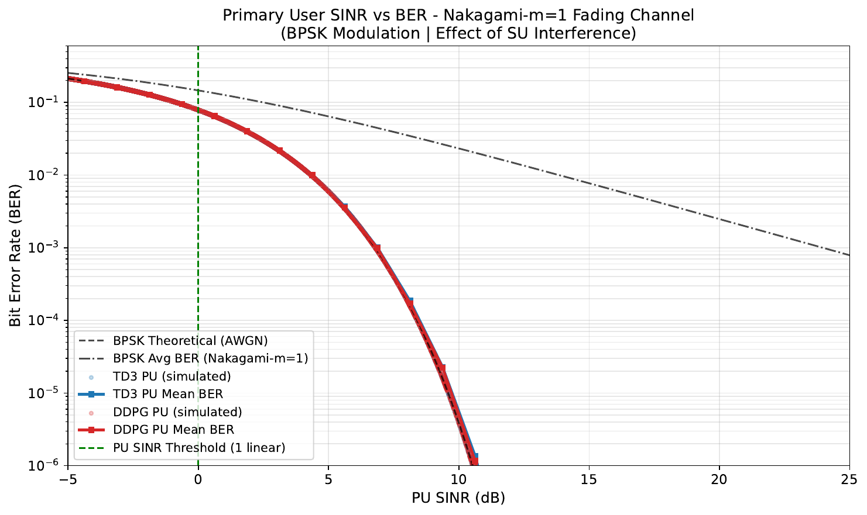
Experiment A — m = 1 BER Behaviour (TD3 vs DDPG)
Figure: SU SINR vs BER scatter against the Nakagami-m=1 BPSK curve.
Figure: PU SINR vs BER scatter — vertical line marks the SINR threshold γ_th.
CRN Power Allocation via Deep RL | RIT, Bangalore

Slide 23
Experiment B — Imperfect CSI, m = 3 (TD3 vs DDPG)
Moderate Nakagami fading — closer to typical urban / line-of-sight CRN deployments.
Metric | TD3 | DDPG | Winner
Avg Reward (last 100 ep) | 241.24 | 209.11 | TD3
SU Throughput (bits/s/Hz) | 2.067 | 1.693 | TD3
PU Throughput (bits/s/Hz) | 0.531 | 0.774 | DDPG
Outage Probability | 0.113 | 0.251 | TD3
Average BER | 0.0280 | 0.0534 | TD3
Training Time (s) | 74 680 | 43 462 | –
Observations
• With less severe fading, TD3 cuts outage roughly in half compared to DDPG (0.11 vs 0.25).
• TD3 also achieves +22 % more SU throughput and ~½ the BER.
• DDPG sacrifices SU performance to maintain higher PU throughput — confirms its conservative behaviour.
• Note — Stick the SU-throughput-vs-episode and outage-vs-episode plots (next slide).
CRN Power Allocation via Deep RL | RIT, Bangalore

Slide 24
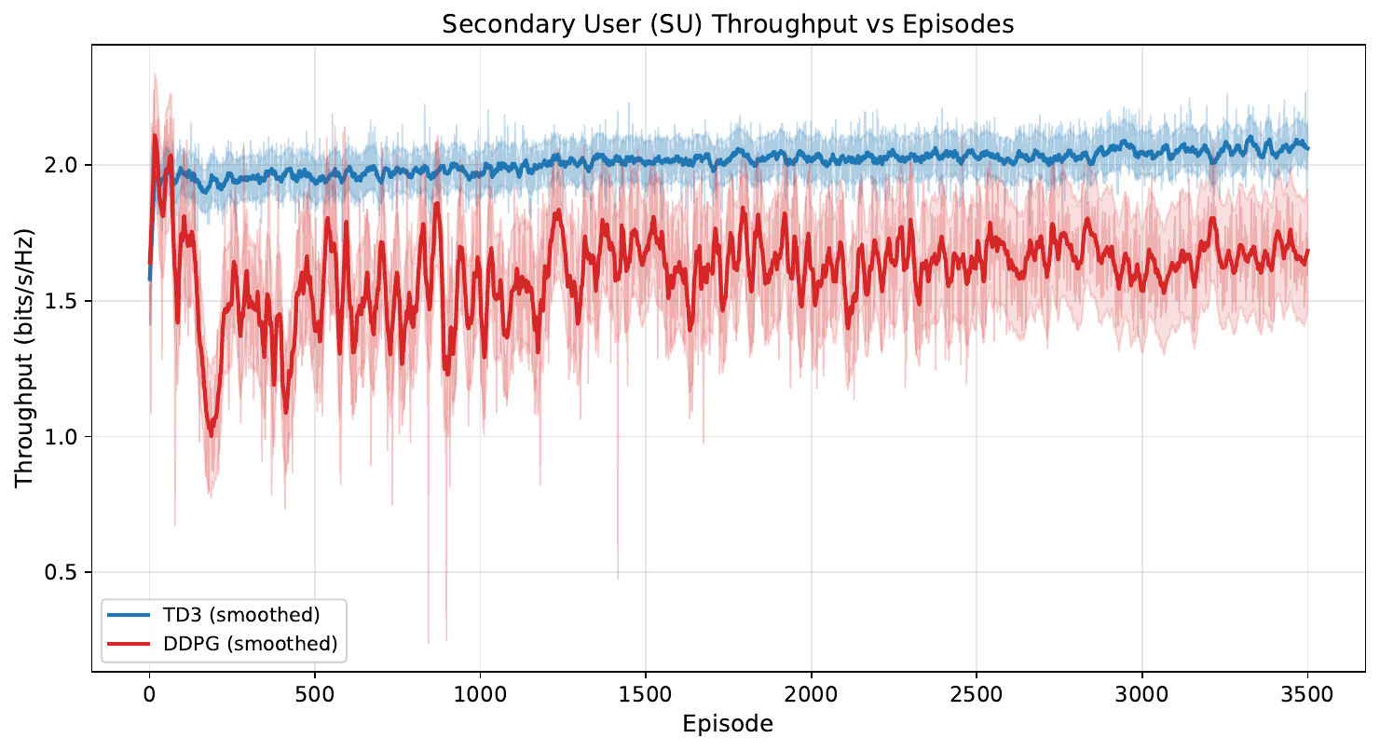
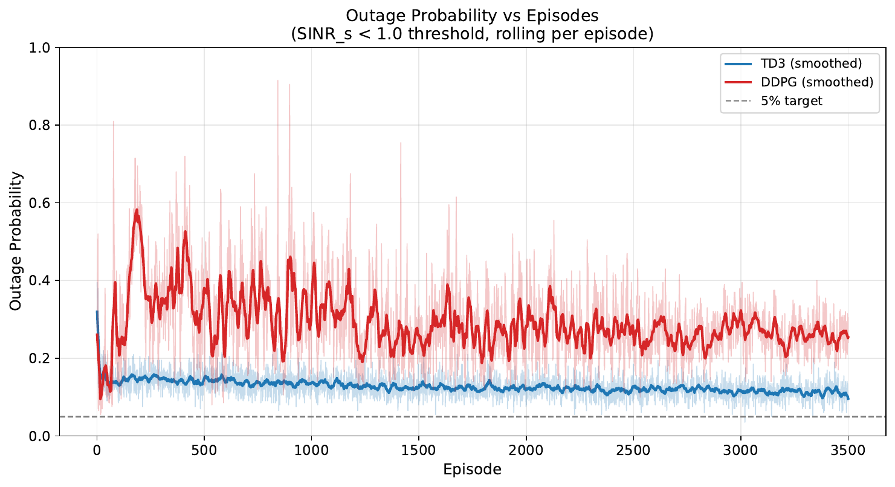
Experiment B — m = 3 Training Curves (TD3 vs DDPG)
Figure: SU throughput vs episodes — TD3 ≈ 2.07, DDPG ≈ 1.69 bits/s/Hz.
Figure: Outage probability — TD3 ≈ 11 %, DDPG ≈ 25 %.
CRN Power Allocation via Deep RL | RIT, Bangalore

Slide 25
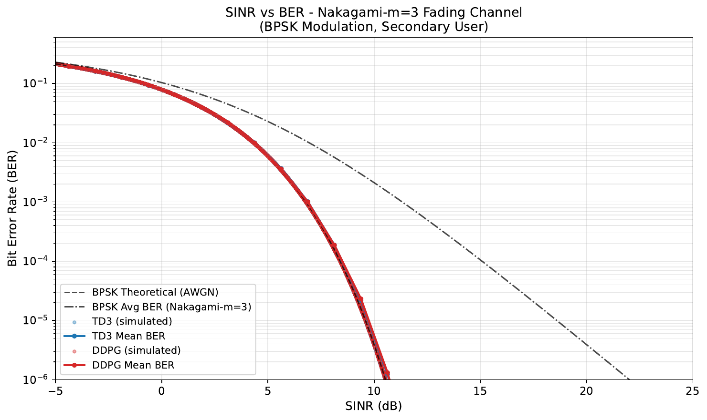
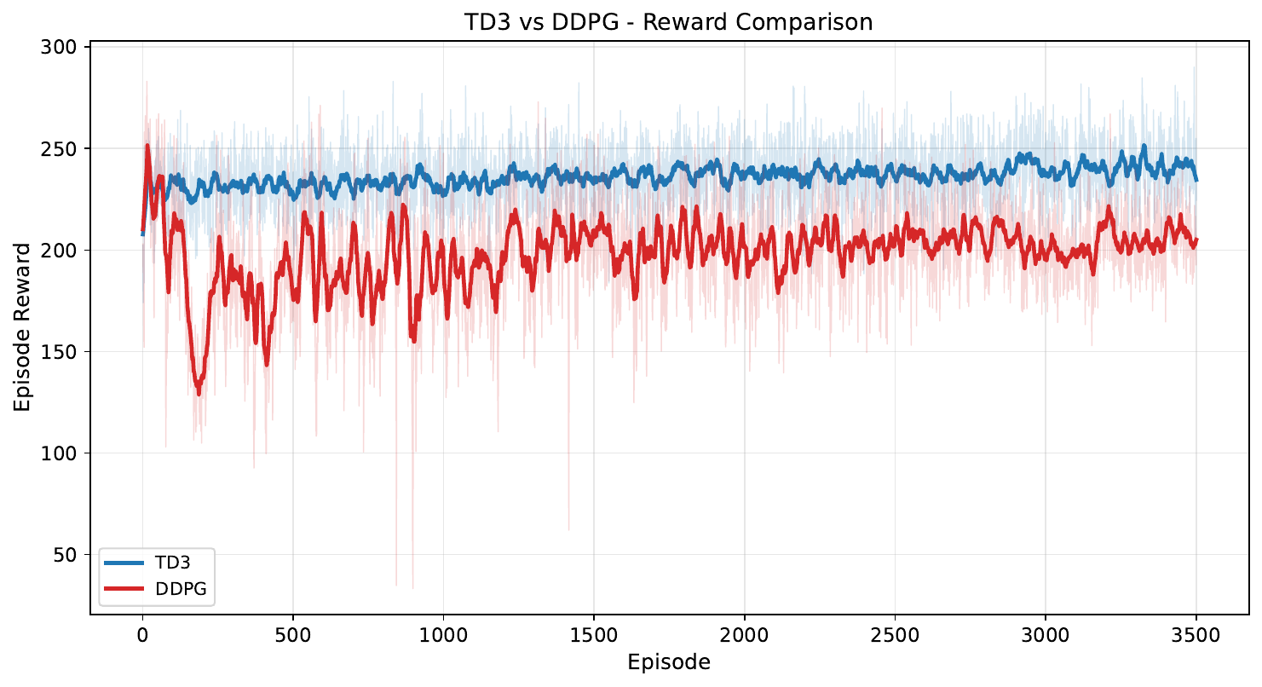
Experiment B — m = 3 BER & Reward Comparison
Figure: SU BER scatter against the Nakagami-m=3 BPSK theory curve.
Figure: Reward overlay — TD3 above DDPG throughout the run.
CRN Power Allocation via Deep RL | RIT, Bangalore

Slide 26
Experiment C — 3-way Comparison (m = 3)
TD3 vs DDPG vs Proposed Algorithm — identical settings, imperfect CSI, m = 3, 1 500 episodes.
Metric | TD3 | DDPG | Proposed | Winner
Avg Reward (last 100 ep) | 241.33 | 245.46 | 247.56 | Proposed
SU Throughput (bits/s/Hz) | 2.081 | 2.103 | 2.100 | DDPG / Proposed
PU Throughput (bits/s/Hz) | 0.519 | 0.516 | 0.529 | Proposed
Outage Probability | 0.107 | 0.104 | 0.104 | DDPG / Proposed
Average BER | 0.0270 | 0.0263 | 0.0264 | DDPG / Proposed
Training Time (s) | 5 487 | 5 214 | 44 387 | –
Observations
• The Proposed Algorithm wins on average reward and PU throughput, and ties on outage / BER / SU throughput — without any manual weight tuning.
• Proposed gives the highest PU throughput at equal outage — safer interference behaviour at equal SU performance.
• Training time ~8× longer (6 critics + GRU + Lagrangian) — expected trade-off.
• Note — Stick the 3-way SU-throughput and reward-comparison graphs on the next slide.
CRN Power Allocation via Deep RL | RIT, Bangalore

Slide 27
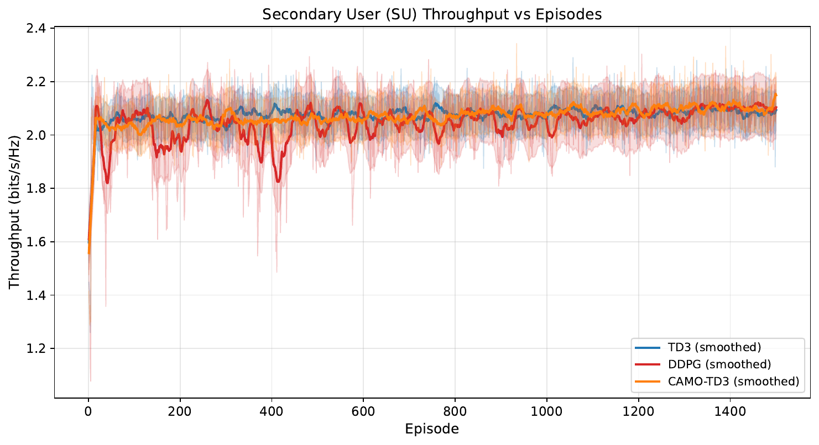
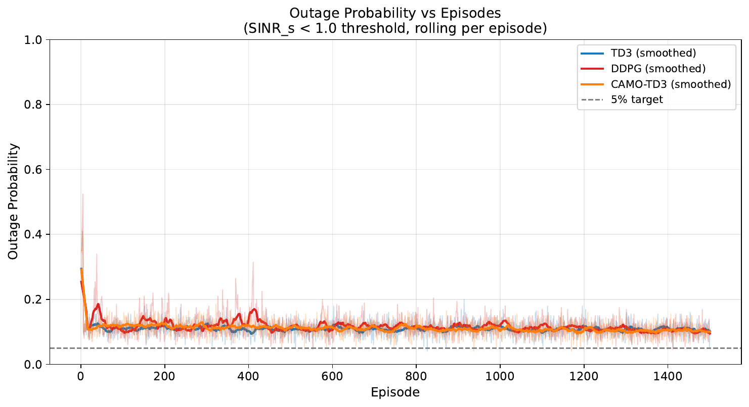
Experiment C — 3-way Curves (m = 3)
Figure: SU throughput — Proposed Algorithm matches or beats both baselines.
Figure: Outage probability — Proposed groups tightly with DDPG; both below TD3 early on.
CRN Power Allocation via Deep RL | RIT, Bangalore

Slide 28
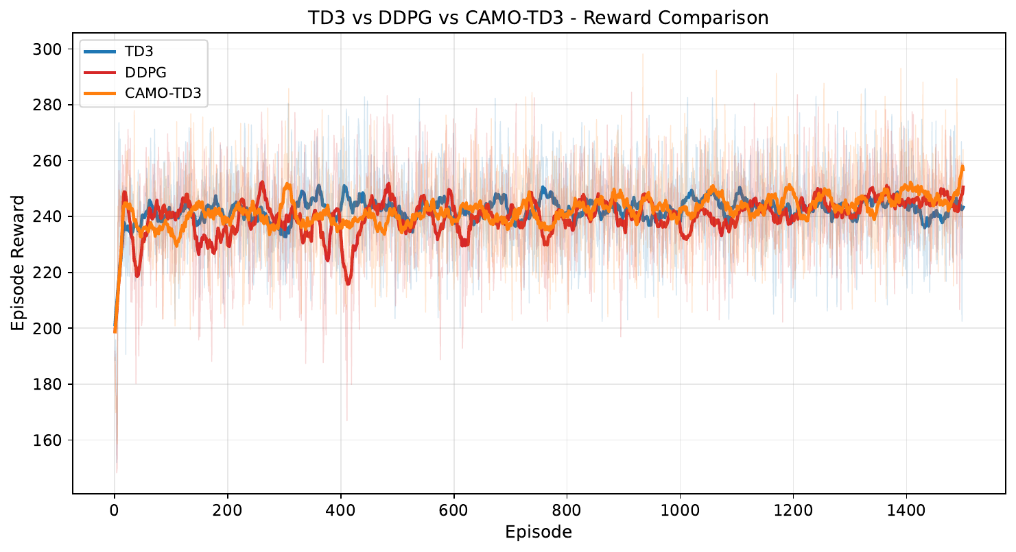
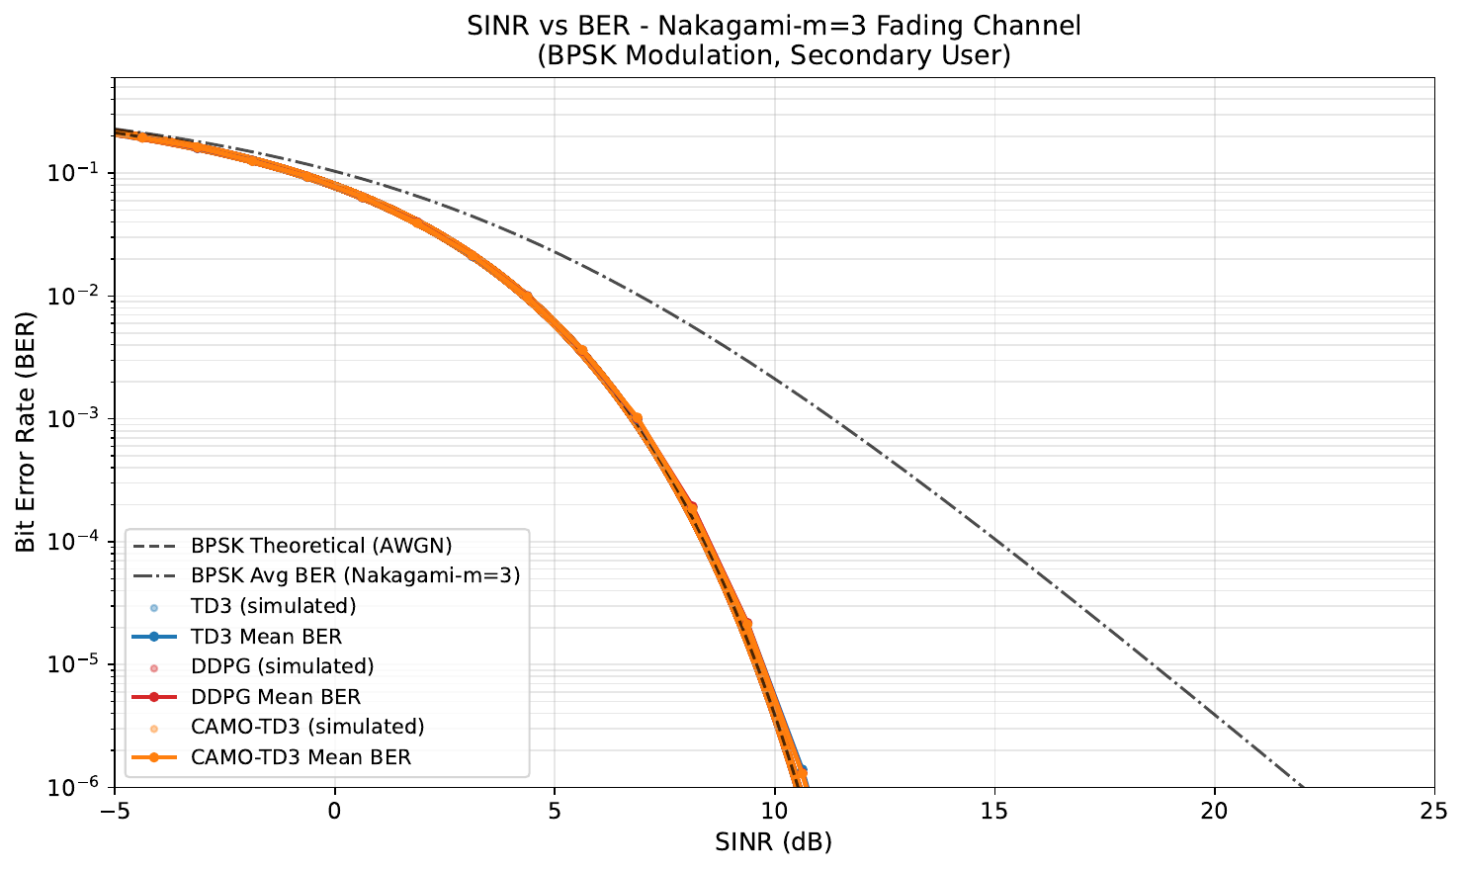
Experiment C — 3-way Reward Overlay (m = 3)
Figure: Episode reward overlay — Proposed Algorithm achieves the highest final average reward (~247.6).
Figure: SU SINR vs BER for all three algorithms.
CRN Power Allocation via Deep RL | RIT, Bangalore

Slide 29
Discussion of Results
Headline Findings
• DDPG → TD3 → Proposed Algorithm gives a clear, monotonic improvement in average reward and constraint adherence.
• TD3's twin-critic + delayed update gives 17–22 % higher SU throughput than DDPG with concurrent reduction in outage.
• The Proposed Algorithm achieves the best average reward and best PU throughput at equal outage / BER — without any manual weight tuning.
Effect of Fading Severity (m = 1 vs m = 3)
• m = 1 (Rayleigh) is hard for all agents — outage hovers 25–32 %; SU is bandwidth-limited by deep fades, not by the agent.
• m = 3 (moderate) gives agents room to exploit good states — outage drops below 12 % for TD3 / Proposed.
Costs and Caveats
• Proposed Algorithm needs ~8× longer training (6 critics + GRU + Lagrangian).
• Inference cost is unchanged — only training scales up.
• Imperfect CSI is the realistic setting; perfect CSI was not assumed anywhere.
CRN Power Allocation via Deep RL | RIT, Bangalore

Slide 30
Conclusion & Future Work
Conclusion
• Built a complete DRL pipeline for underlay CRN power control under Nakagami-m fading and imperfect CSI.
• Quantified TD3's gains over DDPG (≈ +20 % SU throughput, −12 pp outage at m = 3).
• Designed the Proposed Algorithm with four innovations — GRU belief, decomposed critics, adaptive Lagrangians, directional noise.
• Proposed matches the best baseline on throughput while improving PU protection — and removes manual weight tuning.
• Real-time React + WebSocket dashboard makes training observable.
Future Work
• Multi-SU scaling — extend to multiple SU pairs (multi-agent RL).
• SAC baseline for entropy-regularised exploration.
• Prioritised experience replay for faster convergence.
• Transfer learning across different m values.
• Path-loss and mobility for more realism.
• OFDM extension — per-subcarrier power allocation.
• Coupled spectrum sensing + RL power control.
• Docker deployment + Optuna hyper-parameter search.
CRN Power Allocation via Deep RL | RIT, Bangalore

Slide 31
References
• [1] C. Zhong et al., "Deep Reinforcement Learning-Based Optimization for IRS-Assisted Cognitive Radio Systems," IEEE Trans. Commun., vol. 70, no. 6, pp. 3849–3864, Jun. 2022, doi: 10.1109/TCOMM.2022.3171837.
• [2] P. R. Teja, K. Dubey and R. Dubey, "2DRL: Cognitive D2D Control Under Imperfect CSI Via Adaptive Deep Reinforcement Learning," Int. J. Networked Distrib. Comput., vol. 14, p. 6, 2026, doi: 10.1007/s44227-025-00081-0.
• [3] R. Jafari, A. O. Fapojuwo and M. Nozari, "DRL-Powered Sum-Rate Maximization Design for IRS-Assisted Full Duplex Cluster NOMA WPCNs," IEEE Trans. Wireless Commun., vol. 24, no. 11, pp. 9686–9702, Nov. 2025, doi: 10.1109/TWC.2025.3574711.
• [4] E. O. Frimpong, Y. Wang and Z. Tian, "IRIS-DDPG: A Reinforcement Learning-Based Optimization for Irregular Reconfigurable Intelligent Surfaces Exploiting Statistical CSI," IEEE Trans. Cogn. Commun. Netw., vol. 12, pp. 4716–4730, 2026, doi: 10.1109/TCCN.2025.3645496.
• [5] Y. Bi, V. K. N. Lau and D. H. K. Tsang, "Model-Driven Bayesian Reinforcement Learning for IRS-Assisted Massive MIMO-OFDM Channel Feedback, Beamforming, and IRS Control," IEEE Trans. Wireless Commun., vol. 24, no. 3, pp. 2514–2529, Mar. 2025, doi: 10.1109/TWC.2024.3522098.
• [6] S. Fujimoto, H. van Hoof and D. Meger, "Addressing Function Approximation Error in Actor-Critic Methods (TD3)," ICML 2018, arXiv:1802.09477.
• [7] T. P. Lillicrap et al., "Continuous Control with Deep Reinforcement Learning (DDPG)," ICLR 2016, arXiv:1509.02971.
• [8] DDPG-Based Adaptive Power Control, GitHub repo, 2026. https://github.com/adityagangwani30/ddpgminiproject.git
• [9] Actor-Critic Network, GitHub repo, 2026. https://github.com/Ryan-gomezzz/ddpg-actor_critic.git
CRN Power Allocation via Deep RL | RIT, Bangalore

Slide 32
Thank You
Questions and Suggestions Welcome
Department of Electronics and Communication Engineering, Ramaiah Institute of Technology, Bangalore

