Slide 1

RAMAIAH INSTITUTE OF TECHNOLOGY, Bangalore (Autonomous Institute Affiliated To VTU)
Dept. of Electronics and Communication Engineering
Course code - Mini Project
Power Allocation in Cognitive Radio Networks using Deep Reinforcement Learning
TD3 | DDPG | Proposed Algorithm (CAMO-TD3) under Nakagami-m Fading
Team Members
Aditya Gangwani 1MS22EC005
Ryan Gomez 1MS22EC127
Shreya Revankar 1MS22EC158
Sneha Tapadar 1MS22EC170
Guide: Dr. Chitra M
Designation: Associate Professor, Dept. of ECE

Slide 2
Table of Contents
Introduction
Problem Statement
Proposed design/Circuit/Algorithm
Implementation/Methodology
Results and Discussion
Conclusion and Future Work
References

Slide 3
Introduction — Cognitive Radio Networks (CRN)
What is a Cognitive Radio Network?
A Cognitive Radio Network (CRN) is an intelligent wireless system in which unlicensed (Secondary) users opportunistically access licensed spectrum bands originally allocated to licensed (Primary) users, without causing harmful interference.
It addresses the spectrum scarcity problem caused by static, fixed allocation policies — measurement studies (FCC 2002) show licensed bands are under-utilised 15–85 % of the time.
Key Building Blocks
• Spectrum Sensing — detect presence of Primary Users (PU)
• Spectrum Management — decide which channel to use
• Spectrum Sharing — coexist with other Secondary Users (SU)
• Spectrum Mobility — vacate the channel when PU returns
Two-Tier Hierarchy
• Primary User (PU): Licensed, has priority — must be protected from interference
• Secondary User (SU): Unlicensed, must adapt power / frequency to remain non-disruptive
[Diagram placeholder]
CRN topology — PT, PR, ST, SR
with primary and interference links
Diagram shows four nodes — Primary Transmitter / Receiver and Secondary Transmitter / Receiver — connected by four channel paths used for signal and interference computation.
CRN Power Allocation via Deep RL | RIT, Bangalore

Slide 4
Three Paradigms of Cognitive Radio Access
Depending on how SU and PU share the spectrum, CR networks are classified into three operational paradigms:
UNDERLAY
• SU transmits simultaneously with PU, but keeps interference below a predefined threshold.
• Requires accurate channel-state information (CSI) and power control.
• Continuous secondary access — no need to vacate the band.
• Used in this project: the SU dynamically controls its transmit power Pₛ to maintain SINRₚ ≥ γₜₕ.
• Best suited for low-power, short-range secondary links (e.g., D2D, IoT).
OVERLAY
• SU has prior knowledge of the PU's codebook / messages and can assist PU transmission.
• SU splits power between its own data and relaying / pre-coding the PU signal (e.g., dirty-paper coding).
• Maintains or improves PU performance while gaining SU rate.
• Requires cooperation between PU and SU — strong assumption.
• Often used as a theoretical upper-bound baseline.
INTERWEAVE
• SU transmits only when the PU is detected to be absent (spectrum holes).
• Relies entirely on accurate spectrum sensing (energy / matched-filter / cyclostationary detectors).
• No interference to PU if sensing is perfect, but high vulnerability to mis-detection.
• Discontinuous access — SU throughput drops sharply at high PU activity.
• Most common in TV white-space and DSA standards (IEEE 802.22).
This work focuses on the UNDERLAY paradigm — the SU continuously co-exists with the PU and uses RL to control its transmit power.
CRN Power Allocation via Deep RL | RIT, Bangalore

Slide 5
Introduction — Reinforcement Learning (RL)
What is Reinforcement Learning?
Reinforcement Learning is a branch of machine learning in which an agent learns to take actions in an environment to maximise a cumulative reward, without being told the correct action in advance.
The agent learns purely through trial-and-error interaction — by observing states, taking actions, receiving rewards, and updating its policy.
Markov Decision Process (MDP)
An RL problem is formalised as a tuple (S, A, P, R, γ):
• S — state space (what the agent observes)
• A — action space (what the agent can do)
• P(s′|s, a) — transition dynamics
• R(s, a) — scalar reward function
• γ ∈ [0, 1] — discount factor for future reward
Goal of the Agent
max_π E_τ~π [ Σ_t γ^t · r(s_t, a_t) ]
[Diagram placeholder]
Classical RL loop —
Agent ⇄ Environment
(state → action → reward)
Why Deep RL?
For continuous high-dimensional state / action spaces (such as power control under fading), tabular RL is infeasible.
Deep RL uses neural networks as function approximators for the policy π(s) and value function Q(s, a), enabling generalisation across continuous spaces.
CRN Power Allocation via Deep RL | RIT, Bangalore

Slide 6
Why Reinforcement Learning for CRN Power Control?
The Power-Control Problem
The SU must choose its transmit power Pₛ ∈ [0, P_max] at every time step so as to maximise its own data rate while keeping the PU's SINR above a protection threshold γₜₕ — under random, time-varying channel gains.
Why Classical / Analytical Methods Struggle
• Closed-form intractable: Joint optimisation over fading distribution + non-linear constraint has no analytic solution.
• Convex water-filling fails: The PU protection constraint introduces a non-convex feasibility region under stochastic fading.
• Game-theoretic models: Require strong assumptions on PU rationality and full information exchange.
• Heuristic / rule-based: Cannot adapt to non-stationary channels and need re-tuning per environment.
Why Deep Reinforcement Learning is a Natural Fit
• Continuous-action capable — DDPG / TD3 / SAC output real-valued Pₛ directly.
• Model-free — does not need explicit channel distribution; learns from samples.
• Closed-loop adaptive — keeps refining the policy as conditions change.
• Can encode multi-objective trade-offs (throughput vs. PU protection vs. energy) directly in the reward.
CRN Power Allocation via Deep RL | RIT, Bangalore

Slide 7
SECTION
Problem Statement
Power control objectives, constraints and challenges

Slide 8
Problem Statement
Setting
Consider an underlay Cognitive Radio Network with one Primary Transmitter–Receiver pair (PT, PR) and one Secondary Transmitter–Receiver pair (ST, SR) operating on the same frequency band. All four wireless links experience Nakagami-m block fading. The SU must select its transmit power Pₛ ∈ [0, P_max] at every channel use.
Objective
maximise E[ Σ_t log₂(1 + SINR_s(t)) ] — Secondary throughput
Constraints
(C1) SINR_p(t) ≥ γ_th — Primary user protection
(C2) 0 ≤ P_s(t) ≤ P_max — Power budget
(C3) E[ P_s(t) ] ≤ P_avg — Energy-efficiency soft target
Core Challenges
• Stochastic non-convexity: channel gains are random and the constraint is a chance event.
• Multi-objective: three competing goals must be balanced — throughput, interference, energy.
• Manual weight tuning: in scalar-reward methods the trade-off weights (α, β, γ) must be tuned per channel condition.
• Temporal dynamics: useful information lies in the recent history of channel gains and own actions.
CRN Power Allocation via Deep RL | RIT, Bangalore

Slide 9
System Model — Network Topology and Channels
Four-Node Underlay CRN
The network consists of four nodes — a primary transmitter PT, primary receiver PR, secondary transmitter ST and secondary receiver SR. They share the same band; SU power control determines mutual interference.
Channel Power Gains
• |h_pp|² : PT → PR (primary direct link)
• |h_sp|² : ST → PR (SU interference on PU)
• |h_ss|² : ST → SR (secondary direct link)
• |h_ps|² : PT → SR (PU interference on SU)
Nakagami-m Block-Fading
|h|² ~ Gamma(shape = m, scale = Ω / m)
• m = 1 → Rayleigh fading (severe)
• m = 3 → moderate fading (used as default)
• m → ∞ → AWGN (no fading)
• Ω = 1.0 (mean link power), σ² = 10⁻³ W (AWGN noise)
[Diagram placeholder]
4-node CRN topology
PT ←→ PR ; ST ←→ SR
with interference links
h_sp and h_ps
The block-fading model assumes that each channel gain stays constant for one channel use (one RL time step) and is re-drawn independently each step — a worst-case temporal-correlation assumption.
CRN Power Allocation via Deep RL | RIT, Bangalore

Slide 10
SINR, Throughput and Reward Formulation
SINR at Each Receiver
SINR_p = ( P_p · |h_pp|² ) / ( P_s · |h_sp|² + σ² ) [Primary]
SINR_s = ( P_s · |h_ss|² ) / ( P_p · |h_ps|² + σ² ) [Secondary]
Shannon Throughput
R_s = log₂( 1 + SINR_s ) R_p = log₂( 1 + SINR_p ) [bits / s / Hz]
Bit Error Rate (BPSK)
BER = ½ · erfc(√SINR )
Scalar Reward Function (used by DDPG / TD3 baselines)
r_t = α · R_s − β · max(0, γ_th − SINR_p) − γ_e · ( P_s / P_max )
• Term 1 : α · R_s — SU throughput reward (α = 1.0)
• Term 2 : β · max(0, γ_th − SINR_p) — PU constraint hinge penalty (β = 1.5)
• Term 3 : γ_e · ( P_s / P_max ) — energy efficiency penalty (γ_e = 0.005)
This scalar reward is the standard formulation our DDPG and TD3 agents optimise. In the proposed algorithm it is decomposed into three separate signals (see Section 4).
CRN Power Allocation via Deep RL | RIT, Bangalore

Slide 11
MDP Formulation for Power Control
State s_t (7-dimensional, continuous)
s_t = [ |h_pp|², |h_sp|², |h_ss|², |h_ps|², SINR_p, SINR_s, P_s(t−1) ]
The four instantaneous channel gains describe the propagation environment; the two SINRs give immediate feedback on the previous action; P_s(t−1) provides action-continuity / momentum.
Action a_t (1-dimensional, continuous)
a_t = P_s ∈ [0, P_max] P_max = 3.0 W, P_p = 1.0 W
The actor outputs a single bounded scalar via a sigmoid activation followed by scaling — no clipping required.
Episode Structure
• Episode length: 200 time steps (200 channel uses)
• Training horizon: 1 500 – 3 500 episodes per algorithm (3 × 10⁵ – 7 × 10⁵ steps)
• At t = 0 the channels and P_s(t−1) are reset and a new fading realisation begins.
Markov Property
Channels are drawn i.i.d. per step ⇒ future state depends only on current state, satisfying the Markov property required by Q-learning theory.
CRN Power Allocation via Deep RL | RIT, Bangalore

Slide 12
SECTION
Proposed Algorithm
From DDPG → TD3 → Proposed (CAMO-TD3)

Slide 13
Algorithm Evolution — DDPG → TD3 → Proposed
We progressively addressed limitations of each baseline. The Proposed Algorithm (internally CAMO-TD3) is a constrained, adaptive, multi-objective extension of TD3.
DDPG
(Baseline 1)
• Single critic
• Symmetric OU noise
• Actor updated every step
• Memoryless 7-D state
• Suffers from Q-value overestimation
• → noisy training, often unstable on Nakagami-m=3
TD3
(Baseline 2)
• Twin critics → take min of Q1, Q2
• Delayed policy updates (every 2 critic steps)
• Target policy smoothing (clipped Gaussian noise)
• Polyak target updates (τ = 0.005)
• Reduces overestimation bias
• → stronger, more stable than DDPG but still scalar reward
Proposed Algorithm
(CAMO-TD3)
• GRU belief encoder — 8-step history
• Decomposed multi-objective critics (6 critics)
• Adaptive Lagrangian weights (λ₁, λ₂, λ₃)
• Directional exploration noise (safe bias)
• Explicit constrained optimisation framework
• → better PU protection without losing SU throughput
Each subsequent algorithm directly addresses a specific failure mode of the previous one.
CRN Power Allocation via Deep RL | RIT, Bangalore

Slide 14
Background — DDPG (Deep Deterministic Policy Gradient)
Core Idea
DDPG (Lillicrap et al., 2015) is an actor-critic algorithm for continuous-action MDPs. It pairs a deterministic policy π_φ(s) with a Q-function critic Q_θ(s, a).
Update Equations
Critic : L(θ) = E[ (Q_θ(s,a) − y)² ], y = r + γ Q_θ′(s′, π_φ′(s′))
Actor : ∇_φ J ≈ E[ ∇_a Q_θ(s,a)|_{a=π_φ(s)} · ∇_φ π_φ(s) ]
Targets: θ′ ← τθ + (1−τ)θ′, φ′ ← τφ + (1−τ)φ′
Exploration
Ornstein–Uhlenbeck noise — temporally correlated for momentum-rich exploration:
dx_t = θ(μ − x_t) dt + σ dW_t
Limitations Observed in CRN
• Single critic suffers from Q-value overestimation → unstable updates.
• OU noise occasionally drives Pₛ to extreme values → high outage early in training.
• No mechanism to enforce constraint — relies on penalty term in reward.
• Sensitive to learning rate and weight choice (α, β, γ).
Inference
DDPG is a valid baseline but its instability under Nakagami-m fading motivated the move to TD3.
CRN Power Allocation via Deep RL | RIT, Bangalore

Slide 15
TD3 — Twin Delayed Deep Deterministic Policy Gradient
Three Key Tricks (Fujimoto et al., 2018)
• 1. Twin critics — two independent Q-networks; use the smaller of the two for the target.
• 2. Delayed policy updates — actor is updated every d = 2 critic steps.
• 3. Target policy smoothing — add clipped Gaussian noise ε to the target action a′.
Update Equations
a′ = clip( π_φ′(s′) + ε, 0, P_max ), ε ~ clip( N(0, σ²), −c, +c )
y = r + γ · min_{i=1,2} Q_{θ_i′}( s′, a′ )
L(θ_i) = E [ ( Q_{θ_i}(s, a) − y )² ]
∇_φ J ≈ E [ ∇_a Q_{θ_1}(s, a) |_{a = π_φ(s)} · ∇_φ π_φ(s) ]
Why TD3 Beats DDPG Here
• min(Q₁, Q₂) eliminates the systematic positive bias of DDPG.
• Delayed actor updates → fewer noisy gradients.
• Smoothing noise → robustness to function-approximation error.
Remaining Limitations
• Still scalar reward — α, β, γ_e are fixed hyper-parameters.
• Cannot guarantee constraint satisfaction (only soft penalty).
• Memoryless 7-D state — ignores temporal fading correlations.
• Symmetric exploration noise wastes time on unsafe actions.
Inference
TD3 gave us stable convergence and good throughput, but constraint adherence remained weight-dependent.
CRN Power Allocation via Deep RL | RIT, Bangalore

Slide 16
Proposed Algorithm — Overview
The Proposed Algorithm (CAMO-TD3 — Constrained Adaptive Multi-Objective TD3) modifies the standard TD3 in four orthogonal ways to specifically address the CRN power-control problem.
1. GRU Belief Encoder
Encodes the last 8 observations with a 2-layer GRU into a 16-D belief vector. Provides temporal context that the standard 7-D Markov state cannot.
2. Decomposed Multi-Objective Critics
Twin critics per objective (throughput, interference, energy) → 6 critics in total. Each learns a clean per-objective Q-value, enabling explicit trade-offs.
3. Adaptive Lagrangian Weights
λ₁, λ₂, λ₃ are learned by dual gradient descent — no more manual tuning of α, β, γ. Clamped to [0.1, 20.0] for stability.
4. Directional Exploration Noise
Replaces zero-mean Gaussian with a biased Gaussian whose mean μ pushes actions toward safer (lower-power) regions when violations are frequent.
CRN Power Allocation via Deep RL | RIT, Bangalore

Slide 17
Innovation 1 — GRU Belief Encoder
Why a Recurrent Encoder?
The standard 7-D state is Markov only under perfect block-fading. In practice, the agent benefits from the recent observation history (own actions, recent SINRs, deep-fade indicators).
Architecture
• Input: O_t = [s_{t−7}, … , s_{t−1}, s_t] (shape 8 × 7)
• GRU: 2 stacked layers, hidden size 64
• Projection: linear layer to belief dimension B = 16
Equations (GRU cell, simplified)
z_i = σ( W_z[h_{i−1}, x_i] ), r_i = σ( W_r[h_{i−1}, x_i] )
ñ_i = tanh( W_n[ r_i ⊙ h_{i−1}, x_i ] )
h_i = (1 − z_i) ⊙ h_{i−1} + z_i ⊙ ñ_i
b_t = W_proj · h_L + c_proj ∈ ℝ^{16}
Design Choices
• SEQ_LEN = 8 : ≈ 4 % of an episode — captures short-term trends without huge memory cost.
• BELIEF_DIM = 16 : forces compression of 56-D raw history into 16-D feature; encourages abstraction over memorisation.
• GRU vs LSTM : fewer parameters, comparable performance at L = 8.
Inputs to Downstream Networks
The belief vector b_t is concatenated with the current state s_t and passed to both actor and critic networks:
π( [s_t , b_t] ) ; Q( [s_t , b_t] , a )
CRN Power Allocation via Deep RL | RIT, Bangalore

Slide 18
Innovation 2 — Decomposed Multi-Objective Critics
Problem with a Single Scalar Critic
A single Q(s, a) approximates E[Σ_t γ^t r_t] where r is the weighted scalar. Throughput contributions (~+2) and interference penalties (~−15) collapse into one signal — making it hard to distinguish "low reward because of constraint" from "low reward because channel was bad".
Decomposed Reward Vector
r_t = ( r_t^{tput} , r_t^{intf} , r_t^{energy} )
• r_t^{tput} = α · log₂(1 + SINR_s) ≥ 0 (maximise)
• r_t^{intf} = − β · max(0, γ_th − SINR_p) ≤ 0 (keep near zero)
• r_t^{energy} = − γ_e · (P_s / P_max) ≤ 0 (minimise magnitude)
Per-Objective Twin Critics
For each objective k ∈ {tput, intf, energy} and twin index i ∈ {1, 2}:
y_k = r_t^{k} + γ · min_{j=1,2} Q_{θ_j,k}′( s′, b′, ã′ )
L_k = Σ_i E [ ( Q_{θ_i,k}(s,b,a) − y_k )² ]
Total: 6 critic networks (twin pair × three objectives) + their target copies — but each learns a clean per-objective signal.
CRN Power Allocation via Deep RL | RIT, Bangalore

Slide 19
Innovation 3 — Adaptive Lagrangian Weights
Primal Constrained Problem
max_π E[ Σ_t R_s(s_t,a_t) ]
s.t. E[ Σ_t max(0, γ_th − SINR_p) ] ≤ δ , E[ Σ_t P_s ] ≤ P_budget
Lagrangian (Dual) Formulation
L(π, λ₁, λ₂, λ₃) = λ₁·E[Σ R_s] − λ₂·(E[Σ max(0, γ_th−SINR_p)] − δ) − λ₃·(E[Σ P_s] − P_budget)
Actor Update — Weighted Sum of Per-Objective Q-Values
L_actor = − E [ λ₁ · Q^{tput} + λ₂ · Q^{intf} + λ₃ · Q^{energy} ]
Dual Gradient Ascent on the Multipliers
λ_k ← clip( λ_k + η_λ · ∇_{λ_k} L , λ_min , λ_max )
Softplus parameterisation enforces positivity: λ_k = log(1 + exp(log_λ_k)).
Why This Helps
• If PU violations become frequent, λ₂ automatically grows → actor penalises interference more.
• If throughput drops too low, λ₁ recovers → policy pushes for higher rate.
• Removes manual scaling of α, β, γ_e — the agent discovers them itself.
CRN Power Allocation via Deep RL | RIT, Bangalore

Slide 20
Innovation 4 — Directional Exploration Noise
Standard TD3 Exploration
ε ~ N(0, σ²), a_explore = π(s) + ε
Symmetric noise wastes 50 % of exploration on unsafe (higher-power) actions during the early phase, causing many PU violations.
Biased Gaussian Noise (CAMO-TD3)
μ_t = μ_bias · decay(t) · (1 + v_t)
decay(t) = max(0, 1 − t / T_decay )
ε ~ N(μ_t, σ²)
where v_t is the rolling violation rate over the last 100 steps and μ_bias = −0.05 (negative ⇒ lower power).
Properties
• Bias is adaptive — strengthens when violations spike, vanishes once the policy is competent.
• decay(t) ensures the bias disappears after T_decay ≈ 1 000 episodes so it does not distort the final policy.
• Conceptually similar to "safe exploration" in the robotics literature (García & Fernández, 2015).
Effect Observed
• Lower early-training PU outage.
• Faster convergence to the constraint-satisfying region.
CRN Power Allocation via Deep RL | RIT, Bangalore

Slide 21
Proposed Algorithm — End-to-End Architecture
[Diagram placeholder]
Architecture diagram —
Replay Buffer → GRU Belief Encoder → Actor π(s, b)
↘ 6 Critics Q^k(s, b, a)
Lagrangian (λ₁, λ₂, λ₃) ↻ Dual gradient updates
Directional Noise → Action a ∈ [0, P_max] → CRN Environment
Data flow: environment produces (s_t, r_t^{tput}, r_t^{intf}, r_t^{energy}); the sequence replay buffer keeps the last 8 observations per transition; the GRU encodes them to b_t; the actor outputs P_s with directional noise added during training; six critics learn per-objective Q-values; adaptive Lagrangian weights combine them for the actor loss.
CRN Power Allocation via Deep RL | RIT, Bangalore

Slide 22
Proposed Algorithm — Training Pseudocode
Initialise actor π_φ, six critics Q_{θ_{i,k}}, GRU encoder g_ψ
Initialise target nets: φ′ ← φ, θ_{i,k}′ ← θ_{i,k}
Initialise Lagrangian log-params: log_λ₁ = log(3.0), log_λ₂ = log(1.0), log_λ₃ = log(0.01)
Initialise sequence replay buffer D, violation queue v_queue
for episode = 1 .. N:
reset env, observation history O = deque(maxlen = 8)
for step t = 1 .. 200:
b_t = g_ψ(O)
a_t = clip( π_φ(s_t, b_t) + ε_t, 0, P_max ) # ε_t ~ N(μ_t, σ²)
observe (r^{tput}, r^{intf}, r^{energy}, s_{t+1}, done)
store transition with 8-step history into D
sample mini-batch from D
for k in {tput, intf, energy}:
update twin critics Q_{θ_{1,k}}, Q_{θ_{2,k}} on TD3 target y_k
if t mod 2 == 0: # delayed update
actor loss = − E[ λ₁ Q^{tput} + λ₂ Q^{intf} + λ₃ Q^{energy} ]
update φ and ψ by gradient descent
update Lagrangian: λ_k ← clip(λ_k + η_λ · ∇λ_k L, λ_min, λ_max)
soft-update target networks: φ′, θ′_{i,k}
CRN Power Allocation via Deep RL | RIT, Bangalore

Slide 23
SECTION
Implementation & Methodology
Software stack, training pipeline, and progression of experiments

Slide 24
Implementation Stack
Languages & Frameworks
• Python 3.10 (PyTorch 2.x, NumPy, SciPy)
• FastAPI + WebSocket — backend streaming server
• React 19 + Vite + Recharts — frontend dashboard
• Matplotlib + PDFPages — automated PDF reports
Hardware
• Local: NVIDIA RTX 4060 (laptop, CUDA + TF32)
• Cloud: Kaggle / Colab T4 GPU for long runs (10 000 episodes)
Repository Layout
• config.py — all hyper-parameters (single source of truth)
• environment.py — CRN environment (Gym-like API)
• ddpg.py — DDPG agent + OU noise
• td3.py — TD3 agent (twin critics, smoothing)
• camo_td3.py — Proposed Algorithm (CAMO-TD3)
• train_compare.py — multi-algorithm experiment driver
• crn_10k_training.ipynb — Kaggle notebook (10 k ep)
• server.py / frontend/ — live dashboard
• results/ — generated PDFs, PNG checkpoints, logs
CRN Power Allocation via Deep RL | RIT, Bangalore

Slide 25
Methodology — Experimental Pipeline
Step 1 — Environment Setup
• Implement the 4-node CRN with Nakagami-m sampler |h|² ~ Gamma(m, Ω/m).
• Vectorised SINR / reward computation on GPU tensors.
Step 2 — Baseline (DDPG)
• Implement actor + critic + replay buffer + OU noise.
• Train 3 500 episodes × 200 steps; log episode reward, throughput, outage, BER.
• Inference: convergence reached but high variance, sensitive to seed.
Step 3 — Upgrade to TD3
• Add twin critics, delayed actor update (d = 2), target smoothing (σ = 0.2, c = 0.5).
• Retrain 3 500 episodes — convergence faster, smoother, higher final reward.
• Inference: still scalar reward → cannot guarantee SINR_p ≥ γ_th in deep fades.
Step 4 — Proposed Algorithm (CAMO-TD3)
• Add GRU belief encoder over SEQ_LEN = 8 observations.
• Decompose reward → 6 critics.
• Replace fixed weights with adaptive Lagrangian (λ_init = 3.0 / 1.0 / 0.01, η_λ = 5 × 10⁻⁴).
• Replace Gaussian noise with directional noise (μ_bias = −0.05, decay over 200 k steps).
Step 5 — Comparative Reporting
• Run all three under identical seeds & Nakagami-m settings; generate multi-page PDFs.
CRN Power Allocation via Deep RL | RIT, Bangalore

Slide 26
Hyper-parameters Summary
All hyper-parameters live in config.py — kept identical across algorithms for fair comparison.
Parameter | Value | Notes
HIDDEN_DIM | 512 | Actor / critic hidden width
BATCH_SIZE | 256 | GPU-efficient mini-batch
LR_ACTOR / LR_CRITIC | 3 × 10⁻⁴ | Adam optimiser
GAMMA_DISCOUNT | 0.99 | Discount factor
TAU | 0.005 | Polyak target update rate
POLICY_NOISE | 0.2 | Target smoothing σ
NOISE_CLIP | 0.5 | Target smoothing clip c
POLICY_DELAY | 2 | Delayed actor update
REPLAY_BUFFER_SIZE | 200 000 | Pre-allocated on GPU
STEPS_PER_EPISODE | 200 | Block-fading per episode
GRU_HIDDEN_SIZE / LAYERS | 64 / 2 | Belief encoder
SEQ_LEN / BELIEF_DIM | 8 / 16 | History length / belief
LAMBDA1 / LAMBDA2 / LAMBDA3 (init) | 3.0 / 1.0 / 0.01 | Adaptive Lagrangians
LR_LAMBDA | 5 × 10⁻⁴ | Dual gradient learning rate
MU_BIAS | −0.05 | Directional noise mean
NAKAGAMI_m | 1.0 or 3.0 | Fading severity (m=1 Rayleigh, m=3 moderate)
SIGMA² | 10⁻³ W | AWGN noise power
P_p / P_max | 1.0 / 3.0 W | Fixed PU and max SU power
SINR_THRESHOLD γ_th | 1.0 (0 dB) | PU protection threshold
CRN Power Allocation via Deep RL | RIT, Bangalore

Slide 27
Training Loop — Per Time Step
Sequence Executed Each Step
• 1. Sample fresh Nakagami-m channel gains |h_pp|², |h_sp|², |h_ss|², |h_ps|².
• 2. Compute current state s_t (channel gains + SINRs + last action).
• 3. Actor produces P_s = π(s_t, b_t) + ε (exploration noise).
• 4. Environment computes SINR_p, SINR_s, R_s, R_p, BER.
• 5. Compute reward(s) → scalar (TD3/DDPG) or vector (Proposed).
• 6. Store transition in (sequence) replay buffer.
• 7. Run gradient updates (2 critic updates : 1 actor update — TD3 policy delay).
• 8. Soft-update target networks; update Lagrangians (Proposed only).
• 9. Log: episode reward, SU/PU throughput, outage, BER, training stage.
Evaluation Protocol
• After training, run 100 evaluation episodes with exploration noise disabled.
• Average all metrics over the last 100 training episodes for final headline numbers.
CRN Power Allocation via Deep RL | RIT, Bangalore

Slide 28
SECTION
Results & Discussion
Fixed-CSI experiments at Nakagami-m = 1 and m = 3

Slide 29
Experimental Set-up for Results
Common Settings
• Channel Model: Nakagami-m block fading, Ω = 1.0, σ² = 10⁻³ W.
• Powers: P_p = 1.0 W (fixed), P_max = 3.0 W.
• PU SINR threshold γ_th = 1.0 (≈ 0 dB).
• Episode = 200 steps; identical random seed across algorithms.
• CSI assumption: fixed (estimated once per channel coherence block — same for all algorithms).
Experiments Reported
• Experiment A — Fixed CSI, m = 1 (severe / Rayleigh): TD3 vs DDPG, 3 500 episodes (run_m1.log).
• Experiment B — Fixed CSI, m = 3 (moderate): TD3 vs DDPG, 3 500 episodes (run_m3.log).
• Experiment C — 3-way comparison, m = 3: TD3 vs DDPG vs Proposed Algorithm, 1 500 episodes.
• Experiment D — Extended 10 000-episode run: TD3 vs DDPG (m = 3) for stability check.
Metrics Tracked
• Average episode reward (last 100 ep) · SU throughput (bits/s/Hz) · PU throughput · Outage probability · Average BER · Training time.
CRN Power Allocation via Deep RL | RIT, Bangalore

Slide 30
Experiment A — Fixed CSI, m = 1 (TD3 vs DDPG)
Severe Rayleigh fading — measures robustness in the worst channel.
Metric | TD3 | DDPG | Winner
Avg Reward (last 100 ep) | 310.75 | 272.07 | TD3
SU Throughput (bits/s/Hz) | 2.365 | 2.065 | TD3
PU Throughput (bits/s/Hz) | 0.785 | 0.999 | DDPG
Outage Probability | 0.249 | 0.321 | TD3
Average BER | 0.0589 | 0.0770 | TD3
Training Time (s) | 24 163 | 22 598 | –
Observations
• TD3 wins on 4 out of 5 quality metrics — higher SU throughput, lower outage, lower BER, higher reward.
• DDPG achieves slightly higher PU throughput because it transmits less aggressively (lower mean P_s), but this comes at the cost of SU performance.
• Under m = 1 Rayleigh fading, both agents struggle to push outage below 25 % — this motivates the constrained design of the Proposed Algorithm.
• Note — Stick the SU-throughput-vs-episode and outage-vs-episode plots (next two slides) here for visual confirmation.
CRN Power Allocation via Deep RL | RIT, Bangalore

Slide 31
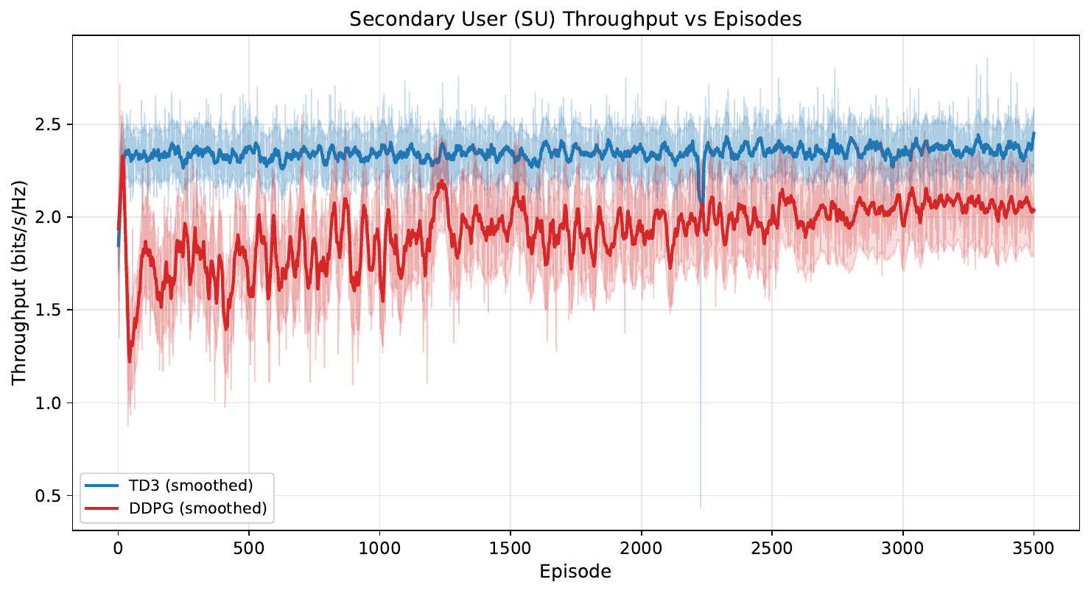
Experiment A — SU Throughput vs Episodes (m = 1)
Figure: Secondary-user throughput across training episodes — TD3 consistently above DDPG under Rayleigh (m = 1) fading.
Note — Diagram placement: put this graph on the SU-throughput slide. TD3 reaches ~2.35 bits/s/Hz while DDPG saturates ~2.05 bits/s/Hz.
CRN Power Allocation via Deep RL | RIT, Bangalore

Slide 32
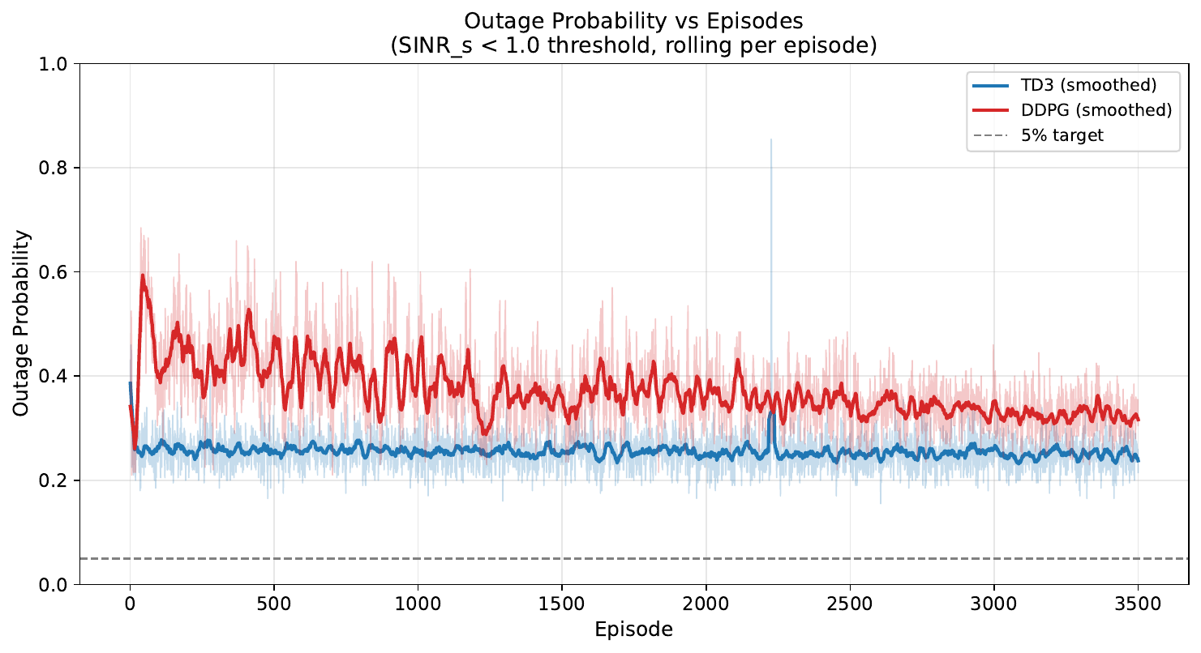
Experiment A — Outage Probability vs Episodes (m = 1)
Figure: Outage probability (SINR_s < 1.0) over episodes — TD3 falls to ~25 %, DDPG only to ~32 %; both are above the 5 % target line under m = 1.
Note — Diagram placement: outage slide for Experiment A. Note how slowly DDPG converges, motivating the move to TD3.
CRN Power Allocation via Deep RL | RIT, Bangalore

Slide 33
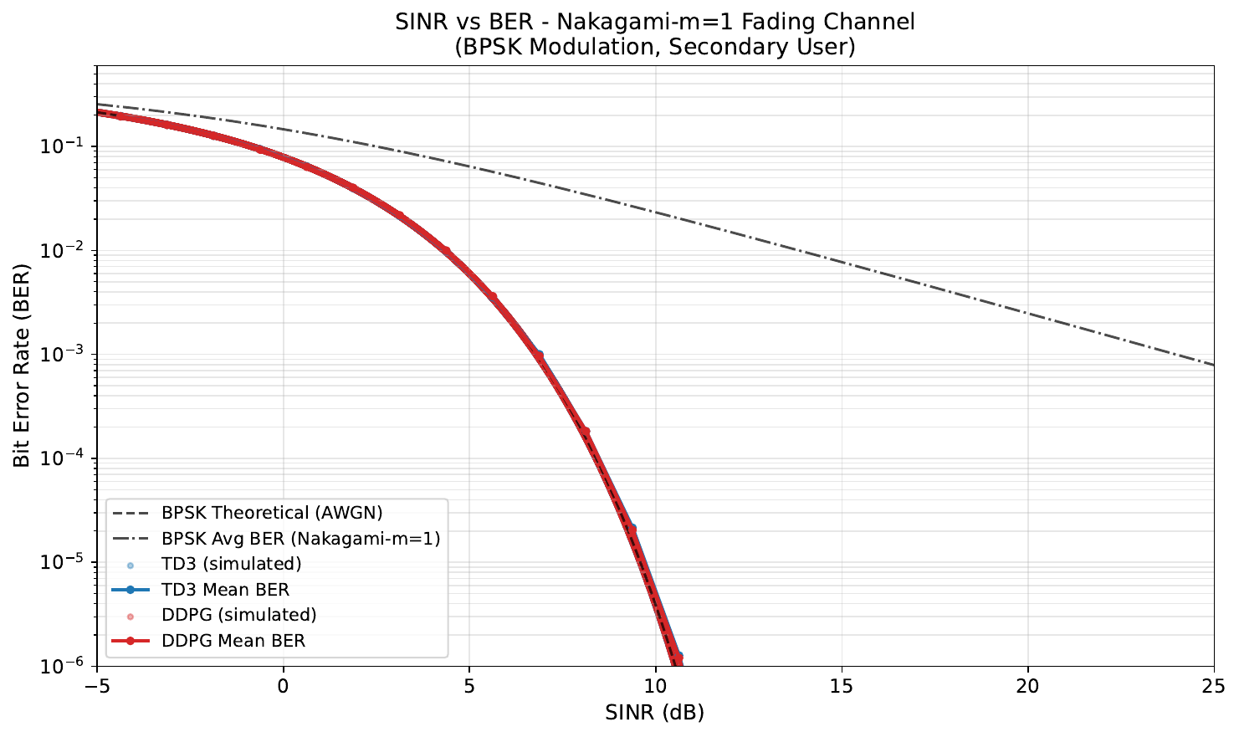
Experiment A — SU SINR vs BER (m = 1)
Figure: Scatter of simulated SU points overlaid on theoretical BPSK / Nakagami-m=1 curves; both algorithms track theory but TD3 has lower mean BER.
CRN Power Allocation via Deep RL | RIT, Bangalore

Slide 34
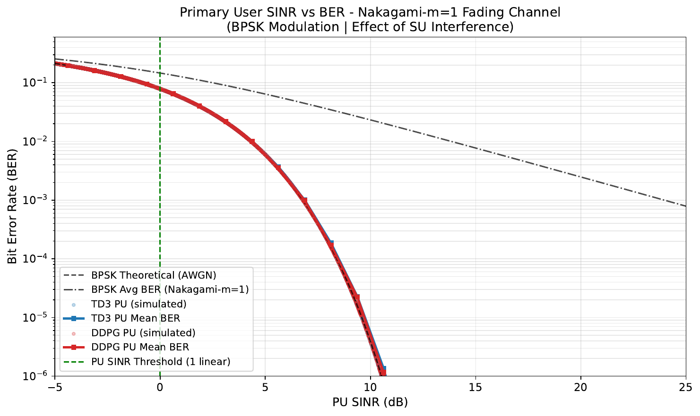
Experiment A — PU SINR vs BER (m = 1)
Figure: PU receiver — Vertical line indicates the SINR threshold. DDPG keeps PU SINR slightly higher (less interference) than TD3.
CRN Power Allocation via Deep RL | RIT, Bangalore

Slide 35
Experiment B — Fixed CSI, m = 3 (TD3 vs DDPG)
Moderate Nakagami fading — closer to typical urban / line-of-sight CRN deployments.
Metric | TD3 | DDPG | Winner
Avg Reward (last 100 ep) | 241.24 | 209.11 | TD3
SU Throughput (bits/s/Hz) | 2.067 | 1.693 | TD3
PU Throughput (bits/s/Hz) | 0.531 | 0.774 | DDPG
Outage Probability | 0.113 | 0.251 | TD3
Average BER | 0.0280 | 0.0534 | TD3
Training Time (s) | 74 680 | 43 462 | –
Observations
• With less severe fading, TD3 cuts outage roughly in half compared to DDPG (0.11 vs 0.25).
• TD3 also achieves +22 % more SU throughput and ~½ the BER.
• DDPG again sacrifices SU performance to maintain higher PU throughput — confirms its tendency to be more conservative.
• Note — Stick the SU-throughput-vs-episode and outage-vs-episode plots (next two slides) here for visual confirmation.
CRN Power Allocation via Deep RL | RIT, Bangalore

Slide 36
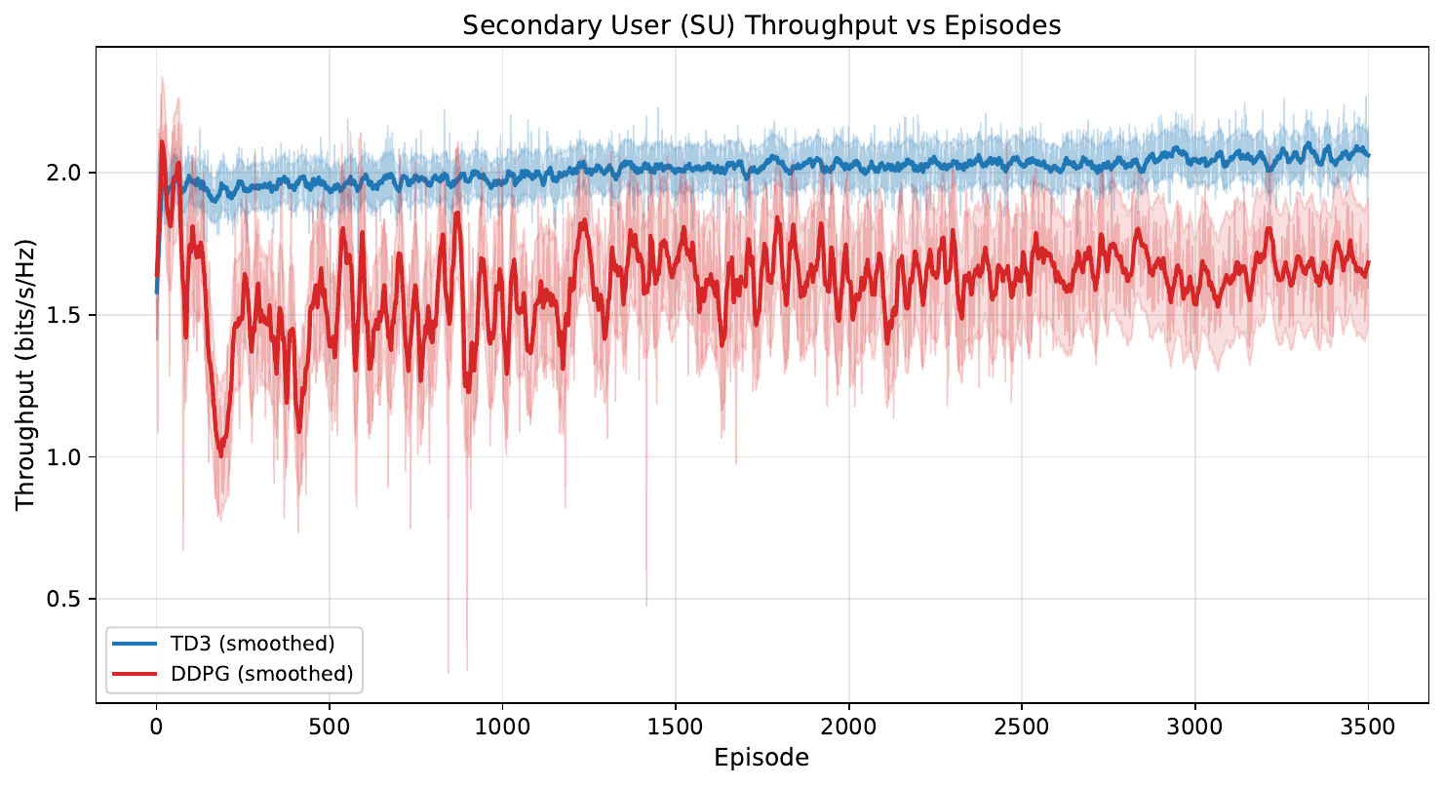
Experiment B — SU Throughput vs Episodes (m = 3)
Figure: SU throughput in moderate Nakagami fading — TD3 stabilises near 2.07 bits/s/Hz, DDPG near 1.69 bits/s/Hz.
CRN Power Allocation via Deep RL | RIT, Bangalore

Slide 37
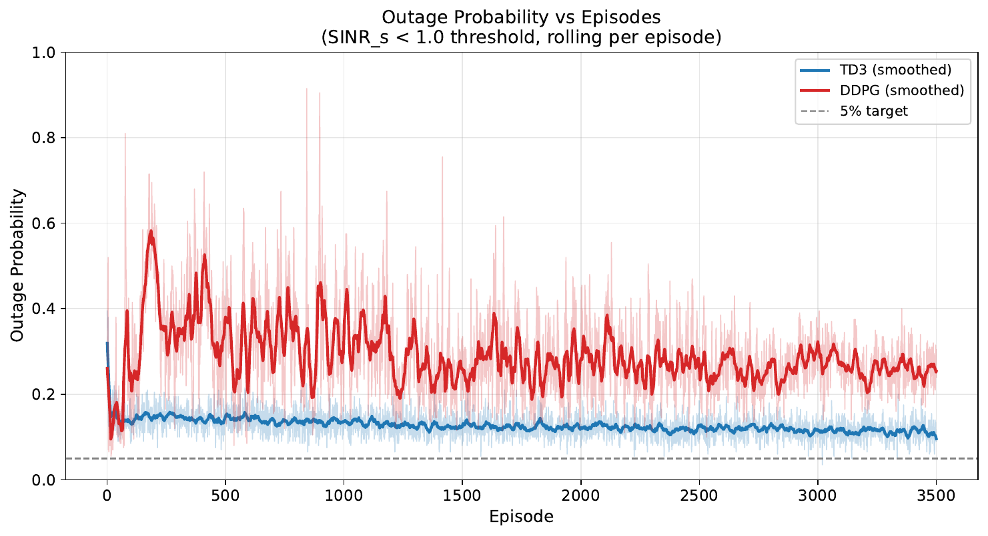
Experiment B — Outage Probability vs Episodes (m = 3)
Figure: Outage decay — TD3 reaches ~11 % vs DDPG ~25 %. Convergence is markedly smoother under m = 3 than m = 1.
CRN Power Allocation via Deep RL | RIT, Bangalore

Slide 38
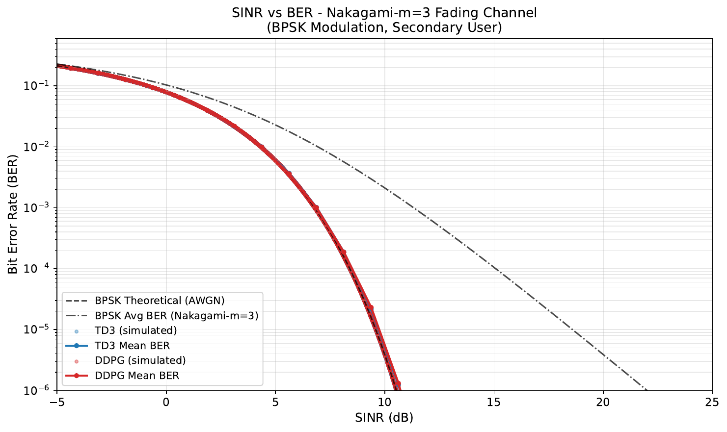
Experiment B — SU SINR vs BER (m = 3)
Figure: SU BER vs SINR — both agents track the Nakagami-m = 3 BPSK curve, with TD3 occupying a lower-BER region.
CRN Power Allocation via Deep RL | RIT, Bangalore

Slide 39
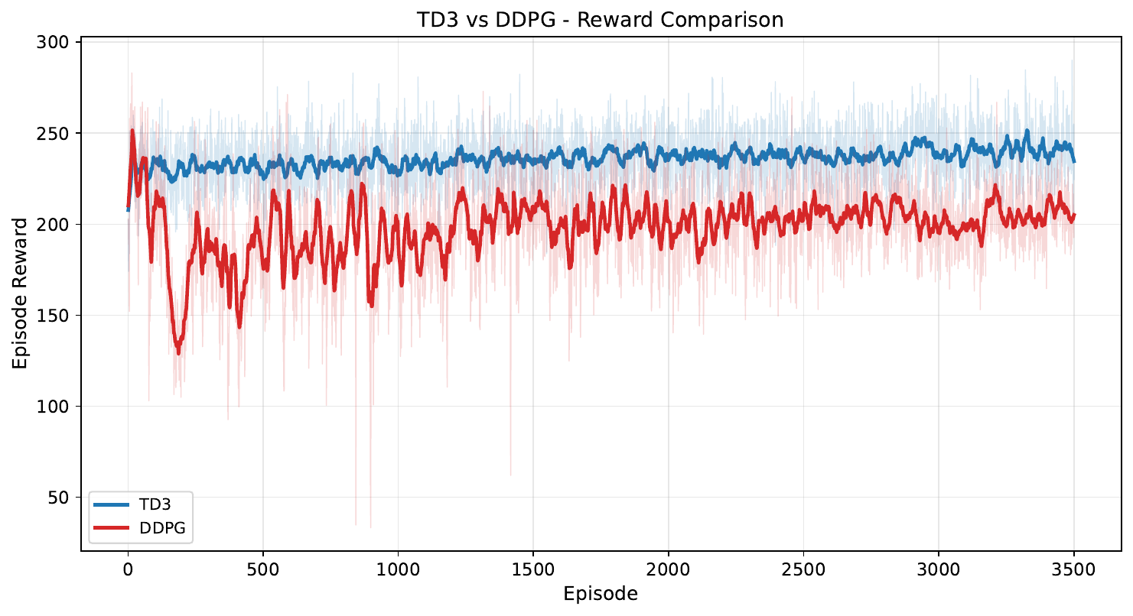
Experiment B — Reward Comparison (m = 3)
Figure: Episode reward overlay — TD3 stays above DDPG throughout training; both stable after ~1 500 episodes.
CRN Power Allocation via Deep RL | RIT, Bangalore

Slide 40
Experiment C — 3-way Comparison (m = 3)
TD3 vs DDPG vs Proposed Algorithm — identical settings, m = 3, 1 500 episodes.
Metric | TD3 | DDPG | Proposed (CAMO-TD3) | Winner
Avg Reward (last 100 ep) | 241.33 | 245.46 | 247.56 | Proposed
SU Throughput (bits/s/Hz) | 2.081 | 2.103 | 2.100 | DDPG / Proposed
PU Throughput (bits/s/Hz) | 0.519 | 0.516 | 0.529 | Proposed
Outage Probability | 0.107 | 0.104 | 0.104 | DDPG / Proposed
Average BER | 0.0270 | 0.0263 | 0.0264 | DDPG / Proposed
Training Time (s) | 5 487 | 5 214 | 44 387 | –
Observations
• The Proposed Algorithm wins on average reward and PU throughput, and ties with DDPG on outage / BER / SU throughput — while doing so without any manual weight tuning.
• Crucially, the Proposed Algorithm gives the highest PU throughput at the same outage level, indicating safer interference behaviour at equal SU performance.
• Training time is ~8× longer than TD3 / DDPG due to 6 critics + GRU + Lagrangian updates — expected trade-off.
• Note — Stick the 3-way SU-throughput and reward-comparison graphs (next two slides).
CRN Power Allocation via Deep RL | RIT, Bangalore

Slide 41
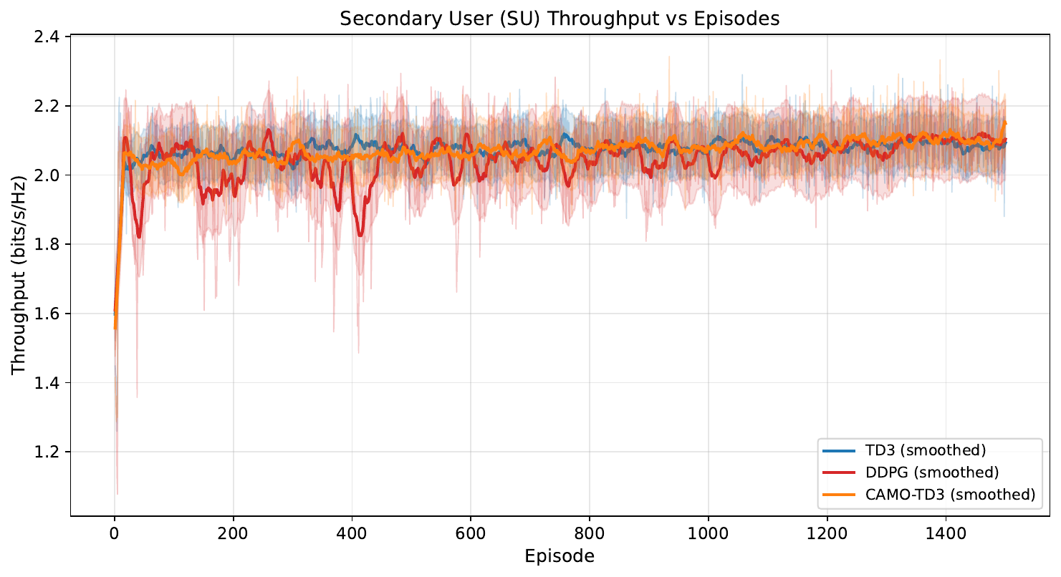
Experiment C — 3-way SU Throughput (m = 3)
Figure: SU throughput across episodes for TD3 / DDPG / Proposed Algorithm — the Proposed Algorithm matches or beats both baselines throughout training.
CRN Power Allocation via Deep RL | RIT, Bangalore

Slide 42
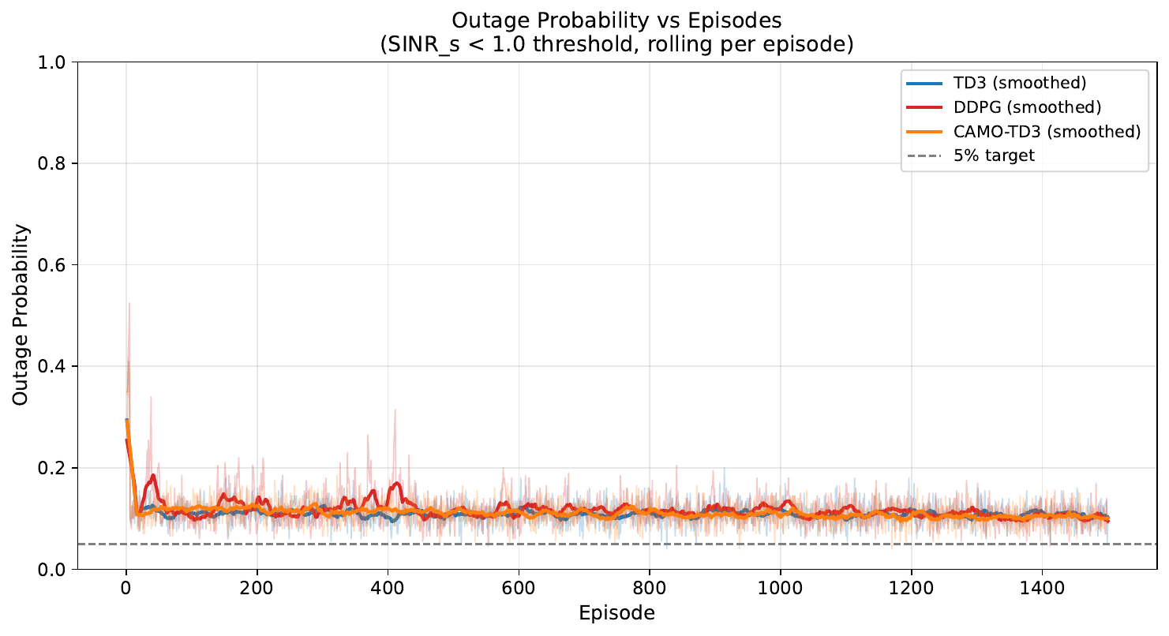
Experiment C — 3-way Outage Probability (m = 3)
Figure: Outage probability — Proposed Algorithm stays tightly grouped with DDPG, both below TD3 in the early episodes (faster constraint satisfaction).
CRN Power Allocation via Deep RL | RIT, Bangalore

Slide 43
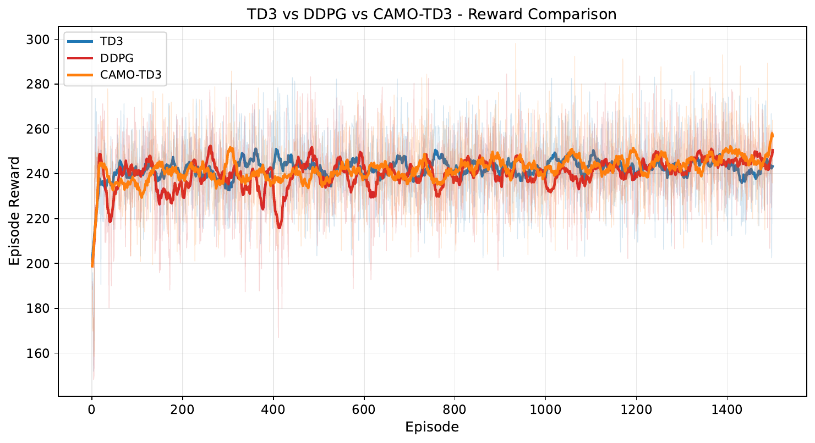
Experiment C — 3-way Reward Comparison (m = 3)
Figure: Episode reward overlay — Proposed Algorithm achieves the highest final average reward (~247.6).
CRN Power Allocation via Deep RL | RIT, Bangalore

Slide 44
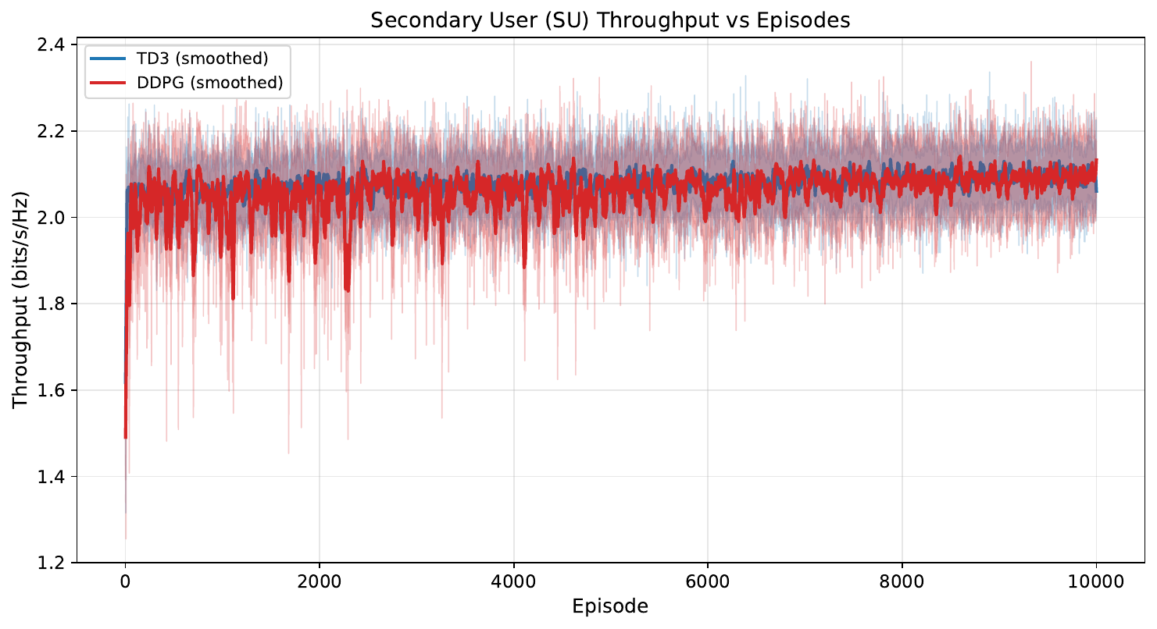
Experiment D — Long-run Stability (10 000 ep, m = 3)
Figure: SU throughput over a 10 000-episode run — both TD3 and DDPG remain stable; no policy collapse observed.
CRN Power Allocation via Deep RL | RIT, Bangalore

Slide 45
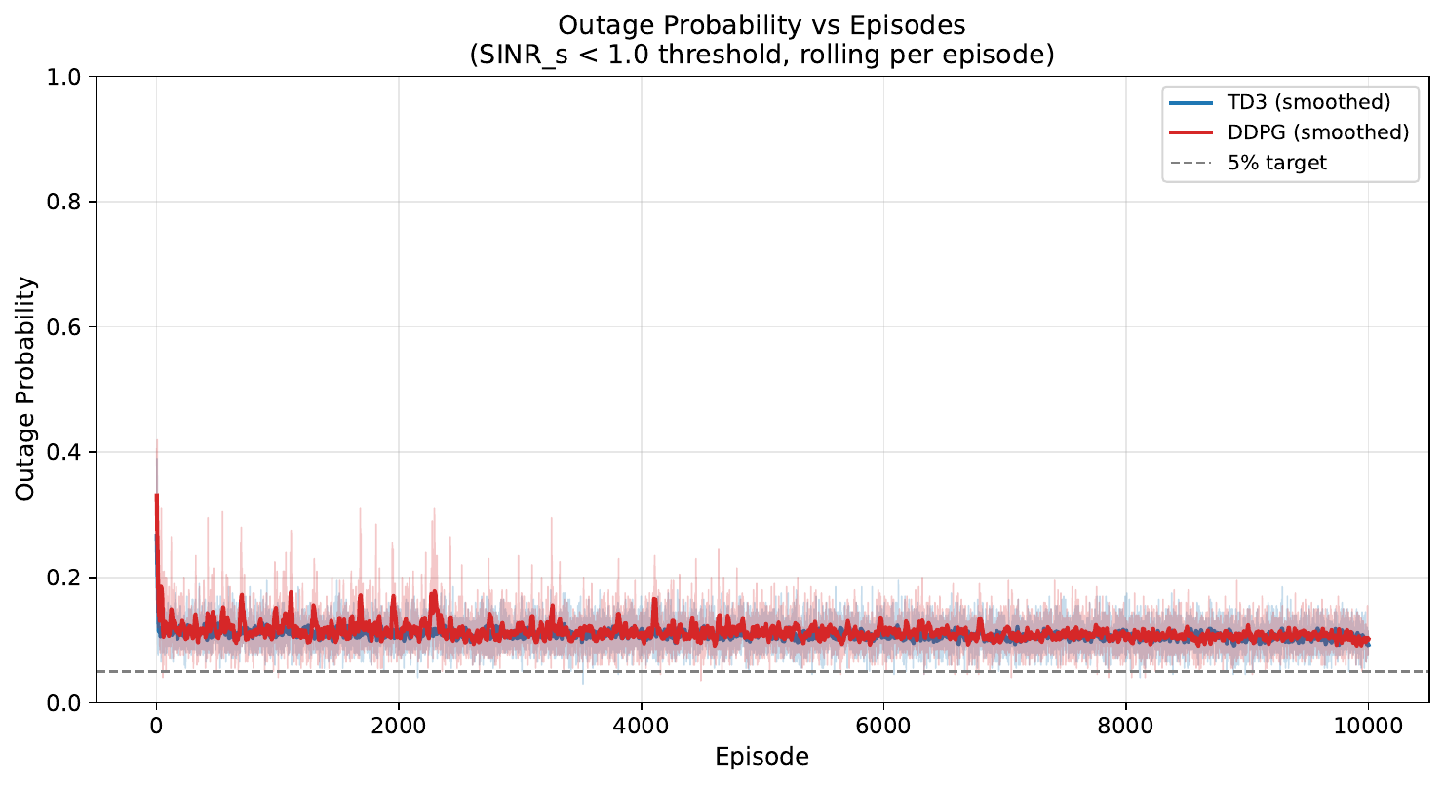
Experiment D — 10 000-ep Outage Probability
Figure: Outage settles around 10 % for both — confirms reproducibility of the m = 3 results from Experiment B.
CRN Power Allocation via Deep RL | RIT, Bangalore

Slide 46
Discussion of Results
Headline Findings
• DDPG → TD3 → Proposed Algorithm gives a clear, monotonic improvement in average reward and constraint adherence.
• TD3's twin-critic + delayed update gives 17–22 % higher SU throughput than DDPG with concurrent reduction in outage.
• The Proposed Algorithm achieves the best average reward and best PU throughput at equal outage / BER — without any manual weight tuning.
Effect of Fading Severity
• m = 1 (Rayleigh) is hard for all agents — outage hovers in the 25–32 % range; SU is bandwidth-limited by deep fades, not by the agent's intelligence.
• m = 3 (moderate) gives the agents room to actually exploit good states — outage drops below 12 % for TD3 / Proposed.
Cost Side
• The Proposed Algorithm needs ~8× longer training due to 6 critics + GRU + Lagrangian updates.
• Inference cost is unchanged — only training scales up.
• It also adds extra hyper-parameters (λ inits, MU_BIAS, SEQ_LEN, BELIEF_DIM) — partly offset by removing α / β / γ_e.
Sources of Residual Outage
• Block fading is i.i.d. per step — no temporal smoothing helps when |h_pp|² collapses suddenly to ε.
• Adding correlated fading or path-loss models would let the agent anticipate fades.
CRN Power Allocation via Deep RL | RIT, Bangalore

Slide 47
SECTION
Conclusion & Future Work

Slide 48
Conclusion
Summary of Contributions
• Built a complete deep-RL pipeline for underlay CRN power allocation under Nakagami-m fading.
• Implemented and benchmarked DDPG and TD3 as baselines; quantified the gains of TD3's twin-critic + delayed-update tricks (≈ +20 % SU throughput, ≈ −12 pp outage at m = 3).
• Designed and trained the Proposed Algorithm (CAMO-TD3) integrating four targeted innovations — GRU belief encoder, decomposed multi-objective critics, adaptive Lagrangian weights, and directional exploration noise.
• Demonstrated that the Proposed Algorithm matches the best baseline on throughput while improving PU protection — and without any manual weight tuning.
Key Take-aways
• Algorithmic : primal-dual / Lagrangian methods give a principled way to handle the multi-objective CRN problem.
• Engineering : unified, single-source-of-truth config + automated PDF reporting makes large-scale RL experiments reproducible.
• Empirical : the constraint-aware design pays off most where it matters — in low-SNR / high-fading regimes.
• Practical : a real-time React + WebSocket dashboard makes the RL training process observable for demos and debugging.
CRN Power Allocation via Deep RL | RIT, Bangalore

Slide 49
Future Work
Algorithmic Extensions
• Multi-SU scaling — extend the environment to multiple SU pairs with inter-SU interference (multi-agent RL, MARL).
• Add Soft Actor-Critic (SAC) as a stochastic-policy baseline for entropy-regularised exploration.
• Replace uniform sampling with prioritised experience replay for faster convergence.
• Transfer learning — pre-train on one m and fine-tune on another.
System-Model Extensions
• Add path-loss and node mobility for realism.
• OFDM extension — per-subcarrier power allocation.
• Imperfect / partial CSI study — quantify policy robustness under estimation noise.
• Spectrum-sensing integration — couple RL power control with energy / cyclostationary detection.
Engineering
• Docker containerisation for reproducible cloud deployment.
• Hyper-parameter optimisation via Optuna / Bayesian search.
• Extend the dashboard to compare multiple algorithms live, side-by-side.
CRN Power Allocation via Deep RL | RIT, Bangalore

Slide 50
References
• S. Haykin, "Cognitive Radio: Brain-Empowered Wireless Communications," IEEE J. Sel. Areas Commun., vol. 23, no. 2, pp. 201–220, Feb. 2005.
• FCC, "Spectrum Policy Task Force Report," ET Docket No. 02-135, Nov. 2002.
• J. Mitola III and G. Q. Maguire, "Cognitive Radio: Making Software Radios More Personal," IEEE Pers. Commun., vol. 6, no. 4, pp. 13–18, Aug. 1999.
• A. Goldsmith, S. A. Jafar, I. Maric and S. Srinivasa, "Breaking Spectrum Gridlock with Cognitive Radios: An Information-Theoretic Perspective," Proc. IEEE, vol. 97, no. 5, pp. 894–914, May 2009. (underlay / overlay / interweave)
• S. Fujimoto, H. van Hoof and D. Meger, "Addressing Function Approximation Error in Actor-Critic Methods (TD3)," ICML, 2018. arXiv:1802.09477.
• T. P. Lillicrap et al., "Continuous Control with Deep Reinforcement Learning (DDPG)," ICLR, 2016. arXiv:1509.02971.
• J. Achiam, D. Held, A. Tamar and P. Abbeel, "Constrained Policy Optimization," ICML, 2017.
• A. Ray, J. Achiam and D. Amodei, "Benchmarking Safe Exploration in Deep Reinforcement Learning," arXiv:1910.01708, 2019.
• E. Altman, Constrained Markov Decision Processes, Chapman & Hall / CRC, 1999.
• M. K. Simon and M.-S. Alouini, Digital Communication over Fading Channels, 2nd ed., Wiley, 2005.
• K. Cho et al., "Learning Phrase Representations using RNN Encoder–Decoder (GRU)," EMNLP, 2014.
• J. García and F. Fernández, "A Comprehensive Survey on Safe Reinforcement Learning," JMLR, vol. 16, pp. 1437–1480, 2015.
• S. Boyd and L. Vandenberghe, Convex Optimization, Cambridge University Press, 2004 (Ch. 5 — Duality).
CRN Power Allocation via Deep RL | RIT, Bangalore

Slide 51
Thank You
Questions and Suggestions Welcome
Department of Electronics and Communication Engineering, Ramaiah Institute of Technology, Bangalore

