Slide 1
Traffic Violations NYC
Group:
404: Group Name Not Found

Slide 2
Motivation
Traffic Violations in NYC during the Holiday Season puts a damper on the Holiday cheer.
Hypothesis - The is a correlation between a vehicle’s properties and its likelihood of getting a traffic violation.
Question - If there is a correlation, what would be the best vehicle configuration to minimize the odds of getting a traffic violation?

Slide 3
Questions to be answered.
Determining if there is a correlation between:
Vehicle Make and number of violation codes
Vehicle Color and number of violation codes
Plate Type and number of violation codes
Vehicle Body Type and number of violation codes

Slide 4
Data Sets Used:
https://www.kaggle.com/new-york-city/nyc-parking-tickets
Violation Statistics for Month of December 2016
https://www.kaggle.com/doaaalsenani/usa-cers-dataset
Auction Statistics across USA
Get a reference of the popularity of vehicle properties

Slide 5
Vehicle Make
Does a vehicle’s make have an effect on the likelihood of getting a traffic violation?

Slide 6
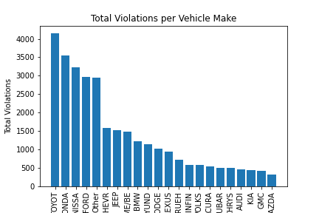

Slide 7
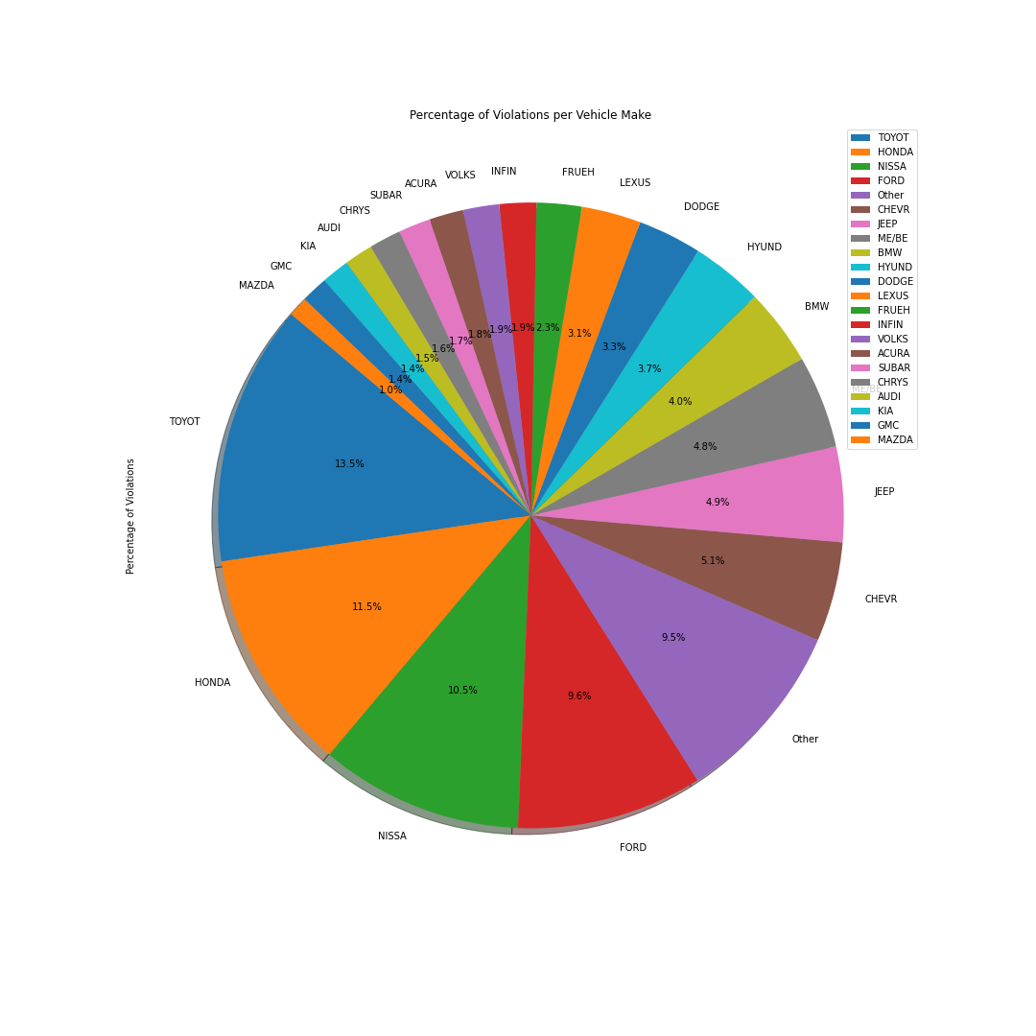

Slide 8
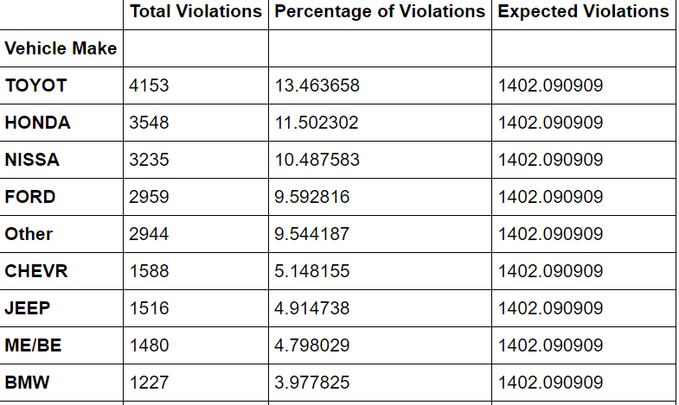
Actual VS Expected

Slide 9
Observations
Power_divergenceResult(statistic=20629.683589444336, pvalue=0.0)
Indicates Significance
Data indicates common vehicle makes as the biggest violators
Toyota, Honda, Nissan, Ford
Could be from the vehicle’s popularity as opposed to increasing likelihood
With this data alone, can not find the exact cause for this correlation
Whether due to sheer popularity, or other outside factor
The "Other" Section, which is comprised of around 101 different makes, just barely doubles the expected amount of traffic violations. This is showing, that despite the sheer amount of different makes, the number of violations given to each is on average, 29 violations, way below the expected.

Slide 10
Vehicle Color
Does a vehicle’s color play a role in how likely it is to be ticketed?

Slide 11
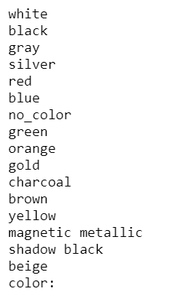
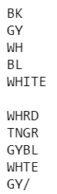
Methodology
Irregular color denotations (samples shown to the right) were normalized, and rows with non-string values were dropped
The top colors from PPG Industries North American car color summaries were analyzed, any others were compiled as ‘other’
Records of ~2500 car auction sales were added to approximate the overall US consumer color preference
Auction sales distribution was used to determine the expected number of violations

Slide 12
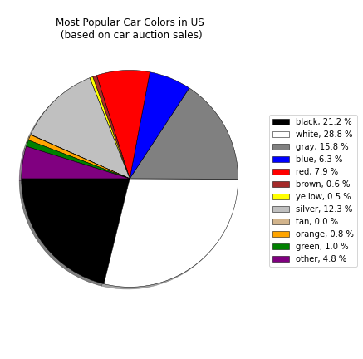
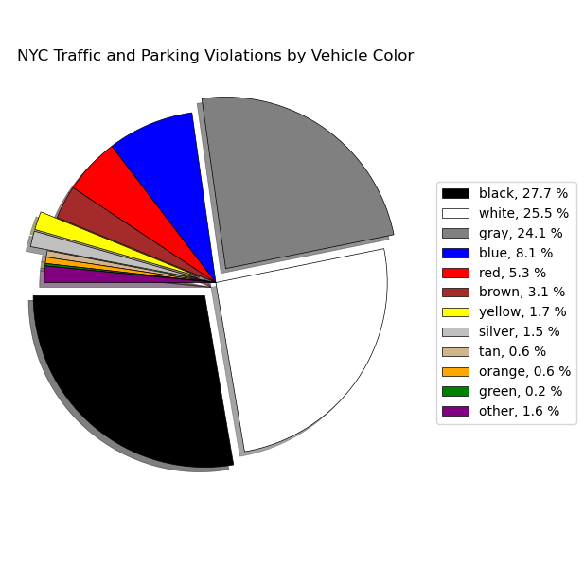

Slide 13
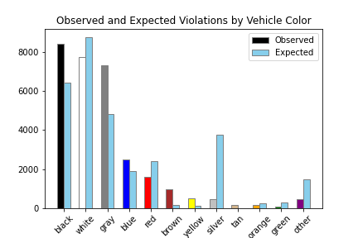
Statistical
Analysis
Critical value: 19.68
Chi-squared: 13001
P-value: ~0.0
Based on the results
of the chi-squared test,
the null hypothesis
must be rejected.

Slide 14
Observations
Gray and silver vehicles’ violations each differed significantly from their expected totals, but their combined totals more closely match their expected combined totals
Grays and silvers may be used interchangeably by police officers writing tickets
Black vehicles were penalized 30 percent more likely than expected
Black vehicles could make up a larger portion of the NYC car population, or they could receive more violations relative to other cars
Yellow vehicles were penalized three times as often as expected
New York City’s yellow taxis (0.6% of NYC car population) appear to receive more violations relative to other cars

Slide 15
Plate Type
Does Plate type influence the probability of getting a violation ticket

Slide 16
Plate types:
There are 37 plate types in the NYC parking tickets data.
The plate types which received the majority of the violation tickets are
PAS - Passenger (72.1%)
COM- Commercial (13.5%)
OMT- Taxi (8.6%)
OMS- Rental (2.2%)
SRF- Specific Passenger Vanity (1.1%)

Slide 17
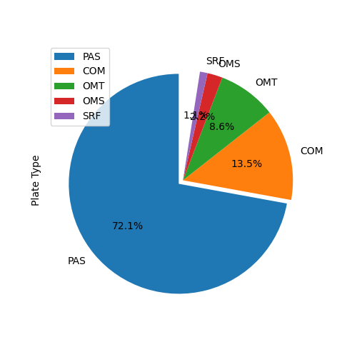
Pie Chart representing the top five Plate types:

Slide 18
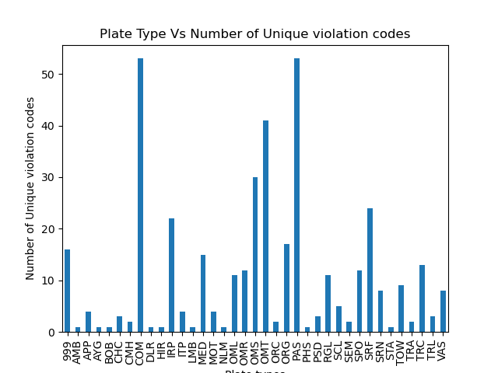
Plate Type Vs Number of Unique violation codes

Slide 19
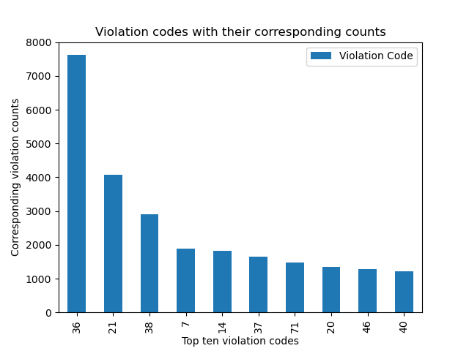
Frequency of the violation codes

Slide 20
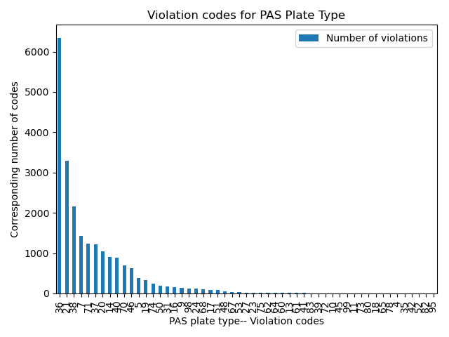
Violation codes counts for Passenger (PAS) plate type

Slide 21
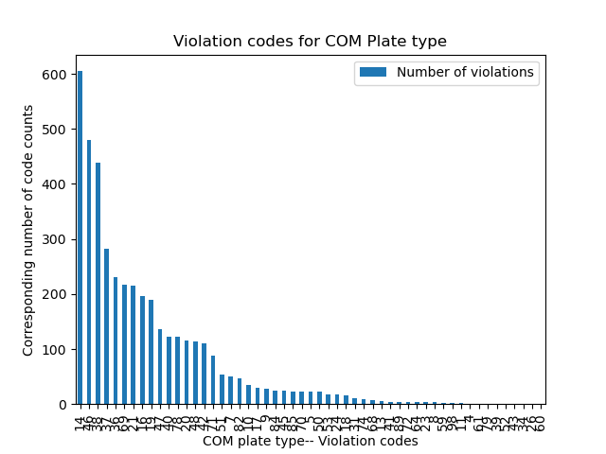
Violation code counts for Commercial (COM) plate type

Slide 22
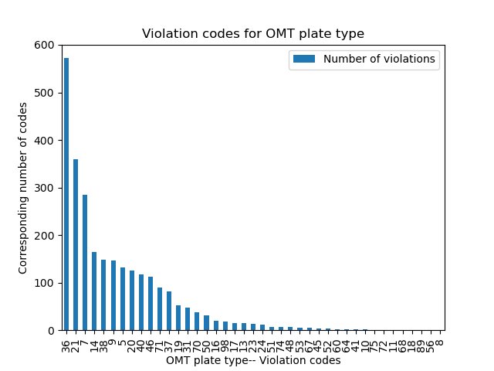
Violation codes counts for Taxi ( OMT) plate type

Slide 23
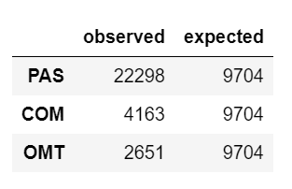
Statistical Analysis:
Chi square 24634.82
pvalue=0.0
Critical Value: 5.99
Since the chi square value of exceeds the critical value of 5.99, we conclude that the results are statistically significant.

Slide 24
Vehicle Body Type
Is there a correlation between vehicle body type & violation count

Slide 25
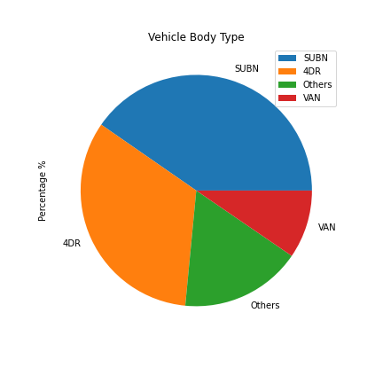
Pie chart representing top 4 vehicle body types

Slide 26
Conclusion
The number of Violation Codes seems to correlate more with the general popularity of the vehicle’s properties.
Although the data is significant, the exact correlation is hard to decipher.
With the data given, we can not say with utmost certainty that these vehicle properties add an additional bias to an officer’s want to ticket the driver.
With more data, we can draw a more detailed conclusion.

Slide 27
Challenges:
Source dataset
The initial file was >4 million rows and crashed our computers
Many fields were filled in manually, which led to inconsistent data

Slide 28
Questions?

