Slide 1
FinSight Lanka
Customer Data Analysis
GitHub Link of Project Files
Ryan Ravikumar

Slide 2
Section 1 - Data Cleaning Process
What was cleaned up?
  Duplicates: Removed 8 Repeated Customer IDs.
  Placeholders: 999,999,999 savings and 9,999,999 withdrawals corrected
  Impossible values: 4 ages rebuilt from date of birth; 4 negative balances blanked and flagged; 5 future dates blanked
  Blank categories: 17 labelled Unknown, so no customer is dropped
  Rule: never invent a number. Every change is in a cleaning log.
508 → 500
LKR 378M
Rows removed after 8 duplicated customer records found
The savings held by over 489 customers containing a usable balance
44%
10.5%
Of customers had taken loans
Of these loans in default

Slide 3
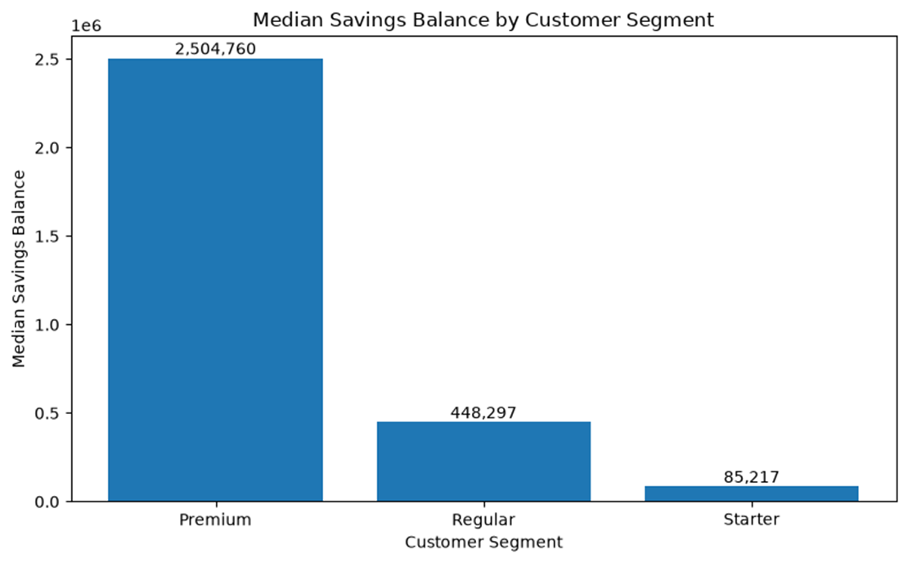
Section 2 - Q1 - Savings & Customer Behaviour
30x
A typical Premium balance compared with a Starter balance
25 → 34
is the age group holding the most savings overall
Key Insight & Recommendation: Premium customers hold significantly higher median savings, making them ideal for targeted investment and premium product offers. Provide affordable savings plans to Regular and Starter customers to encourage growth and wider product adoption.

Slide 4
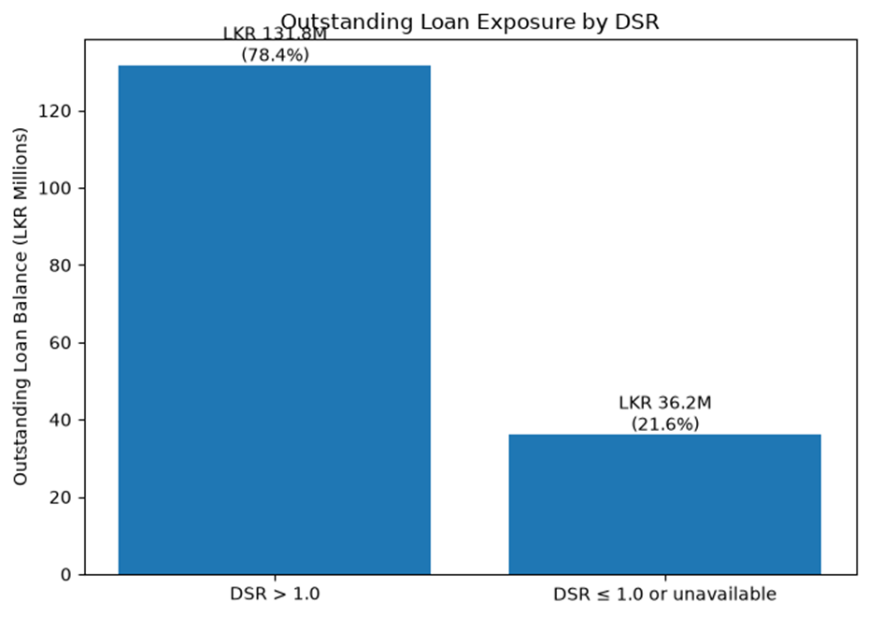
Section 3 - Q2 - Loan Portfolio and Risk
78%
of the loan book is owed by customers who owe more than they have saved
Key Insight & Recommendation: Since most customers have a DSR greater than 1, it warns the organization that most of the customers might default in the future (Not certain, may have other savings/high salary)

Slide 5
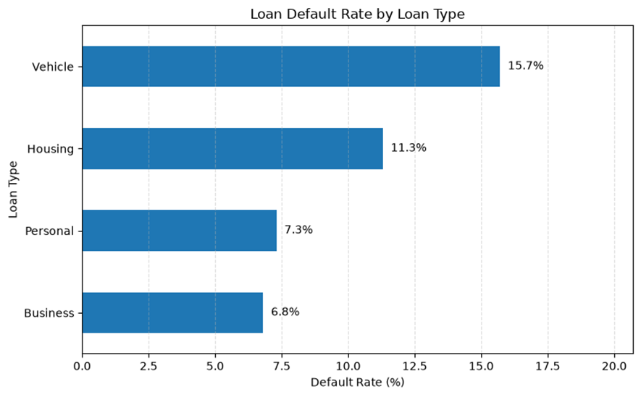
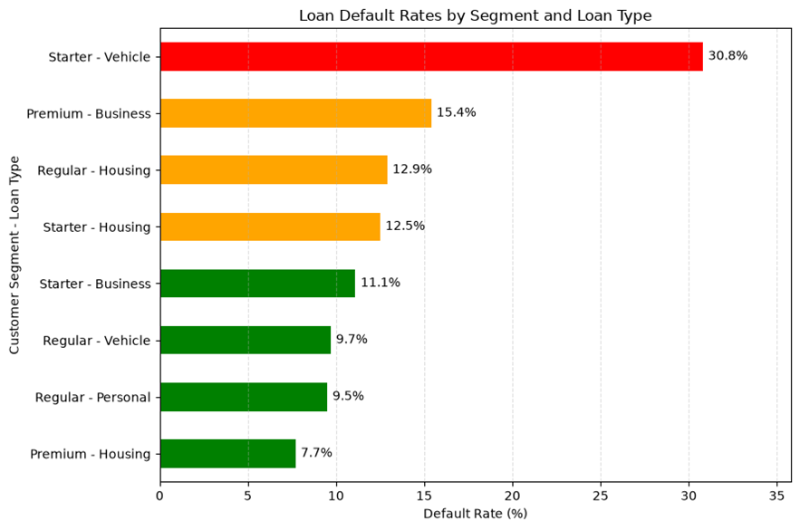
Section 3 - Q2 - Loan Portfolio and Risk
Key Insight & Recommendation: Starter customers with a vehicle loan default 31% of the time. Worth investigating before we lend more.

Slide 6
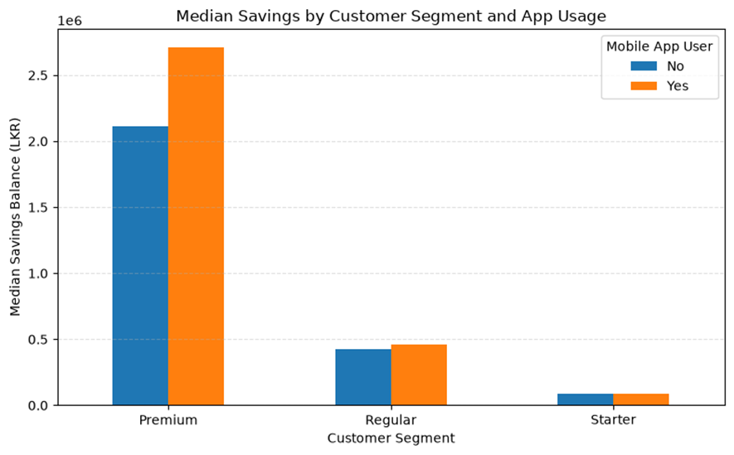
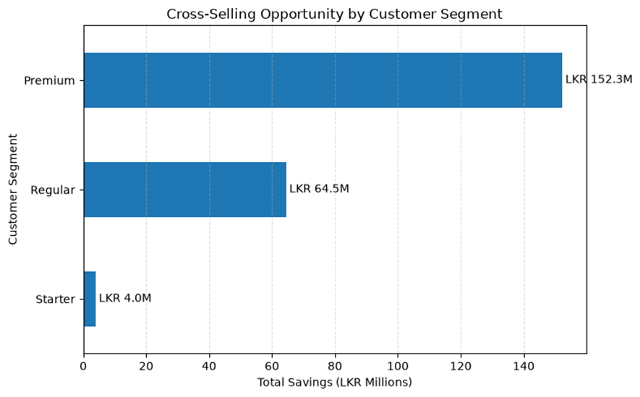
Section 4 - Q3 - Digital Engagement, Product Holdings & Acquisition Channels
Key Insight & Recommendation: App users save only slightly more, mostly in Premium. 251 savers hold no deposit or insurance, with LKR 222M between them.

Slide 7
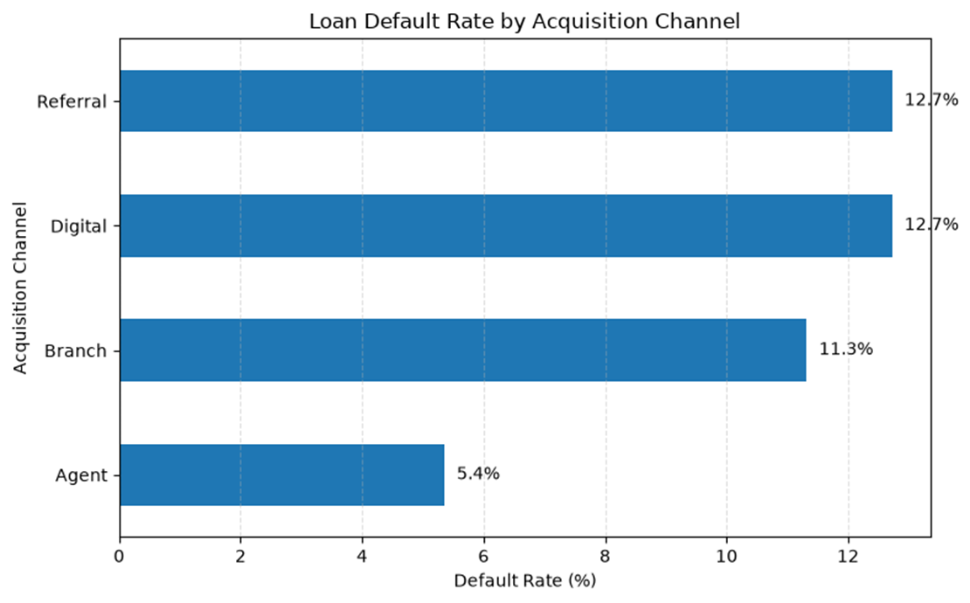
Section 4 - Q3 - Digital Engagement, Product Holdings & Acquisition Channels
5.4%
default rate for Agent customers, the lowest
12.7%
for Digital and Referral customers
Key Insight & Recommendation: Agents seem to perform better, FinSight can look into the factors that contribute to this performance and see if they can be applied to the other acquistion channels.

Slide 8
Section 5 - Q4 - Define 5 KPIs
DEFAULT RATE
LOANS BACKED BY TOO LITTLE SAVINGS
KYC VERIFIED
APP USERS
SAVERS WITH NO OTHER PRODUCT
10.5%
78.4%
70.2%
66.4%
51.3%
Target: 8% or Lower
Target: 60% or Lower
Target: 85% or Higher
Target: 75% or Higher
Target: 40% or Lower
Equation: Defaulted loans / all loans
Equation: Loan balance where DSR > 1 / total balance
Equation: KYC Verified / all customers
Equation: Mobile app users / all customers
Equation: Savers with no FD and no insurance / all savers
Informs: Tighten or relax lending criteria
Informs: Where to cap new lending
Informs: Size of the KYC clean-up
Informs: Digital migration campaigns
Informs: Who gets Fixed Deposit and insurance offers

Slide 9
Section 6 - Q5 - Board Summary & Recommendation
SUMMARY
Savings sit with Premium customers: 18% of customers hold 63% of savings.
RECOMMENDATIONS
78% of the loan book is owed by customers whose debt exceeds their savings.
Check repayment history before lending to Starter customers.
Defaults are highest for Starter customers (19%) and vehicle loans (16%).
Offer deposits and insurance to Premium savers first.
Half of savers (51%) hold no Fixed Deposit or insurance, yet they hold 59% of savings.

Slide 10
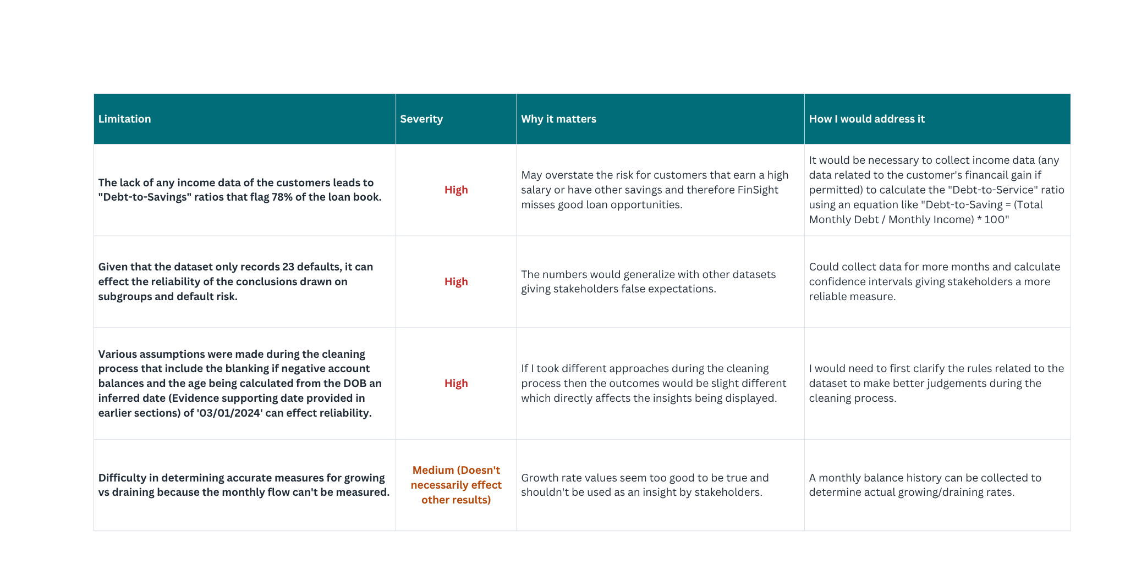
Section 7 - Q6 - Critique Your Own Work

