Slide 1


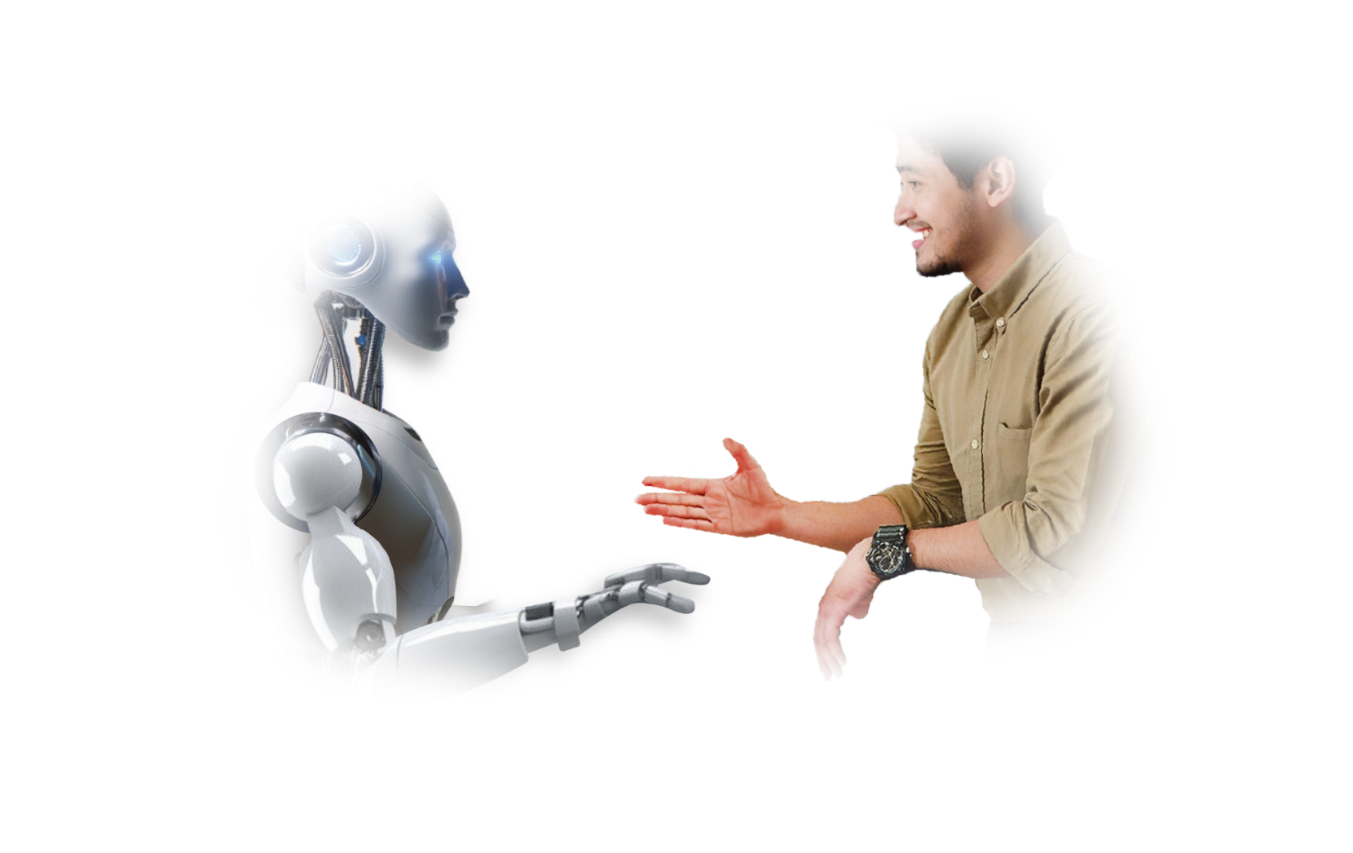
S-PACE: Sync Physiological Alignment Conditioning Embedding for Robust Multimodal Emotion Recognition

Slide 2

Contents
01. 기존 MER
02. Reference papers
03. Novelty
04. Dataset
05. Result

Slide 3
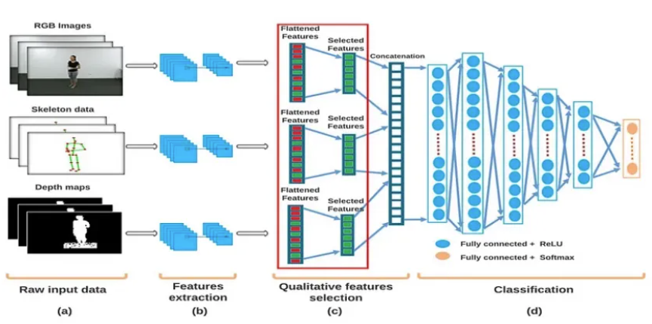
기존 MER
기존 MER Workflow
Data preprocessing -> Feature Extraction -> Cross attention -> Classification

Slide 4
핵심 아이디어
Bio-Anchored Alignment + S-PACE
Two Fundamental Challenges in Multimodal Emotion Recognition
(1) Temporal Misalignment: 행동 반응(ms) vs 생리 반응(1~5초) — bio-behavioral lag
(2) Modality Noise: 얼굴 가림, 음성 왜곡, 센서 아티팩트 — 모달리티별 신뢰도 차이
Our Solution: SGMT (S-PACE Gated Multimodal Transformer)
S-PACE: Bio를 Anchor(K,V)로, Behavioral(Video,Audio)을 Query로 — cross-attention 정렬
Quality-Aware Gate: 신호 품질 기반 동적 모달리티 가중치 (temperature annealing)
Bio-Anchored 설계: 생리신호 = 비자발적, 항상 존재 → 안정적 fusion 기준점
기존 MER: 모달리티를 대칭적으로 처리 → SGMT: Bio를 중심에 놓고 Behavioral이 conditioning
[SGMT Architecture Figure — sgmt_architecture_v3.pdf]

Slide 5
SGMT Architecture
End-to-end Pipeline
[sgmt_architecture_v3.pdf — 전체 아키텍처 그림] Video(ResNet) + Audio(AST) + Bio(ResNet per channel, GASF/GADF/MTF) → Positional + Type + Speaker Embedding → S-PACE Cross-Attention (Bio=K,V / Behavioral=Q) → Quality-Aware Gate (temperature annealing) → Temporal Swin Transformer (hierarchical) → Perceiver Fusion (learnable latent tokens) → Multi-task: Binary A/V + Quadrant + Polar

Slide 6
S-PACE: Stimulus-Phase Alignment via Cross-modal Embedding
설계 원리
수식
Behavioral(Video+Audio) = Query
Bio sensor channels = Key, Value
"현재 행동 관측에 대해 어떤
생리 채널이 가장 관련있는가?"
행동이 먼저 발생 → 생리가 뒤따름
→ Q로 행동을 쓰는 게 인과적으로 맞음
Q = W_Q [V_hat; A_hat] (T x d)
K = W_K B (C x d)
V_att = W_V B (C x d)
B_t = MLP(softmax(QK^T/sqrt(d)) V_att)
→ Time-aligned bio representation
Graceful Degradation
Video 없을 때 (KEMDy20): V_hat = 0 → Query가 Audio-only로 자동 전환
Bio anchor는 항상 존재 → 아키텍처 변경 없이 modality 가감 가능
[S-PACE attention heatmap — space_gate_heatmap.png]

Slide 7
Quality-Aware Gate
Dynamic Modality Fusion
Quality Proxies
Temperature Annealing
q_face = 얼굴 검출 비율 (0~1)
q_audio = spectral flatness 기반
q_bio = 채널별 dynamic range 평균
→ batch-wise z-score 정규화
w = softmax(MLP([V;A;B;q]) / tau)
tau: 2.0 → 1.0 (cosine schedule)
초기: 균등 탐색 → 후기: 전문화
역할: interpretability module
Q-Acc 기여는 미미(-0.1%)하지만, 모달리티 중요도를 사람이 읽을 수 있게 해줌 (50K params, <0.05%)
[Gate weight comparison — gate_comparison.png]

Slide 8
Temporal Swin Transformer + Perceiver Fusion
Hierarchical Temporal Swin
Perceiver Fusion
1D Swin Transformer adaptation
Stage 0: T=16→8 (window=4, shifted)
Stage 1: T=8→4
Stage 2: T=4 (refinement)
4개 병렬 Encoder:
1 post-gate (fused) + 3 intra-modal
(video, audio, bio 각각 독립)
Learnable latent tokens (L=32)
Cross-attention:
latent queries ← multimodal tokens
→ 고정 차원 emotion embedding
→ Multi-task heads:
Binary (A/V), Quadrant, Polar
Multi-scale temporal + heterogeneous modality → compact representation → joint prediction

Slide 9
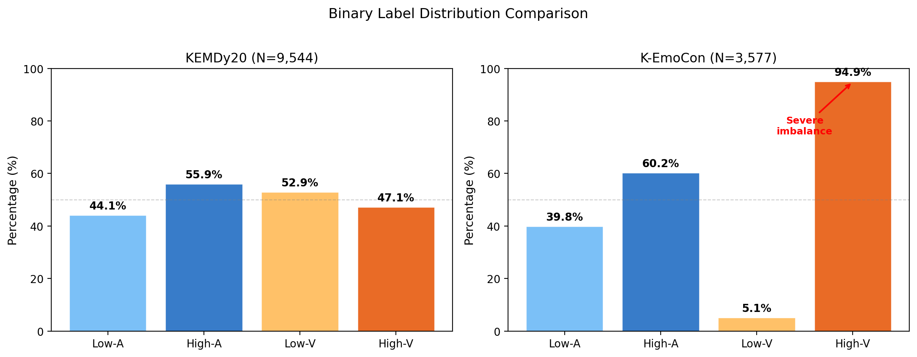
Datasets
KEMDy20 + K-EmoCon
KEMDy20
K-EmoCon
40 sessions, 80 participants
Dyadic emotional conversations
Modalities: Audio + Bio (EDA, TEMP, IBI)
Video 없음 → skip_video=True
Arousal/Valence 5-point → binary
3-fold LOPPO CV
비교적 balanced distribution
32 participants, 16 pairs
Paired conversation
Modalities: Audio + Video + Bio
(BVP, EDA, TEMP, ACC)
Valence: 5.1% Low / 94.9% High
→ extreme class imbalance
6-fold GroupKFold CV

Slide 10
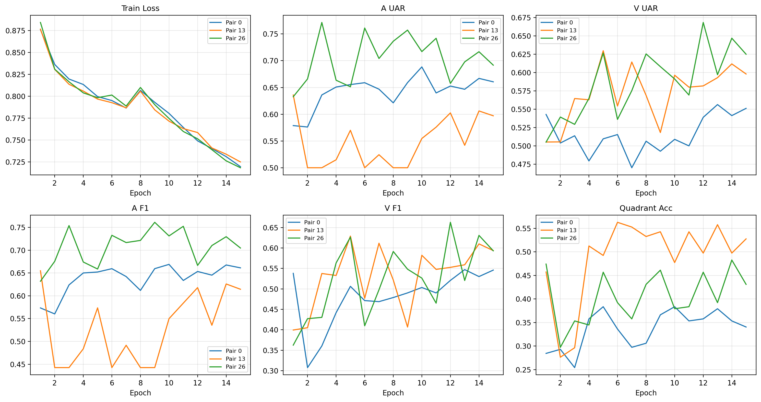
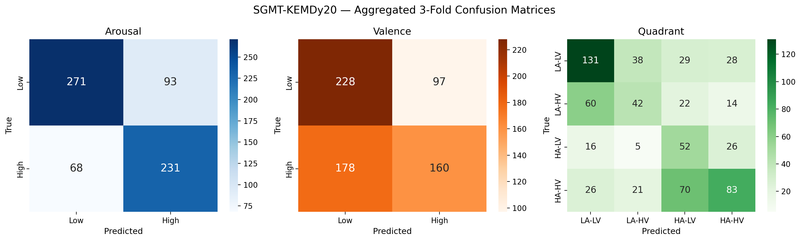
Results — Main Performance
KEMDy20 (Audio + Bio)
K-EmoCon (Audio + Video + Bio)
3-fold LOPPO, skip-video + label smoothing
6-fold GroupKFold, 25 epochs
A-UAR: 68.4 ± 6.2%
V-UAR: 57.6 ± 4.4%
Q-Acc: 44.7 ± 4.8% (chance=25%)
A-F1: 68.5% | V-F1: 55.4%
A-UAR: 62.9 ± 10.6%
A-F1: 73.5% | V-F1: 86.1%
Q-Acc: 62.5 ± 12.3% (chance=25%)
V-UAR 미보고 (5.1% minority → 불안정)
Cross-Dataset Summary
KEMDy20 (A+Bio): A-UAR 68.4% | K-EmoCon (A+V+Bio): A-UAR 62.9%
동일 아키텍처가 modality 가감에 자동 적응 (Gate mechanism)

Slide 11
Ablation Study
KEMDy20 Architectural Ablation
K-EmoCon Component Ablation (6-fold)
Audio-only: A-UAR 71.4 / V-UAR 49.0
Bio-only: A-UAR 54.2 / V-UAR 52.0
Concat: A-UAR 65.9 / V-UAR 51.3
SGMT Full: A-UAR 69.6 / V-UAR 52.8
Audio가 arousal 높지만 valence 최약
→ SGMT = 가장 높은 composite score
SGMT Full: Q-Acc 63.2%
- Binary Head: Q-Acc 59.0% (Δ-4.2)
- Polar Head: Q-Acc 60.7% (Δ-2.5)
- Gate Anneal: Q-Acc 61.1% (Δ-2.1)
- Speaker Emb: Q-Acc 61.8% (Δ-1.4)
- Quality Gate: Q-Acc 63.1% (Δ-0.1)
Binary head이 가장 critical (+4.2%)
Key Findings
Bio contribution: Bio 추가 시 V-UAR +3.8%p (audio-only 49.0 → SGMT 52.8) — valence에서 보완적
Gated > Concat: A-UAR +3.7%p (65.9 → 69.6) — cross-attention + gating의 효과
SkipVideo: video encoder 비활성화 시 +1.4% — zero-value noise 제거 효과

Slide 12
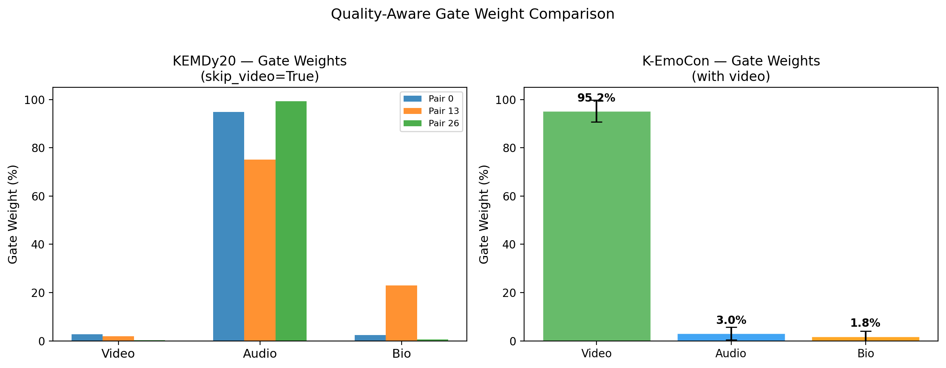
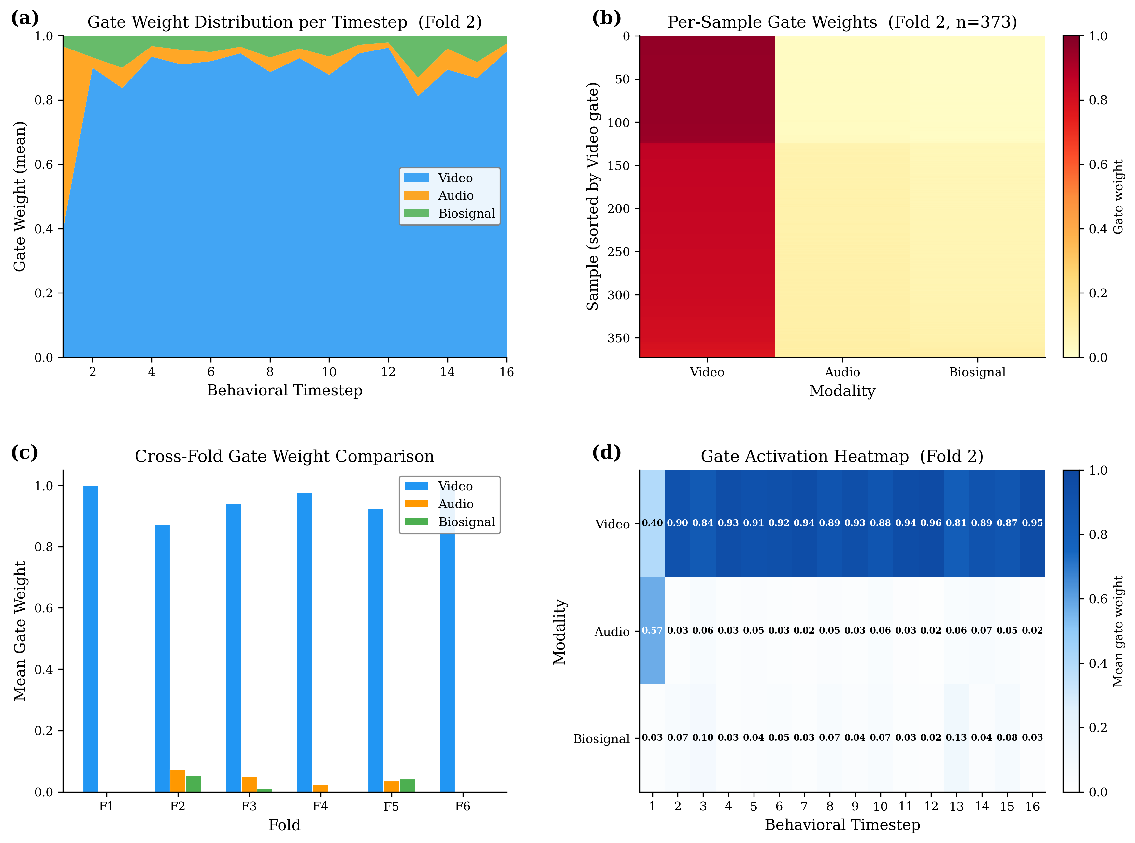
Gate Weight Analysis
Adaptive Modality Selection
K-EmoCon (with Video)
KEMDy20 (no Video)
Video: ~95.2%
Audio: ~3.0%
Bio: ~1.8%
얼굴 표정이 가장 informative
Video: ~1.6% (zero tokens)
Audio: ~89.7%
Bio: ~8.7%
Video 없으면 Audio로 자동 전환
Temporal dynamics: t=1에서 audio 57% + bio 13% → t≥4에서 video 96% (초기 acoustic context → steady-state visual tracking)

Slide 13
Conclusion & Future Work
Contributions
1. S-PACE: bio-behavioral temporal lag를 cross-attention으로 정렬 (bio=anchor)
2. Quality-Aware Gate: temperature annealing으로 modality 신뢰도 기반 동적 fusion
3. Unified Architecture: modality 가감에 아키텍처 변경 없이 적응 (KEMDy20 ↔ K-EmoCon)
4. Gate Analysis: supervision 없이 modality selection 학습 (video 95% ↔ audio 90%)
Limitations
Future Work
Bio gate weight ~2% → bio representation 개선 필요
K-EmoCon valence 94.9% skew → UAR 불안정
Single-fold ablation의 일반화 한계
NormWear (wearable foundation model)로
bio encoder 교체 → representation 개선
DEAP 데이터셋 일반화 검증
Bio signal → LLM token space 직접 주입 (BioToken)

