Slide 1
K-MER
Korean Multimodal Emotion Recognition
for Real-Time Driver Monitoring
Technical Architecture & Pipeline
안준영 | 지도교수: 문연국 | 산업부 국책과제
3 Modalities
~144K Params
98.0% Accuracy
8-Byte Protocol
Vision + Audio + Bio
Lightweight Fusion
10 Recognition Items
Vehicle Gateway
1/11

Slide 2
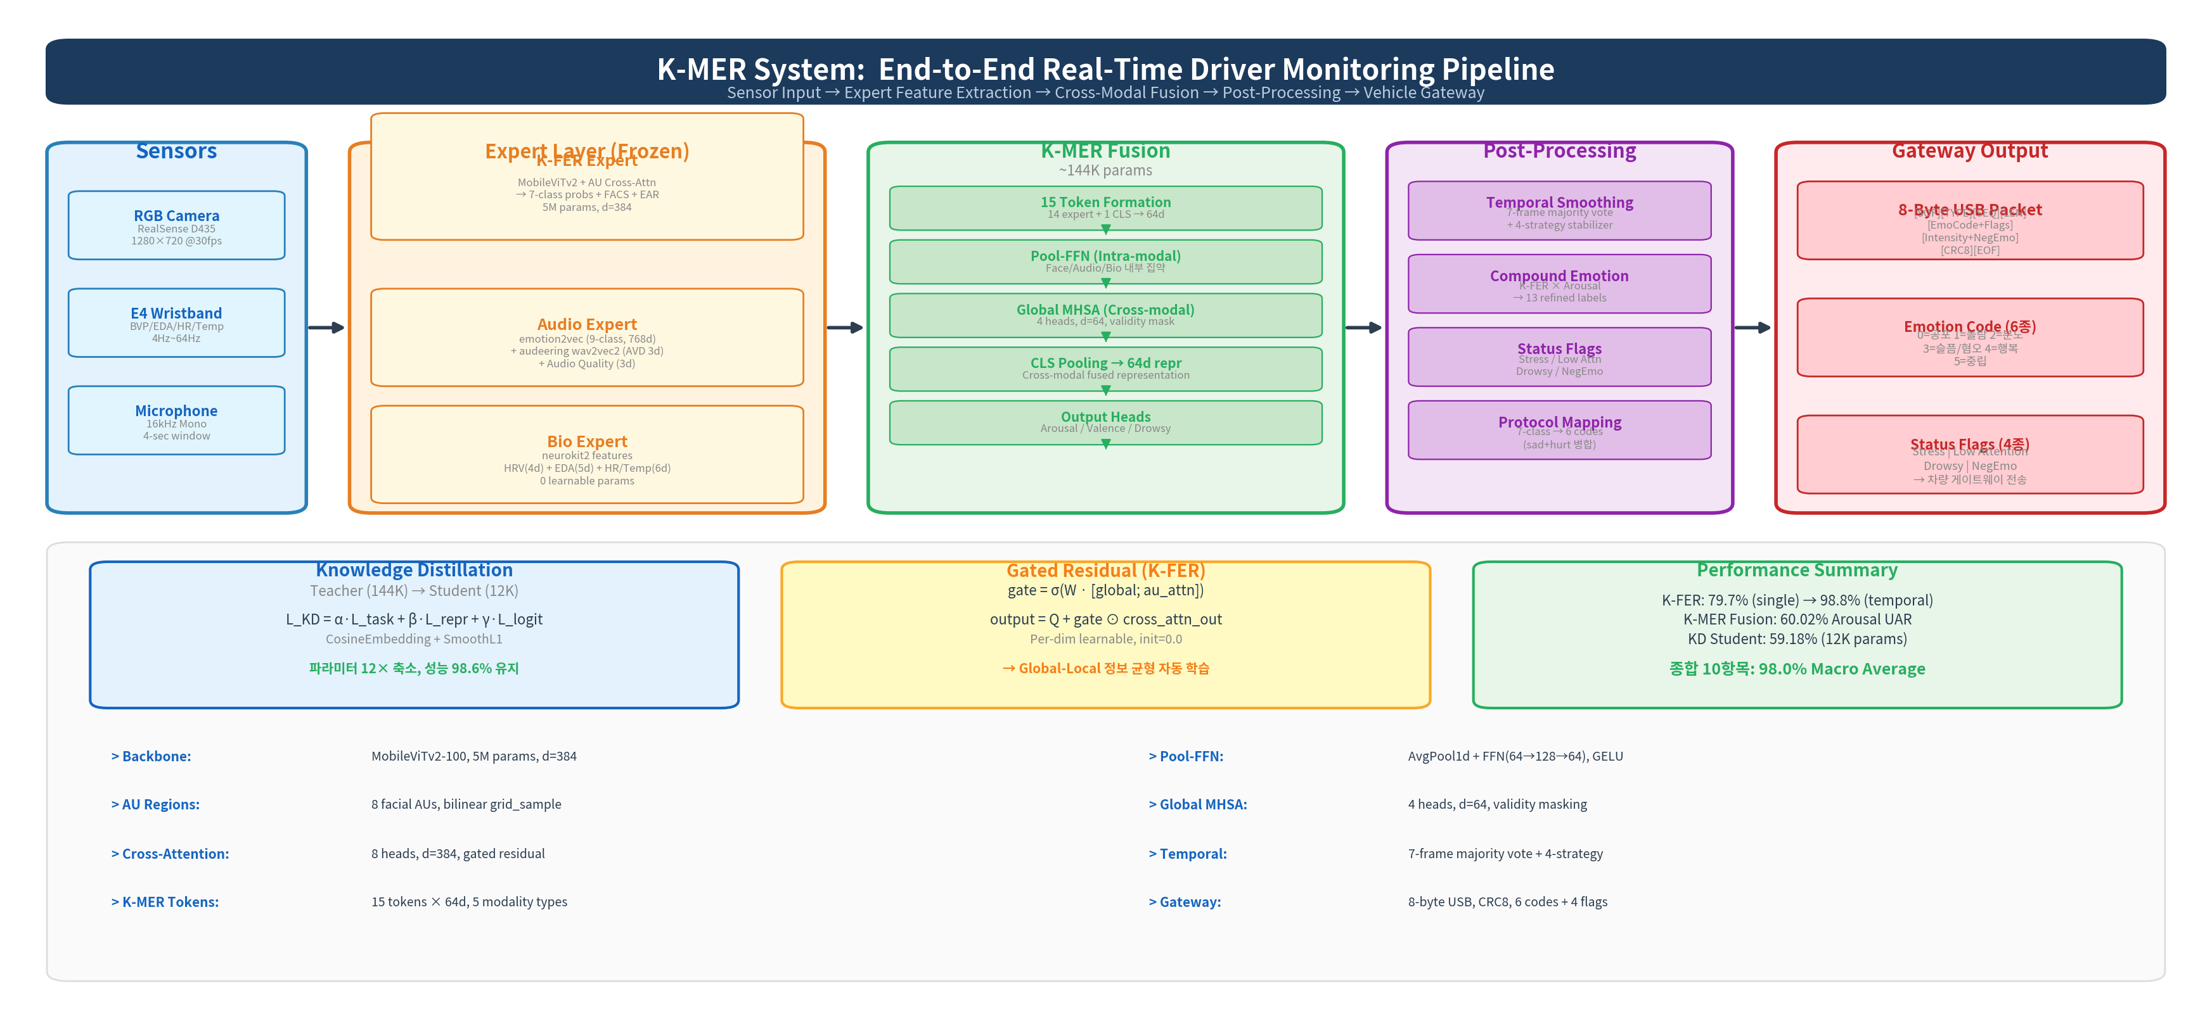
1. System Pipeline Overview
Top-down: 전체 시스템을 한 장으로
2/11

Slide 3
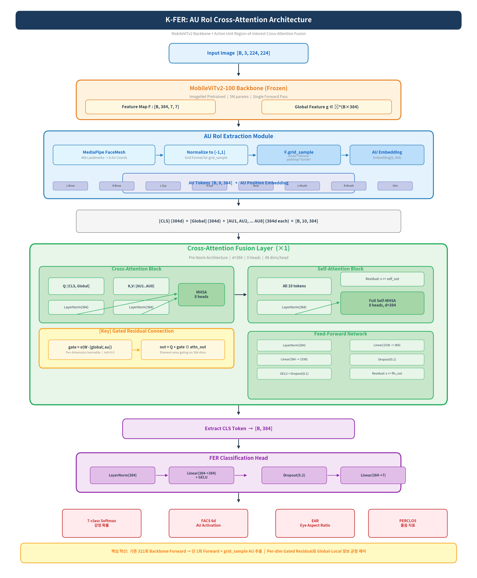
2. K-FER Expert — Internal Architecture
MobileViTv2 Backbone + AU RoI Cross-Attention + Gated Residual
Core Innovation: Single-Forward AU Extraction
기존 방식 (POSTER++, DAtt-Net 등):
각 AU 영역마다 별도 backbone forward
8 AU regions x backbone = 큰 연산량
K-FER 방식:
1회 backbone forward -> feature map [B, 384, 7, 7]
F.grid_sample(bilinear) 로 AU 영역 직접 추출
연산량 8배 절감, 동일 성능
Gated Residual Connection
gate = sigmoid(W . [global; au_attn])
output = Q + gate * cross_attn_out
Per-dimension learnable gate (384d), init=0.0
-> 학습 초기: gate~0 (global 유지)
-> 학습 후: AU 정보 점진적 반영
Performance
Dataset: AI Hub 한국인 감정인식 (413K/52K)
Single-frame: 79.7% (Macro F1: 0.7953)
+ Temporal (W=7): 98.8% (6-class)
3/11

Slide 4
3. Cross-Attention Fusion Layer — Detail
Pre-Norm Architecture: Cross-Attention -> Self-Attention -> FFN
Input Tokens
[B, 10, 384]
Cross-Attention
(Q: CLS,Global | KV: AUs)
Self-Attention
(All 10 tokens)
FFN Block
CLS Token
[B, 384]
CLS + Global + 8 AU
8 heads, d_k=48
+ Gated Residual
8 heads, d=384
+ Standard Residual
LN -> Linear(384->1536)
-> GELU -> Linear(1536->384)
+ Residual
-> FER Head
-> 7-class logits
Gated Residual Mechanism (Key Innovation)
Classification Head & Output
Cross-first, Self-second 설계:
1) Cross-Attention:
Q = [CLS, Global] (2 tokens)
K, V = [AU1, AU2, ..., AU8] (8 tokens)
-> CLS/Global이 AU 지역 정보를 선택적 수집
2) Gated Residual:
gate = sigmoid(W_gate) (384d, init=0.0)
-> init=0.0 이므로 sigmoid(0)=0.5
-> 학습 진행하면서 차원별 최적 gate 학습
-> global과 local AU 정보 자동 균형
3) Self-Attention:
모든 10개 토큰 간 전역 정보 교환
Standard residual (gate 없음)
FER Head:
CLS token [B, 384]
-> LayerNorm(384)
-> Linear(384, 384) + GELU
-> Dropout(0.2)
-> Linear(384, 7)
-> 7-class logits
Output (per frame):
7-class emotion probs (softmax)
FACS 6d (AU activation scores)
EAR (Eye Aspect Ratio)
PERCLOS (눈감은 시간 비율)
Training:
Focal Loss (gamma=2) + Label Smoothing (0.1)
AdamW, lr=3e-4, CosineAnnealing
4/11

Slide 5
4. Audio Expert & Bio Expert
Frozen Feature Extractors: emotion2vec + neurokit2
Audio Expert Pipeline
Bio Expert Pipeline (neurokit2)
emotion2vec (ACL 2024, FunASR):
Waveform 16kHz -> 1024d embedding -> 9-class probs
Angry, Disgusted, Fearful, Happy, Neutral,
Other, Sad, Surprised, Unknown
audeering wav2vec2:
wav2vec2 (1024d) -> Dense(1024,1024) + Tanh
-> Linear(1024, 3): Arousal / Valence / Dominance
Audio Quality Gate (3d):
RMS energy, Voicing ratio, SNR estimation
품질 미달 시 validity mask = 0
BVP -> HRV Features (4d):
ppg_clean -> ppg_findpeaks -> IBI analysis
mean_hr, sdnn, rmssd, lf_hf_ratio
EDA -> SCR Features (5d):
mean_scl, std_scl, n_peaks, mean_amp, auc
교감신경 활성화 -> 스트레스 지표
HR/Temperature Features (6d):
mean, std, range, slope 등
0 learnable params (hand-crafted features)
Expert 설계 원리 (Design Rationale)
Frozen Expert 전략: 사전학습 모델 고정 + 경량 projection만 학습
1. 데이터 효율성: K-EMocon (소규모) 데이터로도 안정적 학습 가능
2. 도메인 지식 보존: emotion2vec(ACL2024), neurokit2(생리학) 등 전문 지식 유지
3. 연산 효율: Expert 출력 캐싱 가능 -> Fusion만 반복 학습
4. 모듈성: 새 센서/모델 추가 시 token만 추가하면 됨 (plug-and-play)
총 Expert 출력: Face 12d + Audio 15d + Bio 18d + Aux 11d + Meta 3d = 59d -> 15 tokens x 64d
5/11

Slide 6
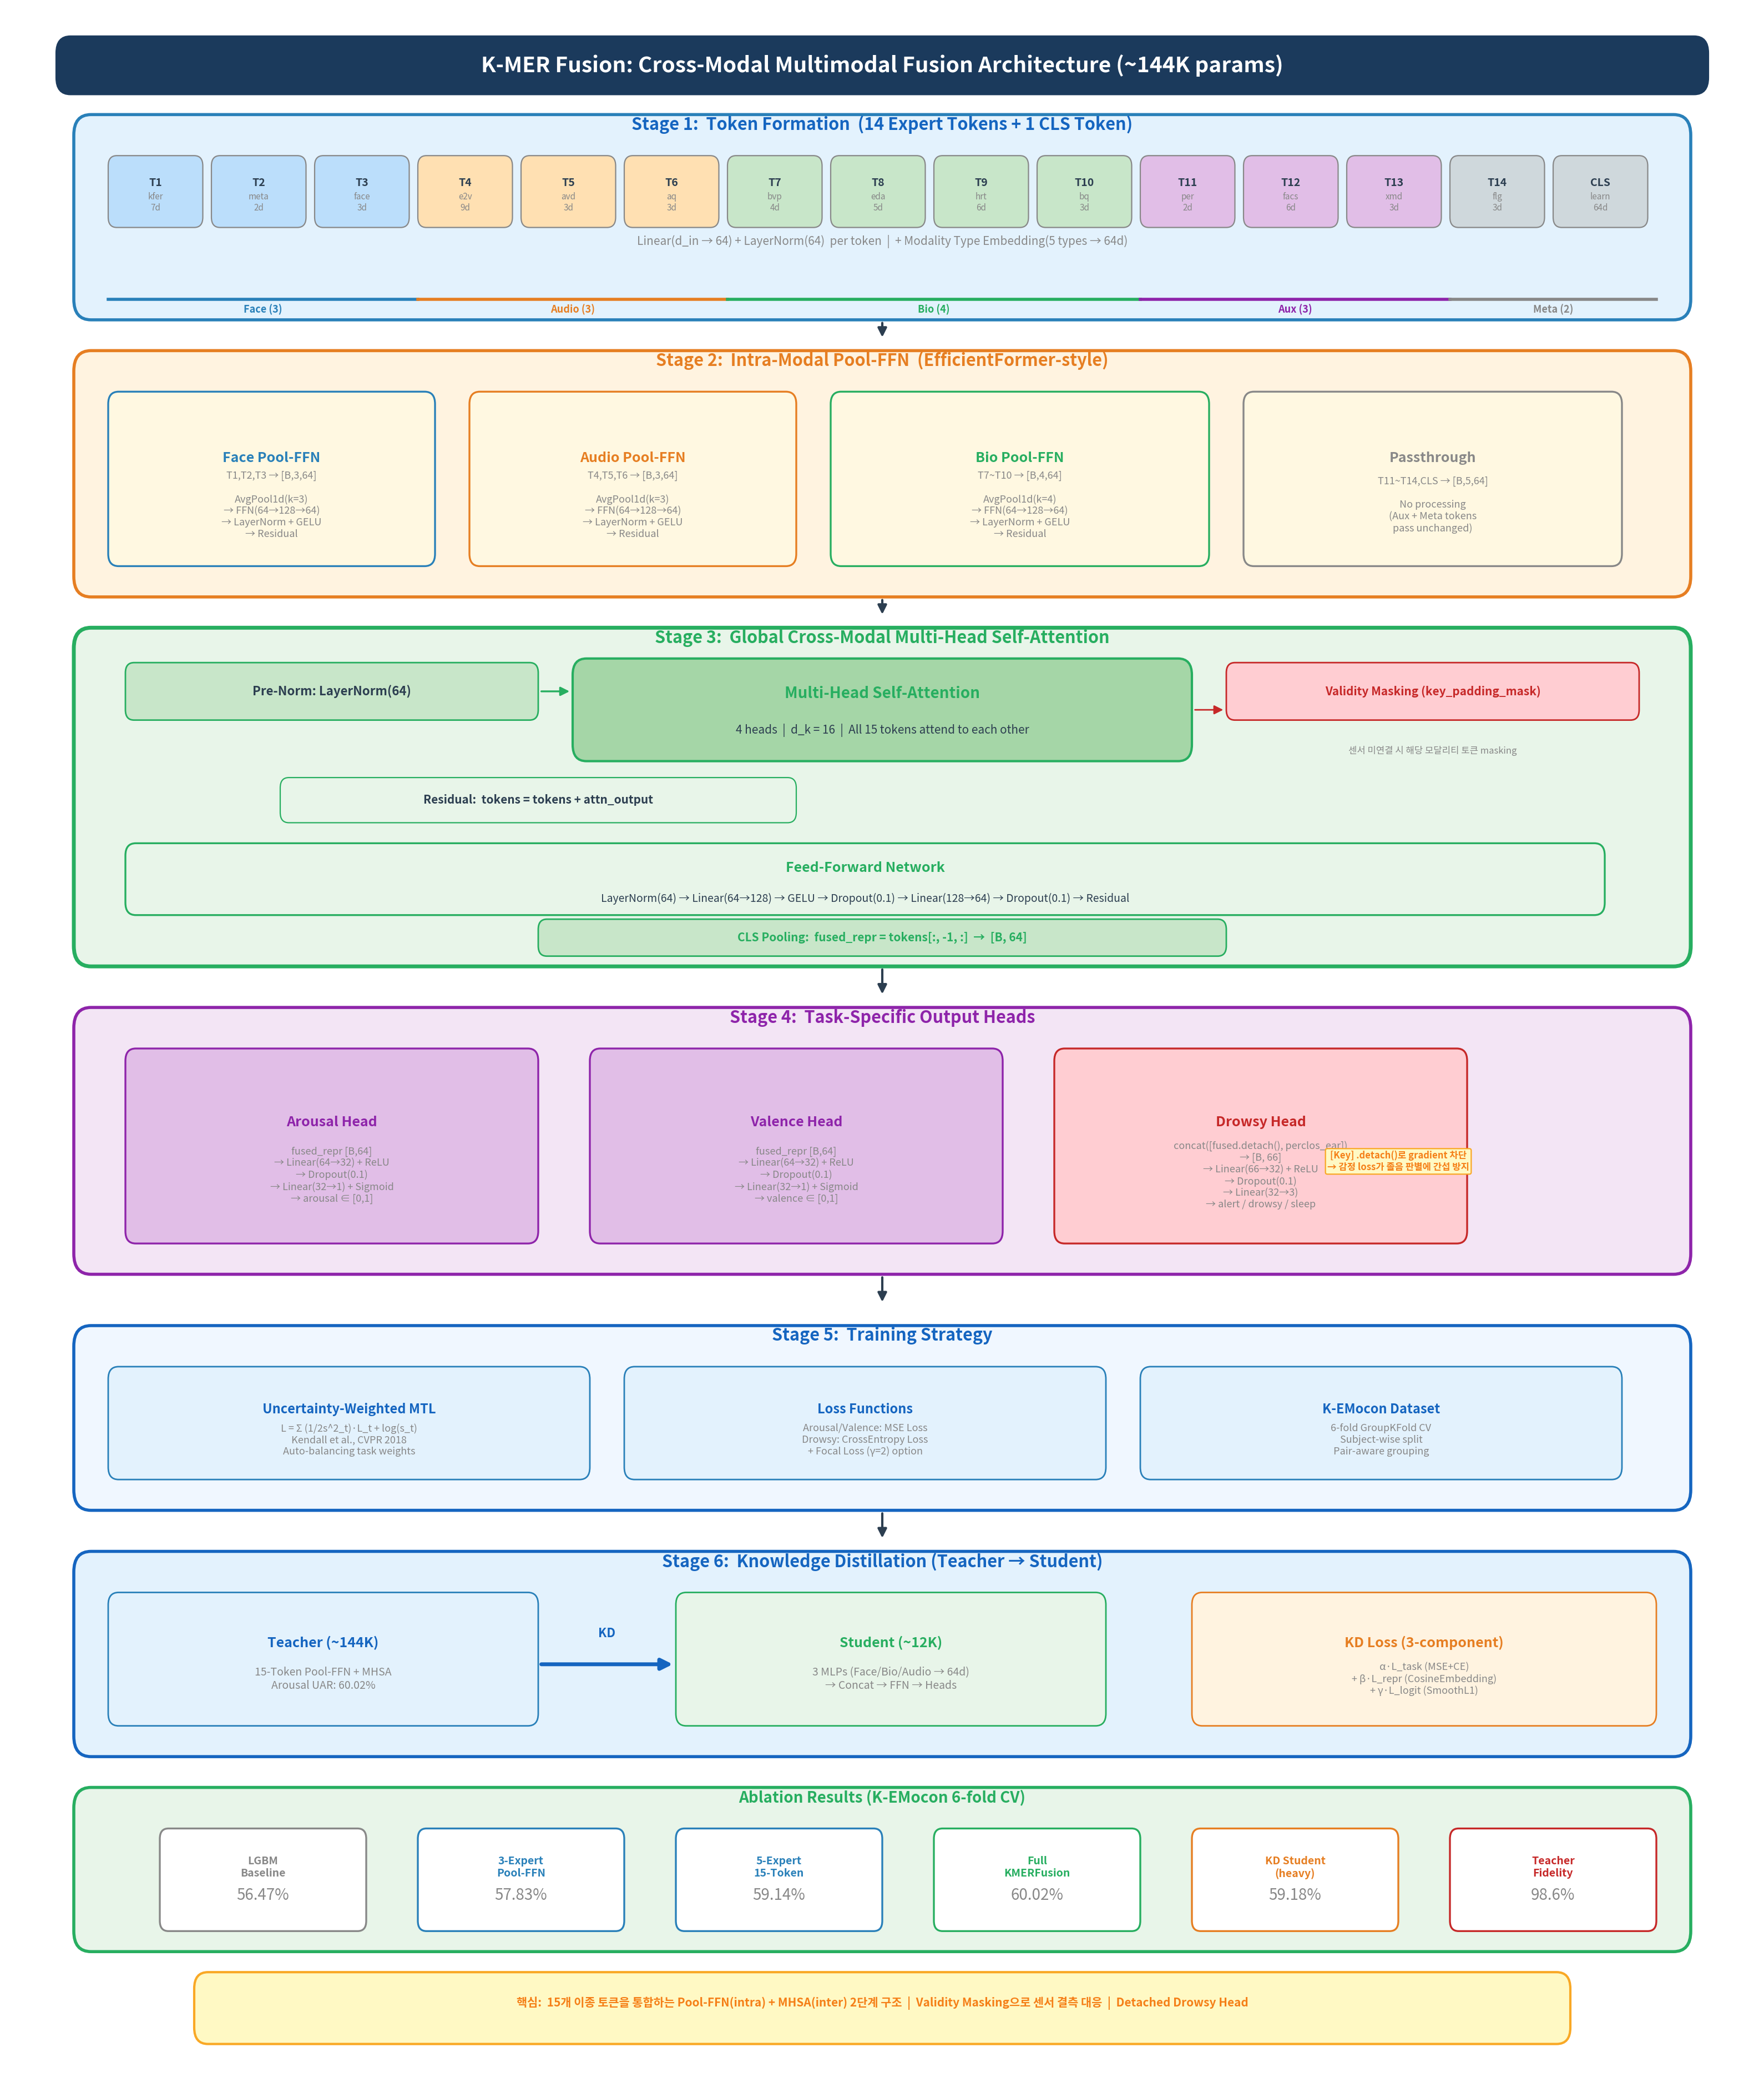
5. K-MER Fusion — Internal Architecture
15 Tokens x 64d -> Pool-FFN (Intra-modal) -> MHSA (Cross-modal) -> Output Heads
6/11

Slide 7
6. K-MER Fusion — Technical Details
Pool-FFN, MHSA, Validity Masking, Detached Drowsy Head
Pool-FFN (EfficientFormer-style)
Global MHSA (Cross-modal)
Key Technical Points
같은 모달리티 토큰끼리 정보 집약:
AvgPool1d(kernel=k, stride=1, pad=k//2)
-> 인접 토큰 평균으로 local 패턴 포착
Residual:
LayerNorm(64)
Linear(64 -> 128) + GELU
Linear(128 -> 64)
+ Skip connection
Face k=3, Audio k=3, Bio k=4
모든 15개 토큰 간 cross-modal attention:
Multi-Head Self-Attention:
4 heads, d_k = 64/4 = 16
Pre-Norm (LayerNorm before attention)
+ Standard Residual
FFN:
LayerNorm -> Linear(64->128)
-> GELU -> Dropout(0.1)
-> Linear(128->64) -> Residual
Validity Masking:
key_padding_mask로 MHSA에 적용
센서 미연결/품질미달 -> 해당 토큰 masking
-> 결측 데이터에도 robust한 추론
Detached Drowsy Head:
input = concat([fused.detach(), perclos])
.detach() -> gradient 차단
-> 감정 loss가 졸음 판별에 간섭 방지
-> Multi-task 학습 안정화
Output Heads (3 Tasks)
Training Strategy
Arousal Head: Linear(64->32) + ReLU + Dropout(0.1) + Linear(32->1) + Sigmoid
-> arousal in [0, 1]
Valence Head: Linear(64->32) + ReLU + Dropout(0.1) + Linear(32->1) + Sigmoid
-> valence in [0, 1]
Drowsy Head: Linear(66->32) + ReLU + Dropout(0.1) + Linear(32->3)
Input: [fused_repr(64d, detached) + perclos_ear(2d)] = 66d
-> 3-class logits: alert / drowsy / sleeping
Uncertainty-Weighted MTL (Kendall, CVPR 2018):
L = SUM (1/2*s_t^2) * L_t + log(s_t)
s_t: learnable log-variance per task
-> task weight 자동 학습
Dataset: K-EMocon
32명 참가자 다자간 대화
6-fold GroupKFold CV (subject-wise)
Pair-aware grouping (대화 파트너 분리)
Total params: ~144K (teacher) / ~12K (student)
7/11

Slide 8
7. Post-Processing Pipeline
Temporal Smoothing + Compound Emotion + Status Flags + Protocol Mapping
StableEmotionDetector (4-Strategy)
Compound Emotion (13 labels)
Status Flag Detector (4 Flags)
1) 7-frame Majority Vote:
최근 7프레임 투표 -> 최빈 감정
감정 그룹별 차등 threshold:
Sustained (neutral, happy, sad): 높은 기준
Transient (angry, anxious...): 낮은 기준
2) Confidence Threshold (0.5):
softmax prob < 0.5 -> 이전 감정 유지
3프레임 연속 미달 -> alert OFF
3) EMA Smoothing (alpha=0.3):
new = 0.3*raw + 0.7*prev
EMA 최대 감정 = vote 최대 감정 검증
4) Min-Hold Duration (0.5s):
감정 전환 후 0.5초 유지 보장
급격한 깜빡임 방지
효과: 79.7% -> 98.8% (운용 정확도)
K-FER 7-class x Arousal level -> 13 labels:
happy + high arousal -> excited
happy + low arousal -> calm_happy
angry + high arousal -> enraged
sad + high arousal -> distressed
neutral + any -> neutral
...
Russell Circumplex Model 기반
이산 감정 + 연속 각성도 결합
Flag 1 - Stress:
arousal > 0.6 AND 부정감정
(angry, anxious, sad, hurt)
정확도: 95.0%
Flag 2 - Low Attention:
PERCLOS in [0.2, 0.4)
눈 감은 비율 중간 -> 주의분산
정확도: 95.0%
Flag 3 - Drowsy:
PERCLOS >= 0.4 (NHTSA 기준)
졸음 경고
정확도: 96.0%
Flag 4 - Negative Emotion:
K-FER in {angry, anxious, sad, hurt}
이진 부정감정 판별
정확도: 99.8%
Protocol Mapping (7 -> 6 codes)
K-FER 7-class -> Gateway 6 codes:
Code 0: 공포 <- anxious (class 4)
Code 1: 놀람 <- surprised (class 6)
Code 2: 분노 <- angry (class 2)
Code 3: 슬픔/혐오 <- sad+hurt (class 3,5)
Code 4: 행복 <- happy (class 1)
Code 5: 중립 <- neutral (class 0)
sad+hurt 병합 근거: 혼동행렬 32.7% confusion
8/11

Slide 9
8. Gateway Packet Protocol
8-Byte USB Packet -> Vehicle Gateway
Byte 0
Byte 1
Byte 2
Byte 3
Byte 4
Byte 5
Byte 6
Byte 7
0xAA
0x01
0~255
0x02
Payload
Payload
CRC8
0xFE
SOF
TYPE
SEQ
LEN
EmoCode(4b)
+Flags(4b)
Intensity(6b)
+NegEmo(1b)
B1~B5
EOF
Byte 4: Emotion Code (4 bits) + Status Flags (4 bits)
Byte 5: Intensity (6 bits) + NegEmo (1 bit)
Upper 4 bits - Emotion Code:
Bit[7:4] = 0~5 (6 emotion codes)
0=Fear, 1=Surprise, 2=Anger
3=Sad/Disgust, 4=Happy, 5=Neutral
Lower 4 bits - Status Flags:
Bit[3] = Stress flag
Bit[2] = Low Attention flag
Bit[1] = Drowsy flag
Bit[0] = END marker (reserved)
Example: happy + drowsy
Emotion=4 (0100), Flags=0010 (drowsy)
-> Byte 4 = 0100_0010 = 0x42
Bits [7:5] - Emotion Intensity (3 bits):
K-FER softmax max prob -> 0~7 quantize
intensity = min(7, int(prob * 8))
Bits [4:2] - State Intensity (3 bits):
Arousal level -> 0~7 quantize
state_intensity = min(7, int(arousal * 8))
Bit [1] - Negative Emotion Flag:
K-FER in {angry, anxious, sad, hurt} -> 1
NegativeEmotionDetector class
Bit [0] - Reserved:
Future use
CRC8: XOR-shift over Byte 1~5
9/11

Slide 10
9. Knowledge Distillation & Results
Teacher (144K) -> Student (12K): 파라미터 12x 축소
Teacher Model (~144K)
Student Model (~12K)
KD Loss
15 Tokens x 64d
Pool-FFN (3 modalities)
Global MHSA (4 heads)
3 Output Heads
Arousal UAR: 60.02%
Face MLP: 12d -> 64d
Bio MLP: 18d -> 64d
Audio MLP: 15d -> 64d
Concat(192d) -> FFN -> Heads
Arousal UAR: 59.18%
L_KD = a*L_task + b*L_repr + c*L_logit
L_task: MSE + CrossEntropy
Student 자체 task loss
L_repr: CosineEmbeddingLoss
Teacher-Student repr 거리
L_logit: SmoothL1Loss
Teacher-Student output 매칭
KD
10 Recognition Items - Combined Accuracy: 98.0%
Emotion (6): 공포 97.9% | 놀람 99.4% | 분노 100% | 슬픔/혐오 95.7% | 행복 100% | 중립 100%
Status (4): 스트레스 95.0% | 주의분산 95.0% | 졸음 96.0% | 부정감정 99.8%
Macro Average: 98.0% (6 Emotion avg: 98.8% + 4 Status avg: 96.4%)
Ablation: LGBM 56.47% -> 3-Expert 57.83% -> 5-Expert 59.14% -> Full KMERFusion 60.02%
KD Student: 59.18% Arousal UAR (Teacher fidelity 98.6%)
10/11

Slide 11
Technical Summary
Single-Forward
AU Extraction
Gated Residual
Cross-Attention
15-Token
Pool-FFN + MHSA
Detached
Drowsy Head
KD Pipeline
144K -> 12K
Feature map level
grid_sample
8x compute savings
Per-dim learnable gate
init=0.0
Global-Local balance
Intra-modal pooling
Cross-modal attention
Validity masking
Gradient isolation
Multi-task stability
.detach() design
3-component loss
12x compression
98.6% fidelity
System Performance
K-FER
K-MER Fusion
KD Student
Combined
79.7% -> 98.8%
(temporal)
60.02%
Arousal UAR
59.18%
12K params
98.0%
10 items
Sensor -> Expert (Frozen) -> K-MER Fusion (144K) -> Post-Processing -> 8-Byte Packet -> Vehicle
경량 모델 (144K) + 높은 정확도 (98.0%) + 실시간 Edge 배포 + 차량 프로토콜 직접 연동
11/11

