Slide 1
The State of AI in Winter 2026
63.3% of the batch analyzed under strict anti-hallucination guards. 105 companies in the high-confidence cohort.
yc-ai-pulse · generated 2026-05-03

Slide 2
TL;DR
• 60 of 105 high-confidence companies build agents.
• 6 companies were classified as no-ai despite being in the YC AI batch.
• OSS posture: 64 closed, 28 unknown, 9 api-only.
Source: github.com/RyanAlberts/yc-ai-pulse

Slide 3
Three views of this batch
What this data implies for capital allocation depends on whose frame you adopt. The memo does not pick a winner.
Marc Andreessen
Ray Dalio
Daron Acemoglu
a16z
Bridgewater
MIT, 2024 Nobel laureate in Economics
AI is the dominant industrial transition of our generation; concentrate capital in the winners; regulation is the existential threat.
AI is real but is one factor among many; debt cycles, monetary regimes, and geopolitical realignment dominate; diversify.
AI's productivity claims are likely overstated; total-factor productivity gains over the next decade are estimated at under 0.7%, with the largest distributional risk being labor-displacement-without-reabsorption.
The Techno-Optimist Manifesto (2023), a16z.com
Principles for Dealing with the Changing World Order, ongoing essays
NBER working paper 32487 (2024) and related work
Source: ADR 0003 in github.com/RyanAlberts/yc-ai-pulse

Slide 4
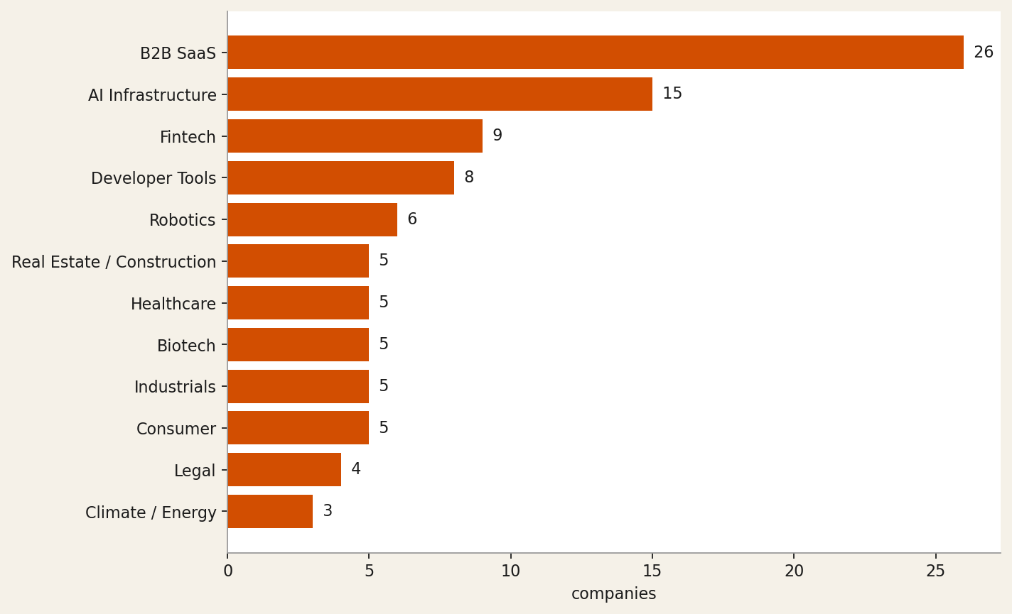
Industry distribution
Top: 26 B2B SaaS, 15 AI Infrastructure, 9 Fintech. Cohort: 105 high+medium-confidence companies.
Source: github.com/RyanAlberts/yc-ai-pulse

Slide 5
"AI platform for protein characterization and quality assessment, unblocking the biopharma development bottleneck created by AI-accelerated …"
— 10x-science
Source: https://www.ycombinator.com/companies/10x-science

Slide 6
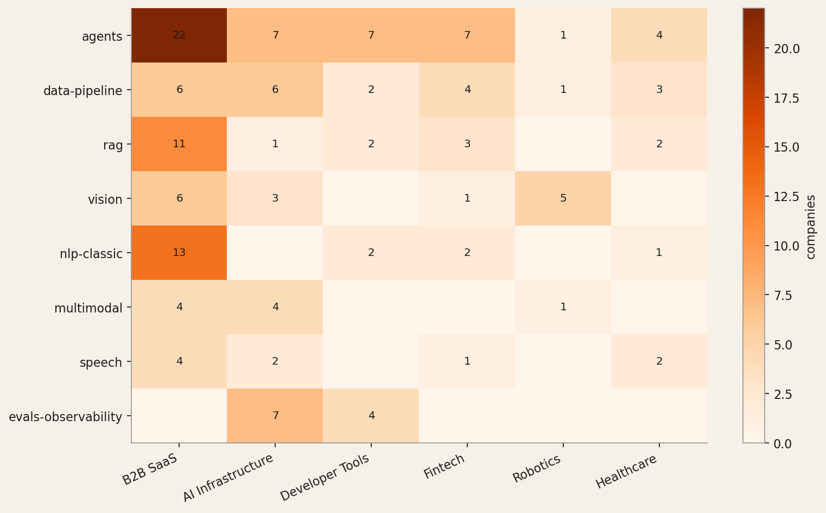
AI capability x industry heatmap
Top capability: agents (60 of 105). Cell label = number of companies pairing that capability with that industry.
Source: github.com/RyanAlberts/yc-ai-pulse

Slide 7
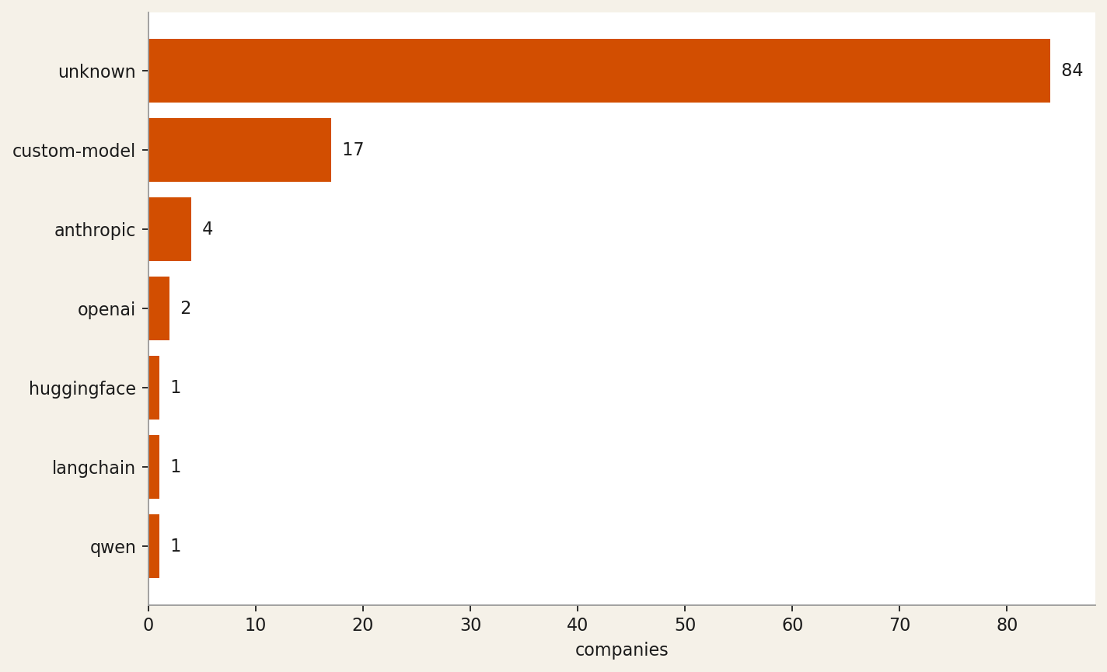
Tech stack signals
Many companies returned tech_stack=unknown — the LLM can only cite what's visible on the website. The named entries are the model providers and frameworks the model could verify from public surfaces.
Source: github.com/RyanAlberts/yc-ai-pulse

Slide 8
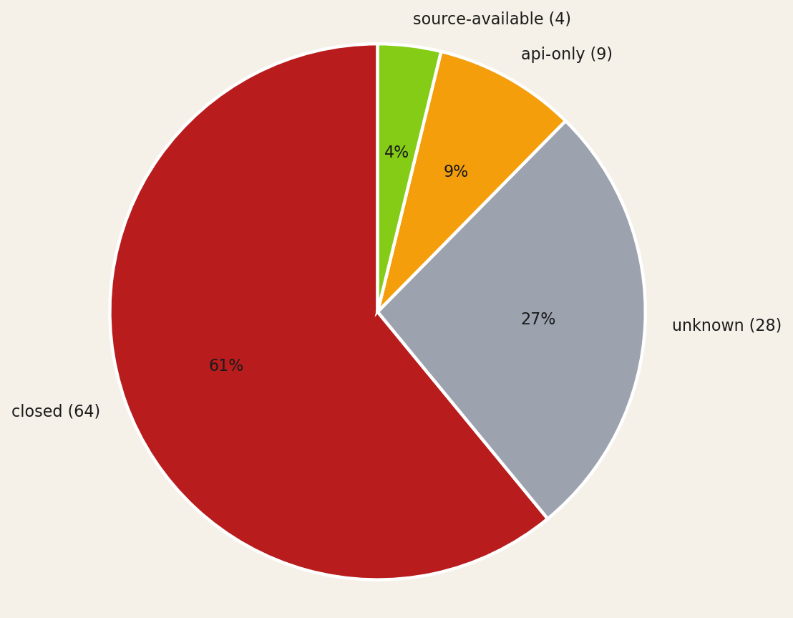
Open-source posture
Closed dominates — typical for B2B SaaS. The unknown slice is the cohort the model could not classify from public surfaces alone.
Source: github.com/RyanAlberts/yc-ai-pulse

Slide 9
"AI agents that automate primary care workflows—prior auths, referrals, risk adjustment—natively inside any EHR for value-based care practic…"
— beacon-health
Source: https://www.ycombinator.com/companies/beacon-health

Slide 10
runanywhere
On-device AI inference runtime + SDK that cuts cloud costs to zero — custom kernels, fleet control plane, enterprise observability.
Industry: AI Infrastructure
AI capability: inference-infra, speech, voice, vision, multimodal
Tech stack: qwen, custom-model
OSS posture: source-available
"RunAnywhere builds 'custom kernels, operator fusion, unified memory optimization' inference engines (MetalRT) and a cross-platform SDK — squarely AI Infrastructure. The 'Open by default' stance, 10.4K GitHub stars, and 'Open Source' YC tag confirm meaningful open posture; multimodal coverage (LLM decode, speech-to-text, speech-to-speech, vision language models) drives the ai_capability set."
Source: https://www.runanywhere.ai/

Slide 11
strand-ai
Foundation models that predict missing biological modalities—proteomics, transcriptomics—from patient data you already have
Industry: Biotech
AI capability: bio-ai, multimodal, vision, data-pipeline, training-infra
Tech stack: custom-model
OSS posture: api-only
"The site explicitly states 'Predict missing biological modalities from the data you already have' and describes custom foundation models (POSTMAN for spatial proteomics, VariantFormer for gene expression imputation); access is gated via 'Request Access' and 'Request Early Access' with no open-source repository mentioned, confirming api-only posture."
Source: https://strandai.com/

Slide 12
human-archive
Multimodal sensorimotor dataset provider fueling embodied AI and humanoid robotics foundation models
Industry: Robotics
AI capability: multimodal, vision, robotics, data-pipeline, training-infra
Tech stack: custom-model
OSS posture: unknown
"The description explicitly states they collect and label 'aligned multimodal data' for 'robotics foundation models and general-purpose robotics companies,' and the website confirms they are 'Building the largest sensorimotor human dataset to ever exist' with modalities including tactile, motion, vision, depth, and wrist POV."
Source: https://www.ycombinator.com/companies/human-archive

Slide 13
axionorbital-space
SAR-to-optical foundation model enabling cloud-proof, 24/7 Earth observation for defense, commodities, and disaster response
Industry: Industrials
AI capability: vision, multimodal, training-infra, data-pipeline
Tech stack: custom-model
OSS posture: closed
"The description explicitly states a 'proprietary architecture uses deterministic one-step diffusion to transform complex radar signals into clear, photorealistic images,' confirming a custom vision/multimodal AI model for satellite data processing. Primary industry is Industrials (space/satellite), with Government / Defense and AI Infrastructure as secondary given the stated end markets ('defense…"
Source: https://www.ycombinator.com/companies/axionorbital-space

Slide 14
pocket
Wearable AI device + app that transcribes conversations in real time and extracts notes, action items, and searchable memory
Industry: Consumer
AI capability: speech, voice, nlp-classic, rag
Tech stack: unknown
OSS posture: closed
"The description states Pocket is 'a tiny AI device that lives on your phone and turns everything you say and hear into clear notes, action items, and search' built on 'custom hardware, AI, and software' — confirming a Consumer + Hardware classification with speech transcription, voice capture, NLP summarization, and semantic search as the core AI capabilities. No AI provider, open-source reposito…"
Source: https://www.ycombinator.com/companies/pocket

Slide 15
corelayer
AI on-call agent that monitors production data and infrastructure to auto-debug issues in minutes for regulated industries
Industry: Developer Tools
AI capability: agents, rag, evals-observability, data-pipeline
Tech stack: unknown
OSS posture: closed
"The description explicitly states 'AI agents that do on-call support' and 'use AI agents to debug and suggest fixes in minutes,' confirming an agents + RAG posture (production data as context). The product targets engineering teams in regulated industries, placing it squarely in Developer Tools; 'flexible model provider and inference options' on the demo page indicates no committed upstream LLM v…"
Source: https://www.ycombinator.com/companies/corelayer

Slide 16
Methodology
• Source: yc-oss/api (last refresh 2026-02-08 01:49:11.368000+00:00).
• Coverage: 132 of 196 from yc-oss/api.
• Tier A: 120 · Tier B: 4 · Tier C (excluded): 8
• LLM cohort: 105 high + 0 medium (19 low excluded). Sonnet 4.6 via Agent SDK.
• Anti-hallucination Layer 1: pydantic schema, source-URL grounding, two-pass cross-check, sentinel on failure.
• Anti-hallucination Layer 2 (this deck): forbidden-phrase scan + numerical-drift check before write.
• Depth=1 website crawl: polite (robots-aware, max 5 pages, 30 KB cap, PII stripped before the LLM).
Source: github.com/RyanAlberts/yc-ai-pulse

Slide 17
Reproduce this deck
pipx install yc-ai-pulse
ycai run-coverage --batch winter-2026 --enrich
ycai report winter-2026/ # produces deck.pptx and report.docx
Source code: github.com/RyanAlberts/yc-ai-pulse

