Slide 1
The State of AI in Winter 2026
63.3% of the batch analyzed under strict anti-hallucination guards. 113 companies in the high-confidence cohort.
yc-ai-pulse · generated 2026-05-02

Slide 2
TL;DR
• 69 of 113 high-confidence companies build agents.
• 7 companies were classified as no-ai despite being in the YC AI batch.
• OSS posture: 75 closed, 24 unknown, 8 api-only.
Source: github.com/RyanAlberts/yc-ai-pulse

Slide 3
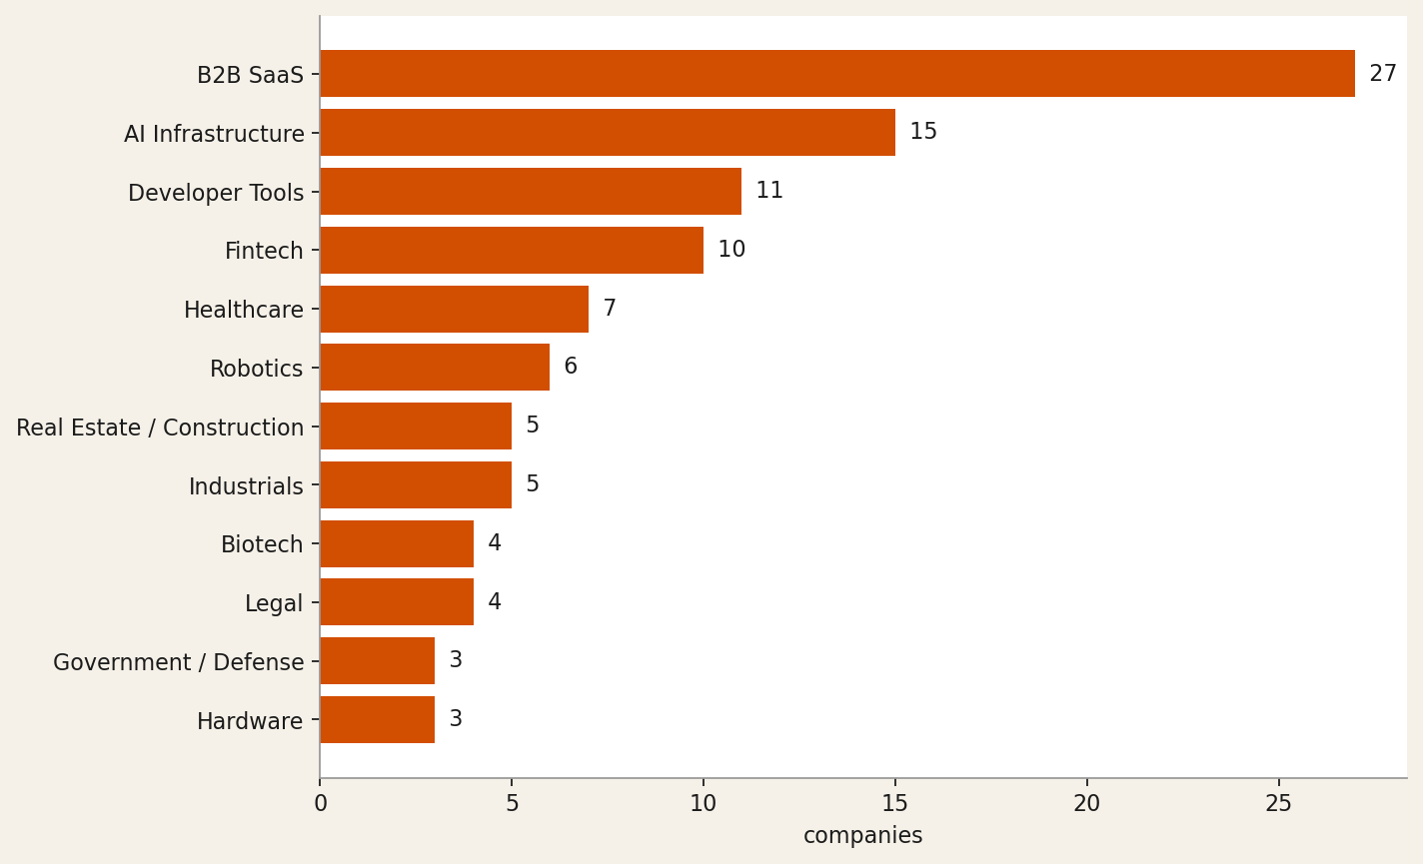
Industry distribution
Top: 27 B2B SaaS, 15 AI Infrastructure, 11 Developer Tools. Cohort: 113 high+medium-confidence companies.
Source: github.com/RyanAlberts/yc-ai-pulse

Slide 4
"Foundation models that translate SAR radar into photorealistic optical imagery for 24/7 all-weather Earth observation across defense, commo…"
— axionorbital-space
Source: https://www.ycombinator.com/companies/axionorbital-space

Slide 5
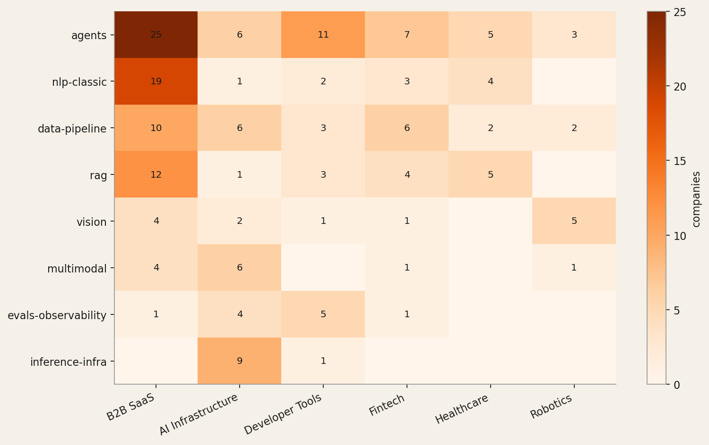
AI capability x industry heatmap
Top capability: agents (69 of 113). Cell label = number of companies pairing that capability with that industry.
Source: github.com/RyanAlberts/yc-ai-pulse

Slide 6
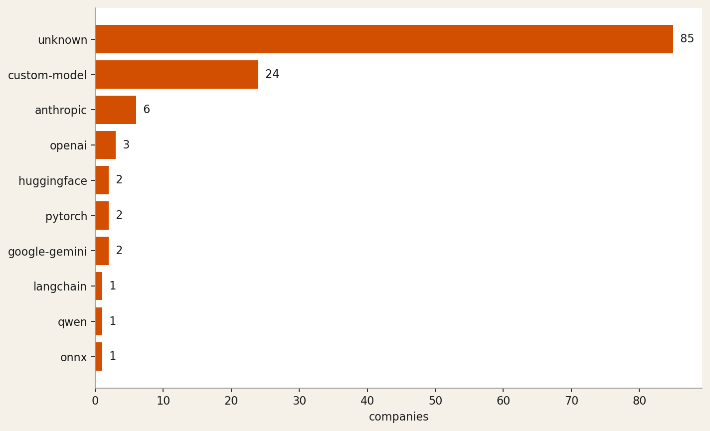
Tech stack signals
Many companies returned tech_stack=unknown — the LLM can only cite what's visible on the website. The named entries are the model providers and frameworks the model could verify from public surfaces.
Source: github.com/RyanAlberts/yc-ai-pulse

Slide 7
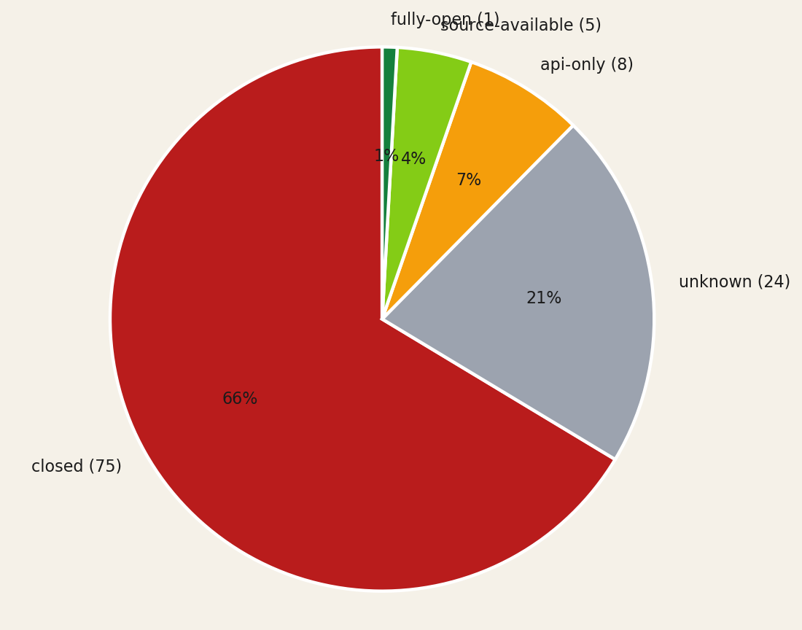
Open-source posture
Closed dominates — typical for B2B SaaS. The unknown slice is the cohort the model could not classify from public surfaces alone.
Source: github.com/RyanAlberts/yc-ai-pulse

Slide 8
"AI agents that automate primary care workflows—prior auths, referrals, risk adjustment—directly inside any EHR for value-based care practic…"
— beacon-health
Source: https://www.ycombinator.com/companies/beacon-health

Slide 9
runanywhere
On-device AI inference SDK + control plane to deploy, manage, and monitor LLMs across edge devices at scale.
Industry: AI Infrastructure
AI capability: inference-infra, speech, voice, vision, multimodal
Tech stack: qwen, custom-model, onnx
OSS posture: source-available
"RunAnywhere builds custom inference runtimes (MetalRT) and cross-platform SDKs for on-device AI execution with LLM, speech, vision, and speech-to-speech capabilities; the about page states 'open by default' with published benchmarks and methodology, and the GitHub reference (10.4K stars) confirms source-available posture, while the YC tags 'Infrastructure' and 'Developer Tools' plus the descripti…"
Source: https://www.ycombinator.com/companies/runanywhere

Slide 10
strand-ai
AI platform that predicts missing biological modalities (proteomics, transcriptomics) from existing patient data to accelerate drug discove…
Industry: Biotech
AI capability: multimodal, vision, bio-ai, data-pipeline
Tech stack: custom-model, pytorch
OSS posture: api-only
"Strand AI builds proprietary foundation models (e.g., POSTMAN, VariantFormer) that predict missing biological modalities from existing patient data — 'One H&E slide becomes 180+ spatial protein maps' — making it a biotech/bio-AI play with a multimodal vision AI core; access is via request/early-access only with no open-source repository mentioned, indicating api-only posture."
Source: https://strandai.com/

Slide 11
shofo
Managed pipeline that continuously indexes, labels, and enriches social-media video at scale for AI pre-training and fine-tuning datasets
Industry: AI Infrastructure
AI capability: data-pipeline, training-infra, vision, multimodal
Tech stack: huggingface
OSS posture: api-only
"Description explicitly states Shofo 'builds large-scale social media training datasets by collecting, labeling, and enriching public content for pre-training and fine-tuning AI models,' placing it squarely in AI Infrastructure with data-pipeline and training-infra capabilities. The homepage prominently features 'Hugging Face Get Data' for dataset distribution, and the commercial framing ('compani…"
Source: https://www.ycombinator.com/companies/shofo

Slide 12
chamber
Autonomous AIOps platform that optimizes GPU cluster utilization so ML teams run ~50% more workloads without manual infra management.
Industry: AI Infrastructure
AI capability: agents, evals-observability, inference-infra, training-infra
Tech stack: unknown
OSS posture: closed
"Chamber's description explicitly states it 'orchestrates, governs, and optimizes your AI infrastructure' using 'agentic AI' that 'continuously monitoring GPU clusters, forecasting demand, detecting unhealthy nodes, and reallocating resources in real time' — clearly AI Infrastructure with agent-based automation. No open-source repository or model weights are referenced anywhere in the crawled page…"
Source: https://www.ycombinator.com/companies/chamber

Slide 13
patientdeskai
AI voice receptionist for dental & healthcare practices — automates scheduling, billing, insurance, and patient comms across any PMS
Industry: Healthcare
AI capability: voice, agents, speech, nlp-classic
Tech stack: unknown
OSS posture: closed
"The YC description explicitly calls it a 'universal AI front desk' using an 'AI voice agent for patient calls' that automates scheduling, insurance, and reminders — mapping directly to voice, agents, speech, and NLP capabilities. The privacy policy confirms it is 'an AI-powered receptionist and patient communication platform designed exclusively for dental and healthcare practices' handling 'AI-h…"
Source: https://www.ycombinator.com/companies/patientdeskai

Slide 14
mousecat
AI-powered fraud investigation platform that auto-generates features, rules, and production decisions for enterprise risk teams.
Industry: Fintech
AI capability: agents, rag, data-pipeline, evals-observability
Tech stack: unknown
OSS posture: closed
"The website explicitly positions MouseCat as 'AI-Powered Fraud Investigation' for Risk Ops and ML/DS teams, closing the loop from investigation to 'production rules, models and decisions'; YC tags confirm Fintech and Fraud Detection, with AI agents and data-pipeline capabilities evidenced by auto-generating features from data warehouses (Databricks/Snowflake) and backtesting rules end-to-end."
Source: https://www.mousecat.ai/

Slide 15
Methodology
• Source: yc-oss/api (last refresh 2026-02-08 01:49:11.368000+00:00).
• Coverage: 132 of 196 from yc-oss/api.
• Tier A: 120 · Tier B: 4 · Tier C (excluded): 8
• LLM cohort: 113 high + 0 medium (11 low excluded). Sonnet 4.6 via Agent SDK.
• Anti-hallucination Layer 1: pydantic schema, source-URL grounding, two-pass cross-check, sentinel on failure.
• Anti-hallucination Layer 2 (this deck): forbidden-phrase scan + numerical-drift check before write.
• Depth=1 website crawl: polite (robots-aware, max 5 pages, 30 KB cap, PII stripped before the LLM).
Source: github.com/RyanAlberts/yc-ai-pulse

Slide 16
Reproduce this deck
pipx install yc-ai-pulse
ycai run-coverage --batch winter-2026 --enrich
ycai report winter-2026/ # produces deck.pptx and report.docx
Source code: github.com/RyanAlberts/yc-ai-pulse

