Slide 1

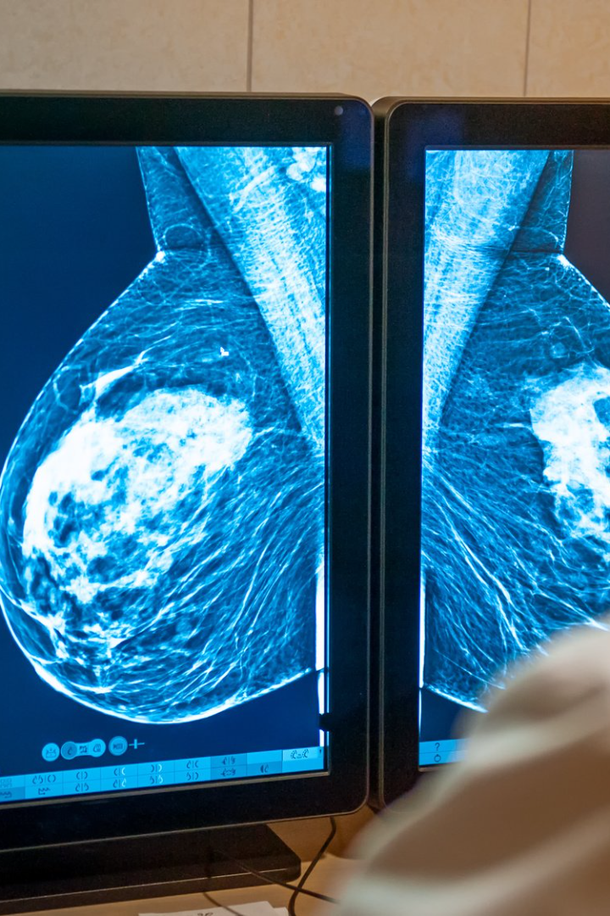
Breast Cancer Diagnosis Using Machine Learning And Deep Learning
Elton Pereira 4NM20CS068
Pranav Shetty 4NM20CS133
Ryan D’Souza 4NM20CS148
Shashank KT 4NM20CS164

Slide 2

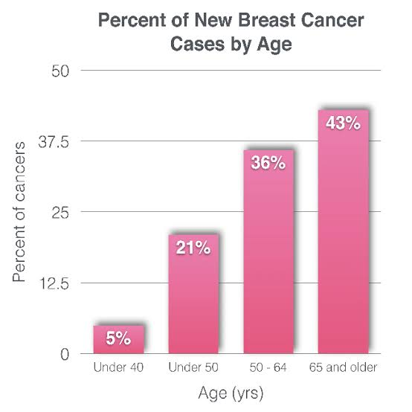
Introduction
Breast cancer is a prevalent malignancy affecting millions of women globally, with early detection being crucial for improved survival rates. Machine learning algorithms offer promising tools for early diagnosis by analyzing medical imaging and patient data. In 2020, an estimated 2.3 million new cases of breast cancer were diagnosed worldwide, making it the most common cancer among women. Timely screening and treatment significantly enhance survival rates, with the 5-year survival rate for localized breast cancer being approximately 99% when detected early. Thus, there is an urgent need for accurate diagnostic tools, and machine learning provides a potential solution.

Slide 3

Problem Statement
To harness machine learning techniques for breast cancer diagnosis, striving to enhance accuracy and early detection while ensuring interpretability, ultimately improving patient outcomes and healthcare efficiency.

Slide 4
Objectives
To implement an automatic breast cancer detection based on statistical dataset, and a pre-trained model.
To develop an accurate, efficient, and reliable system that enhances the early detection and diagnosis of breast cancer.
To improve patient outcomes and assist healthcare professionals in making more informed and timely decisions.

Slide 5
Methodology
Data Collection The first step is to gather a dataset of breast cancer. This dataset should include both positive cases and negative cases to train and evaluate the model effectively. Data should be collected in compliance with privacy and ethical guidelines.
Data Preprocessing often needs preprocessing to enhance their quality and make them suitable for analysis. Common preprocessing steps include resizing, normalization, noise reduction, and contrast enhancement.
Pre-Trained Model Selection Select a pre-trained deep learning models as the foundation for your breast cancer detection system. These models have learned valuable features that can be useful for breast cancer detection.
Data Splitting Split the dataset into training, validation, and test sets to train, tune, and evaluate the machine learning model, respectively. Use stratified sampling to maintain class balance.
Model Selection Choose an appropriate machine learning model for the task. Common choices include deep learning model(ANN) and various classifiers (e.g. KNN, SVM, Random Forests) for data.

Slide 6
Methodology
VI. Model Training Train the selected models on the training dataset. Employ data augmentation techniques to enhance model generalization.
VII. Model Evaluation Assess the model's performance on the test dataset using metrics such as accuracy, precision, recall and f1. Evaluate both the model's overall performance and its performance on different subsets (e.g., sensitivity for early detection).

Slide 7
Literature Review
SL.NO | Author | Methodology | Inference
1. | Zeyad Q. Habeeb1, Branislav Vuksanovic2, and Imad Q. Al-Zaydi3 | Datasets include CBIS-DDSM, COCO, and INbreast for CNN framework training/testing and architecture presentation. | Challenges defining mammogram features hinder accuracy. Deep learning aids crucial feature identification, hampered by limited datasets. MRI-CT fusion offers promise. Pre-trained CNNs, notably InceptionV3, excel in breast cancer detection.
2. | V. Durga Prasad Jasti, Abu Sarwar Zamani, K. Arumugam, Mohd Naved, Harikumar Pallathadka | Preprocessing with geometric mean, AlexNet for extraction, relief algorithm for selection, LS-SVM for classification. | Various methods enhance breast cancer detection: data mining aids statistical analysis from cancer logs, promising for future research. Deep learning, ensembles, and CNNs ensure precise diagnosis and risk prediction advancement.
3. | Prannoy Giri and K. Saravanakumar | Pre-processing, segmentation, extraction lead to edge detection, texture analysis, NN classification | Detecting macrocalcification in dense breast tissue is challenging due to white pixel similarity. Machine learning aids cancer diagnosis, enhancing traditional methods, especially in pattern recognition.
4. | Shubhangi A. Joshi, Anupkumar M. Bongale Dr, Arunkumar M. Bongale Dr | Bibliometric analysis: spotlight on ML for breast cancer detection, automated diagnostics aiding pathologists. | The study emphasizes ML, particularly deep learning, automating with BreaKHis. Techniques like transfer learning, CNNs analyzed. Bibliometrics highlight global trends, stressing automated breast cancer diagnosis' importance.
5. | Sushovan Chaudhury, Alla Naveen Krishna, Suneet Gupta, K. Sakthidasan Sankaran | Method uses image processing, ML for breast cancer: mammograms, CLAHE enhancement, classifier. | Research explores mammography techniques: enhancement (adaptive histogram equalization, difference pics, region growth), segmentation, aiding lesion detection. SVM, perceptron, Bayesian classifiers ensure accurate breast cancer diagnosis.

Slide 8
Literature Review Cont.
SL.NO | Author | Methodology | Inference
6. | V Harvind Viswanath, Lorena Guachi-Guachi and Saravana Prakash Thirumuruganandham | Study classifies mammograms: preprocessing, reduction, selection, employing SVM, K-NN, RF classifiers for diagnosis. | An SVM, K-NN, RF-based automated mammogram classifier; RF excels, stressing pre-processing importance. Future goal: fully autonomous system aiding radiologists in interpretation.
7. | Neela A G, S Gayathri, Jayashree K | Biomedical ML focuses on supervised, unsupervised learning: neural networks, regression, clustering. | Breast cancer detection explored via data mining, image processing, ML. Algo comparison for benign/malignant classification, emphasizing error estimation, model selection for early prevention.
8. | Sri Hari Nallamala, Pragnyaban Mishra, Suvarna Vani Koneru | Logistic Regression predicts with equations, SVM separates classes, KNN versatile, evaluated on interpretability. | An ensemble voting ML approach achieves 98.50% precision in breast cancer analysis, using only 16 features.
9. | Monika Tiwari, Rashi Bharuka, Praditi Shah, Reena Lokare | ML, DL methods diagnose breast cancer, applying Logistic Regression, KNN, SVM, CNN, ANN for accuracy. | Study explores breast cancer prediction: ML (SVM, Random Forest), DL (CNN, ANN) on Wisconsin dataset. SVM, RF reach 96.5%, CNN, ANN surpass with 97.3%, 99.3%, emphasizing DL's superior efficacy.
10. | Pradeeba.R, Mrs.C.Clement Sherlin | Efficient cancer detection via FCM segmentation in mammograms proposed. | Study assesses ML in breast cancer detection from digitized fine needle aspirate images. Deep learning promising but hindered by limited data, conversion challenges for CNN. Recommendations: future enhancements with expanded data.

Slide 9
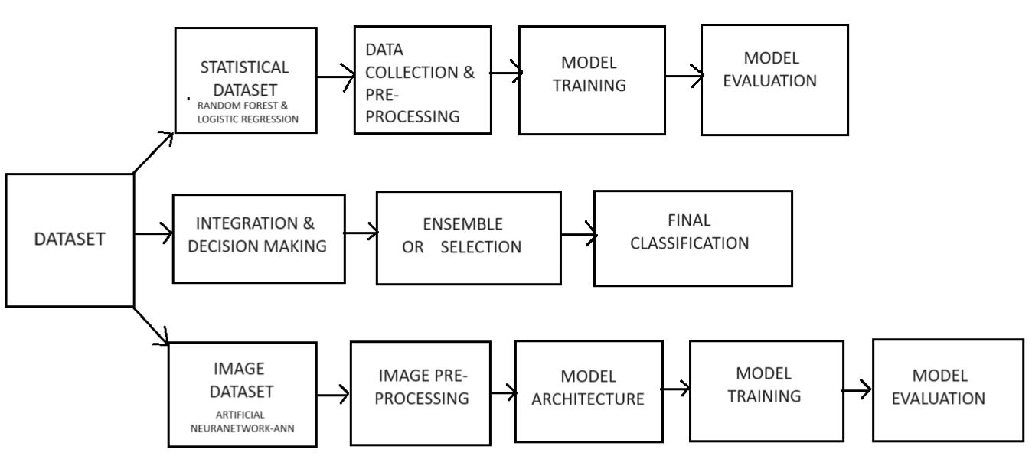
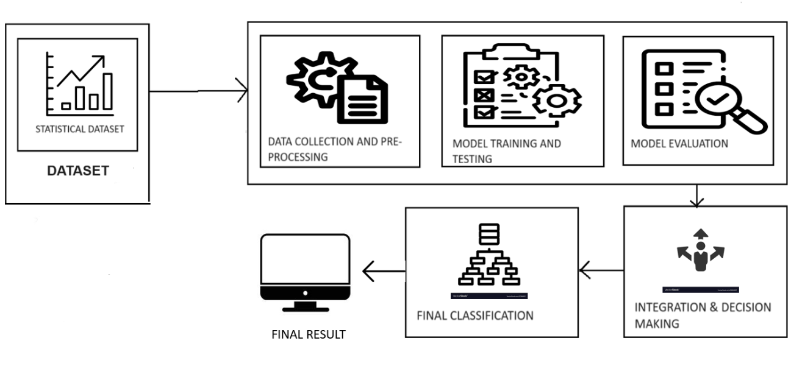
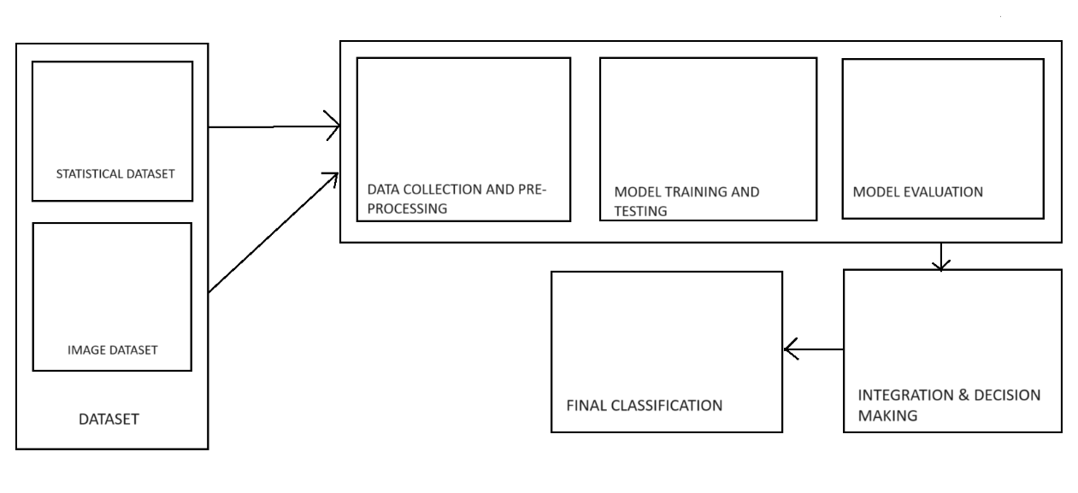









Architecture Diagram
FINAL RESULT

Slide 10
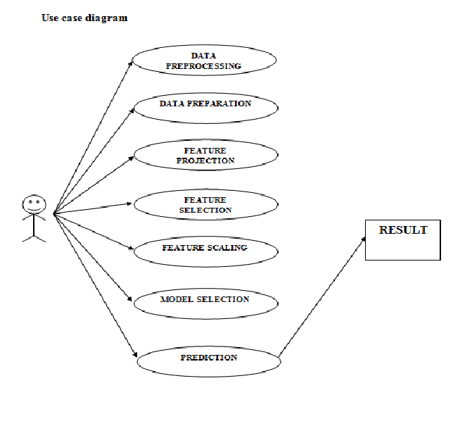
Use Case Diagram
USER

Slide 11
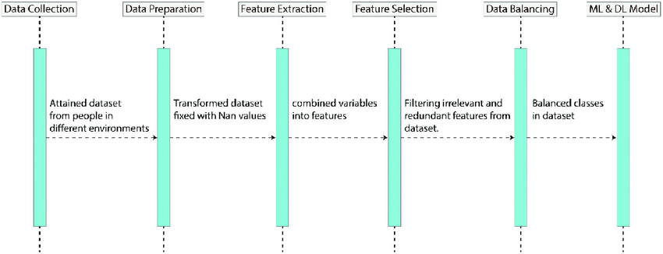
Sequence Diagram

Slide 12
Implementation
DATASET
Source: Kaggle
ATTRIBUTES: Age, T-Stage, N-Stage, 6th Stage, Differentiate, Grade, A-Stage, Tumor Size, Estrogen Status, Progesterone Status,
Regional Node Examined, Regional Node Positive, Survival Months, Status
1. Data Loading and Preprocessing:
Import necessary libraries.
Check and clean column names.
Handle missing values.
Analyze and visualize data distributions, correlations, and relationships among variables.
2. Data Splitting and Feature Scaling:
Split the data into training and testing sets.
Scale numerical features to a uniform range (0 to 1).
3. Model Building and Evaluation:
Use three machine learning algorithms: Support Vector Machine (SVM), Random Forest, and k-Nearest Neighbors (KNN).
Use stratified k-fold cross-validation to evaluate the models. Visualize and compare model performance using various
metrics like accuracy, precision, recall, and F1-score.

Slide 13
Implementation
4. Simple Neural Network Implementation:
Define a neural network class with forward and backward propagation methods.
Train the neural network on the breast cancer dataset.
Evaluate the neural network's performance using accuracy and cost.
5. Model Comparison:
Compare the test accuracies of all models to determine the best-performing model.

Slide 14
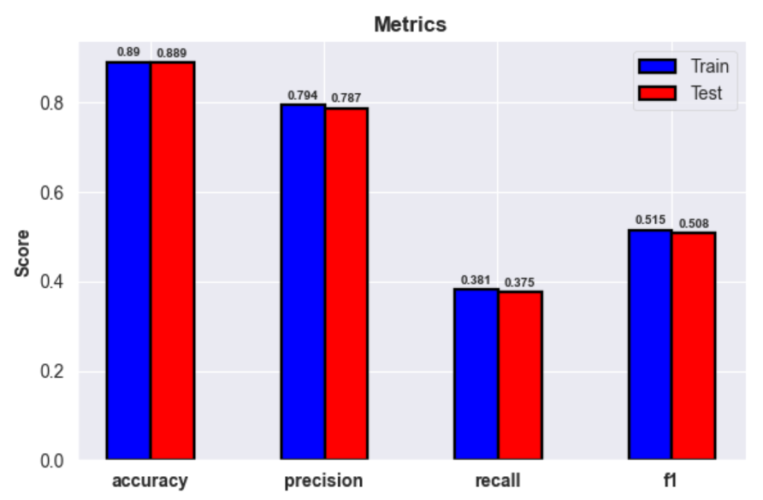

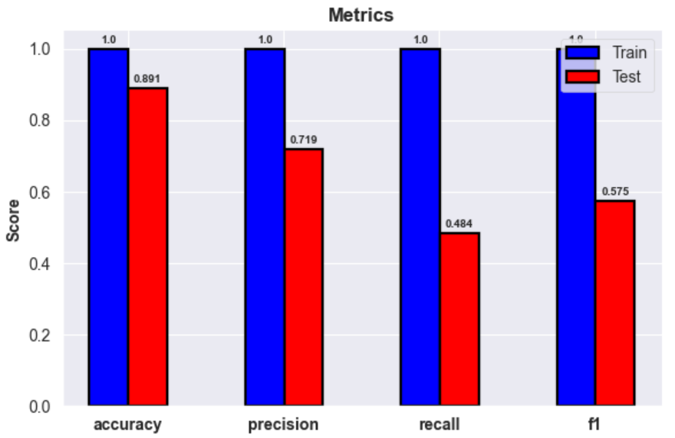
Results
SVM
In the domain of breast cancer diagnosis using machine learning techniques, all three models (SVM, kNN, and Random Forest) demonstrated commendable performance. And, ANN has test accuracy of 86.3%.
Support Vector Machine (SVM)
Test Accuracy: 88.9%
Performance Analysis: SVM demonstrated a robust performance with an accuracy of 88.9%. SVM is known for its ability to handle high-dimensional data effectively by finding the optimal hyperplane that best separates the classes in the feature space.
k-Nearest Neighbors (kNN)
Test Accuracy: 88.8%
Performance Analysis: kNN performed closely to SVM with a test accuracy of 88.8%. kNN is a non-parametric, lazy learning algorithm that classifies a data point based on how its neighbors are classified.
Random Forest
Test Accuracy: 89%
Performance Analysis: Random Forest emerged as the top-performing model with an accuracy of 89%. Random Forest is an ensemble learning method that combines multiple decision trees to make predictions, which often leads to improved accuracy and robustness.
KNN
RF

Slide 15

Software and Hardware Requirements
1. Hardware Requirements:
Processor: Ryzen 5 4800H
GPU: GTX 1650ti 4GB 8GB VRAM.
Memory: RAM (16GB)
2. Software Requirements:
Deep Learning Frameworks.
Library : scikit-learn
Programming Language: Python 3.7 .
IDE- Jupyter notebook

Slide 16
Conclusion
In our quest to develop an automatic breast cancer detection system using machine learning, we evaluated four models: Random Forest, SVM, kNN, and ANN. The Random Forest model demonstrated the highest accuracy at 89%, followed closely by SVM at 88.9% and kNN at 88.8%. The ANN model achieved an accuracy of 86.3%. These models successfully addressed our objectives of enhancing early detection and diagnosis, aiding healthcare professionals in making timely and informed decisions. While Random Forest proved most effective, all models contributed to a reliable and efficient system, supporting improved patient outcomes in breast cancer diagnosis.

Slide 17
References
[1]https://www.hindawi.com/journals/scn/2022/1918379/
[2]https://dspace.bracu.ac.bd/xmlui/bitstream/handle/10361/11723/14201029_CSE.pdf?sequence=1
[3]https://www.computerscijournal.org/vol10no2/breast-cancer-detection-using-image-processing-techniques/
[4]https://pubs.aip.org/aip/acp/article-abstract/2808/1/040006/2891839/Literature-review-of-breast-cancer-detection-using?redirectedFrom=fulltext
[5]https://ijcrt.org/papers/IJCRT2304784.pdf
http://www.kresttechnology.com/krest-academic-projects/krest-mtech-projects/ECE/M-TECH%20DSPDIP%202019-20/M-TECH%20DSP%20-BP-2019-2020/2%20basepaper.pdf
[6]http://www.joig.org/uploadfile/2023/JOIG-V11N1-1.pdf
[7]https://pure.port.ac.uk/ws/portalfiles/portal/71336034/JOIG_V11N1_1.pdf

