Slide 1
Bellabeat Case Study
How Can a Wellness Technology Company Play It Smart?
By: Ryan Attia

Slide 2
🔍 Business Task
Analyze smart device usage trends to inform Bellabeat’s marketing strategy.
Goals:
- Understand how users engage with smart fitness devices.
- Identify actionable insights for product-specific marketing.
- Recommend high-level strategies to drive user engagement.

Slide 3
📊 Data Overview
Source: Fitbit Fitness Tracker Dataset from Kaggle
Scope: 30 users' minute-by-minute fitness, sleep, and activity data
Features:
- Daily steps, calories, distance
- Sleep records and duration
- Activity intensities (sedentary, light, very active)

Slide 4
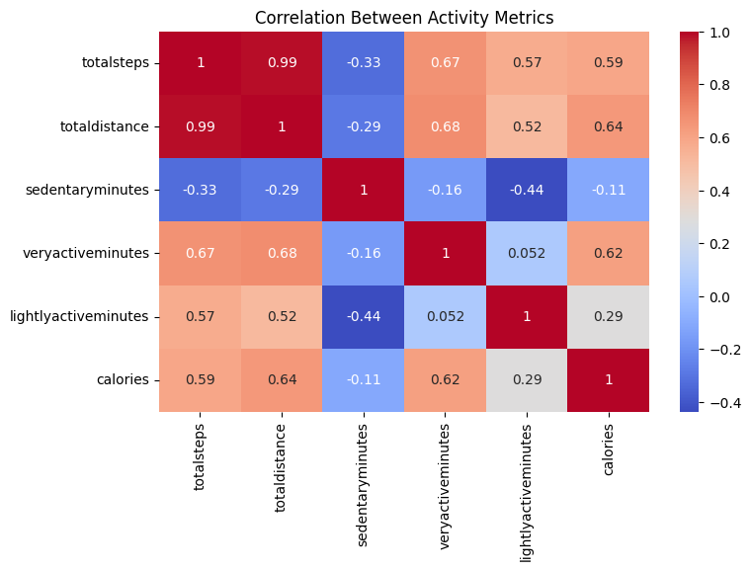
🔎 Key Insights from EDA
1. Users are most active on weekdays, especially Tuesday–Thursday.
2. Steps and calories burned show a strong positive correlation.
3. Sleep duration
has a mild link to
daily step count.
4. Most users fall
into 'Low' or
'Medium' activity
level brackets.

Slide 5
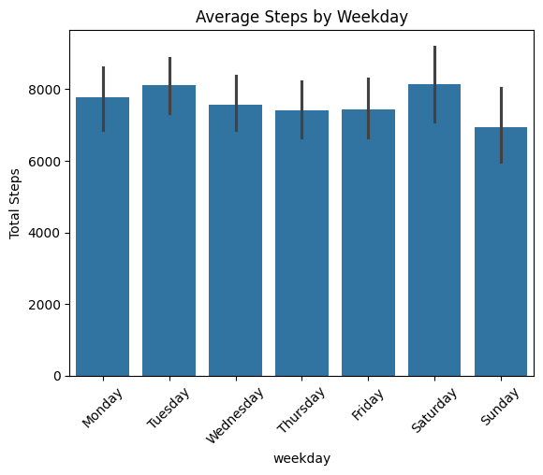
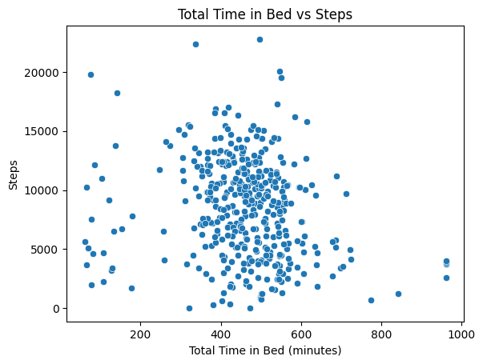
📅 Visual Insight: Weekday Activity
Users are more active on weekdays than weekends. Ideal time for marketing push and fitness challenges.

Slide 6
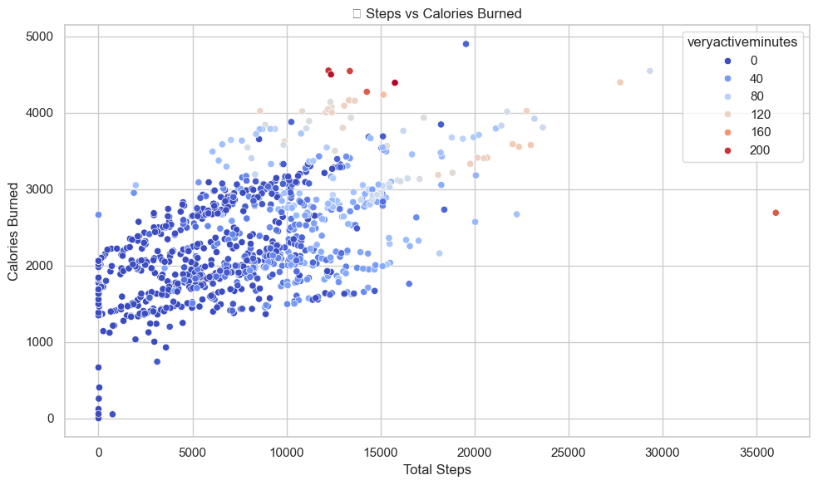
🔥 Visual Insight: Steps vs Calories
Steps are a key driver of calories burned. Promoting step-based goals can drive health outcomes.

Slide 7
💡 Recommendations
1. Run weekday challenges (Mon–Fri) to boost activity.
2. Use the Bellabeat app to notify users about inactivity.
3. Bundle Leaf/Time with sleep guidance features.
4. Personalize insights based on user activity segments.

Slide 8
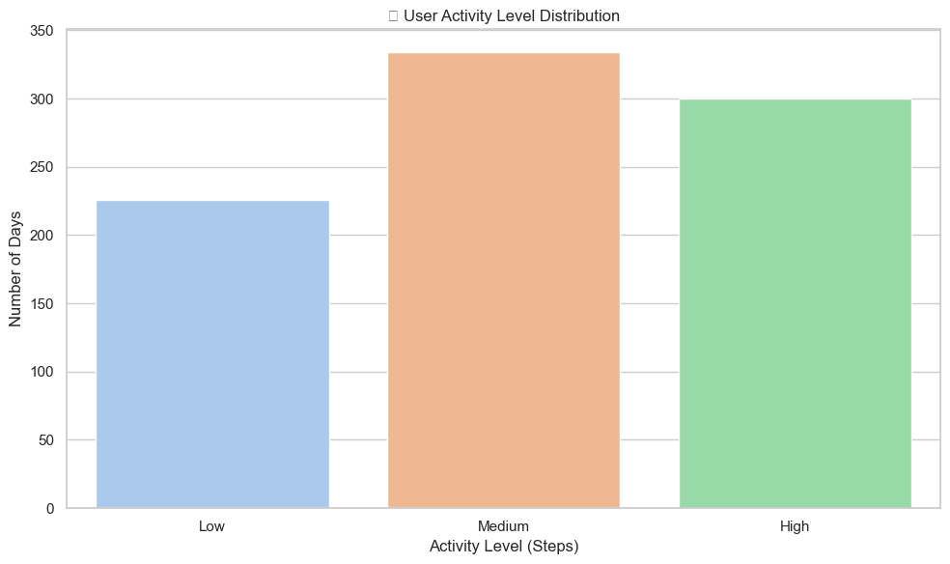
🚀 Final Thoughts
Smart usage patterns reveal strong trends Bellabeat can use.
Invest in personalized, data-backed marketing.
Leverage device strengths in steps, sleep, and wellness insights.

