Slide 1
Team 3
Ryan Azzara, Inaya Khan, Alexa Saniel, Akiva Segal, Toyoaki Yahagi

Slide 2

Company Access
Contact within company: Dr. Eric Segal
Contact Information:
Email-epilepsynj@epilepsygroup.com
Phone - 2013436676
Notes:
Akiva

Slide 3
Background Information
The epilepsy program at Northeastern Regional Epilepsy Group is a for-profit medical care company founded in 1988 to provide exceptional health care for those living in Northeast America
~50 employees, including doctors, nurses, nutritionists, technicians, researchers, psychologists, managers, and other specialists
By seeing the gap in the healthcare system where patients were often misdiagnosed or treated poorly, Dr. Marcelo Lancman, the founder of the group, was motivated to change the industry
Notes:
Akiva

Slide 4
Innovation and Link to UN Goals
Innovation: Hospitals give the Northeastern Regional Epilepsy Group exclusivity on all non-emergency epilepsy care and in return, the Northeastern Regional Epilepsy Group could make the hospital a prestigious epilepsy center, including very prestigious elective epilepsy surgery.
By setting up specialized centers, the Northeastern Regional Epilepsy Group increased accessibility for individuals with epilepsy, ensuring they received the necessary medical attention for their condition which was strongly linked with the UN Sustainable Goal of Good Health and Well-Being.
Notes:
Akiva

Slide 5
Data Collection Methods and Timeline
Data collection #1
Method: Phone Interview
Date: September 30
Duration: 26 Minutes
Data Collection #2
Method: Phone Interview
Date: October 14
Duration: 40 Minutes
Notes:
Akiva

Slide 6
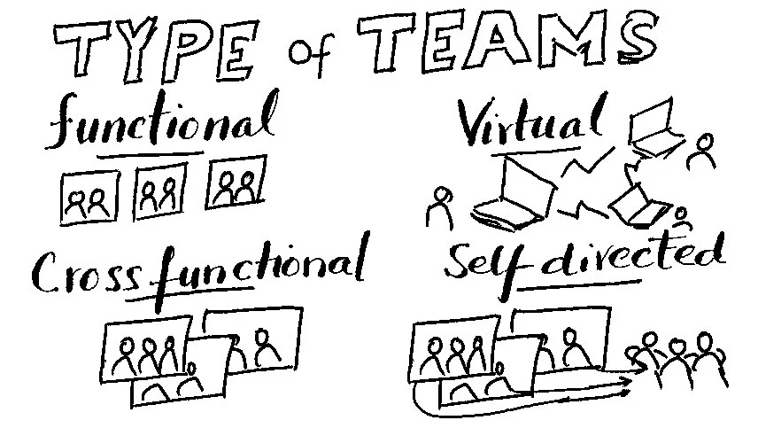
Integration with First Course Concept
Concept 1 from week 2: “Team types” (cross-functional)
Definition: Cross functional teams are those comprised of different areas in an organization to solve a problem or achieve a common goal.

Slide 7
Evidence linking concept
Diverse expertise:
The Northeast Regional Epilepsy Group combines a wide variety of skills and specialties including doctors, psychiatrists, nurses, technicians, researchers, managers, and many more. The collaboration among these individuals leads to the organization’s innovative treatments such as their personalized epilepsy management plans.

Slide 8
Evidence linking concept
Research and Innovation:
The Northeast Regional Epilepsy Group has a strong focus on research and investigating where improvement on treatment can occur. The group conducts research studies and clinical trials, where collaboration among physicians, neuropsychologists, and researchers is critical to designing studies, analyzing data, and applying findings to patient care.

Slide 9

Integration with Second Course Concept
Concept 2 from week 5: “Justice and Values” (acting consistently with one’s values)
Definition: Acting consistently with ones values means making choices and behaving in line with your core values and beliefs.

Slide 10
Evidence linking concept
Core Values
The patient first values instilled into the organization have allowed for over 30,000 patients served and several hundred epilepsy surgeries. Their guiding principle is to “develop our services around patient needs”. This is reflected in the Northeast Regional epilepsy being a leading research group in the epilepsy field. Proven by having 3 level 4 accredited epilepsy centers (Highest level given by National Association of Epilepsy Centers).

Slide 11
Evidence linking concept
Beliefs
Similar to their core values, the Northeast Regional Epilepsy Group believes in patient care, research, and education. In order to act according to these beliefs they insure that they only hire the most qualified staff, many of the epilepsy specialists were voted Best Doctors of America and America's Top Physicians. In addition, they provide second opinions, out of state, and international treatment consultations furthering how they act consistently with one’s value.

Slide 12
Recommendation #1
Organize meetings and workshops where members from each branch of the company come together to learn and discuss the inner workings of another branch.

Slide 13
Downsides of Recommendation #1
Some members may not be willing to put in the extra time it would take to hold these meetings.
The time it would take to hold these meetings/workshops can be spent on other things.
Clashes between members with different skill sets, power, and knowledge could occur

Slide 14
Recommendation #2
Develop a reward system for employees, actively demonstrating the organization’s values of helping to provide healthcare to patients

Slide 15
Downsides of Recommendation #2
Unrewarded employees may feel unvalued and reduce effort
Monitoring behaviors adds to managers' workload
Excessive competition could shift focus from values to short-term rewards

Slide 16
Communication Strategies and Influencing Tactics
Providing data that backs up recommendations
  By numerically showing how recommendations would lead to expansion and showing how other companies who took a similar approach succeeded, it is more likely that the client will take any recommendations and believe it is effective
Clear and detailed communication
  By breaking down recommendations into actionable steps with a timeline, requirements, and drawbacks of not doing so, the client would not find the plans as daunting and would be more likely to accept them.

